Slide 1
Hope lights up the darkness

Slide 2
HOPE
OPTIMISM

Slide 3
HOPE
OPTIMISM

Slide 4
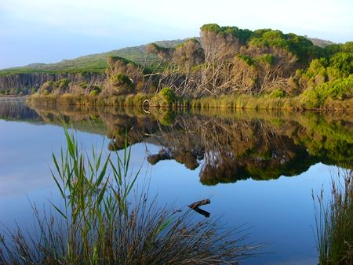
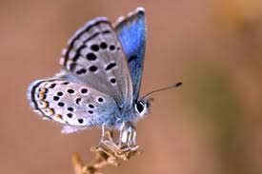
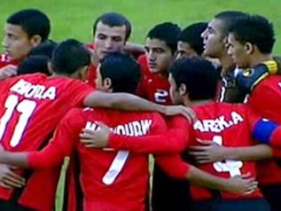
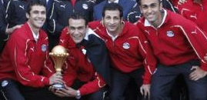
Where to find hope?

Slide 5


Slide 6
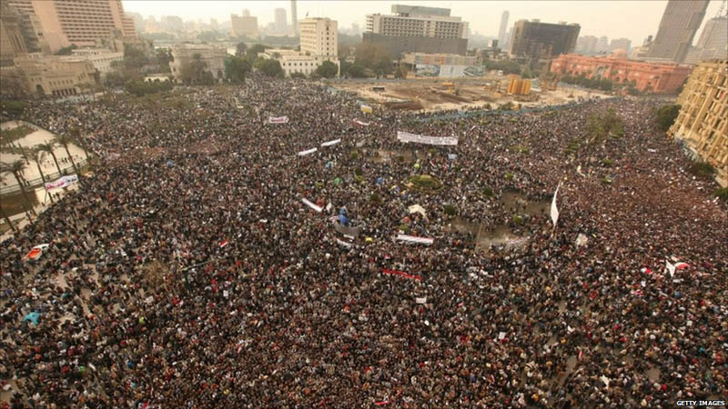

Slide 7
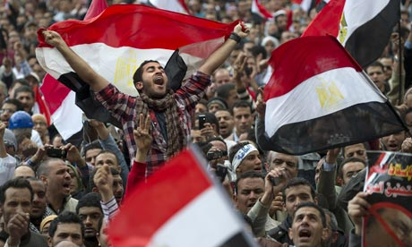

Slide 8
However,

Slide 9


story

Slide 10


Slide 11
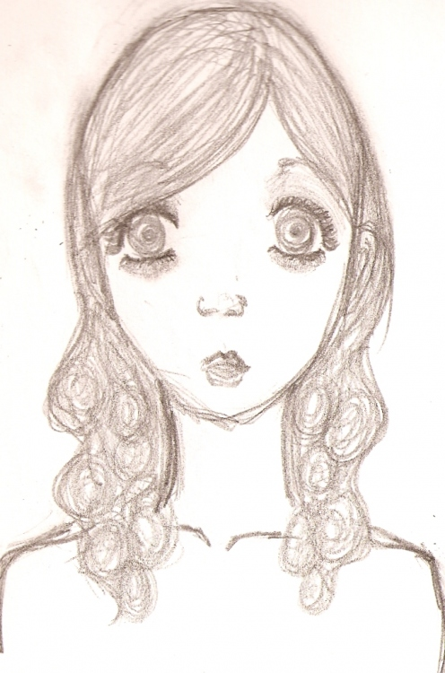
Welcome to high school

Slide 12
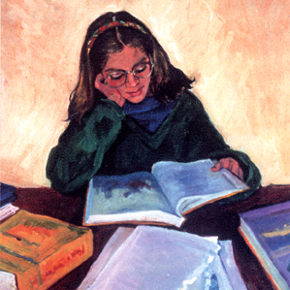

Slide 13
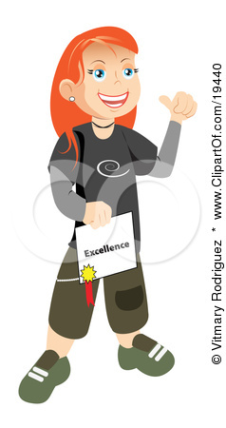

Slide 14

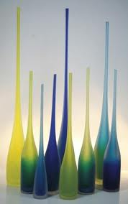
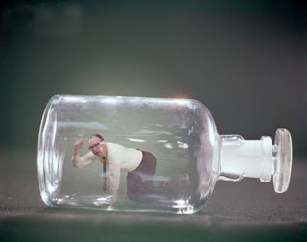
The final jam

Slide 15

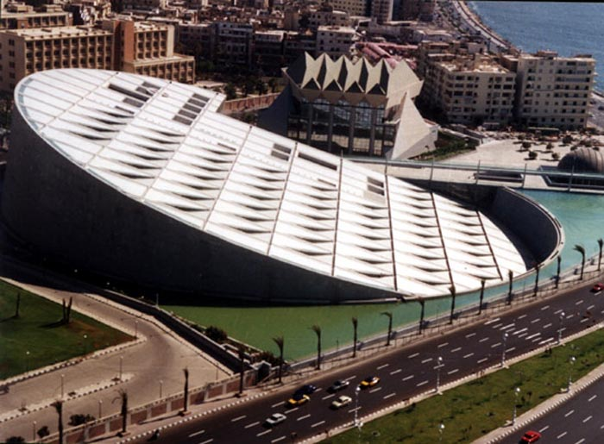

Slide 16


Slide 17
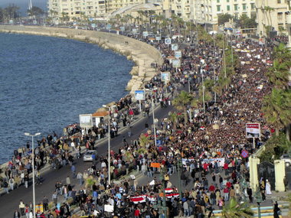
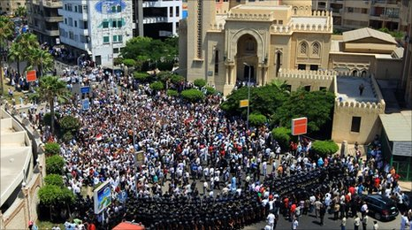

Slide 18

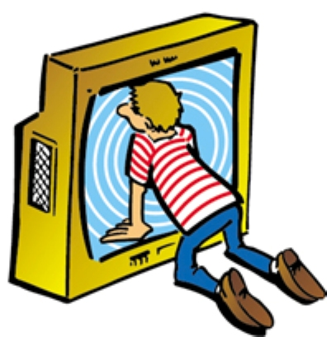

Slide 19

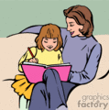


Slide 20
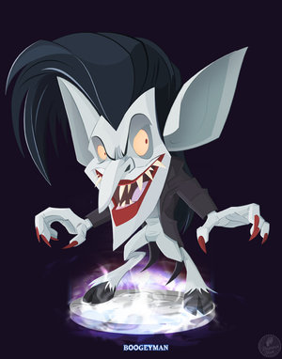
The Bogeyman

Slide 21
Cancer

Slide 22


Slide 23

What the hell do you know about cancer?

Slide 24
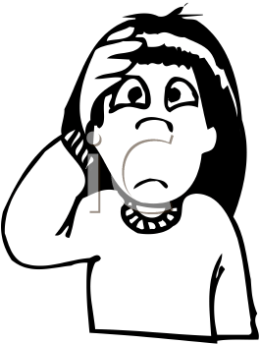


Slide 25
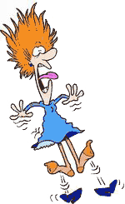
operation
hormonaltherapy
bibalex
chemotherapy
High school
radiotherapy
examinations

Slide 26
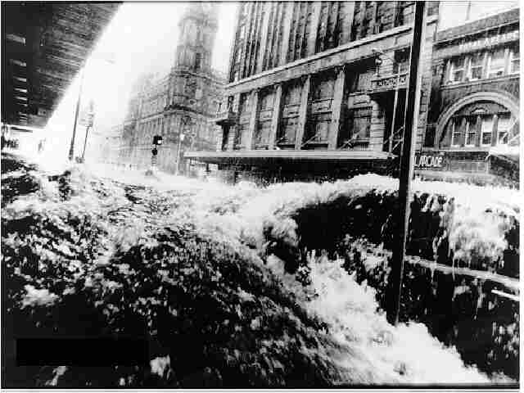


Slide 27
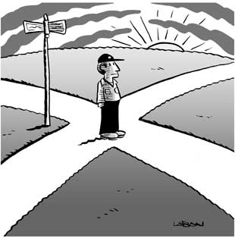

Slide 28
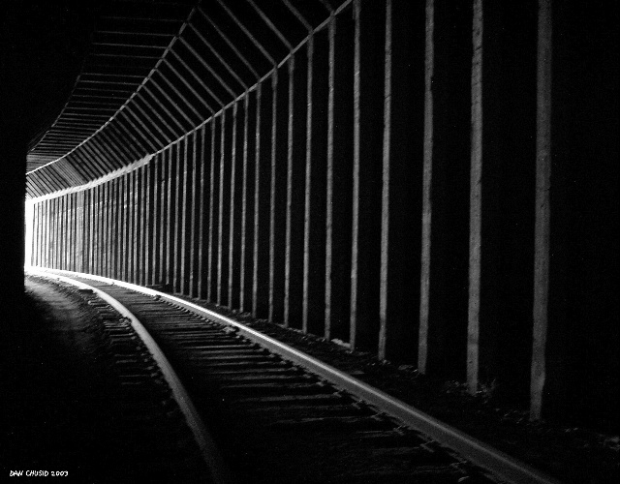
Light in the end of the tunnel

Slide 29


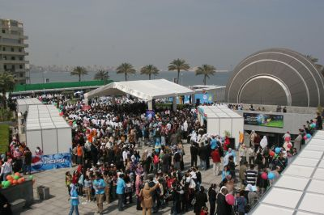

Slide 30
Tips
Be aware, spread awareness.
Don´t be paranoid.
Surround yourself with good friends.
Let it go.
Always have a goal in life.

Slide 31
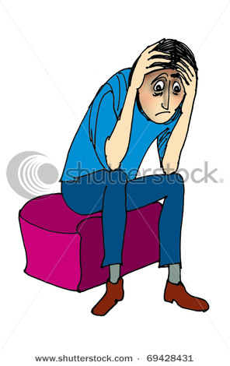

Why??????

Slide 32
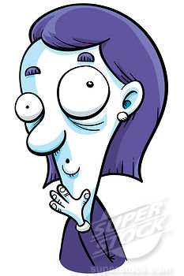
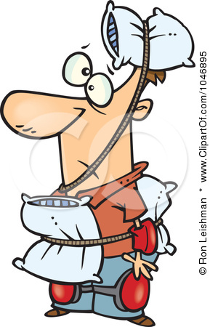

Slide 33

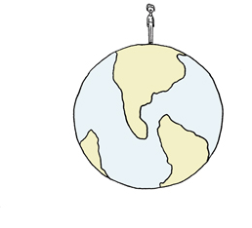
help

Slide 34
To all those who think that hope is just an empty, meaningless word to be written in books or said in conferences and meetings I´ll prove that you can´t be more wrong.

Slide 35
References
Cancer therapy group created by: Roy Thomson in Florida, U.S.A .
Www.WHO.com .
Ayadi al mostaqpal charitable hospital.
http://www.suncure.net/

Slide 36

Done and presented by:
salma said soliman.
E_mail :
salma said souliman@hotmail.com

