Slide 1
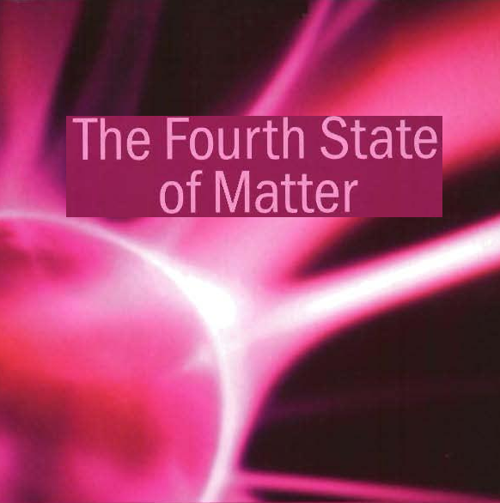

Slide 2
”و أن ليس للإنسان إلا ما سعى* و أن سعيه سوف يرى“
صدق الله العظيم

Slide 3
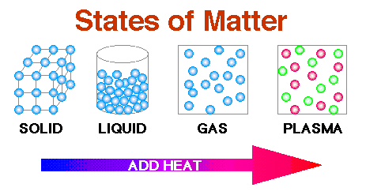
The states of matter:

Slide 4
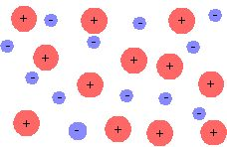
What Is Plasma?
a plasma is a mixture of positively and negatively charged particles.

Slide 5
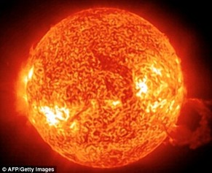
Where Is Plasma?
Plasma exists everywhere in the universe.
The visible Universe is 99.999% plasma. The Sun is about 100% plasma, as are all stars.

Slide 6
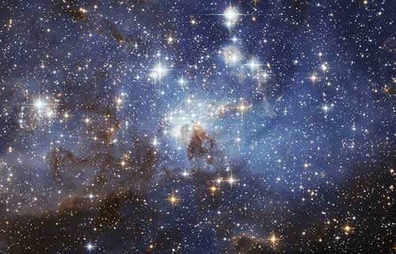
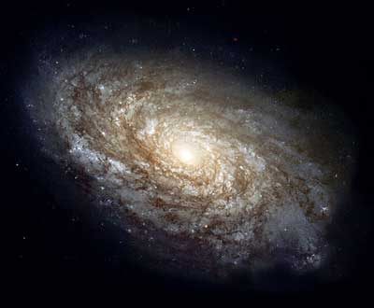
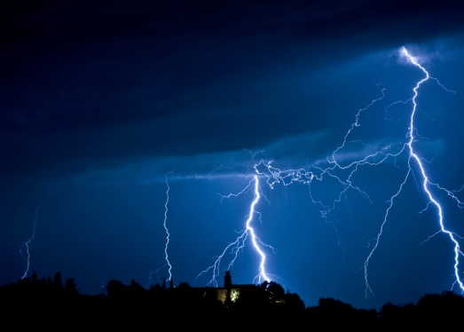

Slide 7
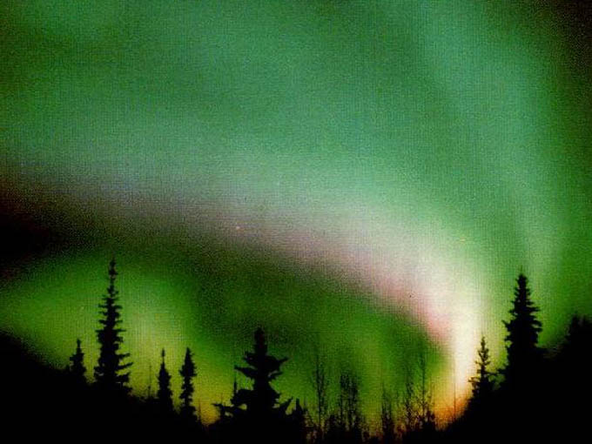
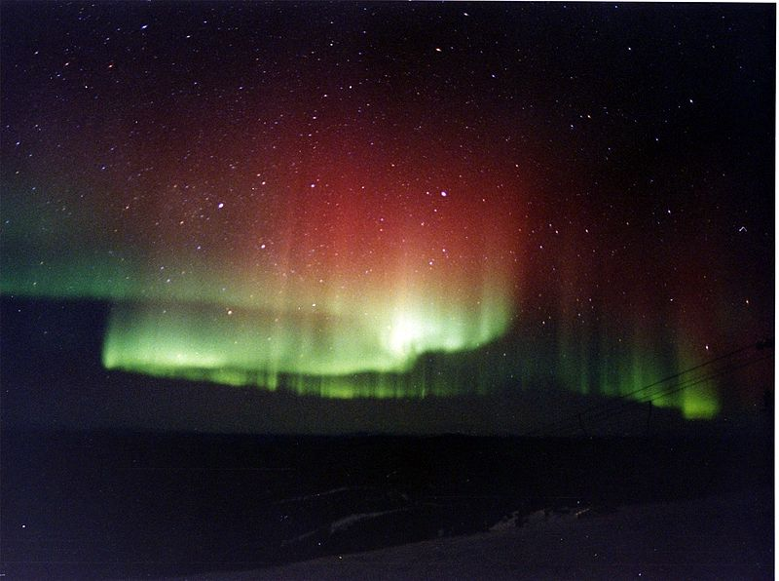
An aurora is a natural light display in the sky particularly in the high latitude (Arctic and Antarctic) regions.

Slide 8
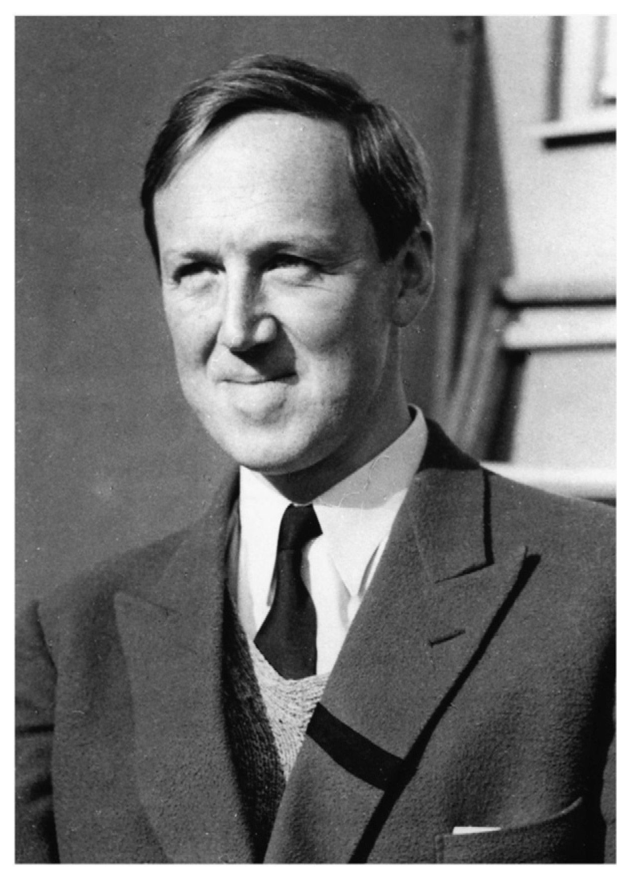
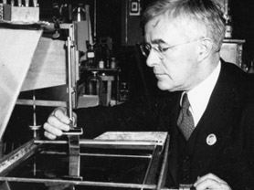
Discovered by..
Hannes Alfvén
Irving Langmuir

Slide 9
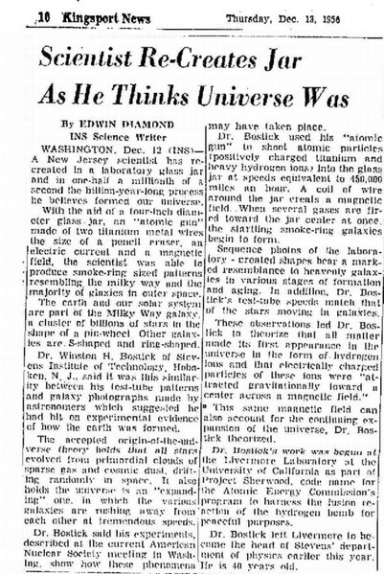
Scientific Revolution

Slide 10
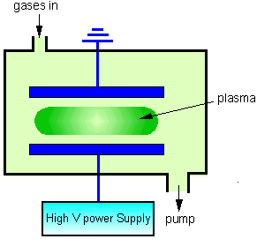
Plasma Creation

Slide 11
Plasma Cosmology
The fact is that plasmas are highly scalable, and super-computing capabilities have enabled us to model plasma behaviours on galactic scales ... utilising only a few simple formulae. These models are consistent with reality. Big Bang cosmology, by contrast, fails to adequately account for the filamentary structures that we observe.
Plasma cosmology does NOT rely on abstract mathematical modelling or an increasing array of exotic hypotheticals like Dark Matter and Dark Energy!

Slide 12

Know plasma, know 99.999% of the Universe
(No plasma, no Universe)

Slide 13
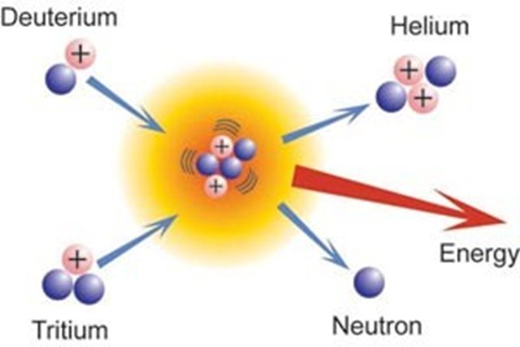
Plasma in Nuclear Fusion
What Is Nuclear Fusion?

Slide 14
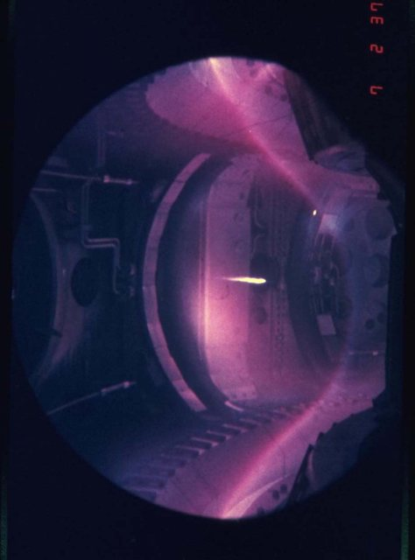
Inside Nuclear Fusion Reactor
Reaching 150 000 000 °C

Slide 15
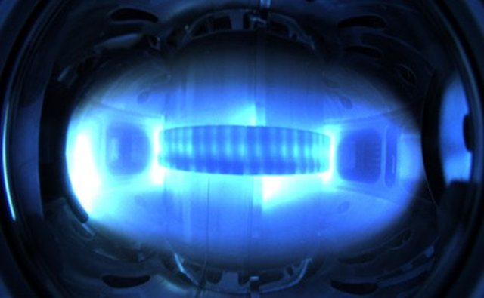
Plasma Confinement
Plasmas consist of charged particles—positive nuclei and negative electrons—that can be shaped and confined by magnetic forces.

Slide 16
ITER (International Thermonuclear Experimental Reactor)
International Collaboration for a New Source of Energy
The ITER project was born. The initial signatories: the former Soviet Union, the USA, the European Union (via EURATOM) and Japan, were joined by the People's Republic of China and the Republic of Korea in 2003, and by India in 2005. Together, these six nations plus Europe represent over half of the world's population.

Slide 17
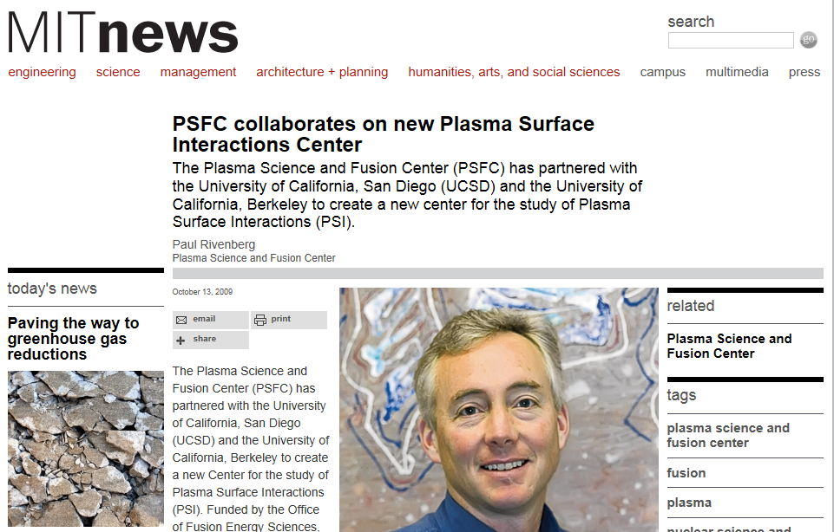
Plasma Surface Interactions

Slide 18
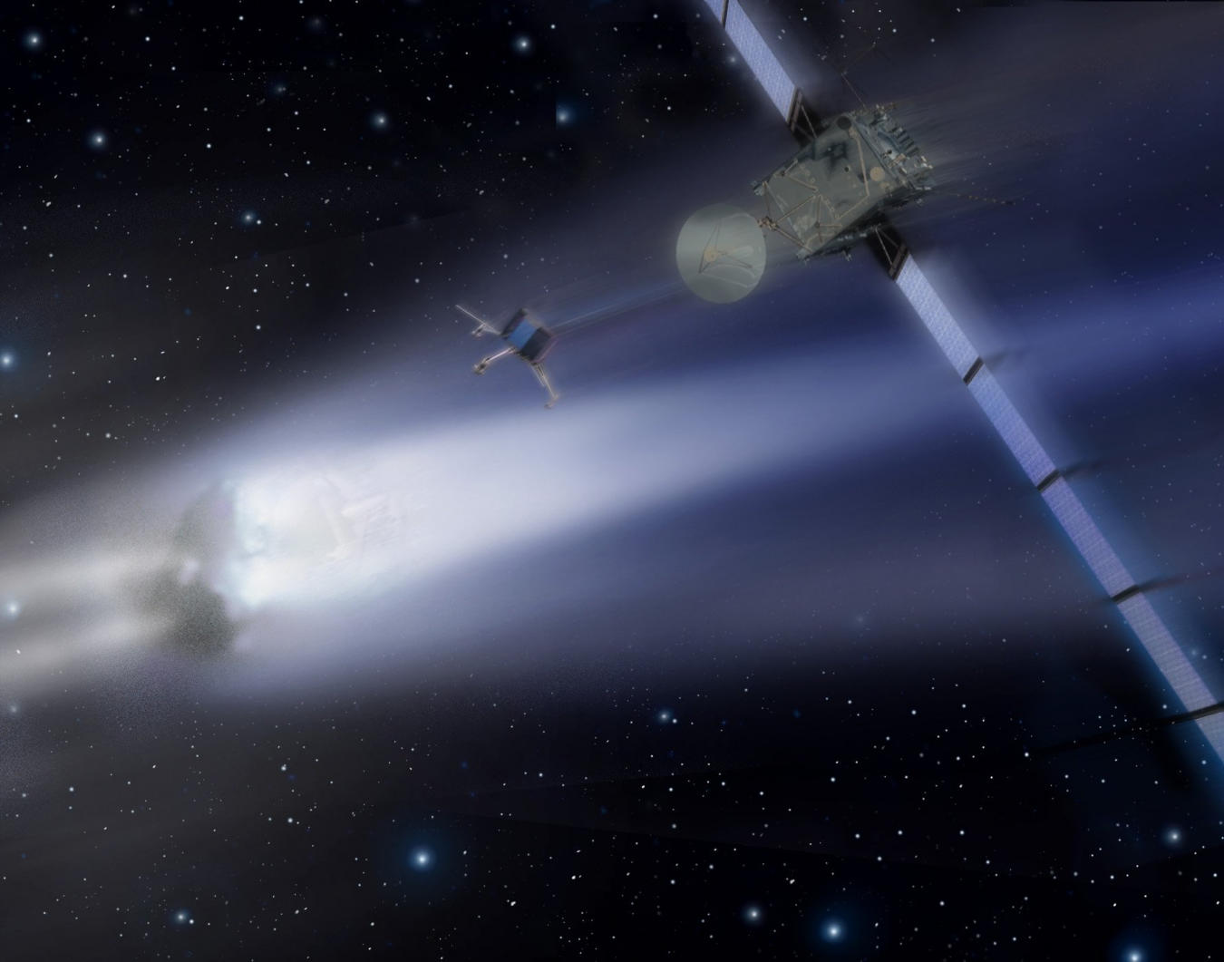
Why…..?

Slide 19
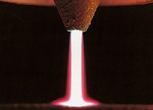
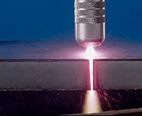
Plasma Industry

Slide 20
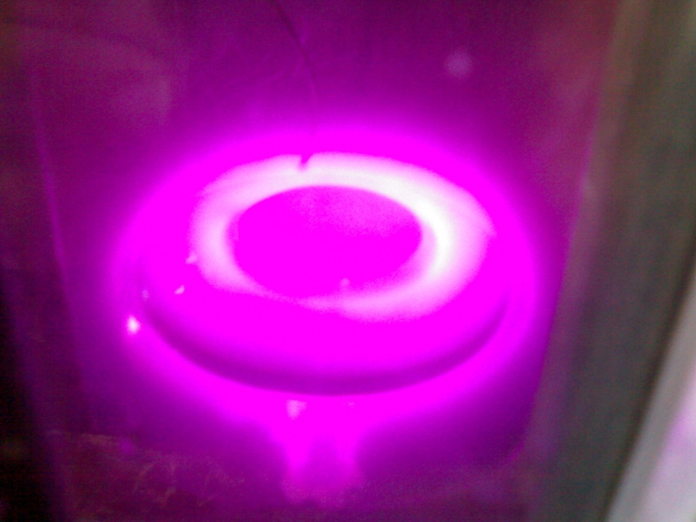
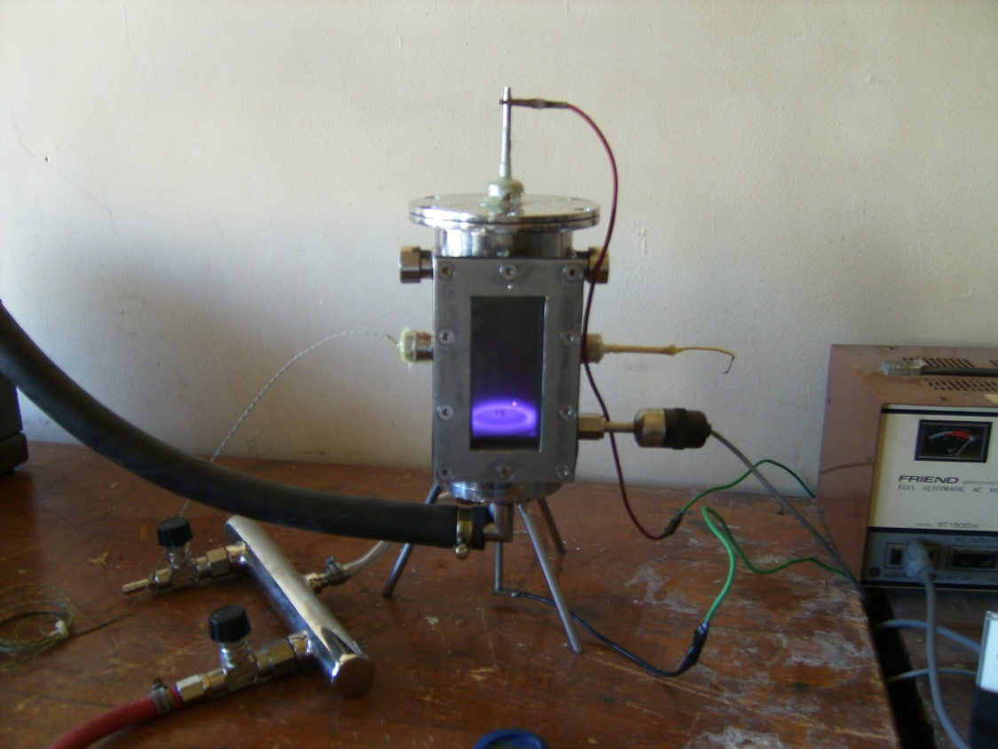

Slide 21
References
http://www.plasma-universe.com/Plasma-Universe.com
http://www.2012spiritual.info/the-sun---our-star.html
http://www.physlink.com/education/askexperts/ae662.cfm
http://www.iter.org/sci/plasmaconfinement
http://web.mit.edu/newsoffice/2009/psfc-collaborates.html
http://www.iter.org/

Slide 22
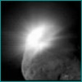
Thank You

