Slide 1
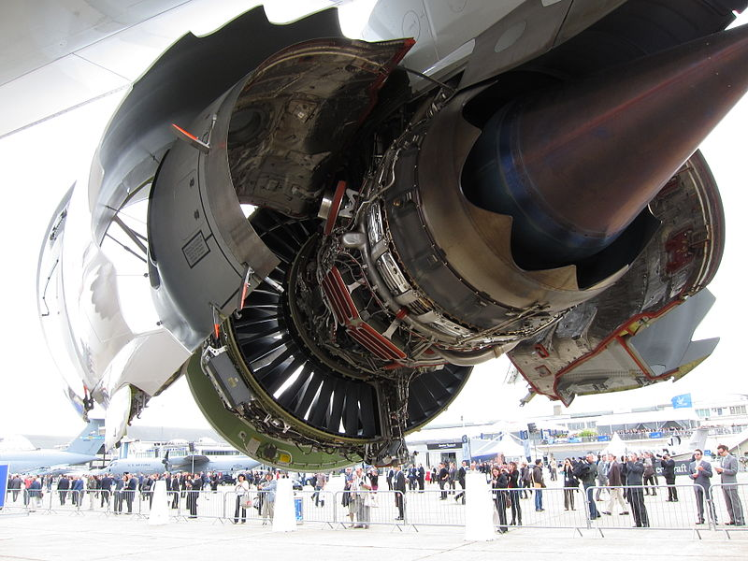
Jet Engines .
By : Hesham Mohamed

Slide 2
-Jet engine : is the engines which exhaust fluid at high speed to produce a driving force based on the principle of Newton's third law of motion.
- Jet Engine also includes :
turbine jet
turbine helicopters
missiles

Slide 3
- The use of jet engine :
Air crafts .
Natural gas production .
Energy generating stations .

Slide 4
- The jet engines in our life :
Water pumps .
Vacuum .
Fridge compressor .

Slide 5
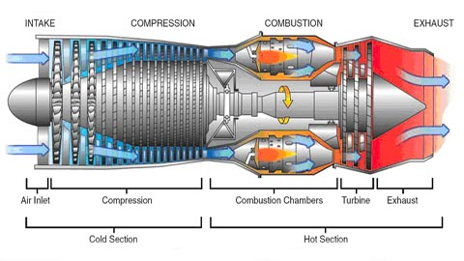
- Cut way of Jet Engine :

Slide 6
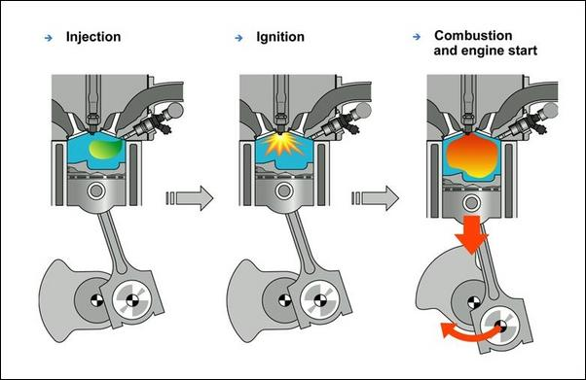
- Cut way of cylinder :

Slide 7
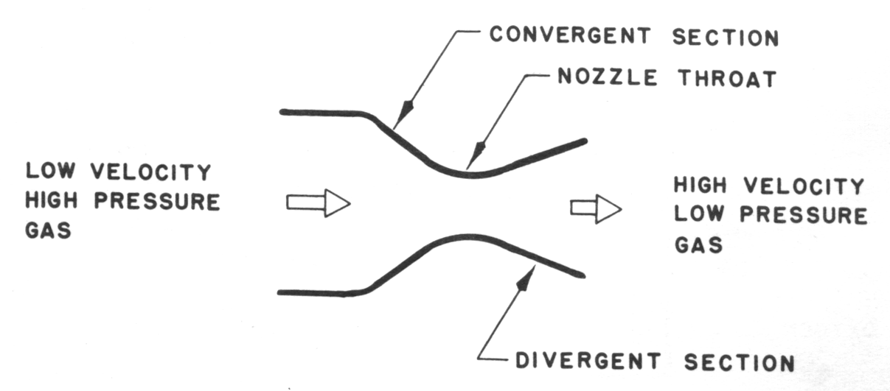
- How does the jet engine work?!!

Slide 8
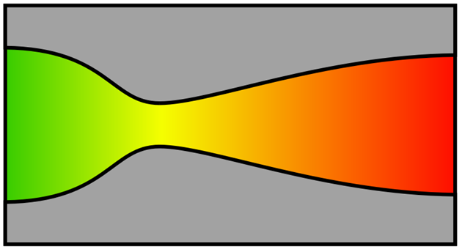
-De Laval nozzle :

Slide 9
- Jet engine & the environment :

Slide 10
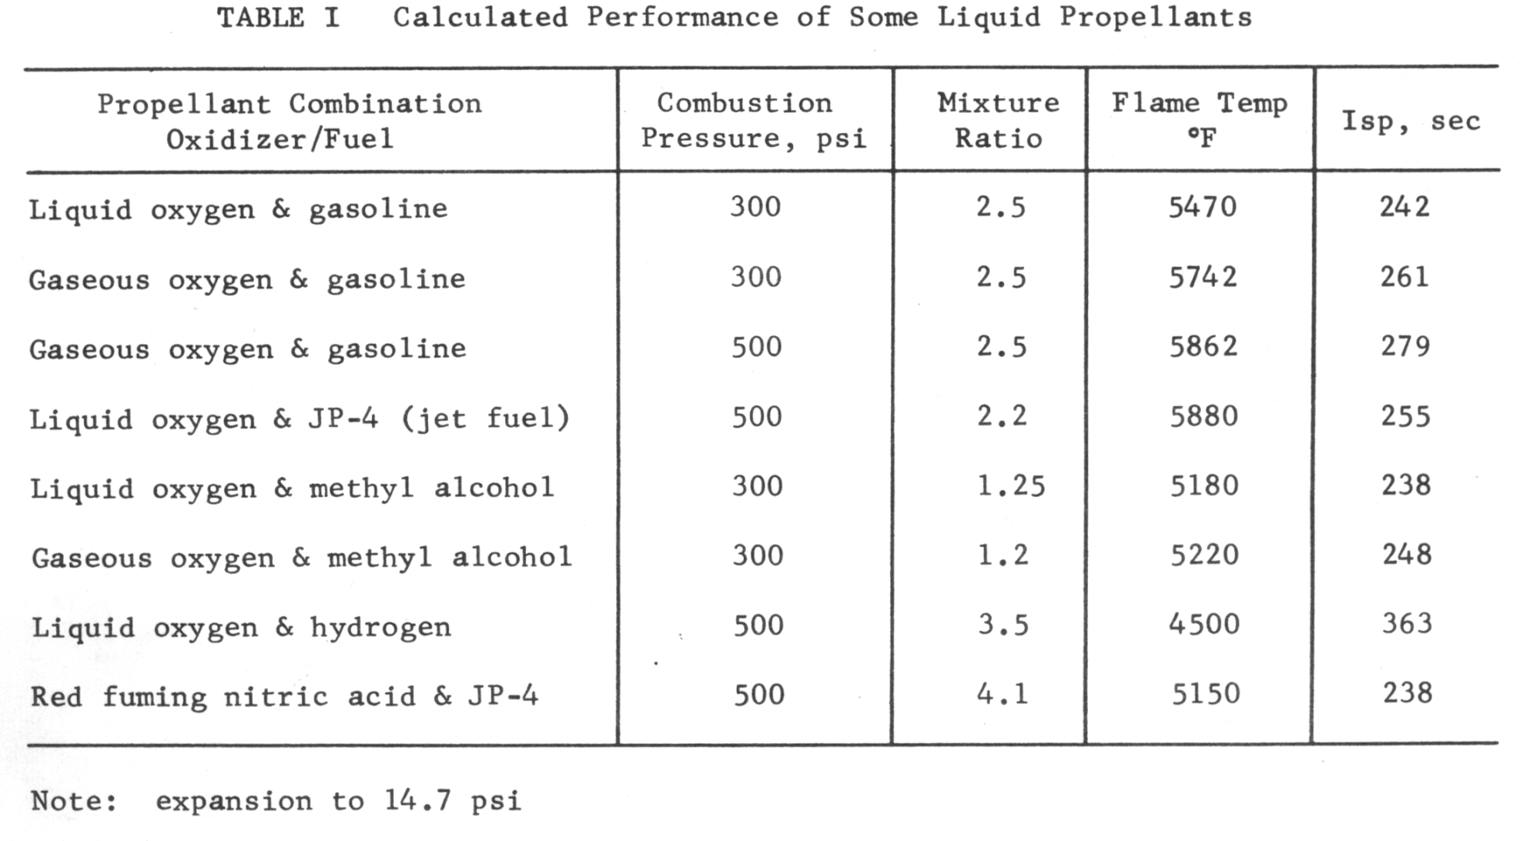
-Propellants :

Slide 11
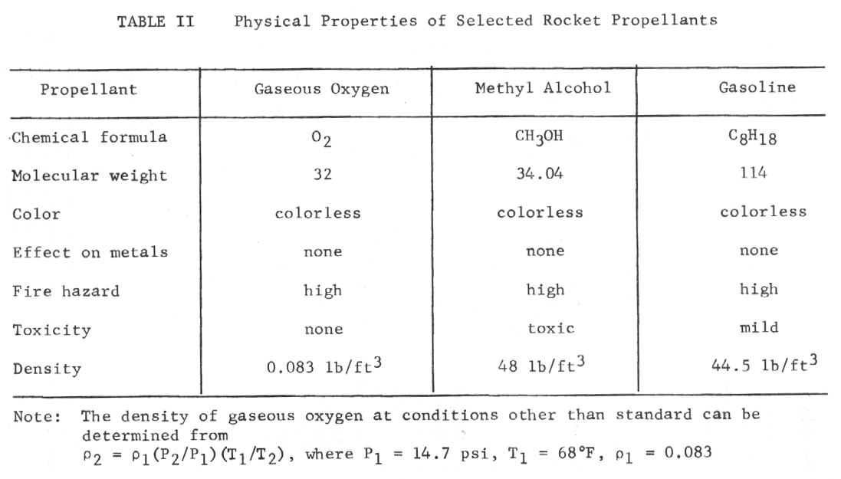
-Propellants Properties :

Slide 12
- All off that cause :
Toxic exhausts .
Global warming .
Acid Rains .
Ozone damage .

Slide 13
- The solution :
Metallurgy “ Engineering Materials “ .
Hydrogen Cells .
Generating impulse through the physics principles .
Do research about Air craft shapes to get the best Aerodynamics to decrease the amount of burner fuel .

Slide 14
- The End .

Slide 15
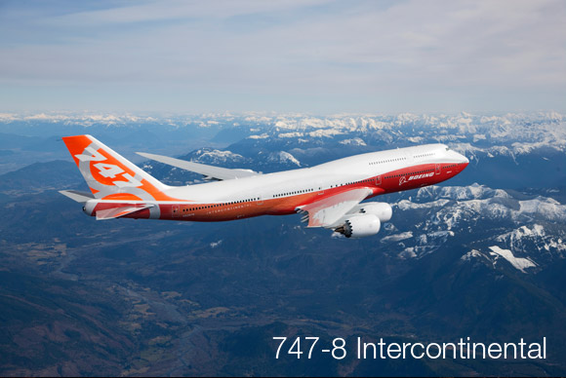
Questions ?!
- Hesham Mohamed

