Slide 1

The six hats

Slide 2
Plan
Introduction of the book
N.B about thinking
The white hat
The yellow hat
The red hat
The black hat
The green hat
The blue hat
References

Slide 3

About the book

Slide 4

thinking....

Slide 5
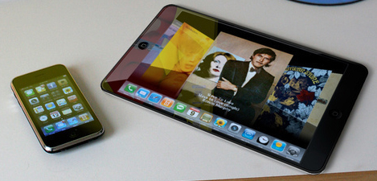

Slide 6


Slide 7


Slide 8

The white hat

Slide 9


Slide 10


Slide 11


Slide 12

The red hat

Slide 13


Slide 14


Slide 15

The yellow hat

Slide 16


Slide 17
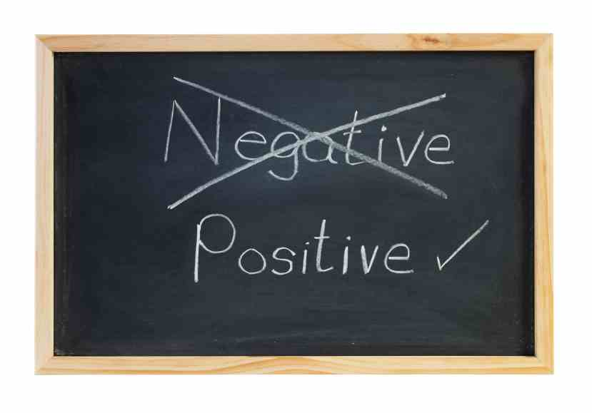

Slide 18


Slide 19

The black hat

Slide 20


Slide 21
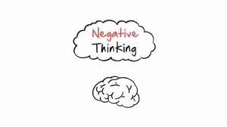

Slide 22


Slide 23
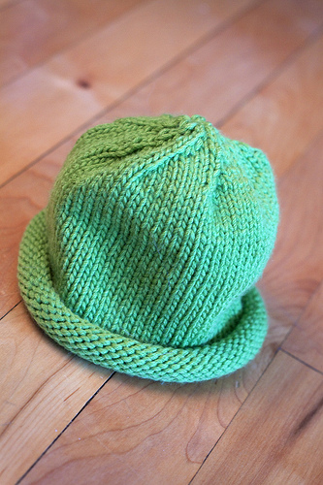
The green hat

Slide 24


Slide 25


Slide 26

The blue hat

Slide 27


Slide 28


Slide 29
Presented by : Mahinour El-sheikh
E-mail: Mahinour_elsheikh@hotmail.com

Slide 30


Slide 31
References
https://www.universitylifecafe.k-state.edu/bookshelf/i-cant-concentrate/
http://www.loosetooth.com/Viscom/gf/6thinkinghats.htm
http://blogs.funiber.org/formacion-profesores/2011/01/23/six-thinking-hats/
http://learn.esu10.org/mod/wiki/view.php?i
d=751
http://trialbyfireparenting.blogspot.com/2012/03/episode-168-man-with-yellow-hat-is.html
http://www.radicalstrengthcoach.com/inspirational-thoughts.html

Slide 32
http://www.brillianceactivator.com/services/training/six-thinking-hats/
http://pluskw.com/blog/?attachment_id=153
http://www.census.gov/mcd/database/
http://www.elllo.org/english/0851/T865-Shibika-Feelings.htm
http://consciousdiscipline.com/store/pc/Liste\n-to-Your-Feelings-6p157.htm
http://www.shutterstock.com/pic-112143155/stock-photo-two-way-street-sign-with-positive-thinking-and-negative-thinking-concept-isolated-on-white.html?src=cf1340cfc8e7bebdccde429283b0a570-1-64
http://vimeo.com/41376463
http://bigthink.com/ideafeed/the-positive-power-of-negative-thinking
http://www.selfhypnosistherapy.com/stop-negative-thinking.html

Slide 33
Apart from a presentation in Ashrakat center :el tafkir
http://www.center4pm.com/?page_id=306
http://www.skillsconverged.com/TrainingMaterials/ManagementTraining/TrainingMaterialCreativityandInnovation/tabid/309/Default.aspx
http://www.sitofono.com/concept-of-critical-thinking-for-it-companies
http://mcsbzu.blogspot.com/2011/11/solution-silberschatz-galvin-operating.html#.UKJjheQ3vCk

