Slide 1

*What’s the meaning of anthropology ??
Study of man, in every time and place

Slide 2
anthropology
Latin
Anthropos
logia
* Study of man *

Slide 3

It’s not a new field of science, Known as the study of man (anthropology)
since ancient times
Came from different patterns of communities and cultures on the earth in general

Slide 4
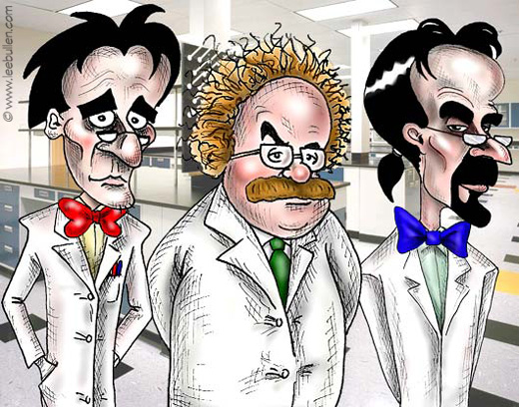

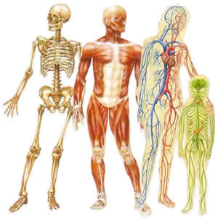

Anthropologists look for man
A
B
C
Social
physical
Culture

Slide 5
anthropology
1- Social anthropology
2-Physical anthropology
3-Culture anthropology

Slide 6

Social anthropology
Afraid of…..
community

Slide 7

Who can live alone???
As Aristo said Human social nature

Slide 8
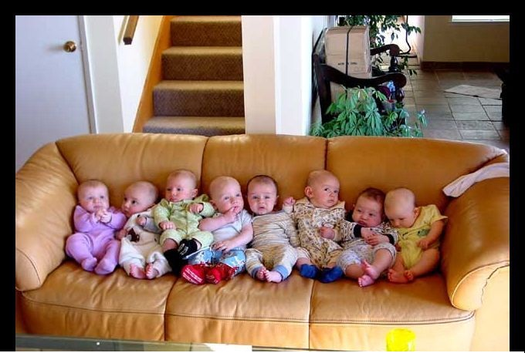


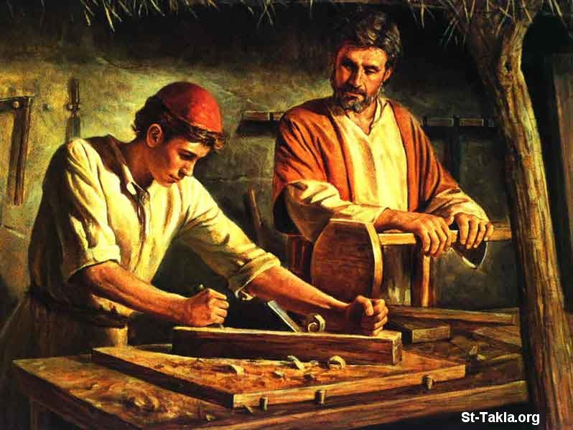
Social, inborn / acquired???

Slide 9

Culture anthropology
What’s the meaning of culture
Every thing human has been discovered
On the earth – all habits and traditions
Man is the only one w ho can learn and teach

Slide 10
References
كتاب ( مدخل الى الانثربولوجيا)
تأليف اعضاء هيئة التدريس
بقسم الأنثربولوجى بكلية اداب جامعة الاسكندرية
ص11 :ص22

