Slide 1
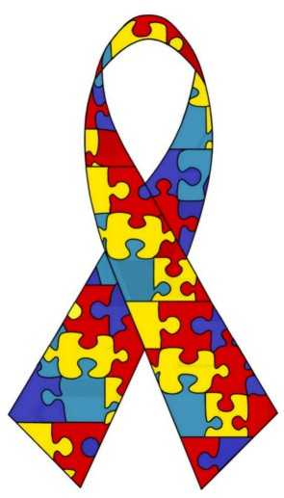
Autism
by: Amal Samir El-Refaey
Mariam Medhat
faculty of science
Notes:
http://cdn.blogs.babble.com/strollerderby/files/2010/02/autism_ribbon.jpg

Slide 2
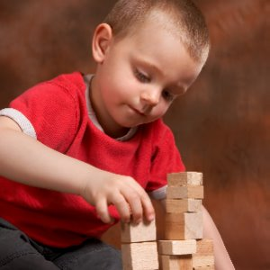
Autism
What is Autism?
Symptoms of Autism.
Diagnosis of autism.
Causes of Autism.
Treatment.
Notes:
http://topnews.in/files/autism-spectrum-disorders.jpg

Slide 3
Autism
What is Autism?
Symptoms of Autism.
Diagnosis of autism.
Causes of Autism.
Treatment.

Slide 4
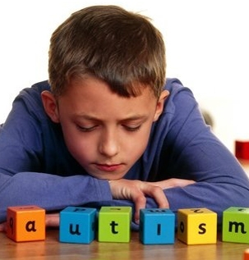
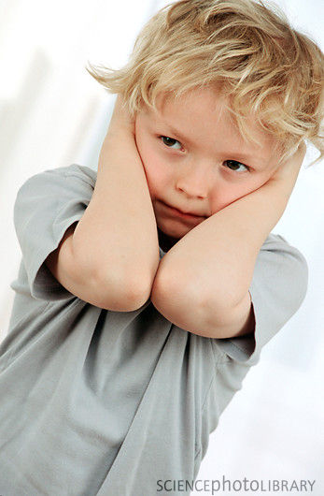
What is Autism
Autism spectrum disorders are a group of developmental disabilities that can cause significant social, communication and behavioral challenges.
Notes:
http://tebasel.com/mag/wp-content/uploads/autistic.jpg
http://biomechanism.com/wp-content/uploads/2012/04/autism-child.jpg

Slide 5
Autism
What is Autism?
Symptoms of Autism.
Diagnosis of autism.
Causes of Autism.
Treatment.

Slide 6
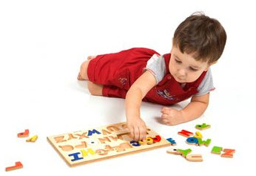
Symptoms of Autism
Social Skills.
Communication.
Unusual Interests and Behaviors.
Other Symptoms.
Notes:
http://www.cdc.gov/ncbddd/autism/images/autism-treatment-graphic2.jpg

Slide 7
Symptoms of Autism
Social Skills.
Communication.
Unusual Interests and Behaviors.
Other Symptoms.

Slide 8
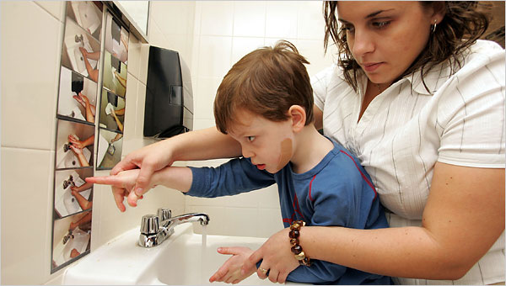
Social Skills
Not respond to their name. (12 months)
Not point at objects to show interest. (14 months )
Not play "pretend" games. (18 months)
Avoid eye contact and want to be alone.
Get upset by minor changes.
Have unusual reactions
Notes:
http://whatifpost.com/wp-content/uploads/2010/05/autism-school.jpg

Slide 9
Symptoms of Autism
Social Skills
Communication
Unusual Interests and Behaviors
Other Symptoms

Slide 10
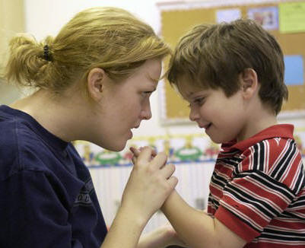
Communication
Delayed speech and language skills
Does not understand jokes, sarcasm
Repeats words or phrases
Talks in a flat voice
Reverses pronouns
Uses few or no gestures
unrelated answers to questions.
Notes:
http://2.bp.blogspot.com/-M3GWnq3gWU0/T4UZDwpLiKI/AAAAAAAABO0/izhfCmTpVcE/s1600/Autism%2Bspectrum%2Bdisorders.jpg

Slide 11
Symptoms of Autism
Social Skills.
Communication.
Unusual Interests and Behaviors.
Other Symptoms.

Slide 12
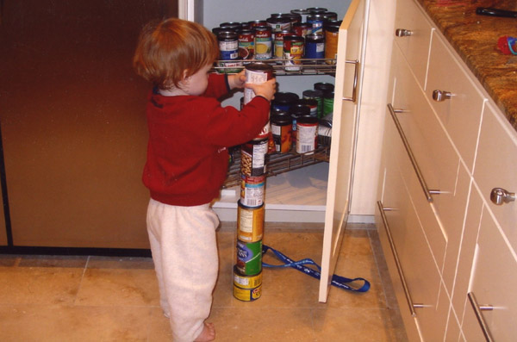
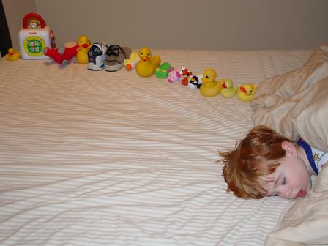
Unusual Interests and Behaviors
Lines up toys or other objects.
Plays with toys the same way every time.
Likes parts of objects. (wheels)
Has to follow certain routines.
Has obsessive interests.
very organized.
Flap hands, rock body, or spin in circles.
Notes:
http://www.decodedscience.com/wp-content/uploads/2011/10/Autistic-sweetiepie-boy-with-ducksinarow.jpghttp://cdn.sheknows.com/articles/crave/autistic-boy-stacking-cans-600.jpg

Slide 13
Symptoms of Autism
Social Skills.
Communication.
Unusual Interests and Behaviors.
Other Symptoms.

Slide 14
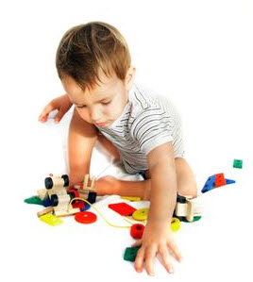
Other Symptoms
Aggression.
Unusual reactions.
Hyperactivity.
Lack of fear or more fear than expected.
Impulsivity.
Unusual mood or emotional reactions.
Short attention span.
Temper tantrums.
Unusual eating and sleeping habits.
Causing self injury.
Notes:
http://www.cdc.gov/ncbddd/autism/images/autism-signs-graphic2.jpg

Slide 15
Autism
What is Autism?
Symptoms of Autism.
Diagnosis of autism.
Causes of Autism.
Treatment.

Slide 16
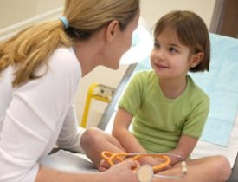
Diagnosis of autism
All children should be screened at:
9 months
18 months
24 or 30 months
Notes:
http://www.joint-pain-solutions.com/images/juvenile-rheumatoid-arthritis-in-children.jpg

Slide 17
Autism
What is Autism?
Symptoms of Autism.
Diagnosis of autism.
Causes of Autism.
Treatment.

Slide 18
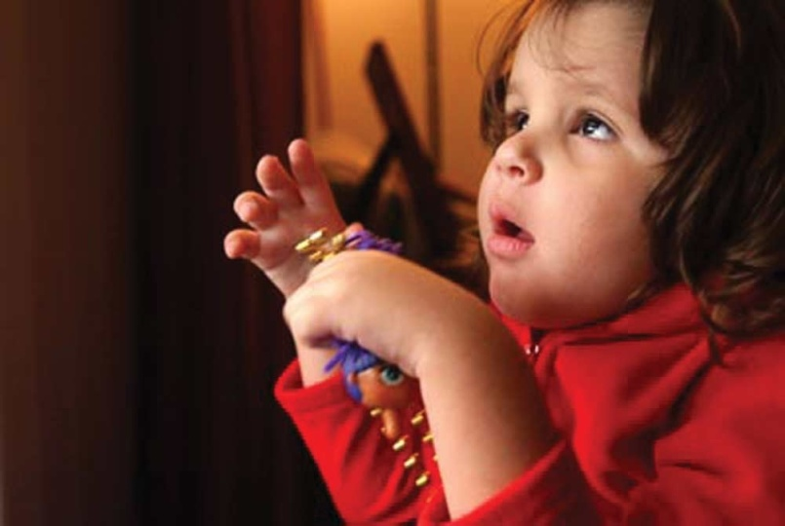
Causes of Autism
For most people the cause is not known.
genes and the environment.
identical twins (60-96%).
non-identical twins decreases with(0-24%).
parents who have a child with autism (2-19%).

Slide 19
Autism
What is Autism?
Symptoms of Autism.
Diagnosis of autism.
Causes of Autism.
Treatment.
The genius of Autism

Slide 20
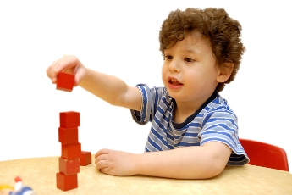
Treatment
no medications to cure autism.
medication might help manage high energy levels, inability to focus or depression.
Behavior and Communication Approaches.

Slide 21
World Autism Awareness Day
2 April

Slide 22
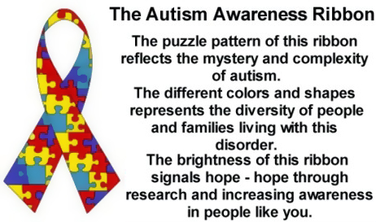
http://ecautismsociety.com/yahoo_site_admin/assets/images/autism-ribbon-storry.55170636_std.jpg

Slide 23
http://www.cdc.gov/ncbddd/autism/index.html
http://www.cdc.gov/ncbddd/autism/signs.html
http://www.cdc.gov/ncbddd/autism/screening.html
http://www.cdc.gov/ncbddd/autism/screening.html
http://www.cdc.gov/genomics/resources/diseases/autism.htm
http://www.cdc.gov/ncbddd/autism/treatment.html
http://www.who.int/mental_health/world_autism_awareness_day/en/
http://www.emro.who.int/emhj-volume-18-2012/issue-2/article-12.html

