Slide 1
السلام عليكم و رحمة الله و بركاته

Slide 2
(( يا ايها الذين امنوا اذا تحيتم بتحيه فردو باحسن منها او ردوها ))

Slide 3
الاستفاده العائده عليك من هذا العرض
ستكتسب معلومات جديده
ستكتسب شجاعه النقض و التحليل
ستزيد من قوة استنتاجك

Slide 4
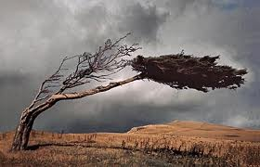
Wind Energy
But in the beginning. What the meaning of the word winds ?
Wind is the movement of air from an area of high pressure to an area of low pressure. In fact, wind exists because the sun unevenly heats the surface of the Earth. As hot air rises, cooler air moves in to fill the void. As long as the sun shines, the wind will blow.
.

Slide 5
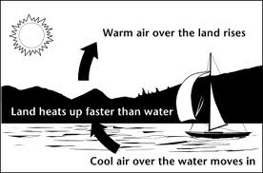
How consist wind

Slide 6

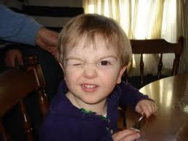

How it works (Windmills )
Deduce

Slide 7


Slide 9
Top 10 countries by windpower electricity production
(2011 totals)^{[65]}
% world total | Windpower production (TWh) | Country
26.2 | 120.5 | United States
19.3 | 88.6 | China
10.6 | 48.9 | Germany
9.2 | 42.4 | Spain
5.4 | 24.9 | India
4.3 | 19.7 | Canada
3.4 | 15.5 | United Kingdom
2.7 | 12.2 | France
2.1 | 9.8 | Italy
2.1 | 9.8 | Denmark
14.7 | 67.7 | (rest of world)
100% | 459.9 TWh | World total

Slide 10

Egypt is my mather
Windpower production (MWh) | Country
550 | Egypt

Slide 11
Are there negative effects winds
Deduce

Slide 14
THE Reference
http://www.youtube.com/watch?v=tsZITSeQFR0
http://www.youtube.com/watch?v=eXejxcW-XGo
http://www.energyquest.ca.gov/story/chapter16.html
http://environment.nationalgeographic.com/environment/global-warming/wind-power-profile/
http://www.awea.org/
http://windeis.anl.gov/guide/basics/index.cfm

