Slide 1
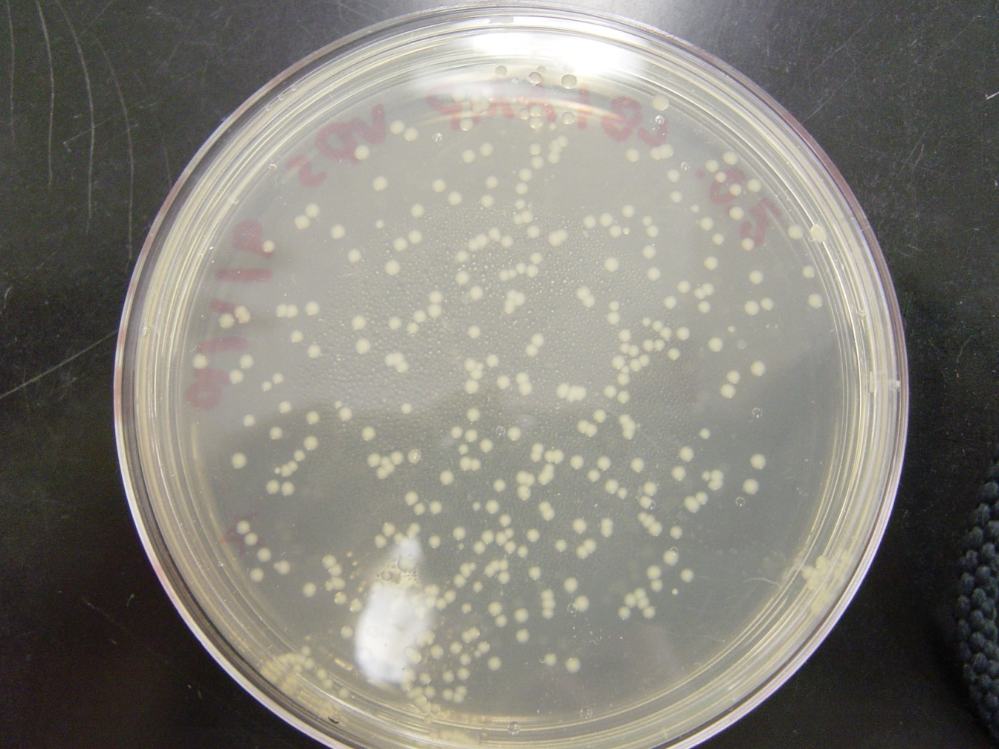
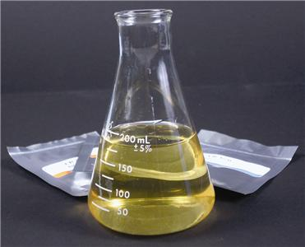
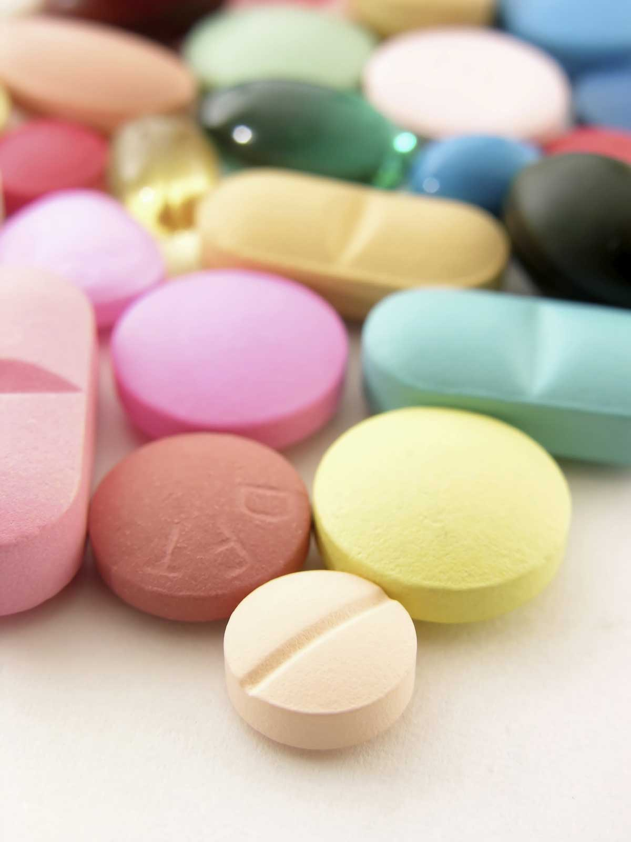
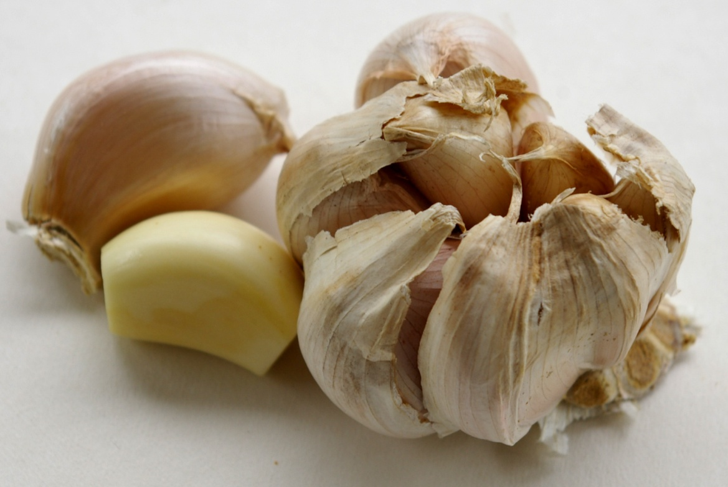
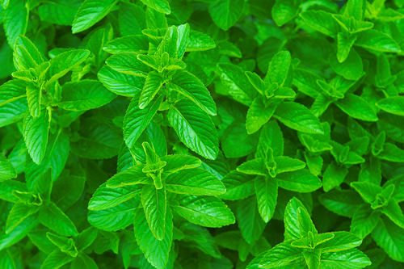
Antibiotics
Mohamed Wahby Hussien
Alexandria University – Faculty of science
Microbiology/Environmental sciences
Bibliotheca Alexandrina - 4 March 2012

Slide 2
Contents
What are antibiotics?
Discovery and history
Production in lab.
Complications
Wrong habits
Antibiotics in food

Slide 3
Contents
What are antibiotics?
Discovery and history
Production in lab.
Complications
Wrong habits
Antibiotics in food

Slide 4
http://3.bp.blogspot.com/-tC9JsDqCxhE/ThRiSsvticI/AAAAAAAAAJM/uIR6WUCAru4/s1600/Pills.jpg

Slide 5
What are antibiotics?
Chemical substance produced by a living organism, generally a microorganism, that is detrimental to other microorganisms.
http://www.britannica.com/EBchecked/topic/27751/antibiotic

Slide 6
What are antibiotics?
Chemical substance produced by a living organism, generally a microorganism, that is detrimental to other microorganisms.
Natural, Synthetic and semi-synthetic
http://www.britannica.com/EBchecked/topic/27751/antibiotic

Slide 7
Contents
What are antibiotics?
Discovery and history
Production in lab.
Complications
Wrong habits
Antibiotics in food

Slide 8
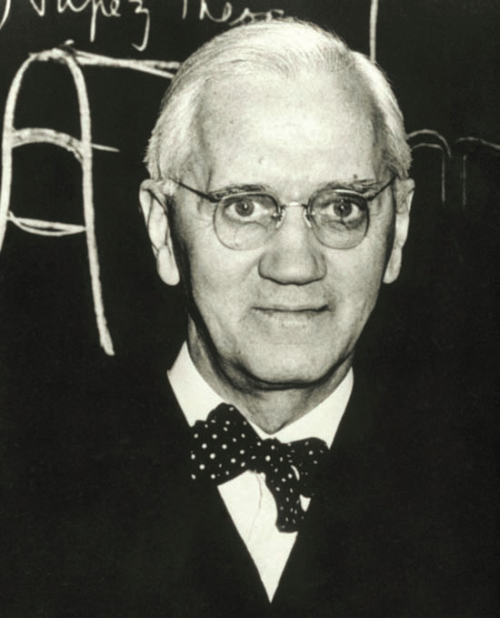
Sir Alexander Fleming (National Library of
Medicine/Photo Researchers, Inc.)
Image taken from: “Deadly diseases and epidemics, antibiotics-resistant bacteria”. Patrick G. Guilfoile, Ph.D. FOUNDING EDITOR, The Late I. Edward Alcamo. Distinguished Teaching Professor of Microbiology, SUNY Farmingdale. FOREWORD BY David Heymann. World Health Organization. Library of Congress Cataloging-in-Publication Data. ISBN: 978-0-7910-9188-3

Slide 9
August 6th, 1881 -March 11th ,1955
Discovery made 1921
The Nobel Prize in Physiology or Medicine 1945
Sir Alexander Fleming (National Library of
Medicine/Photo Researchers, Inc.)
http://www.nobelprize.org/nobel_prizes/medicine/laureates/1945/fleming-bio.html

Slide 10
Normal bacterial growth pattern
http://vdsclass.files.wordpress.com/2010/09/zoe-9-3-10-a.jpg

Slide 11
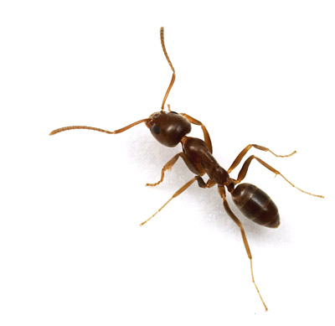
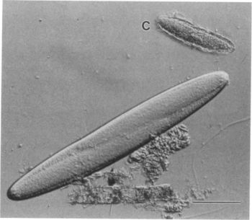
Micro scale
Leaf-cutter ants
Epulopiscium fishelsoni
4 mm
0.5 mm
http://pested.ifas.ufl.edu/newsletters/2011-01/rolloverant.jpg
http://microbewiki.kenyon.edu/images/thumb/7/78/E.fish.JPG/350px-E.fish.JPG

Slide 12
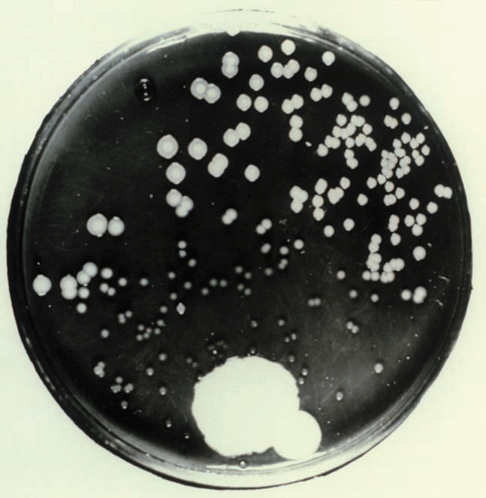
Photograph of the original culture plate of the fungus
Penicillium notatum made by Sir Alexander Fleming (St. Mary’s
Hospital Medical School/Photo Researchers, Inc.)
Notes:
Image taken from: “Deadly diseases and epidemics, antibiotics-resistant bacteria”. Patrick G. Guilfoile, Ph.D. FOUNDING EDITOR, The Late I. Edward Alcamo. Distinguished Teaching Professor of Microbiology, SUNY Farmingdale. FOREWORD BY David Heymann. World Health Organization. Library of Congress Cataloging-in-Publication Data. ISBN: 978-0-7910-9188-3

Slide 13
In 1938 …

Slide 14
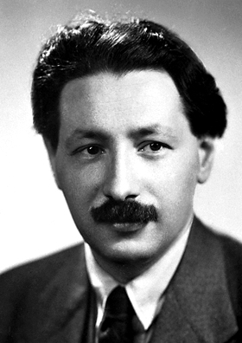
Ernst Boris Chain
19 June 1906 - 12 August 1979
http://www.nobelprize.org/nobel_prizes/medicine/laureates/1945/chain.html

Slide 15
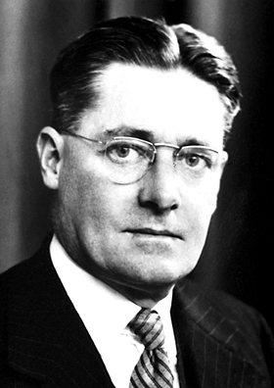
Sir Howard Walter Florey
24 September 1898 - 21 February 1968
Ernst Boris Chain
19 June 1906 - 12 August 1979
http://www.nobelprize.org/nobel_prizes/medicine/laureates/1945/florey.html

Slide 16
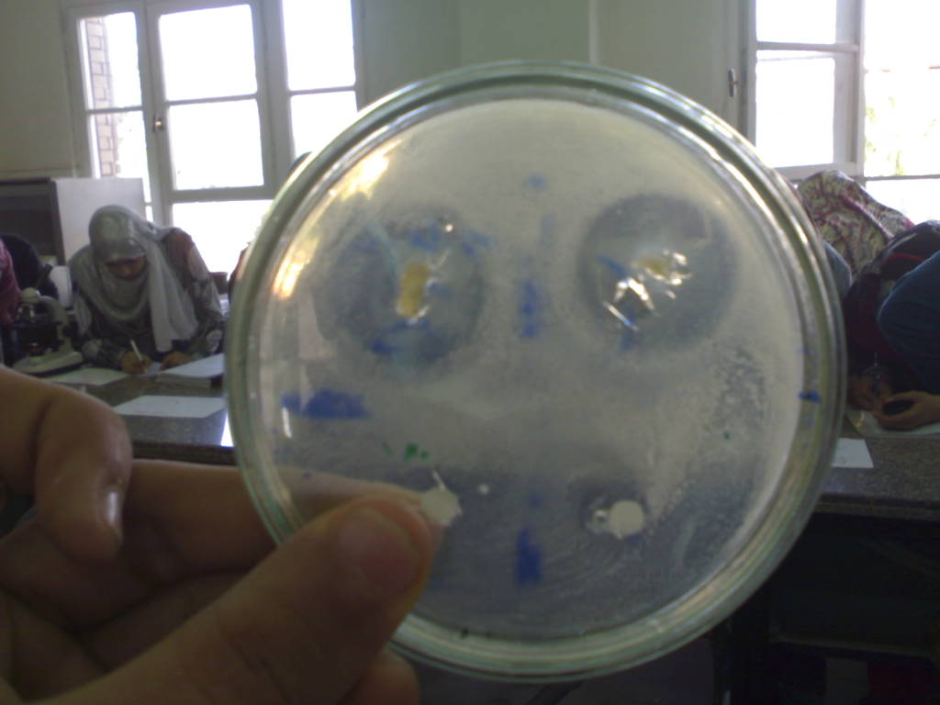
Inhibition zone
Bacterial susceptibility test. Practical section of course “General bacteriology ” Mic.311. Department of Microbiology, faculty of science, Alexandria University. Semester Autumn 2010.

Slide 17
Contents
What are antibiotics?
Discovery and history
Production in lab.
Complications
Wrong habits
Antibiotics in food

Slide 18
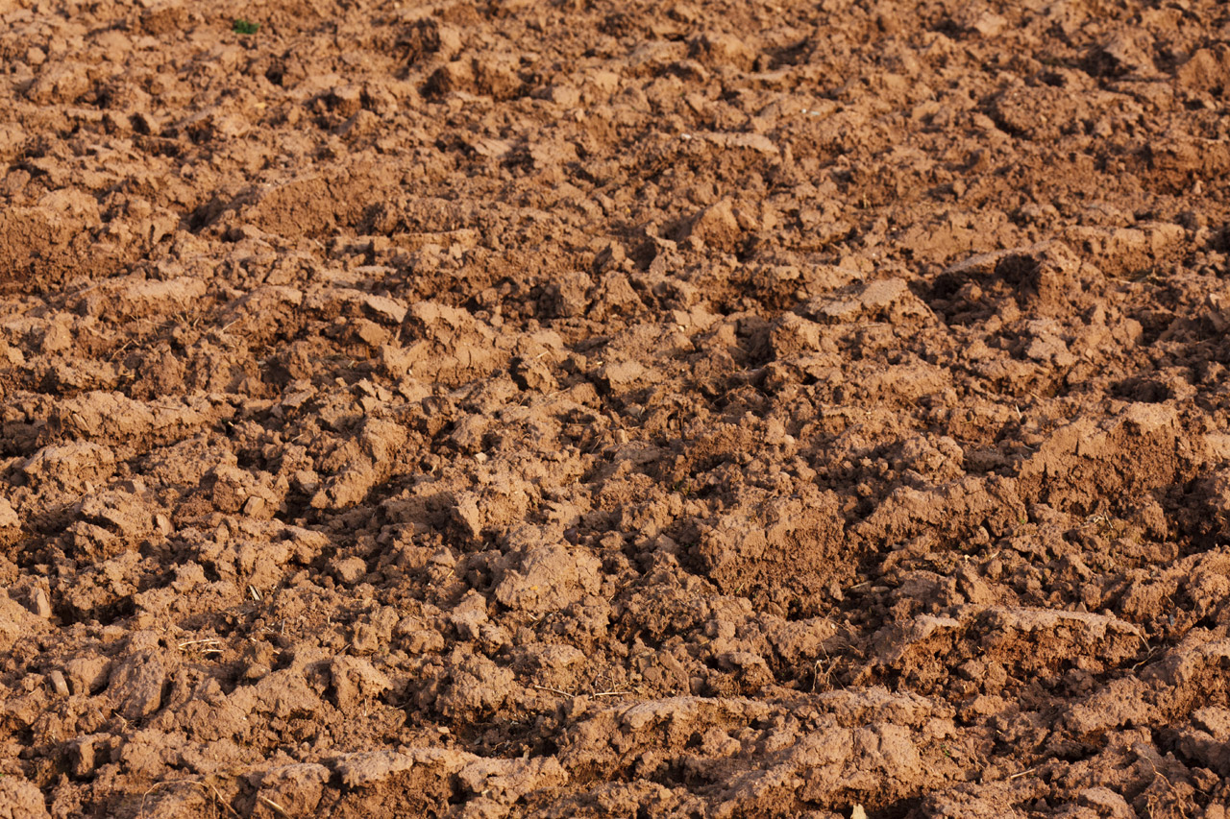
Source of isolation
http://www.publicdomainpictures.net/pictures/20000/velka/soil-texture.jpg

Slide 19
Media for growth
http://www.gbiosciences.com/EducationalUploads/EducationalProductsImages/mediumimages/LB%20Broth.jpg

Slide 20
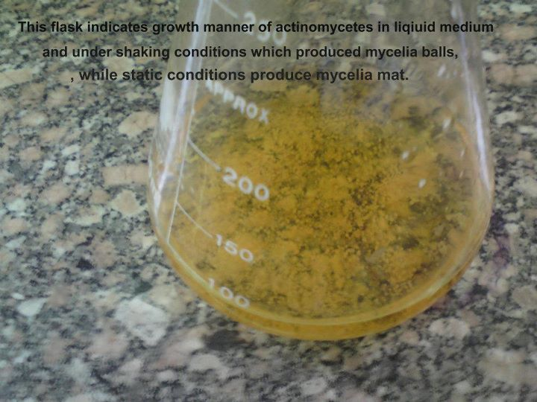
Fermentation process
Actinomycetes after fermentation. Practical section of course “Actinomycetes” Mic.411. Department of Microbiology, faculty of science, Alexandria University. Semester Autumn 2011.

Slide 21
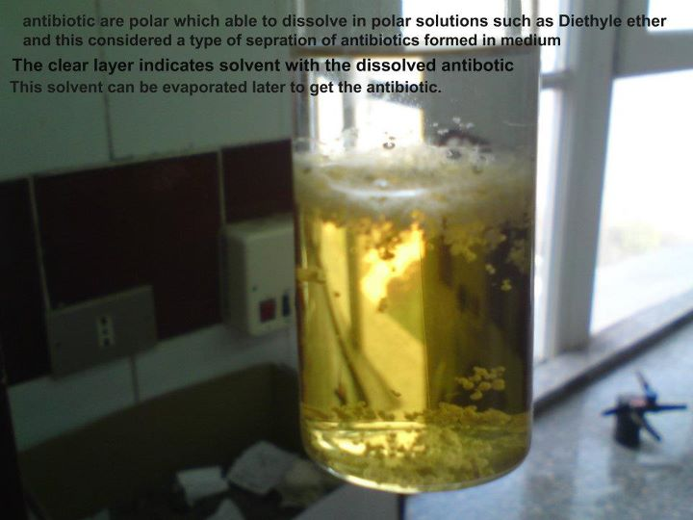
After fermentation
Production of antibiotic layer after fermentation. Practical section of course “Actinomycetes” Mic.411. Department of Microbiology, faculty of science, Alexandria University. Semester Autumn 2011.

Slide 22
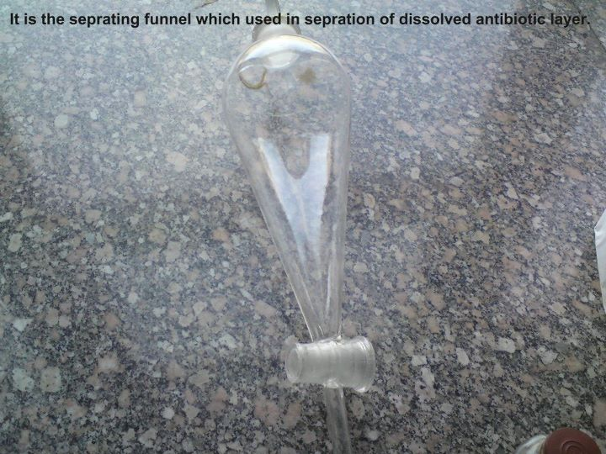
Purification
Separation flask used in the separation of antibiotic form the bacterial suspension. Practical section of course “Actinomycetes” Mic.411. Department of Microbiology, faculty of science, Alexandria University. Semester Autumn 2011.

Slide 23
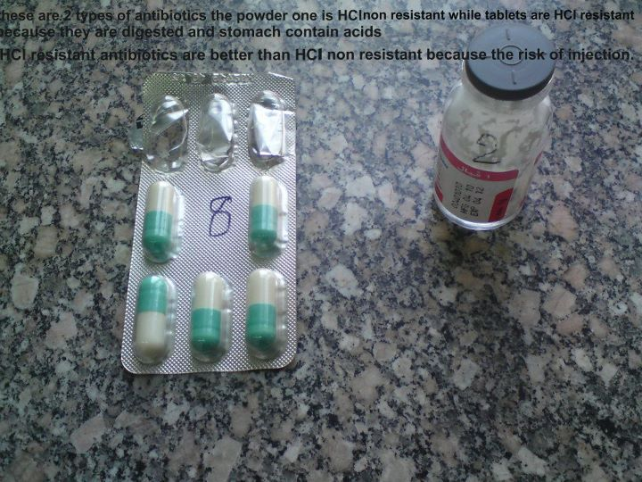

Slide 24
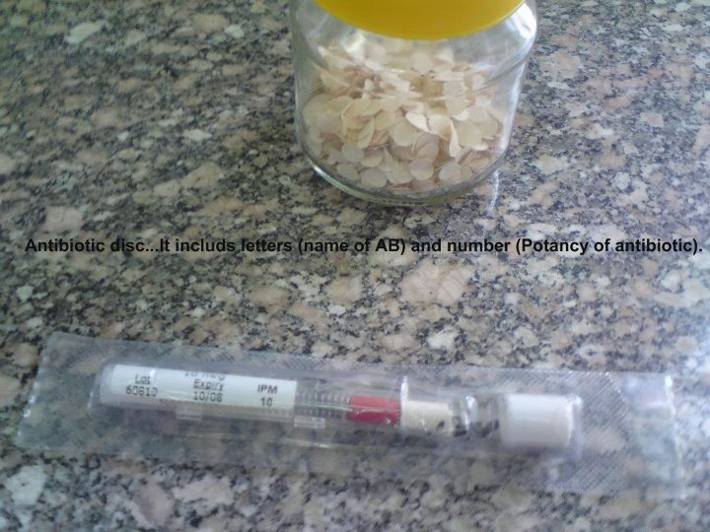

Slide 25
Bacterial susceptibility test
Bacterial susceptibility test. Practical section of course “General bacteriology ” Mic.311. Department of Microbiology, faculty of science, Alexandria University. Semester Autumn 2010.

Slide 26
Contents
What are antibiotics?
Discovery and history
Production in lab.
Complications
Wrong habits
Antibiotics in food
http://www.who.int/mediacentre/factsheets/fs194/en/

Slide 27
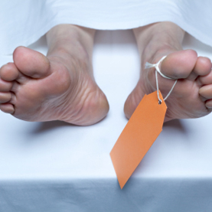
Infections caused by resistant microorganisms often fail to respond to conventional treatment, resulting in prolonged illness and greater risk of death.
http://www.scientificamerican.com/media/inline/patchy-us-death-investigations_1.jpg

Slide 28
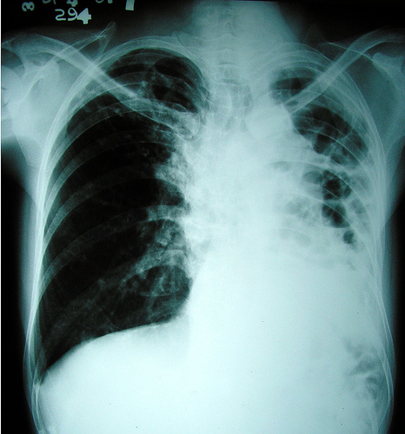
About 440 000 new cases of multidrug-resistant tuberculosis (MDR-TB) emerge annually, causing at least 150 000 deaths.
http://topnews.ae/images/tuberculosis-AIDS-virus.jpg

Slide 29
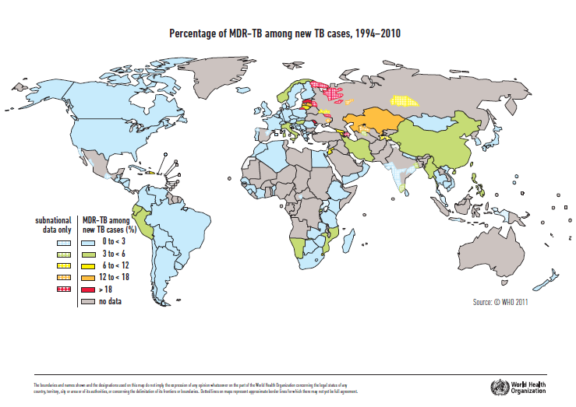

Slide 30
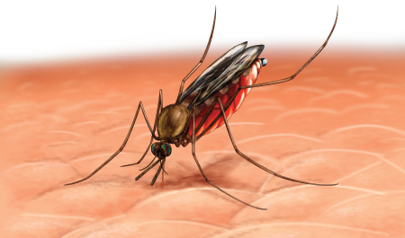
Resistance to earlier generation antimalarial medicines such as chloroquine and sulfadoxine-pyrimethamine is widespread in most malaria-endemic countries.
http://www.malaria-symptoms.org/images/malaria_symptoms.jpg

Slide 31
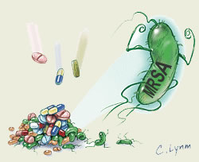
A high percentage of hospital-acquired infections are caused by highly resistant bacteria such as methicillin-resistant Staphylococcus aureus (MRSA).
http://2.bp.blogspot.com/_Yfot5nhi8BA/TQeaJ3iylKI/AAAAAAAAABM/Cjf3LbJofDI/s1600/antibiotic-resistance-mrsa.jpg

Slide 32
Contents
What are antibiotics?
Discovery and history
Production in lab.
Complications
Wrong habits
Antibiotics in food

Slide 33
Antibiotics do NOT fight infections caused by viruses, such as
Colds
Flu
Most coughs and bronchitis
Sore throats, unless caused by strep
http://www.nlm.nih.gov/medlineplus/antibiotics.html

Slide 34
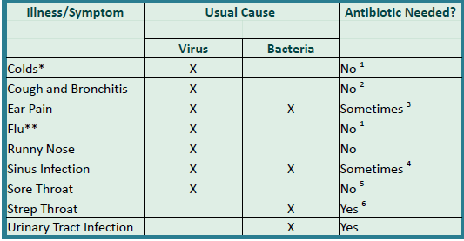
“When do I need antibiotic”, fact sheet. “A Quick Reference Sheet from the Alliance for the Prudent Use of Antibiotics”. Downloaded from Alliance for Prudent Use of Antibiotics http://www.tufts.edu/med/apua/consumers/personal_home.shtml

Slide 35
Contents
What are antibiotics?
Discovery and history
Production in lab.
Complications
Wrong habits
Antibiotics in food

Slide 36
Foods that Contain Natural Antibiotic Qualities/Properties
http://www.steadyhealth.com/articles/Natural_Antibiotics___Foods_that_Work_as_Antibiotics_a979.html

Slide 37
Garlic
Onions
Honey
Fruits (vit. C)
Eucalyptus
Goldenseal
http://www.nlj.gov.jm/FeastingontheHeritage/garlic.jpg

Slide 38
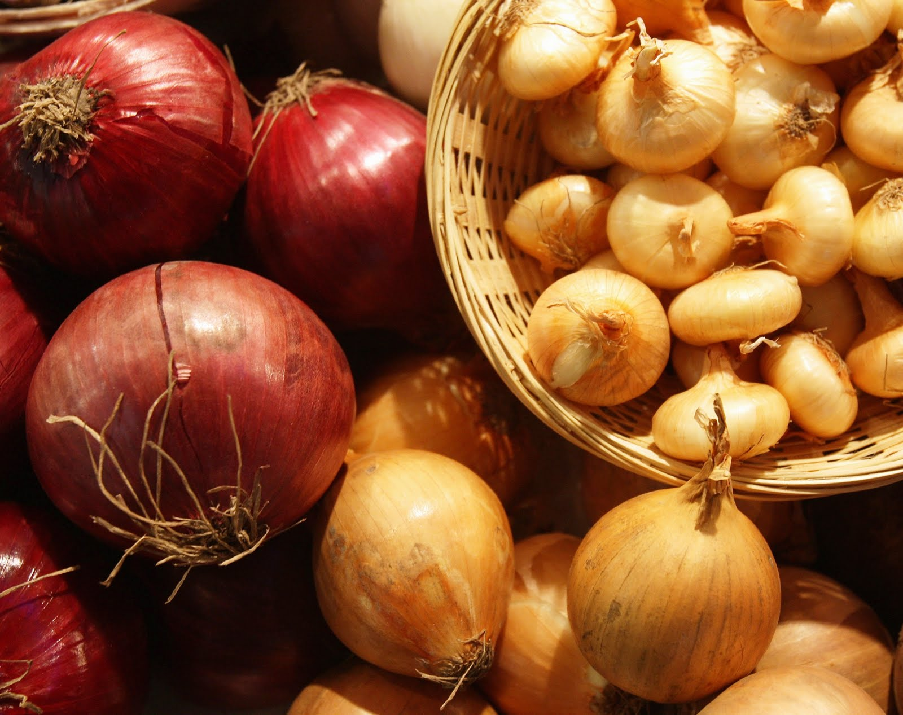
Garlic
Onions
Honey
Fruits (vit. C)
Eucalyptus
Goldenseal
http://4.bp.blogspot.com/_TvbjZxLkgdk/S9RE-9laUUI/AAAAAAAABCM/8lWfwr1EHkY/s1600/onion.jpg

Slide 39
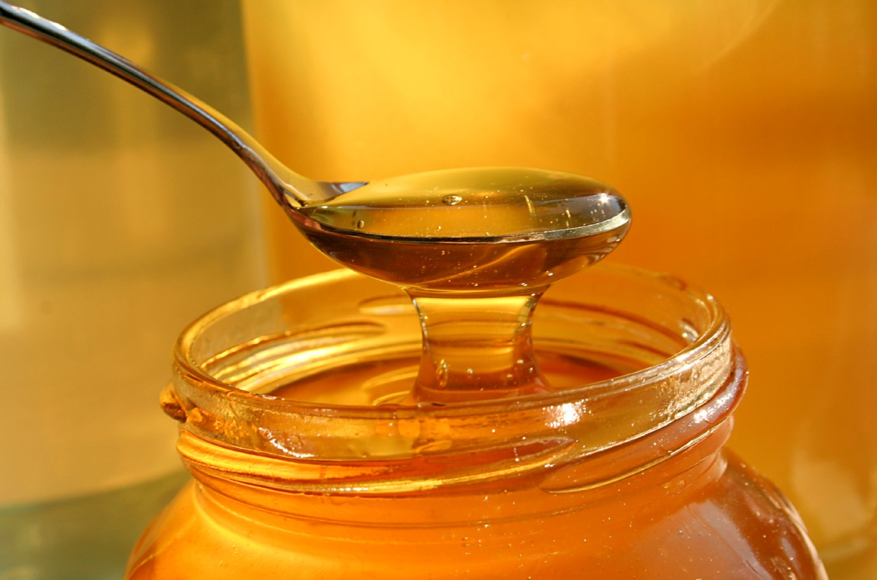
Garlic
Onions
Honey
Fruits (vit. C)
Eucalyptus
Goldenseal
http://usahitman.com/wp-content/uploads/2011/10/honey.jpg

Slide 40
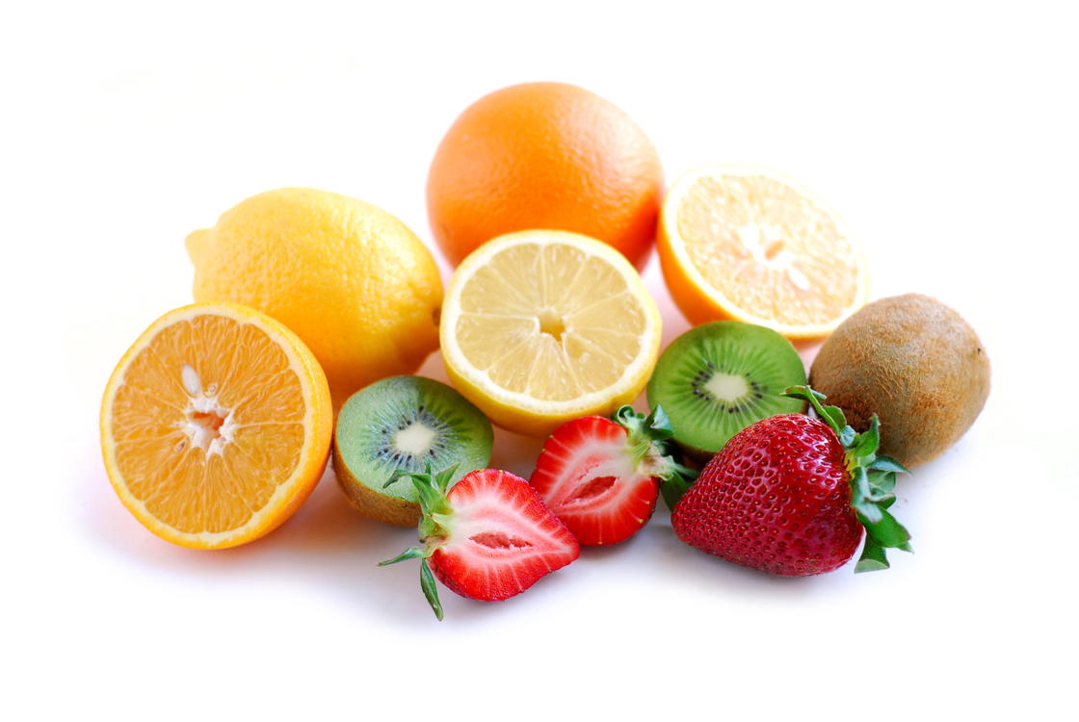
Garlic
Onions
Honey
Fruits (vit. C)
Eucalyptus
Goldenseal
http://www.perfectfuelchocolate.com/wp-content/uploads/2012/02/MP9004387871.jpg

Slide 41
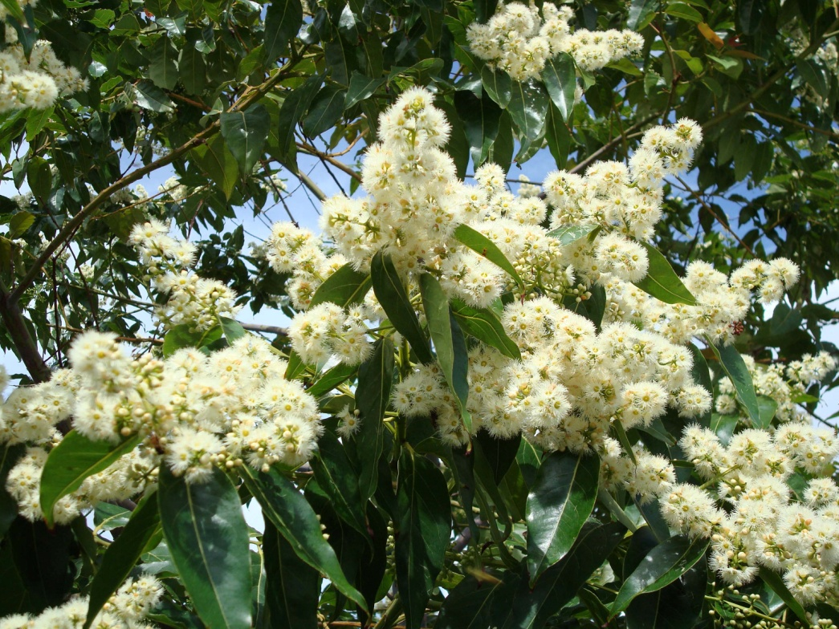
Garlic
Onions
Honey
Fruits (vit. C)
Eucalyptus
Goldenseal
http://mgonline.com/media/Images/R/rainbow07.jpg

Slide 42
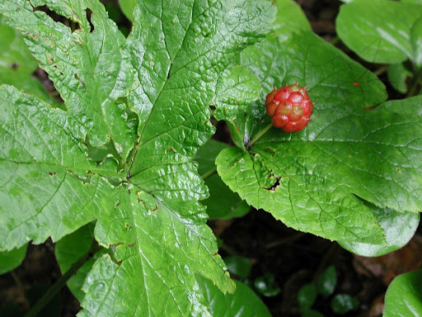
Garlic
Onions
Honey
Fruits (vit. C)
Eucalyptus
Goldenseal
http://lh6.ggpht.com/_b8Vu1aZK2n4/SmmmoN8c8RI/AAAAAAAAB2M/H6RTAvEZBmI/Hydrastis%20canadensis%20Goldenseal.jpg

Slide 43
Herbs that Contain Natural Antibiotic Qualities/Properties

Slide 44
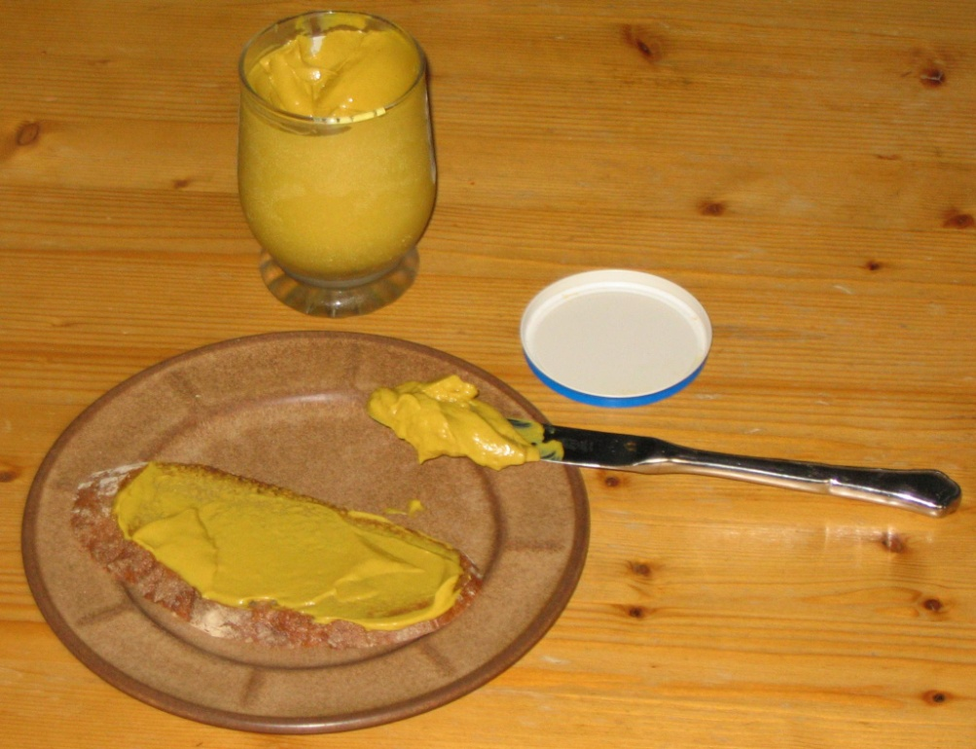
Herbs that Contain Natural Antibiotic Qualities/Properties
Mustard
Pepper
Mint sage
Chilli peppers
Rosemary
Cumin
http://tribeofdad.net/wp-content/uploads/2009/02/bread_with_mustard.jpg

Slide 45
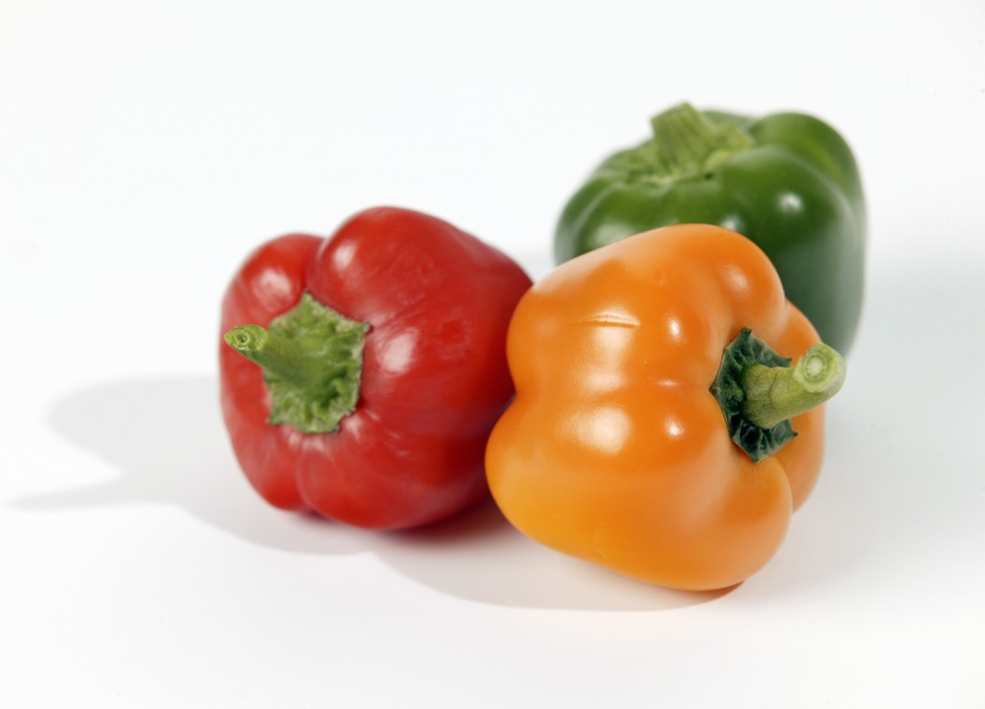
Herbs that Contain Natural Antibiotic Qualities/Properties
Mustard
Pepper
Mint sage
Chilli peppers
Rosemary
Cumin
http://www.greeneryuk.com/images/products-feature/920pepper.jpg

Slide 46
Herbs that Contain Natural Antibiotic Qualities/Properties
Mustard
Pepper
Mint sage
Chilli peppers
Rosemary
Cumin
http://herbs.gems4friends.com/images/spearmint.jpg

Slide 47
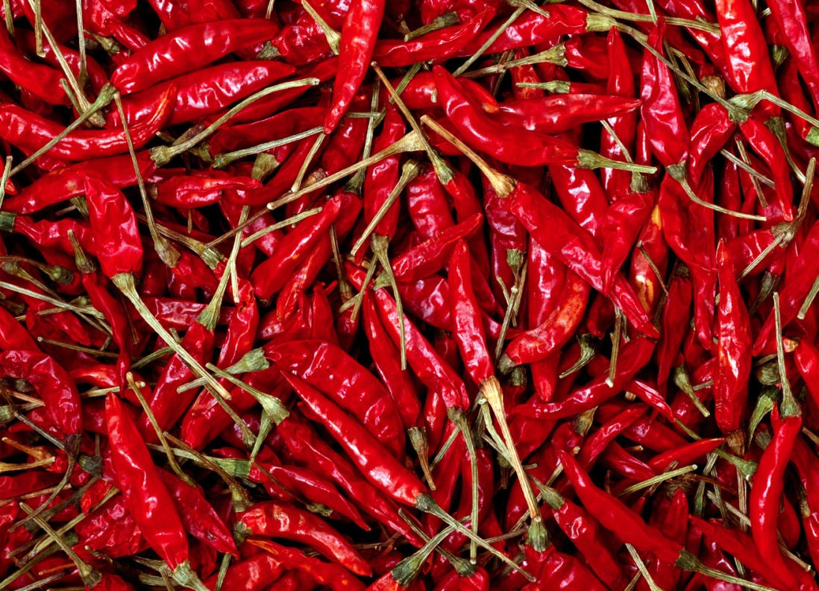
Herbs that Contain Natural Antibiotic Qualities/Properties
Mustard
Pepper
Mint sage
Chilli peppers
Rosemary
Cumin
http://www.theworldrecipebook.com/img/articles/76/RedChillis.jpg

Slide 48
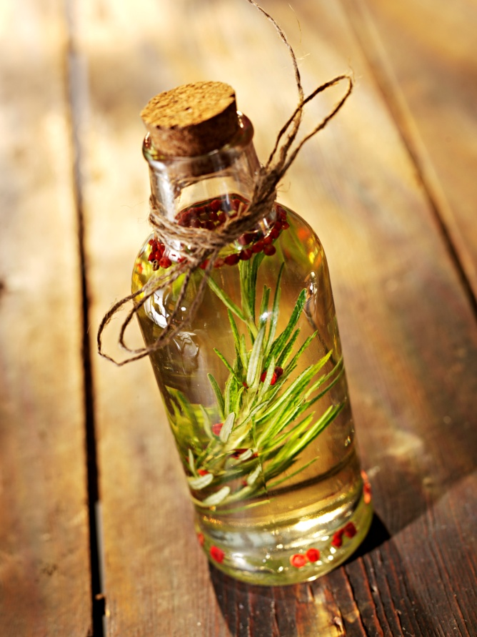
Herbs that Contain Natural Antibiotic Qualities/Properties
Mustard
Pepper
Mint sage
Chilli peppers
Rosemary
Cumin
http://blushless.com/blog/wp-content/uploads/2011/06/rosemary_oil_in_a_bottle2.jpg

Slide 49
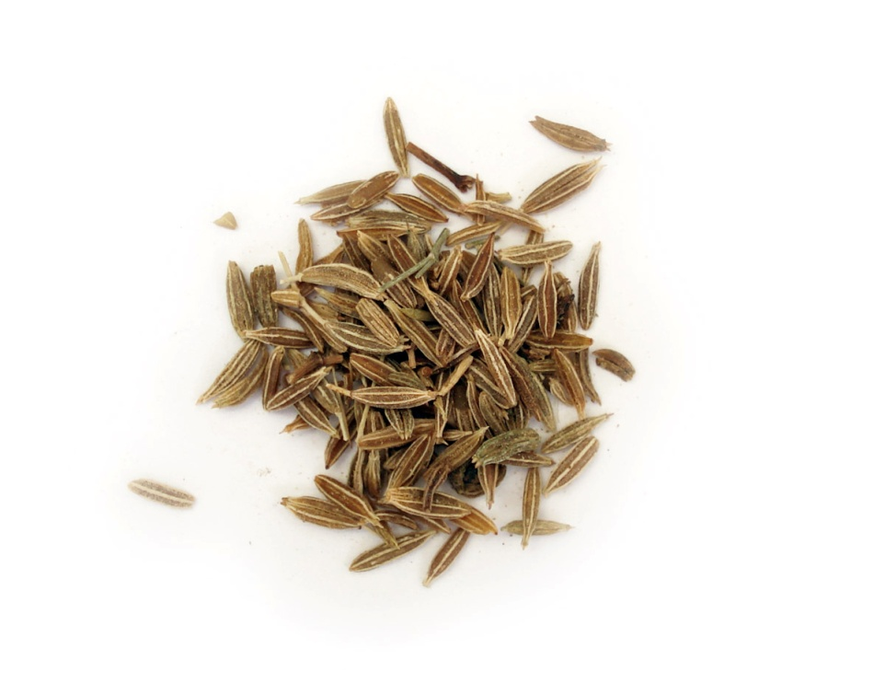
Herbs that Contain Natural Antibiotic Qualities/Properties
Mustard
Pepper
Mint sage
Chilli peppers
Rosemary
Cumin
http://guacamole-recipe.net/files/2010/12/cumin-seeds-for-guacamole.jpg

Slide 50
Contents
What are antibiotics?
Discovery and history
Production in lab.
Complications
Wrong habits
Antibiotics in food

Slide 51
Thanks you

