Slide 1
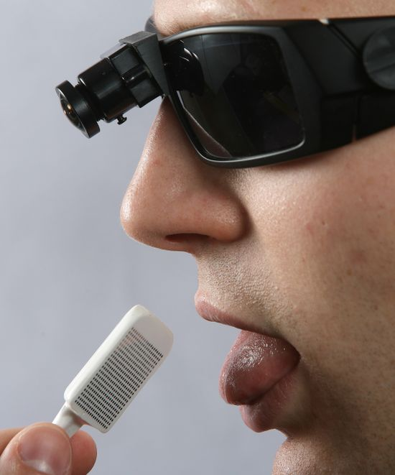
Seeing with tongue
الرؤية باللسان

Slide 2
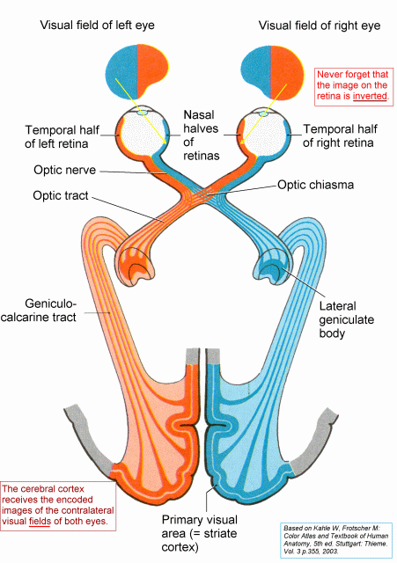
HOW CAN WE SEE ???

Slide 3
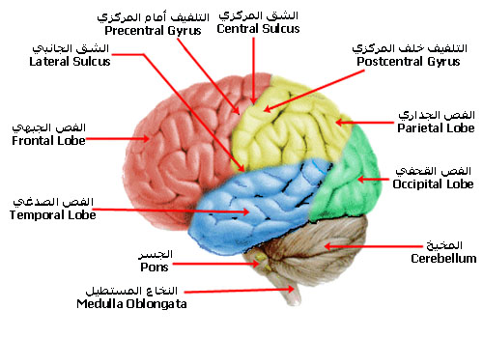
PARTS OF BRAIN ….

Slide 4
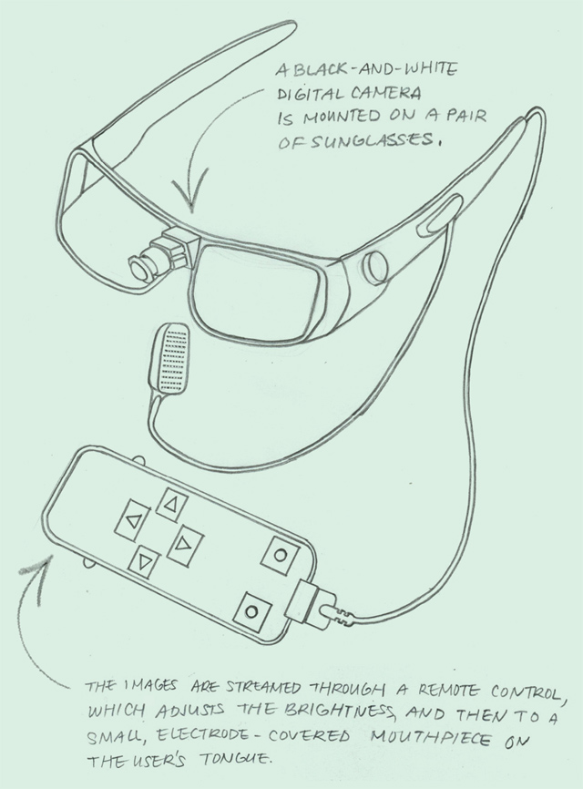
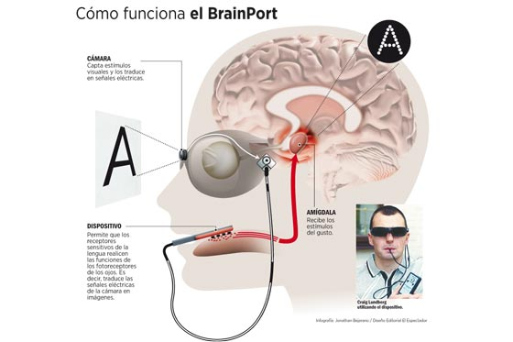
Brainport Device

Slide 5
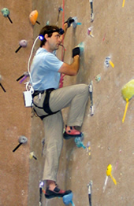

Challenge

Slide 6

YOU
And
ONLY YOU

Slide 7
References
1-http://vision.wicab.com/technology/
2-http://www.wicab.com/
3-http://tcnl.bme.wisc.edu/contact_wicab.ph

Slide 8
Than Q
For Good Listing

