Slide 1
The quest for the scientific explanation of magic
Abdulkadir Aliyu
6th April, 2013
ALYM

Slide 3
Magic
Magic is the art of producing a desired effect or result through the use of incantation, ceremony, ritual, the casting of spells or various other techniques that assure human control of supernatural agencies/natural forces.

Slide 4
Supernatural
Not subject to the laws of nature

Slide 5
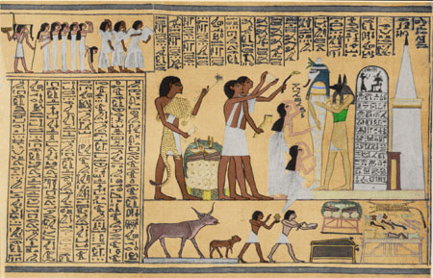
History of magic

Slide 6
Magical language
The performance of magic involves the use of language which can be
Spoken out loud
Unspoken (body)
Written words
used to access or guide magical power

Slide 7
Types of Magic
Ceremonial magic
Folk magic
Witchcraft
Left and Right Hand Magic
Black and White Magic

Slide 8
Ceremonial magic
It depends on book learning; precise, complicated ritual; and intricate sets of correspondences.
gaining divine knowledge
Purification
Attraction of proper influences

Slide 9
Folk magic
healing,
attracting luck or love,
driving away evil forces,
finding lost items,
bringing good harvests,
fertility.

Slide 10
Witchcraft
witchcraft meant malevolent magic, Witches were thought to:
kill
Maim
cause sterility
blight crops
poison water

Slide 11
Left and Right Hand Magic
Based on the benefit
positive
Negative

Slide 12
Black and white magic
Social acceptability

Slide 13


Slide 14
Elements of scientific thoughts and magic

Slide 15
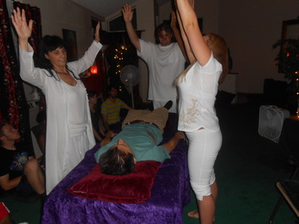
Purpose

Slide 16

Question at issue

Slide 17
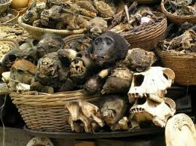
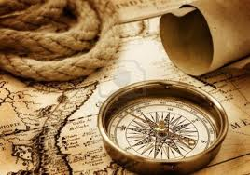
Information (data) collection

Slide 18
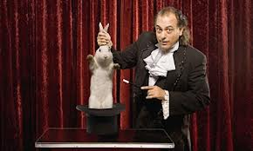
Interpretation and inferences

Slide 19
Concepts
Laws
Theories
Principles
Models etc

Slide 20
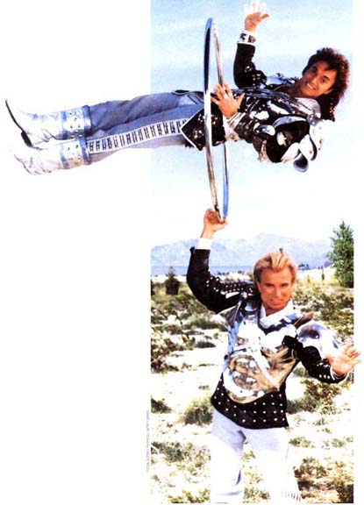
Assumptions

Slide 21
Implication & consequencies

Slide 22

Point of view
IT IS THIS
IT IS THIS
IT IS THIS
IT IS THIS

Slide 23
Why is magic scientific phenomena

Slide 24
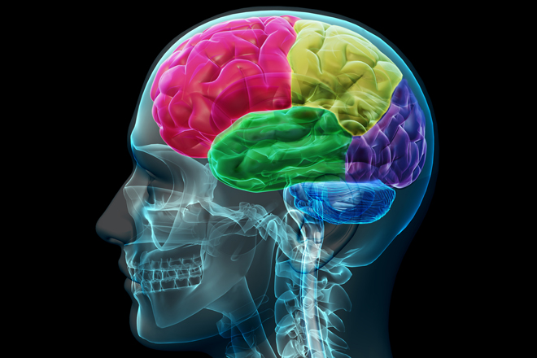

Slide 25
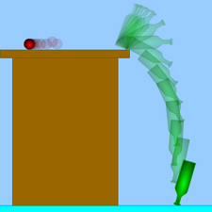

Slide 26
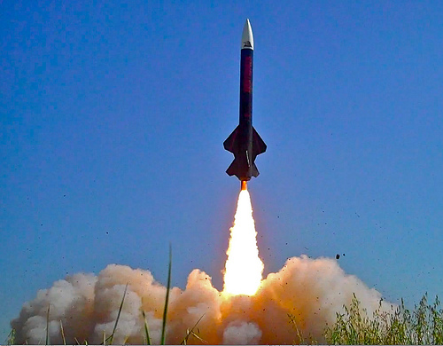

Slide 27
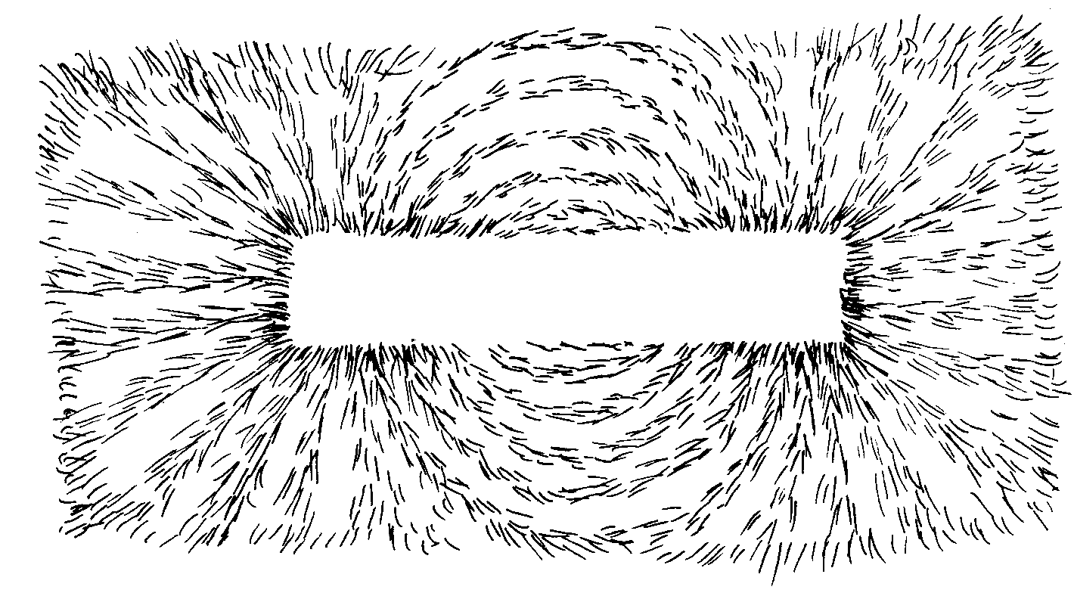

Slide 28
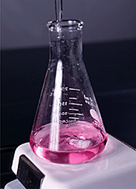

Slide 29
If, in short, there is a community of computers living in my head, there had also better be somebody who is in charge; and, by God, it had better be me.
JERRY FODOR

Slide 30
fictional world is populated with all the images, events, sounds, smells, hunches, presentiments, and feelings that the subject sincerely believes to exist in his or her stream of consciousness.
Daniel Dennett

Slide 31
References
Paul, R. and Elder L. (2003). Miniature guide to scientific thinking. The foundation for critical thinking , www.criticalthinking.org
Daniel Dennett (2003). Explaining the magic of consciousness. Journal of Cultural and Evolutionary Psychology, 1(2003)1, 7.19
Http://www.Mcaegypt.Org/oldworldmagic.Html
Http://altreligion.About.Com/od/ritualsandpractices/tp/types-of-magic.Htm
Http://en.Wikipedia.Org/wiki/magic_(paranormal)

Slide 32
Thank you

