Slide 1


Slide 2
فيديو

Slide 3


Slide 4
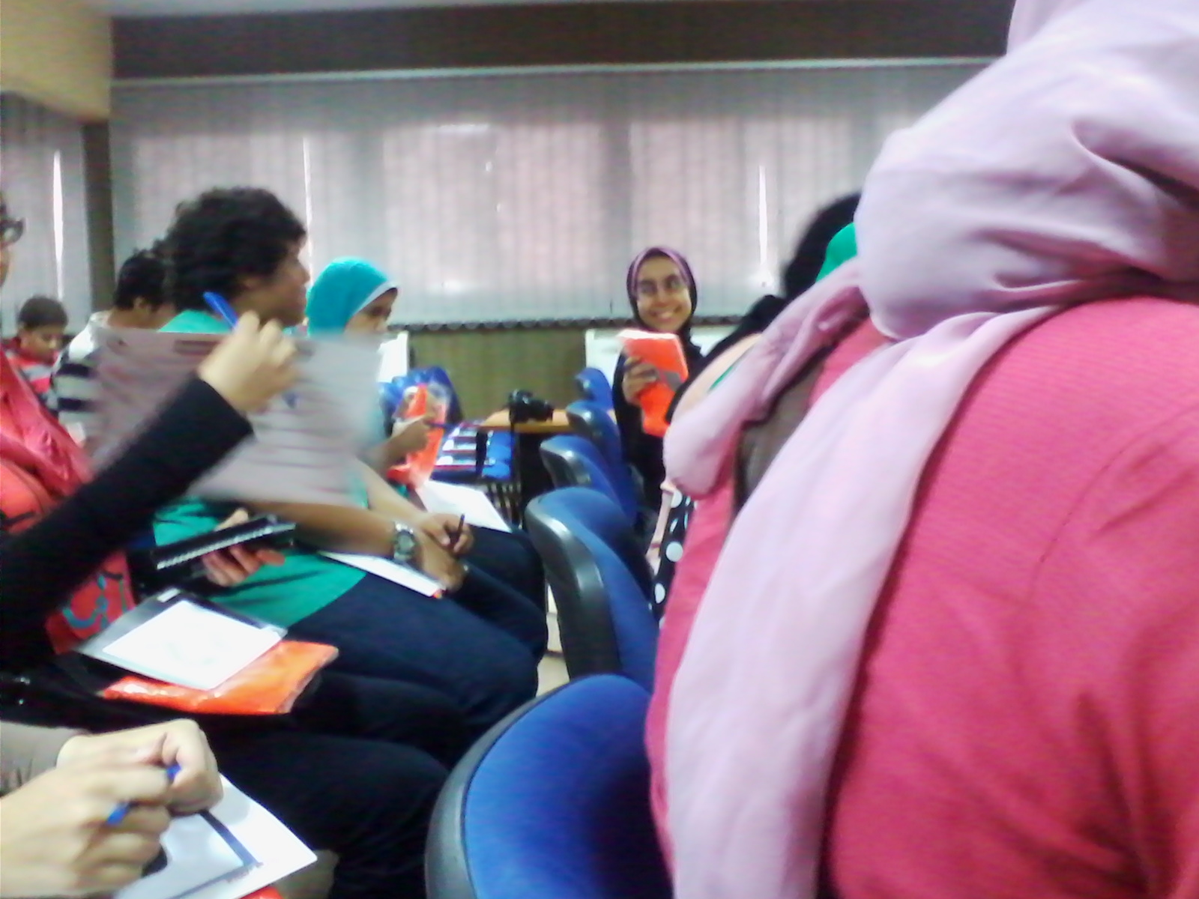

Slide 5
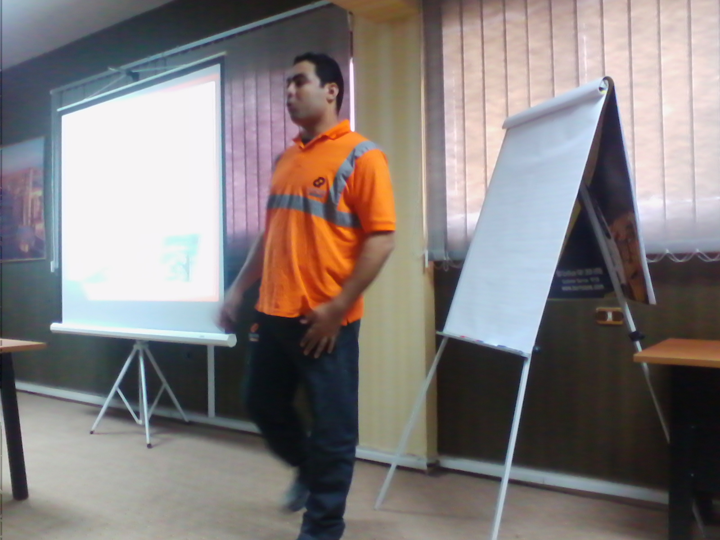
ايه اللي كنتوا متوقعين تشوفوه ؟؟؟

Slide 6
فروع الشركة :
3 قارات
8 دول
39 مصنع

Slide 7
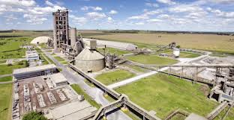
About us

Slide 8
الحفاظ علي امن و سلامة المهندسين و العاملين :
1) اصدار تصريح عمل في جميع الاعمال المطلوبة و تقيم مخاطر العمل .
2) عمل الاجرائات اللازمة بعزل الكهرباء كاملة .
3) الاستخدام الامن للادوات و تخزينها بطريقة سليمة .
4) اتباع تعليمات القيادة الامنه داخل المصنع وفقا لقواعد الشركة .
5) اتباع اجرائات السلامة عند العمل علي ارتفاعات .

Slide 9
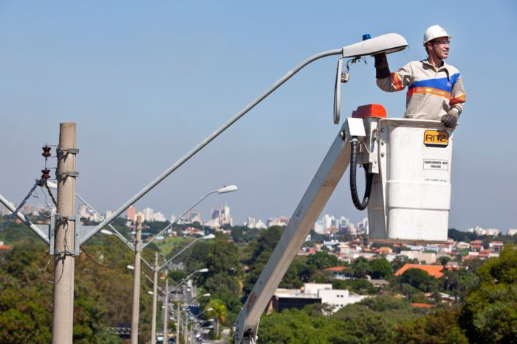

Slide 10
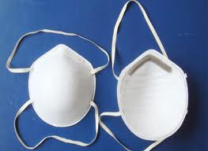
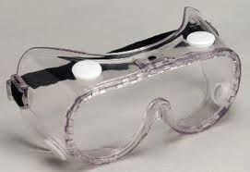






Slide 11
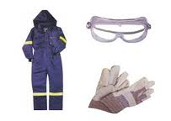
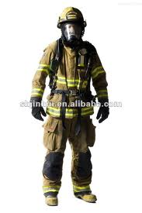

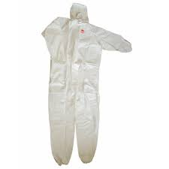
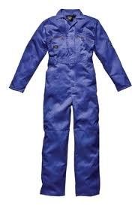




Slide 12
Manufacturing Cement

Slide 13
Brief History

Slide 14

اساحبي مش الأسمنت ده بيبقي حاجة زي تراب علي الأرض و احنا بناخده نعبيه في شكائر و نبيعه ؟!

Slide 15
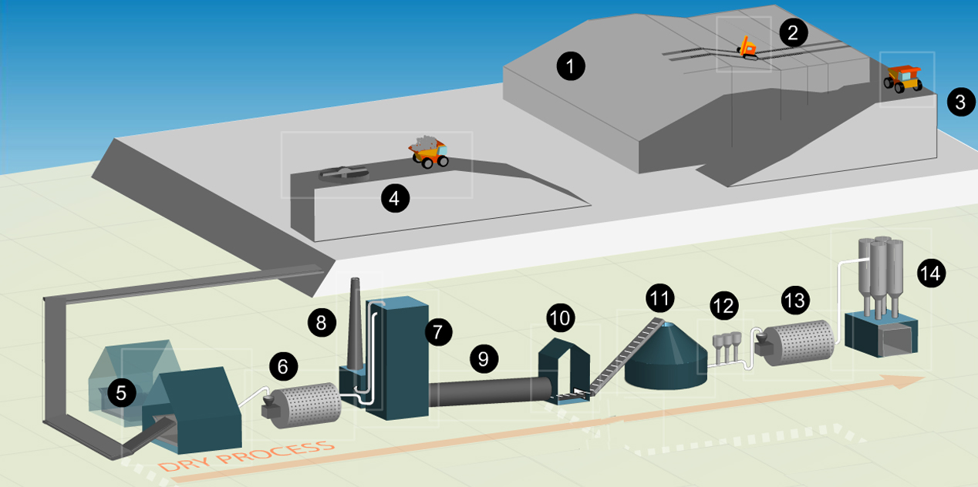

Slide 16
Step 1 - Quarrying:
The raw material for cement manufacture is a rock mixture which is about 80% limestone (which is rich in CaCO₃) and 20% clay or shale (a source of silica, alumina and Fe₂O₃).These are quarried and stored separately.
The lime and silica provide strength of the cement, while the iron reduces the reaction temperature and gives the cement its grey color.

Slide 17
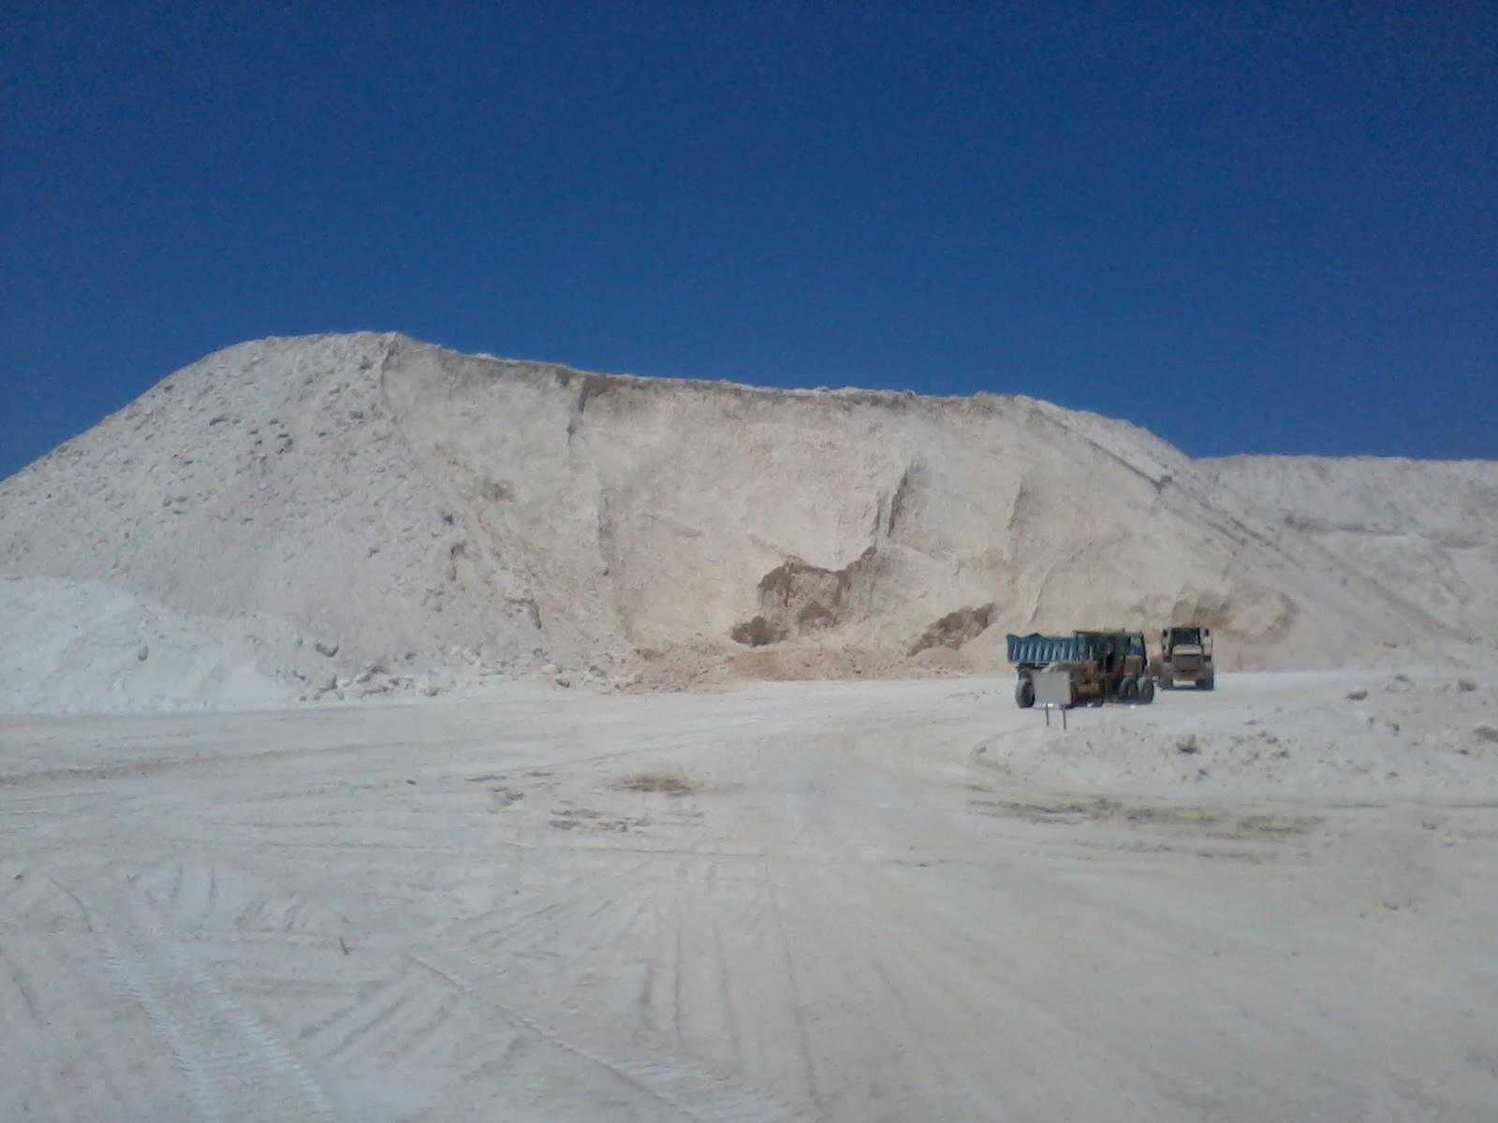

Slide 18
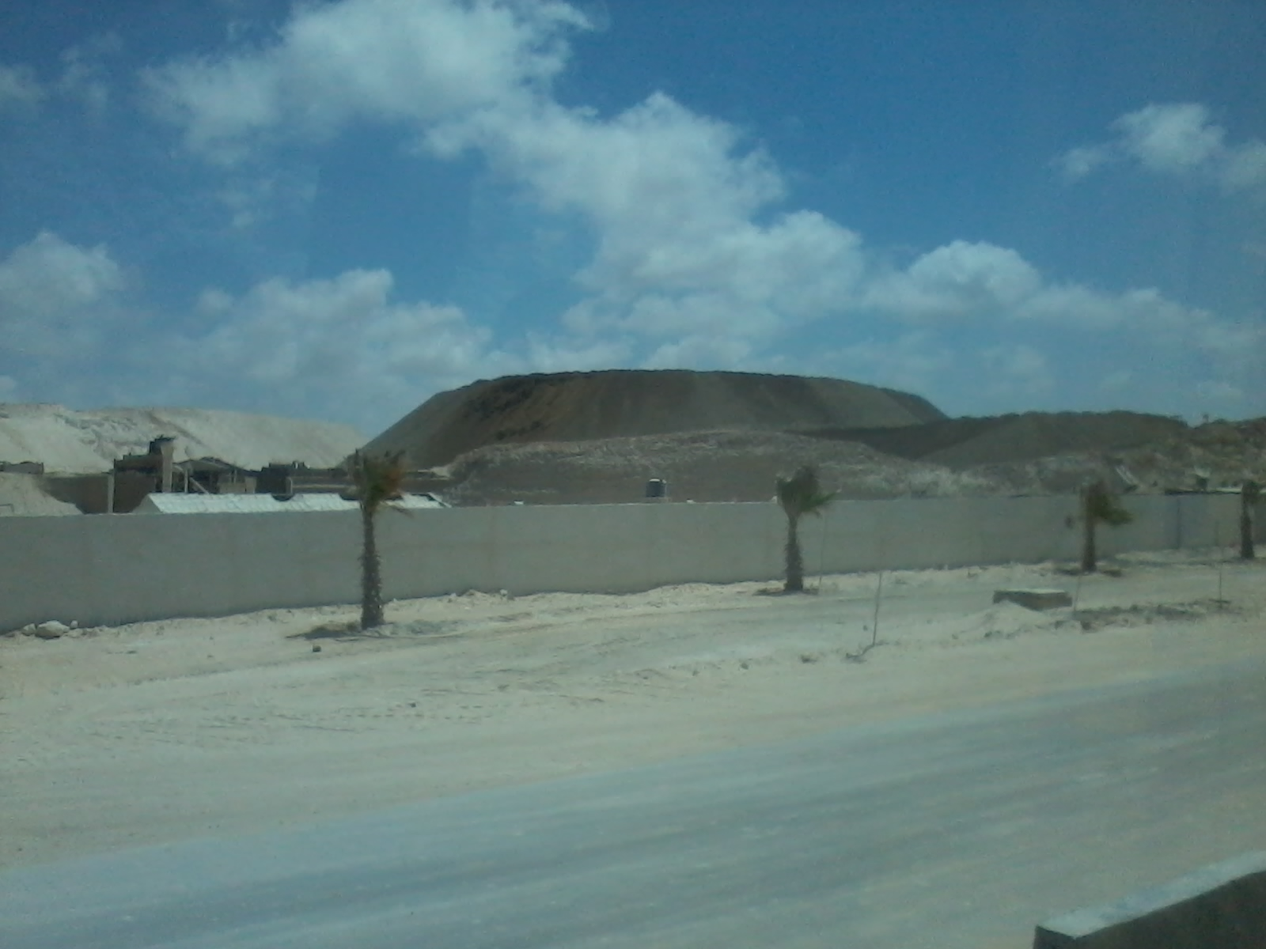

Slide 19
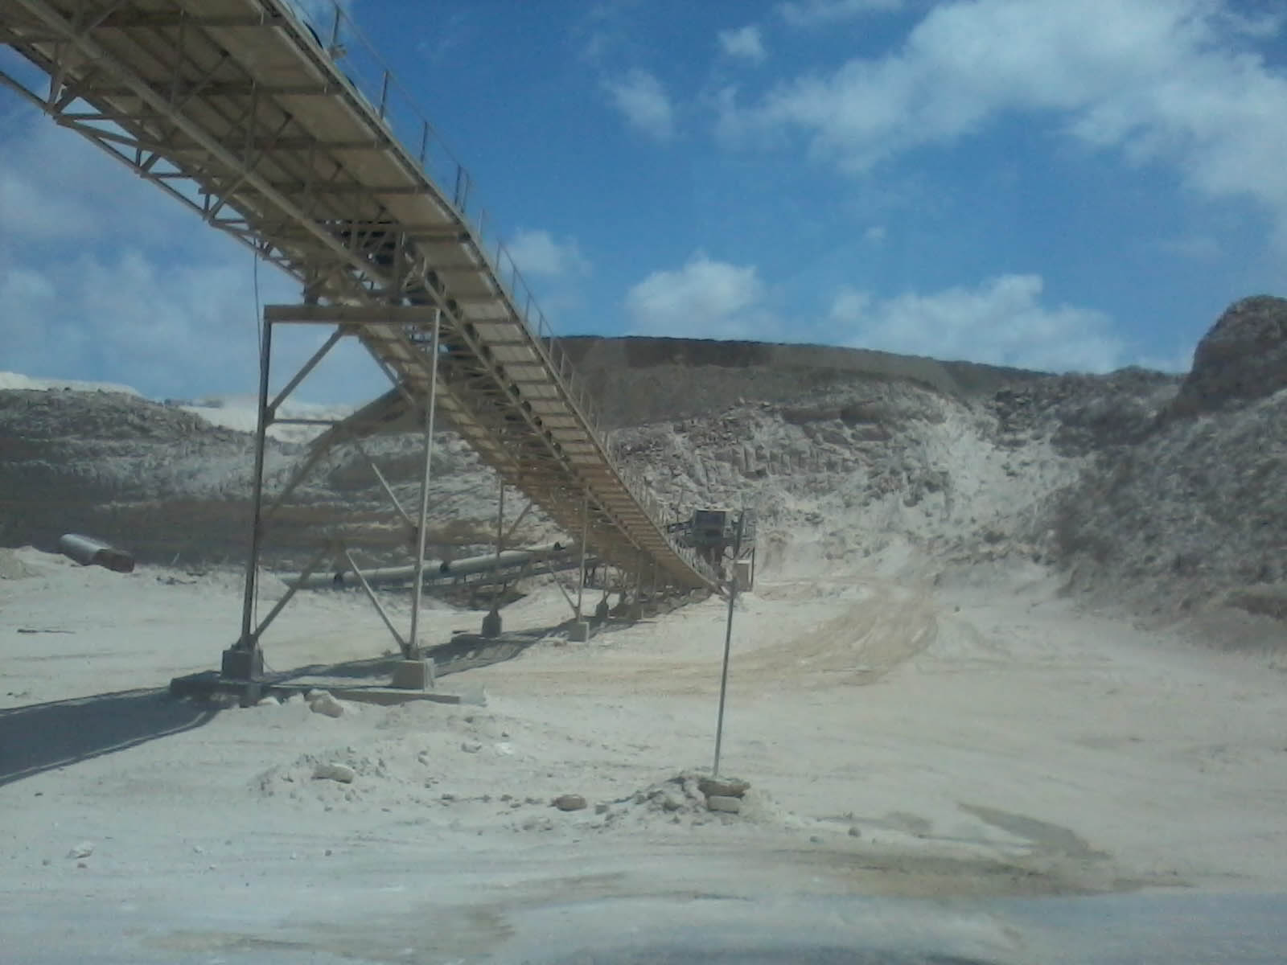

Slide 20
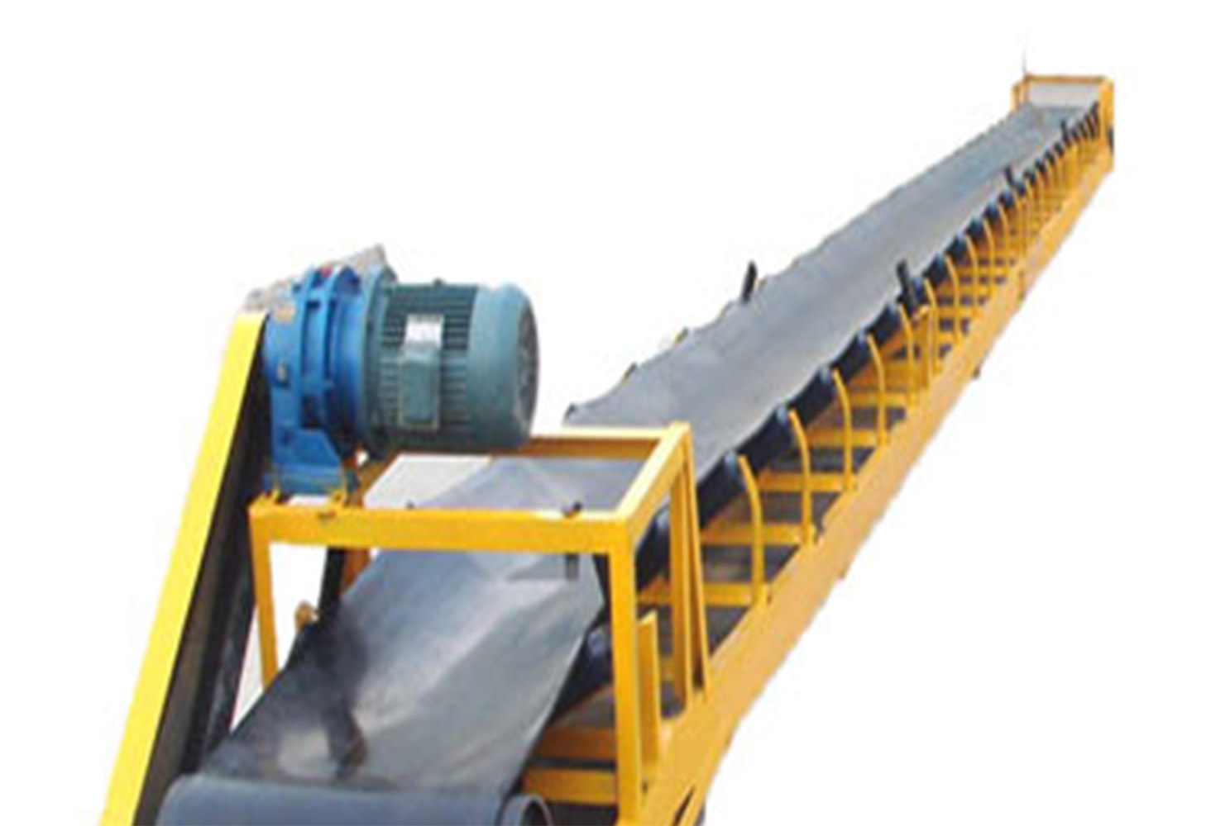
Conveyor Belt

Slide 22
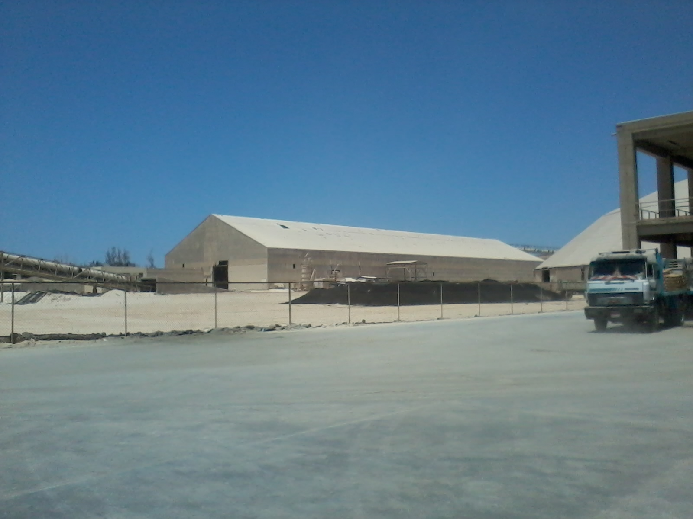

Slide 23
Step 2 - Raw material preparation : (The dry process)
1) Clay and limestone are crushed until nothing bigger than a tennis ball remains.
2) Samples are then sent off to the laboratory for mineral analysis.

Slide 25
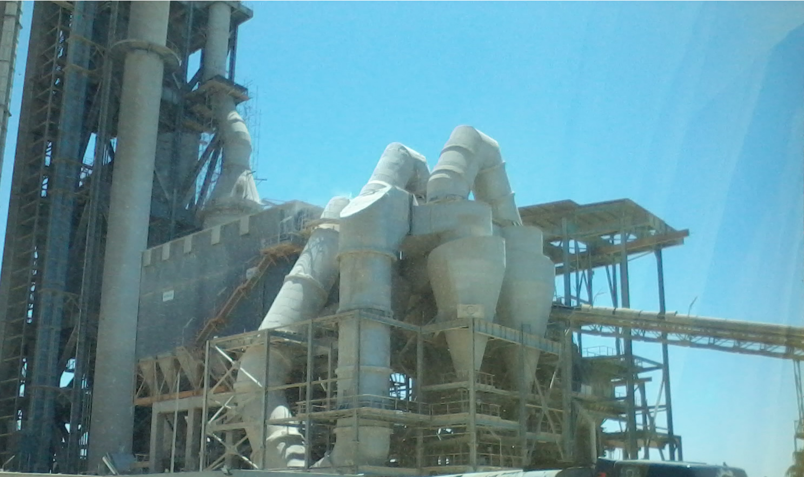

Slide 26
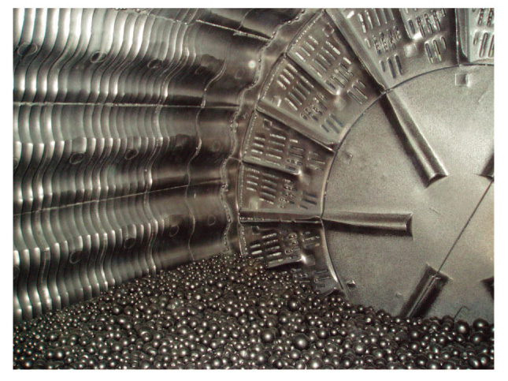

Slide 28
1) Pre-heater tower
The powder from the dry process doesn't contain much moisture, so can be dried in a pre-heater tower

Slide 29
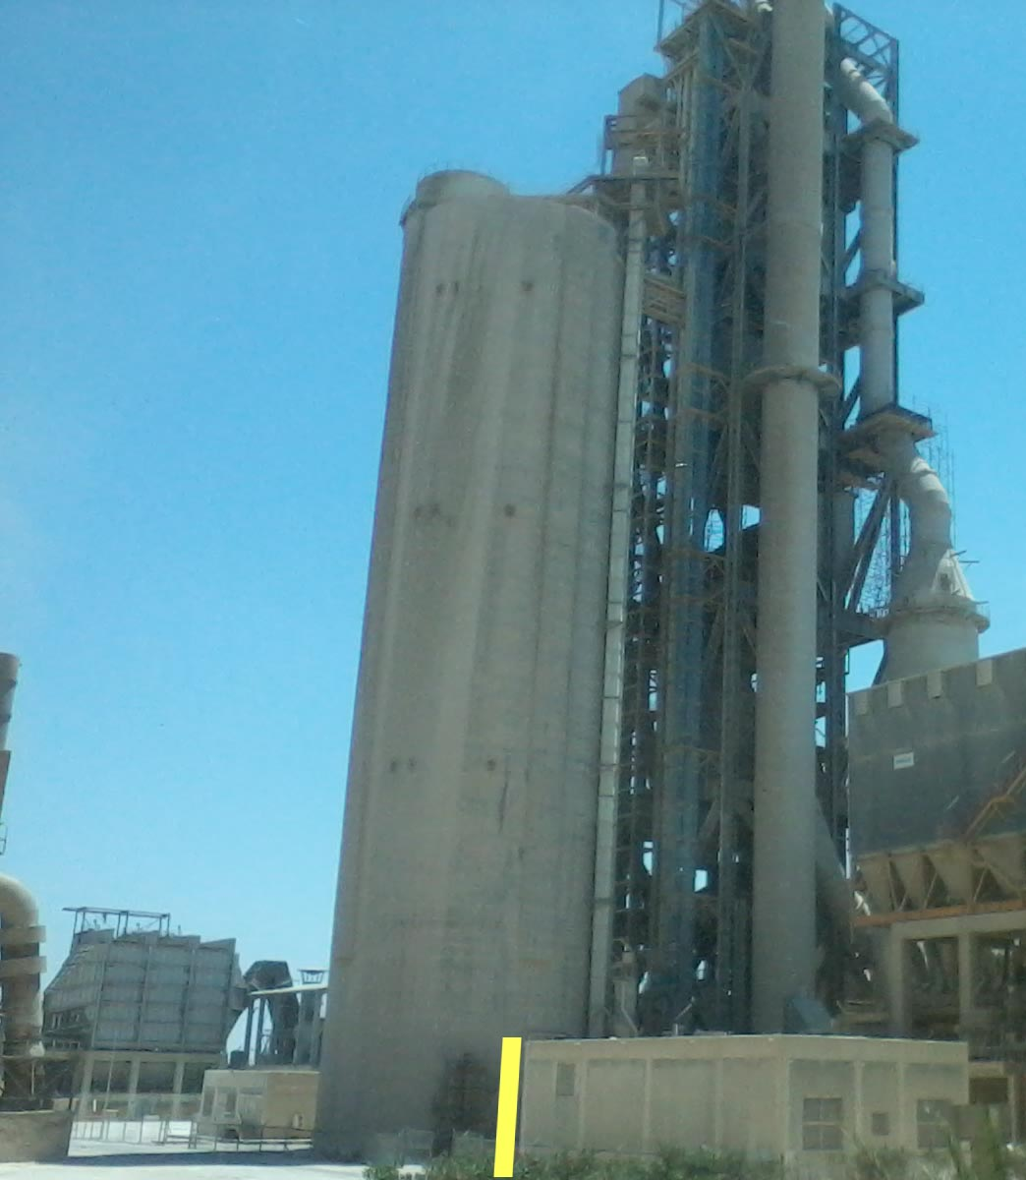
~ 3M

Slide 30
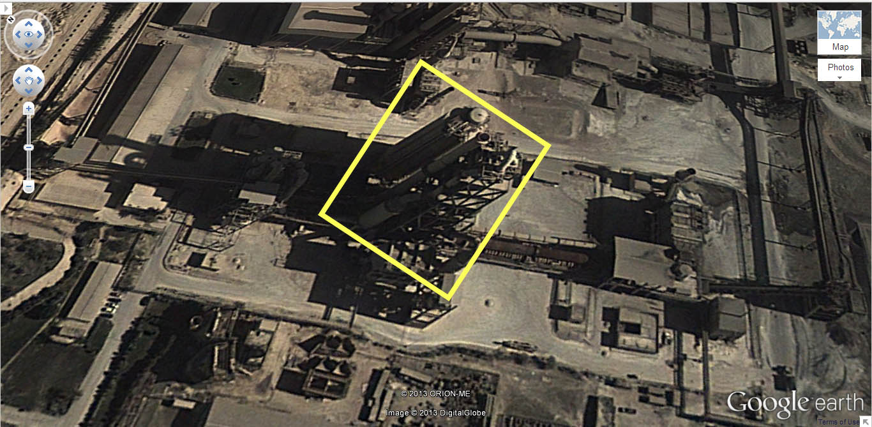

Slide 32
2) The kiln :
This is the step which is characteristic of Portland cement. The finely ground material is
dried, heated (to enable the sintering reactions to take place) and then cooled down again.
While it is being heated various chemical reactions take place to form the major mineral
constituents of Portland cement.

Slide 33
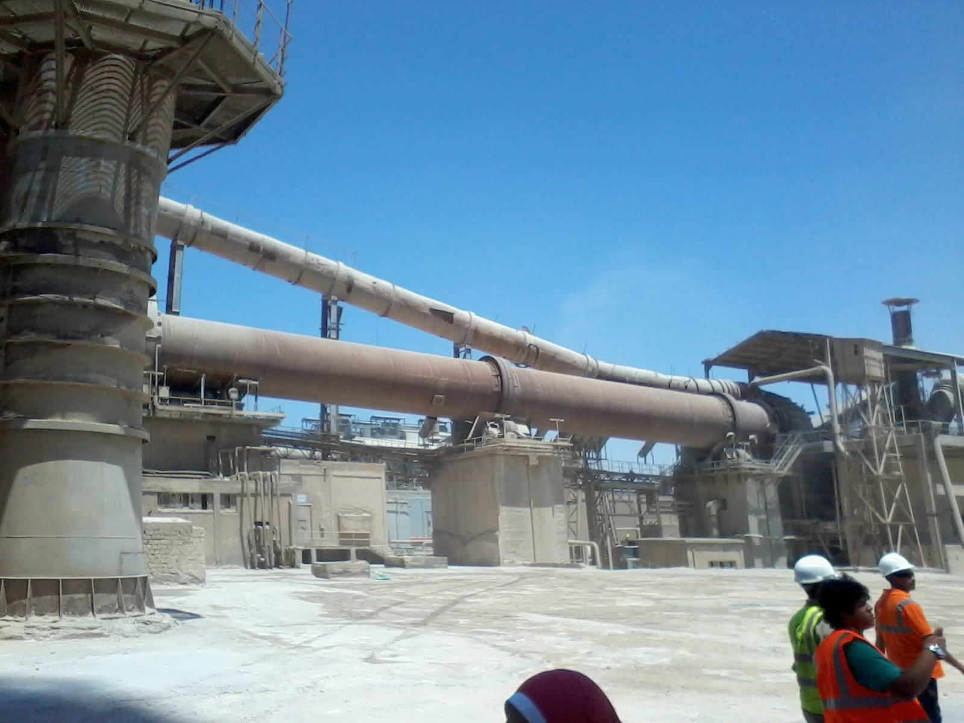

Slide 35
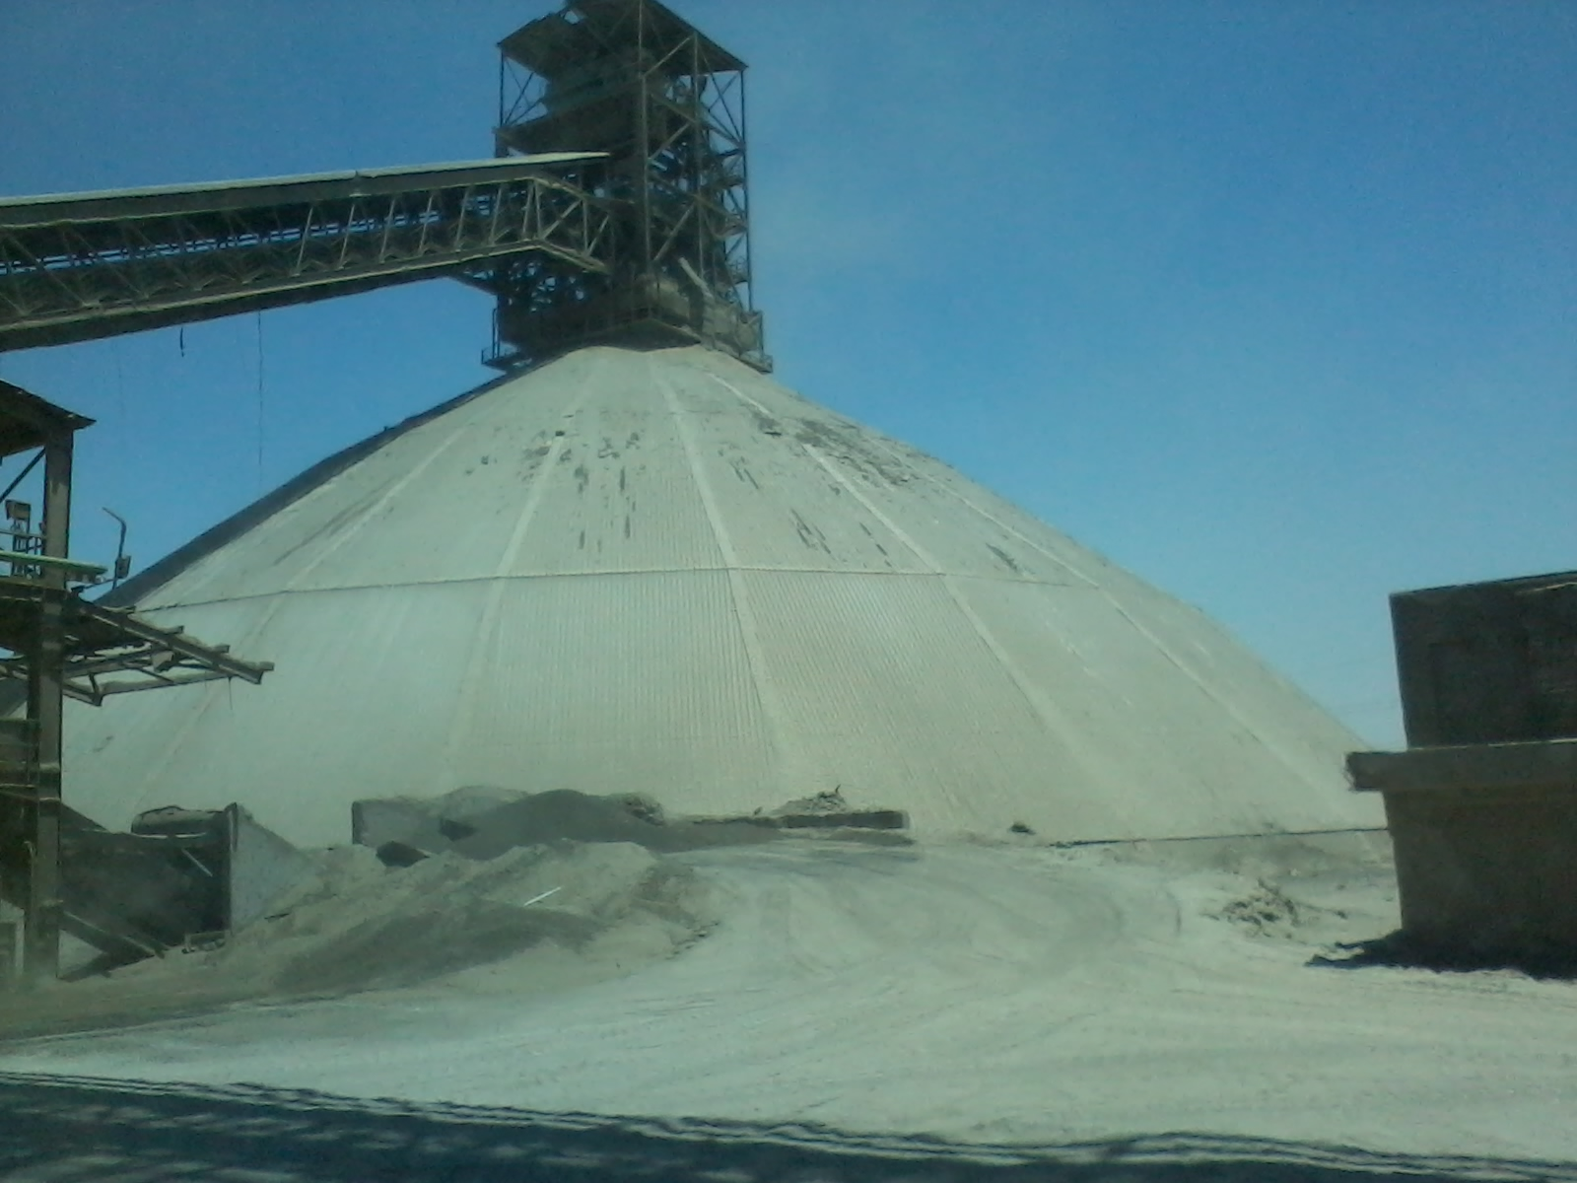

Slide 37
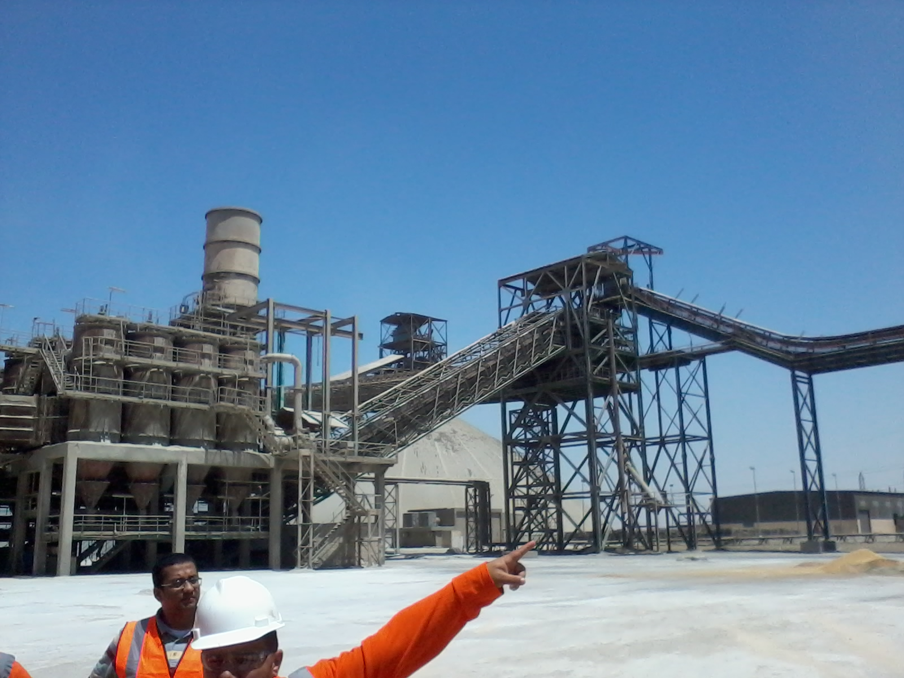

Slide 38
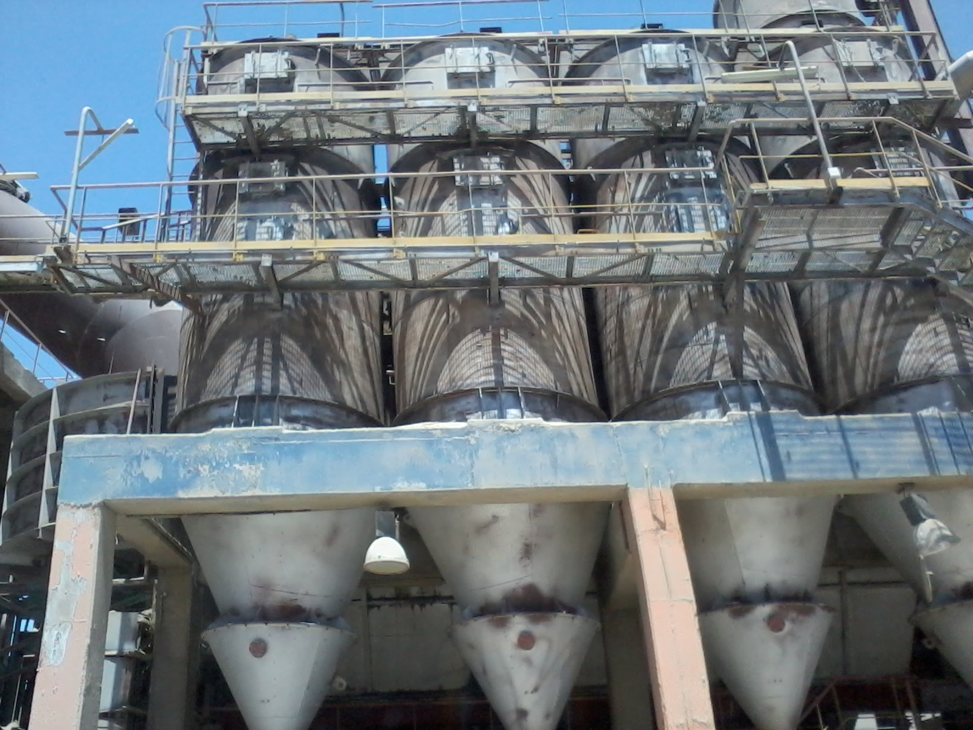

Slide 39
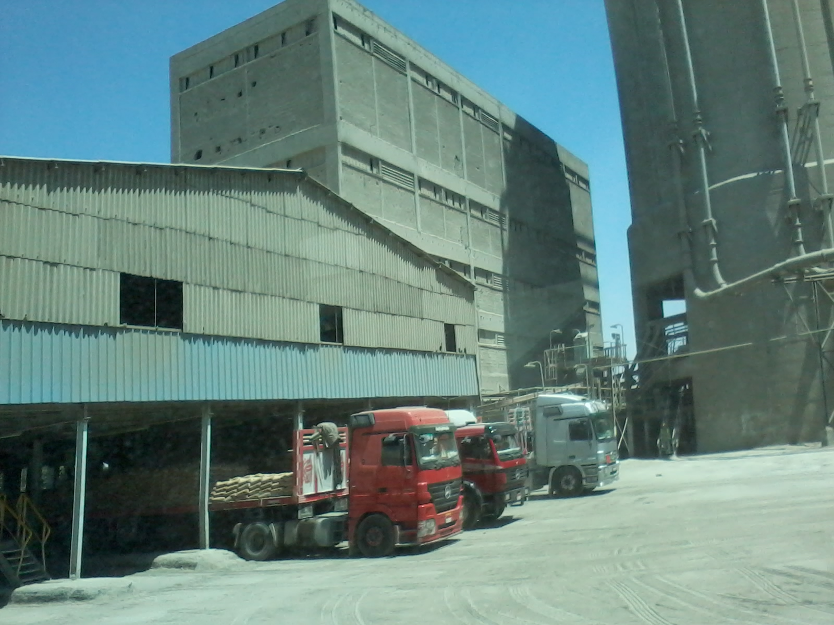

Slide 40
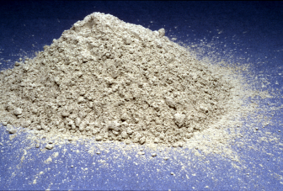

Slide 41

مشاريع بيئية

Slide 42
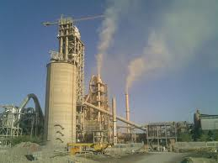

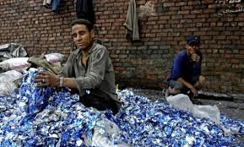

Slide 43
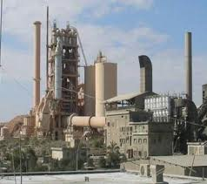

Slide 44


Slide 45
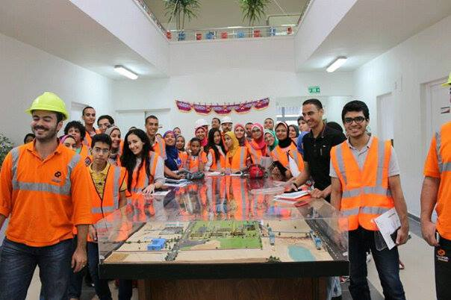
“ جولة داخل المصنع “

Slide 46


Slide 47
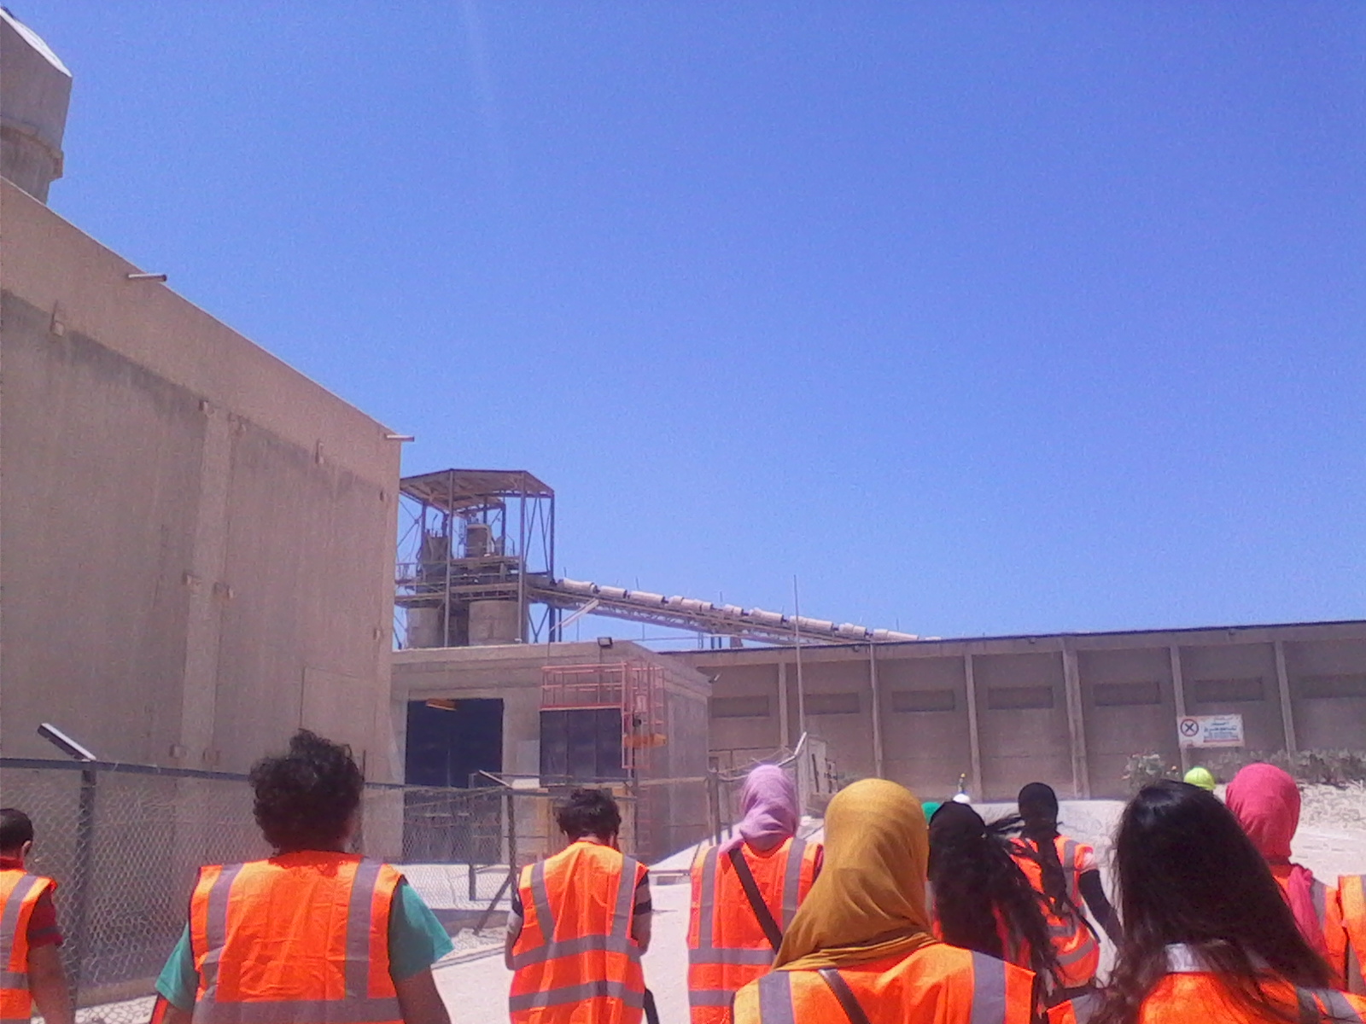

Slide 48
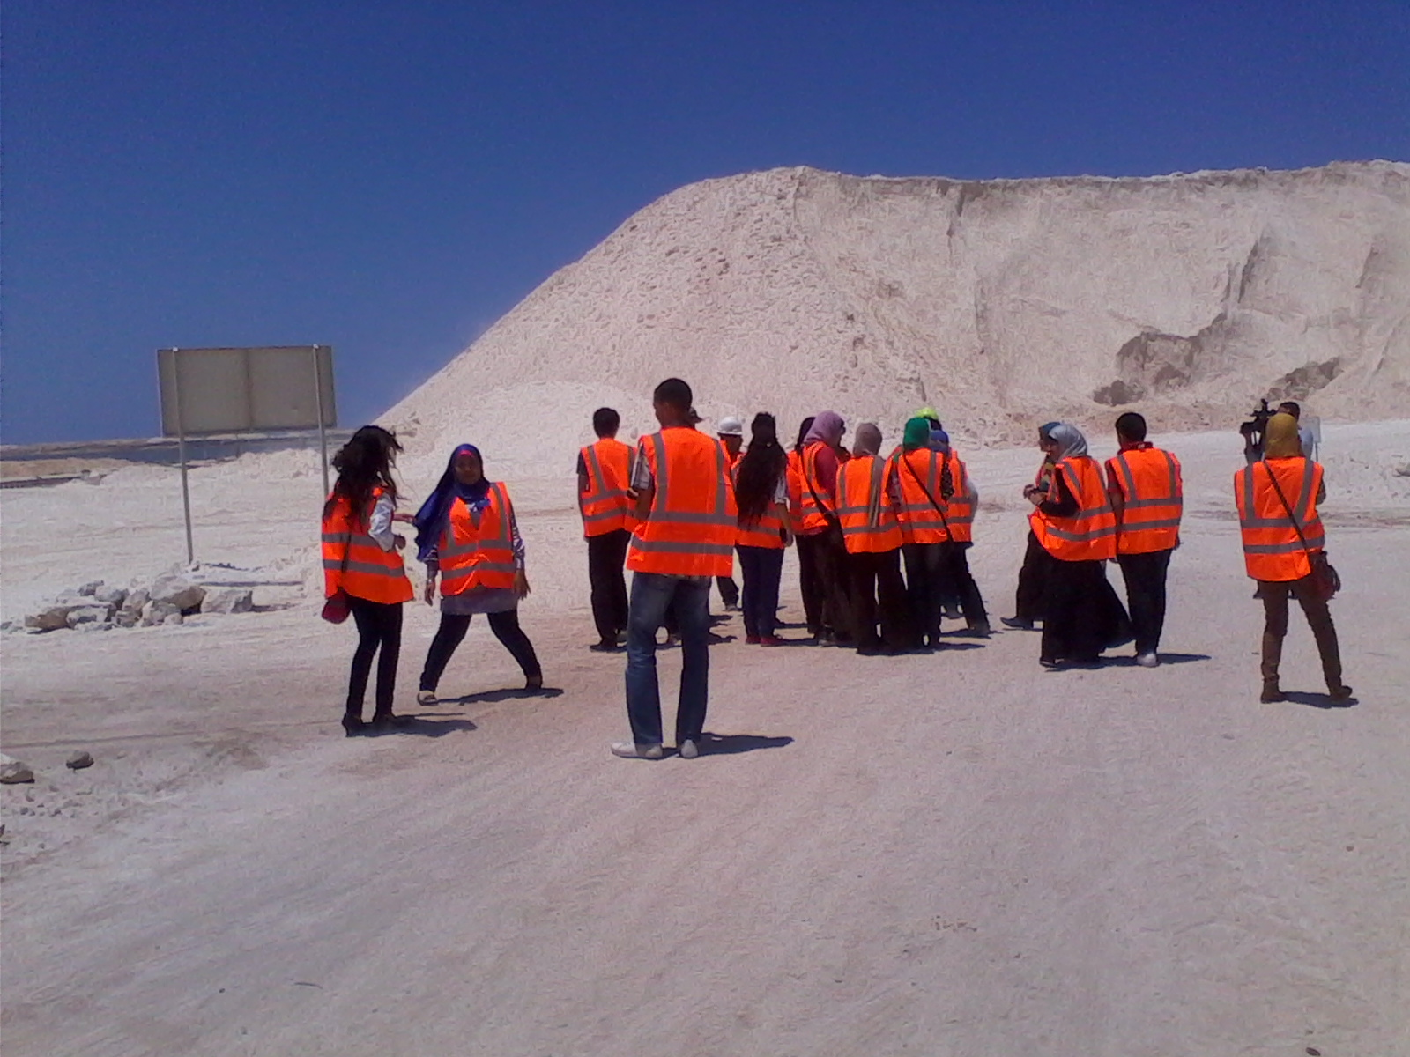
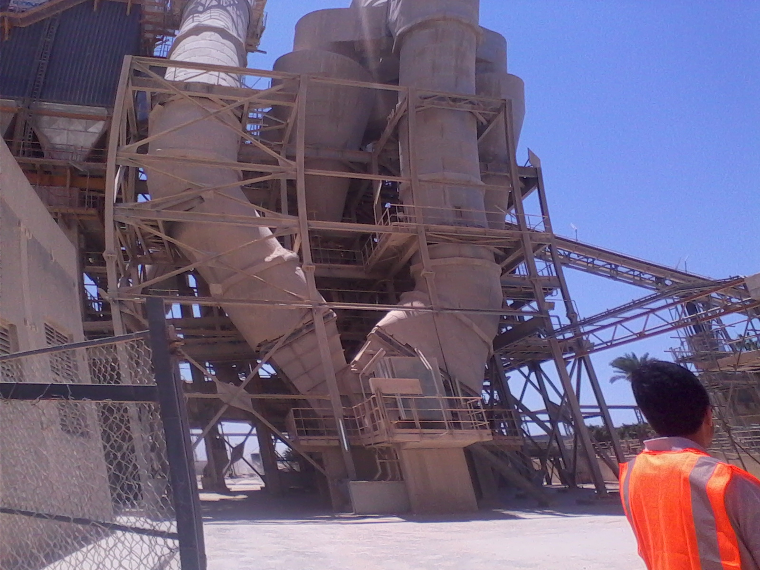

Slide 49
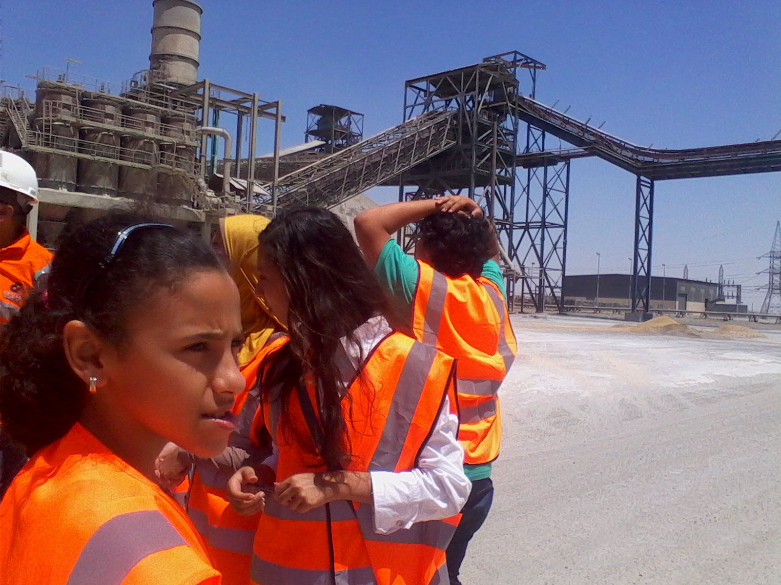

Slide 51
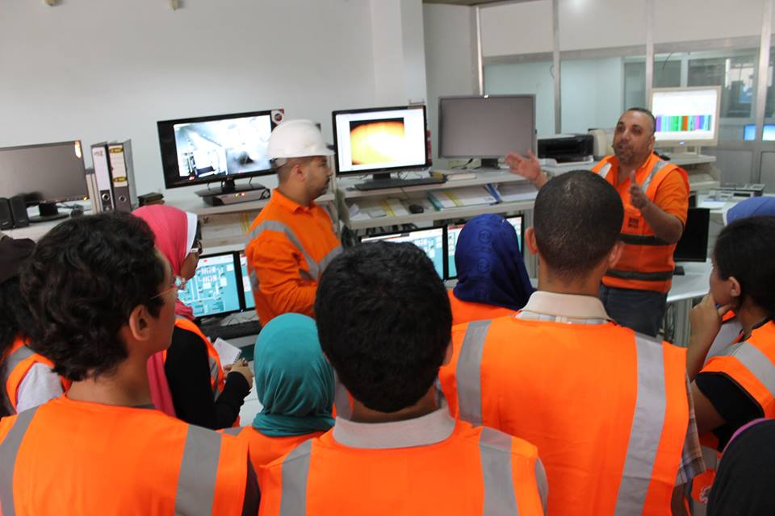

Slide 52
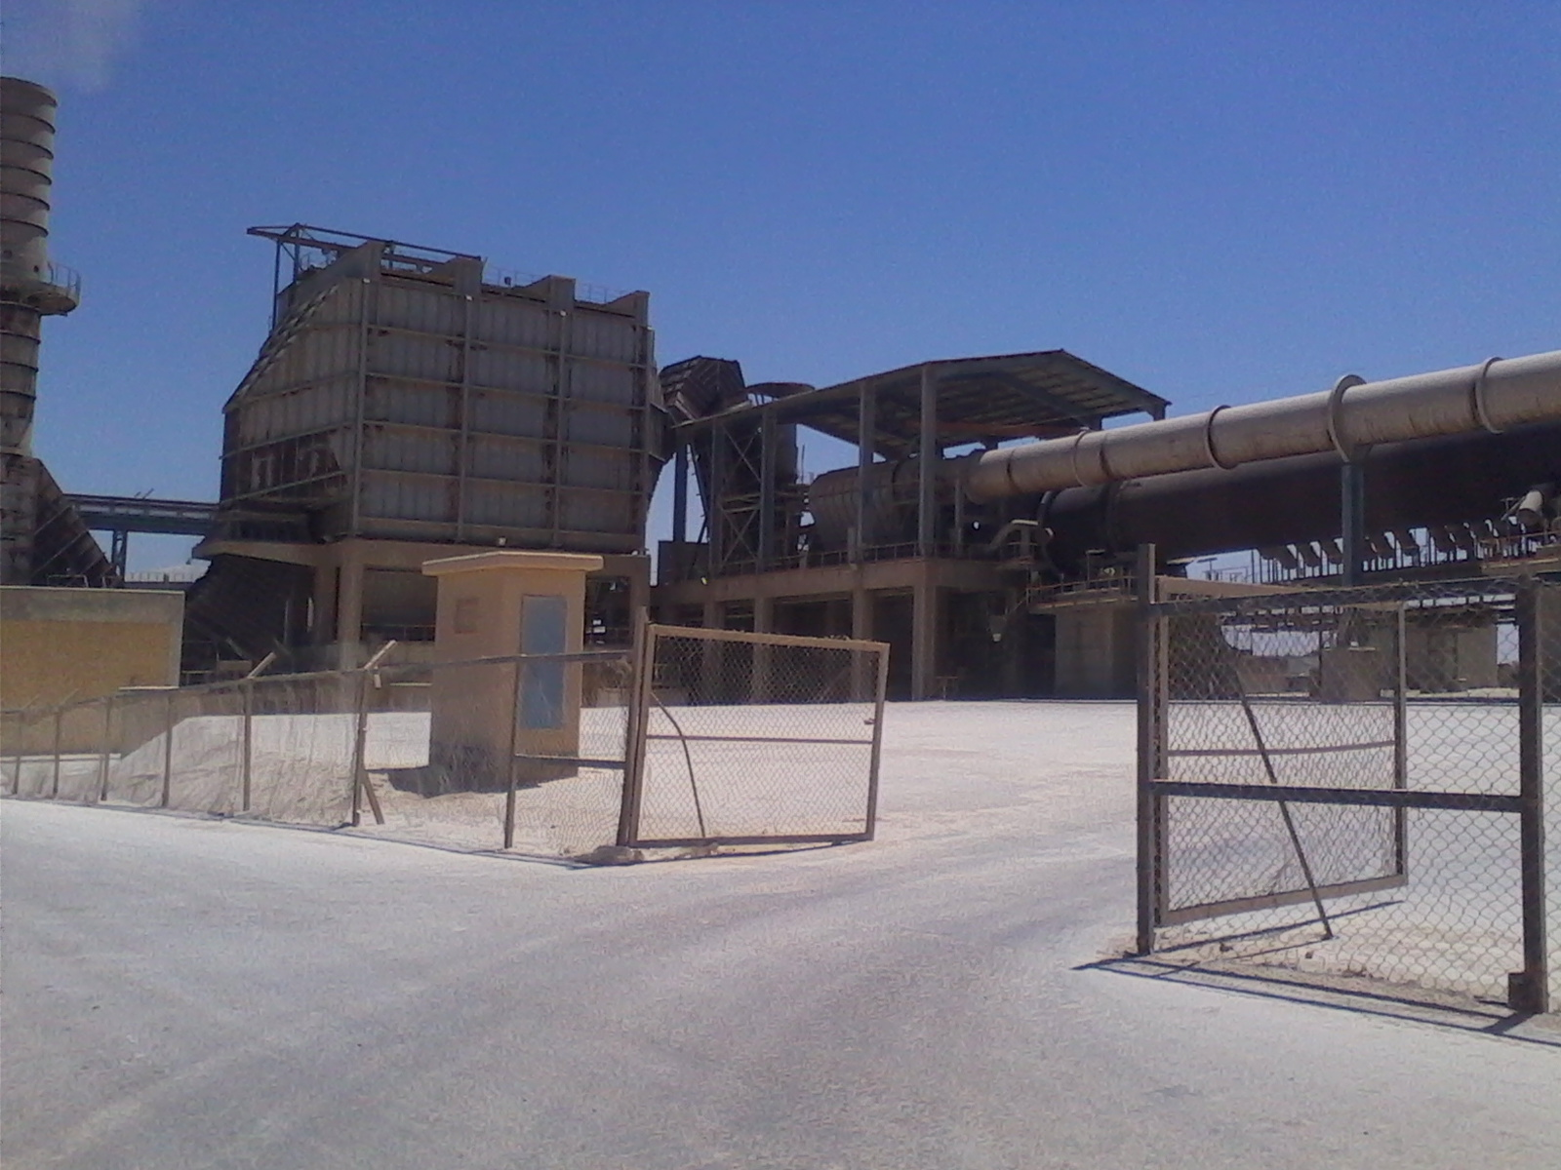

Slide 53
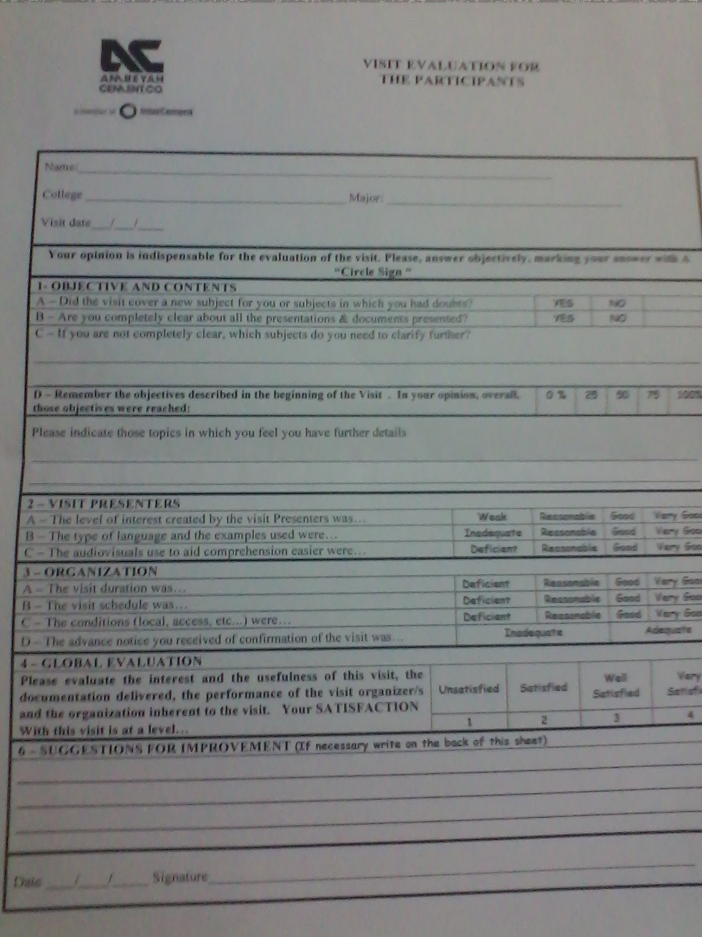
استطلاع رأي :

Slide 54
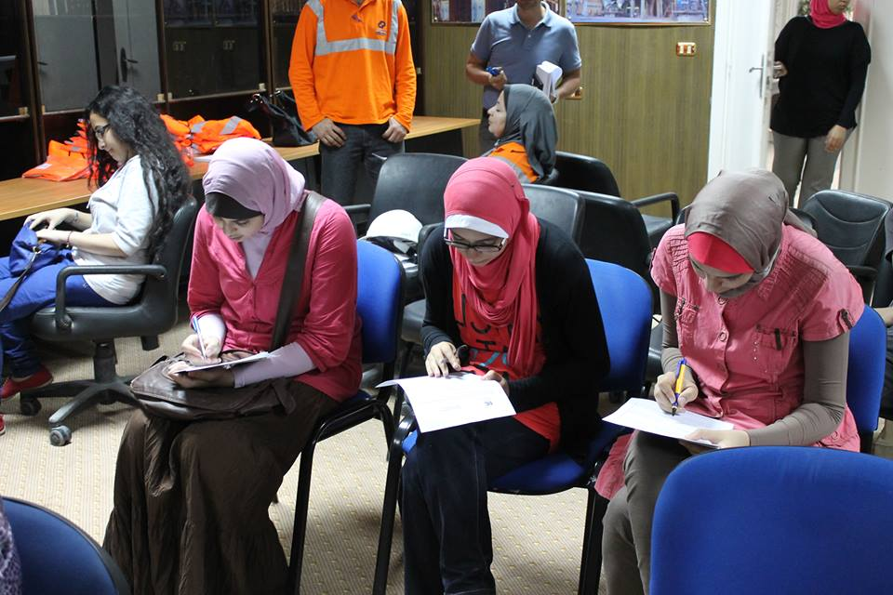

Slide 55
References
http://www.intercement.com/en/#/home
http://www.cimpor.com/
http://www.cembureau.be/about-cement/cement-manufacturing-process
nzic.org.nz/ChemProcesses/inorganic/9B.pdf

