Slide 1
MAFA
On field job training.

Slide 2
First things first
Orientation
Program
7 days that changed my views about farming
Conclusion.

Slide 3
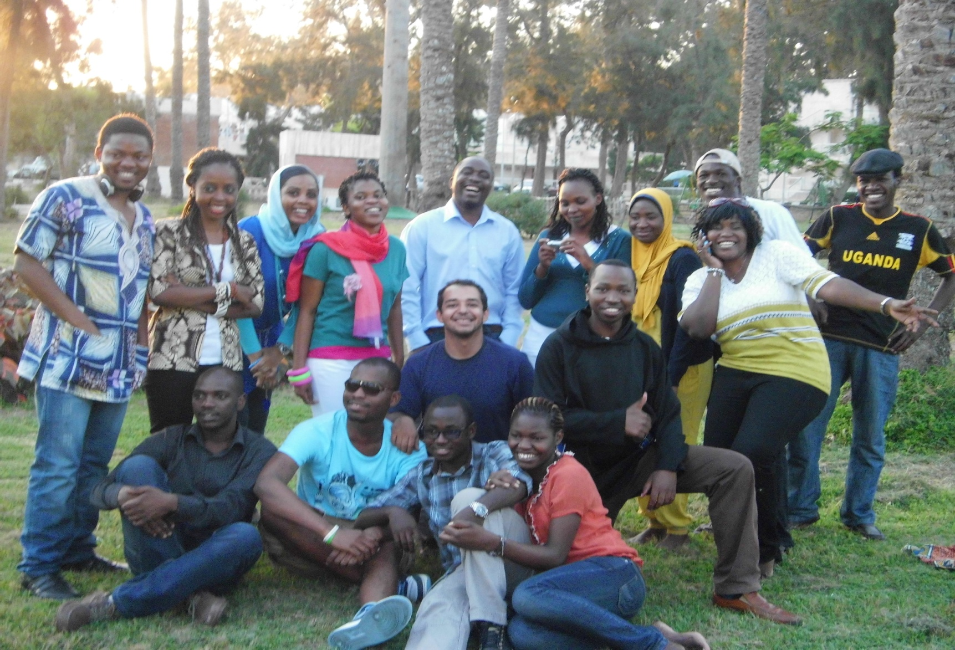
First things first
The need for experience, something that takes away the summer boredom.

Slide 4
Logistics.
Proposal
Space available for 21 people.
Evacuations
13 registered
8 to 10 people completed the training
7 days. We left 6 am and came back 3 pm.
Transportation was available.
Started on the 24th July.

Slide 5
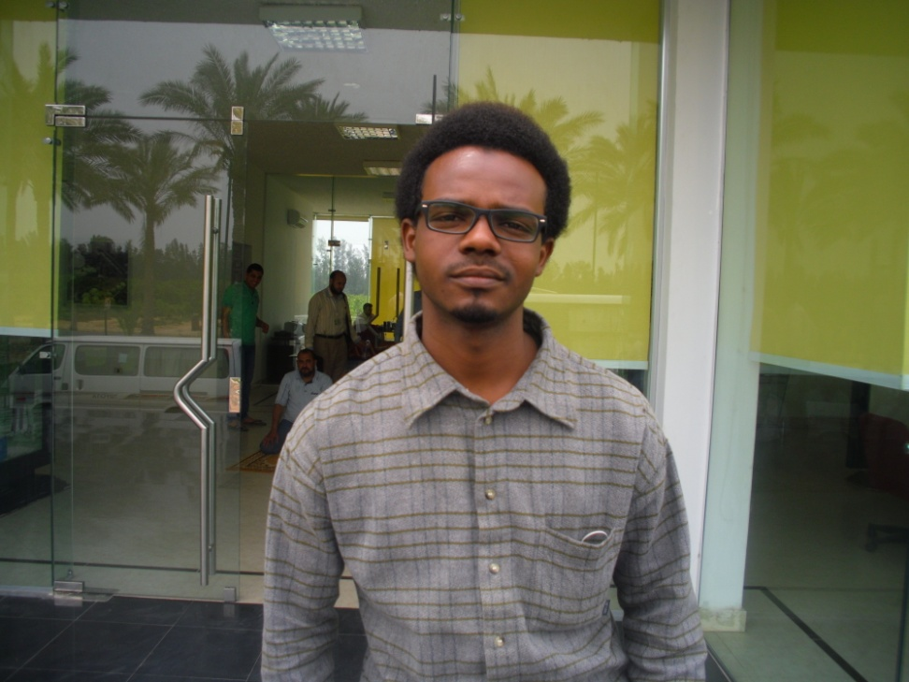
Before we start !
His translation depended mostly if he was in a good mood.
Its important that we learn the Arabic language.

Slide 6
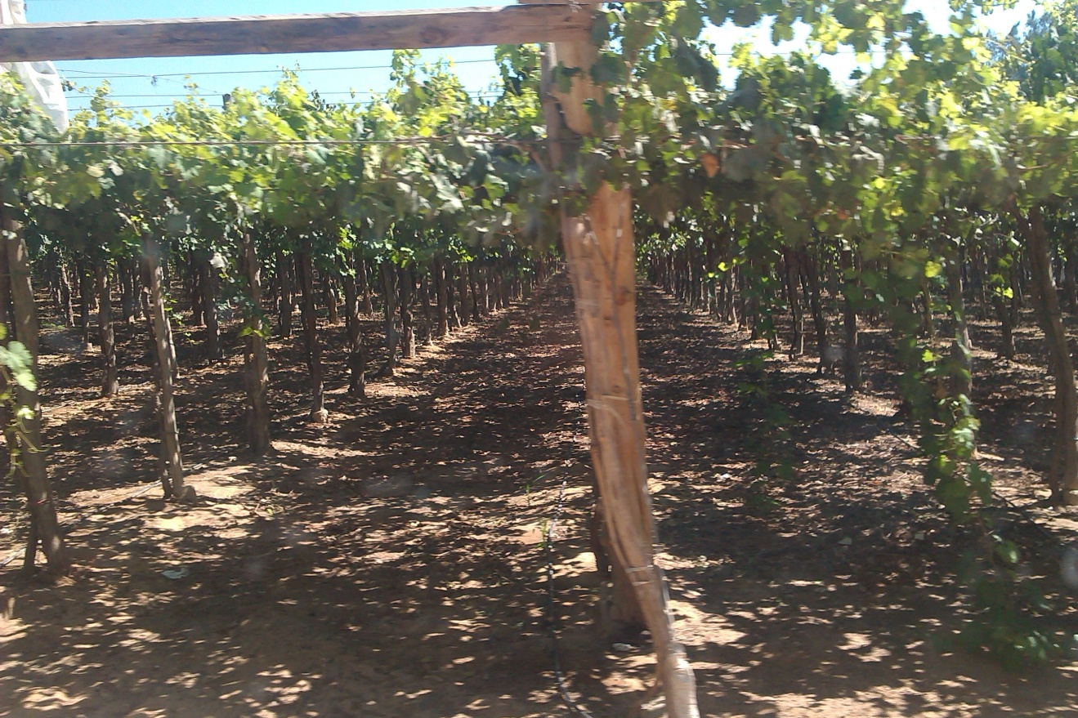
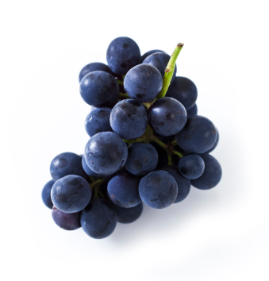
5. The first 2 days.
–everyone is excited.

Slide 7
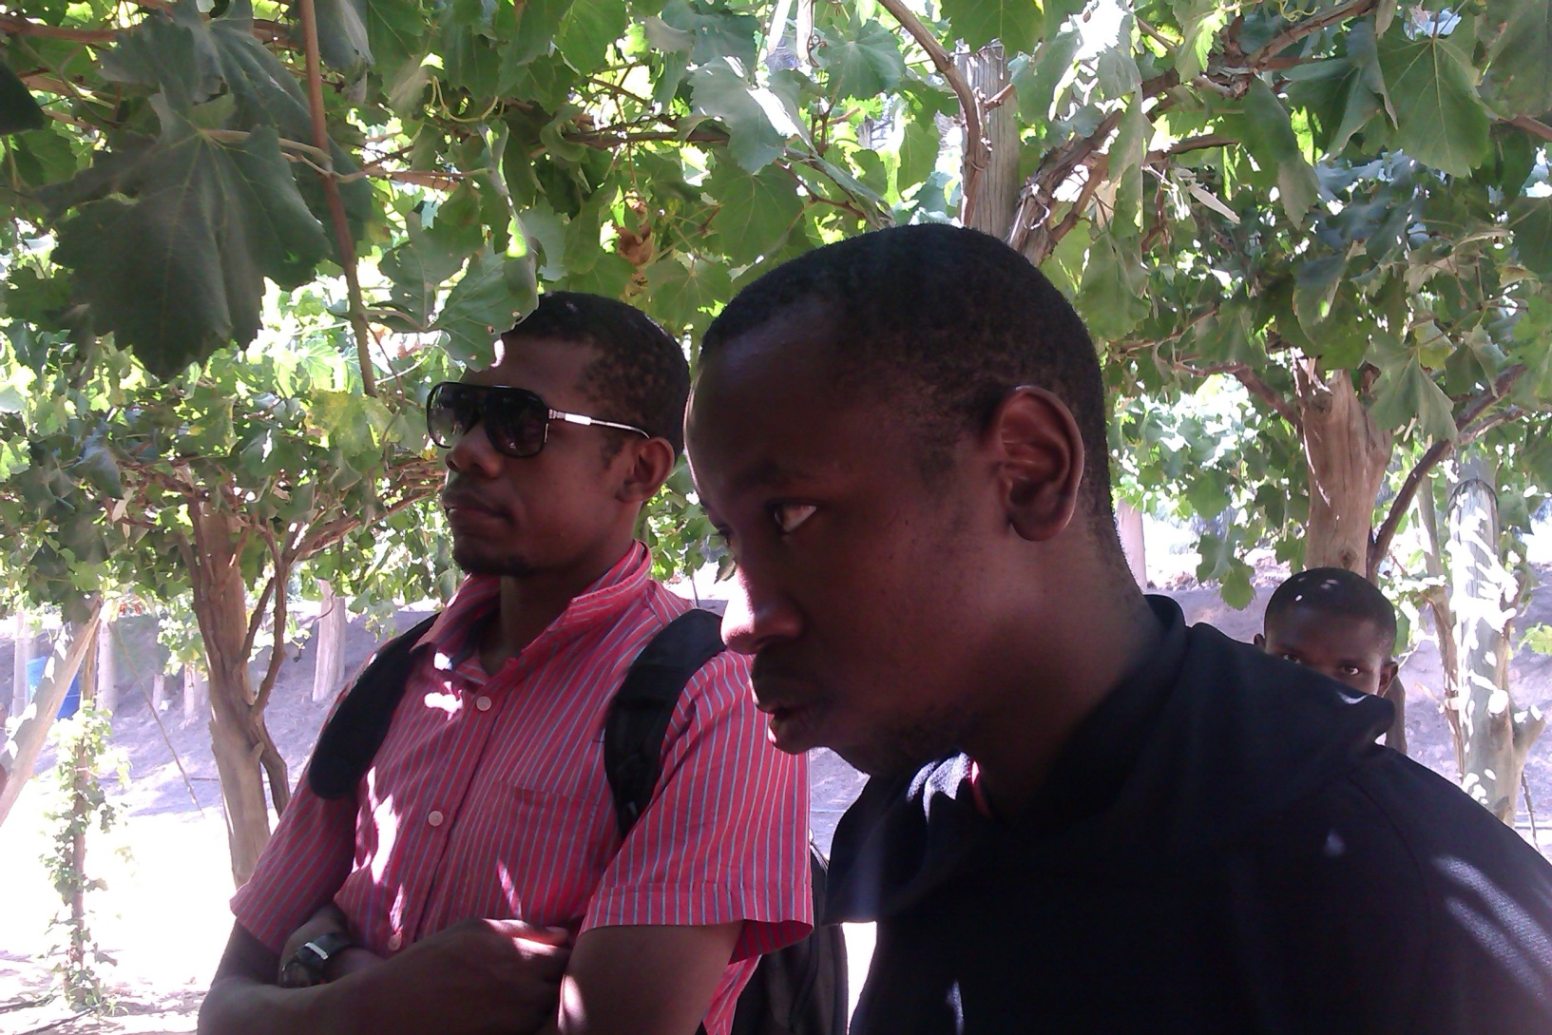

Slide 8
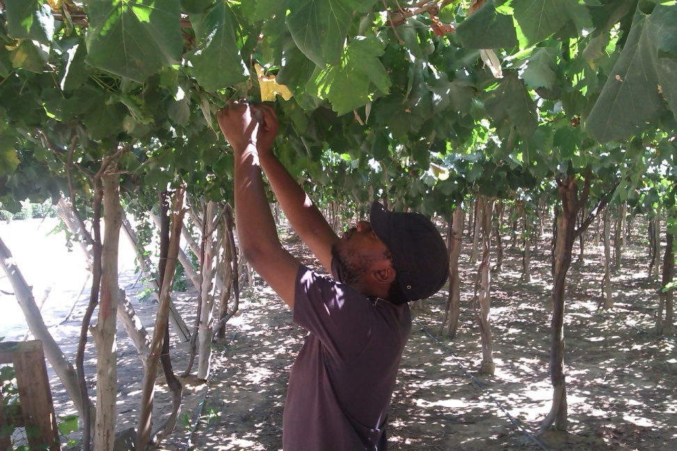
Koumba’s Day.
Harvesting
Quality checking
Selection
Grading
Transportation to warehouse.
Regis makes friends
Mubarak’s photo dilemma.

Slide 9
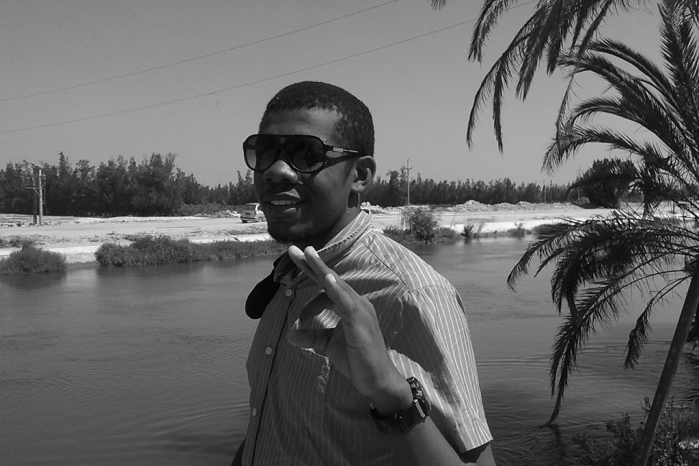
Citrus.
Lime
Lemons
Oranges
Cultivation
Pesticide control
Irrigation
Windbreaks
People start disappearing.

Slide 10
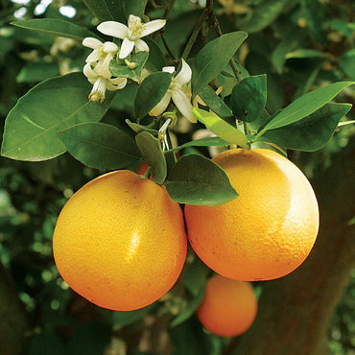
Max’s day. 2
Same thing like day before just way too hot.
Questions start to flood – gets interesting!
Mostly agronomic

Slide 11
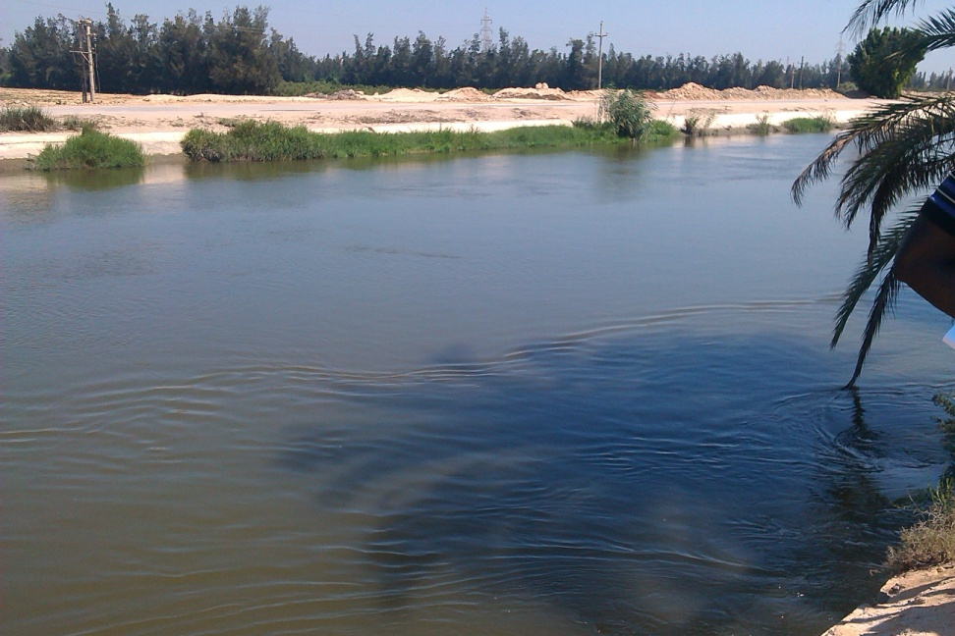
Power and Irrigation
Nile river
Sadat Dam
Water treatment
Fertigation and pesticide treatment
Installations
Power back-up
Mateso’s day.

Slide 12
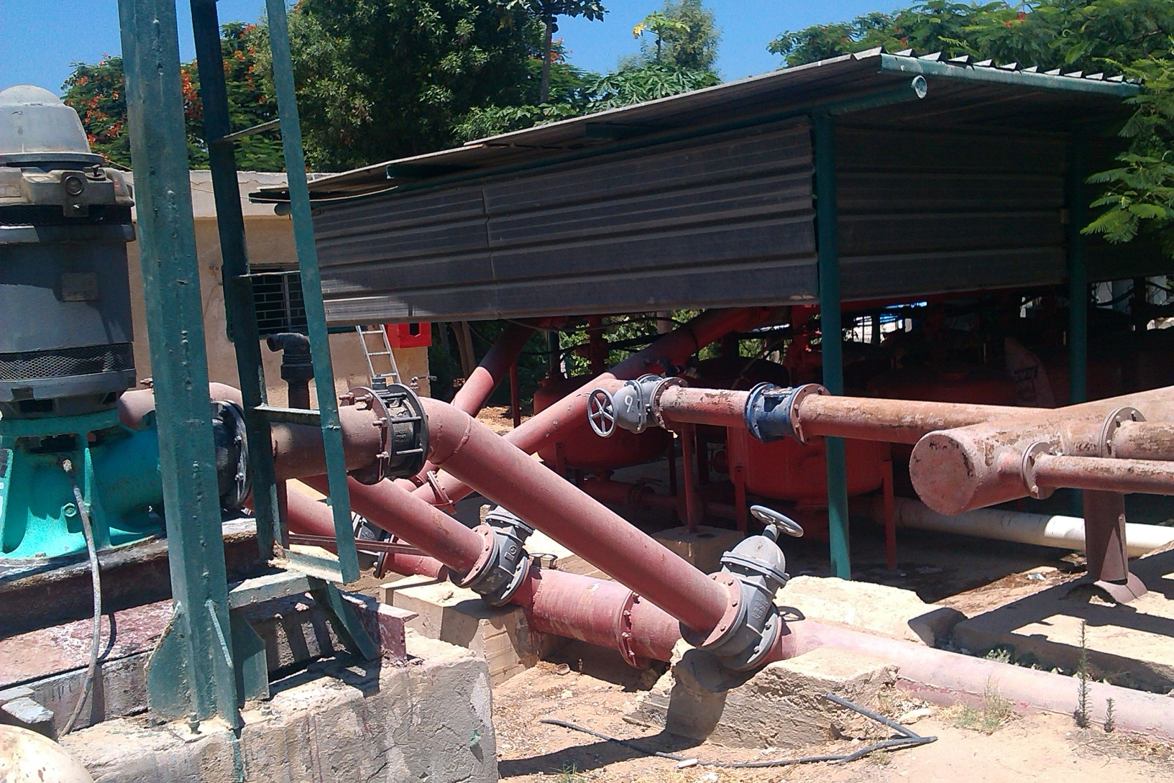

Slide 13
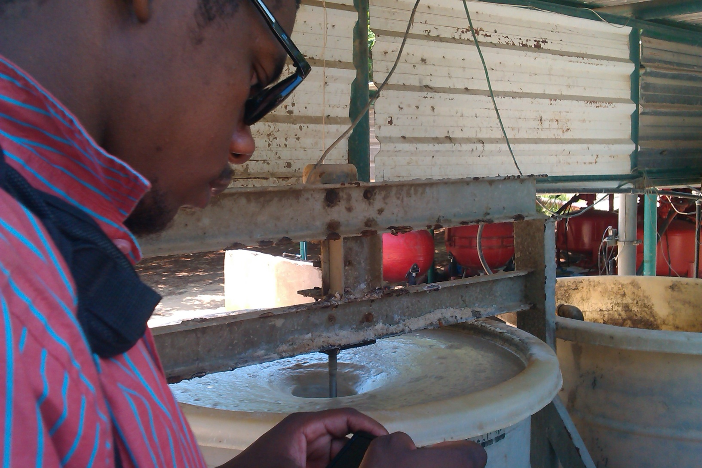

Slide 14
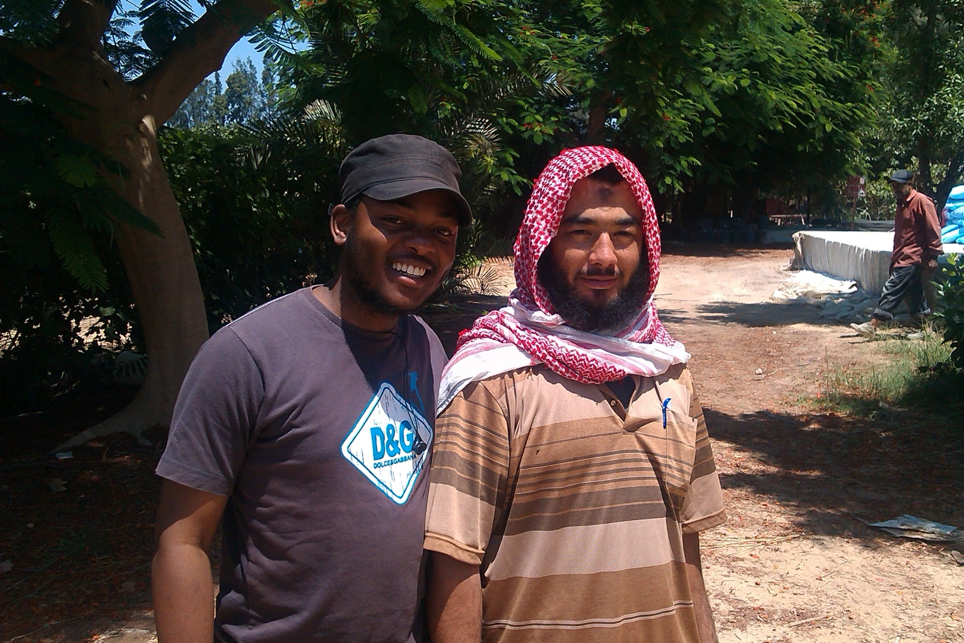

Slide 15
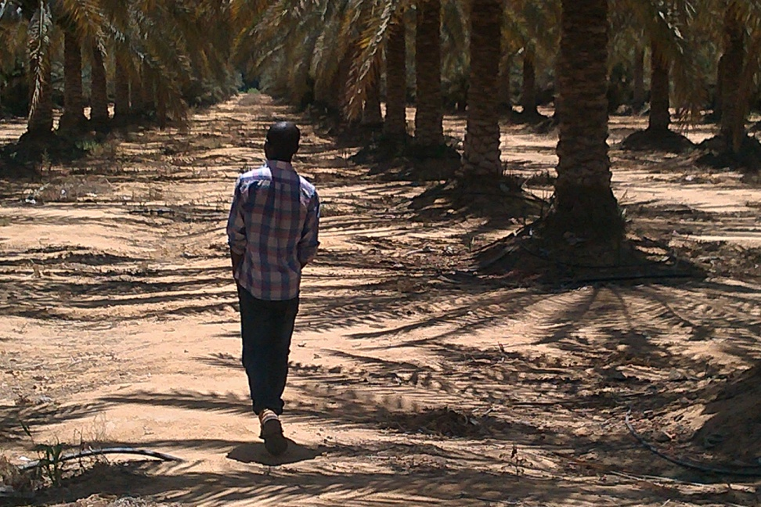
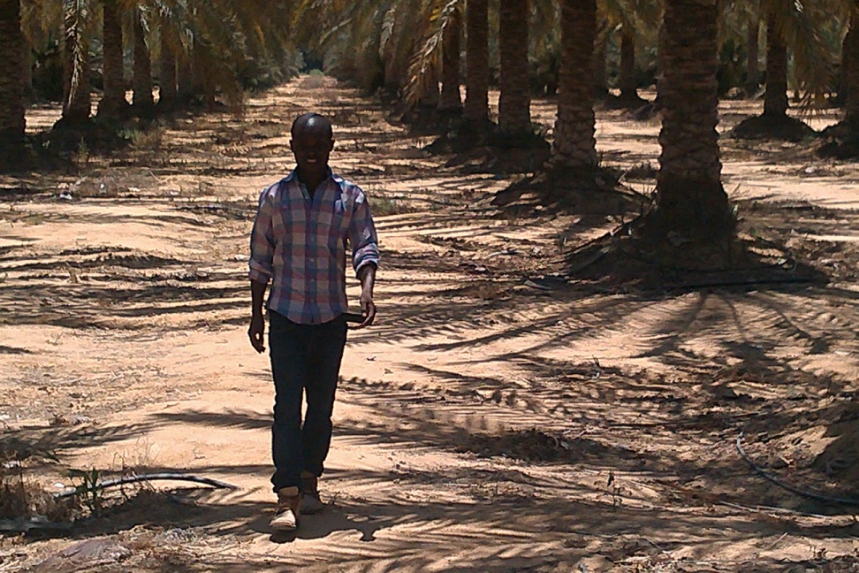
Vegetable and Palm-day

Slide 16
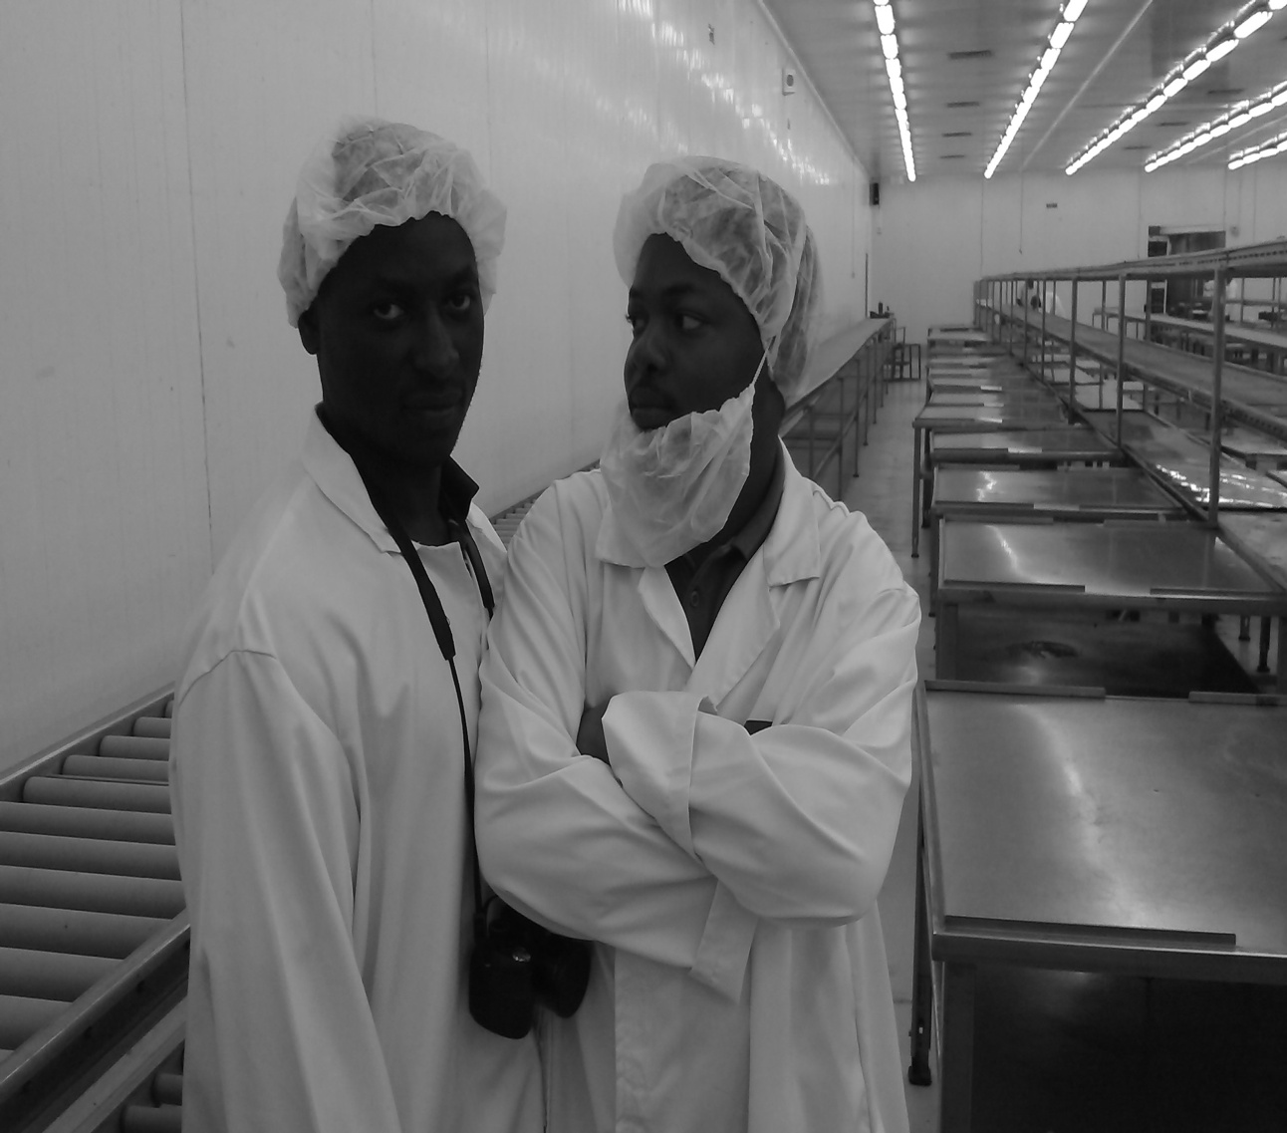
The warehouses
Professionalism
Activities
-trimming
-packaging
-weighing
Quality assurance
Mal-practices.

Slide 17
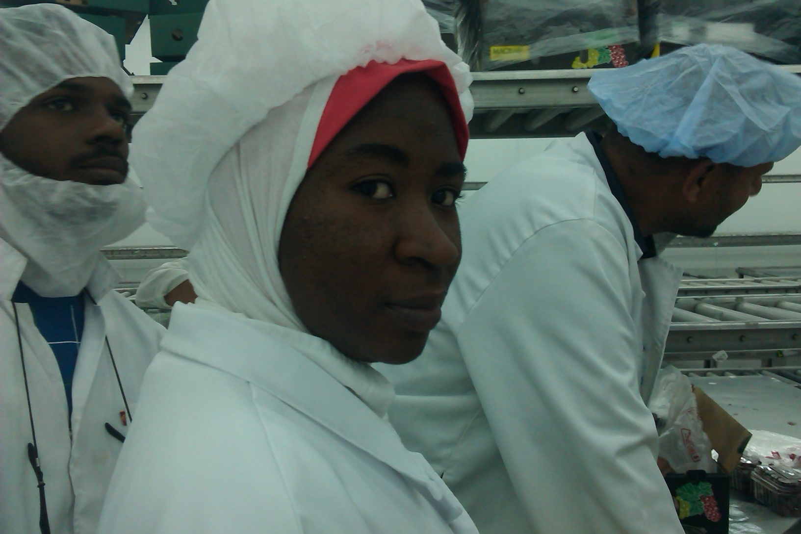

Slide 18
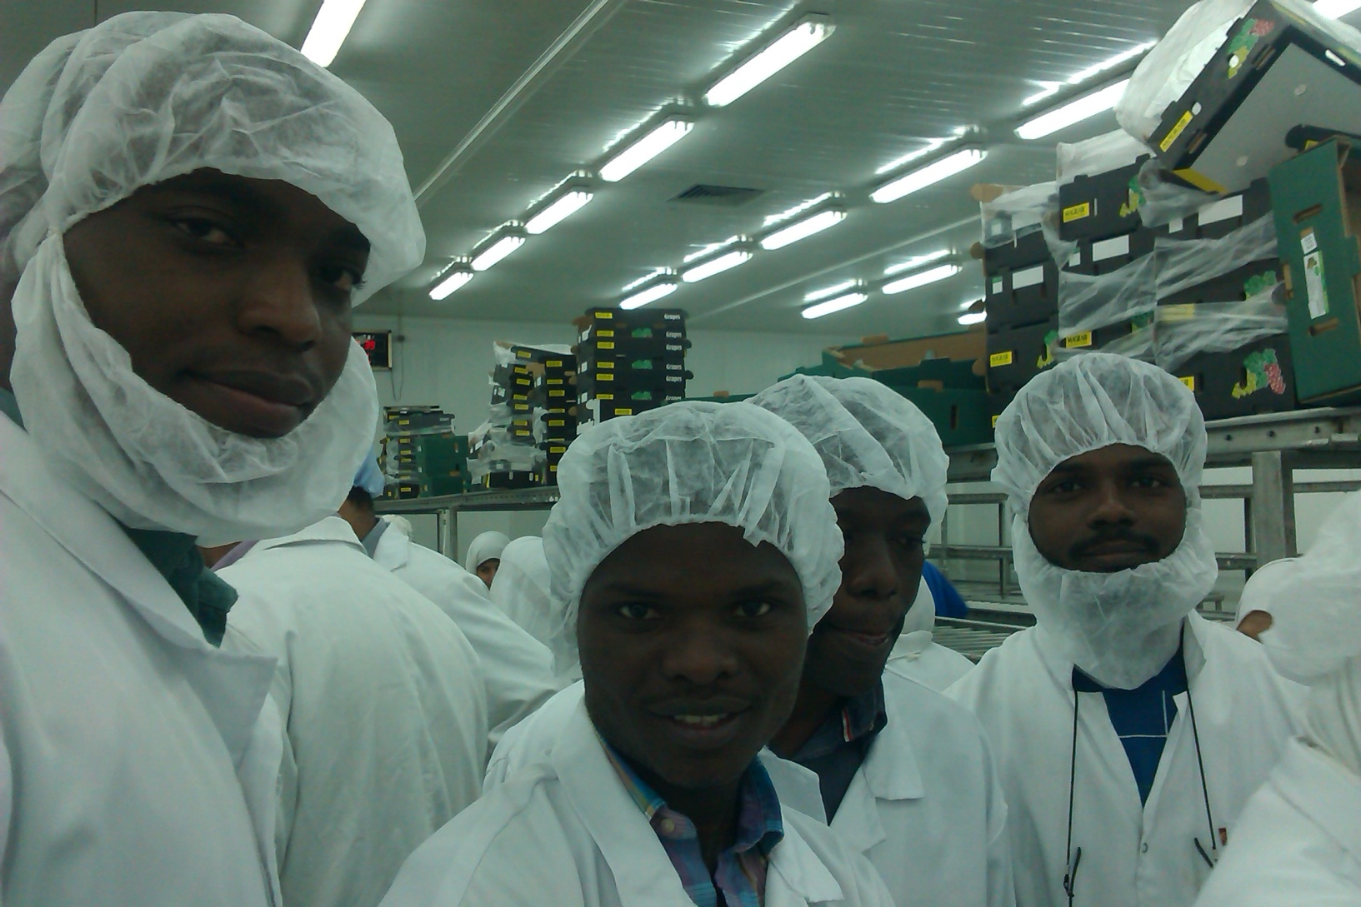

Slide 19
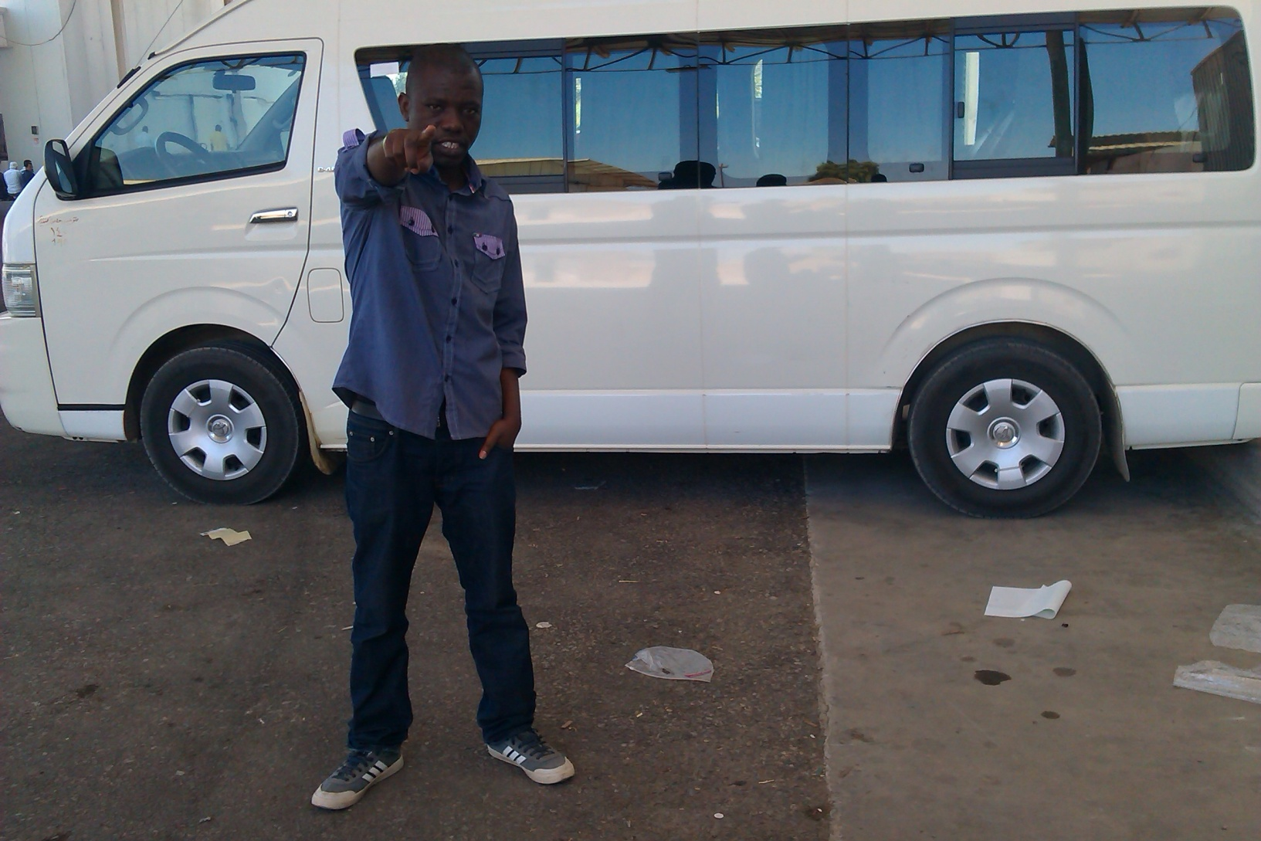

Slide 20
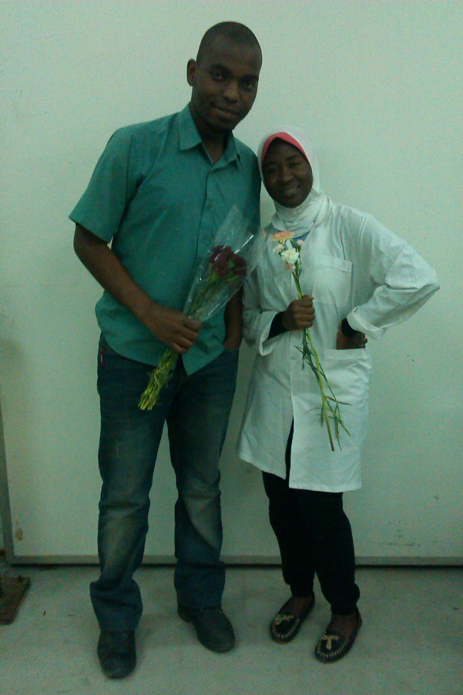
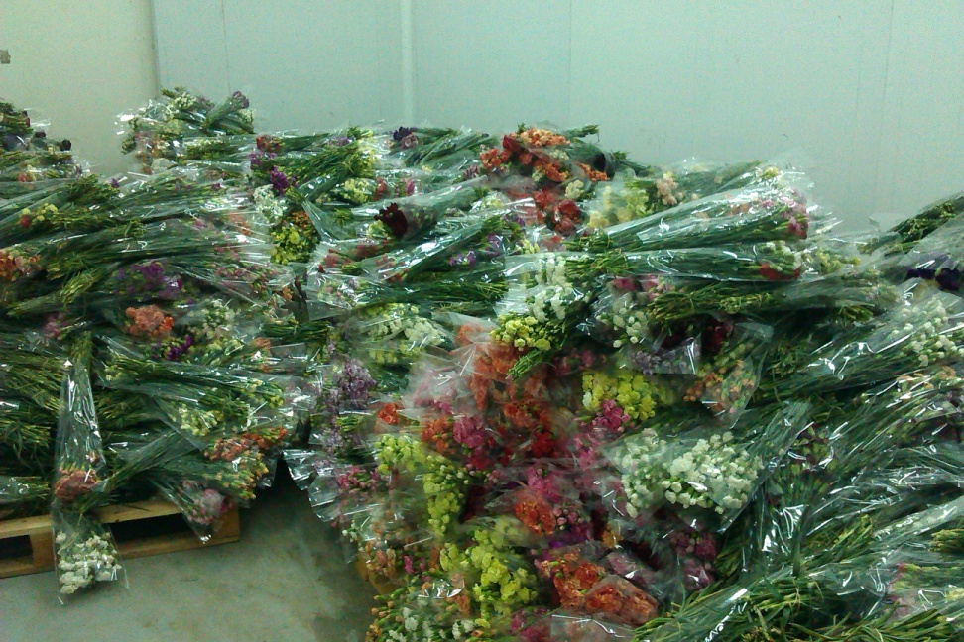
Au revoir

Slide 21
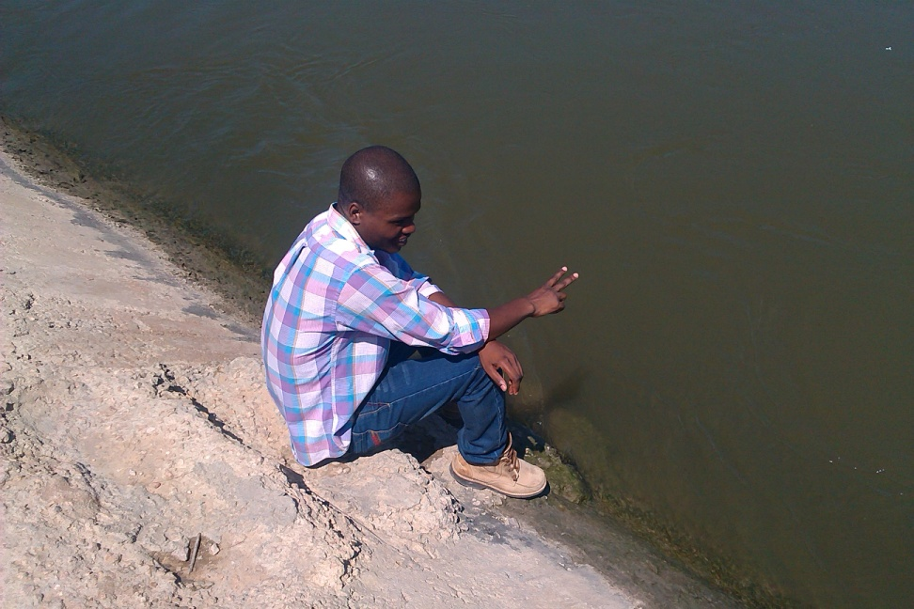
Last day : Anastase Day.
Excited of getting a certificate.
Happy to have completed the training.

Slide 22
Lessons learnt
We cannot disregard the value of the Nile. Therefore it must be well protected.
Farming is not as easy as it may seem. When we are managers, let us be reasonable in the way we deal with farmers
We should visualize.

Slide 23
Thank you.

