Slide 2
Vision
Is to engage the African students – both Egyptians and foreigners- together into a series of lectures to enrich their knowledge and to make them gain more information about Africa and the African Union, also it will be a suitable platform for them to get the required skills to apply for the vacancies at the African Union.

Slide 3
Mission
One of the most important aims of the specialized programs such as ALYM, LYM and YESBU is to help the students in different ages to understand the meaning of sustainability, get to understand the concept of the out-school learning, how to benefit from the information exchanging methods and to achieve the required skills to be the leaders of tomorrow’s world. On the same methodology the idea of the model came out to be a part of a long chain of ideas which benefit the youth or as we call them “Young Masters”.

Slide 4
Plan
The model is one of the projects initiated by the Center of Environmental Studies “CES”, so it will be publicized and announced at the different programs which are managed by the center.
After the announcement, the interviews stage will begin for both the staff members and the participants.

Slide 5
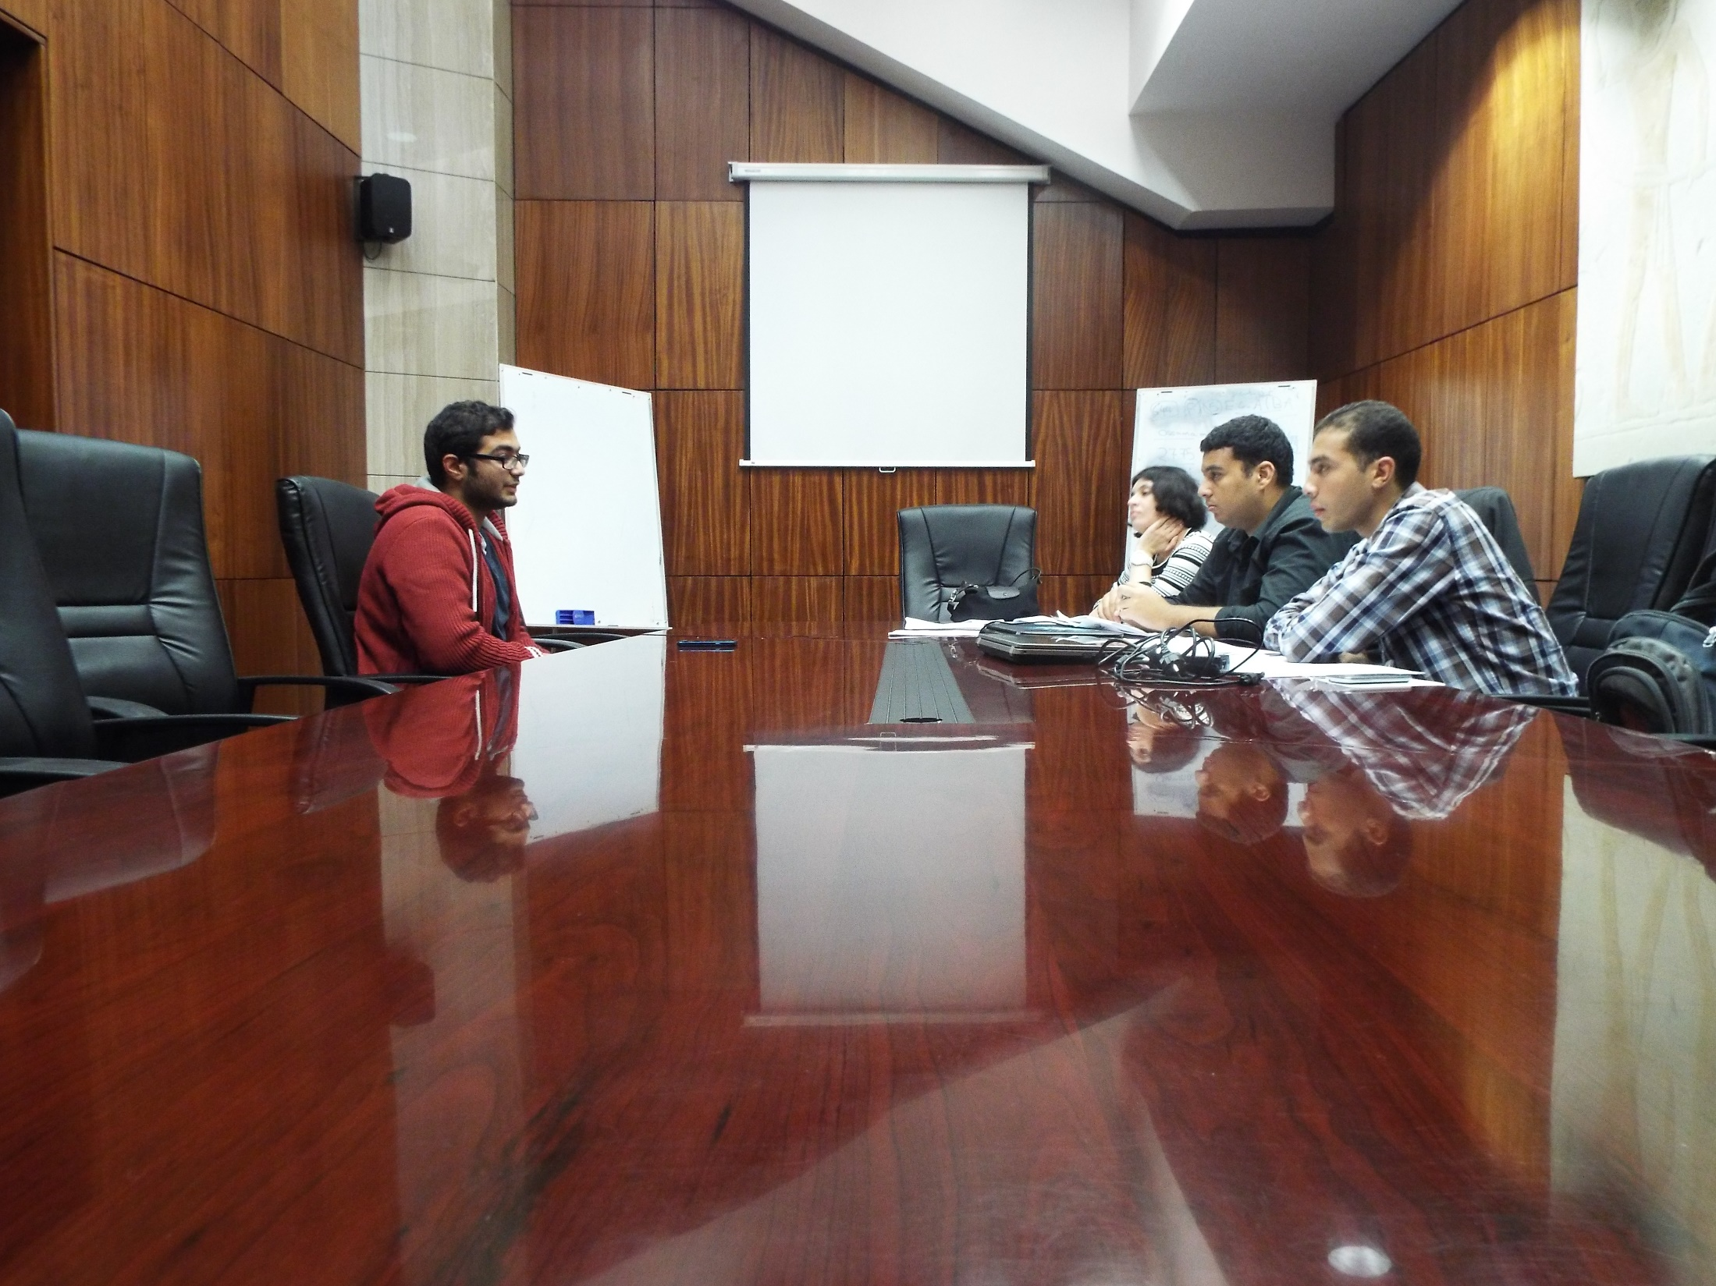

Slide 6
After accepting the required number of staff members and participants, a series of meetings will be held to fully introduce the model to the accepted staff members.
Number of Applicants for Staff Members | 236
Number of Applicants for Participants | 284
Number of Accepted Staff Members | 48
Number of Accepted Participants – Egyptians - | 35
Number of Foreign Applicants | 8
Required Number of Foreigners for Phase I | 60
Number of Delegates | 35

Slide 7
Model Construction
Organizing team: the team who is responsible of organizing the session days and to maintain order during the sessions.
Number of team members: 16

Slide 8
Model Construction
Media team: the team who is responsible of the media coverage, social media, photography, video editing and the magazine.
Number of team members: 5 - two more persons can be added -

Slide 9
Model Construction
Activities team: the team who is responsible of the transfer of the scientific material to the participants and it will be responsible of the workshops or any other way of illustrating the scientific material.
Number of team members: 12

Slide 10
Model Construction
Human resources team: the team who is responsible of preparing reports of every single session, which will help at the final evaluation to select the best team, etc.
Number of team members: 4

Slide 11
Model Construction
Public relations team: the team who is responsible of representing the entire model through mass-media and the will be responsible of training the participants on public speaking.
Number of team members: 11

Slide 12
The model will begin in 12th February, 2015 and will last till 30th April, 2015.
During this period, the lectures will be presented by accepted activities team members.
The lecture will be 4 hours per day and we will have two sessions per week for the two months mentioned above.
On every lecture there will be a task which allows the human resources team to evaluate the performance of the participants and it will also help the participants in achieving the most benefit from their participation.
Each task will be set by grades which will help in selecting the best team who did the most remarkable performance, because it’s an educational competition as we mentioned before.

Slide 13
The main topics to be discussed
On the behave of the African Union, we selected five commissions to be described and discussed during the model, the selection was based on the most related commissions to the work which is done by the Center of Environmental Studies “CES”, the selected commissions are the Social Affairs commission, Infrastructure and Energy, Human Resources, Science and Technology, Agriculture and Rural Economy, Economic Affairs.

Slide 14
Social Affairs
Health, nutrition and population.
Employment and Migration.
Social Welfare, Vulnerable Groups and Drug control.
Culture and Sports.

Slide 15
Infrastructure and Energy
Energy, Transport, Communications.
Infrastructure and Tourism.

Slide 16
Human Resources, Science and Technology
Education
Human Resources and Youth.
Science and technology.

Slide 17
Rural Economy and Agriculture
Agriculture and Food Security
Environment, Climate Change.
Water and Land Management.
Rural Economy.

Slide 18
Economic Affairs
Economic Integration and Regional Cooperation.
Economic Policies.

Slide 20
Thank You

