Slide 2
U feel like

Slide 3
We will talk about :
1- what are Bacteria .
2- Bacteria’s role in our world .
3- facts about bacteria .

Slide 4
1-what are bacteria ?
Bacteria are M.O’s too small to see with nacked eye . They found everywhere .

Slide 5
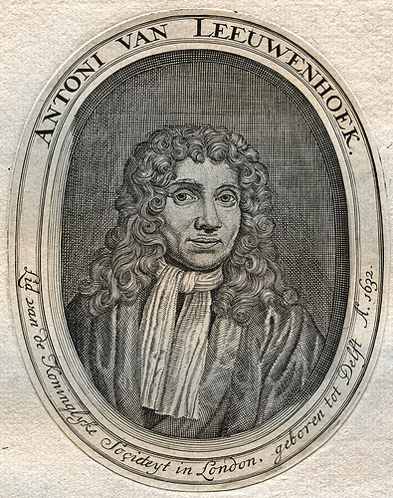
Discovery of Bacteria :
By Antony van Leeuwenhoek

Slide 6
Bacteria= Germs ?
Many people, when regarding bacteria, lump them all together as “germs” and don’t think much more about bacteria than the fact that germs can cause disease .

Slide 7
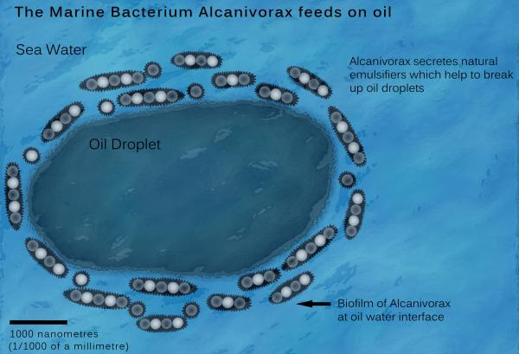
Bacteria’s Role in our World :
1- Bacteria to Clean Up Oil Spill

Slide 8
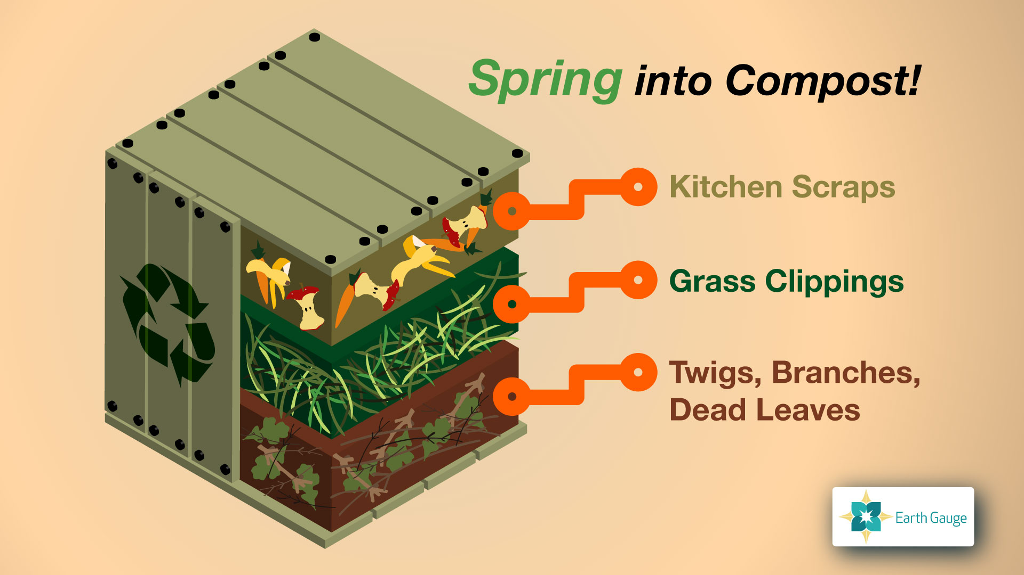
2- Recycling ( composting )

Slide 9
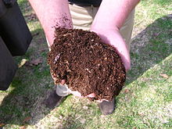
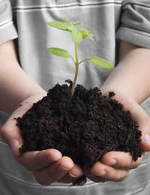

Slide 10
3- Bacterial Batteries
Convert Sugar into electricity by Rhodoferax

Slide 11
4- Biofuel production :
Researchers have engineered the harmless gut bacteria E.coli to generate renewable propane.

Slide 12
5- Decomposers

Slide 13
6- Food production :

Slide 14
3- Facts about Bacteria :
1- Bacteriography:
Combination between photography and microbiology by Zachary-Copfer.

Slide 21
After all of these we must respect Bacteria Because they rule our world

Slide 23
Resources
http://www3.imperial.ac.uk
http://bioweb.uwlax.edu
http://www.livescience.com/
http://www.waraqat.net/7582/
http://www.factslides.com/
http://www.slideshare.net/

