Slide 1
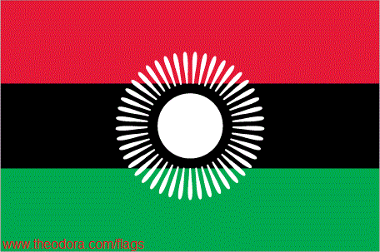
THE WARM HEART OF AFRICA

Slide 2
MALAWI
Republic of Malawi, is a landlocked country in southeast Africa that was formerly known as Nyasaland.
The name Malawi comes from the Maravi, an old name of the Nyanja people that inhabit the area. The country is also nicknamed, "The Warm Heart of Africa
It is bordered by Zambia to the northwest, Tanzania to the northeast, and Mozambique on the east, south and west.

Slide 3
Malawi is over 118,000 km² (45,560 sq mi) with an estimated population of more than 13,900,000
Its capital is Lilongwe, which is also Malawi's largest city; the second largest is Blantyre and the third is Mzuzu.

Slide 6
HISTORY
In 1891 Malawi was colonized by the British. In 1953 Malawi, then known as Nyasaland, became part of the semi-independent Central African Federation (CAF)
The Federation was dissolved in 1963 and in 1964, Nyasaland gained full independence and was renamed Malawi.

Slide 7
Dr Hastings Kamuzu Banda
(first president)

Slide 8
Dr Bakili Muluz
(2nd president & 1st in the multiparty regime)

Slide 9
Prof Bingu wa mutharika
(The current president)

Slide 10
organisations
Malawi ismember of the following bodies
SADC
AU
UN
COMESA

Slide 11
ECONOMY
The economy is based on agriculture, and more than one-third of GDP and 90% of export revenues come from this.
Agriculture accounts for 35% of GDP
Industry for 19%
services for the remaining 46%

Slide 12
The poverty rate in Malawi is decreasing through the work of the government and supporting organizations, with people living under the poverty line decreasing from 54% in 1990 to 40% in 2006, and the percentage of "ultra-poor" decreasing from 24% in 1990 to 15% in 2007.

Slide 13
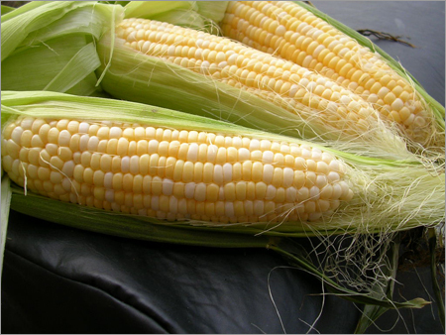
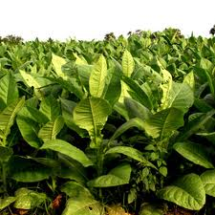
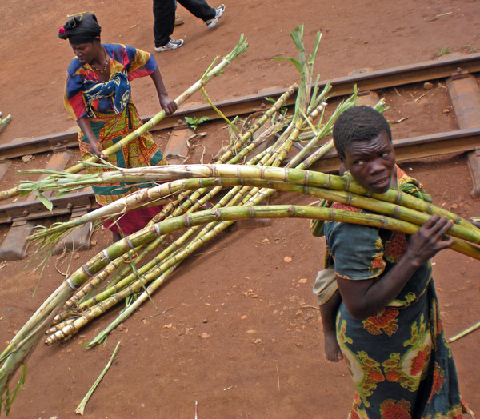
AGRICULTURE AND INDUSTRY
The main agricultural products of Malawi include :

Slide 14
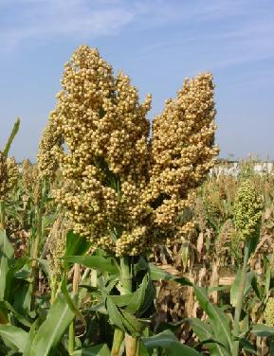
Maize,sorghum,tea & tobacco

Slide 15
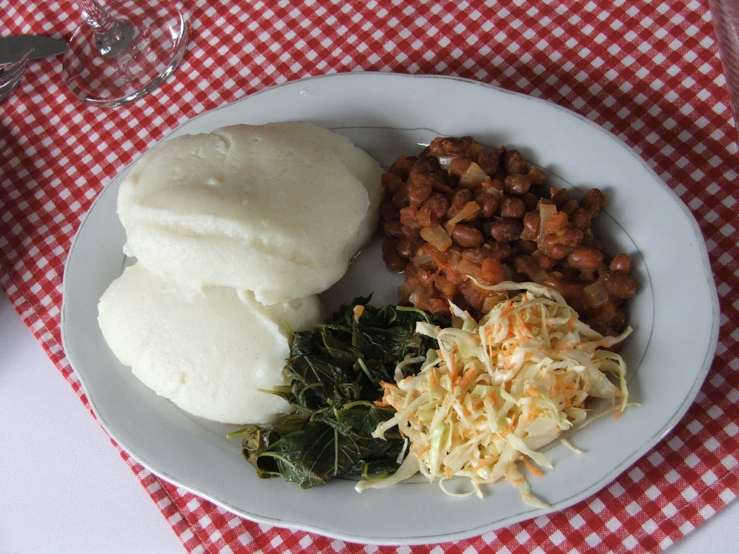
LOCAL FOOD:nsima which is from corn

Slide 16
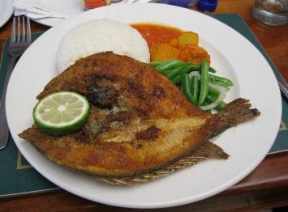

Slide 17
CULTURE
ETHINIC GROUPS
Chewa 32.6% Lomwe 17.6% Yao 13.5% Ngoni 11.5% Tumbuka 8.8% Nyanja 5.8% Sena 3.6% Tonga 2.1% Ngonde 1% other 3.5%

Slide 18
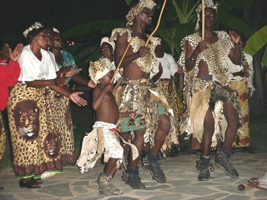
Cultural Dances

Slide 19
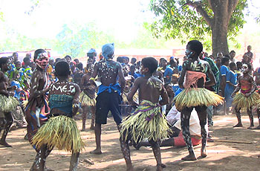
Beni,malipenga,manganje,gulewamkulu among others

Slide 21
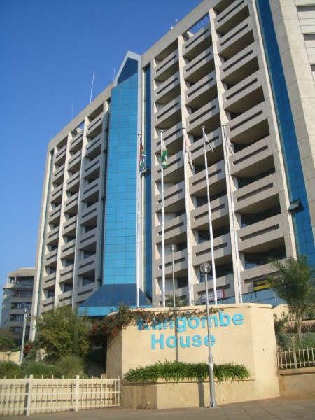
Infrastructure

Slide 22
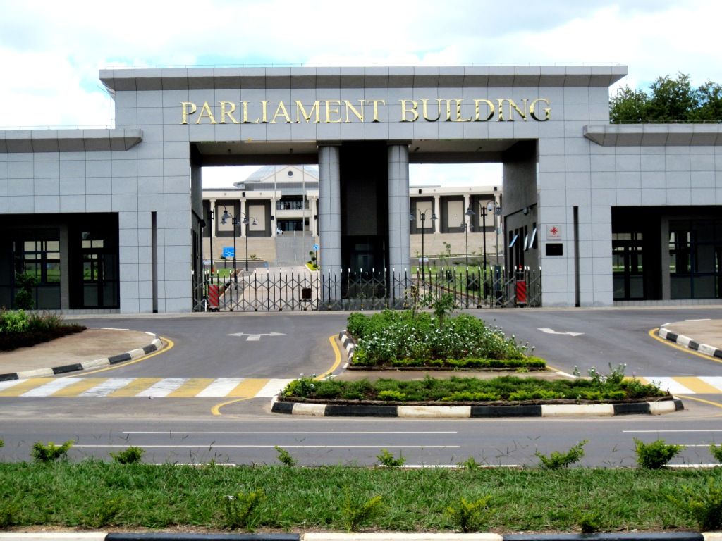
Government buildings

Slide 23
schools

Slide 24
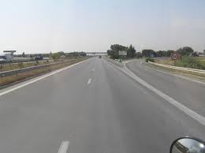
Roads and bridges

Slide 25
shopping.

Slide 26
EDUCATION
In Malawi, primary education is divided in three major sections,primary,secondary and tertiary,it is not compulsory, but the Constitution requires that all people be entitled to at least five years of primary education.
In 1994, free primary education for all children was established by the government, which increased attendance rates
Youth literacy has also increased, moving from 68% in 2000 to 82% in 2007

Slide 27
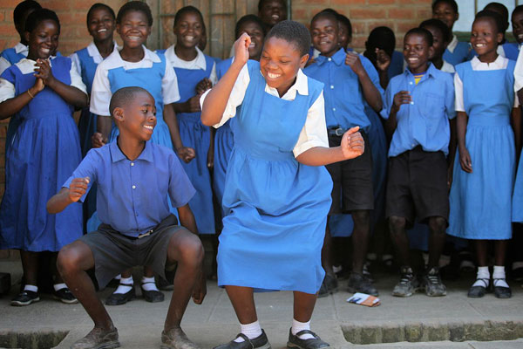
Primary education
The first level of education
Begins with grade one to eight in government schools and one to six in most private schools

Slide 28
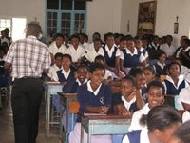
Secondary education
It ranges from form one to four
Its equivalent to O-level in the British system
Some may go up to form 6 which leads to attainment of an A-Level

Slide 29
Tertiary education
The University of Malawi is one of educational institutes, established in 1964 and composed of five constituent colleges located in Zomba,Blantyre, and Lilongwe.
Bunda College, (Lilongwe)
Chancellor College, (Zomba)
College of Medicine, (Blantyre)
Kamuzu College of Nursing, (Lilongwe),
Malawi Polytechnic, (Blantyre)

Slide 30
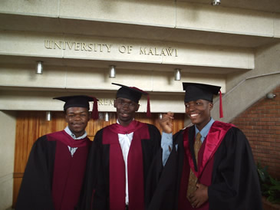
Compus and grduates

Slide 31
Other universities
Mzuzu univesrity
The catholic University
Natural resources and many other institutions including vocational institutes

Slide 32
TOURISM
There is considerable potential for tourism in Malawi
The tourist industry has grown greatly since the mid 1970s.
The tourist industry promotes Malawi's national parks including Nyika Nationa Park, Kasungu National Park, and Liwonde National Park

Slide 33
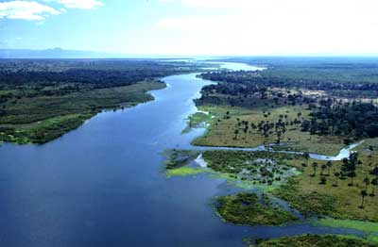
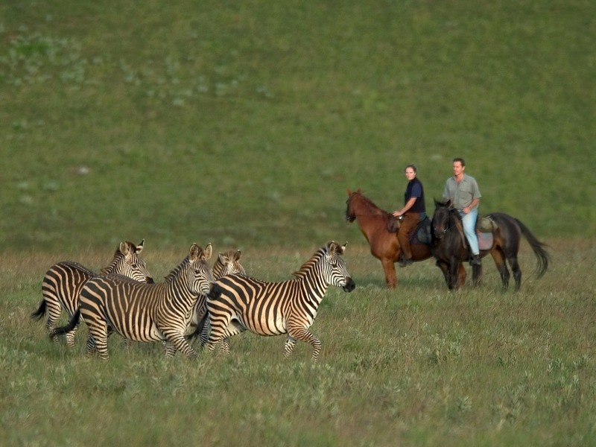

Slide 34
The world’s most beautiful lake
Lake Malawi is an African Great Lake and the southernmost lake in the East African Rift system.
This lake, the third largest in Africa and the eighth largest lake in the world.
This great lake's tropical waters are reportedly the habitat of more species of fish than those of any other body of freshwater on Earth, including more than 1000 species of cichlids.

Slide 35
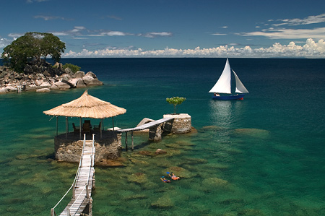

Slide 37
Mulanje mountain.

Slide 39
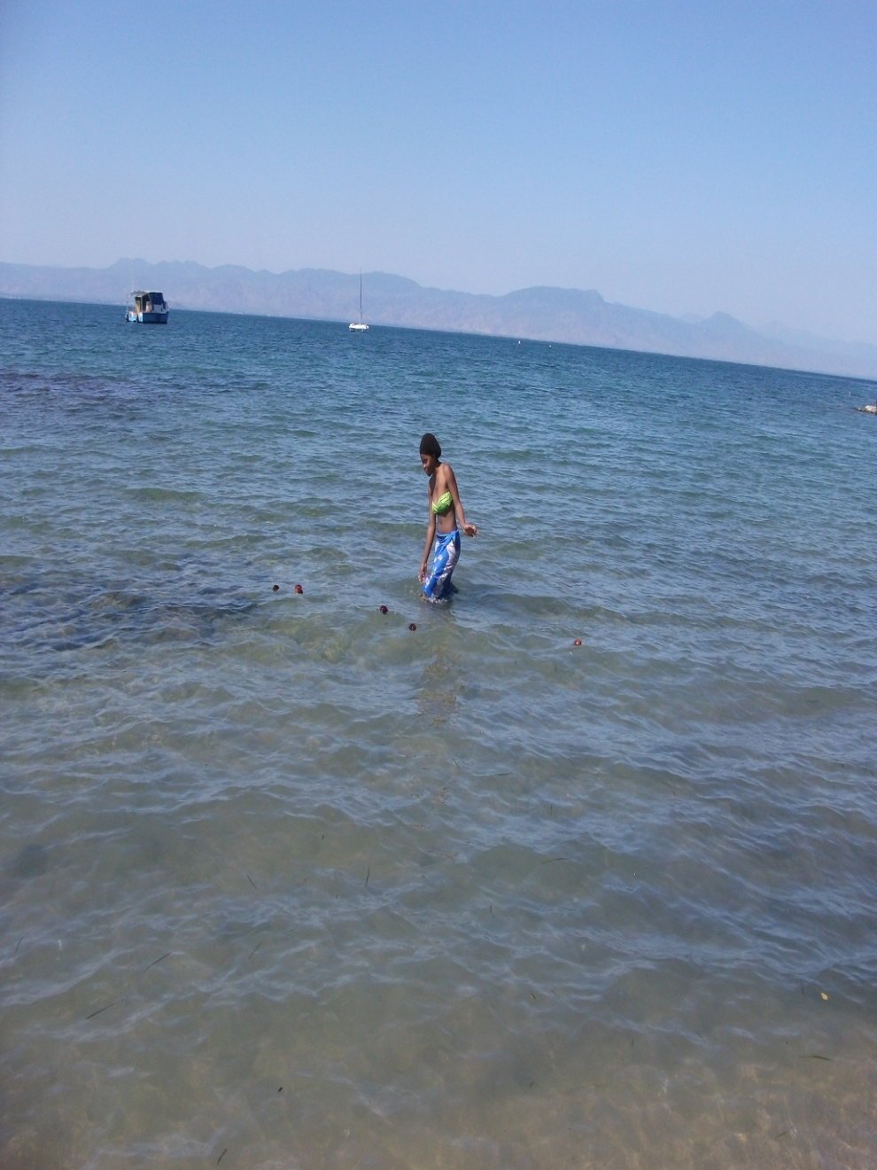
Yambani ndinu amalawi campaign

Slide 42
THANK YOU !!!!

