Slide 1
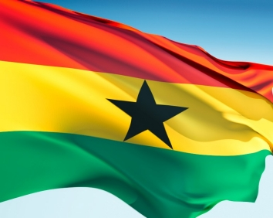
THE REPUBLIC OF GHANA
BY: RASHIDA ABDUL-GANIYU

Slide 2
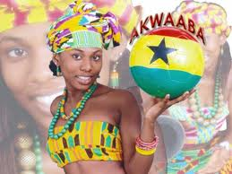
FORMAT
Brief History
Some Facts about Ghana
Geography
Regions and Districts
Government and Politics
Economy
Demographics
Education and Culture
Some important sites, structures

Slide 3
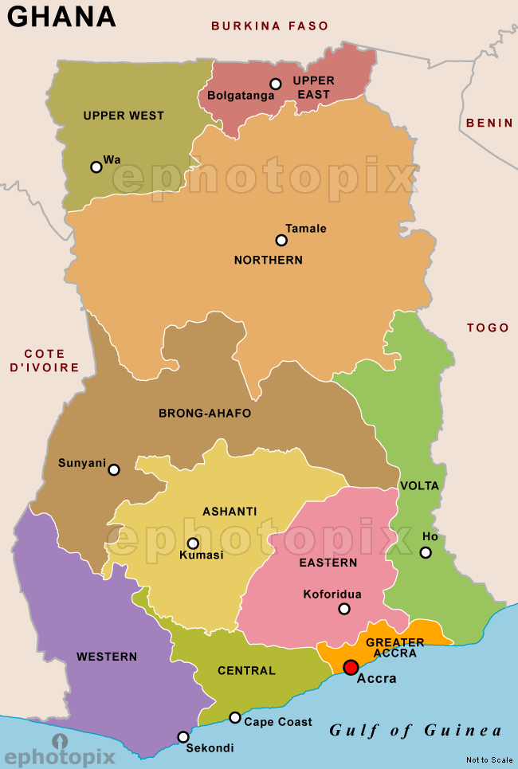
Where is Ghana located???

Slide 4
Brief History
Ghana was once called the Gold coast before its independence in 1957.
The name Ghana was adopted from the ancient Ghana Empire which means “Warrior King”
Ghana gained its independence from the British in 1957 and became a Republic in 1960
Its first president was Dr. Kwame Nkrumah who together with “the big six” fought for Ghana’s Independence.

Slide 5
Brief History
A series of coups took place after its independence from 1966 to 1981, ended with the ascension to power of Flight Lieutenant Jerry John Rawlings in 1981-1991.
He was then democratically elected as President from 1992-2000.
A new constitution restoring multi-party politics was also set up in 1992.

Slide 6
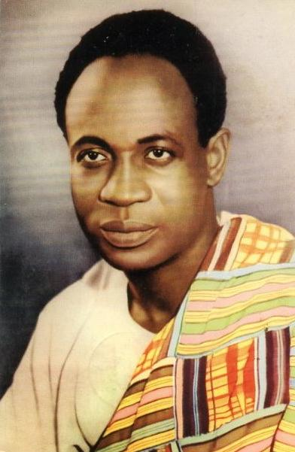
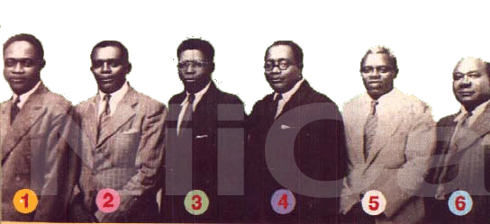
Dr.Kwame Nkrumah and the Big Six
1. Dr. Kwame Nkrumah 2. Obetsebi Lamptey 3. Dr. Ako Adjei 4. Ofori Atta 5. J.B. Danquah 6. Akufo Addo

Slide 7
Some Facts about Ghana
The capital and largest City – Accra
Official language- English
President- John Dramani Mahama
Vice President- Kwesi Emissah-Arthur
Total Area- 238,535kms(land),water(3.5%)
Population as of 2010- 24.2 million
Density- 101.5kmsq
GDP- US $90billion
Percapita- US$3.520
Currency- Ghana Cedi (GH₵)
Time Zone- GMT
currently inhabited by 52 ethnic groups

Slide 8
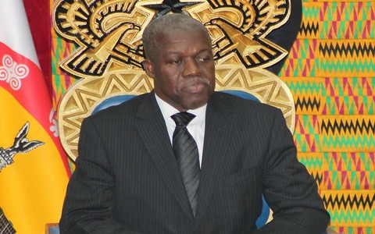
President Mahama and his Vice

Slide 9
Geography
Ghana:
is a country located along the Gulf of Guinea, only a few degrees north of the Equator, therefore giving it a warm climate.
is closer to the "centre" of the world than any other country.
encompasses flat plains, low hills and a few rivers
highest point is Mount Afadjato which is 885 m (2,904 ft) and is found in the Akwapim-Togo Ranges.
There are two main seasons in Ghana: the wet and the dry seasons. Wet(btn March nd Nov)

Slide 10
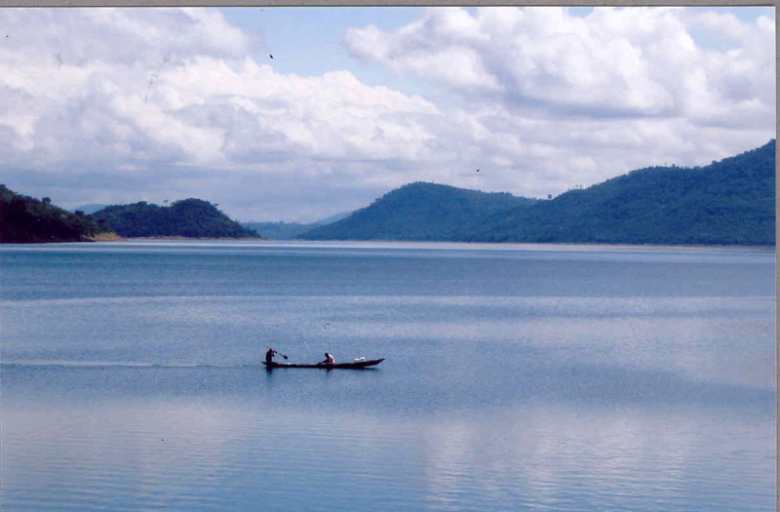
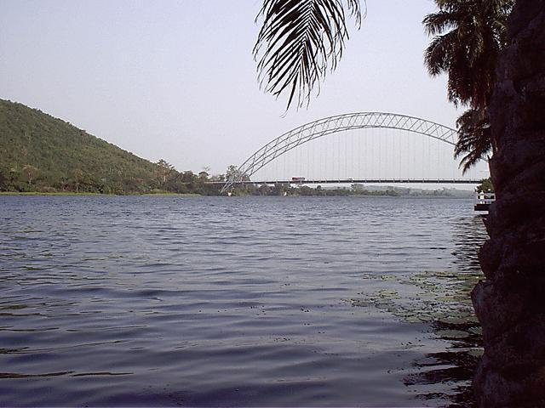
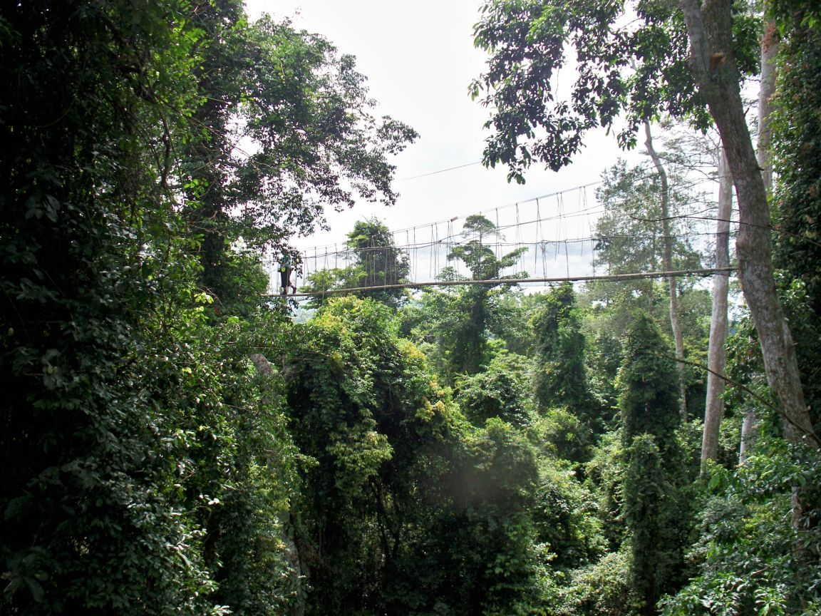
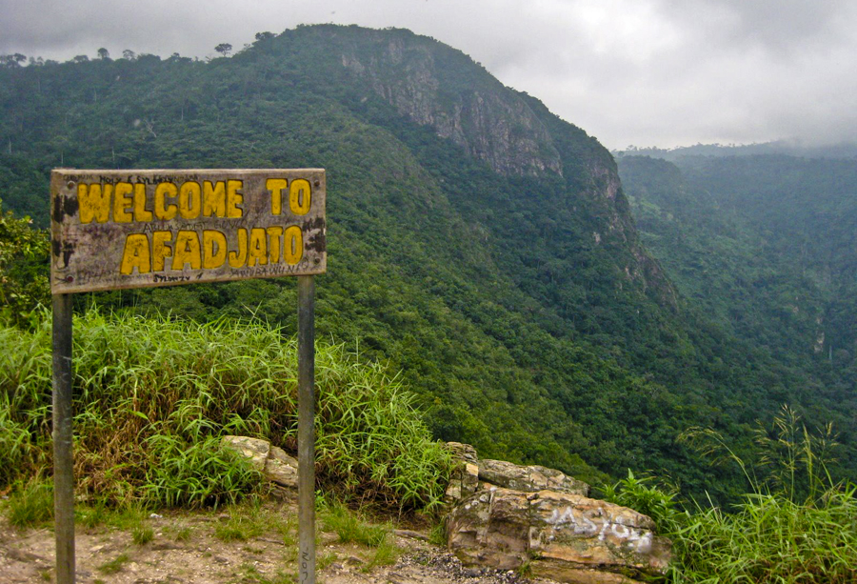
1
2
White volta
Lake volta showing the Akosombo dam
4
3

Slide 11
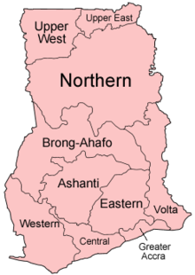
Regions and Districts
Ghana is divided into 10 administrative regions, subdivided into a total of 170 districts. The regions are:
Ashanti, capital Kumasi
Brong Ahafo, capital Sunyani
Central, capital Cape Coast
Eastern, capital Koforidua
Greater Accra, capital Accra
Northern, capital Tamale
Upper East, capital Bolgatanga
Upper West, capital Wa
Volta, capital Ho
Western, capital Sekondi-Takoradi

Slide 12
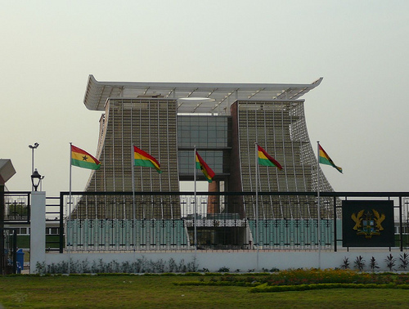
Government and Politics
Flag stuff house
According to the 2009 Failed States Index, Ghana is ranked the 53rd least failed state in the world and the second least failed state in Africa after Mauritius.
The 1992 constitution divides powers among a president, parliament, cabinet, council of state, and an independent judiciary

Slide 13
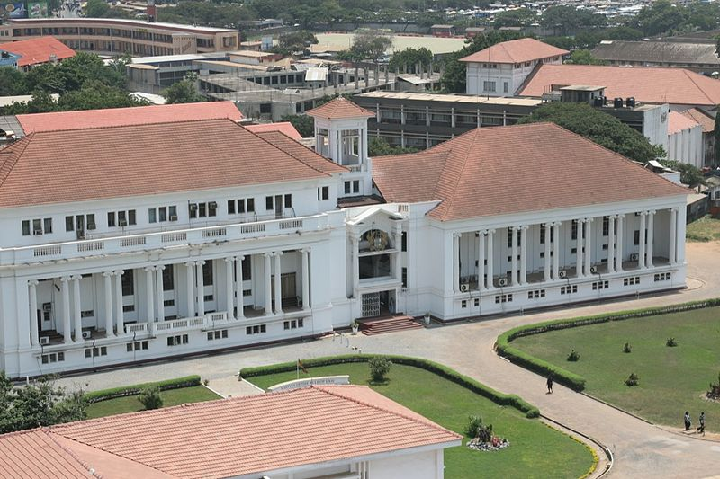
Government and Politics
Supreme court of Justice
The legal system is based on British common law, customary (traditional) law, and the 1992 constitution.

Slide 14
Government and Politics
Coat of Arms
Political corruption in Ghana is on the rise, jumping from 50 in 2002 to 70 in 2003 and 63 to 69 in the 2011.
Political parties became legal in mid-1992 after a ten-year hiatus.
The major Political Parties are National Democratic Congress(NDC),New Patriotic Party(NPP) and Convention Peoples Party(CPP)

Slide 15
Government and Politics
Inside the Parliament house

Slide 16
The National Flag
The Flag of Ghana, consisting of the colours red, gold, green, and the black star.
blood that was shed towards independence
mineral wealth of Ghana,
rich agriculture,
is the symbol of African emancipation

Slide 17
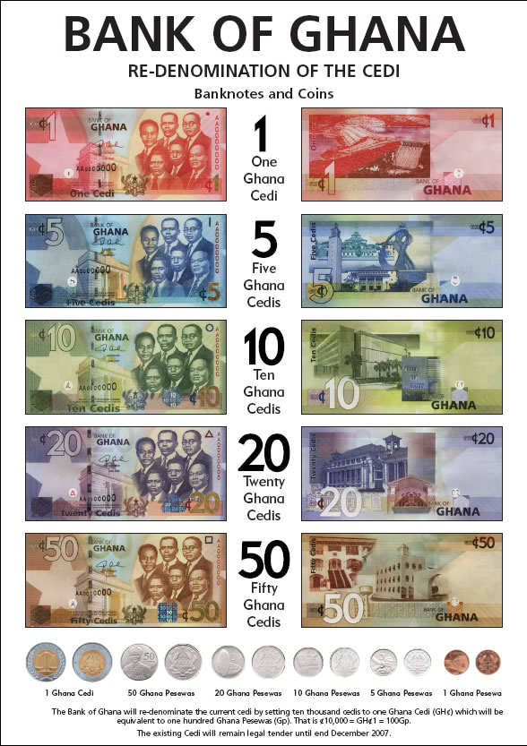
Economy
Ghana is a Middle Income Economy
27% of Ghana's population are living on less than $1.25 per day and there is a rate of 25% youth unemployment.
Ghana has more than twice the per capita output of the poorer countries in West Africa

Slide 18
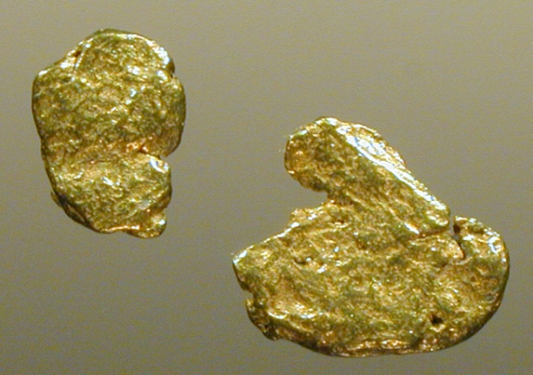
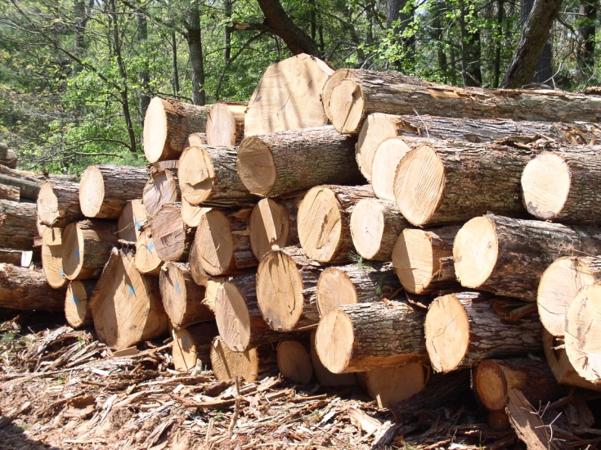
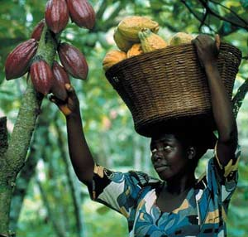
Economy
1
Ghana remains one of the world's top gold producers
Other exports such as cocoa, crude oil, natural gas, timber, electricity, diamond, bauxite, and manganese are major sources of foreign exchange
2
3

Slide 19
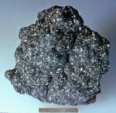
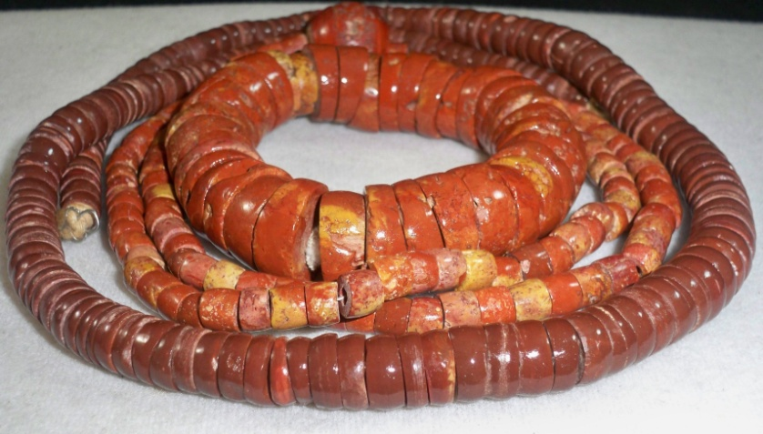
Economy
The Ghana Stock Exchange (GSE) is the third largest stock exchange in Africa after the Johannesburg Stock Exchange (JSE) and the Nigerian Stock Exchange (NSE).

Slide 20
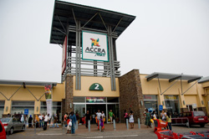
Economy
A typical Ghanaian market
Shopping malls

Slide 21
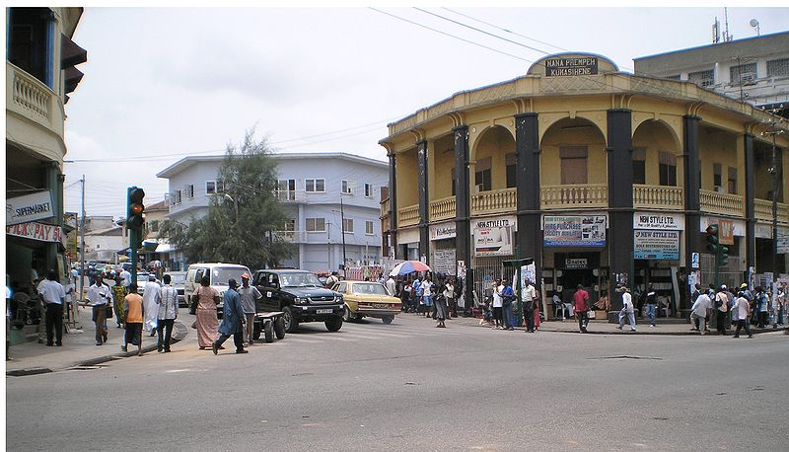
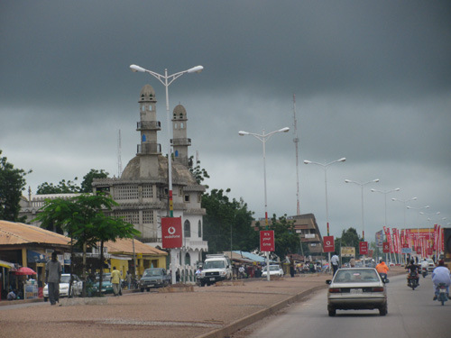
Demographics
Ghana has a population of about 24 million people.
is currently inhabited by 52 ethnic groups
The official language is English; however, most Ghanaians also speak at least one local language
Each region may include several cities, which are in very close proximity to each other
kumasi
Tamale

Slide 22
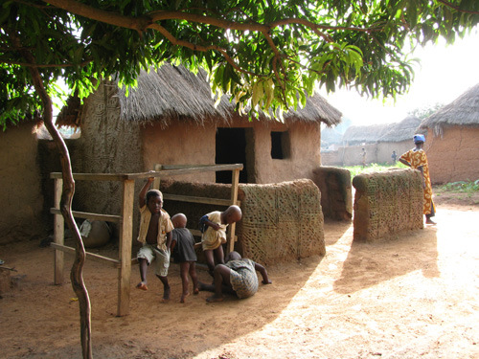
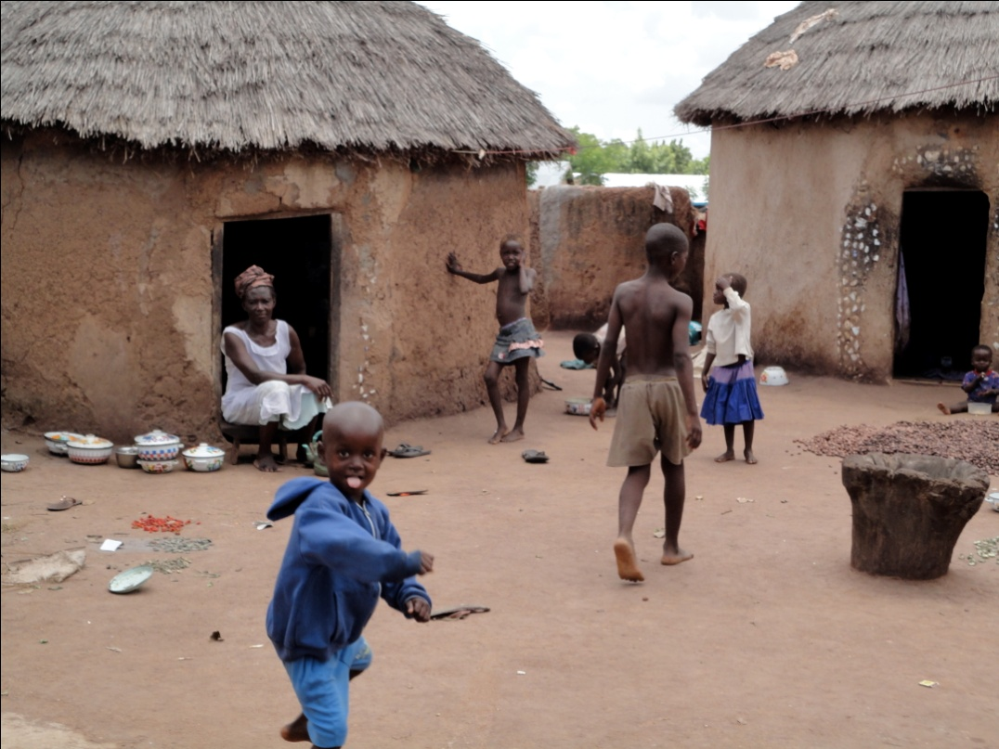
Demographics
Accra
Some villages

Slide 23
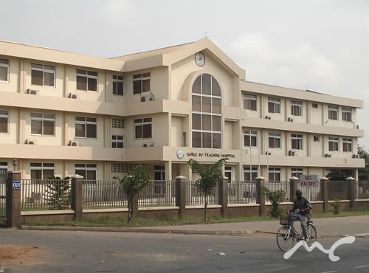
Demographics
Health-As of 2009, life expectancy at birth is about 63 yrs for M &F with infant mortality at 51/ 1000 live births
There are about 15 physicians and 93 nurses per 100,000 persons
Language-a total of 79 languages
Korle Bu TH

Slide 24
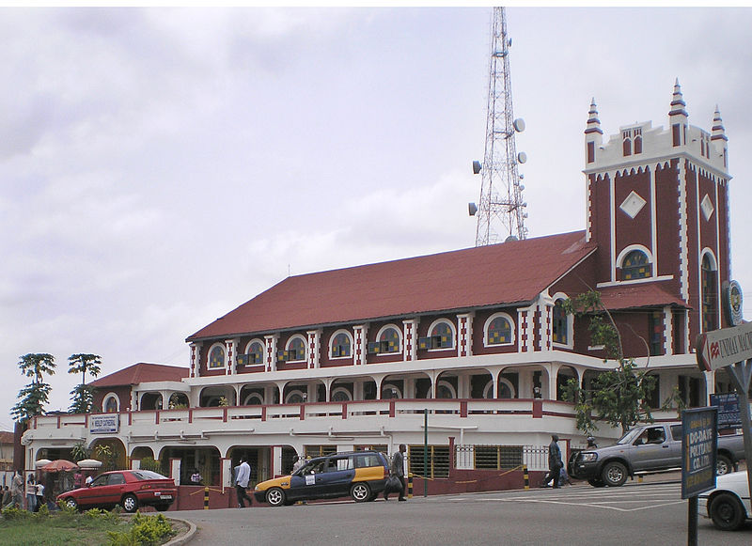
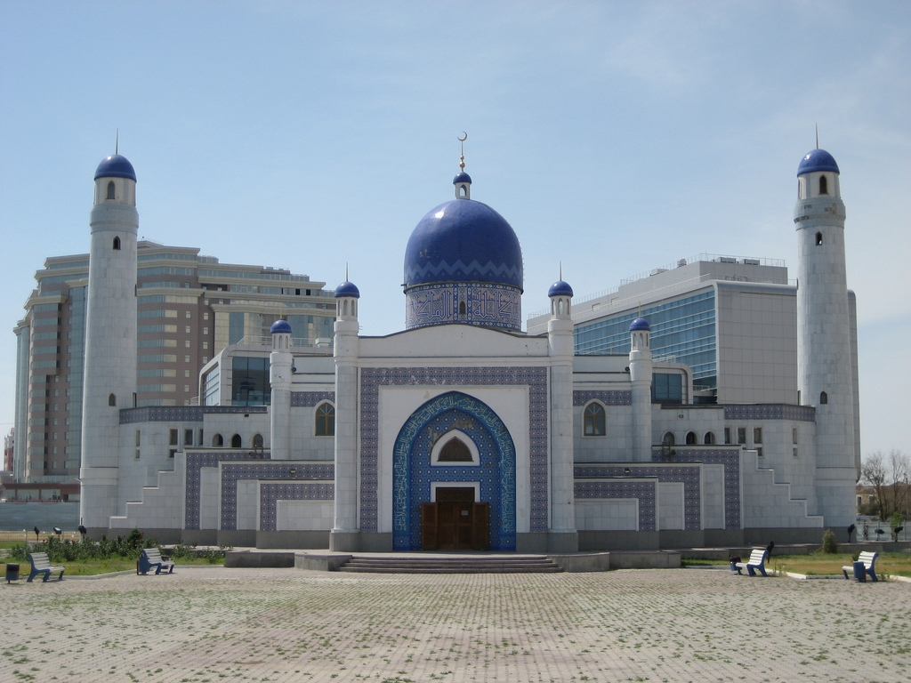
Demographics
Religion-Christianity is the country's largest religion(69%), Islam(16%) and traditional(8.5%)
Christian–Muslim relations in Ghana are peaceful, tolerant and bilateral, without sectarian violence

Slide 25
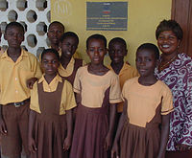
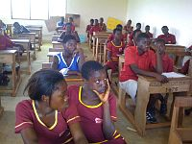
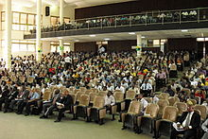
Education and Culture
Primary school kids
Education- Ghana has a 6-year primary education system beginning at age 6
3-year JHS system. At the end of the 3rd year of junior high, there is a mandatory "Basic Education Certificate Examination".
the 3-year SHS program
Tertiary Education
JHS pupils
University students

Slide 26
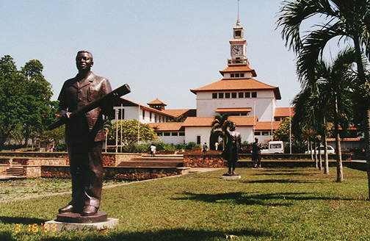
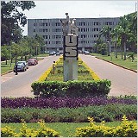
Education
University of Ghana
Education-Presently, Ghana has 21,530 primary schools, 8,850 JHS, 900 shs, 52 public training colleges, 5 private training colleges, 5 polytechnical institutions, 4 non-university public tertiary institutions, 8 public universities and over 45 private tertiary institutions
KNUST

Slide 27
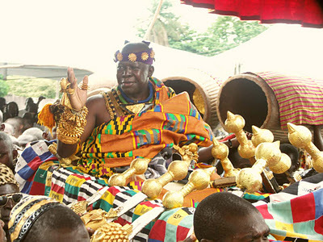
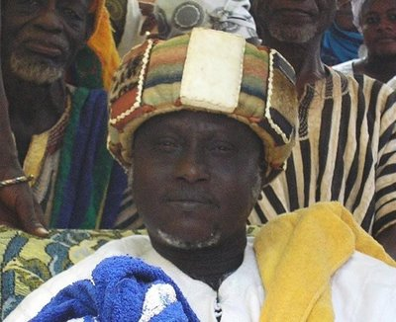
Culture
Chiefs
Culture-Ghana is an ethnically diverse country
Ghanaian culture is a mixture of the cultures of its peoples, predominantly Akan, Ewe, Ga-Adangbe, and Dagomba, with the Akan being dominant.
Ghana's cultural diversity is most evident in cuisine, arts, and clothing

Slide 28
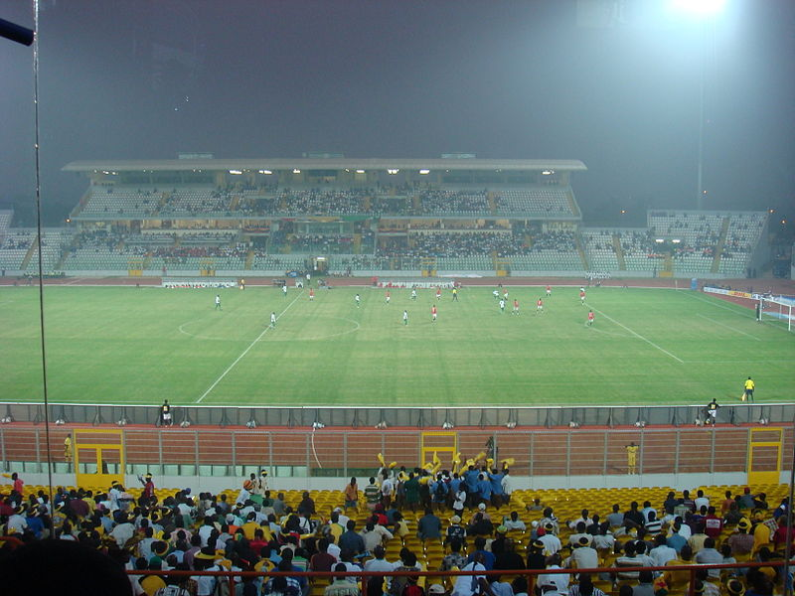
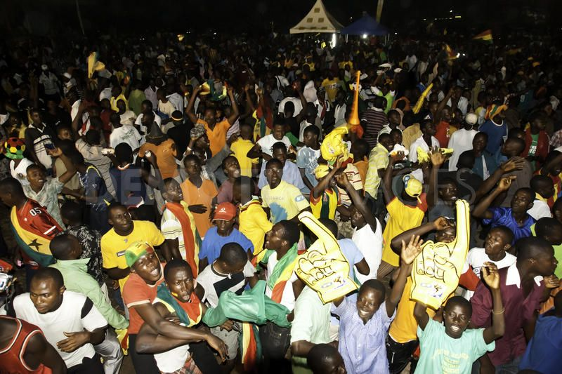
Culture
Sports-Football is the most popular sport. The national men's football team -the Black Stars
under-20 team- the Black Satellites.
Ghana has participated in many championships including the African Cup of Nations, the FIFA World Cup and the FIFA U-20 World Cup

Slide 29
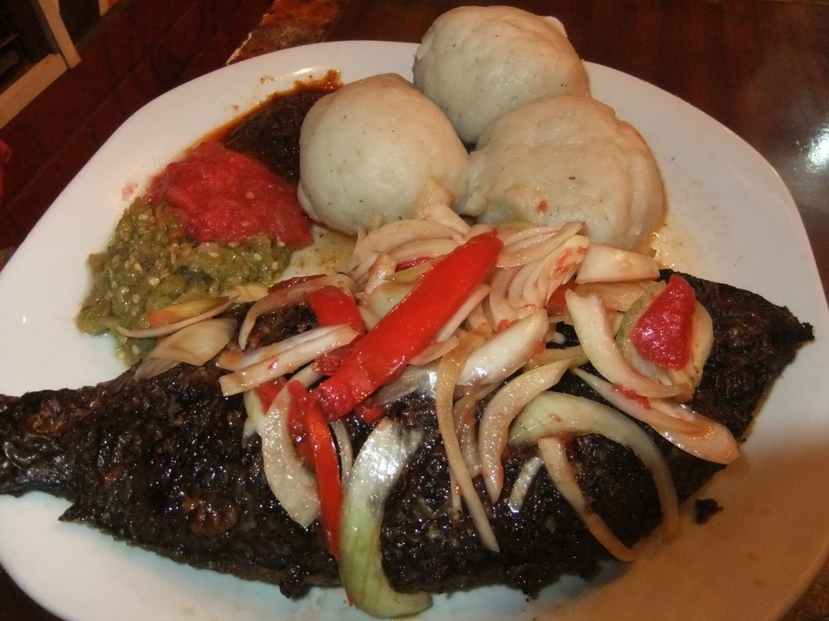
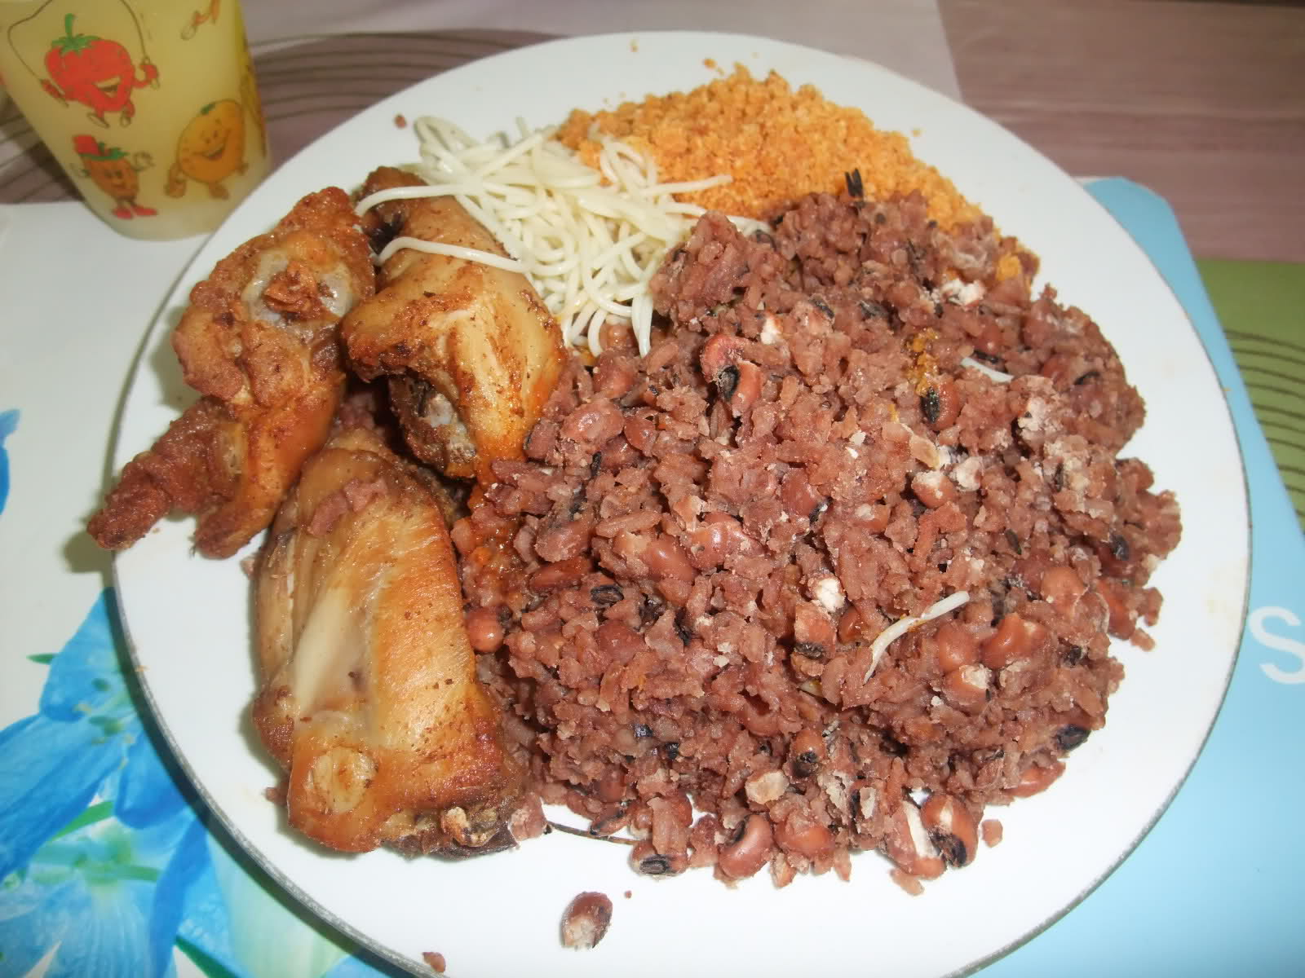
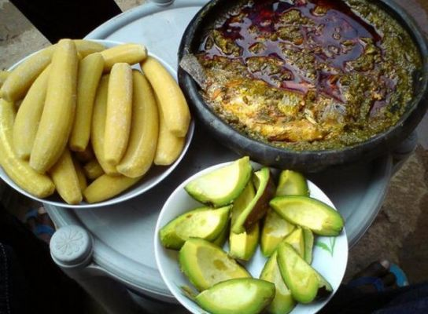
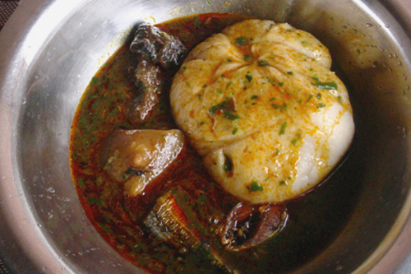
Some Ghanaian Dishes
Banku
Wakye
Apim
T.Z

Slide 30
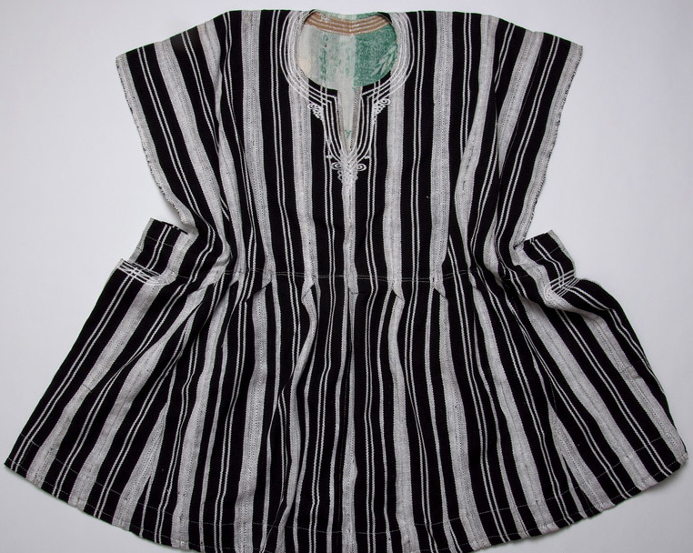
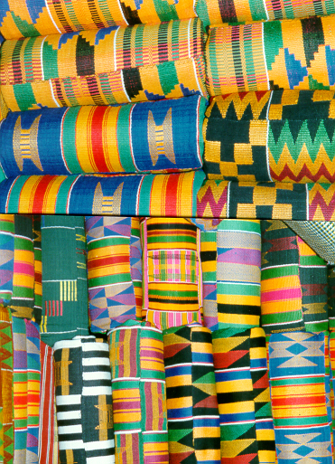
Culture
Arts-Textiles are very important in Ghanaian culture.
Different symbols and different colours mean different things.
Kente is probably the most famous of all the Ghanaian cloths. Kente is an Akan ceremonial cloth hand-woven on a horizontal treadle loom.
Smock
Kente

Slide 31
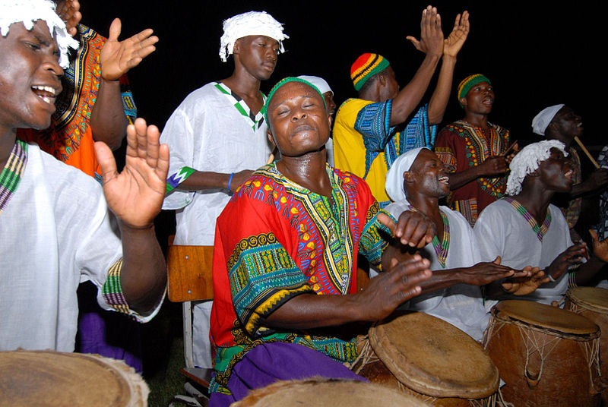
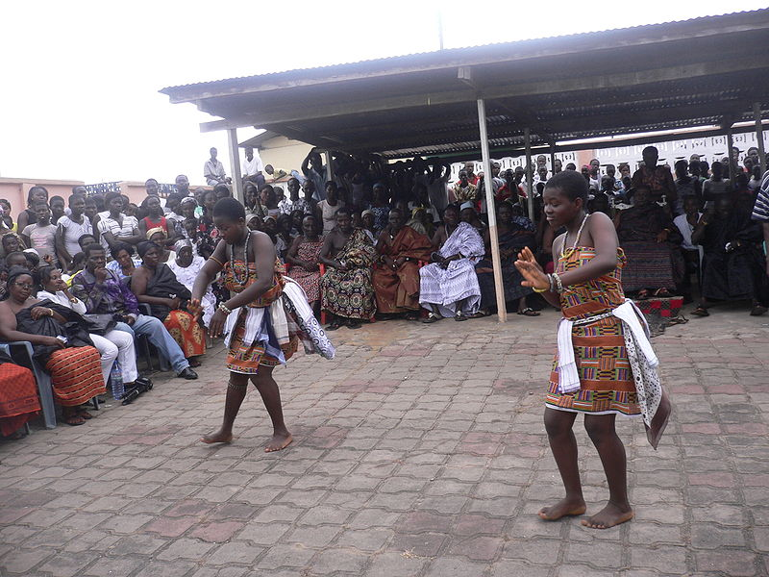
Culture
Music and Dance-The music of Ghana is diverse and varies between different ethnic groups and regions.
Each ethnic group has their own traditional dances and there are different dances for different occasions.
There are dances for funerals, celebrations, storytelling, praise and worship etc. Some of these dances include Adowa, Kpanlogo, Azonto, Llama, and Bamaya
Adowa dance

Slide 32
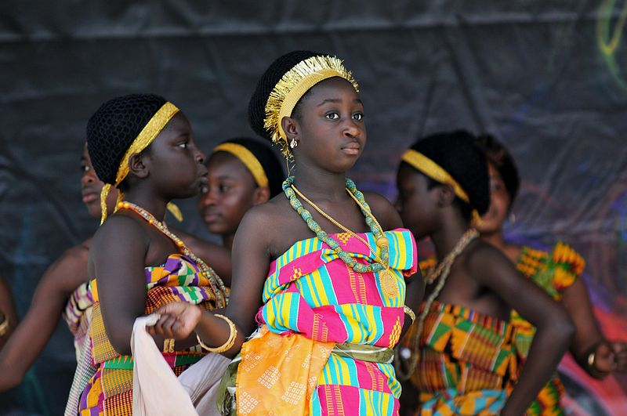
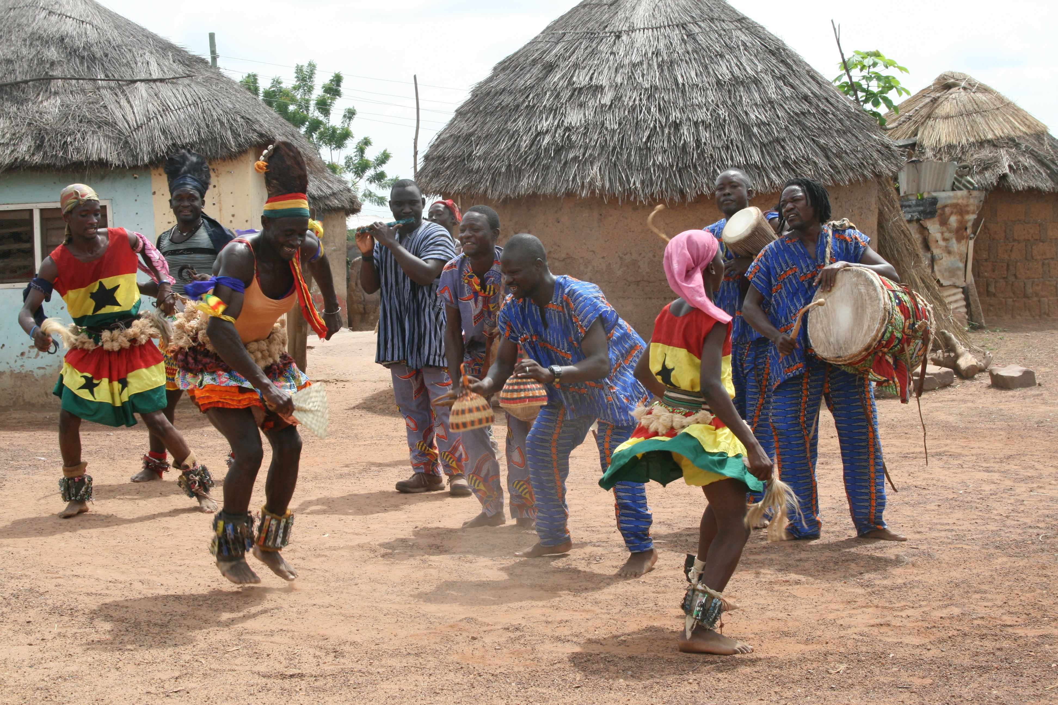
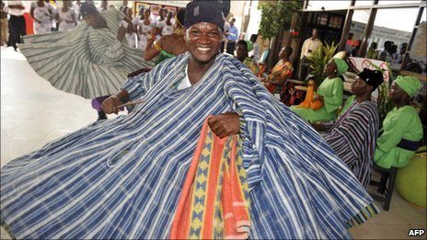
Traditional dance
Bamaya
Lung

Slide 33
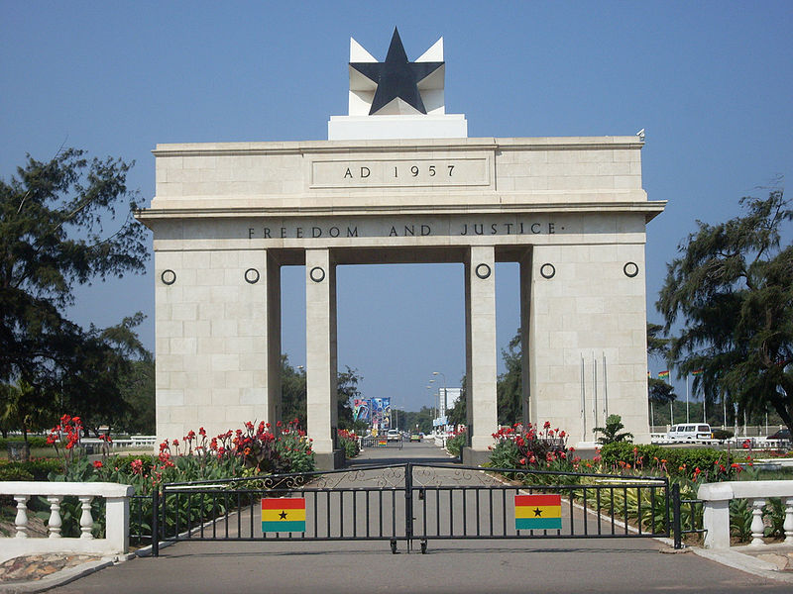
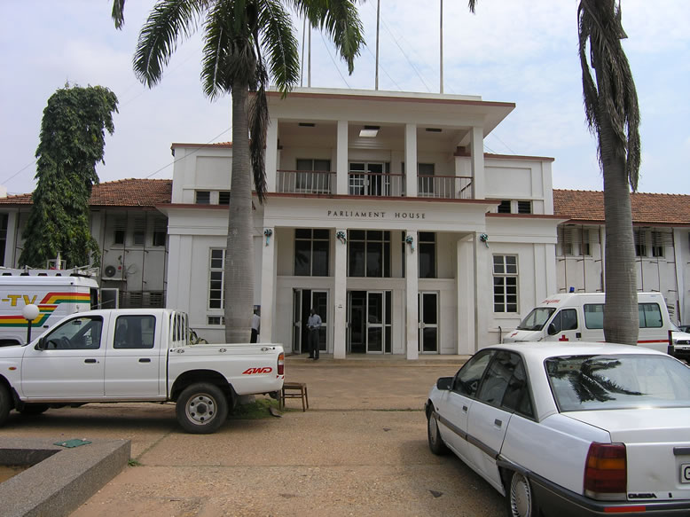
Some Important sites and Structures
Independence square
Parliament house

Slide 34
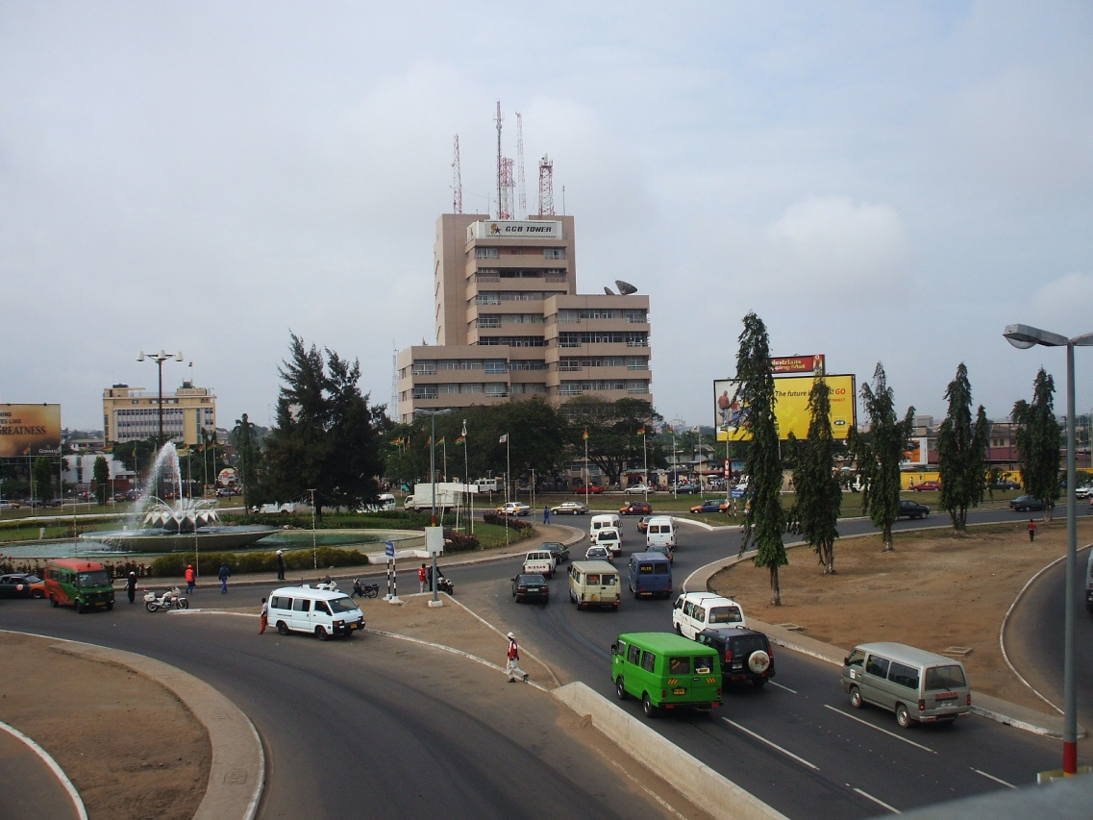
Infrastructure

Slide 35
Some Tourist Attractions
Kakum National Park
Cape Coast Castle
Kintampo Water falls

Slide 36
Some Tourist Attractions
Paga Crocodile Pond
Adomi Bridge
Beach
Mole Game Reserve

Slide 37
Some Tourist Attractions
Akosombo Dam
Larbanga mosque

Slide 38
References
http://en.wikipedia.org/wiki/Ghana
http://en.wikipedia.org/wiki/File:Dance_performance_in_Ghana.jpg
http://en.wikipedia.org/wiki/File:Dashiki_and_kufi.jpg
http://www.google.com/search?hl=en&tbo=d&biw=1639&bih=800&tbm=isch&sa=1&q=smock+cloth+of+northern+ghana&oq
http://www.google.com/search?hl=en&tbo=d&site=&source=hp&q=tourist+sites+in+ghana&oq=tourist+sites+in+ghana&gs_l=hp.1.0.0l3j0i30l3j0i5i30l4.1387.20537.0.21827.46.26.9.11.15.1.986.8257.3j6j2j10j2j1j2.26.0.les%3B..0.0...1c.1.MKt_-61Re7A
http://www.google.com/search?hl=en&tbo=d&site=&source=hp&q=map+of+ghana+regions&oq=map+of+ghana+&gs_l=hp.1.0.0l10.1129.27168.0.68484.13.10.0.3.3.0.418.3129.2-5j4j1.10.0.les%3B..0.0...1c.1.2.hp.k4PBjtVS41w
http://www.niica.on.ca/ghana/leaders.aspx
http://www.google.com/search?q=ghanaian+food&hl=en&tbo=d&tbm=isch&biw=1639&bih=800&gs_l=img.1.0.0j0i24l9.92867.101983.0.104391.33.18.0.0.0.1.890.4520.2j1j4j3j3j0j1.14.0...0.0...1c.1.M7VIOUbzWdc&oq=Ghanaia

