Slide 1
UNDERSTANDING THE AFRICAN LOCAL COMMUNITY, the case of Gasenyi village, Karongi District in Rwanda
Prepared by
Nicolas UWITONZE
B.Sc. Agric (Agric. Extension Educ.)
Professional certificate in B.A
ALYM, 19/10/2013

Slide 2
Outline
Introduction
Reaching the community
Common characteristics of Rwandese local communities
Particular characteristics
Some challenges and possible solutions
Conclusion

Slide 3
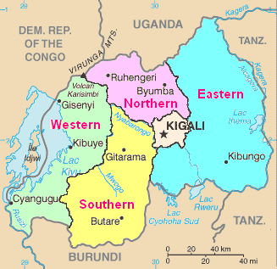
INTRODUCTION
My village is Gasenyi. It is 25 Km away from The Western Province headquarters (Kibuye city) in Karongi district, in the country of a thousands hills in Rwanda.

Slide 4
REACHING THE COMMUNITY

Slide 5
Heading towards the Western Province of Rwanda…..

Slide 6
Nyabarongo River (Source of Nile)

Slide 7
Kirinda bridge (River Nyabarongo)

Slide 9
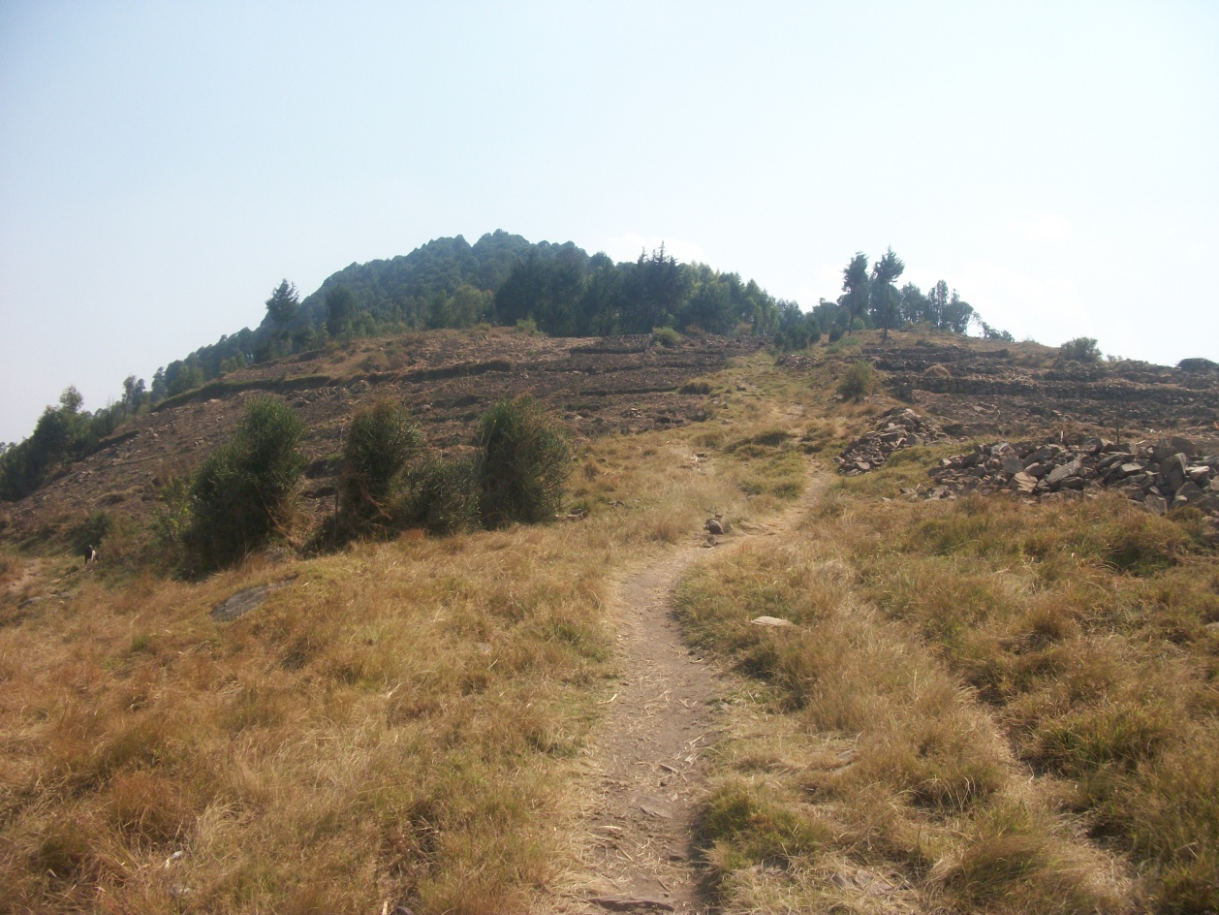

Slide 10
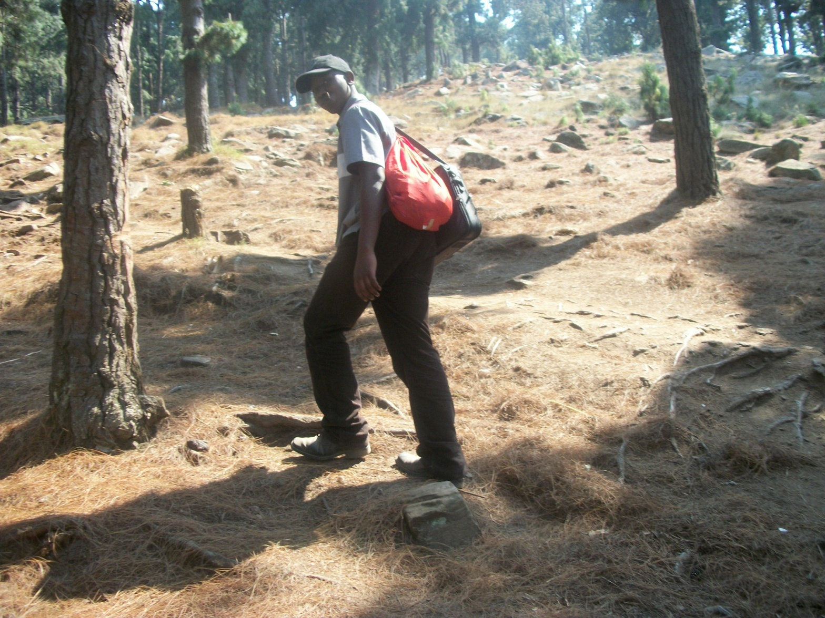

Slide 13
COMMON CHARACTERISTICS OF RWANDESE LOCAL COMMUNITIES

Slide 14
Common market

Slide 15
Primary schools

Slide 16
Gasenyi secondary school

Slide 17
Churches

Slide 18
Health centers/ Dispensary
Rounded up Houses (Imidugudu)
Basic infrastructures (water, Electricity,..)
Question to answer: what else do you have in your local community/village?

Slide 19
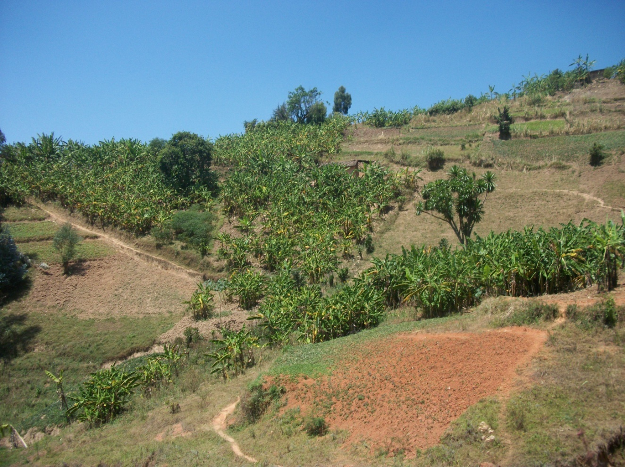
PARTICULAR CHARACTERISTICS FOR MY LOCAL COMMUNITY (Gasenyi village)

Slide 20
Karongi tea factory limited: handed over to the UK-based Borelli Tea Holdings limited

Slide 21
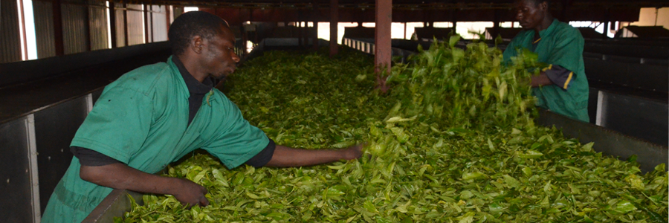
Tea harvesting

Slide 22
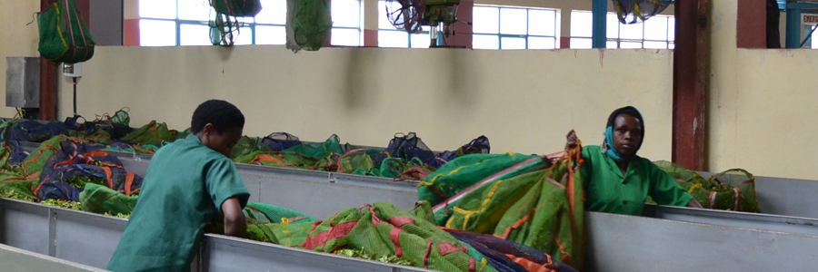
Reception of raw tea leaves

Slide 23
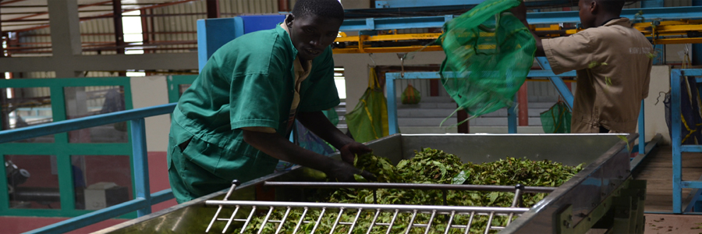

Slide 24
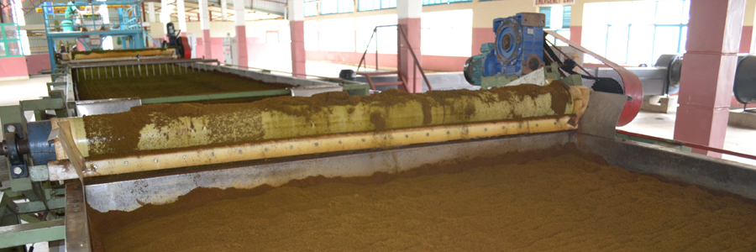

Slide 25
Final product-Trade

Slide 26
REFERENCES
http://en.wikipedia.org/wiki/Rwanda
http://karongitea.com/spip.php?article12
http://www.minagri.gov.rw/index.php?id=469&tx_ttnews%5Btt_news%5D=273&cHash=2d0523e00c7568f922a82dd789774fd8

