Slide 1
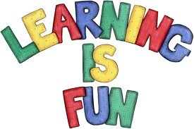
ASSESSING LEARNING STYLES FOR INDIVIDUALS, ORGANIZATION TO BE EFFECTIVE ANYTIME; ANYWHERE
By Nicolas UWITONZE
4th year student of the Agric. extension education department
Faculty of Agriculture, Alexandria university
©ALYM 2013

Slide 2
Scope of the presentation
For many of us the word ‘learning’ is something to do with memorizing.
None of us learns in the same way. Over the years we all develop different approaches to learning.
According to the assessment done, 80% of ALYM members have a mix of learning styles and 60% are not sure of their one style of learning
The African League of Young Master organization facilitates members to learn under “learning organization” and even after they graduate (“Lifelong learning”).
Notes:
Learning carries with it the idea of developing something- a skill, knowledge, the power or argument

Slide 3
The question is how?

Slide 4
Table of Contents
Definitions: What is learning?
Types of learning
Learning styles
Learning organization
Lifelong learning
Further reading
References

Slide 5
Definitions: What is learning?
acquire information or skill: to acquire knowledge of a subject or skill through education or experience
find out: to gain information about somebody or something
memorize something: to memorize something such as facts, a poem, a piece of music, or a dance
teach somebody something: to teach a topic or skill to somebody .
Notes:
e.g1: I'm learning to play the piano
e.g2: I’ve learned that they're arriving tomorrow
e.g3: learn the periodic table

Slide 6
Definitions: What is learning?
Learning is a process through which an individual acquires the facts, attitudes, or skills that produce changed behavior (Simpson, 1980, P.55)
Learning is the process by which an activity an activity originates or is changed through reacting to an encountered situation, provided that the characteristics of the change in activity cannot be explained on the basis of native response tendencies, maturation, or temporary states of the organism(e.g Fatigue,drugs,etc)

Slide 7
Types of learning
Teacher trainers often divide learning into three main types of skill:
Psychomotor: Concerned with physical abilities e.g: Drive a car, Public speaking, ride a bicycle, playing football,..
Cognitive: Concerned with developing and increasing knowledge
Affective: Concerned with change in attitude

Slide 8
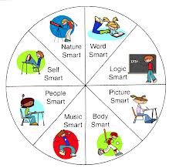

Slide 9
Types of learning (Examples)
Learning to focus attention
Learning to anticipate and hypothesize
Learning to interpret and analyze data
Learning to make notes,
Learning to identify key points
Learning how to put these skills together “Strategies of learning”
N.B get pictures for very skill and have sthg to say about each!

Slide 10
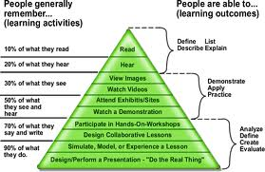
Learning how to learn

Slide 11
Learning how to learn

Slide 12
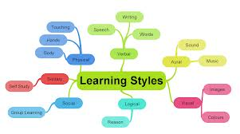
Learning styles
The successful learners are the persons who have developed a range of strategies from which they are able to select appropriately and adapt flexibly to meet the needs of a specific situation.
Style means a way of doing something. Or method, approach, way, manner, fashion, technique, mode…
Notes:
Style: way of doing something. i.e method, approach, way, manner, fashion, technique, mode.
Strategy: a carefully devised plan of action to achieve a goal

Slide 13
Learning styles

Slide 14
Activist learning style
Enjoy active ways of learning
Love new experiences and are happy when having fresh problems to solve
Thrive on the excitement of the moment and enjoy being part of a team
On the other hand
They are not happy when they have to work on their own
Have to follow precise instructions or sit and listen to lectures
They need to be able to join in.

Slide 15
Theorist learning styles
There is nothing theorists like than to have their minds stretched and challenged
Analytical, happier with complex ideas, like to test assumptions
They are largely unswayed by emotions or feelings
It is no use asking them for a snap decision, they need to be allowed time to examine their subject in depth.

Slide 16
Reflector learning styles
Have plenty time to observe what is taking place before embarking on a project
Happy undertaking dogged research with few time constraints
They don’t like it when somebody gives a deadline or expect them to do something spontaneously.
Ask reflector to do a role-play and they will probably want to write themselves a script first.

Slide 17
Pragmatist learning style
Pragmatists like to be able to see the point of something
They are the ones learning French, Piano, Arabic, music, business, or something for their holidays rather than for the fun of it.
They like to know if there is some practical, useful output at the end of the course
They thrive on plenty of practice and often need strong guidance as to how to complete a task.
Notes:
Note: Don’t expect a pragmatist to cope well with theory.Anything thata doesn’t look like real life can put them off completely.

Slide 19
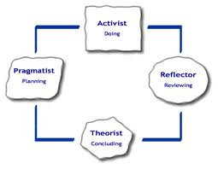
Summary of learning styles
Activist-Like to get in there and do it
Pragmatist- Needs to know why he or she is learning something
Reflector-Likes the time to think about what they’re learning, to observe others
Theorist- Goes for structured , theoretical, methodological approach to learning
Notes:
Several academics have researched the concept of learning styles thoroughly. One of them, Peter Honey, identified 4 basic styles

Slide 20
Learning organization

Slide 21
What is a "Learning Organization"?
A "Learning Organization” is one in which people at all levels, individually and collectively, are continually increasing their capacity to produce results they really care about.
Why should organizations care?
Because, the level of performance and improvement needed today requires learning, lots of learning.

Slide 22
What's in it for the people?
Learning to do is enormously rewarding and personally satisfying. For those of us working in the field, the possibility of a win-win is part of the attraction. That is, the possibility of achieving extraordinary performance together with satisfaction and fulfillment for the individuals involved

Slide 23
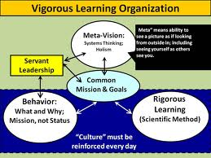
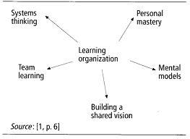
Are there any examples of Learning Organizations?
Yes, but the Learning Organization is an ideal, a vision. Various organizations or parts of organizations achieve this in varying degree.

Slide 24
Motivation for learning

Slide 25
Motivation for learning

Slide 26
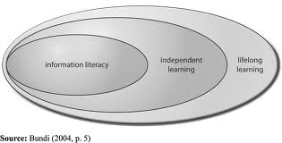
The traditional way of learning was for a front-loaded’ model-school, apprenticeship, then real work.
Any education at a later stage was unusual, haphazard or even impossible.
Lifelong learning is the idea that education is something we need to be engaged on throughout our lives

Slide 27
WHAT IS LIFELONG LEARNING? Lifelong learning may be broadly defined as learning that is pursued throughout life: learning that is flexible, diverse and available at different times and in different places. Lifelong learning crosses sectors, promoting learning beyond traditional schooling and throughout adult life (ie post-compulsory education).
Lifelong learning is the "ongoing, voluntary, and self-motivated"pursuit of knowledge for either personal or professional reasons. Therefore, it not only enhances social inclusion, active citizenship and personal development, but also competitiveness and employability

Slide 28
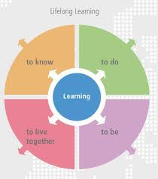
Learning to know - mastering learning tools rather than acquisition of structured knowledge.
Learning to do – equipping people for the types of work needed now and in the future including innovation and adaptation of learning to future work environments.
Learning to live together, and with others – peacefully resolving conflict, discovering other people and their cultures, fostering community capability, individual competence and capacity, economic resilience, and social inclusion.
Learning to be – education contributing to a person’s complete development: mind and body, intelligence, sensitivity, aesthetic appreciation and spirituality.
Notes:
This definition is based on Delors’ (1996) four ‘pillars’ of education for the future

Slide 29
The distinction between formal and non-formal learning environments
It is about where learning takes place.
Formal learning occurs within institutions established primarily to deliver education and training, often leading to recognized outcomes and qualifications.
Non-formal learning has intended education and training outcomes, however, the setting is outside dedicated learning institutions, most often in places where learning is not the primary business.
Informal learning is distinguishable by intent. It can occur almost anywhere, but as a by-product of other activities. It is often unplanned and without explicit emphasis on learning, yet may still lead to the acquisition of valuable skills, knowledge and attitudes

Slide 30
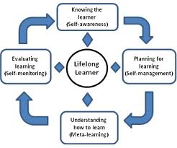

Slide 31
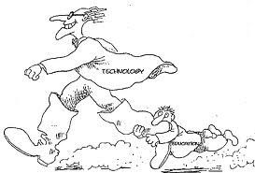
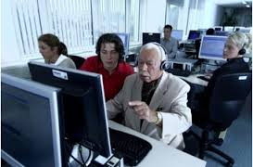
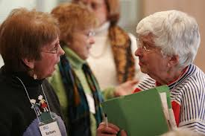
The elderly learn .what about me, who is still young?

Slide 32
Further reading

Slide 33
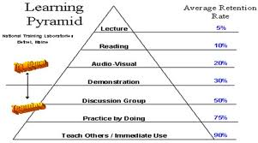
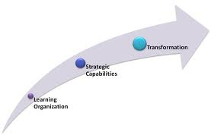
Conclusion
Teaching learners to become aware of the cognitive processes and learning strategies and teaching them how to use each strategy should be considered as important tasks for any teacher.
Notes:
Students with learning difficulties who are trained to develop an increased sense of personal control over their learning tend to experience improvements in their level of recorded achievement. (Cooper Mcinttyre, 1994, P.21)
Mayer(1998,P.11) defines “Learning strategies: as behaviors of a learner that are intended to influence how the learner processes information.

Slide 35
References
https://www.google.com/search?psj=1&bav=on.2,or.r_qf.&biw=1024&bih=494&um=1&ie=UTF-8&hl=en&tbm=isch&source=og&sa=N&tab=wi&ei=WkhnUa3RMoWHhQez1YHoBA&q=Types%20of%20learning (photos)
https://www.google.com/search?q=Lifelong+learning&source=lnms&tbm=isch&sa=X&ei=gThnUeXMEcOqhQfHw4HADw&ved=0CAcQ_AUoAQ&biw=1024&bih=494(Photos)
http://www.std.com/~lo/ (Learning Organization)
http://www.llcq.org.au/01_cms/details.asp?ID=12http://en. (lifelong learning )
wikipedia.org/wiki/Lifelong_learning

