Slide 1
Bwambale Jamada
Alexandria university
Faculty of agriculture
1st year

Slide 2
Africa’s problems. Who is to blame?

Slide 3
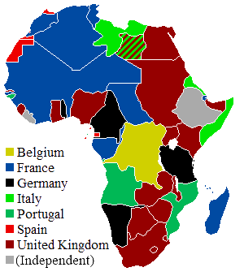
1.colonialism
1885 Berlin conference;scramble and partition of africa
Colonial maps created countries with “divided and ruled people” causing lack of cohesion.
Slave trade; about 10-28 million africans shipped overseas.
-Some of today’s richest former colonies ;USA, canada,singapore, new zealand.
-Some of today’s poorest countries that were never colonised;Ethiopia,liberia, Nepal.
Colony possessions`

Slide 4
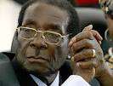
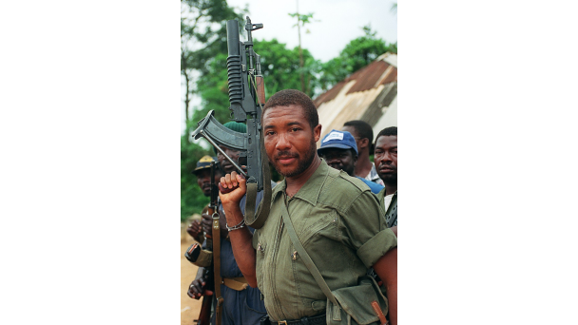
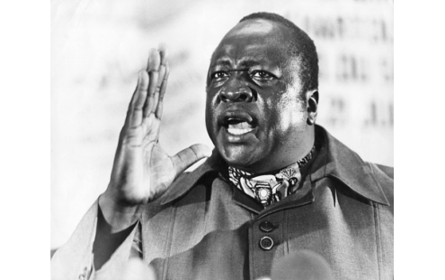
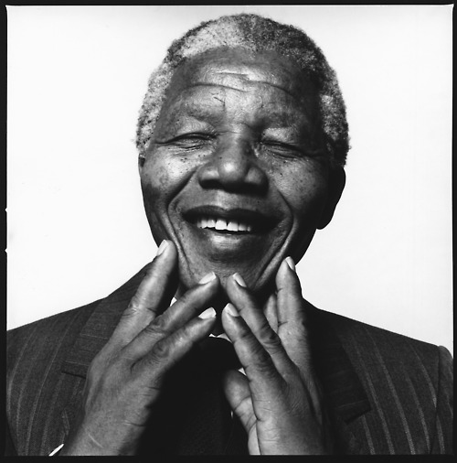
`j
In 1960 south korea and Ghana had almost the same per capita income.Today,south korea’s per capita income is ten times that of Ghana;US$32,000 to US$3,200.why?

Slide 5
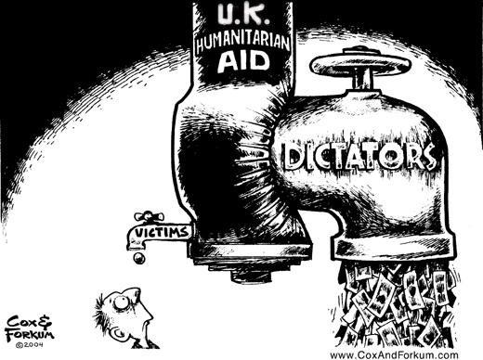
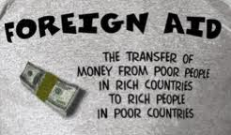
2.corruption
Diversion of nation resources,money laundering,acquiring properties in developed states etc by african leaders.
Transparency international report says 32 of the 38 world’s highly indebted poor coutries(HIPC) are in Africa yet no clear positive developments made
International aid to Africa is about US$50 billion yearly.

Slide 6
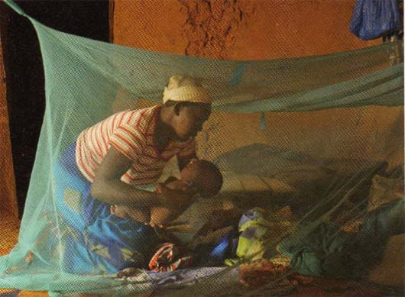
3.Health
WHO says Africa’s health problems are getting worse.
In 2011,sub saharan Africa had 71% of the world’s AIDS deaths(approx 1.2 million people)
Lack of access to quality medicine ,probably due to
Embezzlement of public resources in the health sector
Absenteeism of health workers
Low competence causing incorrect diagnosis and treatment
such as the 2012 allegations of misusing US$51 million Global fund grant to fight Aids, malaria, tuberclosis in Uganda where between70,000 to 100,000 people die from malaria each year.

Slide 7
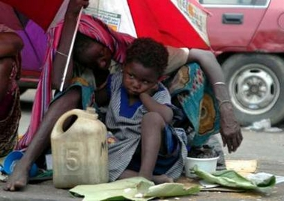
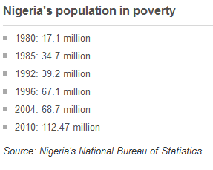
4.poverty
Transparency international says sub saharan africa remains the only region of the world where poverty has increased in the past 25 years.
Nigeria is Africa’s leading oil producer but more than half of it’s people live in poverty .why?
Have natural resources caused expectable positive effects to africa?
We don’t see greater transparency in the revenue which governments receive from resource extraction and how the money is spent.

Slide 8
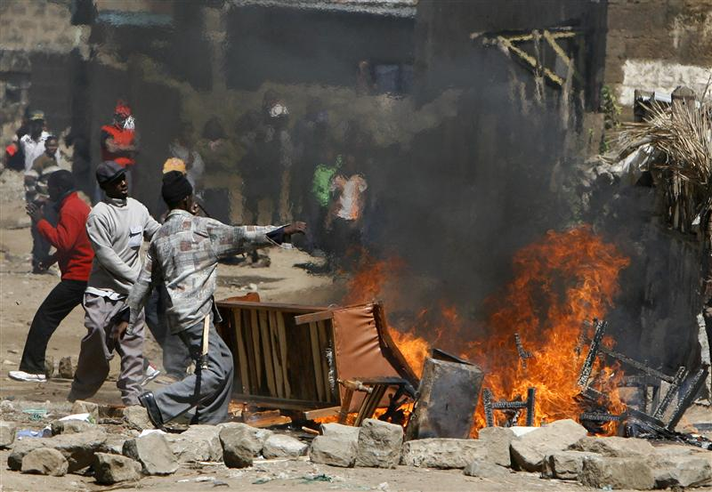
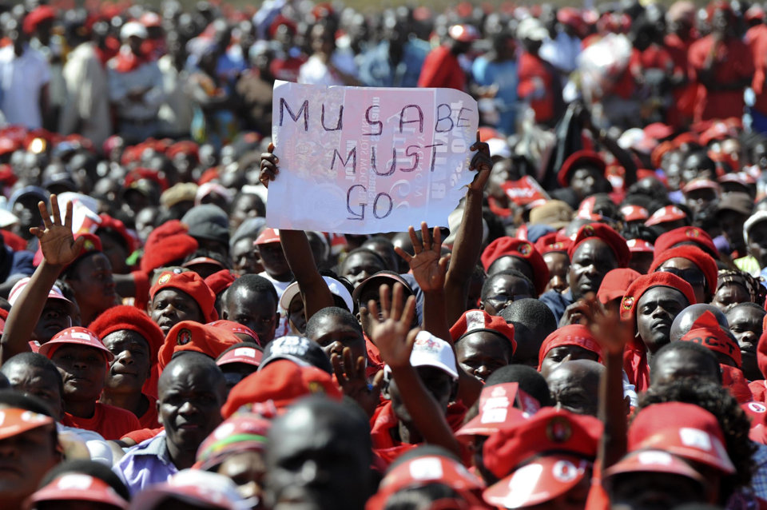
5.Unending armed conflicts
irregular wars have erupted in Africa since 1960s.Their causes are majorly based on domestic grievances
failed democratic transition in political systems
2008 kenya post election violence killed more than 1000 people
2008 zimbabwe election violence atleat 180 people killed

Slide 9
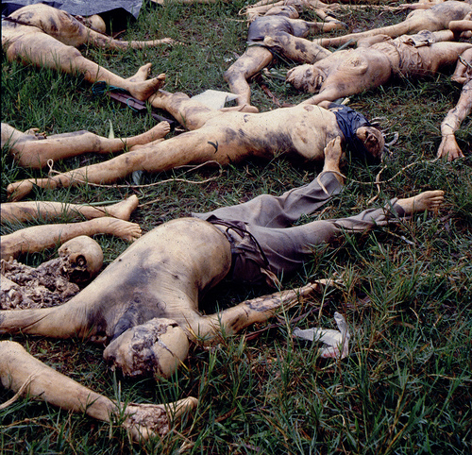
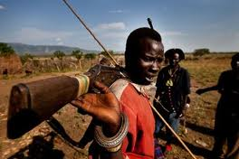
Ethnic rivalry
1994 Rwanda genocide.over 800,000 people killed in a space of 10 days
South sudan Tribal conflict ,over 100,000 civilians have been displaced

Slide 10
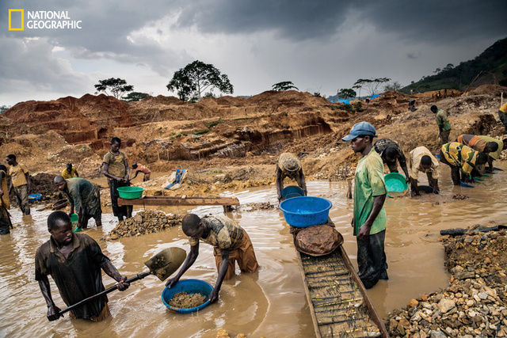
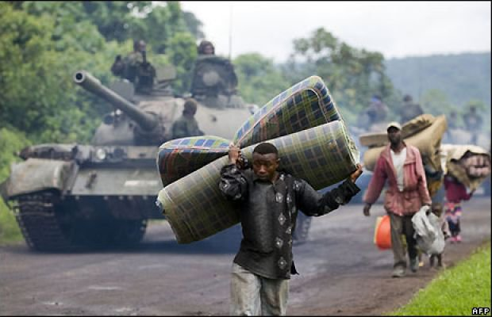
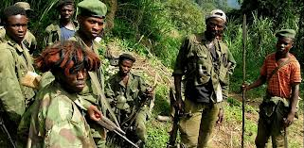
Mismanagement of land and natural resources.
natural resources a curse or gift to D.R Congo.
(top)Workers in a rebel controlled gold mine in goma,eastern DRC

Slide 11
In as much as Africa’s colonial masters can not be excluded from Africa’s disputes,it’s leaders at various levels on the other hand are the major problems betraying the continent.
Africa’s growth and development depend on the collective will and determination of it’s leaders.
“the future of Africa is up to Africans,” USA president Barrack Obama

Slide 12
Thanks (shukraan)

Slide 13
references
http://www.bbc.co.uk/news/world-africa-17015873
http://www.who.int/topics/millennium_development_goals/diseases/en/
http://transparency.org/

