Slide 1
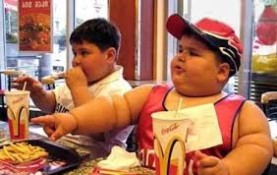
Babangida Miya
OVERWEIGHT AS IT RELATE TO HEALTH AND BEAUTY

Slide 2
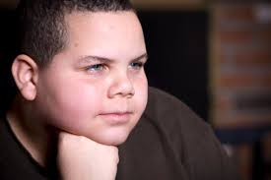
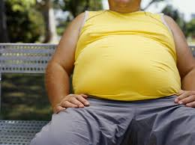
What is overweight????
BMI

Slide 3
BMI….
Body mass index (BMI) weight (kg)/ height squared (m²).
BMI is significantly correlated with total body fat content.
With a BMI of: | You are considered:
Below 18.5 | Underweight
18.5 - 24.9 | Healthy Weight
25.0 - 29.9 | Overweight
30 or higher | Obese
Notes:
Body mass index (BMI) is a mathematical ratio which is calculated as weight (kg)/ height squared (m²).
It is used to describe an individuals relative weight for height, and is significantly correlated with total body fat content. BMI is intended for those 20 years of age and older.
You can find tables on the web that have done the math and metric conversions for you.
http://www.nhlbisupport.com/bmi

Slide 4
Obesity
Obesity is further divided into three separate classes, with Class III obesity being the most extreme of the three.
Obesity class | BMI (kg/m²)
Class I | 30.0- 34.9
Class II | 35.0-39.9
Class III (Extreme Obesity) | ≥ 40.0
With a BMI of: | You are considered:
Below 18.5 | Underweight
18.5 - 24.9 | Healthy Weight
25.0 - 29.9 | Overweight
30 or higher | Obese
CDC, NHLBI
Notes:
BMI greater than 30 is considered obese. However, there are three different classes of obesity: Class 1 is when BMI is in the range of 30 to 34.9. Class 2 is with BMI ranges from 35 to 39.9 and Class 3 is when BMI is greater than 40.

Slide 5
Facts about overweight and obesity
leading risks for global deaths.
Around 3.4 million DEATHS per year.
44% of the diabetes burden,
23% of the ischaemic heart disease burden
7% to 41% of certain cancer burdens .

Slide 6

WHO global estimates from 2008
More than 1.4 billion adults, 20 and older, were overweight.
over 200 million men and nearly 300 million women were obese.
Overall, more than 10% of the world’s adult population was obese.

Slide 7
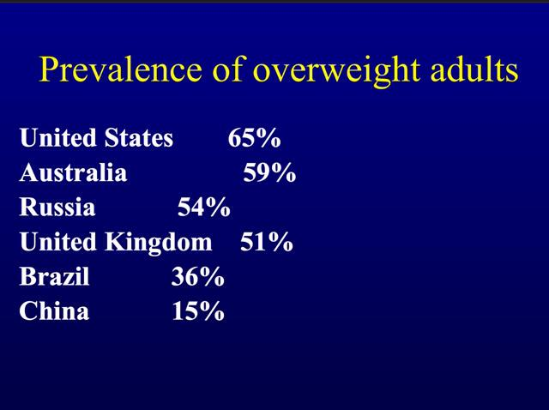

Slide 8
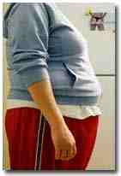

What Causes Obesity?
Energy imbalance over a long period of time.
Energy in > Energy out.
Excess calories and lack of physical activity.
Energy balance is like a scale. When calories consumed are greater than calories used, weight gain is the result.
CDC
Notes:
Overweight and obesity are a result of energy imbalance over a long period of time.
An energy imbalance arises when the number of calories consumed is greater than the number of calories used by the body.
Weight gain usually involves the combination of consuming too many calories and not expending enough through physical activity, although weight gain could result from one or the other.

Slide 9
Calories Used
Eating, digestion, sleeping, breathing, and movement.
Excess calories.
Physical activity.
Energy Balance
Necessary physiological functions
Calories in
Calories used
(consumed)
(expended)
Food/beverages consumed
Physical activity
CDC
Notes:
Our bodies need calories to perform necessary daily functions:
For breathing, for digesting the food we eat, and for movement.
Weight gain occurs when the calories we consume exceed this need.
Physical activity plays a key role in energy balance because it uses up calories consumed.

Slide 10
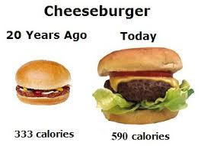

Slide 11
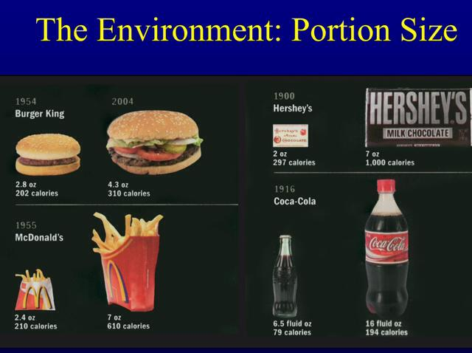

Slide 12
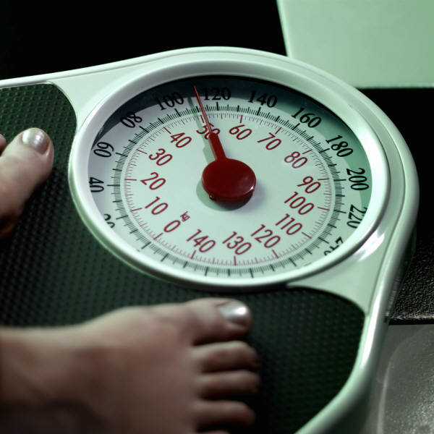
Overweight
The Right Approach
If your BMI is between 25 and 30 and you are otherwise healthy
  Try to avoid gaining any additional weight
  Look into healthy ways of losing weight and increasing physical activity
NIDDK

Slide 13
Overweight
The Right Approach
Talk to your doctor about losing weight if you fall into any one of the three scenarios:
BMI is 30 or above, or
BMI is between 25 and 30 and:
  You have other health conditions
Waist measures > 35 inches (women) or
> 40 inches (men)
and:
  You have other health conditions
NIDDK
Notes:
Talk to your doctor about losing weight if you fall into any one of the three scenarios:
Your BMI is 30 or above, or
Your BMI is between 25 and 30 and you have:
Two or more of the following health problems:
diabetes, high blood pressure, heart disease, stroke, cancer, sleep apnea, osteoarthritis, gallbladder disease, liver disease, irregular menstrual periods, or
A family history of heart disease or diabetes
Your waist measures over 35 inches (women) or 40 inches (men)– even if your BMI is less than 25– and you have:
Two or more of the health problems listed above, or
A family history of heart disease or diabetes

Slide 14

Weight Loss & Maintenance
Strategies to Consider
Physical Activity
&
Diet Therapy
Notes:
The safest strategies to consider for weight loss are increasing physical activity and considering a calorically reduced exchange diet. Reducing total caloric intake while eating a variety of foods is the safest way to lose weight in the long run.

Slide 15
Why Treat Overweight and Obesity?
Because there is strong evidence that weight loss reduces risk factors for diabetes and cardiovascular disease, such as:
blood pressure
serum triglycerides
total serum cholesterol
low-density lipoprotein cholesterol
blood glucose levels
NHLBI
Notes:
Because there is strong evidence that weight loss:
In overweight and obese individuals reduces risk factors for diabetes and cardiovascular disease.
Reduces blood pressure in both overweight hypertensive and non-hypertensive individuals.
Reduces serum triglycerides and increases high-density lipoprotein (HDL) cholesterol; and produces some reduction in total serum cholesterol and low-density lipoprotein (LDL) cholesterol.
Reduces blood glucose levels in overweight and obese persons with and without diabetes.

Slide 16
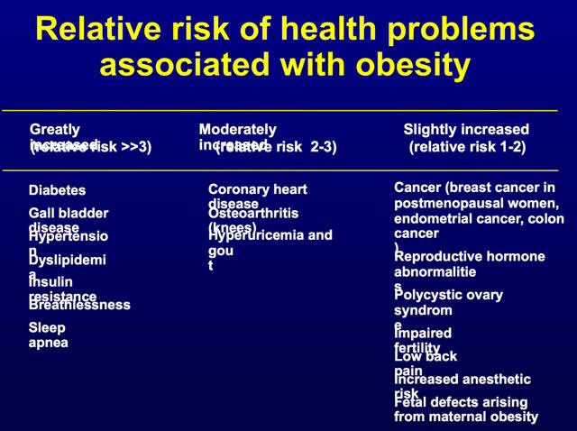

Slide 17
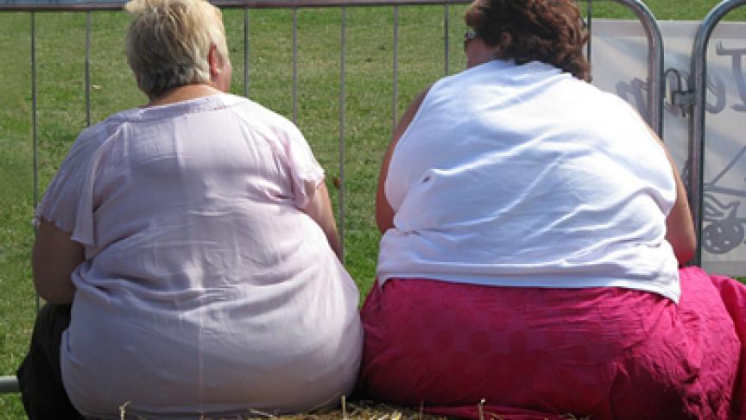
Its believed that slender people are much more beautiful and atractive!!!!!

Slide 18
Weight Loss Programs
Any safe and effective weight-loss program should include these components:
Healthy eating plans that reduces caloric intake
Regular physical activity and/or exercise instruction
Tips on healthy behavior
Slow and steady weight loss of about ¾ to 2 pounds a week
Medical care if needed
A plan to keep the weight off after you have lost it
NIDDK
Notes:
Any safe and effective weight-loss program should include these components:
Healthy eating plans that reduce calories without ruling out specific foods or food groups
Regular physical activity and/or exercise instruction
Tips on healthy behavior changes that also consider your cultural needs
Slow and steady weight loss of about ¾ to 2 pounds a week and not more than 3 pounds a week (although weight loss may be faster at the start of a program)
Medical care if planning to lose weight by following a special formula diet
A plan to keep the weight off after you have lost it

Slide 19
Weight Loss
The key to any successful weight loss is making changes in your eating and physical activity habits that you can keep for the rest of your life.
NIDDK

Slide 20

Physical Activity

Slide 21
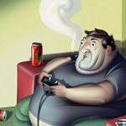
Physical Inactivity
Many studies show that people are too sedentary.
Due to
  Increased use of technology.
  Increased use of automobiles.
According to the Behavioral Risk Factor Surveillance System, in 2000 more than 26 percent of adults reported no leisure time physical activity.
CDC
Notes:
Despite all of the health effects associated with regular physical activity, many Americans remain sedentary.
Increases in technology have increased the ease at which we live our lives.
For example, cars are used to run short distance errands; whereas in the past one may have walked to their destination, or biked.
According to the Behavioral Risk Factor Surveillance System, in 2000 more than 26 percent of adults reported no leisure time physical activity.

Slide 22

Physical Activity
Contributes to weight loss.
Helpful for the prevention of overweight and obesity.
Helps maintain weight loss.
CDC
Notes:
Physical activity contributes to weight loss, especially when it is combined with a calorie reduction.
Regular physical activity is extremely helpful for the prevention of overweight and obesity.
Regular physical activity is also very important in maintaining weight loss.

Slide 23
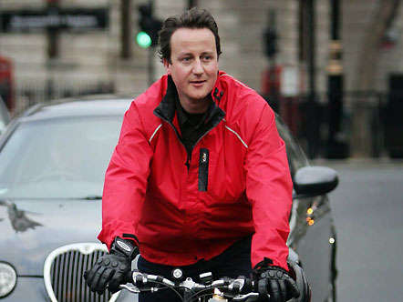

Slide 24
Physical Activity
  Occupational work
    Carpentry, construction, waiting tables, farming
  Household chores
    Washing floors or windows, gardening, or yard work
  Leisure time activities
    Walking, skating, biking, swimming, playing Frisbee, dancing, softball, tennis, football, aerobics
CDC
Notes:
Physical activity is any bodily movement produced by skeletal muscles that results in an expenditure of energy with a range of activities such as:
Occupational work
Carpentry, construction, waiting tables, farming
Household chores
Washing floors or windows, gardening, or yard work
Leisure time activities
Walking, skating, biking, swimming, playing Frisbee, dancing, softball, tennis, football, aerobics

Slide 25
Physical Activity
Regular physical activity is good for overall health.
Physical activity decreases the risk for:
  Colon cancer
  Diabetes
  High blood pressure
Physical activity also helps to:
  Control weight
  Contribute to healthy bones, muscles, and joints
  Reduce falls among the elderly
  Relieve the pain of arthritis.
CDC
Notes:
Regular physical activity is good for overall health.
Physical activity decreases the risk for:
Colon cancer
Diabetes
High blood pressure
Physical activity also helps to:
Control weight
Contribute to healthy bones, muscles, and joints
Reduce falls among the elderly
Relieve the pain of arthritis.

Slide 26

How Much Physical Activity a Day?
The 2005 Dietary Guidelines for Americans recommend the following for adults:
  To reduce the risk of chronic diseases in adulthood: Engage in at least 30 minutes of moderate-intensity physical activity, above usual activity, at work or home on most days of the week.
  To help manage weight and prevent gradual, unhealthy weight gain in adulthood: Engage in approximately 60 minutes of moderate- to vigorous-intensity activity on most days of the week while not exceeding caloric intake requirements.
  To sustain weight loss in adulthood:
  Participate in at least 60 to 90 minutes of daily moderate- to vigorous-intensity physical activity while not exceeding caloric intake requirements. (Some may need to contact their healthcare provider before participating in this level of activity.)
Dietary Guidelines for Americans
Notes:
How Much Physical Activity a Day?
The 2005 Dietary Guidelines for Americans recommend the following for adults:
To reduce the risk of chronic diseases in adulthood:
Engage in at least 30 minutes of moderate-intensity physical activity, above usual activity, at work or home on most days of the week.
To help manage weight and prevent gradual, unhealthy weight gain in adulthood:
Engage in approximately 60 minutes of moderate- to vigorous-intensity activity on most days of the week while not exceeding caloric intake requirements.
To sustain weight loss in adulthood:
Participate in at least 60 to 90 minutes of daily moderate- to vigorous-intensity physical activity while not exceeding caloric intake requirements. (Some may need to contact their healthcare provider before participating in this level of activity.)

Slide 27

How Much Physical Activity a Day?
Any activity helps.
Moderate physical activity brings health benefits.
Make it personal.
Start slowly (10 minute walk/day).
Notes:
The key is that physical activity does not have to be vigorous in intensity in order to receive health benefits.
Moderate physical activity, such as 30 minutes of brisk walking five or more times a week, also has health benefits.
Not everyone will begin at the same level, either.
Start slowly (10 minute walk/day) and gradually increase the amount and duration of your activities.

Slide 28

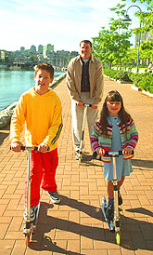
Increasing Physical Activity
You can increase your physical activity by taking small steps to change what you do everyday.
If you normally… | Then try this instead!
Park as close as possible to the store | Park farther away
Let the dog out back | Take the dog for a walk
Take the elevator | Take the stairs
Have lunch delivered | Walk to pick up lunch
Relax while the kids play | Get involved in their activity
Women’s Health

Slide 29
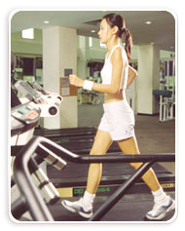
How Many Calorie Am I Burning?
Calories burned/hour of activity
Activity | 100 lb | 150 lb | 200 lb
Bicycling, 6 mph | 160 | 240 | 312
Bicycling, 12 mph | 270 | 410 | 534
Jogging, 7 mph | 610 | 920 | 1,230
Jumping rope | 500 | 750 | 1,000
Running, 5.5 mph | 440 | 660 | 962
Running, 10 mph | 850 | 1,280 | 1,664
Swimming, 25 yds/min | 185 | 275 | 358
Swimming, 50 yds/min | 325 | 500 | 650
Tennis singles | 265 | 400 | 535
Walking, 2 mph | 160 | 240 | 312
Walking, 3 mph | 210 | 320 | 416
Walking, 4.5 mph | 295 | 440 | 572
American Heart Association
Notes:
The chart shows the approximate calories spent per hour by a 100-, 150-, and 200- pound person doing a particular activity.

Slide 30
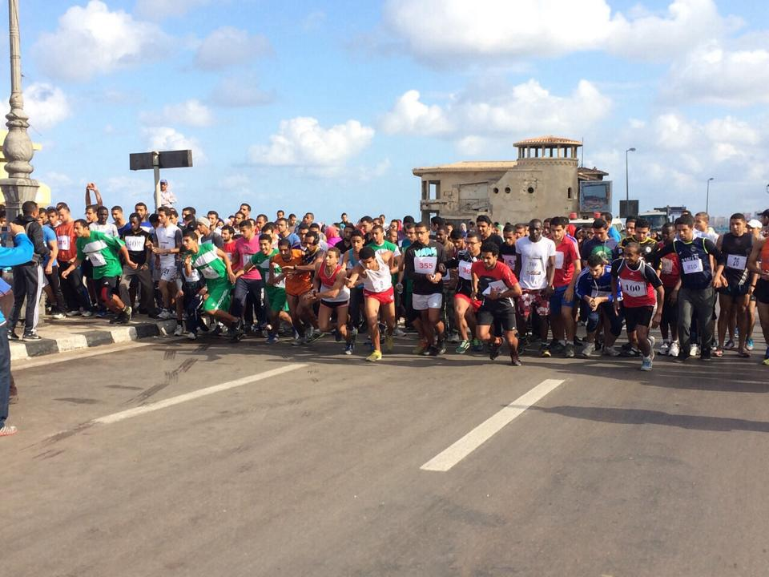
On the Path to Increased Physical Activity

Slide 31
Before Beginning an Exercise Program
You should check with your doctor before beginning an exercise program if you:
Are a man older than age 40 or a woman older than age 50
Have had a heart attack
Have a family history of heart-related problems before age 55
Have heart, lung, liver or kidney disease
Feel pain in your chest, joints, or muscles during physical activity
Have high blood pressure, high cholesterol, diabetes, arthritis, osteoporosis, or asthma
Have had joint replacement surgery
Smoke
Are overweight or obese
Tale medication to manage a chronic condition
Have an untreated joint or muscle injury, or persistent symptoms after a joint or muscle injury
Are pregnant
Unsure of your health status.
Mayo Clinic
Notes:
You should check with your doctor before beginning an exercise program if you:
Are a man older than age 40 or a woman older than age 50
Have had a heart attack
Have a family history of heart-related problems before age 55
Have heart, lung, liver or kidney disease
Feel pain in your chest, joints, or muscles during physical activity
Have high blood pressure, high cholesterol, diabetes, arthritis, osteoporosis, or asthma
Have had joint replacement surgery
Smoke
Are overweight or obese
Tale medication to manage a chronic condition
Have an untreated joint or muscle injury, or persistent symptoms after a joint or muscle injury
Are pregnant
Unsure of your health status.

Slide 32
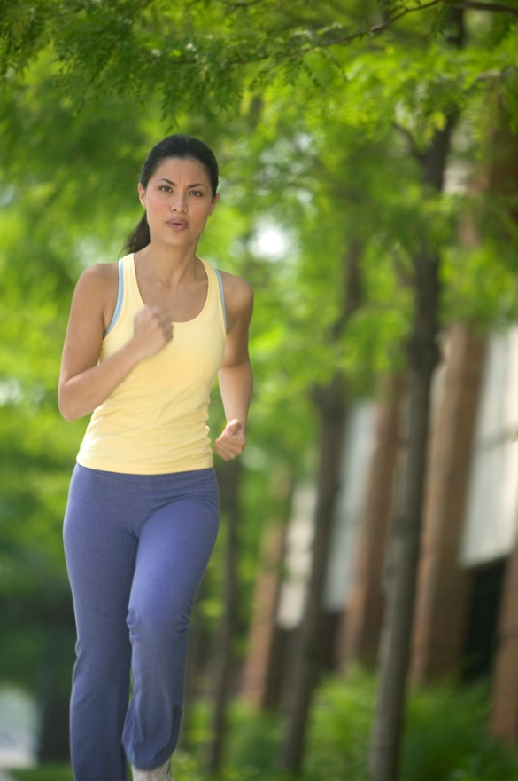
Health Benefits of Physical Activity

Slide 33

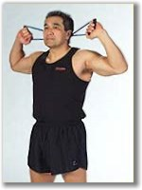
Physical Activity
Primary Effects on Diabetes Mellitus
Aerobic and resistance types of exercise decrease the incidence of type 2 diabetes.
A modest weight loss through diet and exercise reduces the incidence of diabetes.
CMAJ. 2006;174(6): 801-809.
Notes:
Both aerobic and resistance types of exercise have been shown to be associated with a decreased risk of type 2 diabetes.
In a large prospective study, each increase of 500 kcal in energy expenditure per week was associated with a decreased incidence of type 2 diabetes of 6%.
A modest weight loss through diet and exercise has been suggested to reduce the incidence of diabetes among high-risk people (e.g. those who are overweight) by about 40-60% over 3-4 years.

Slide 34
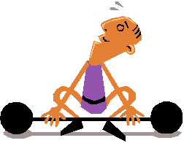
Physical Activity
Secondary Effects on Diabetes Mellitus
Exercise helps in the management of diabetes.
Aerobic and resistance training help in the control of diabetes
CMAJ. 2006;174(6): 801-809.
Notes:
Exercise interventions have also been shown to be effective in the management of diabetes.
Both aerobic and resistance training have been shown to be of benefit for the control of diabetes; however, resistance training may have a greater benefits than aerobic training on glycemic control.
In a cohort study, it was found that physically inactive men with established diabetes had a 1.7-fold increased risk of premature death when compared to physically active men with diabetes.

Slide 35
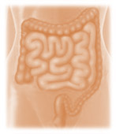
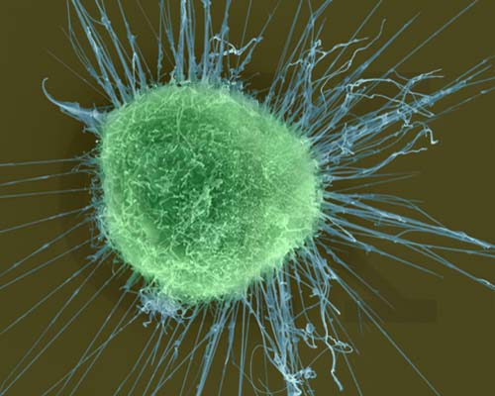
Physical Activity
Primary Effects on Cancer
Routine activity reduces the incidence cancers.
Activity results in a 30-40% reduction in the relative risk of colon cancer and breast cancer.
Moderate physical activity is believed to exhibit a greater protective effect than activities of less intensity.
CMAJ. 2006;174(6): 801-809.
Notes:
Several studies have indicated that routine activity, whether as part of a job or as a leisure activity, is associated with reductions in the incidence of specific cancers, in particular colon and breast cancer.
One recent study of colon and breast cancer revealed a 30-40% reduction in the relative risk of colon cancer in physically active men and women, and a 20-30% reduction in the relative risk of breast cancer in physically active women when compared to their inactive counterparts

Slide 36
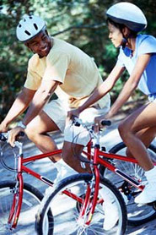
Physical Activity
Secondary Effects on Cancer
Regular physical activity - important.
Increased self-reported physical activity = decreased reoccurrence of cancer and a decreased risk of death from cancer.
Reduced cancer-related death.
CMAJ. 2006;174(6): 801-809.
Notes:
Regular physical activity may be associated with health benefits to patients with established cancer.
Two recent studies involving cancer patients (breast and colon) indicated that increased self-reported physical activity was associated with a decreased reoccurrence of cancer and a decreased risk of death from cancer.
Another investigation revealed a reduction of 26-40% in the relative risk of cancer-related death and recurrence of breast cancer among the most active women when compared to the least active

Slide 37
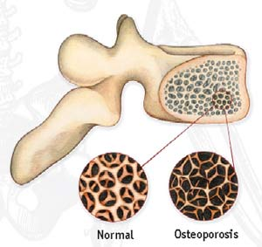
Physical Activity
Primary Effects on Osteoporosis
Many studies have been conducted.
According to findings, routine physical activity, especially weight-bearing and impact exercise, prevents bone loss associated with aging.
CMAJ. 2006;174(6): 801-809.
Notes:
Several longitudinal studies have examined the effects of exercise training on bone health in children, adolescents and young, middle-aged, and older adults.
Although the numbers of studies and total participants are small when compared to studies found in the cardiovascular literature, the results are rather compelling and they indicate that routine physical activity, especially weight-bearing and impact exercise, prevents bone loss associated with aging.

Slide 38
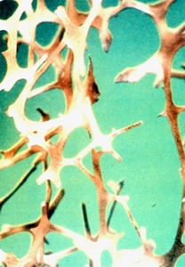
Physical Activity
Secondary Effects on Osteoporosis
Regular physical activity can lead to stronger bones.
Bone responds to physical stress at any age; even in the elderly.
Osteoporosis
CMAJ. 2006;174(6): 801-809.
Notes:
Preliminary evidence suggests that regular physical activity is an effective secondary prevention strategy for the maintenance of bone health and the fight against osteoporosis.
Two studies, one on older women ages 75-85 and another on early postmenopausal women, have supported this finding.

Slide 39

Eating for Weight Loss

Slide 40
The Critical Role of Healthy Eating
Good nutrition leads to a healthier life.
Many do not eat based on MyPyramid recommendations.
CDC
Notes:
Research shows that good nutrition lowers one’s risk for many chronic diseases, including heart disease, stroke, some types of cancer, diabetes, and osteoporosis.
Although Americans are slowly adopting healthier diets, there still remains a large gap between recommended dietary patterns and what Americans actually eat.

Slide 41
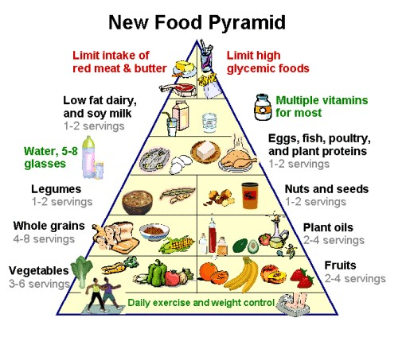
Food pyramid

Slide 42
U.S. Eating Habits
In 2000, the larger
majority of U.S. adults
reported that they
did not consume 5 or more
servings of fruits and
vegetables/day.
81%
77%
73%
CDC. Behavioral Risk Factor Surveillance System
Notes:
According to a study by CDC, In 2000, the larger majority of U.S. adults reported that they did not consume 5 or more servings of fruits and vegetables/day.

Slide 43

Dietary Guidelines 2005
MyPyramid, which is the newest Food Guide Pyramid, recommends the following for a healthy lifestyle:
Make half your grains whole
Vary your veggies
Focus on fruit
Get your calcium rich foods
Go lean with protein
Find your balance between food and physical activity
MyPyramid: http://mypyramid.gov/
Notes:
MyPyramid, which is the newest Food Guide Pyramid, recommends the following for a healthy lifestyle:
Make half your grains whole
Vary your veggies
Focus on fruit
Get your calcium rich foods
Go lean with protein
Find your balance between food and physical activity

Slide 44
A Healthy Diet
The 2005 Dietary Guidelines for Americans defines a healthy diet as one that:
Emphasizes fruits, vegetables, whole grains, fat-free or low-fat milk, & milk products;
Includes lean meats, poultry, fish, beans, eggs, and nuts
Is low in saturated fats, trans fats, cholesterol, salt (sodium), and added sugars.
MyPyramid: http://mypyramid.gov/
Notes:
The Dietary Guidelines for Americans (2005) recommends that we eat more whole grains, more fruits and vegetables and less sugar and fat.

Slide 45
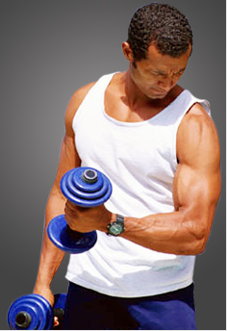
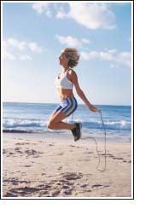
Weight loss:
Goals for Weight
Management of Weight Lost
Notes:
To follow a sensible weight loss plan includes both a slow weight loss due to dietary changes and an adoption of a physical activity program that can be maintained in the long term.

Slide 46

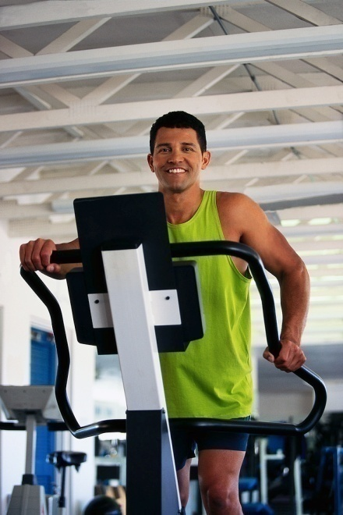

Calorie Deficit
Needed For Weight Loss
A calorie deficit of no more than 500 kcal/day.
This can be achievable through the combination of diet + exercise.
An example of how to create a calorie deficit of 500 kcal/day through diet + exercise would be: eating 250 kcal less per day, along with burning 250 calories through exercise
ACS
Notes:
A calorie deficit of 500 kcal/day generally results in approximately 1 lb lost/ week.
This can be achievable through dieting alone (eating 500 less kcal/day).
However, the deficit is easier to achieve through the combination of diet + exercise.
An example of how to create a calorie deficit of 500 kcal/day through diet + exercise would be: eating 250 kcal less per day, along with burning 250 calories through exercise

Slide 47
Calorie Deficit
Needed For Weight Loss
A caloric deficit of 500 can be done by:
Eating 250 kcal less per day:
Leave out mayonnaise in a sandwich
Leave out dessert
Switch from soft drinks to water
Reduce portion sizes
burning 250 calories through exercise:
Walk for 30 minutes
Swimming 25 yards
Bicycling for 30 minutes

Slide 48
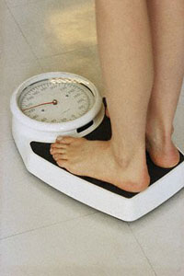
Exercise + Dieting
Calorie Deficit
Initially physical activity, in combination with dieting, is an important component of weight loss.
However, after around 6 months, physical activity will not lead to substantially greater weight losses when combined with dieting.
The benefit of sustained physical activity thereafter is mainly through its role in the prevention of weight gain.
In addition, it has a benefit in reducing cardiovascular and diabetes risks beyond that produced by weight gain alone.
NHLBI
Notes:
Initially (during the first 6 months) physical activity, in combination with dieting, is an important component of weight loss.
However, after around 6 months, physical activity will not lead to substantially greater weight losses when combined with dieting.
The benefit of sustained physical activity thereafter is mainly through its role in the prevention of weight gain.
In addition, it has a benefit in reducing cardiovascular and diabetes risks beyond that produced by weight gain alone.

Slide 49
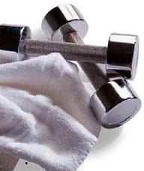
Goals for Weight Loss
And Management
The initial goal of weight loss therapy is to reduce body weight by approximately 10 percent from baseline. Once this goal is achieved, then further weight loss can be attempted, if necessary.
A reasonable time line for a 10 percent reduction in body weight is 6 months.
Experience reveals that lost weight is usually regained unless a weight maintenance program, consisting of diet therapy, physical activity and behavior therapy, is continued indefinitely.
NHLBI
Notes:
The initial goal of weight loss therapy is to reduce body weight by approximately 10 percent from baseline. Once this goal is achieved, then further weight loss can be attempted, if necessary.
A reasonable time line for a 10 percent reduction in body weight is 6 months.
Experience reveals that lost weight is usually regained unless a weight maintenance program, consisting of diet therapy, physical activity and behavior therapy, is continued indefinitely.

Slide 50
Goals for Weight Loss
And Management
For overweight individuals with BMIs in the typical range of 27 to 35 kg/m², a decrease of 300 to 500 kcal/day will result in weight losses of about ½ to 1 lb per week.
A 10 percent weight loss could be achieved within 6 months.
For more severely obese individuals (BMI > 35), deficits of up to 500 to 1,000 kcal/day will lead to weight losses of about 1 to 2 lb per week.
A 10 percent weight loss could be achieved within 6 months.
NHLBI
Notes:
For overweight individuals with BMIs in the typical range of 27 to 35 kg/m², a decrease of 300 to 500 kcal/day will result in weight losses of about ½ to 1 lb per week.
A 10 percent weight loss could be achieved within 6 months.
For more severely obese individuals (BMI > 35), deficits of up to 500 to 1,000 kcal/day will lead to weight losses of about 1 to 2 lb per week.
A 10 percent weight loss could be achieved within 6 months.

Slide 51
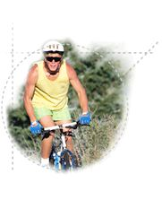
Goals for Weight Loss
And Management
After 6 months of weight loss treatment, the individual should be assessed.
If no further weight loss is needed, then the current weight should be maintained.
Sustained physical activity is particularly important in the prevention of weight regain.
If further weight loss is desired, another attempt at weight reduction can be made.
Notes:
After 6 months of weight loss treatment, the individual should be assessed.
If no further weight loss is needed, then the current weight should be maintained.
Sustained physical activity is particularly important in the prevention of weight regain.
If further weight loss is desired, another attempt at weight reduction can be made.

Slide 52
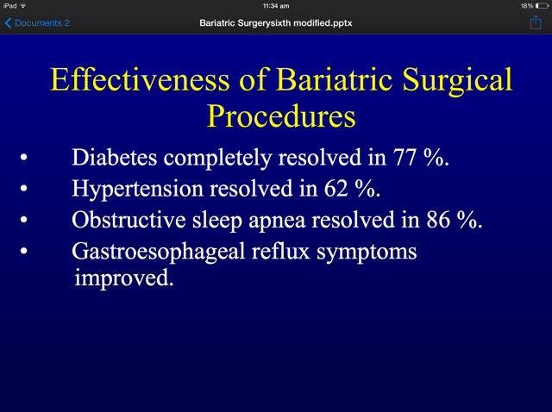
SURGICALLY

Slide 53
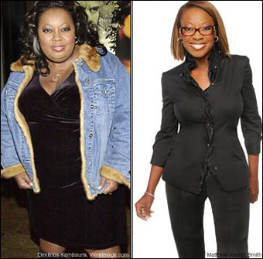

Slide 54
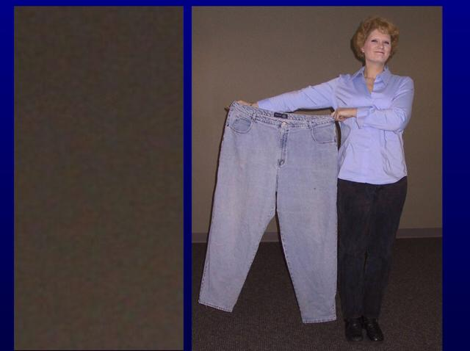
THANK YOU

Slide 55
reference
http://www.who.int/mediacentre/factsheets/fs311/en/
%2F%2Fwww.pbrc.edu%2Ftraining-and-education%2Fppt%2FObesity-%2520Diet%2520and%2520Exercise.ppt&h=-AQETduOi

