Slide 1
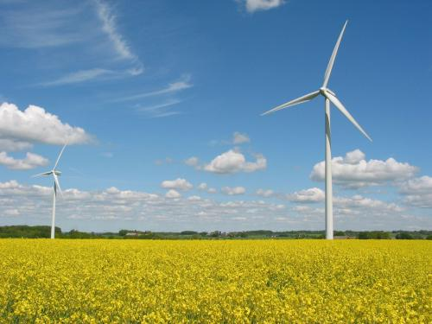
Energy In Egypt
Ahmed Hebala
Teaching Assistant, AAST,
Electric Power and Control Engineering

Slide 2
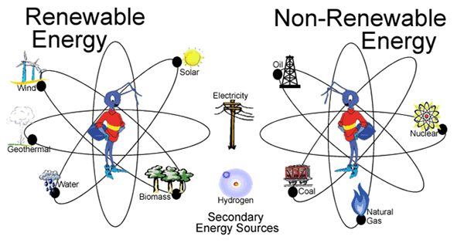
Sources of Energy
It’s a Matter of:
Where and How and What??

Slide 3
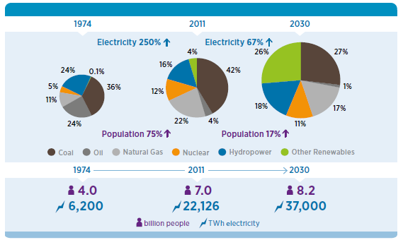
Electricity generation and population growth

Slide 4
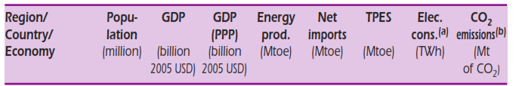

Population vs Energy
  1 toe = 11.63 megawatt hours

Slide 5
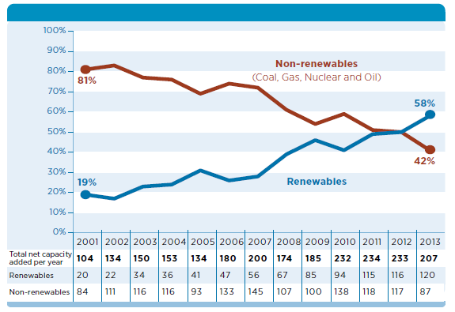
Renewables as a share of global capacity additions (2001–2013)

Slide 6
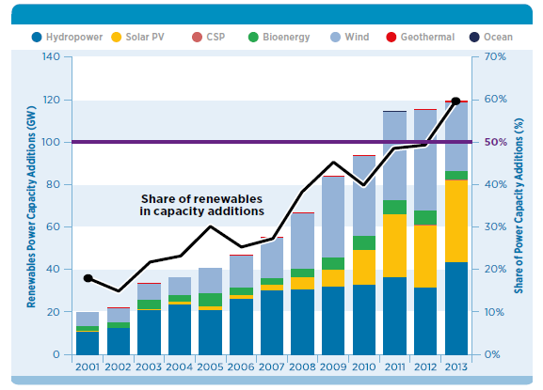
Annual renewables capacity addition by technology (2001-2013)

Slide 7
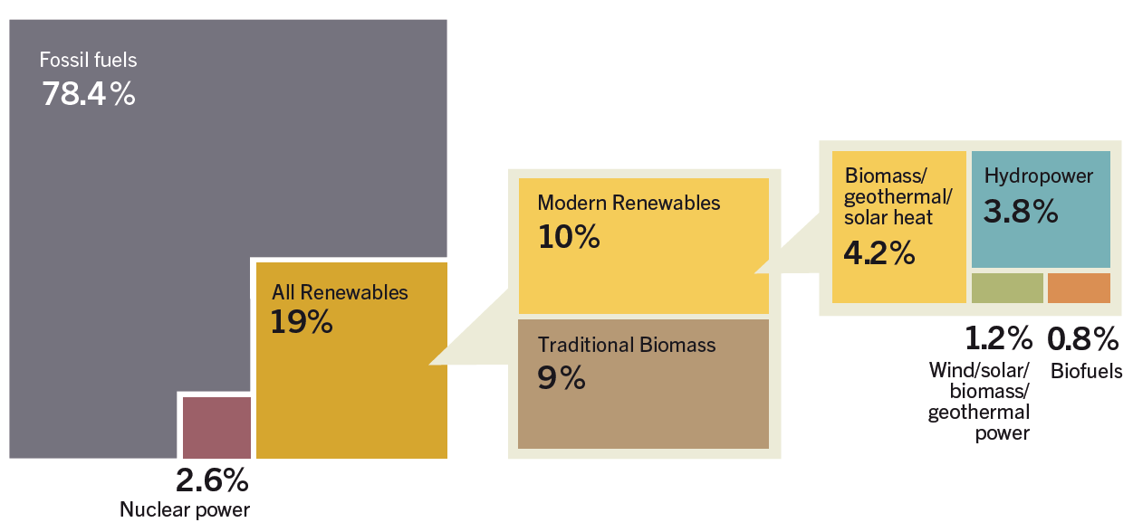
Energy Global Consumption, 2012

Slide 8
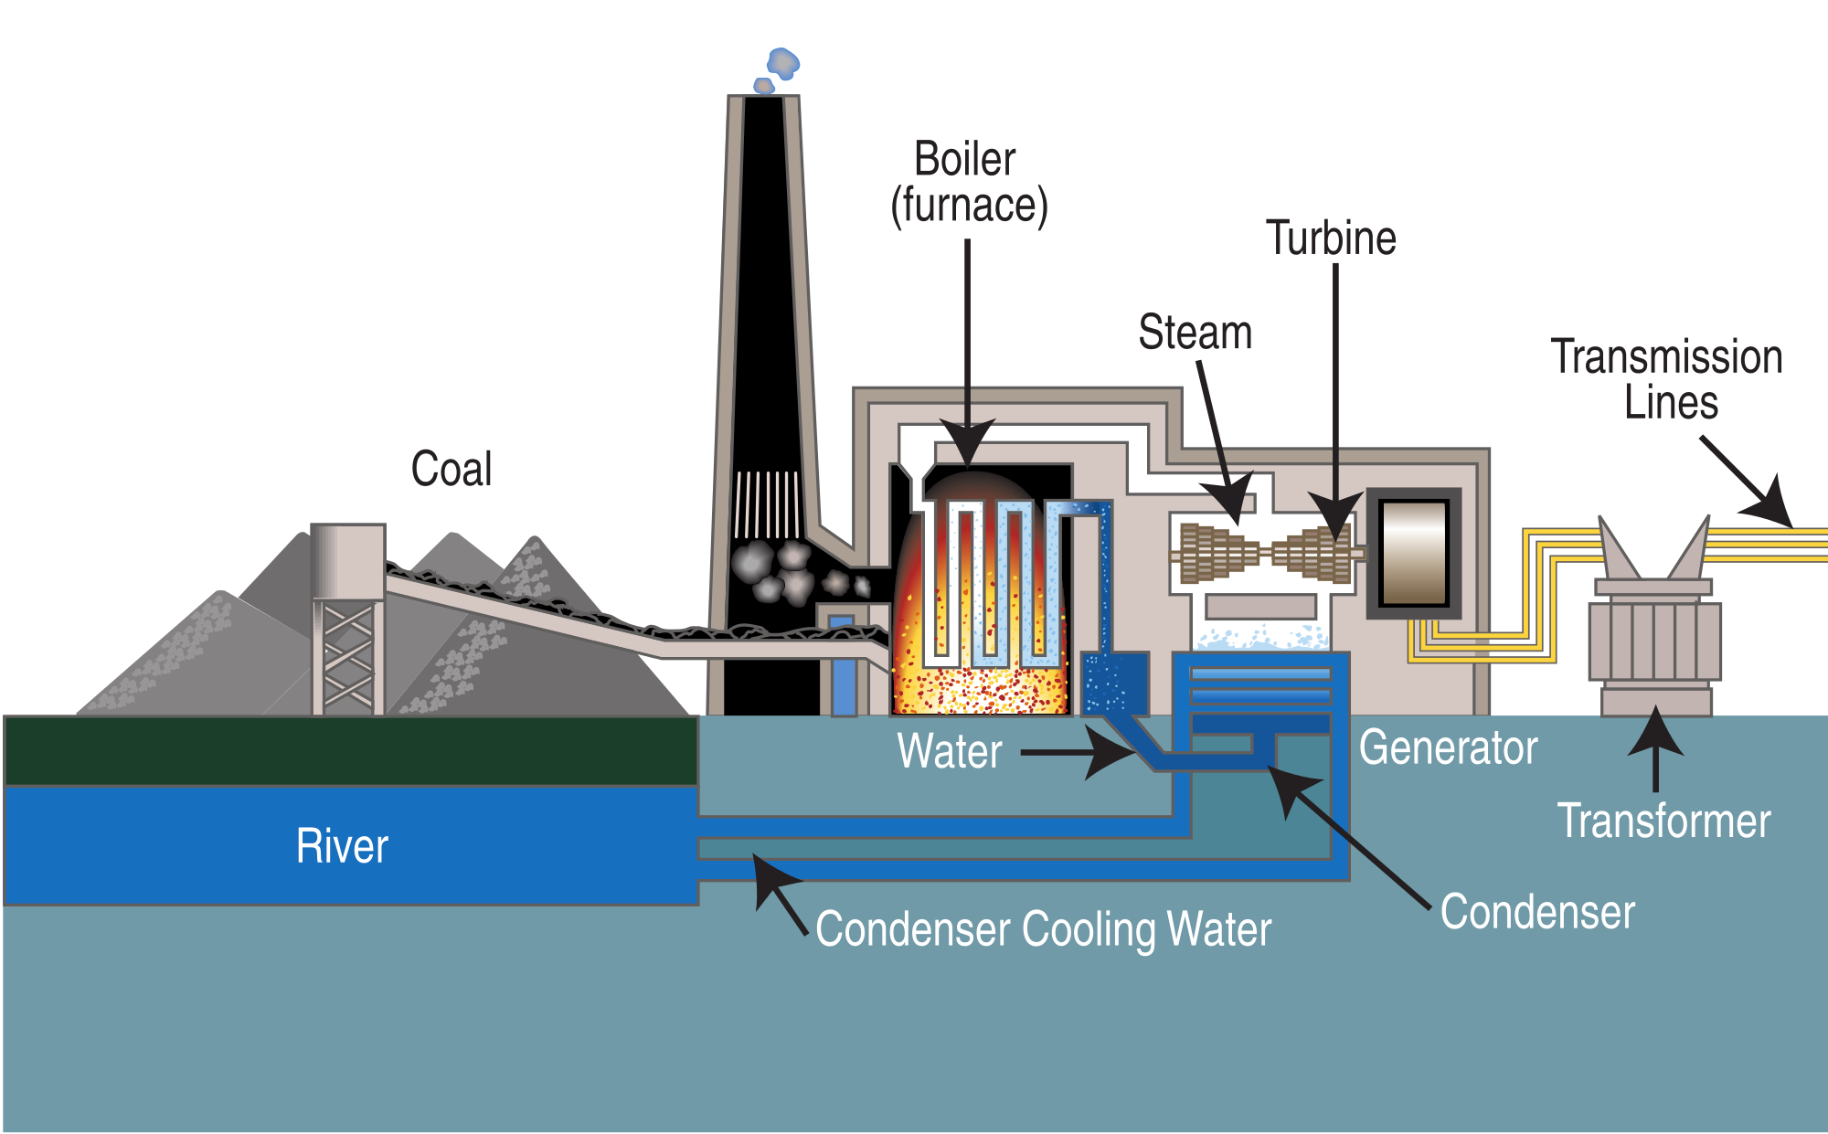
Basic Concept of Thermal Power Plants

Slide 9
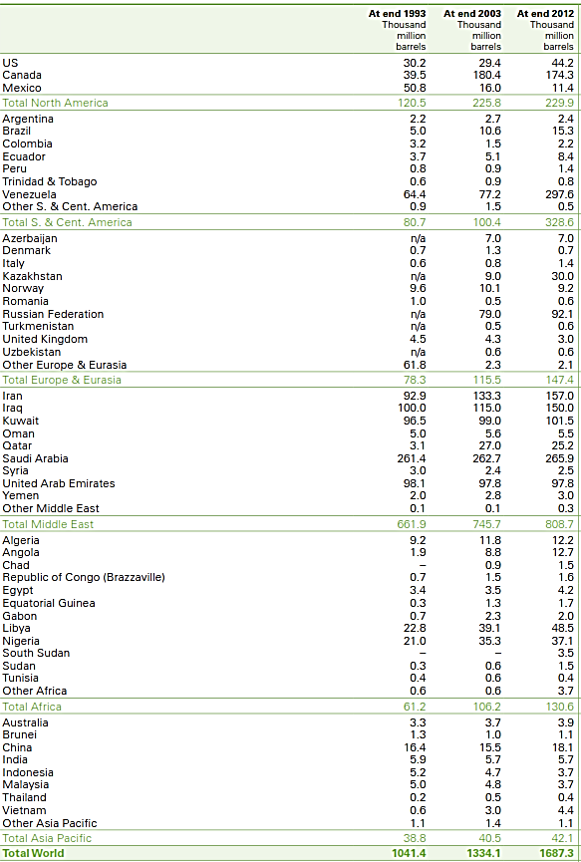
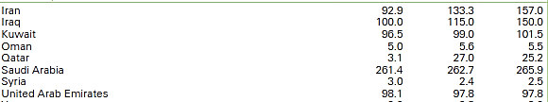
Oil: Proved Reserve

Slide 10
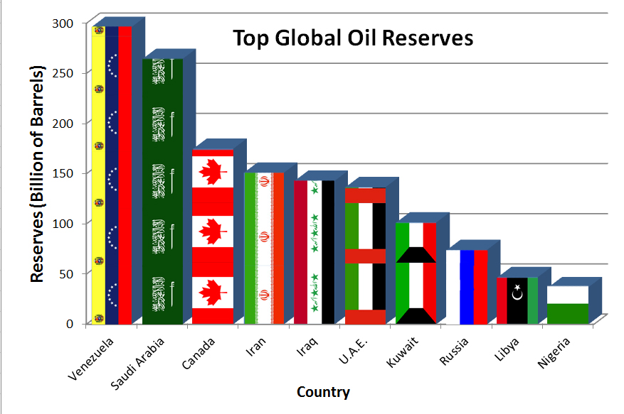
Oil: Proved Reserve
At current rates of production these reserves can last 64 years.

Slide 11
Oil: World Consumption
Advanced Countries Vs Developing Countries

Slide 12
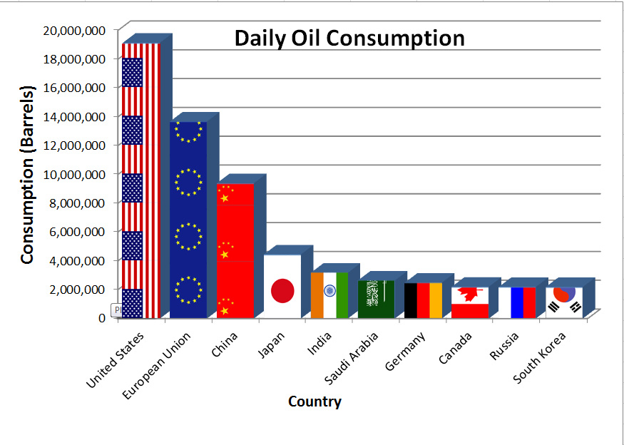
Oil: World Consumption

Slide 13
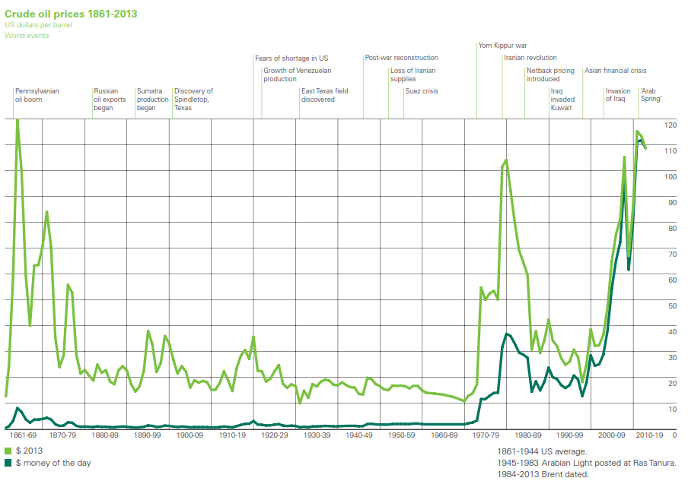
Oil and Political Events

Slide 14

Natural Gas: Proved Reserves
Egypt Exports Natural Gas
so it must have a HIGH reserve right?!

Slide 15
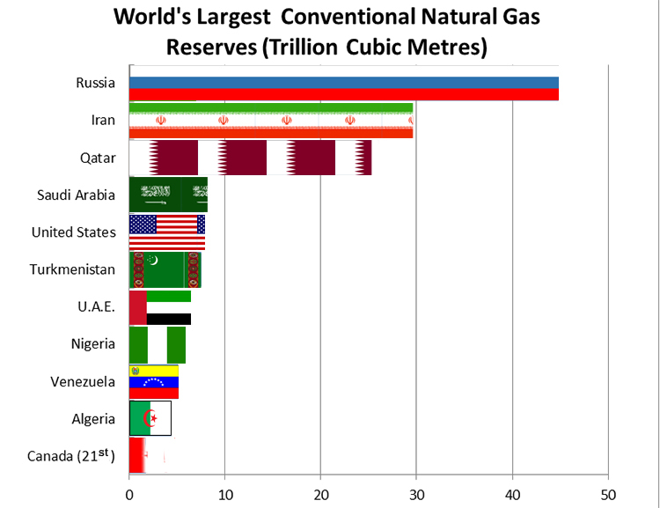
Natural Gas: Proved Reserves
“the best estimate is that new sources will stretch gas supplies to 250 years at current levels.”

Slide 16

Natural Gas: Consumption
Advance Countries Vs Developing Countries

Slide 17
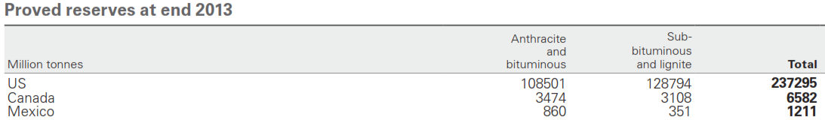
Coal: Reserve

Slide 18
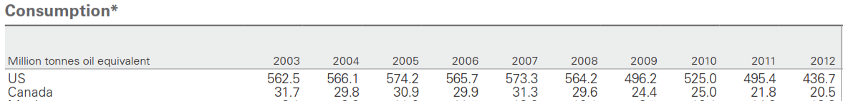
Coal: Consumption
Advance Countries Vs Developing Countries

Slide 19
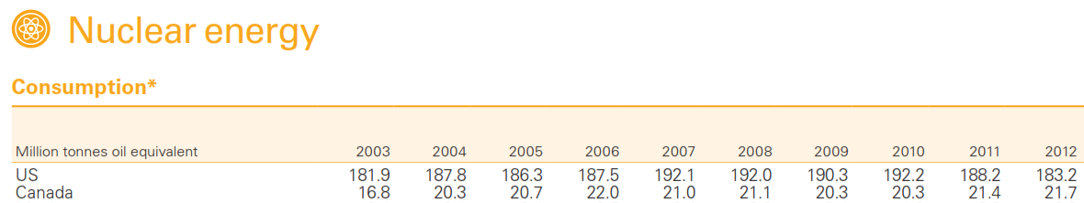
Nuclear Energy
We Are too late to even Start!
But we must!

Slide 20
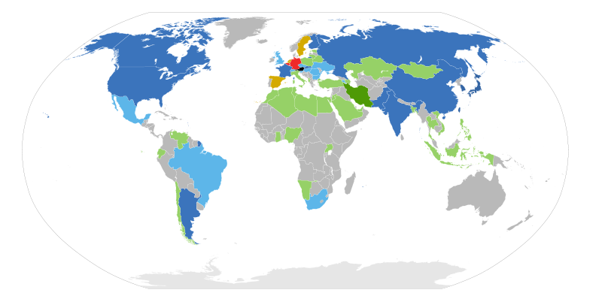
Nuclear Energy Outlook
Dark Blue: Operating reactors, building new reactors
Light Blue: Operating reactors, planning new build
Dark Green: No reactors, building new reactors
Light green: No reactors, new in planning
Red: Operating reactors, decided on phase-out
Yellow: Operating reactors, stable

Slide 21
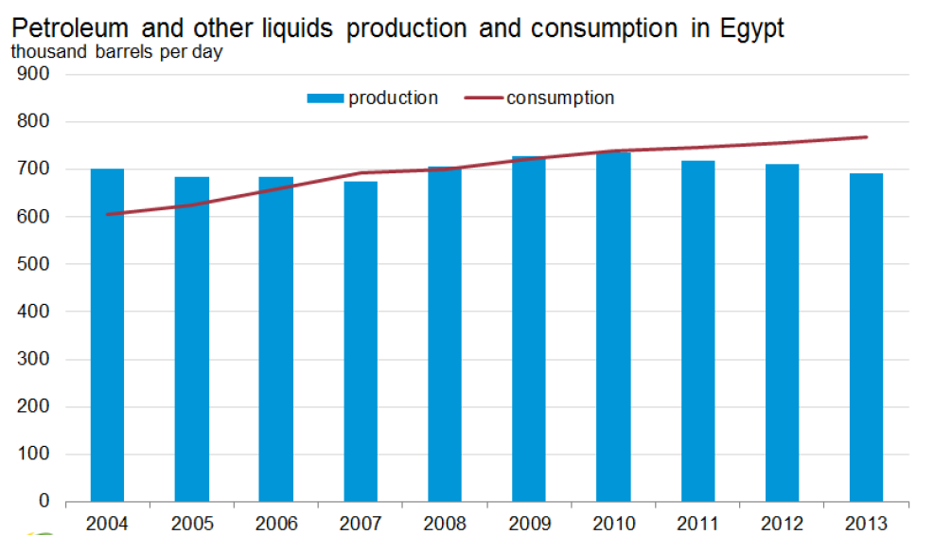
So Can We Depend on:
Petroleum and Oil ??

Slide 22
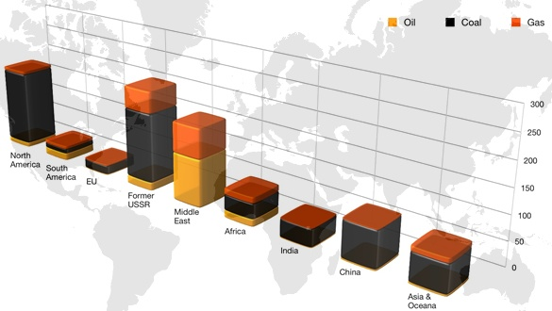
Conclusion of Conventional Sources of Energy
Time Limit
Location Limit
Price!

Slide 23
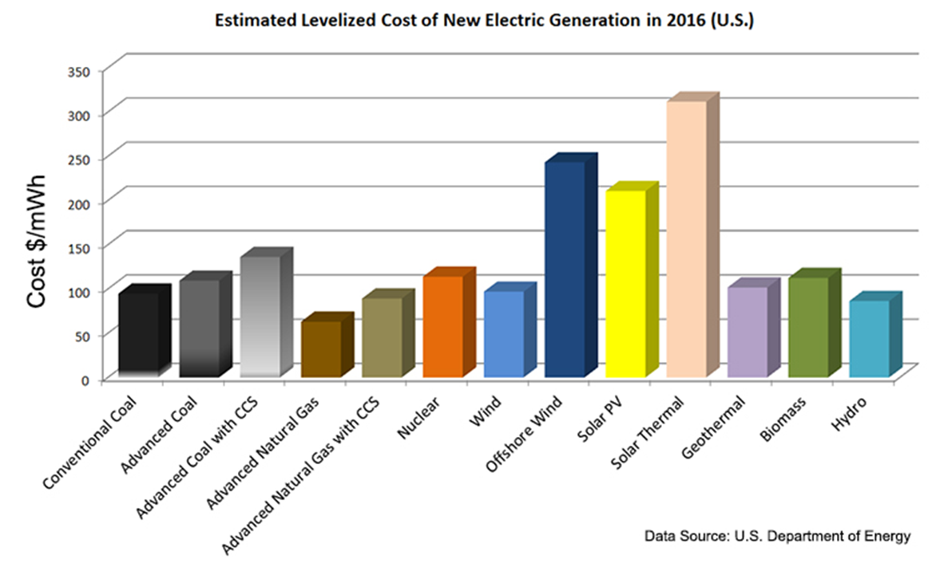
Estimated Cost of Electric Energy in 2016.

Slide 24
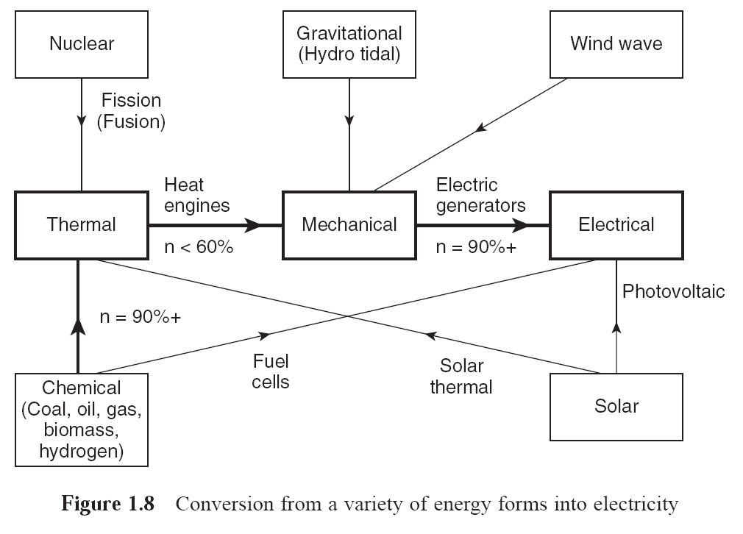
Why Do we Prefer Direct Electric Sources

Slide 25
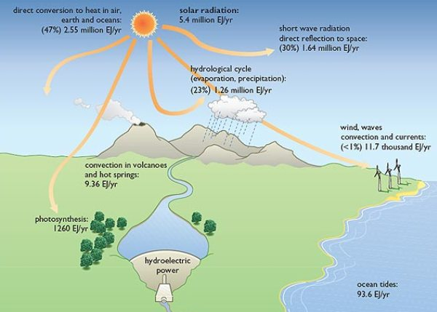
Sun is the Ultimatum Source

Slide 26
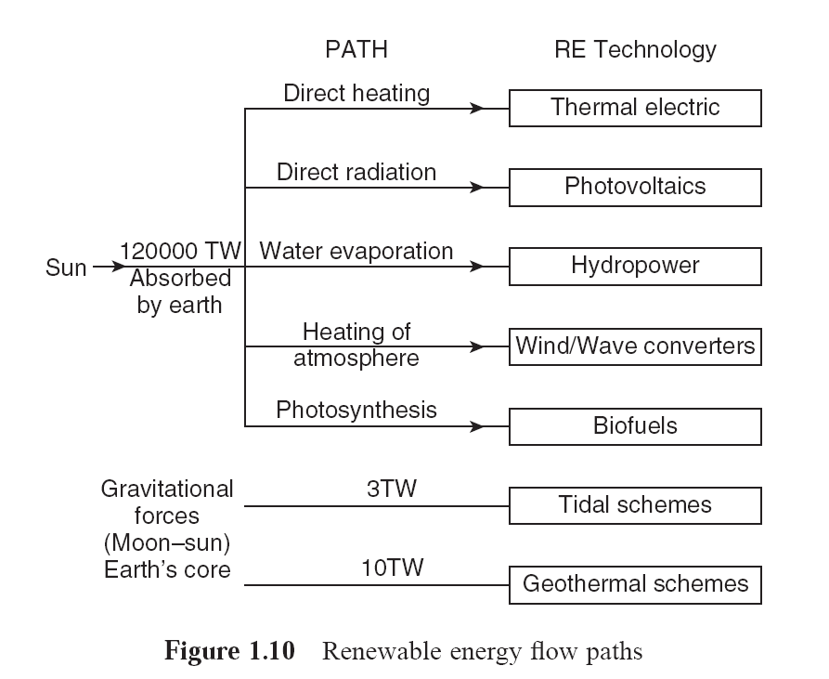
Sun is the Ultimatum Source

Slide 27
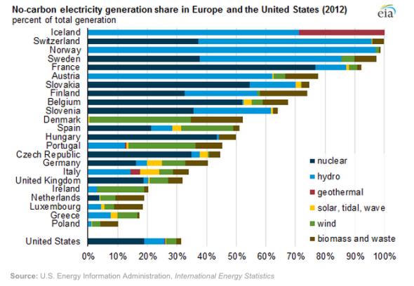

Slide 28
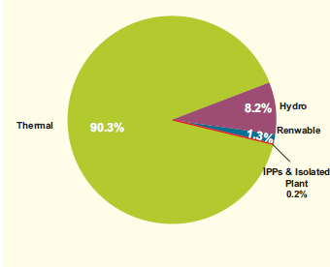
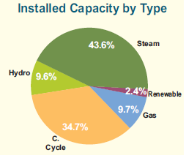
EGYPT Energy Data
Production by Type
Capacity by Type

Slide 29


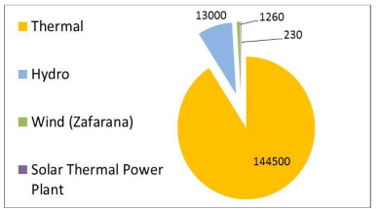
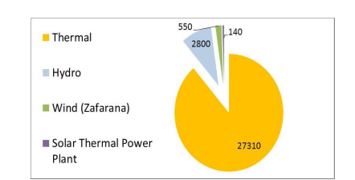
Electric Power In Egypt

Slide 30
Electric Power In Egypt
Max Demand = 31 GW
Max Produced < 30 GW
Max Shortage = 3 GW

Slide 31
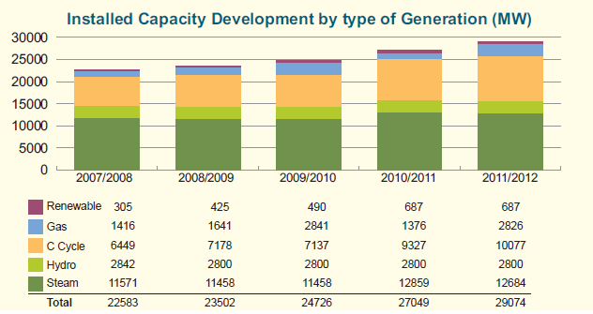

Slide 32
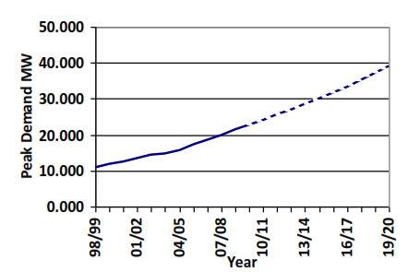
Maximum Demand of Electricity in Egypt

Slide 33

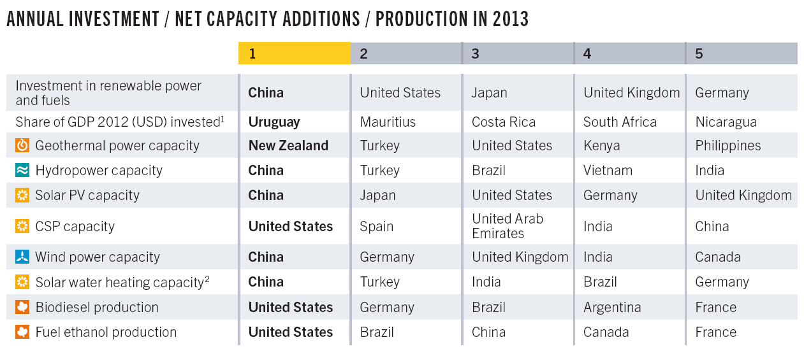

Slide 34
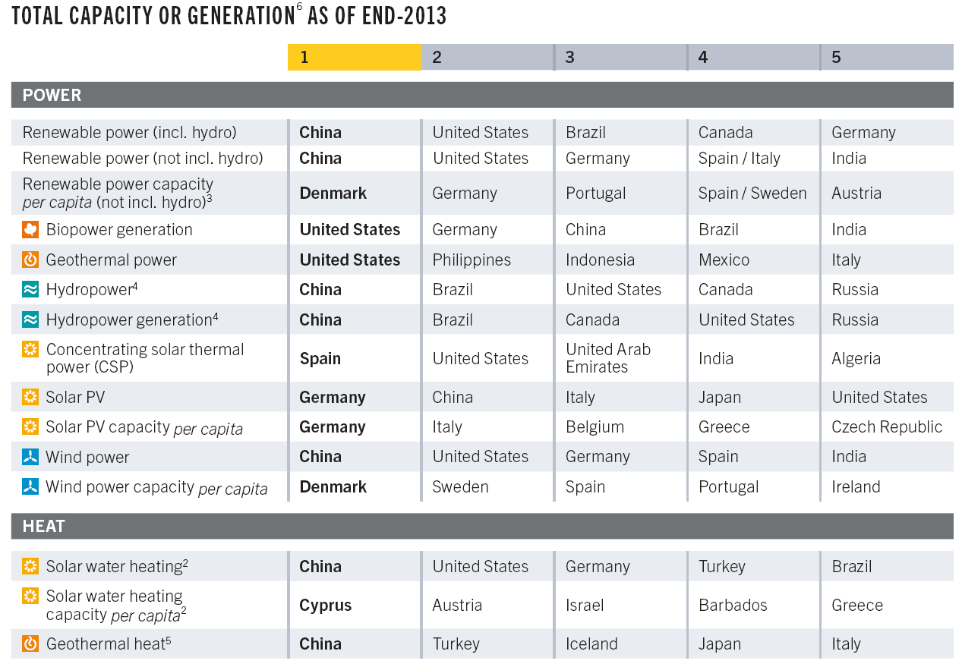

Slide 35
Hydro Power Plants Basic Concept

Slide 36
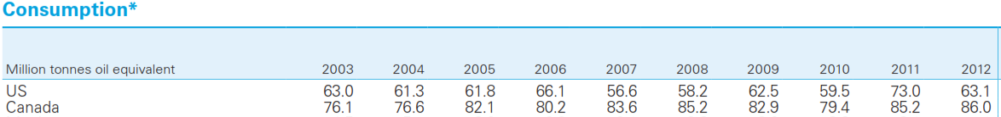
Hydro Consumption.
Usually A Steady Capacity

Slide 37
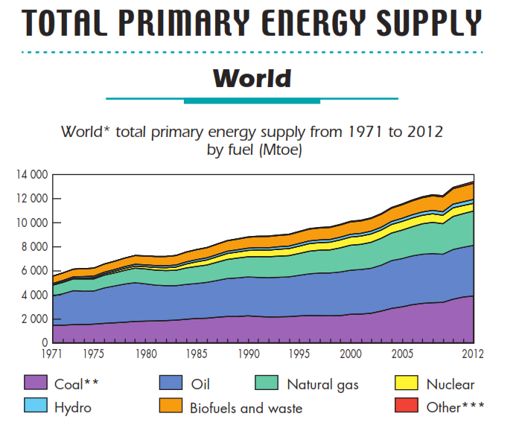

Slide 38
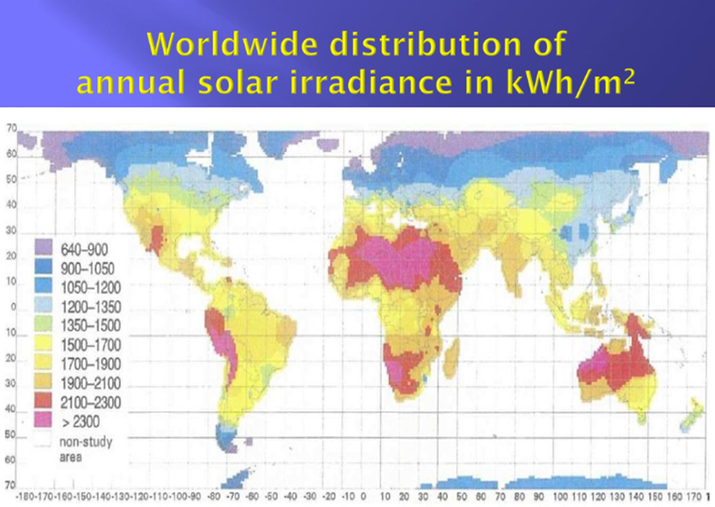

Slide 39
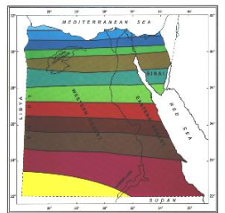

Egypt’s Annual Average of Solar Radiation

Slide 40
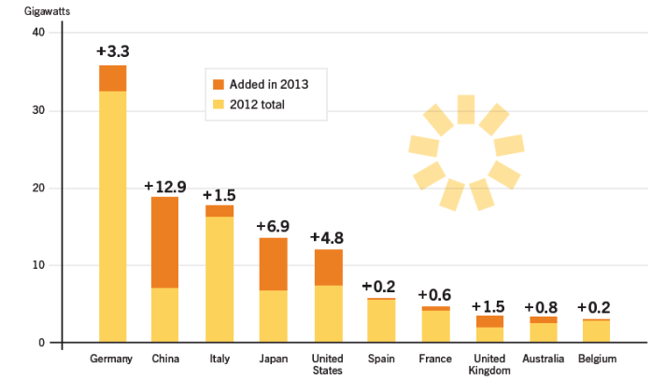
Solar PV Capacity and Additions, 2013
30GW Egypt Max
3GW Egypt Shortage

Slide 41
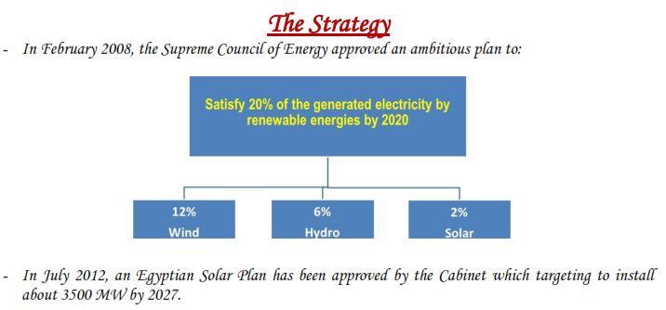
Egypt Plan For Solar
So our HUGE plan is to add 3.5 GW in 15 Years!

Slide 42
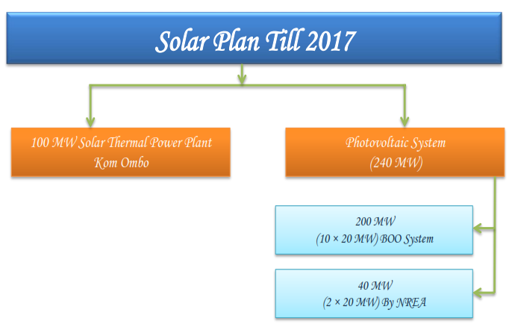
Egypt Plan For Solar
Do you Remember
Germany Addition
in 2013?

Slide 43
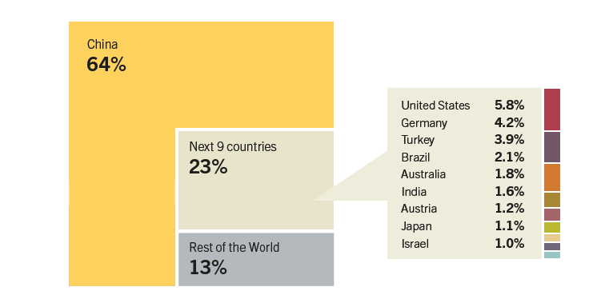
Solar Water Heating Collectors Global
Capacity, Shares of Top 10 Countries, 2012

Slide 44
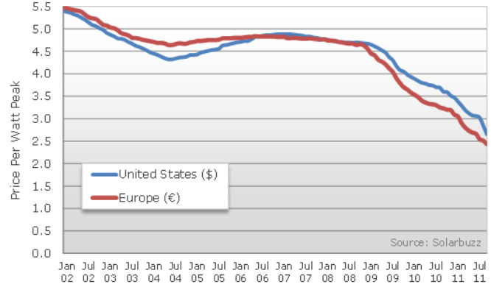
Solar Power Cost
Now(2015) around 1$/watt

Slide 45
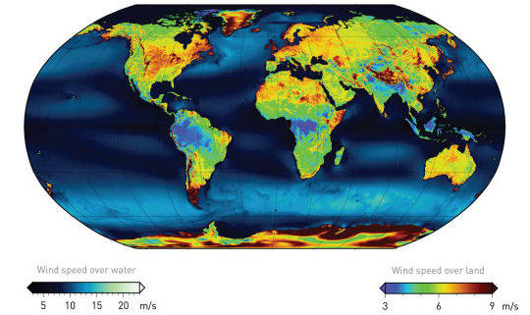
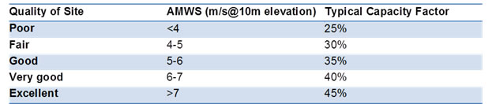
World Wind Atlas

Slide 46
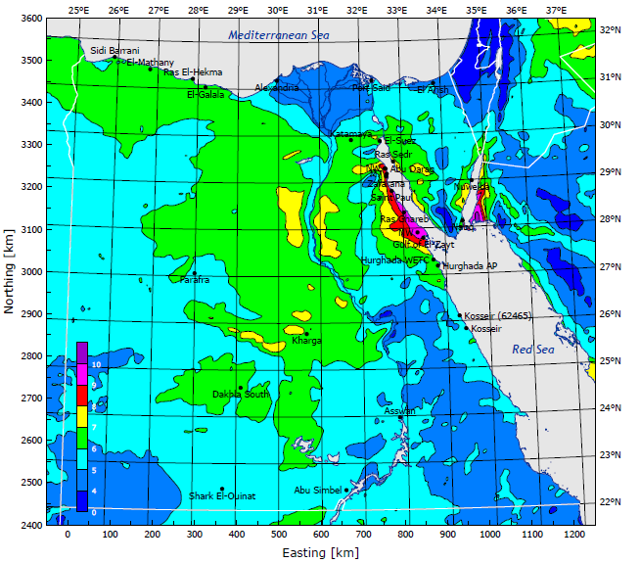

Wind Atlas of Egypt

Slide 47
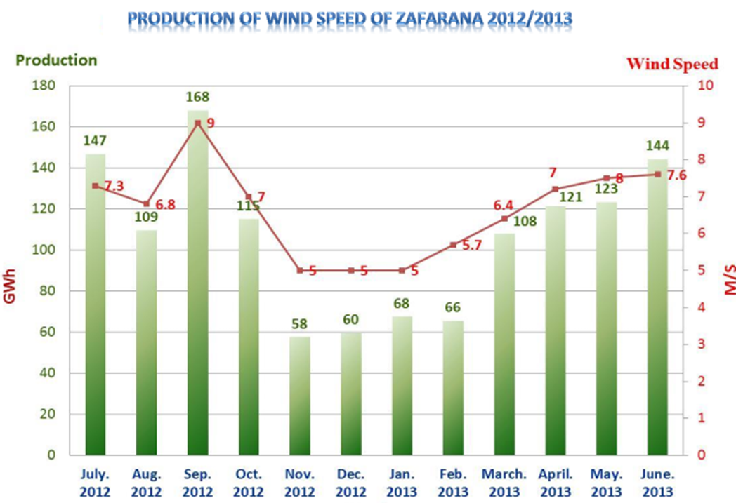

Slide 48
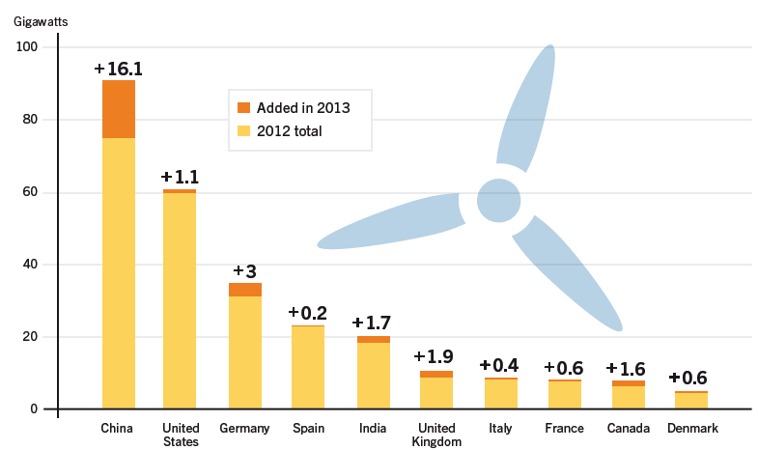
Power Capacity and Additions,
Top 10 Countries
30GW Egypt Max
3GW Egypt Shortage

Slide 49
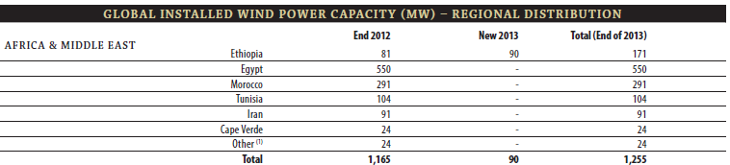
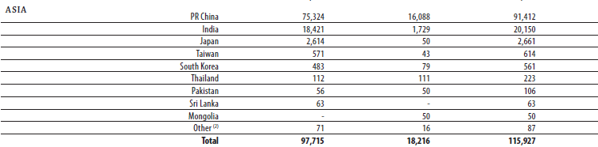
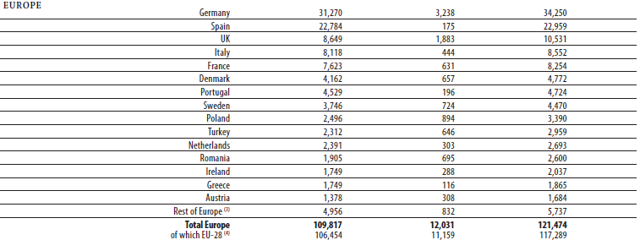

Slide 50

Egypt Plan for Wind
What Really
Happened?

Slide 51

Egypt Plan for Wind

Slide 52

Egypt Plan for Wind

Slide 53

World Top Average

Slide 54

Other Ways to Improve

Slide 55


BioFuels
Ethanol Biodiesle

Slide 56

Biodiesle In Egypt

Slide 57
Final Conclusion
We are not that superior in Oil or Natural Gas.
We Have got all what it needs to overcome the current shortage of energy!
Solar, Wind, Nuclear and Biofuels are great Potentials
We need to act, but act quick and effectively.
There is Hope!

Slide 58
Thanks!
Any Questions?

