Slide 1
Affiliated to Bibliotheca Alexandrina Supported by Ministry of Communications & Information Technology
The Center for Documentation of Cultural
& Natural Heritage
www.cultnat.org
CULTNAT

Slide 2
Calendars across history
Center for Documentation
of Cultural & Natural Heritage
Prof. Dr. Fathi Saleh
CULTNAT

Slide 3
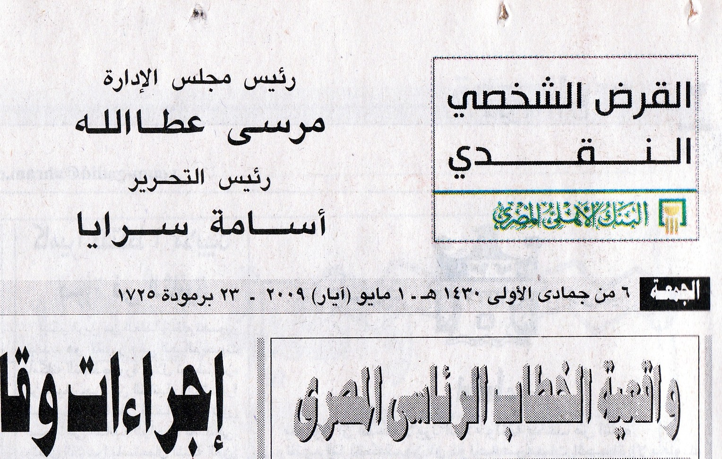

Slide 4
Center for Documentation
of Cultural & Natural Heritage
The Year 2000 AD is equivalent to :
- 6236 according to First Egyptian Calendar
- 5760 according to Jewish Calendar
- 1716 according to Coptic Calendar
- 1420 according to Islamic Calendar
- 1378 according to Persian Calendar
CULTNAT

Slide 5
Center for Documentation
of Cultural & Natural Heritage
Calendars
Year: Rotation of earth around the sun (365.2422 day)
Month: Rotation of moon around the earth (29.53 day)
Week: Human invention
Day: Revolution of earth around itself
Moon
(month)
sun
Earth (day)
year
CULTNAT

Slide 6
Center for Documentation
of Cultural & Natural Heritage
Elements of Calendars
Years
Seasons
Months
Weeks
Days
Hours
CULTNAT

Slide 7
Center for Documentation
of Cultural & Natural Heritage
Other Elements of Calendars
Start of the Calendar
Start of the year
Year naming (names vs numbers)
Season naming
Month naming
Week days naming
CULTNAT

Slide 8
Center for Documentation
of Cultural & Natural Heritage
Types of years
Year Month No.of months
Solar year 365.2422 30.43685 12
Lunar year 354.36 29.53 12
Lunar/solar year 365.2422 29.53 12/13
(Lunisolar year)
CULTNAT

Slide 9
Center for Documentation
of Cultural & Natural Heritage
Calendars
Timeline

Slide 10
2000AD
Modern
1800AD
1000AD
Islamic
650AD
Byzantine / Coptic
0
Ptolemaic
300BC
1000BC
Pharaonic
2000BC
3000BC
3000BC
Predynastic
4000BC
5000BC
CULTNAT

Slide 11
Center for Documentation
of Cultural & Natural Heritage
Solar Calendars

Slide 12
Center for Documentation
of Cultural & Natural Heritage
Solar Calendar
(First Approximation)

Slide 13
2000AD
Modern
1800AD
1000AD
Islamic
650AD
Byzantine / Coptic
0
Ptolemaic
300BC
1000BC
Pharaonic
2000BC
3000BC
3000BC
Predynastic
First Egyptian Calendar (4241 BC)
4000BC
5000BC
CULTNAT

Slide 14
Center for Documentation
of Cultural & Natural Heritage
Evolution of the Solar Year
One year = 365.2422 days
First Approximation
(Early Ancient Egyptians Year EY)
One Year = 365 days
CULTNAT

Slide 15
Center for Documentation
of Cultural & Natural Heritage
Evolution of Solar Calendar
First Approximation (2)
One Year = 365 day
- 12 months
- 30 days/month + 5 days (Isis, Osiris, Seth, Nyphtis, Horus)
CULTNAT

Slide 16
Center for Documentation
of Cultural & Natural Heritage
Solar Calendar
(Second Approximation)

Slide 17
2000AD
Modern
1800AD
1000AD
Islamic
650AD
Byzantine / Coptic
0
Ptolemaic
300BC
1000BC
Leap Year
(2000 BC)
Pharaonic
2000BC
3000BC
3000BC
Predynastic
First Egyptian Calendar (4241 BC)
4000BC
5000BC
CULTNAT

Slide 18
Center for Documentation
of Cultural & Natural Heritage
Evolution of Solar Calendar
Second Approximation
One Year = 365.25
- 12 months
- 30 days/month + 5/6 holydays
- Year starts with first appearance of sirius (sotis) on 18th or 19th of July
CULTNAT

Slide 20
Center For Documentation of Cultural & Natural Heritage
CULTNAT

Slide 21
Center for Documentation
of Cultural & Natural Heritage
Evolution of Solar Calendar
Month = 3 decans (weeks)
Decan = 10 days
One year = 36 decan
Season = 4 months
Season are :
- Inundation (Akhet)
- Growing (Peret)
- Harvesting (Chemou)
CULTNAT

Slide 23
Center for Documentation
of Cultural & Natural Heritage
CULTNAT
Content of Rhind Mathematical Papyrus (RMP)
* Recto
Cover page
Title : “Correct method of reckoning, for grasping the meaning of things and knowing everything that is, obscurities … and all secrets”.
Name of scribe: Ahmose
Date of copying: fourth month of inundation season of the year 33 of reign period of king Auserre (15th dynasty)
CULTNAT

Slide 24
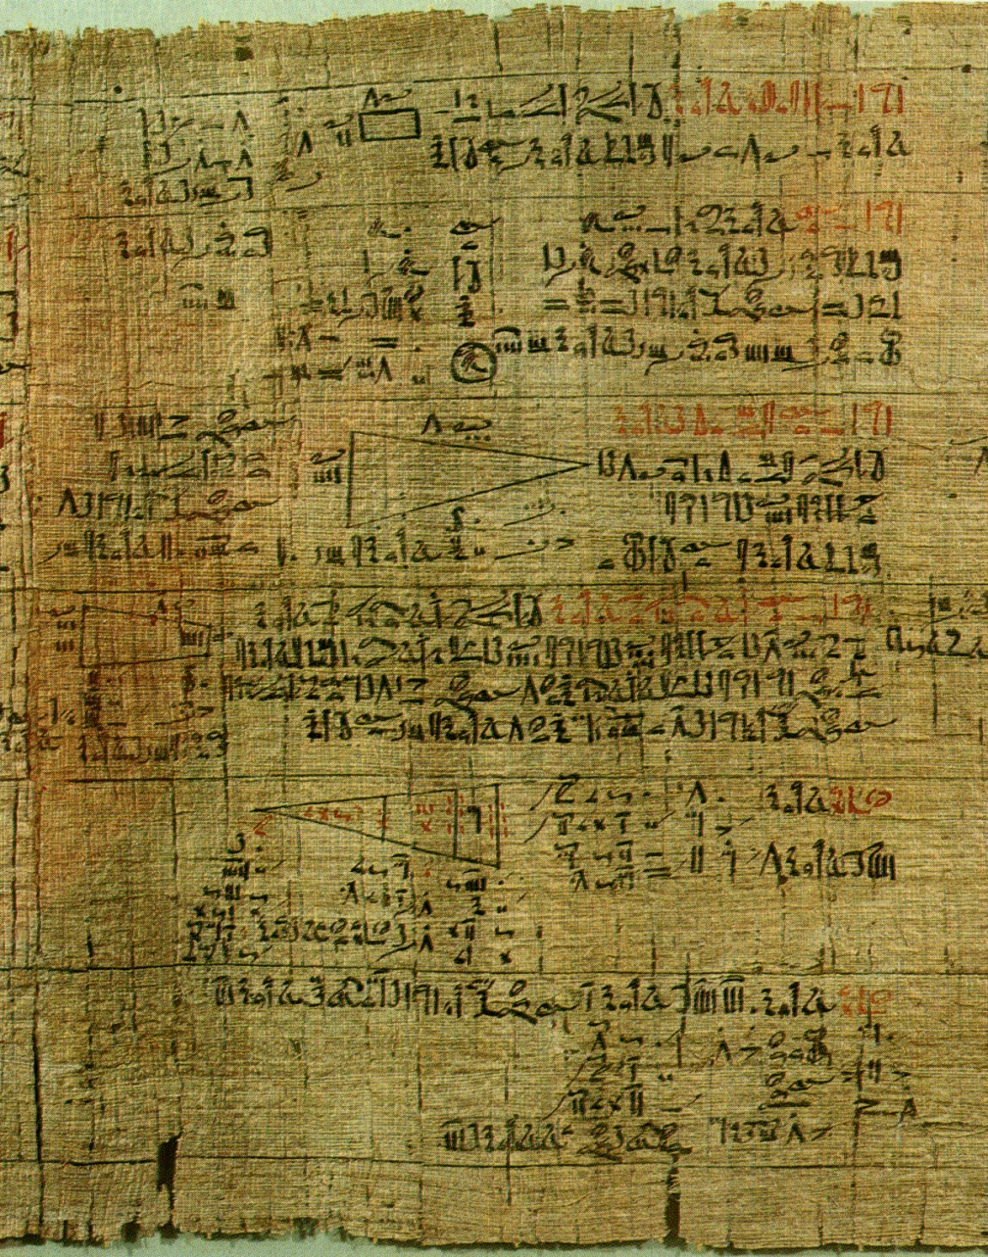
Center for Documentation
of Cultural & Natural Heritage
CULTNAT
Part of RMP
CULTNAT

Slide 25
Center for Documentation
of Cultural & Natural Heritage
Solar Calendar
(Third Approximation)

Slide 26
2000AD
Modern
1800AD
1000AD
Islamic
Julian Calendar
(30 AD)
650AD
Byzantine / Coptic
0
Ptolemaic
300BC
1000BC
Leap Year
(2000 BC)
Pharaonic
2000BC
3000BC
3000BC
Predynastic
First Egyptian Calendar (4241 BC)
4000BC
5000BC
CULTNAT

Slide 27
Center for Documentation
of Cultural & Natural Heritage
Evolution of Solar Calendar
Third approximation ( Julian Year JY)
One year = 365.25 days
Difference from EY =365.25 – 365 = 0.25 days
Or add one day every FOUR EY years
Correction of one day every four EY years
CULTNAT

Slide 28
Center For Documentation of Cultural & Natural Heritage
Pharaonic Julian
First month 30 31 January
Second month 30 29/30 February
Third month 30 31 March
Forth month 30 30 April
Fifth month 30 31 May
Sixth month 30 30 June
Seventh month 30 31 July
Eighth month 30 30 August
Ninth month 30 31 September
Tenth month 30 30 October
Eleventh month 30 31 November
Twelfth month 30 30 Decamber
Additional 5/6
CULTNAT

Slide 29
Center For Documentation of Cultural & Natural Heritage
Pharaonic Julian
First month 30 31 31 January
Second month 30 29/30 28/29 February
Third month 30 31 31 March
Forth month 30 30 30 April
Fifth month 30 31 31 May
Sixth month 30 30 30 June
Seventh month 30 31 31 July
Eighth month 30 30 31 August
Ninth month 30 31 30 September
Tenth month 30 30 31 October
Eleventh month 30 31 30 November
Twelfth month 30 30 31 Decamber
Additional 5/6
CULTNAT

Slide 30
Center for Documentation
of Cultural & Natural Heritage
Evolution of Solar Calendar
Julian Calendar
31/28/31/30/31/30/31/31/30/31/30/31
Feb. 28/29 depending on leap condition
Year starts first of January (Originally 21 of March)
Calendar starts with the Birth of Jesus
CULTNAT

Slide 31
Center for Documentation
of Cultural & Natural Heritage
The Story of the month
January
February
March Matius (Mars)
April Aprilis (Aphrodite)
May Maius (elders )
June Junius (youth)
July Quintilis (fifth) Julius
August Augustus
September 7er
October 8er
November 9er
December 10er
CULTNAT

Slide 32
Syrian months
January |  | كانون الثاني
February |  | شباط
March |  | آذار
April |  | نيسان
May |  | أيَار
June |  | حزيران
July |  | تموز
August |  | آب
September |  | أيلول
October |  | تشرين الأول
November |  | تشرين الثاني
December |  | كانون الأول

Slide 33
Center for Documentation
of Cultural & Natural Heritage
The story of the week
Days of the week are related either to
Layers of heavens represented by the planets (Babilonian)
God created the universe in six days and had a rest on the seventh – sabat (Biblical)
CULTNAT

Slide 34
Center for Documentation
of Cultural & Natural Heritage
The Story of Weak Days
English |  | French
Monday | moon | Lundi | lune
Tuesday |  | Mardi | mars
Wednesday |  | Mercredi | mercure
Thursday |  | Judi | Jupiter
Friday |  | Vendredi | Venus
Saturday | Saturn | Samedi
Sunday | sun | Dimanche
CULTNAT

Slide 35
Center for Documentation
of Cultural & Natural Heritage
The Story of Weak Days
English |  | French |  | Arabic
Monday | moon | Lundi | lune | Ethnin | 2
Tuesday |  | Mardi | mars | Thulathaa | 3
Wednesday |  | Mercredi | mercure | Arbaa | 4
Thursday |  | Judi | Jupiter | Khamis | 5
Friday |  | Vendredi | Venus | Jomaa
Saturday | Saturn | Samedi |  | Sabt
Sunday | sun | Dimanche |  | Ahad | 1
CULTNAT

Slide 36
Center for Documentation
of Cultural & Natural Heritage
Solar Calendar
(Fourth Approximation)

Slide 37
2000AD
Modern
Gregorian Calendar (1582 AD)
1800AD
1000AD
Islamic
Julian Calendar
(30 AD)
650AD
Byzantine / Coptic
0
Ptolemaic
300BC
1000BC
Leap Year
(2000 BC)
Pharaonic
2000BC
3000BC
3000BC
Predynastic
First Egyptian Calendar (4241 BC)
4000BC
5000BC
CULTNAT

Slide 38
Center for Documentation
of Cultural & Natural Heritage
Evolution of Solar Calendar
Fourth approximation (Gregorian GY)
One year = 365.2425 days
Difference from JY =365.25 – 365.2425 = 0.0075 days
Or subtract one day every 125 GY years
Every 400 GY years we drop THREE days
Centinential years are leap every four centuries
eg. 2000 is leap 2100, 2200, 2300 are not
CULTNAT

Slide 39
Center for Documentation
of Cultural & Natural Heritage
Evolution of Solar Calendar
Fourth approximation ( Gregorian)
Thursday October 4, 1582
was followed by Friday October 15, 1582
CULTNAT

Slide 40
Center for Documentation
of Cultural & Natural Heritage
Easter Problem
Western Church
First Sunday following fullmoon following Equinox
Eastern Church
First Sunday following Fos’h feast of the jews
CULTNAT

Slide 41
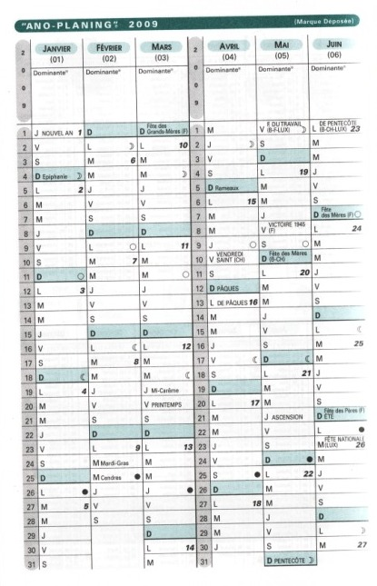
Full moon
Easter
Equinox

Slide 42
Center for Documentation
of Cultural & Natural Heritage
Christmas Problem
Western Church
Follows Gregorian Calculations (365.2425)
Eastern Church
Follows Julian Calculations (365.25)
CULTNAT

Slide 43
Center for Documentation
of Cultural & Natural Heritage
Evolution of Solar Calendar
Fifth approximation ( John)
One year = 365.2422 days
Difference from GY =365.2425 – 365.2422
= 0.0003
Or subtract one day every 3333 GY years
CULTNAT

Slide 44
Center for Documentation
of Cultural & Natural Heritage
Solar Calendar
(Persian Calendar)

Slide 45
2000AD
PersianCalendar (1000 AD)
Modern
Gregorean Calendar (1582 AD)
1800AD
1000AD
Islamic
Julian Calendar
(30 AD)
650AD
Byzantine / Coptic
0
Ptolemaic
300BC
1000BC
Leap Year
(2000 BC)
Pharaonic
2000BC
3000BC
3000BC
Predynastic
First Egyptian Calendar (4241 BC)
4000BC
5000BC
CULTNAT

Slide 46
Center for Documentation
of Cultural & Natural Heritage
Another examples of Solar Calendars
5. Persian Calendar
30 * 6 + 31 * 5 + (30/31) * 1
length of the year is calculated astronomically
Year starts on the 21st of March (Nowrooz)
Calendar starts with the Hajir ( like the Islamic calendar).
Was developed by Khayyam
CULTNAT

Slide 47
Center for Documentation
of Cultural & Natural Heritage
Lunar Calendars

Slide 48
Center for Documentation
of Cultural & Natural Heritage
Evolution of the Arabic Lunar Calendar
Lunar month = 29.53 days
First approximation
One Month = 29 days
CULTNAT

Slide 49
Center for Documentation
of Cultural & Natural Heritage
Evolution of the Arabic Lunar Calendar
Second approximation
One month = 29.5 days
Difference =29.5 – 29 = 0.5 days per month
Or add one day every TWO months
CULTNAT

Slide 50
Center for Documentation
of Cultural & Natural Heritage
Evolution of the Arabic Lunar Calendar
Third approximation
One month = 29.53 days
Difference =29.53 – 29.5 = 0.03 day
Add one day every 33 months
(You will have two consecutive months of 30 days every 33 years)
CULTNAT

Slide 51
Center for Documentation
of Cultural & Natural Heritage
Lunar Calendar
(Islamic Calendar)

Slide 52
2000AD
PersianCalendar (1000 AD)
Modern
IslamicCalendar (632 AD)
Gregorean Calendar (1582 AD)
1800AD
1000AD
Islamic
Julian Calendar
(30 AD)
650AD
Byzantine / Coptic
0
Ptolemaic
300BC
1000BC
Leap Year
(2000 BC)
Pharaonic
2000BC
3000BC
3000BC
Predynastic
First Egyptian Calendar (4241 BC)
4000BC
5000BC
CULTNAT

Slide 53
Center for Documentation
of Cultural & Natural Heritage
Examples of lunar calendars
Islamic Calendar (Hagir)
Year = 12 months
Months are either 29 or 30 days
Months starts by first appearance of the moon
The calendar starts with the year of Hegra (migration of profit Mohamed to Medina) 632 AD
CULTNAT

Slide 54
Islamic months
English | Arabic | Number
Muharram | محرم | 1
Safar | صفر | 2
Rabiul-Awwal | ربيع أول | 3
Rabi-uthani | ربيع ثان | 4
Jumadi-ul-Awwal | جمادى أول | 5
Jumadi-uthani | جمادى ثان | 6
Rajab | رجب | 7
Sha'ban | شعبان | 8
Ramadan | رمضان | 9
Shawwal | شوال | 10
Dhil-Q'ada | ذو القعدة | 11
Dhil-Hijja | ذو الحجة | 12

Slide 55
Center for Documentation
of Cultural & Natural Heritage
Lunisolar Calendar
(Jewish Calendar)

Slide 56
2000AD
PersianCalendar (1000 AD)
Modern
IslamicCalendar (632 AD)
Gregorean Calendar (1582 AD)
1800AD
1000AD
Islamic
Julian Calendar
(30 AD)
650AD
Byzantine / Coptic
Destruction of Second
Temple 70 AD
(Second Temple)
0
Hebrew Calendar (500BC)
Ptolemaic
Cyrus 538
300BC
Sargon 722
(First temple)
1000BC
David 1000
Leap Year
(2000 BC)
Moses 1200
Pharaonic
2000BC
3000BC
3000BC
Predynastic
First Egyptian Calendar (4241 BC)
4000BC
5000BC
CULTNAT

Slide 57
Center for Documentation
of Cultural & Natural Heritage
Examples of lunar/solar(lunisolar) calendar
Hebrew Calendar
Year is determined by the cycle of the sun
Month is determined by the cycle of the moon
Correction is done by adding one month every three years
Approximately
Year = 12 month, 12 month, 13 month, 12, 12, 13, …etc
First approximation: One year = 354 days
Second approximation: One year = 363.22 days
Third approximation: One year = 365.2422
CULTNAT

Slide 58
Jewish months
Syrian | Hebrew | Number | Length | Gregorian Equivalent
 | Nissan | 1 | 30 days | March-April
 | Iyar | 2 | 29 days | April-May
 | Sivan | 3 | 30 days | May-June
 | Tammuz | 4 | 29 days | June-July
 | Av | 5 | 30 days | July-August
 | Elul | 6 | 29 days | August-September
 | Tishri | 7 | 30 days | September-October
 | Cheshvan | 8 | 29 or 30 days | October-November
 | Kislev | 9 | 30 or 29 days | November-December
 | Tevet | 10 | 29 days | December-January
 | Shevat | 11 | 30 days | January-February
 | Adar I (leap years only) | 12 | 30 days | February-March
 | Adar (called Adar II in leap years) | 12 (13 in leap years) | 29 days | February-March
نيسان
أيَار
حزيران
تموز
آب
أيلول
تشرين الأول
تشرين الثاني
كانون الأول
كانون الثاني
شباط
آذار

Slide 59
Center for Documentation
of Cultural & Natural Heritage
Hours Considerations
Number of hours per day
Regular vs irregular hours
Beginning of the day
(Sunset or meridian)
CULTNAT

Slide 60
Center for Documentation
of Cultural & Natural Heritage
Final Look

Slide 61
 | Pharaonic | Hebrew | Julian | Islamic | Persian | Gregorian | Coptic
Beg. of the calendar | New King | Genesis |  | Higra | Higra | Christ Birthday | Martyr
Beg. of the Year | Sirius 18/19 July |  | Spring Equinox | Higra | Spring Equinox | Christ Birthday
Year naming | Numbers | Names (numbers) |  | Numbers (names) |  | numbers | numbers
Seasons | 3 |  | 4 |  |  | 4
Month naming | Numbers | Babylonian | Names (numbers) | Names | Names | Names | Names
Week days | Numbers | Numbers | Babylonian | Numbers | Numbers | Babylonian | numbers

Slide 63
With the compliments
of
The Center for Documentation of Cultural & Natural Heritage
www.cultnat.org

Slide 64
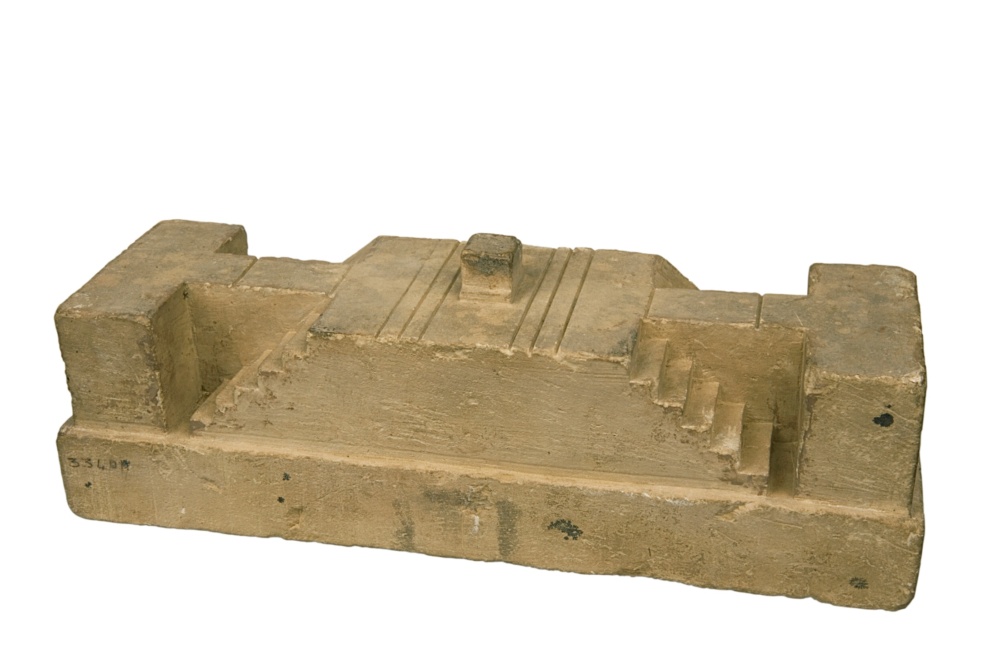

Slide 65
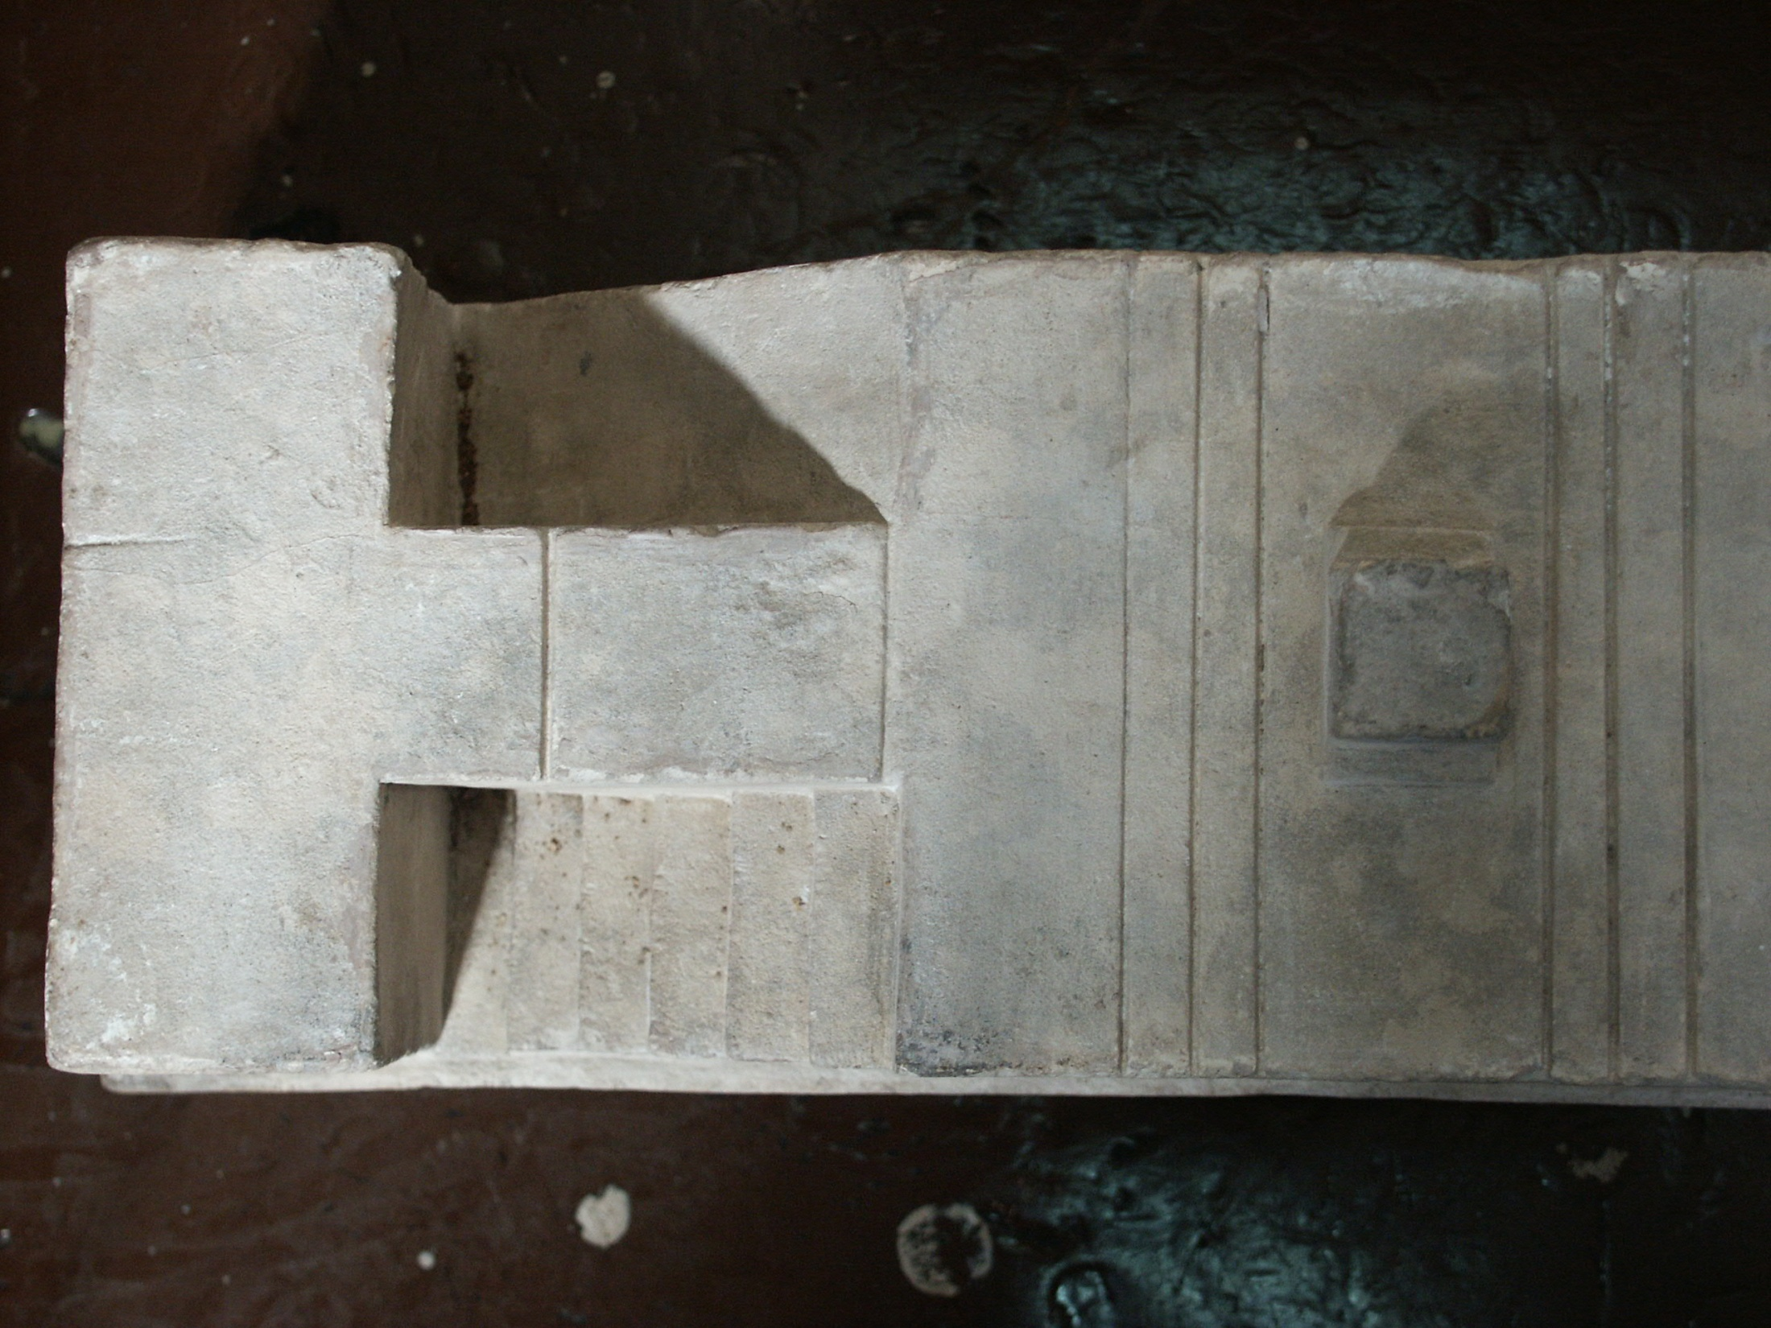

Slide 66
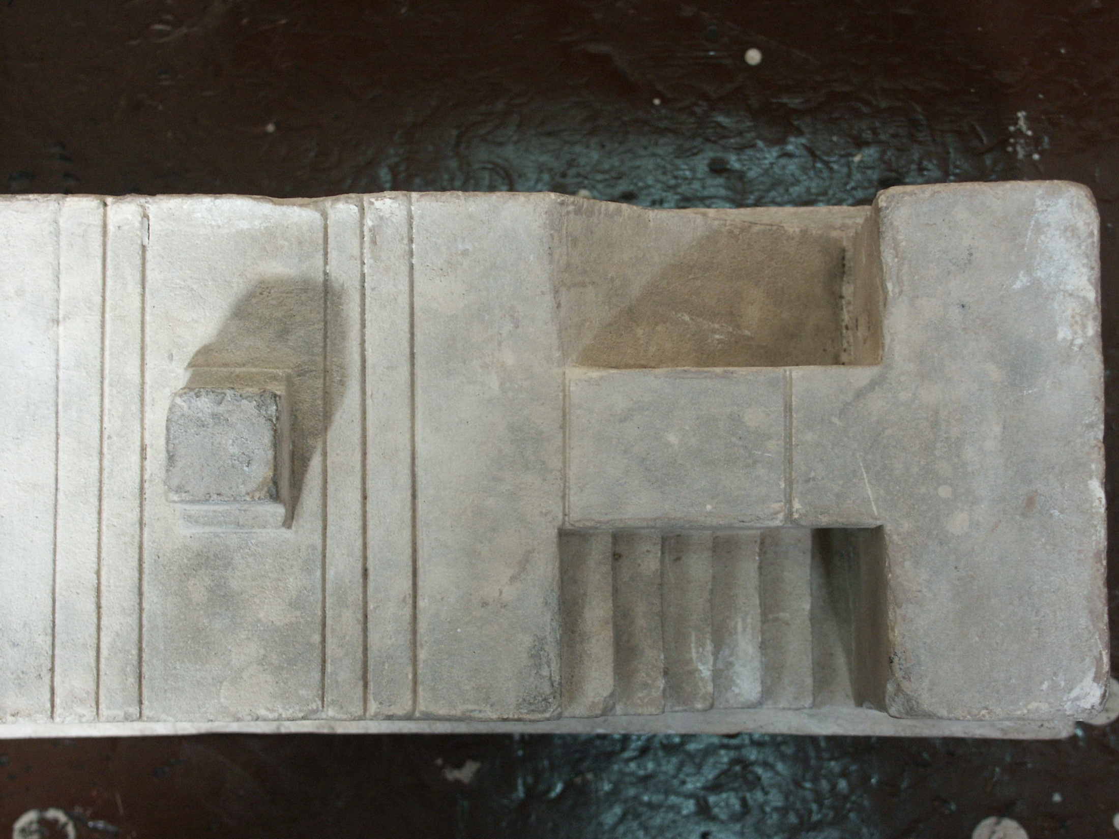

Slide 67
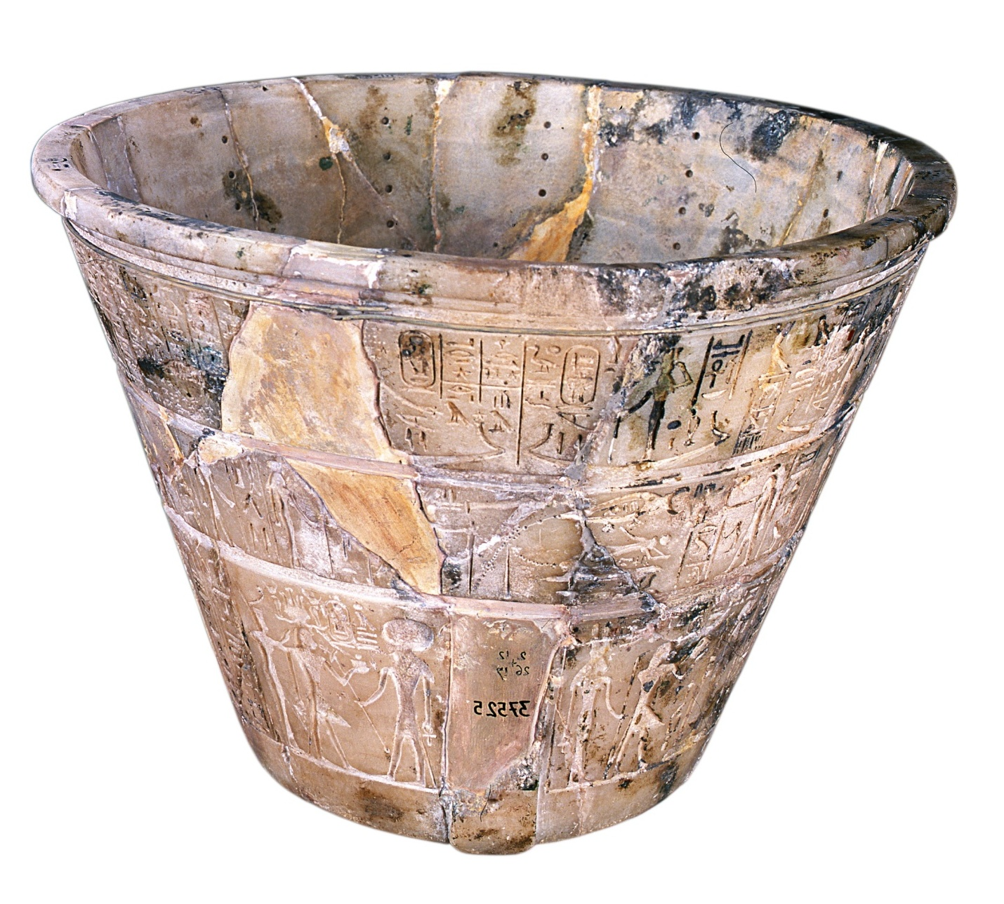

Slide 68
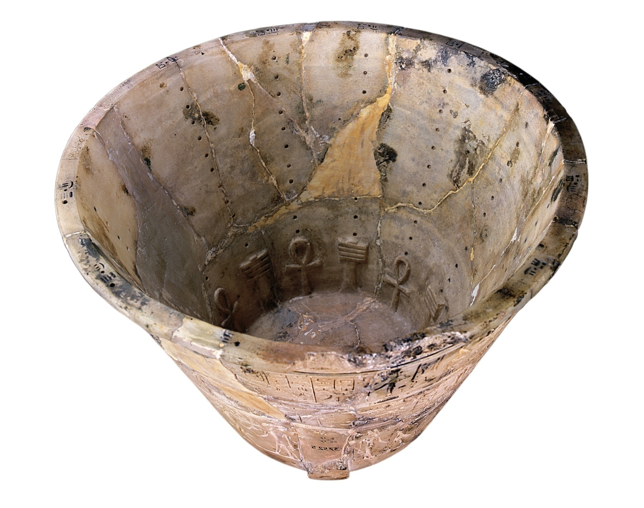

Slide 69
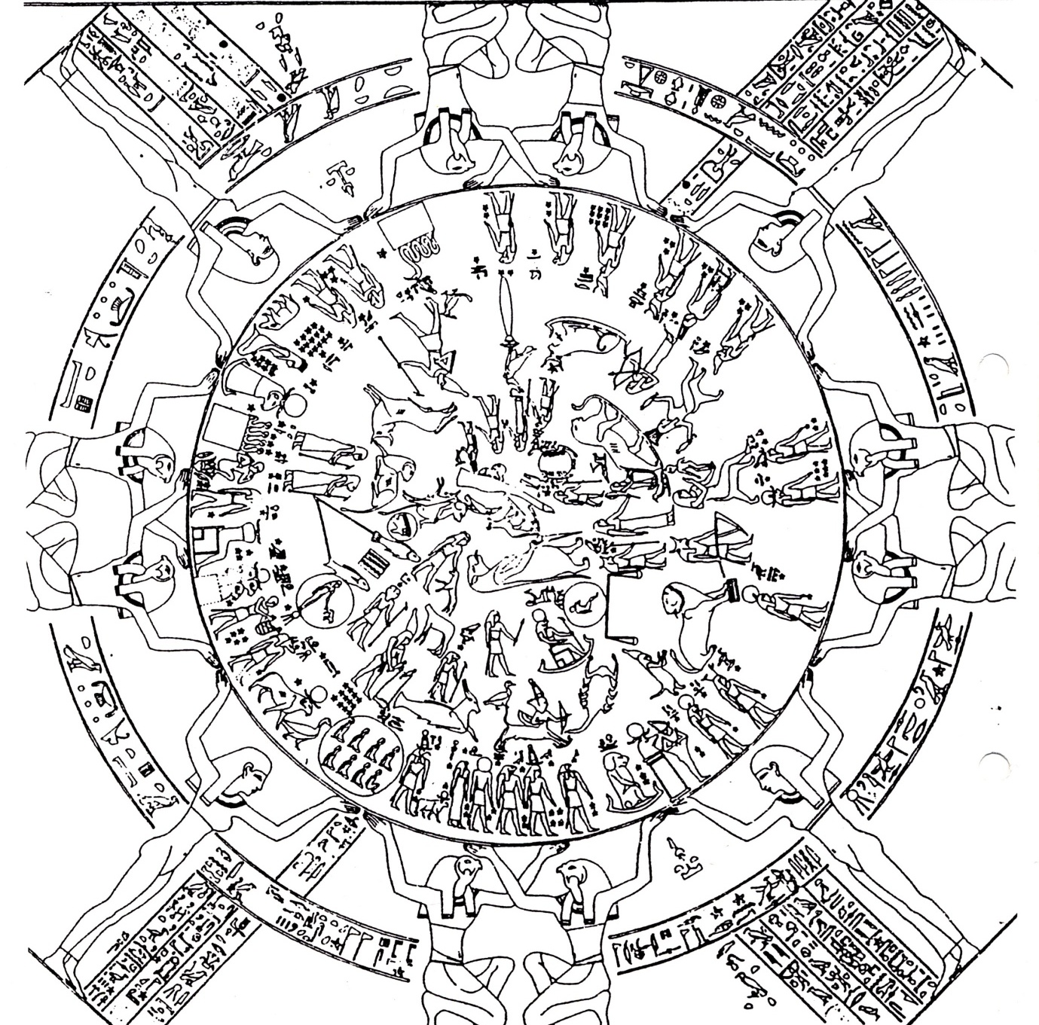

Slide 70
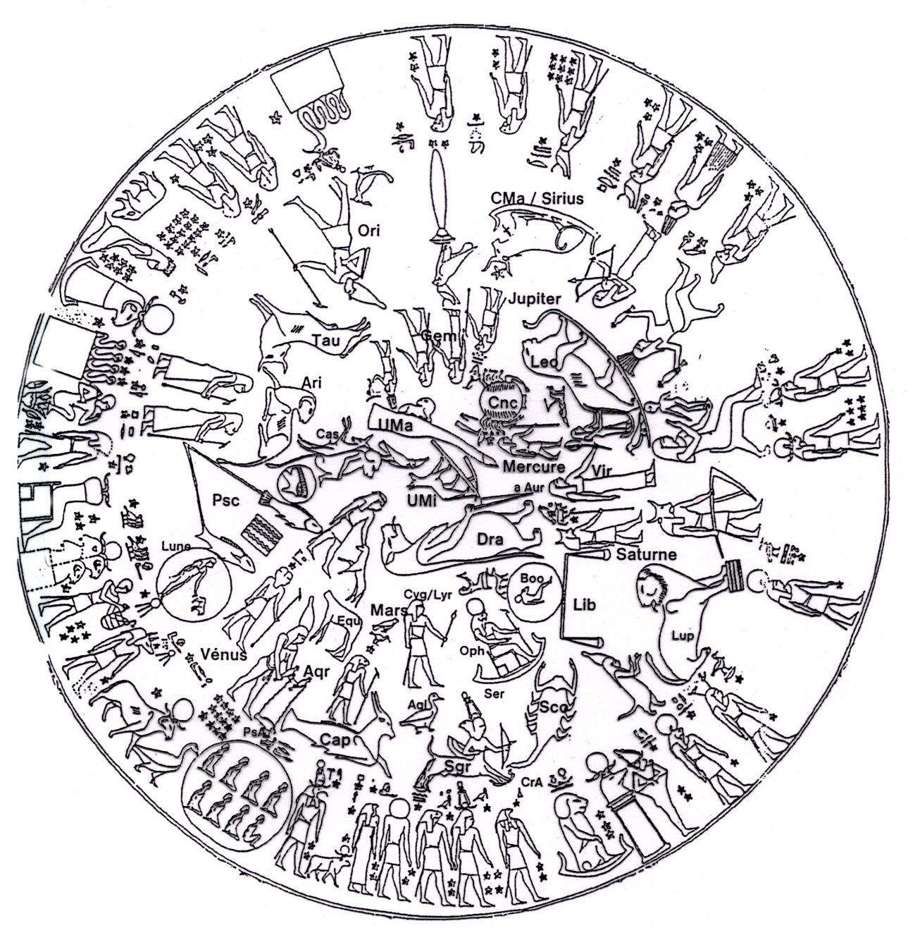

Slide 71
Northern Sky
Zodiac + Planets
Southern Sky
Decans

Slide 72
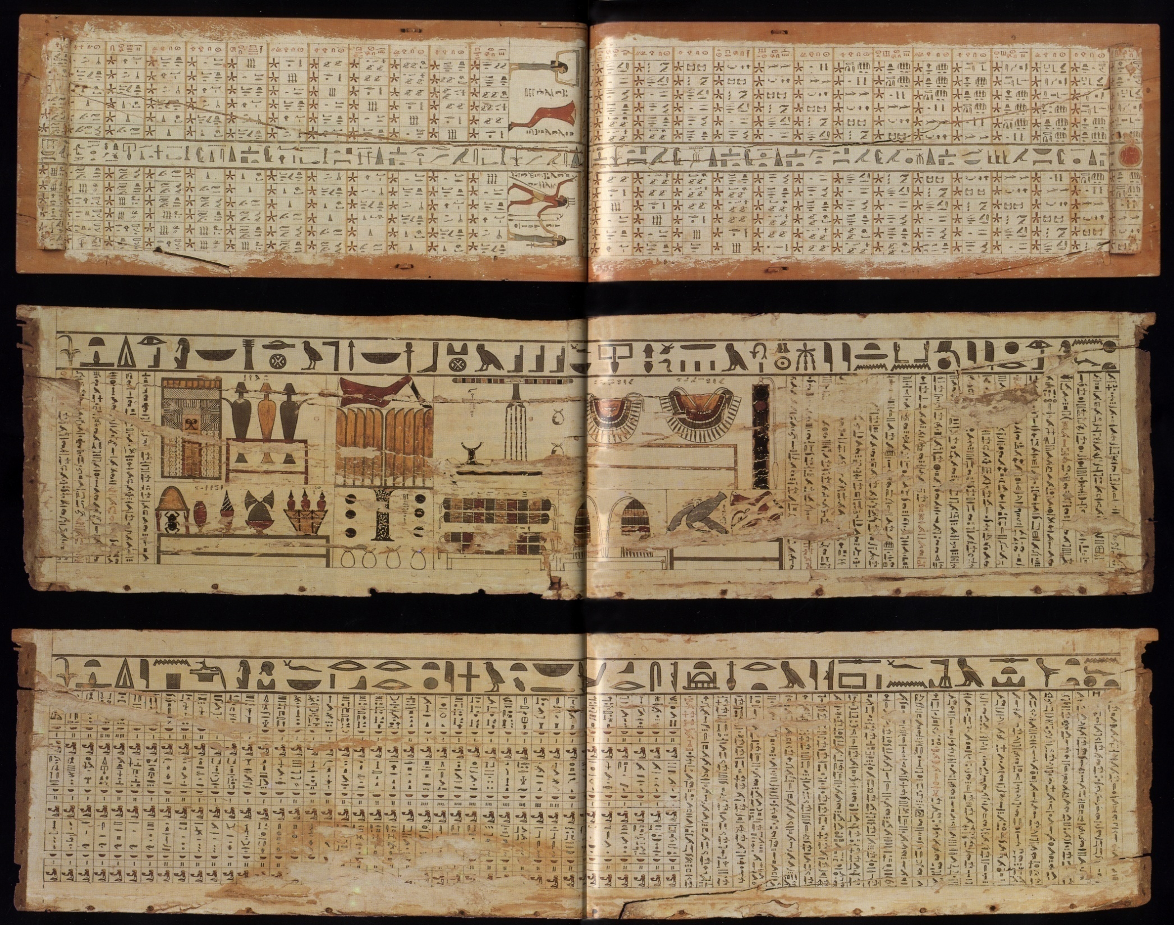

Slide 74
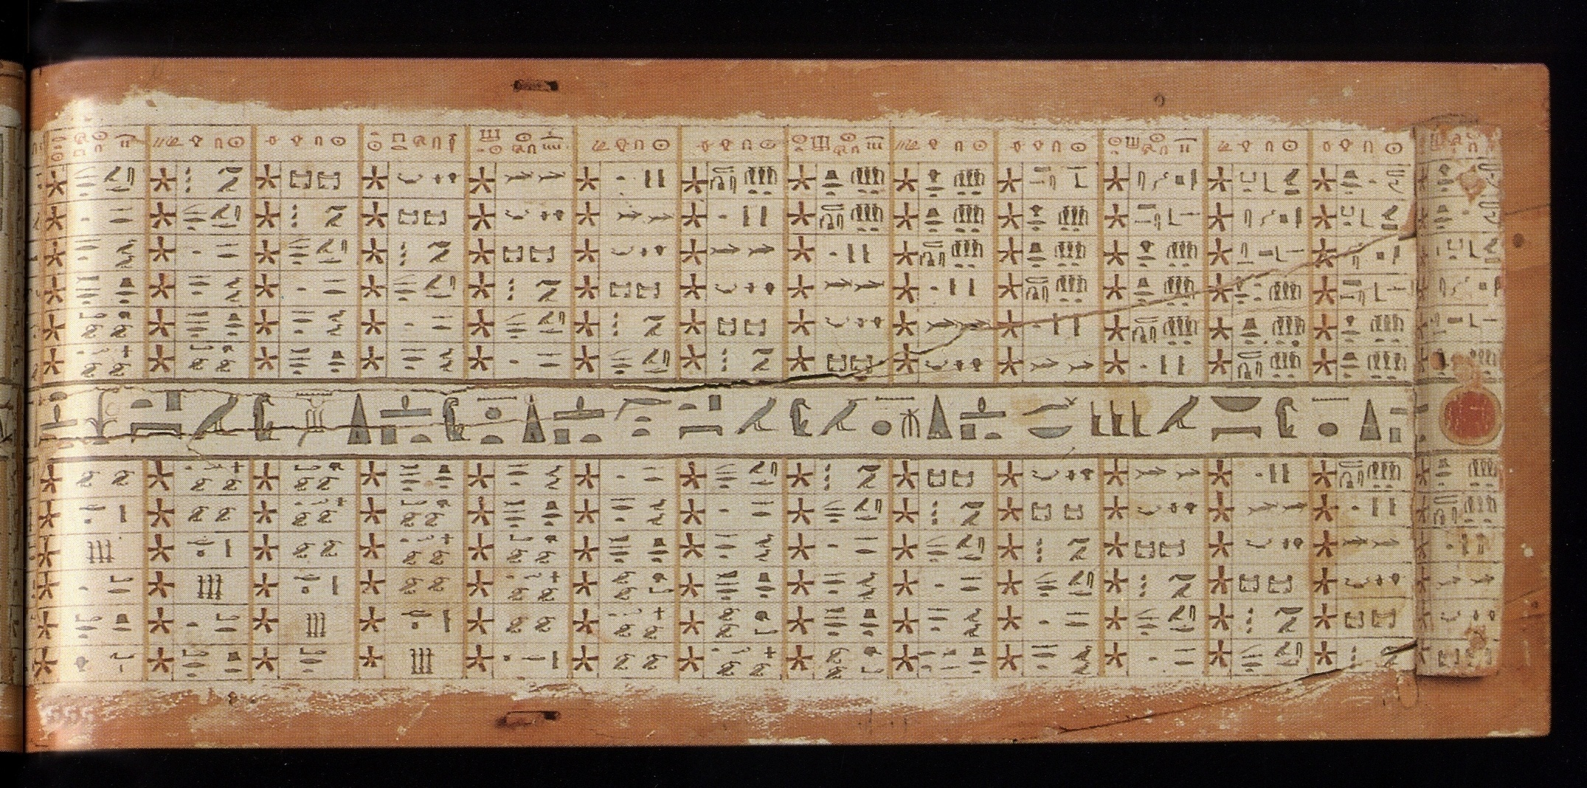

Slide 75
Last decan
Second month
First decan
Akhet season
middle decan

Slide 76
With the compliments
of
The Center for Documentation of Cultural & Natural Heritage
www.cultnat.org

Slide 80
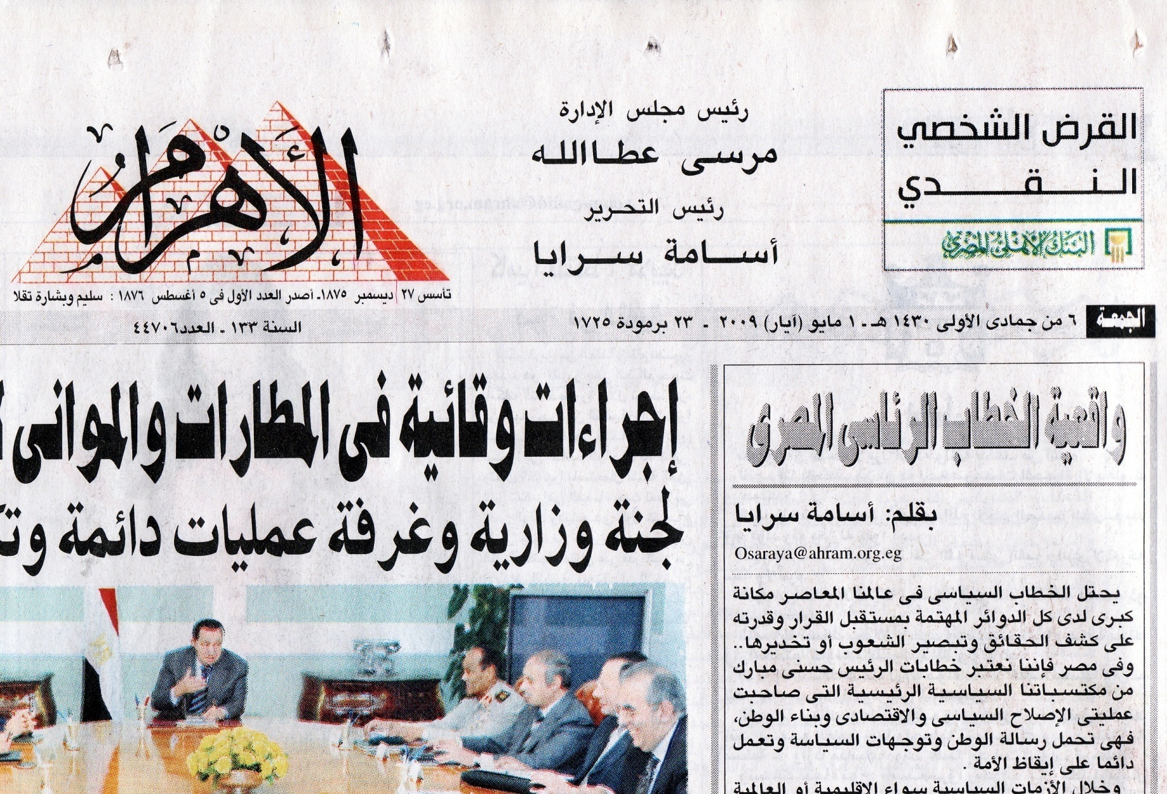

Slide 81
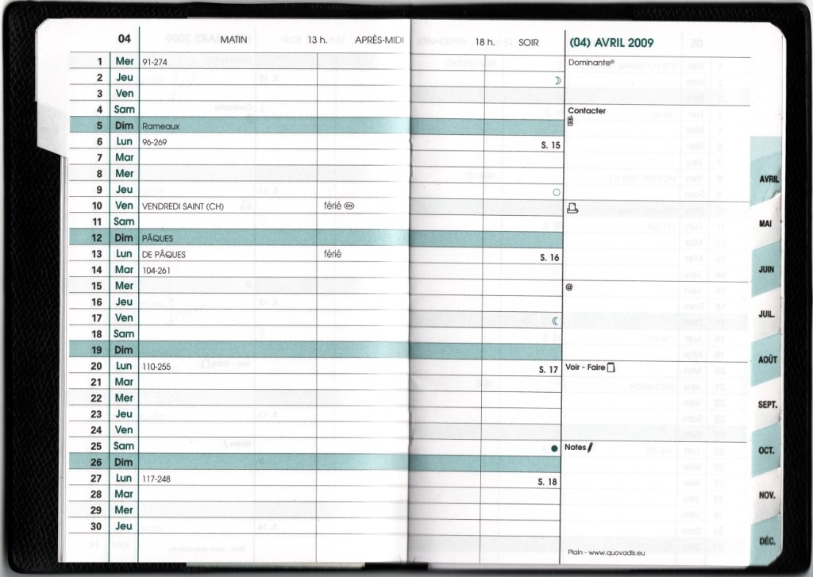

Slide 85
2000AD
PersianCalendar (1000 AD)
Modern
IslamicCalendar (632 AD)
Gregorean Calendar (1582 AD)
1800AD
1000AD
Islamic
Julian Calendar
(30 AD)
650AD
Second temp
Destruction 70 AD
(Second Temple)
Byzantine / Coptic
Hebrew Calendar (600BC)
0
Ptolemaic
Cyrus 538
Sargon 722
(First temple)
300BC
David 1000
1000BC
Moses 1200
Leap Year
(2000 BC)
Pharaonic
2000BC
3000BC
3000BC
Predynastic
First Egyptian Calendar (4241 BC)
4000BC
5000BC
CULTNAT

Slide 86
2000AD
Modern
1800AD
1000AD
Islamic
650AD
Byzantine / Coptic
0
Ptolemaic
300BC
1000BC
Pharaonic
2000BC
3000BC
3000BC
Predynastic
4000BC
5000BC
CULTNAT

Slide 87
2000AD
Modern
1800AD
1000AD
Islamic
650AD
Byzantine / Coptic
0
Ptolemaic
300BC
1000BC
Pharaonic
2000BC
3000BC
3000BC
Predynastic
4000BC
5000BC
CULTNAT

Slide 88
2000AD
Modern
1800AD
1000AD
Islamic
650AD
Byzantine / Coptic
0
30BC
Greek
Ptolemaic
330BC
Persian
300BC
Assyrian
1000BC
883BC
Babylonian
1728BC
Pharaonic
2150BC
Sum Ur III
2000BC
Akkadian
2350BC
Sumerian
3000BC
3000BC
3000BC
Predynastic
4000BC
5000BC
CULTNAT

Slide 89
2000AD
Modern
1800AD
1000AD
Islamic
650AD
Second temp
Destruction 70 AD
(Second Temple)
Byzantine / Coptic
0
30BC
Greek
Ptolemaic
330BC
Cyrus 538
Persian
Sargon 722
(First temple)
300BC
Assyrian
1000BC
883BC
David 1000
Babylonian
Moses 1200
1728BC
Pharaonic
2150BC
Sum Ur III
2000BC
Akkadian
2350BC
Sumerian
3000BC
3000BC
3000BC
Predynastic
4000BC
5000BC
CULTNAT

Slide 90
2000AD
Modern
IslamicCalendar (432 AD)
Gregorean Calendar (1582 AD)
1800AD
1000AD
Islamic
Julian Calendar
(50 AD)
650AD
Second temp
Destruction 70 AD
(Second Temple)
Byzantine / Coptic
0
30BC
Greek
Ptolemaic
330BC
Cyrus 538
Persian
Sargon 722
(First temple)
300BC
Assyrian
1000BC
883BC
David 1000
Leap Year
(2000 BC)
Babylonian
Moses 1200
1728BC
Pharaonic
2150BC
Sum Ur III
2000BC
Akkadian
2350BC
Sumerian
3000BC
3000BC
3000BC
Predynastic
First Egyptian Calendar (4241 BC)
4000BC
5000BC
CULTNAT

Slide 91
2000AD
PersianCalendar (1000 AD)
Modern
IslamicCalendar (632 AD)
Gregorean Calendar (1582 AD)
1800AD
1000AD
Islamic
Julian Calendar
(30 AD)
650AD
Second temp
Destruction 70 AD
(Second Temple)
Byzantine / Coptic
Hebrew Calendar (500BC)
0
Ptolemaic
Cyrus 538
Sargon 722
(First temple)
300BC
David 1000
1000BC
Moses 1200
Leap Year
(2000 BC)
Pharaonic
2000BC
3000BC
3000BC
Predynastic
First Egyptian Calendar (4241 BC)
4000BC
5000BC
CULTNAT

