Slide 1
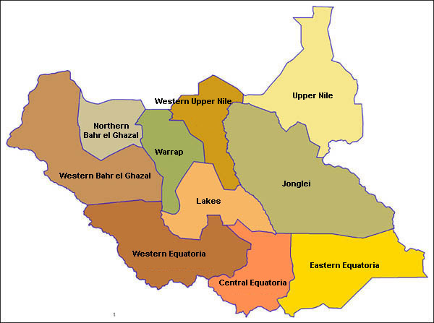
The republic of south sudan

Slide 2
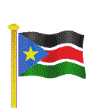

The flag and army coat

Slide 3
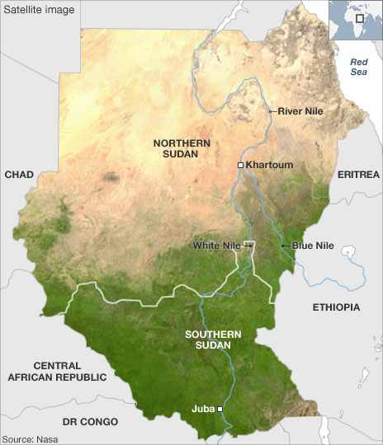
South Sudan is a country number 193rd according to UN membership and 54th in Africa, its separated from north Sudan on 9/7/2011 through referendum which was conducted in 9/1/2011.

Slide 4
Official Name: Republic of South Sudan
Independence Day: 9 July 2011
Capital City: Juba
Time Zone: East African Time (GMT+3)
Official Language: English
Currency: South Sudan Pound (SSDG)
Population: 8,260,490

Slide 5
The annually rain season in south Sudan:
In South Sudan regions it has a nine-month rainy season (April-December) and receives an average of 1,142 millimeters (45.0 in) of rain each year

Slide 6
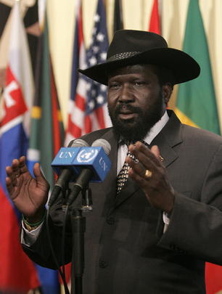
The president of the republic of south Sudan

Slide 7
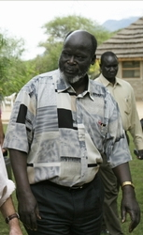
Dr: john garand(vision never die)

Slide 8
Natural resources
South Sudan is considered one of the richest countries in the world in terms of natural resources. It is endowed with fertile agricultural lands, potable wealth, minerals and tourist sites. South Sudan is also characterized by its vast virgin areas and varied climates as matter that makes the country capable of the production of different cereals and horticultural crops.

Slide 9
Minerals
petroleum; iron ore, copper, chromium ore, zinc, tungsten, mica, silver, gold; hydropower and uranium

Slide 10
Agriculture
100 % of the land is fertile but only 4.5% of south Sudan's land is currently under cultivation and the main crop is sorghum follow by maize(corn)

Slide 11
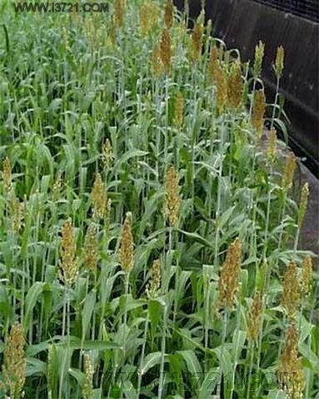
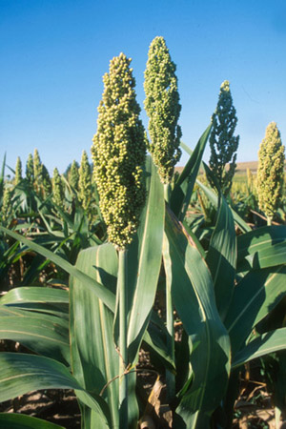
sorghum

Slide 12
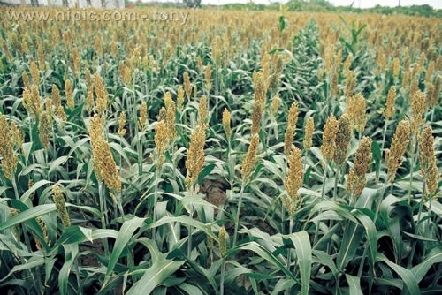
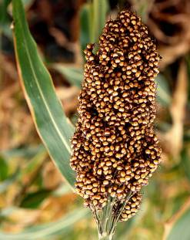

Slide 13
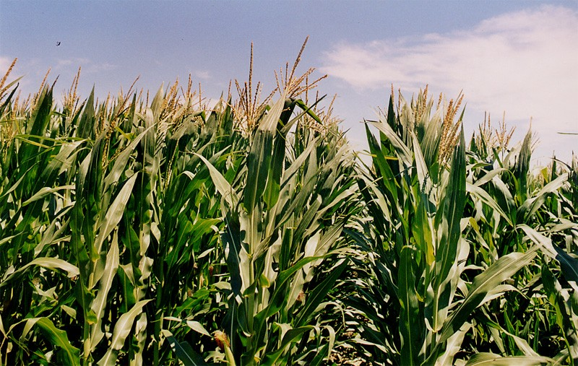
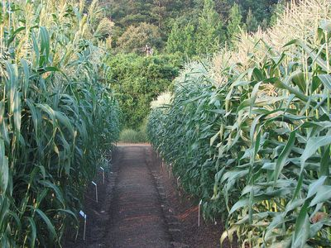
Maize is the second main crop

Slide 14
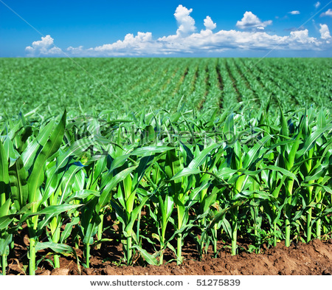

Slide 15
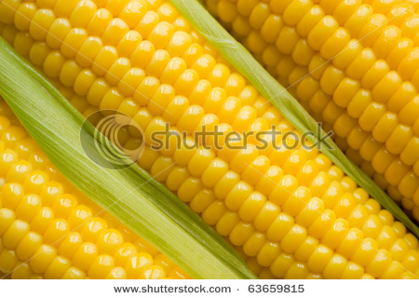
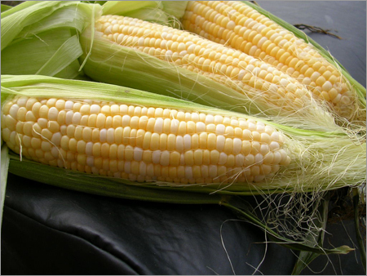

Slide 16
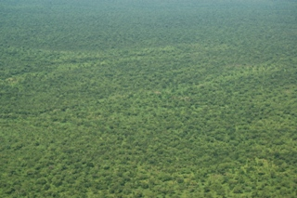
Thick forest in equatorial region cover an area of about 25,000 KM2.

Slide 17
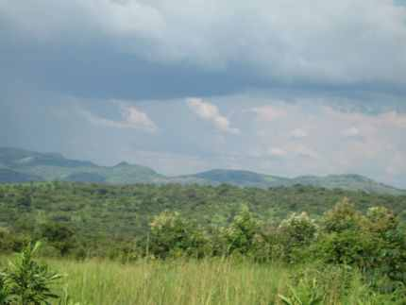
Rich forest cover South Sudan

Slide 18
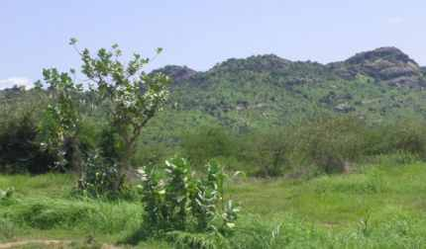
Panoramic view of Southern Sudan landscape

Slide 19
Livestock
South Sudan assumes the top place among the countries in the world regarding the animal wealth and ranks the second in Africa. It has a national herd of about 135 million heads of livestoc (cattle - Sheep - goats - horse species). The animal resources contribute considerably to the Gross Domestic Product (GDP) of the country.

Slide 20
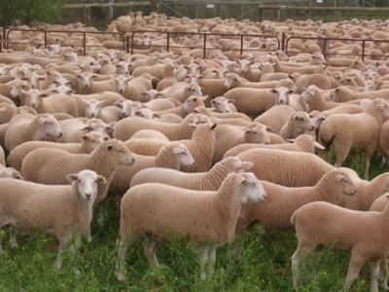
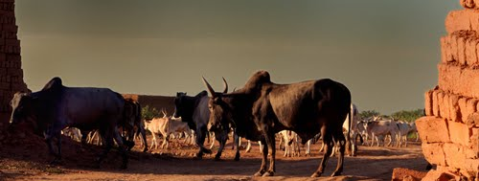
livestock

Slide 21

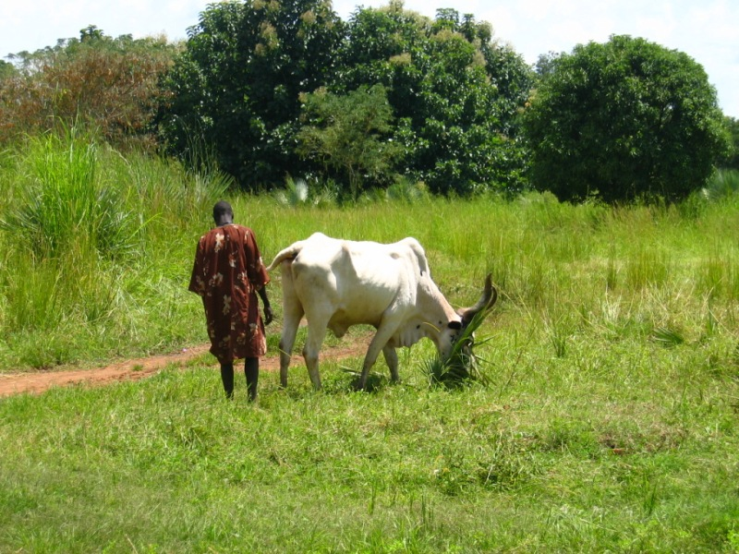
cows

Slide 22
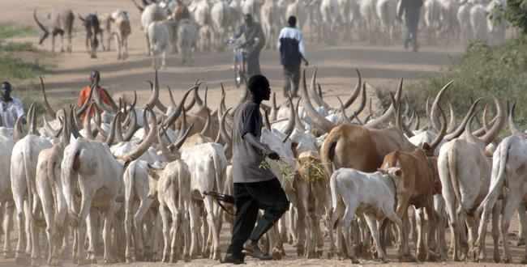
Cows of south Sudan

Slide 23
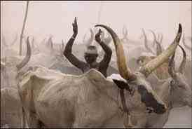
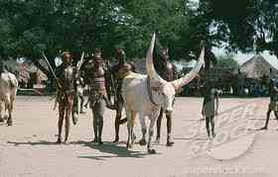

Slide 24
Tourism
There are about seven national parks and twelve game reserves in South Sudan. Recent surveys by the government in partnership with the Wildlife Conservation Society reveal that these parks and reserves have diverse wildlife species. They were inaccessible to human populations during the civil war and are today inhabited by large populations of kob, hartebeests, bongo and topis, giant and red river hogs, elephants, buffaloes, giraffes, chimpanzees and forest monkeys, hippos, hyenas, gazelles, zebras, ostriches and lions.

Slide 25
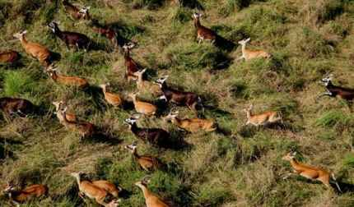
A group of kobs antelopes in Southern Sudan

Slide 26
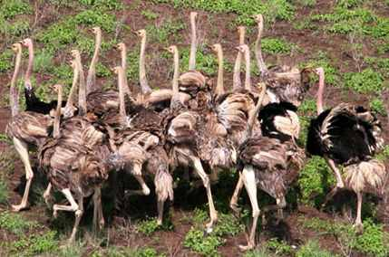
A group of ostriches in Southern Sudan

Slide 27
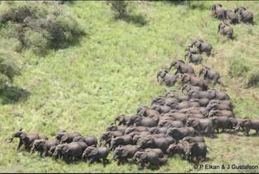
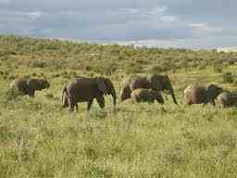
Group of elephants

Slide 28
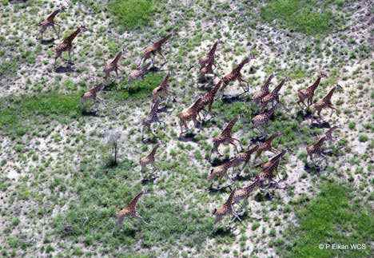
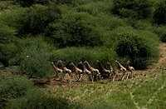
Group of giraffe

Slide 29
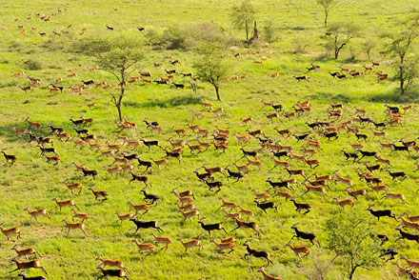
Group of ghazal

Slide 30
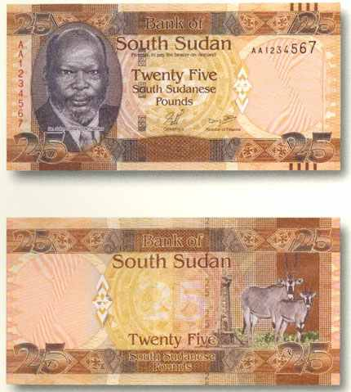
South Sudan currency

Slide 31
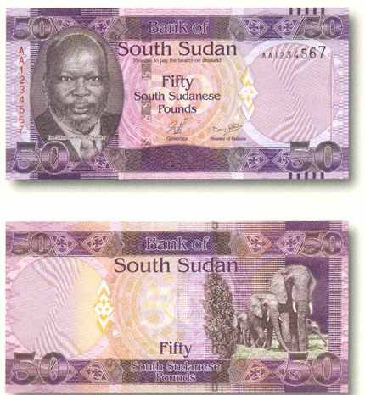

Slide 32
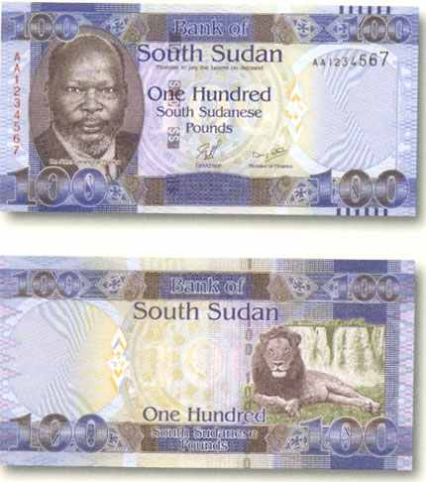

Slide 33
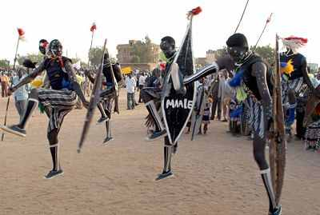
South Sudan is multicultural (273) tribes with different traditional

Slide 34
Sport and games
South Sudan is popular for many traditional and modern games and sports. Among these wrestling and mock battles were the most popular. These sports were mainly played after the harvest seasons to celebrate the harvests and wind up the farming seasons. The wrestlers were generally strong young men who were well trained
During the matches, they smear themselves with ochre . perhaps to enhance the grip or just to heighten their mysterious perception

Slide 35
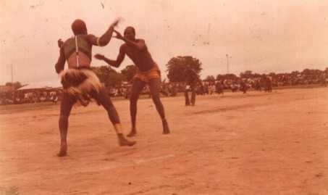

Slide 36
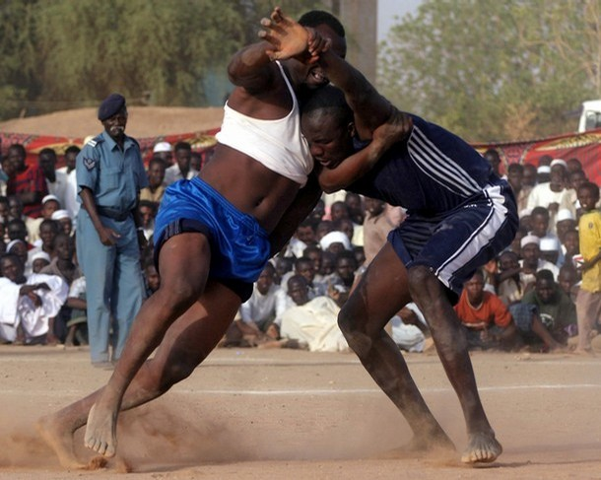

Slide 37
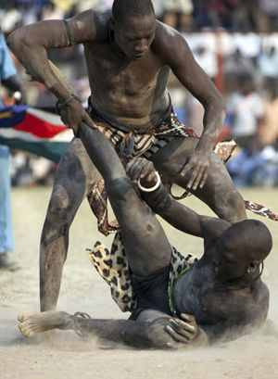

Slide 38
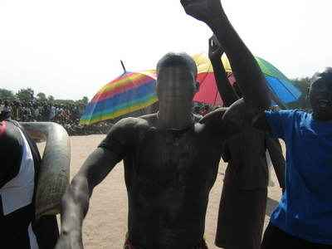

Slide 39
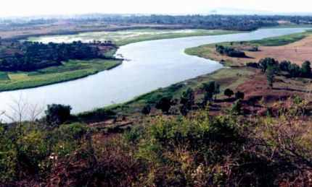
Nile is the longest river in the world and one of the seven wonder. It is 6,650 km (4,130 miles) long

Slide 40
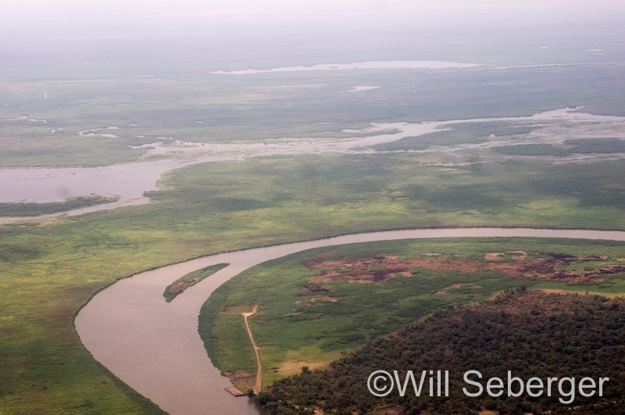

Slide 41
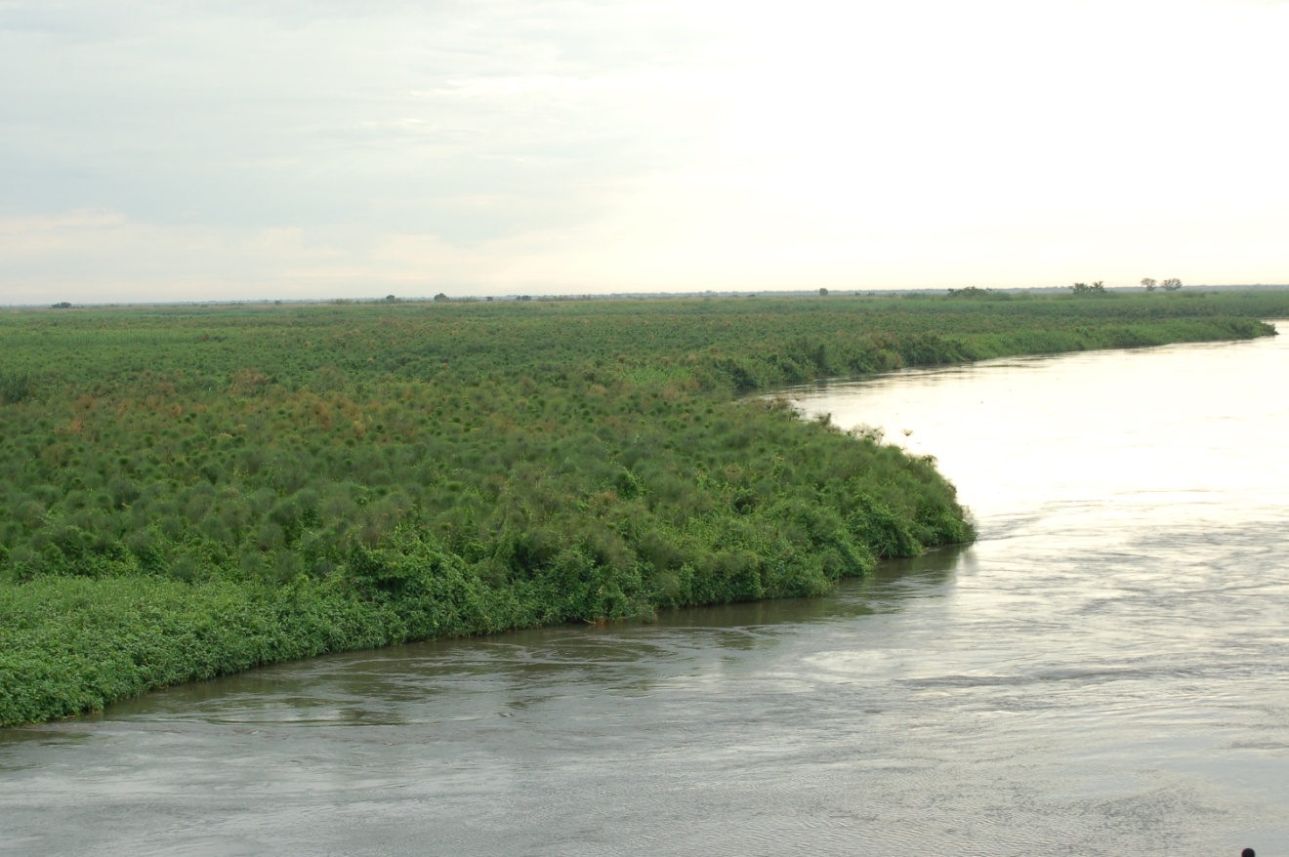

Slide 42
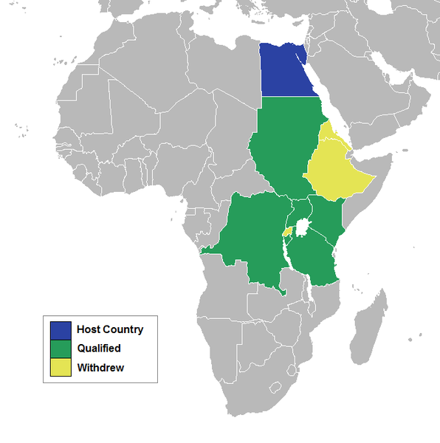
Nile basin countries map

Slide 43
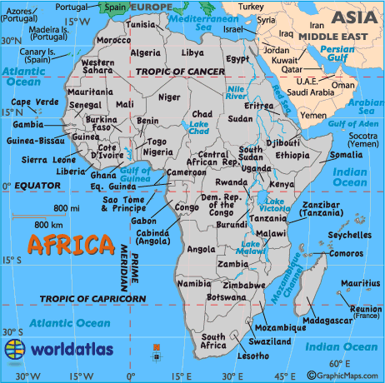
God bless Africa

Slide 44
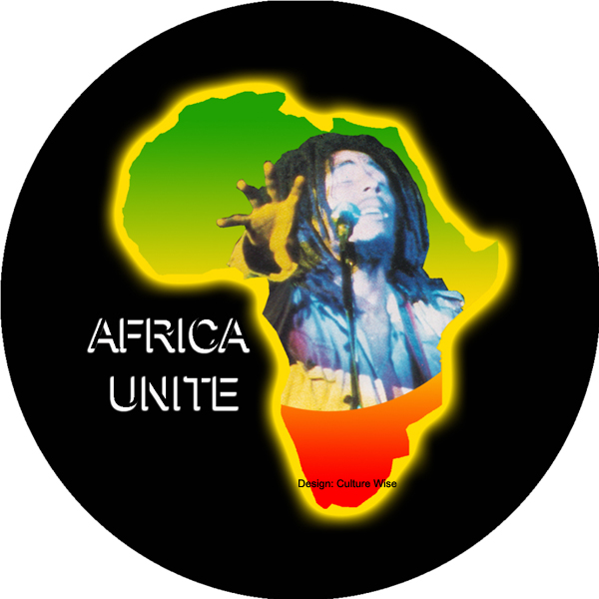
Together with one hands let us develop our continent scientifically

Slide 45
Thank you
for
Your
Attention and patience

