Slide 1
Post Graduate Studies
By :
Mukiibi Robert
Animal Scientist

Slide 2
Common Reasons for pursuing PG Study
Enjoyment of subject at undergraduate level
Specialise further in your degree area or new area.
Require PG study to pursue a chosen profession
(Teaching, Speech & Language Therapist, Psychologist). Specific Masters or PG Diplomas required.
Require PG study to pursue a career in academia- Lecturing/Research roles. PhD required for Universities. Masters for Institutes of Technology to be on a ‘Lecturer Career ‘Grade
Want to convert to a new career area
( Business, IT , Law…)
A Lecturer suggested this option
An opportunity to study / work abroad

Slide 3
Benefits of doing PG Study
Opportunity to specialise at a higher academic level-attractive to some employers, not important to others as you’ll be trained by company.
Gain more specialised knowledge/ relevant work related transferable and technical skills – e.g. project management skills, research & analytical skills – attractive skills to potential employers.
May gain relevant work experience-very important to employers
Increased Salary possibility(but many employers don’t offer extra on graduate entry to a job)
Good networking opportunity ( class mates can be from various backgrounds/attendance at conferences)

Slide 4
Types of Post Graduate Study
Masters
Taught (9-12 months on average) or Research
(18-24 months normally but sometimes converted to a PhD)
In USA and Other European Universities 24 months.
PhD- Research (3yrs minimum up to 5 years) necessary for an academic career in Universities.
Conversion Courses –( e.g. your degree is in IT and you want to add a specialisation in Business).Often called Higher/Graduate Diplomas.
Special Qualification Courses
( e.g. Teaching-Post Graduate Diploma in Education)
Higher Diplomas/Graduate Diplomas
Full time. Part time, distance/e learning, modular.

Slide 5
How to find Post Graduate Taught Courses and Scholarships
Search from independent universities’ sites
Joint programmes like Erasmus programmes
Some departments in the college have collaborations with other colleges.
Egyptian government may be offering some scholarships(am not so sure) so try to consult in the respective colleges and the university main building

Slide 6
1. Plan ahead
Research the colleges and universities where you would like to attend, focusing on the best programs that are the right match pertinent to your academic interests and personal needs.
Find out if any of the faculty are doing research in an area that interests you.
Go on-line or call the University for application and information materials. Double check the deadlines (most programs will not accept late applications).
Some schools have two deadlines; a fellowship deadline, which is earlier, and a later general application deadline.
Make sure you apply before the first deadline if you wish to be considered for university fellowships. Ideally, you want to obtain the right match of the program, the university and faculty you wish to work with.
In general, you should consider applying to at least 3 schools you believe would be a good match with your future goals

Slide 7
Entry requirements
The relevant degree major for that specific programm.
The required GPA or percentage please always remember not to waste money and time applying for a course whose requirements you do not possess.
Note: Some universities accept a 3year transcript while others only accept a full 4year transcript
Standardized tests(IELTS, TOEFL, GRE)
Know the minimum score required and prepare for the maximum scores.
Avoid getting below 20 in any of the sections for the iBT-TOEFL
University codes are important when registering for the tests
personal statement.
Letters of recommendation
CV or resume
Some other documents like passport photocopies

Slide 8
Recommendation Letters
For graduate study, letters of recommendation are extremely important.
Letters from faculty are usually preferred by admission committees since they believe only faculty can truly ascertain your intellectual and graduate student potential.
You need 2-3 letters of recommendation.
Try to get all three from faculty with whom you’ve had an upper-division class, or have done research with. Some graduate programs require related work/internship experience, and you will need one or two letters from these entities in addition to one or two from faculty.
Professors will invariably state your class grade in the letter, so use caution when choosing your evaluators. Approach the faculty member and ask her/him if they are able to write a positive letter of recommendation for you. If they hesitate, say they can only write a neutral letter, approach someone else.
Provide the evaluators with additional material such as copies of your transcript, resume, your statement of purpose, and personal statement (which should provide information about any pertinent personal history). This can strengthen the letter they write for you. Make sure to give them all the proper letter of recommendation forms, addresses, and deadlines. Ask them how they'd like to proceed regarding sending out multiple letters. They may prefer an electronic submission format provided your university.

Slide 9
Statement of Purpose or Personal Statement
The statement of purpose is one of the most important parts of the application process
It is from this essay that the admissions committee will discern the seriousness of your intentions, your experience, and your motivation for graduate school.
Why you want to undertake postgraduate study?
2. Your reasons for wanting to study at a particular university?
3. The courses available to you and decide which you are most interested in
and why?

Slide 10
4. The elements of the course, which are of particular interest to you, for example a placement opportunity offering employment related or experience, specialist modules or a specific research opportunity?
5. The previous practical or academic experience you may have already
undertaken which either indicates your interest in the area of study
and/or the career it may lead to?
6. What skills you have which will enable you to make this transition and be successful in your chosen course or research area?
Before writing your Personal Statement, use the points above as a checklist.
Try to have at least two or three comments or points for each question.
These will help to focus your first draft on the areas those reading it will be
interested in.

Slide 11
Statement composition
Think of the statement of purpose as a composition with three different parts.
The first is a brief paragraph introducing yourself, the program you want to study, and your research focus.
The second part should be a summary of your college experiences. Briefly describe what brought about your interest in graduate study. Describe any research experiences, clarifying who you worked with, your responsibilities, results, and if you published the findings or presented them at a conference. Be as specific as possible, as it is professors in your discipline who are reading this statement. But don’t be vague.
The third and most important part of the essay discusses why you want to go to graduate school, what you wish to study and ideally, one or two professors you’d like to work with. This should be a fully developed paragraph addressing an issue or topic that hasn’t been done before, or expanding an undergraduate research project. Professors seek students who have intellectual passion, scholarly potential, and serious intention about graduate study. Scholarly endeavors undertaken beyond degree requirements will be positively noted by admissions and fellowships committees. Avoid going to the extreme or exaggerating.

Slide 12
Financing your Postgraduate studies
Private
This involves student paying for him
or herself.
Fellowships or scholarships.
Different funding bodies all over the world are offering financial assistance to mainly outstanding students.

Slide 13
University Scholarships and independent foundations/organisations
University sponsorship come as:
1.Assistantships(Mainly in U.S.A)
Teaching assistantships
Research assistantships
2.University scholarships or
Fellowships
These are given by the Universities to the admitted students and the finances are usually provided different orginasations or the Universities themselves or governments(organizations)
One needs to be sure if the scholarship is a full or a partial-one
3. Governmental Scholarships.
Especially the European Union Scholarships that are funded by the EU through its education commission.
These include:
Erasmus Mundus Scholarships 2. emmerge scholarships

Slide 14
Scholarship search tips
The major source of information is the internet.
Use specific terms like “scholarship of masters in plant biotechnology”
Save all those websites that seem to have what you are looking for usually an email folder works better.
Always remember it takes time, it can even take months of search with no positive results
Consult those that have already got these opportunities
For the Egyptians we have an Erasmus information centre in the college of Agric in the dairy Dept

Slide 15
Application tips for the scholarships
Usually applications are for the programme and then the potential applicants are directly considered for the financial aid or scholarships. e.g Erasmus, and European university scholarships
Others you have to complete separate application forms one for admission for the programme and second one is for the scholarship.
Some have online applications others pdf applications that can be downloaded.

Slide 16
Research Masters/ PhDs
If you are interested in doing a Research Masters then contacting your department- Head or a lecturer is the first step to check out the possibilities.
Funding and a lecturer willing to supervise your Masters is required.
Some Lecturers/Heads of Departments apply for government and other funding each year
Inquiry letter writing is so important in this case.

Slide 17
Choosing a Post Graduate Course
What course(s) interests you and where are they available?
Match your self knowledge to the course demands.
Methods of study-full/part-time
Selection Procedures
Job Prospects/ Career benefits

Slide 18
Courses of interest and availability
Research your options and apply in time! Closing Dates vary from November to Summer . Application forms often require a good deal of time to complete and competition for places is high.
Where are the courses that interest you and are you prepared to relocate?
U.S.A/ Europe / Rest of world

Slide 19
Match your self-knowledge to the course demands
Think about your academic interests, degree of motivation to study alone/ in a class, your available time, costs involved. Other commitments.
Consider the demands of Taught (class based/assignments /exams) Vs. Research Masters(need to be highly self motivated and like working alone)
You want to convert to a new area (e.g. from engineering to business) or specialise (e.g. international marketing for Business Students)

Slide 20
Give Evidence in your application
Have you researched this course fully? Are you clear on what skills, qualities and experience are essential for this course and ultimately for this career?
Your past is evidence of your future potential. Essential to draw on your past experiences (college/work/relevant hobbies/work shadowing) to demonstrate your skills/experience in this field
Are you using the right language (key words can often be found in the college/course prospectus or web site) Use the language of your degree - business e.g. Evaluated… Analysed… Reconciled….Designed…..

Slide 21
Deadlines
Be careful to look at the deadline dates to submit the online filled forms and the hard copies of the forms and the supporting documents, as they do differ from university to university or according to the desired programme
Also deadlines differ for local students and us for us the international students.
Always complete and send your applications atleast three weeks before the deadline.
Always use express mail services as they are much safer and easy to track the documents.(EMS, Fedex, DHL, Middle East Couriers).
After the days of expected delivery of the

Slide 22
Summary
Spend time on the internet looking out for the new opportunities that come up and always note them down.
Prepare in time all the required documents (transcripts, recommendation letters, personal statements and cv and passport photographs)
Always endeavor to submit the documents in time, maximum 3 weeks before the deadline
Check very well the documents to be submitted should all be signed and organized well.
Make sure the right address is written on the envelope with the right address with the phone number of the office to receive the documents
Its always not right to think that you have a lot of time and also having excellent grades do not exempt you from the from the rules that govern the application procedures

Slide 23
Further Resources
www.kent.ac.uk/careers/postgradmenu.htm
Emerge scholarships
http://emerge.uaic.ro/mobility-guidelines/how-to-apply/application-form
Erasmus scholarships
http://eacea.ec.europa.eu/erasmus_mundus/funding/scholarships_students_academics_en.php
Study in Sweden
http://www.studyinsweden.se/Scholarships/
Study in Belgium
http://www.studyinflanders.be/en/study-programmes/exchange-programmes
Australian scholarships
http://www.studyinaustralia.gov.au/en/Study-Costs/Scholarships/Scholarships
http://www.scholarships.org.au/
Fullbright scholarships

Slide 24
Some European Universities offering scholarships
Ghent University Belgium.
Copenhagen University Denmark.
Swedish University of Natural sciences.
Wageningen University Netherlands.

Slide 25
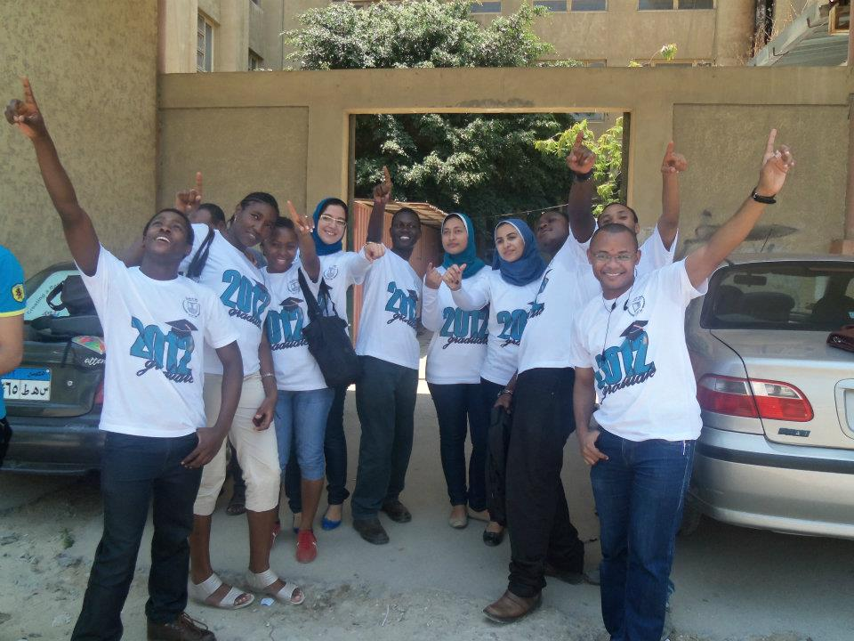
THANK YOU

