Slide 1
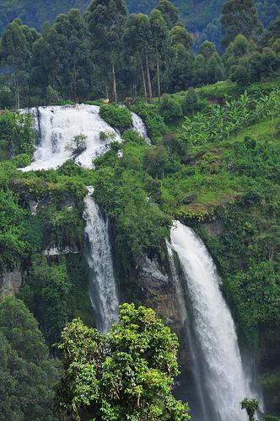
Ugandan Forestry
PRESENTED BY
Mukiibi Robert.

Slide 2
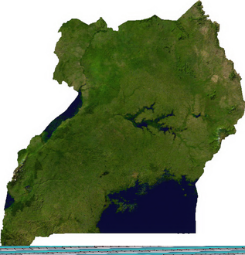
Introduction
Uganda has a total land area of 241,000 km²,out of which 12% or 30,980 km2 is gazetted.
Out of the total protected area, 12,757 km² are forest reserves under the Forest Department and local governments ,while Game Reserves
and National Parks cover 321,000 ha.
The combined effect of high economic growth and population growth has a
significant effect on the forestry sector.
Rural areas support 90% of Uganda‘s population.
The rural and urban population use woodfuel for domestic energy
needs.
In urban areas, charcoal is the main source of energy.
Fuel wood consumption is estimated at 16.7 million tons annually, while annual charcoal production is estimated at 418,000 tons

Slide 3
Forest classification in Uganda
The forests in Uganda are divided into two main categories.
Natural forests
including:
Savanna
Woodlands
Tropical rain forests
(ii) Planted forests

Slide 4
1. Savanna, which is composed of scattered trees within grasslands, is characterized by the strong influence of herbivores and fires. Savanna is the most abundant kind of vegetation in Uganda. Fig. below shows a forest/savanna mosaic at medium altitudes. Black crowns are evergreen; shaded ones drop their leaves at irregular intervals; unshaded ones are deciduous.

Slide 6
2.Woodland is defined as open forest with "small or medium sized trees with the crowns more or less touching, the canopy remaining light; the grass stratum sometimes sparse, often mixed with other herbaceous or suffrutescent vegetation" (LANGDALE-BROWN et al., 1964). Woodland may be a climax vegetation or a stage of succession towards forest depending on its environment

Slide 9
3.The tropical high forest in Uganda consists mainly of lowland evergreen or semi-deciduous rain forests with a canopy up to 50m and with several storeys of trees. As subtype of this vegetation type, the Cynometra zone at 700-1,200m in the lowest parts of Uganda covers most of Uganda's potential forest zone
Tree species include: Albizia, Antiaris, Blighia, Canarium schweinfurthii, Celtis africana, C. durandii, Entandrophragma, Fagara, Lovoa, Majidea and Pycnanthus, richiliaprieuriana, Khaya anthotheca, Khaya anthotheca, Celtis mildbraedii, and Cynometra alexandri, Allophyllus macrobotrys and Cassipourea ruwenzorensis

Slide 10
Mabira Forest

Slide 12
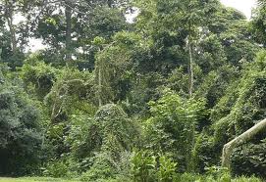

Slide 13
Planted Forests
The first plantation was started in 1908 using indigenous species, Markhamia platycalyx, Melicea excelsa and Entandrophragma spp. Plantations of exotic coniferous species were started in 1940 to meet the future demand for timber.
Wood production plantations were established at an accelerated rate after 1948 with emphasis on tropical Pinus spp. and Cupressus spp. Planting reached a peak in the early 1970s and then came to a standstill in 1978.
Meanwhile, the private sector established non-industrial plantations for products such as fuelwood and poles. As a result, plantations are now very important for the supply of both industrial and non-industrial wood. Moreover, they are a very important element in reducing the pressure on fragile natural forests

Slide 14
Species composition
Of planted forests
Coniferous species and Eucalyptus spp. each comprise about 50 percent of the plantation area.
(i)Coniferous species
Cupressus spp. and Pinus spp. are planted for timber and also reduce pressure on the natural forests.
One third of the coniferous plantations are Cupressus spp. and the rest are Pinus spp.
(ii)Eucalyptus species
Eucalyptus spp. are planted for the production of transmission poles, building construction timbers and fuelwood.
Fuelwood is the most important product, both for domestic energy as well as for some agricultural uses such as tobacco curing or tea production

Slide 15
Species | Notes | Suitable in Uganda
Eucalyptus grandis | First introduced around 1912. ➢ Commonly planted for fuel wood and poles and important source of income for small farmers since it is easy to raise from seed, coppices vigorously when cut with rotations of 8-15 years. ➢ Cool moist, cool wet areas (18-220) and Rainfall:1 250-1 500 mm. | Central and Mid Eastern, Western and Midwest, West Nile
Pinus caribaea | It copes well with shallower soils on lower elevation sites and performs well on fairly dry sites. ➢ P.c. var. hondurensis is easy to raise from improved seed for commercial planting with rotations of 18-25 years ➢ Warm wet, hot wet conditions (22-240). ➢ Rainfall: >1 250 mm.

Slide 16
Species | Notes | Suitable in Uganda
Maesopsis eminii | Fast growing indigenous species for timber production and general purpose hardwood timber although not easy to grow in plantations. ➢ Prefers moderately fertile, deep and well drained soils for it is a natural pioneer species in the Tropical High Forest - around Lake Victoria's shore, Albertine Rift. ➢ Cool, moist, wet and or slightly warm (18-240) with rainfall: <1 200 mm | Lake shore basins
Clonal Eucalyptus | Hybrid clones of E. grandis x E. camuldulensis (GC) and E. grandis x E. urophylla (GU) were imported from South Africa in 2002/2003, trial plots of provenances were established in different parts of the country. ➢ The clones have shown tremendous potential to expand the plantable area for eucalypts in Uganda. ➢ For drier and hotter sites. | Central, Western, Northern, Southern, West Nile

Slide 17
Pinus trees in Uganda

Slide 18
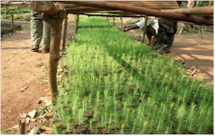
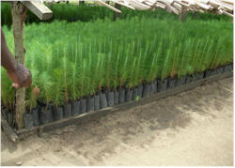
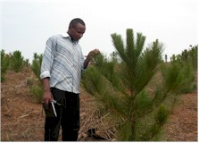
Pinus

Slide 19
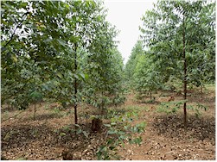
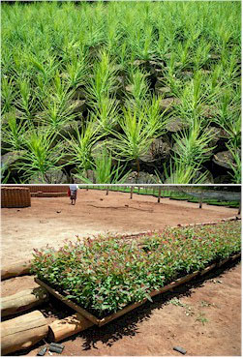
Eucalyptus

Slide 20
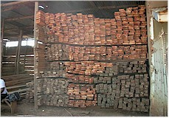
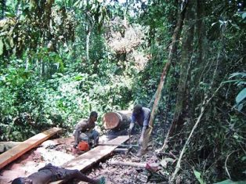
Products from Forests
Timber used for building,
furniture

Slide 21
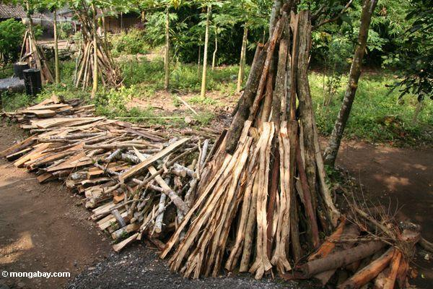
More products
Poles for building
Wood for fuel

Slide 22
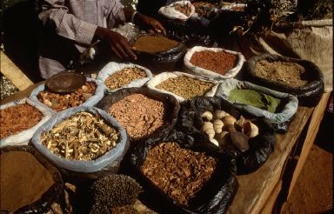
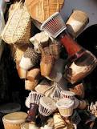
Artfacts
Local herbal medicines

Slide 23
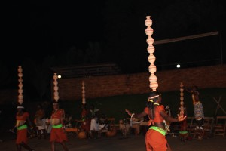

Slide 26
References
http://www.fao.org/forestry/partnerships/22753/en/
http://www.fao.org/forestry/country/18316/en/uga/
http://www.cfa-international.org/yfa_diaries.php
http://wn.com/The_Great_Uganda's_Mabira_Forest
http://www.nfa.org.ug/

