Slide 1
Allergic , I am

Slide 2
Our storyboard
What is Allergy ?
History of Allergy
What causes Allergy?
What happens in your body during Allergy ?
Allergy ..is it dangerous ?
Allergic ..then what ??

Slide 3
What is Allergy ?
An allergy is the response of the body's immune system to a normally harmless substance, such as pollen, food, or house dust mite. The body has an automatic reaction to what it sees as a threat, and while in most people these substances pose no problem, in those with allergies the immune system identifies them as a threat and produces an inappropriate response to them.

Slide 4


Slide 5
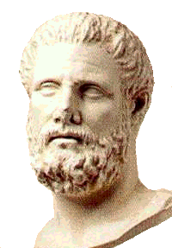
History of Allergy

Slide 6

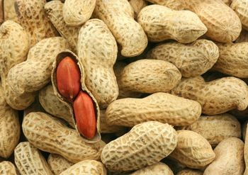
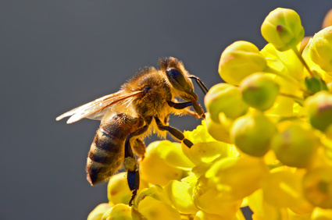
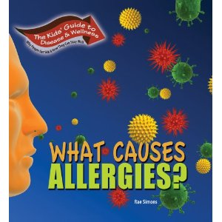
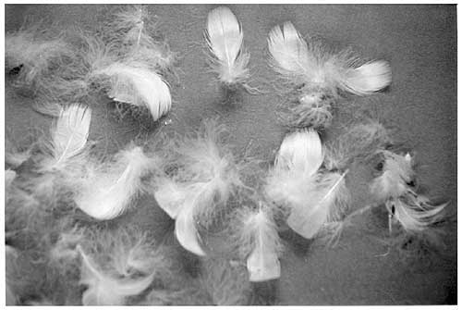
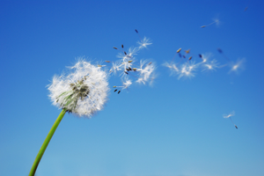

Slide 7
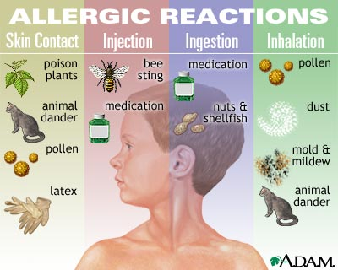

Slide 8
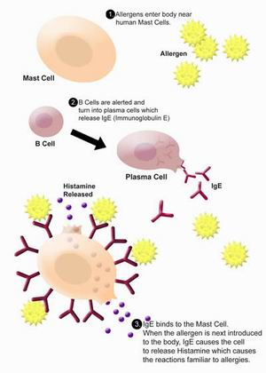
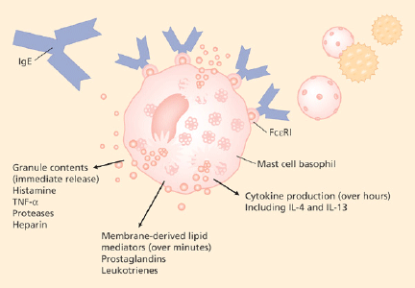
What happens in your body when you have allergies ??

Slide 9
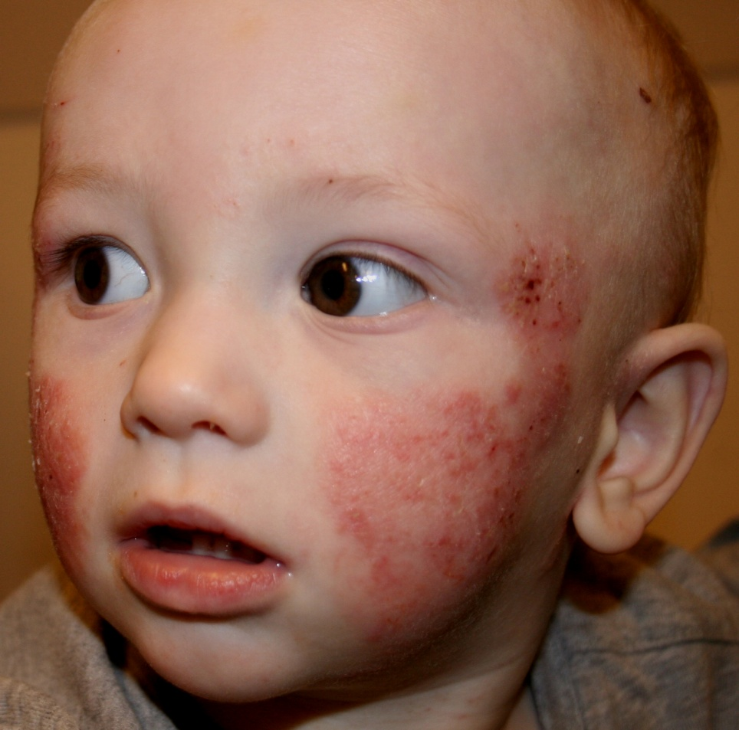
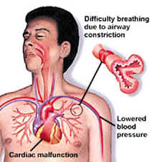
Allergy …is it dangerous ??

Slide 10

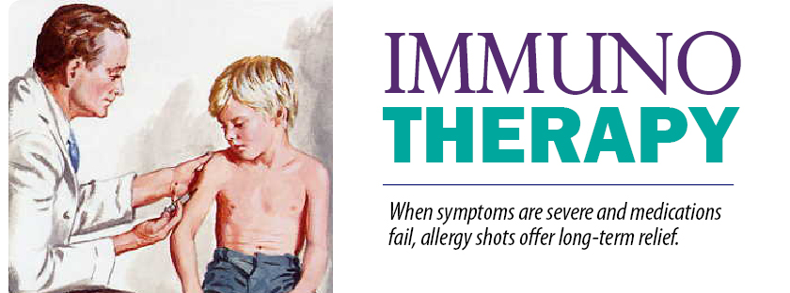
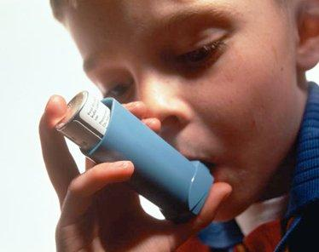
Allergic ..then what ?

Slide 11
References
Mark’s Basic Biochemistry A clinical approach, 2nd Edition , chapter 44.
Roitt_Roitts Essential Immunology 10th Edition , chapter 5.
Roitt_Roitts Essential Immunology 10th Edition
Chapter 16.
http://accessscience.com/search.aspx?topic=BIO:BIOSCI:IMM&term=allergy+and+ige+antibodies
http://pathmicro.med.sc.edu/mayer/igstruct2000.htm
VIDEO : http://www.youtube.com/watch?v=y3bOgdvV-_M

Slide 12

Done and presented
by :
Salma Said Souliman
2nd year medical student
E-mail: salmasaidsouliman@hotmail.com

