Slide 2
Diabetes Mellitus
Type I
Type II

Slide 3
Type I Diabetes Mellitus:
Insulin dependent diabetes mellitus.
Occurs mostly in childrens.
Immune system attacks and destroy beta cells in pancreas that secrete insulin.
The pancreas then produces little or no insulin.

Slide 4
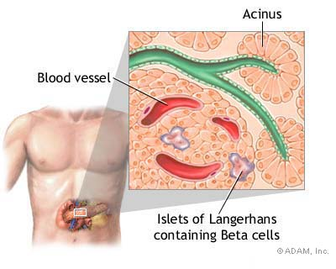
Beta cells present in langerhans islets in pancreas which secrete insulin hormone.

Slide 5
Symptoms:
Thirst and urination.
Constant hunger.
Weight loss.
Blurred vision.
Extreme fatigue.
Diabetic coma may present.

Slide 6
Diagnosis: Fasting blood sugar is greater than 140mg/dl.
Treatment:
Patient must take insulin daily.

Slide 7
Type II Diabetes Mellitus:
Non-insulin-dependent diabetes mellitus.
Defect is in responsiveness to insulin.
Almost involving insulin receptors in cell membranes.
Occurs mostly in adults.
Patient percent of this type is from 85% to 95% around the world.

Slide 8
Diagnosis:
Measuring blood glucose level.
Treatment:
- It first treated by increasing physical activity.
- Decreasing carbohydrates & lipid intake in diet.
- Weight loss.

Slide 9
Gestational diabetes:
It resembles type II diabetes mellitus.
Involving during pregnancy.
May improve or disappear after delivery.

Slide 10
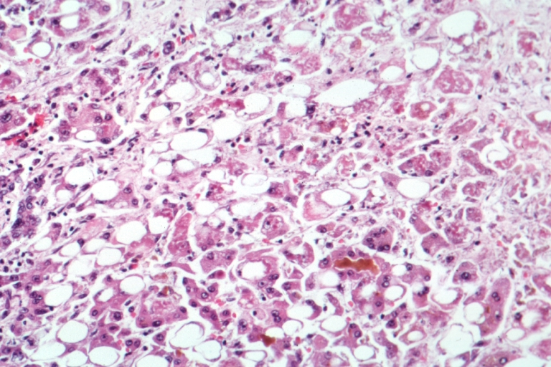
Hepatitis:
Definition :
Liver inflammation characterized by the presence of inflammatory cells.

Slide 11
Hepatitis causes:
- Not only caused by some viruses ,but also we can see that toxins like (alcohols, drugs, industrial organic solvents) cause it.
- It’s usually caused by a virus.
- The three most common hepatitis viruses
are hepatitis A, hepatitis B, or hepatitis C.

Slide 12
Hepatitis A :
Unlike some other hepatitis viruses, hepatitis A rarely leads to permanent liver damage .
The hepatitis A virus (HAV) is transmitted through the feces ) فضلات الطعام (of infected individuals .

Slide 13
Hepatitis B virus (HBV) :
It is transmitted from person to person through blood or other body fluids.
People who share needles are at risk of becoming infected because it's likely that the needles they use will not have been sterilized.

Slide 14
Hepatitis C :
Hepatitis C is the most serious type of hepatitis .
The hepatitis C virus (HCV) is transmitted from person to person through blood or other body fluids .
Like hepatitis B, hepatitis C can lead to cirrhosis or liver cancer.

Slide 15
Infection ways:
- Contaminated needles.
- Contaminated blood.
- Unprotected sex.
From mother to her baby
during pregnancy period.
( Regarding virus B & C )

Slide 16
Symptoms of hepatitis include:
Yellowing of the skin and eyes, known as jaundice.
Fever.
Nausea.
Vomiting.
abdominal pain .
dark-colored urine.

Slide 17
How to protect yourself against hepatitis?
Vaccines can protect people against hepatitis A and hepatitis B. What about hepatitis C and other types of hepatitis (A,B) too ?

Slide 18
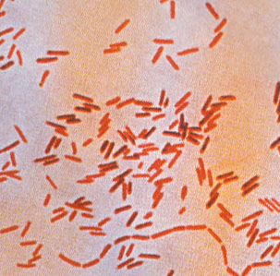
Typhoid :
Typhoid fever is an infectious feverish disease.
Typhoid fever is caused by an infection with a bacterium (Salmonella typhi).

Slide 19
Symptoms :
Typhoid fever symptoms are headaches,
generalized aches and pains, fever, and tirdness.
Diagnosis :
A widal test is made for the person.
Treatment :
Usually by using antibiotics.

Slide 20
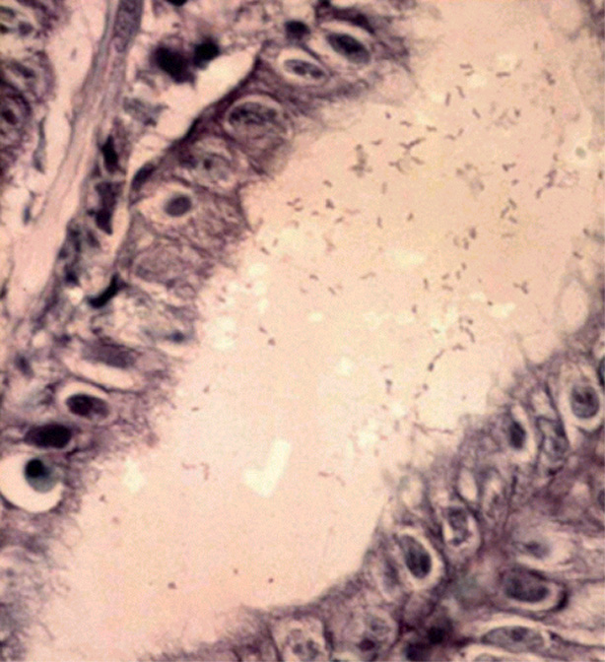
Peptic ulcer disease :
- It is the most studied disease related to H. pylori infection.
- H. pylori can produce and release several bioactive factors that may directly affect the stomach's parietal cells, which produce hydrochloric acid, that leads to low PH.

Slide 21
- More than half of the population in the world carries H. pylori in their stomach. However, only a few people develop symptoms of infection and therefore many never know they have the bacteria present in their system.
- Other than peptic ulcers, it can even lead to stomach cancer as well as esophageal adenocarcinoma.

Slide 22
Causes of H. pylori Infection:
H. pylori can spread through food and water contaminated by fecal matter. It is very contagious and can spread even through direct contact with contaminated body fluids like saliva, vomit or stools.

Slide 23
Symptoms:
nausea, vomiting, abdominal pain.
Pain or discomfort in stomach.
Dark stools.
Diagnosis:
Blood tests like blood antibody test.
A breath test
rapid urea test
ELISA test
microbial culture growth from stool samples.

Slide 24
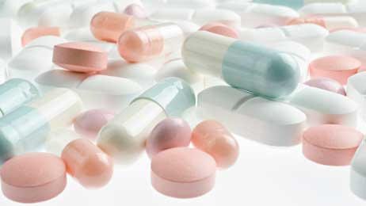
Treatment:
The patient is advised antibiotics to treat the bacterial infection. Other antibiotic is advised to reduce the acid production in the stomach.

Slide 25
References:
http://www.idf.org/content/diabetes
http://www.diabetes.org/diabetes-basics/type-1/?loc=HomePage-type1-tdt
http://www.who.int/csr/disease/hepatitis/en/
http://www.webmd.com/hepatitis/default.htm
http://textbookofbacteriology.net/salmonella.html
http://www.healthplus24.com/diseases/peptic-ulcer/h-pylori-infection.aspx

Slide 26
Presented
By
☺ Doaa Zamel ☺
E-mail: doaazamel@yahoo.com

