Slide 1
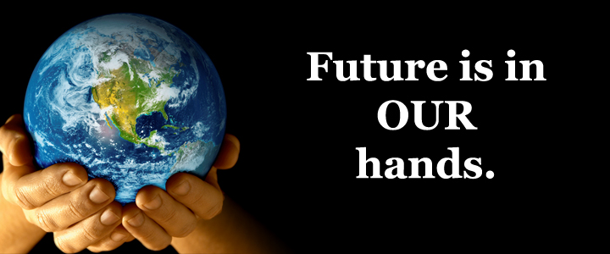
The presentation project
Contamination & pollution
This Project Prepared by:
Menna tallah khaled
Salwa Sameh Bakr
Nourhan Mustafa

Slide 2
Contamination
Contamination is the presence of a minor and unwanted constituent in a physical body.
Environmental Contamination :
- It can cause catastrophic harm to health as well as drastically diminish property value . People can be exposed to toxic chemicals in groundwater soil ; through drinking contaminated water, breathing polluted air, or coming into contact with dangerous toxins released into the environment by events such as oil spills.

Slide 3
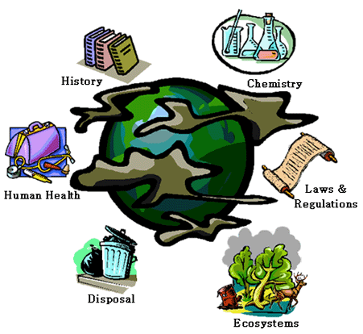
Pollution
Pollution: is the introduction of contaminants into the environment that cause harm to humans or other living organisms which can come in the form of chemical substances, or energy such as noise, heat or light.
Pollutants: The components of pollution, can be either foreign substances/energies or naturally occurring contaminants. Pollution is often classed as point source or nonpoint source pollution.

Slide 4
Health is Wealth
Health is a state of wellbeing free from all types of diseases. It is the general condition of complete physical, mental and social well being. Nobody is totally healthy or totally sick. Each of us is a unique combination of health and sickness. The saying, ‘Health is Wealth’, signifies the importance of health. Healthy living is not a difficult step; it is merely about making small changes in lifestyle.

Slide 6
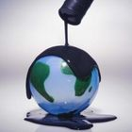
11 facts About pollution
. Pollution is one of the biggest global killers, affecting over 100 million people. That’s comparable to global diseases like malaria and HIV.
Over 1 billion people worldwide lack access to safe drinking water. 5,000 people die each day due to dirty drinking water.
14 billion pounds of garbage are dumped into the ocean every year. Most of it is plastic.
Over 1 million seabirds and 100,000 sea mammals are killed by pollution every year.
People who live in places with high levels of air pollutants have a 20% higher risk of death from lung cancer than people who live in less-polluted areas.
The Mississippi River carries an estimated 1.5 million metric tons of nitrogen pollution into the Gulf of Mexico each year, creating a “dead zone” in the Gulf each summer about the size of New Jersey.

Slide 7
7. Approximately 46% of the lakes in America are too polluted for fishing, aquatic life, or swimming.
8. Americans make up an estimated 5% of the world’s population. However, the U.S. produces an estimated 30% of the world’s waste and uses 25% of the world’s resources.
9. Each year 1.2 trillion gallons of untreated sewage, storm water, and industrial waste are dumped into U.S. water.
10. While children only make up 10% of the world’s population, over 40% of the global burden of disease falls on them. More than 3 million children under age five die annually from environmental factors.
11. Recycling and composting prevented 85 million tons of material away from being disposed of in 2010, up from 18 million tons in 1980

Slide 8
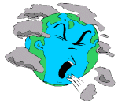
Types of Pollution
Air Pollution
Light Pollution
Littering
Noise pollution
Radioactive contamination
Thermal pollution
Water Pollution

Slide 9
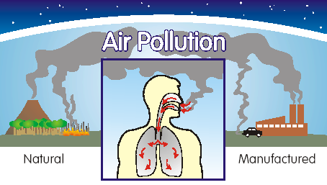
Air Pollution: The release of chemicals and particles into the atmosphere. Common gaseous pollutants include carbon monoxide, sulfur dioxide, chlorofluorocarbons (CFCs) and nitrogen oxides produced by industry and motor vehicles
Radioactive contamination: resulted from 20th century activities in atomic physics, as nuclear power .
Thermal pollution: is excess heat that creates undesirable effects over long periods of time.

Slide 10
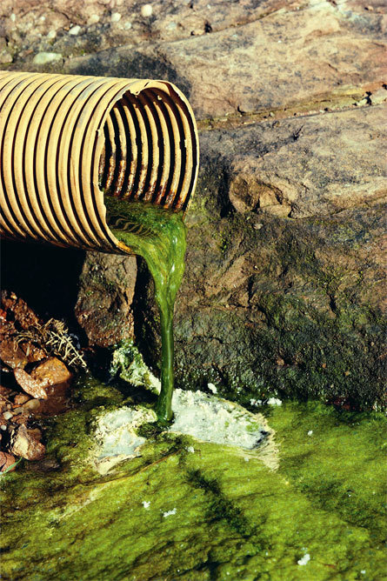
Water Pollution: by the discharge of waste water from commercial and industrial waste (intentionally or through spills) into surface waters; discharges of untreated domestic sewage, and chemical contaminants, such as chlorine, from treated sewage.
Pollution can also be the consequence of a
natural disaster. For example,
hurricanes involve water contamination from
sewage, and petrochemical spills from
ruptured boats.
Larger scale and environmental damage
is not uncommon when coastal oil rigs or refineries are involved.
Some sources of pollution, such as nuclear power or oil tankers, can produce widespread and potentially hazardous releases when accidents occur.

Slide 11
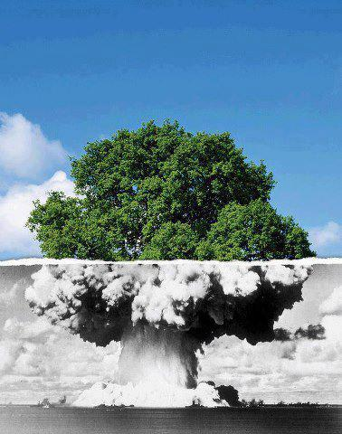
Radioactive pollution
Nuclear energy is a form of energy that’s released by the splitting of atoms , it has also been used to generate electricity.
It has been recognized as a clean energy because it doesn’t release pollutants such as CO₂ to the atmosphere.
Despite the advantage of nuclear energy as a clean energy, the big concern is the waste resulted from nuclear reaction, which is a form of pollution, called radioactivity ; which is a form of energy traveling through space.

Slide 12
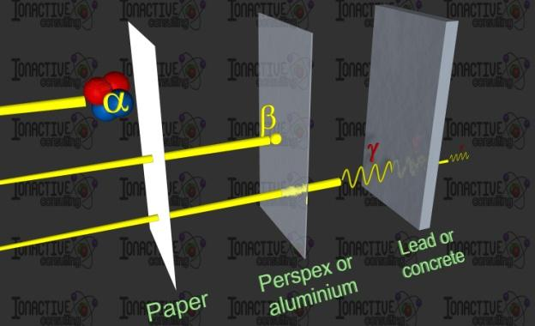
Types of Radiation
Alpha particles
Beta particles.
Gamma rays

Slide 13
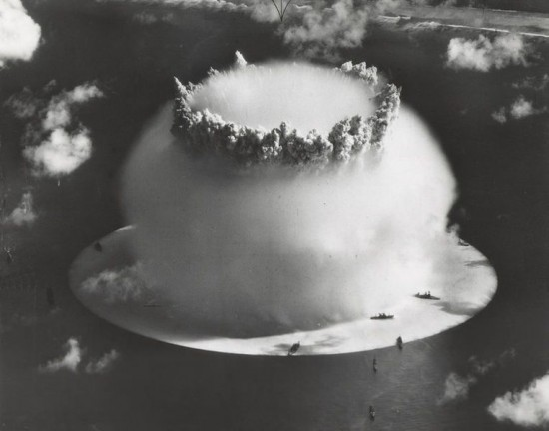
Thermonuclear weapon
A thermonuclear weapon
is a nuclear weapon design that uses
the heat generated by a fission bomb to
compress a nuclear fusion stage which
indirectly results in greatly increased
energy yield , referred to as a hydrogen bomb or H-bomb because it employs hydrogen fusion, though in most applications the majority of its destructive energy comes from uranium fission, not hydrogen fusion by itself.
A nuclear weapon is an explosive device that derives its destructive force from nuclear reactions, either fission or a combination of fission and fusion. Both release vast quantities of energy from relatively small amounts of matter.

Slide 15
Effect of pollution on humans
Adverse air quality can kill many organisms including humans. Ozone pollution can cause respiratory disease, cardiovascular disease, throat inflammation, chest pain, and congestion.
Water pollution causes approximately 14,000 deaths per day, mostly due to contamination of drinking water by untreated sewage in developing countries.
1,000 Indian children die of diarrhea every day.
Nearly 500 million Chinese lack access to safe drinking water.656,000 people die prematurely each year in China because of air pollution. In India, air pollution is believed to cause 527,700 fatalities a year.
Studies have estimated that the number of people killed annually in the US could be over 50,000.
Oil spills can cause skin irritations and rashes.
Noise pollution induces hearing loss, high blood pressure, stress, and sleep disturbance .
Lead and other heavy metals have been shown to cause neurological problems.
Chemical and radioactive substances can cause cancer and as well as birth defects

Slide 16
Pollution control
Is a term used in environmental management , It means the control of emissions and effluents into air, water or soil.
Without pollution control, the waste products from heating , mining, manufacturing, transportation and other human activities, whether they accumulate or disperse, will degrade the environment pollution prevention and waste minimization are more desirable than pollution control.
Some practices to prevent Pollution:
Reusing
Reducing
Recycling
preventing
compost

Slide 18
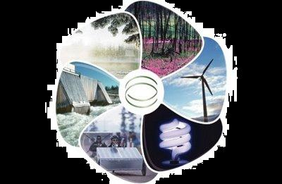
Recycling
Recycling is processing used materials (waste) into new products to prevent waste of potentially useful materials, reduce the consumption of fresh raw materials, reduce energy usage, reduce air pollution and water pollution by reducing the need for "conventional" waste disposal, and lower greenhouse gas emissions as compared to plastic production
Recycling is a key component of modern waste reduction and is the third component of the "Reduce, Reuse, Recycle" waste hierarchy.

Slide 19
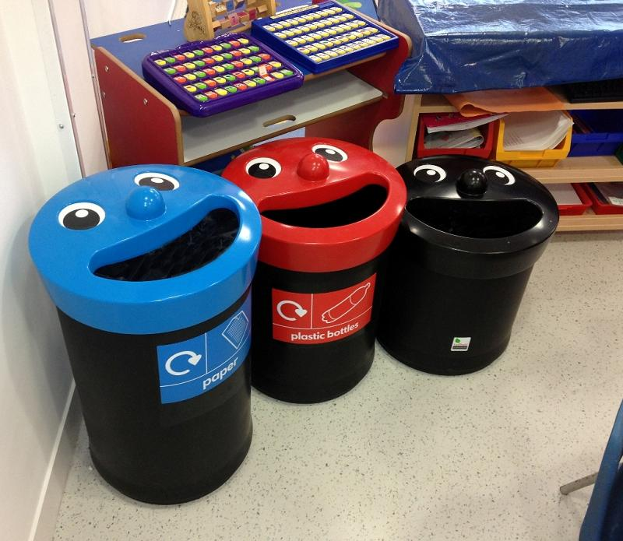

Slide 20
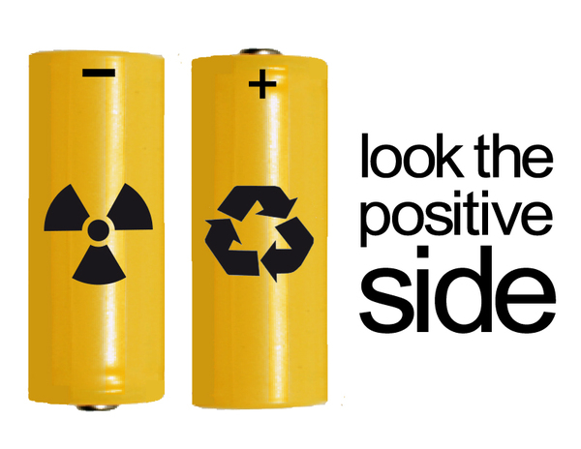

Slide 24
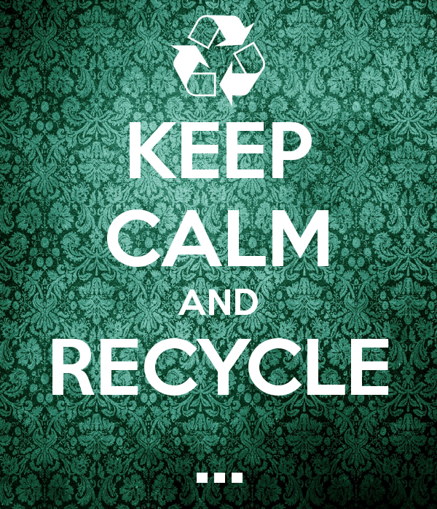

Slide 25
Save the Earth from ourselves

