Slide 1
World Cancer Day

Slide 8
World Cancer Declaration

Slide 9
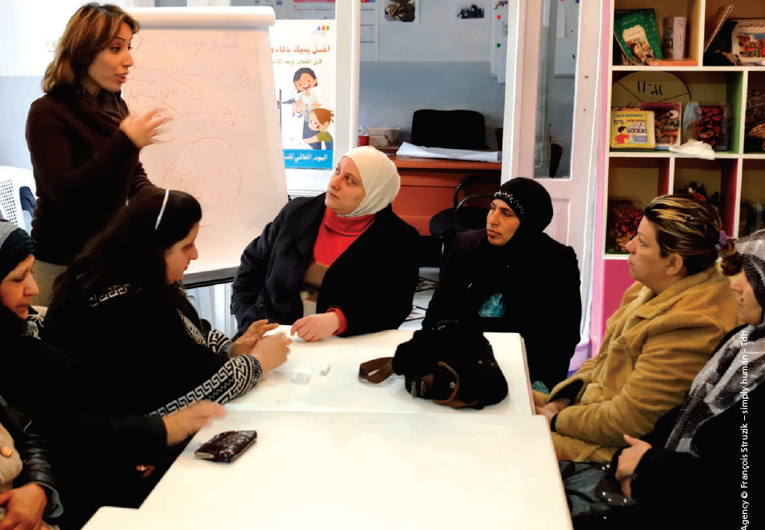
Take home messages
Spread Awareness .

Slide 10
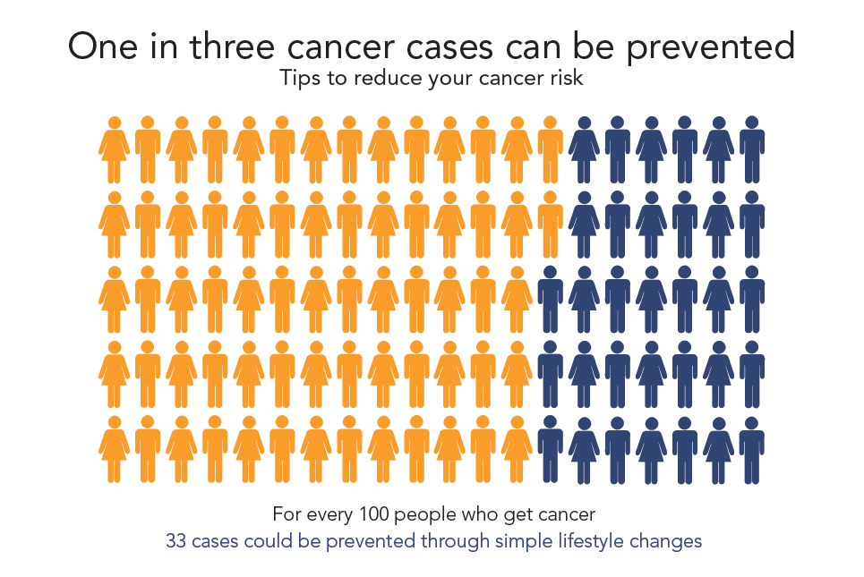
Take home messages
Cancer can be preventable .

Slide 11
Take home messages
Sign the declaration

Slide 12
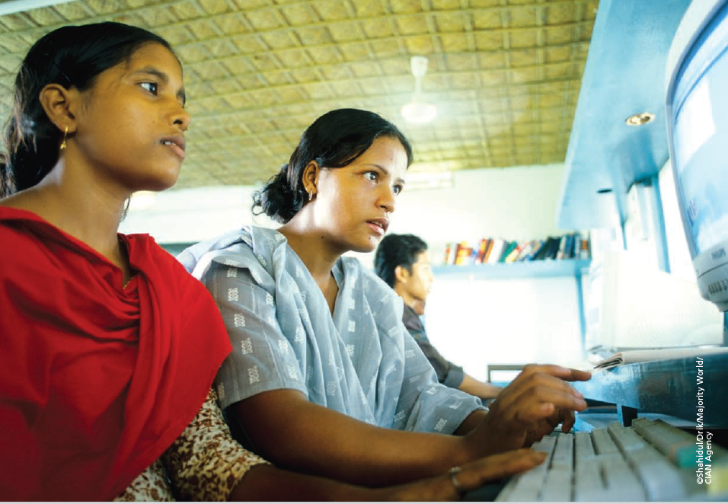
Take home messages
The more you know , the more preventable it is .

Slide 14
Done and presented by : Salma Said Souliman 2nd grade medical student. E-mail : salmasaidsouliman@hotmail.com

