Slide 1
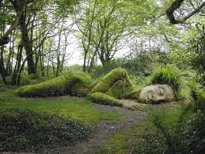
Awakening Africa, the sleeping Giant by Maxwell Nghidinwa

Slide 2
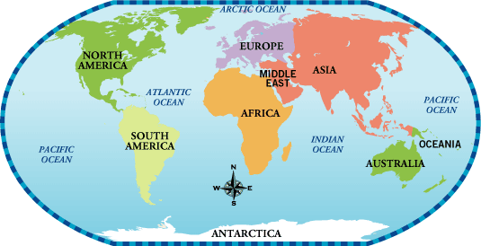
Introduction
The seven continents of the world.
Africa is the only continent that consume more compared...but not produce, it’s the least developed and the most despised

Slide 3
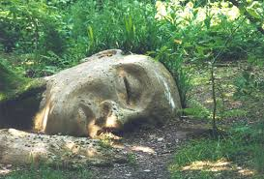
Introduction
How does one awaken a giant that have been asleep for a long time?

Slide 4
Questions to answer
1. Is Africa asleep or dead?

Slide 5
Questions to answer
2. What caused Africa to sleep?

Slide 6
Questions to answer
3. Who caused Africa to sleep?

Slide 7
Questions to answer
4. Can it be awaken?

Slide 8
Questions to answer
4. Who can awaken it?

Slide 9

Its a Question of life or death
Question : Is Africa sleeping or dead?

Slide 10
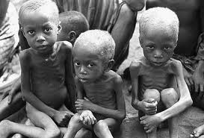
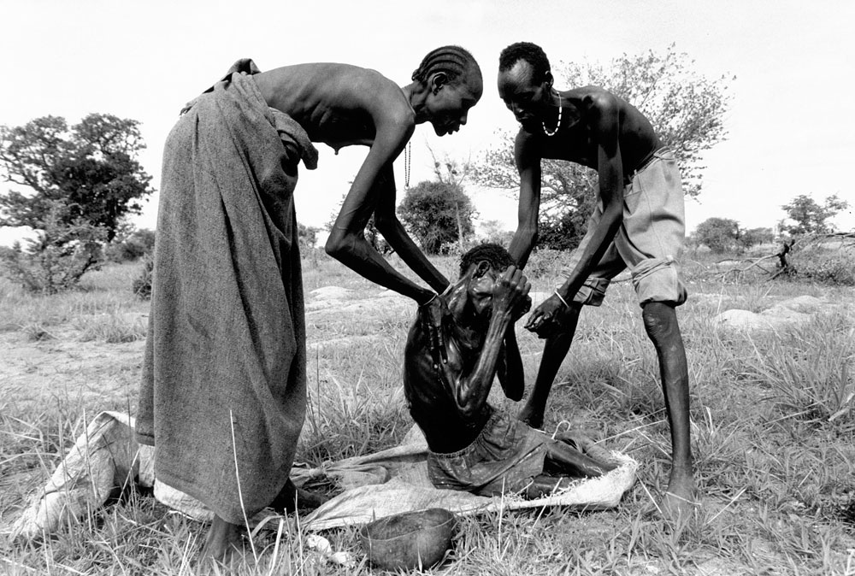
Considering: Poverty and food insecurity

Slide 11
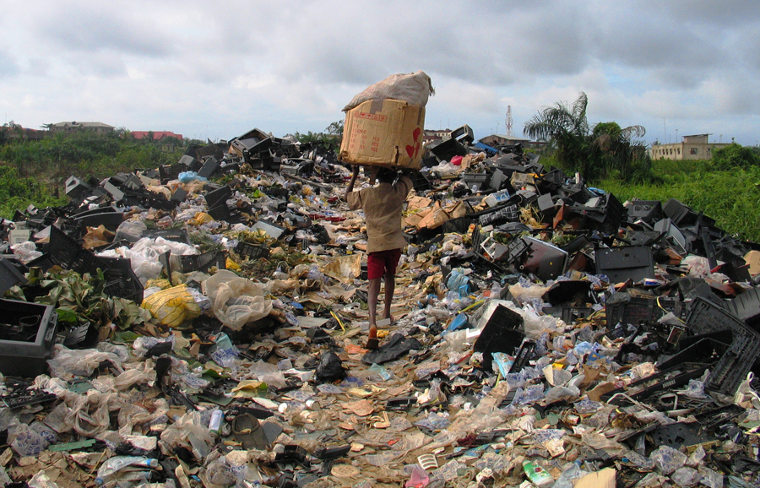
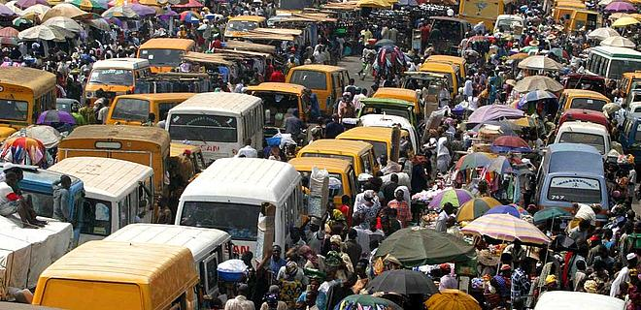


Considering:
The Poor infrastructure of Africa

Slide 12
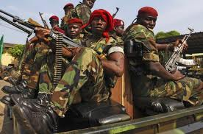
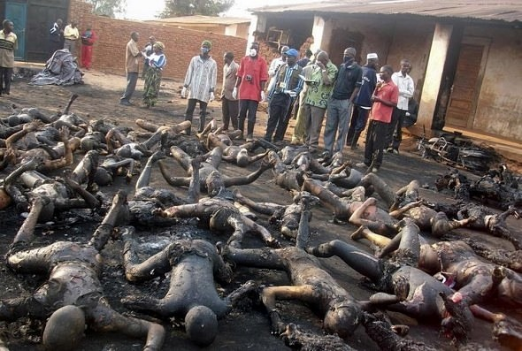
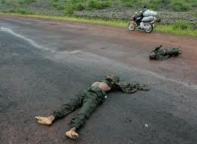
Considering: Continuous wars & Instability

Slide 13

Is Africa alive or dead?
Africa is still alive!
but we have to change our mode of thinking: from inferiority to superiority! For inferiority brings death!

Slide 14
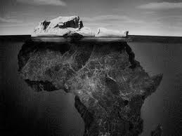
Africa has so much potential.
What we don’t see, is greater than what we see

Slide 15
Discovering the truth
2. So, What caused Africa to sleep?

Slide 16
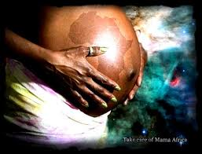
Discovering our roots
The story of the pregnant woman

Slide 17
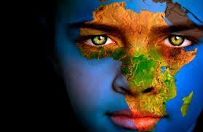
Her name was to be called
Libertas Prosperitas,

Slide 18
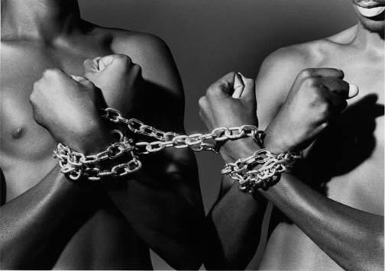
Libertas means coming from this

Slide 19


To this….

Slide 20

Prosperitas means

Slide 21
Libertus prosperitas’ birth was delay after the freedom from colonization
She is still in her mother’s womb because of Colonization in the 21st Century.
We need her to get her out, because she needs to breath fresh air!

Slide 22
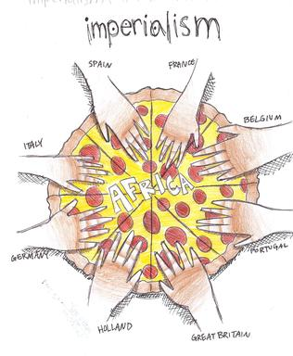
Discovering our roots
“Scramble for Africa”
Berlin West Africa Conference of 1884–85

Slide 23
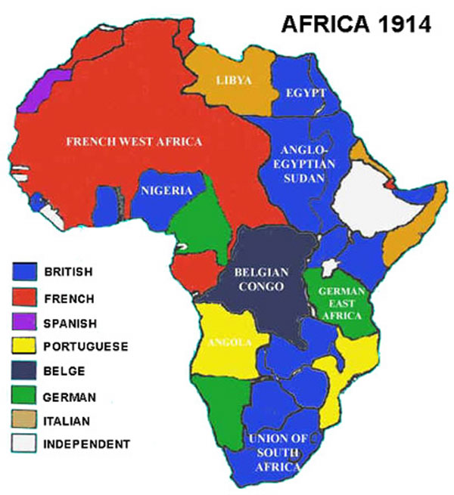
Discovering our roots
“Scramble for Africa”
Before World War 1-

Slide 24
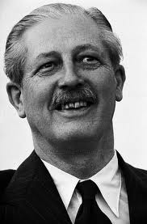
Discovering why Africa is asleep
“Year of Africa”-Decolonization begins(1960)
The year 1960 was heralded throughout Africa and the West as "the Year of Africa" for the inspiring change that swept the continent.
17 African territories gained independence from the strong arm of European colonial rule.
Fully recognizing the potential for the remarkable change that African independence could bring to global politics, on February 3, 1960, Harold Macmillan, prime minister of Great Britain from 1957 to 1963, delivered his famous speech, "Wind of Change,"

Slide 25
Discovering why Africa is asleep
“Wind of Change speech” by Macmillan
"The growth of national consciousness in Africa is a political fact," Macmillan said,
"and we must accept it as such. … I believe that if we cannot do so we may imperil the precarious balance between the East and West on which the peace of the world depends."
He cautioned Western nations to change their behavior toward Africa to prevent the continent from falling under the sway of the East.

Slide 26
Discovering why Africa is asleep
“Reasons for development of Cold war”
Capitalism (West) vs Communism (East)
The fundamental cause of the Cold War was the difference of ideologies between the West and the East, USA and the USSR in particular.
This two ideologies were practically opposites of each other, allowing for suspicion and mistrust between the two sides.
A capitalist economy is based on private ownership, private profit and free competition. It encourages private individuals to own businesses and make profits.
A communist economy, on the other hand, is quite different. The economy is controlled by the government. A country's wealth and resources are owned by the state or government.
The state controls and plans all economic activity so that everybody benefits.

Slide 27
Discovering why Africa is asleep
“Africa, stuck in the middle”
The unfortunate fact was that the cold war was during the era when African countries were receiving independence.
It was this fear of Soviet influence in Africa, particularly on the part of the United States, that created such a major problem for African nations.
Western powers viewed African independence through the lens of the Cold War, which rendered African leaders as either pro-West or pro-East

Slide 28
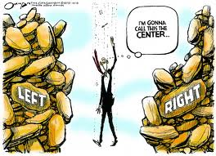
Discovering why Africa is asleep
“African leaders attempt neutrality”

Slide 29
Discovering why Africa is asleep
“African leaders attempt neutrality”
Naïvely, most African leaders believed that they could navigate the political land mines of the Cold War through political neutrality
Along these lines, in his speech on the occasion of Kenya's independence from Britain in 1963, Prime Minister Jomo Kenyatta (in power from 1964 to 1978) declared:
“The aim of my government which starts today is not to be pro-left or pro-right. We shall pursue the task of national building in friendship with the rest of the world. Nobody will ever be allowed to tell us, to tell me: you must be friendly to so-and-so. We shall remain free and whoever wants friendship with us must be a real friend”

Slide 30
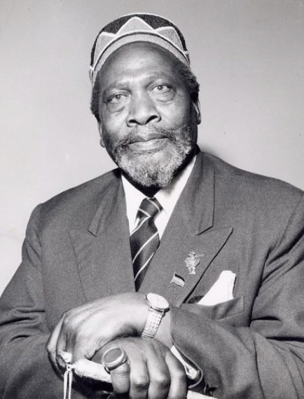
Discovering why Africa is asleep
“African leaders attempt neutrality”
Jomo Kenyata

Slide 31
Discovering why Africa is asleep
“Either you are with us or against us!”
Nonetheless, as Africans declared themselves neutral, Cold War politics deprived them of the freedom to truly shape the economies of their countries.
USA and Western European countries began controlling the newly independent African nations because they could not trust them.
They granted aid to African nations,
But they also coerced governments to support their agendas and instigated and aided coups against democratically elected governments which was not on their side.

Slide 32
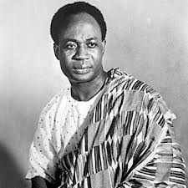
Discovering why Africa is asleep
“USA involvement in Ghanaian coup”
United States government involvement in the 1966 overthrow of Ghanaian President Kwame Nkrumah.
The coup d'etat, organized by dissident army officers, toppled the Nkrumah government on Feb. 24, 1966 and was promptly hailed by Western governments, including the U.S.
Nkrumah warned other African nations about what he saw as an emerging pattern.

Slide 33
Discovering why Africa is asleep
“The Congo Crisis”
They also fomented civil unrest to ensure that governments friendly to their Cold War agenda remained in power
But those that were not were removed by political machinations or assassination.
Example was in the Congo, where Joseph Mobutu
took a strong anti-communist (Pro-West) and was well rewarded.
??? How???

Slide 34
Discovering why Africa is asleep
“Either you are with us or against us!”
12 weeks after independence , the USA and United Nation helped Joseph Mobutu helped orchestrate the coup that removed and ultimately brought about the murder of Patrice Lumumba, the Prime Minister of Congo.
Patrice Lumumba was among the most anti-democratic leaders on the continent, wanted to give the wealth to his people.
Mobutu rose to power and brought economic and political damage to Congo in the process

Slide 35
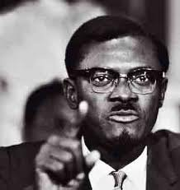
Discovering why Africa is asleep
“The Murder of Patriotic African leaders”
Patrice Émery Lumumba
was the first democratically elected Prime Minister of the Republic of the Congo after he helped win its independence from Belgium in June 1960.
Only twelve weeks after independence, Lumumba's government was deposed in a coup during the Congo Crisis.
He was subsequently imprisoned and executed by firing squad under the command of the governments of Belgium, and possibly the United States via the CIA.
The Belgian government officially apologized in 2002.

Slide 36
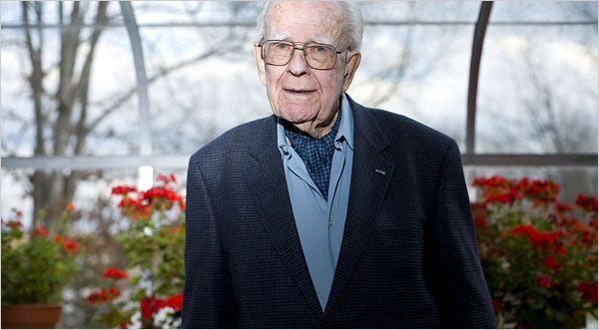
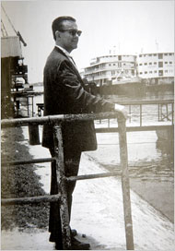
Discovering why Africa is asleep
“Confessions: Murder of Patriotic African leaders”
Mr. Devlin had no problems with bribery, blackmail or other varieties of skulduggery — “all part of the game” for the C.I.A. under Allen Dulles at the height of the cold war, he said.
But he thought the order to kill
Patrice Lumumba, the charismatic Congolese politician the Eisenhower administration feared would become an African Fidel Castro, was both wrong and stupid
So he stalled. And Lumumba’s political rivals eventually killed him without the C.I.A.’s help.
http://www.nytimes.com/2008/02/24/world/africa/24congo.html?ref=mobutuseseseko&_r=0

Slide 37
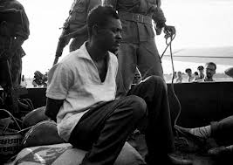
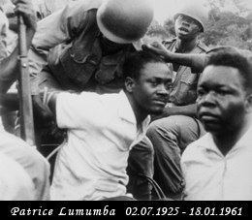
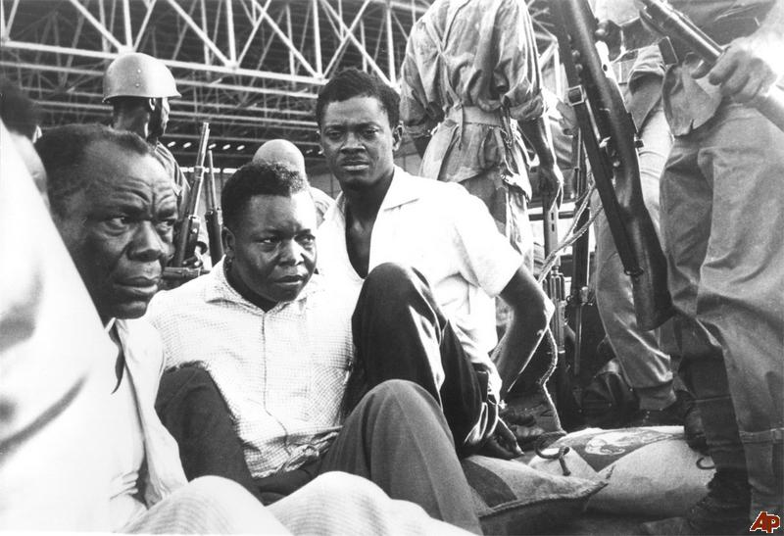
Discovering why Africa is asleep
“The Arrest and Murder of Patrice”

Slide 38
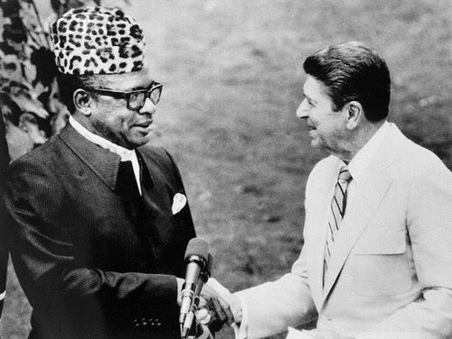
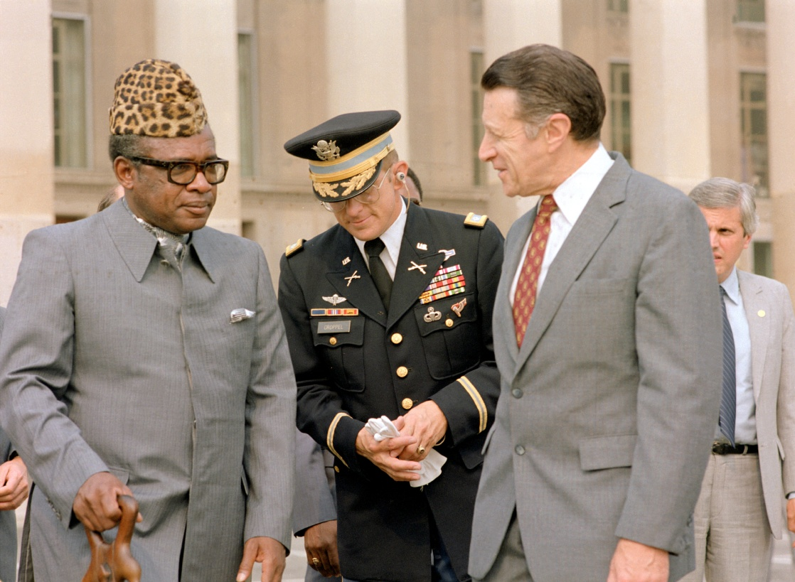
Discovering why Africa is asleep
“Mubuto’s relationship with U.S after
Lumumba’s death”

Slide 39
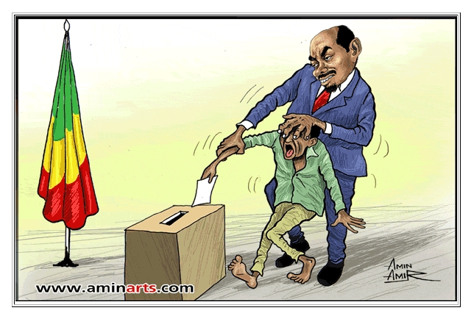
Discovering why Africa is asleep
“The beginning of Inequality”

Slide 40
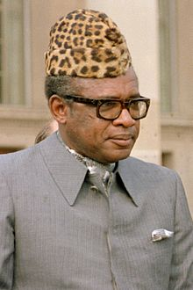
Discovering why Africa is asleep
“The Beginning of Inequality and Dictatorship”
Mobutu Sese Seko Za Banga,
Became the President of the Democratic Republic of the Congo Zaire from 1965 to 1997 after the assassination of Patrice Lumumba
From 1965 to 1991, Zaire received more than $1.5 billion from the U.S and military aid.
In return, U.S. multinationals increased their share of the ownership of Zaire's fabulous mineral wealth.

Slide 41
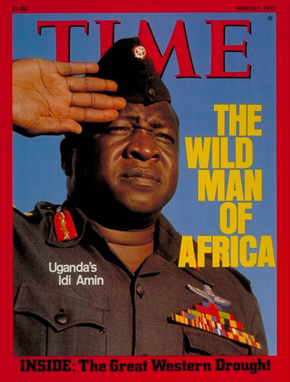
The beginning of Inequality
Dictator of Uganda
Idi Amin

Slide 42
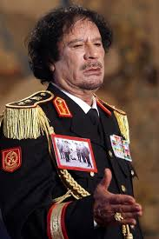
The beginning of inequality
Gaddafi of Libya
1977 to 2011

Slide 43
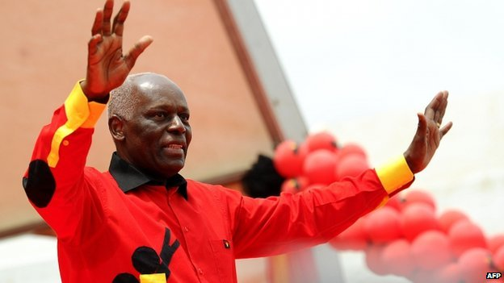
Discovering why Africa is asleep
“The beginning of Inequality”
José Eduardo dos Santos is has been President of Angola since 1979. (32 Years in power)

Slide 44
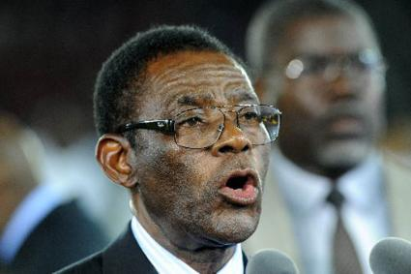
Discovering why Africa is asleep
“The beginning of Inequality”
Teodoro Obiang Nguema Mbasogo is President of Equatorial Guinea since 1979.
Obiang is Africa's longest serving leader, having been in power for three decades.
[Equatorial Guinea is one of the continent’s largest producers of oil, but ranks very poorly in the United Nations human development index;
the vast majority of Equatorial Guineans hardly have access to clean drinking water.

Slide 45
Discovering why Africa is asleep
“The richest, is the poorest”
Top Riches country in Africa 2013
1.Equatorial Guinea $19,600
2.Gabon $16,400
3.Botswana $16,200
4.Mauritius $15,100
5.Libya $14,100
6.South Africa $11,100
7.Tunisia $9,6008
8. Namibia $7,5009.
9. Algeria $7,40010.
10. Egypt $6,600
Source: CIA World Factbook Rows
http://www.aneki.com/africa_richest.html

Slide 46
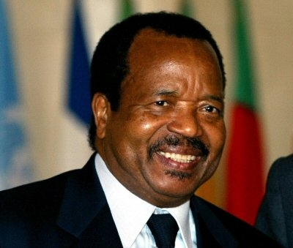
Discovering why Africa is asleep
“The beginning of Inequality”
Paul Biya the President of Cameroon since 6 November 1982.
(29 Years in power)

Slide 47
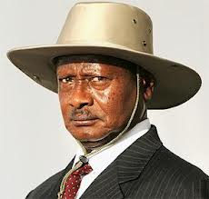
Discovering why Africa is asleep
“The beginning of Inequality”
Yoweri Kaguta Museveni is has been President of Uganda since 29 January 1986.

Slide 48
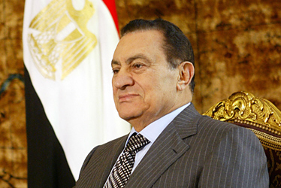
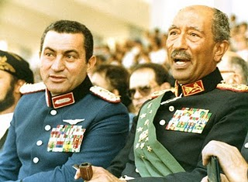
Discovering why Africa is asleep
“The beginning of Inequality”
Hosni Mubarak of Egypt ruled for 30 years

Slide 49

Discovering why Africa is asleep
“The beginning of Inequality”

Slide 50
So….What caused Africa to “fall sleep”?

Slide 51

“African leaders were too blind to see
Who their true enemy was.
The West was never an ally of Africa…
And after the death of many leaders, they were too afraid to
Speak and stand up angainst the West’s oppression”

Slide 52
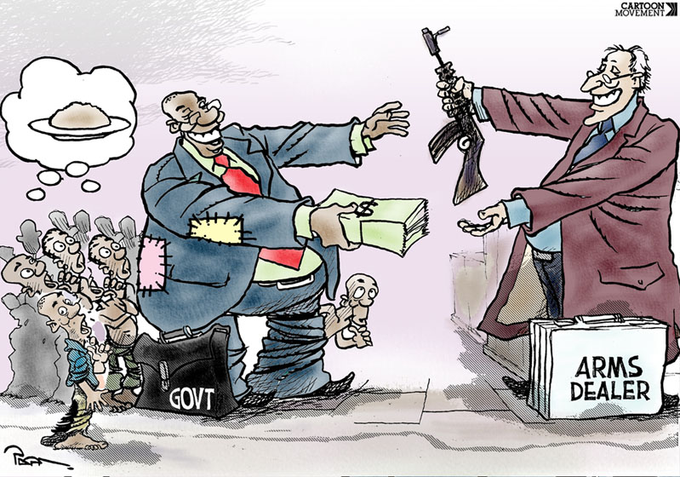
Throughout the Cold War (1950-1989), the U.S. delivered over
$1.5 billion worth of weaponry to Africa.
Many of the top U.S. arms clients – Liberia, Somalia, the Sudan, and Zaire (now the Democratic Republic of the Congo or DRC) – have turned out to be the top basket cases of the 1990s in terms of violence, instability, and economic collapse.
Discovering why Africa is asleep

Slide 53
The U.S. also prolonged the rule of Zairian dictator Mobutu Sese Soko by providing more than $300 million in weapons and $100 million in military training. Mobutu used his U.S.-supplied arsenal to repress his own people and plunder his nation’s economy for three decades, until his brutal regime was overthrown by Laurent Kabila’s forces in 1997.
Discovering why Africa is asleep
http://www.worldpolicy.org/projects/arms/reports/congo.htm

Slide 54
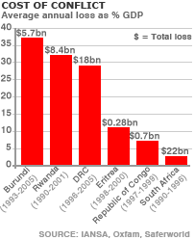
African governments spent he billions of money in wars, when if it was suppoaed to be invested in Agricultural research, infrastructure- imagine impact!
Discovering why Africa is asleep

Slide 55
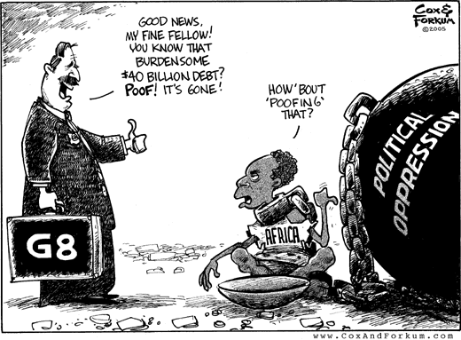
“And it has not changed today”

Slide 56
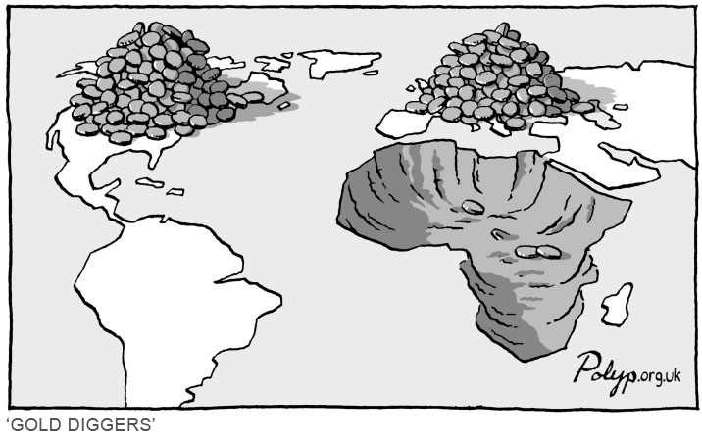
Africa was always a source for labor (slavery)& raw material (natural resources)

Slide 57
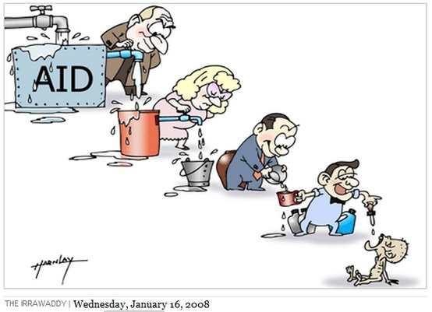
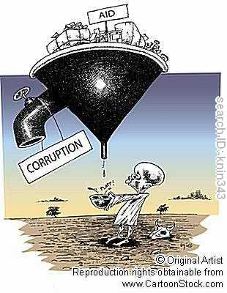
Aid to Africa: a way to control African countries only, as poor people do not benefit

Slide 58
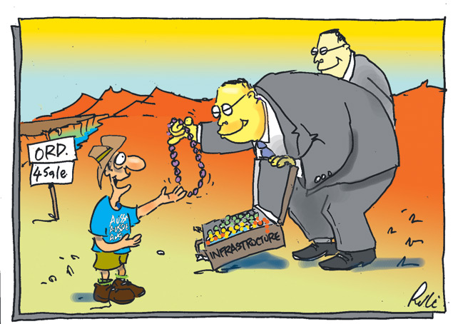
Aid to Africa: Never trust a china man!

Slide 59
Questions to answer
4. Can Africa be awaken?

Slide 60




Slide 61




Slide 62
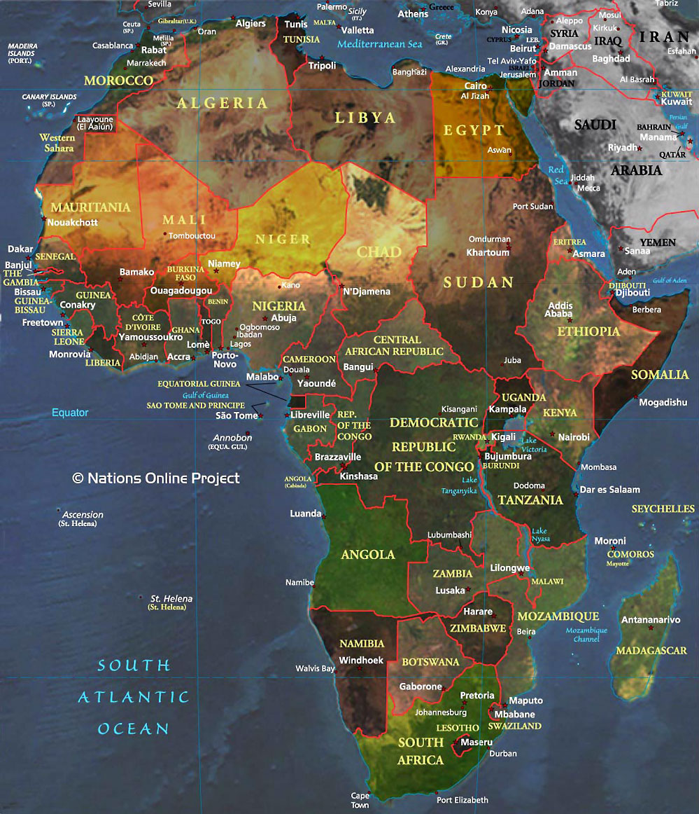
Discovering Africa’s Pontentia
“Africa”

Slide 63

Discovering Africa’s Pontential
1. Economical and Political Unification of Africa
Unity of African countries is the only way to make Africa emerge
From poverty”

Slide 64
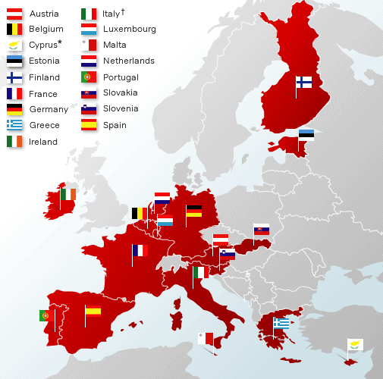
Discovering Africa’s Pontential
“To become the best, learn from the West”
What does EU stands for?

Slide 65

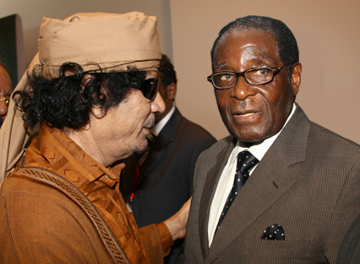
Discovering Africa’s Pontential
Proposition of Unites States of Africa
The United States of Africa is a proposed concept for a federation of some or all of the 55 sovereign states of Africa.
Former Libyan leader Muammar al-Gaddafi, who was the 2009 Chairperson of the African Union (AU), advanced the idea of a United States of Africa at two regional African summits:
Gaddafi had previously pushed for its creation at a summit at Lomé, Togo in 2000
In June 2007 at AU summits, Conakry, Guinea,
Then February 2009 in Addis Ababa, Ethiopia.
A number of senior AU members also support the proposed federation, believing that it could bring peace to a 'new' Africa.

Slide 66
Discovering Africa’s Pontential
African Union
“Africa to unifie in 2025”
The African Union has set itself the task of building a "united and integrated" Africa by 2025
The nations of Eritrea, Ghana, Senegal, Zimbabwe, and Cape Verde have supported an African federation.
Others such as South Africa, Kenya, and Nigeria
have shown less interest in the idea.
Support appears to be inversely proportional to a nation's power and influence.

Slide 67
Discovering Africa’s Pontential
The Unification has began:
African Union
The African Union is a union consisting of 54 African states.
The only all-African state not in the AU is Morocco.

Slide 68

Discovering Africa’s Pontential
The Unification has began
Why has unification taken long?

Slide 69
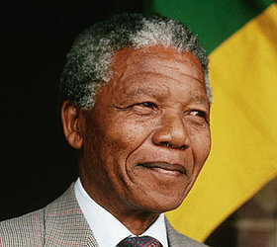
Discovering Africa’s Pontential
Silence from Africa’s influential leaders such as
Nelson Mandela about Africa becoming one federation

Slide 70
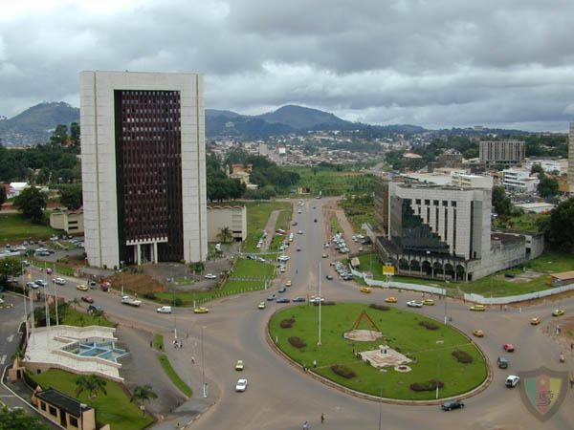

Discovering Africa’s Pontential
Most countries are experiencing growth & each government first want to built and develop their countries-achieving national visions

Slide 71

Recent forecasts of GDP growth rates in Africa

Slide 72

Recent forecasts of GDP growth rates in Africa

Slide 73

Discovering Africa’s Pontential
The Unification has began
EAC consist of 5 countries: :
Burundi, Kenya, Rwanda,
Tanzania and Uganda
Pierre Nkurunziza, the President of the Republic of Burundi, is the EAC's current Chairman.

Slide 74
Discovering Africa’s Pontential
The Unification has began
Aim & Objectives of the EAC
EAC agreed to an expanded free trade area including the member states of all three.
The East African Community is a potential precursor to the establishment of the East African Federation, a proposed federation of its five members into a single state.
In 2010, the EAC launched its own common market for goods, labour and capital within the region, with the goal of a common currency by 2012 and full political federation in 2015.
The geographical region of EAC covers an area of 1.8 million square kilometres,
with a combined population of about 132 million
EAC also aims to make one passport for its member states Under the proposal for the visa,
East African single visa will be issued by any member state's embassy.
Tourists could apply for one country's entry visa which would then be applicable in all regional member states as a single entry requirement.

Slide 75

Discovering Africa’s Pontential
The Unification has began
SADC consist of (15 countries -1 ) =14:
Angola, Namibia, South Africa
Botswana, Democratic Republic of the Congo
Lesotho, Malawi,
Mauritius, Mozambique
Swaziland, Tanzania,
Zambia, Zimbabwe,,
Seychelles & Suspended Madagascar – Membership currently suspended after the coup d'état led by Andry Rajoelina

Slide 76

Discovering Africa’s Pontential
Challenges of Unification process
1. High level of Corruption in other African countries

Slide 77

Discovering Africa’s Pontential
Challenges of Unification process
2. Poverty and Aids is occupying most African countries
agendas

Slide 78

Discovering Africa’s Pontential
Challenges of Unification process
Unequal Natural resources & Economical growth

Slide 79

Discovering Africa’s Pontential
Challenges of Unification process
Multi-ligual continent

Slide 80

Discovering Africa’s Pontential
Challenges of Unification process
Unequal freedom of Speech: (Press or Media)

Slide 81

Discovering Africa’s Pontential
Challenges of Unification process
Multi-Religious Continent

Slide 82


Discovering Africa’s Pontential
“2. Africa the treasure island of the World”
Sustainable management of Africa’s natural resources is one of the keys for overcoming poverty.
The key lies in investing in the new generation of Africa, to become masterminds in engineering, technology, science .
Harvesting and fairly sharing these resources can assist in contributing African countries’ to have the fast growing economies; 5 times faster than China and
India combined .

Slide 83

Discovering Africa’s Pontential
“Natural resources in Southern Africa”

Slide 84

Discovering Africa’s Pontential
“Natural resources in Central Africa”

Slide 85

Discovering Africa’s Pontential
“Natural resources in East Africa”

Slide 86
Discovering Africa’s Pontential
“Natural resources in North Africa”

Slide 87

Discovering Africa’s Pontential
“Natural resources in West Africa”

Slide 88

Discovering Africa’s Pontential
“Leasing of Land for Bio-fuel production is the sign that the world needs Africa!
The West has no land and the high prices of oil has caused Bio-fuels to occupy agricultural lands ”

Slide 89

Discovering Africa’s Pontential
“3. Africa, the only continent with sufficient land to
Feed the poor-with food prices going up
”

Slide 90


“Agriculture is the key, to redeeming Africa’s integrity”
Discovering Africa’s Pontential
WASHINGTON, October 24, 2012—A new World Bank report says that Africa’s farmers can potentially grow enough food to feed the continent and avert future food crises if countries remove cross-border restrictions on the food trade within the region.
Africa strategically position itself as the world’s biggest supplier
Especially with the world population reaching 7.2 Billion in 2015
Africa’s food systems currently valued at US$313 billion a year from agriculture, could triple if governments and business leaders radically rethink their policies and support to agriculture, farmers, and agribusinesses

Slide 91
Awaking the Giant…….
“giving birth to a new Africa”

Slide 92

“All African countries are insiders, and all western nations are our friends; but outsiders!
Waking the giant

Slide 93

“Bad tendency!”
Waking the giant

Slide 94
Message to future generation Egyptians leaders
Egyptians may be off Arab-descend,
We share the same continent (Not In ASIA)
We share the Nile, We share the same history;
We were all colonized!
We should therefore embrace each other as Africans!
Egyptians can therefore never think they are superior over sub-Sahara
Africa and neither Africa…
We are one!

Slide 95

“Being proud of being African & loving other African countries and cultures!
Waking the giant

Slide 96

We have so much to be proud about!
The beautiful diversity in culture Africa :
Burundi

Slide 97


Namibia
The beautiful diversity in culture of Africa :
Ethiopia

Slide 98


Kenya
The beautiful diversity in culture of Africa :

Slide 99


The beautiful diversity in culture of Africa :
South Africa
GHANA

Slide 100


The beautiful diversity in culture of Africa :
Malawi
Nigeria

Slide 101


We can be proud of the beautiful and diversity in Africa’s landscape and wildlife
Tea Plantation in Ruanda
Uganda

Slide 102


The beautiful diversity in landscape and wildlife
Cape Town, South Africa
Victoria Falls,
Zimbwabwe

Slide 103



The beautiful diversity in landscape and wildlife
Mountain Kilimanjaro,
Kenya
Tanzania

Slide 104



The beautiful cities of Africa
Windhoek, Namibia

Slide 105



The beautiful cities of Africa

Slide 106



The beautiful cities of Africa
Durban, South Africa
Kenya: Nairobi
&
Mombasa

Slide 107

“Dare to Dream by setting your mind free”
Lastly….Waking the giant

Slide 108


“We need to freely and fearlessly dream to what we want Africa to become in the future; despite of the reality we see today ”
Lastly….Waking the giant
When we stop dreaming, we STOP moving forward!

Slide 109

“Dreaming fearlessly means, daring to dream about dreams higher than our capabilities; stopping to make the words developing countries & poverty our excuse for not advancing in science and technology.
It must start with a generation that dreams”
Waking the giant

Slide 110


“Dreaming fearlessly “ is when we begin to confidently ask:
WHY NOT IN AFRICA??”
Waking the giant

Slide 111

Waking the giant
“We are the generation who have to restore Africa’s dignity”
Africa needs her Students and professionals back”

Slide 112


Estimates show that 860 million people live in sub-Saharan Africa, and the population is rapidly growing. Africa’s demand for food staples is expected to double by 2020, but African farmers have not been able to increase productivity to satisfy rising demands.
“IF WE ARE GOING FOR MASTERS, MAKE SURE WE GO BACK HOME ”

Slide 113
“Africa is robbing her self”
Waking the giant
QUESTIONS TO PONDER
How can Africa ever be developed, if all her bright people are migrating to the U.S.A, France and Britain?
When all her people are ashamed of her?
3. How can we ever be proud of Africa, if we are taking our knowledge to the very same countries that are responsible for the inequality, injustice that exist in Africa?
4. The very same countries that make us hate our continent

Slide 114
Remember :Her name was to be called
Libertas Prosperitas,

Slide 115
Libertas means coming from this

Slide 116
To this….

Slide 117
Prosperitas means

Slide 118

There is hope for Africa , because
She is beautifully alive!
Thank you!

