Slide 1
FOREIGN AID.

Slide 2
DEFINITION.
In international relations, aid (also known as international aid, overseas aid, or foreign aid) is a voluntary transfer of resources from one country to another, given at least partly with the objective of benefiting the recipient country.

Slide 3
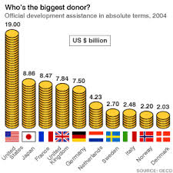

Slide 4
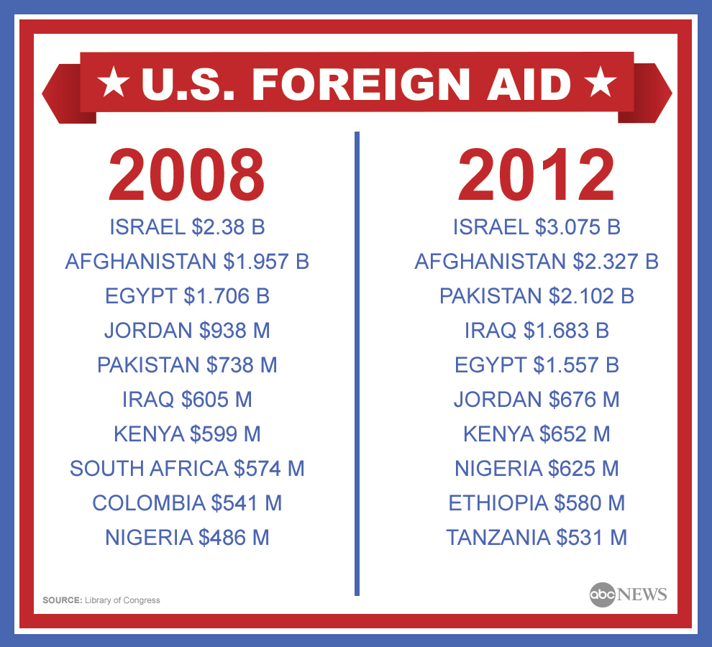

Slide 5
Since 1946, the United States has given over $146 billion in humanitarian assistance to foreign countries.
In 1985, the United States provided over $10 billion in non-military aid abroad, ranging from free food to balance-of-payments support to project-assistance and population-planning programs.

Slide 6
HISTORY OF FOREIGN AID.
After World War II, the Truman administration decided that a larger, more centralized effort was necessary to revitalize the war-torn economies of Europe.
Economic planning was the rage in Washington in the late 1940s, and Marshall Plan administrators exported their new-found panacea.

Slide 7
The Marshall Plan poured over $13 billion into Europe and coincided with an economic revival across the continent.
The best analysis indicates that Europe would have recovered regardless of U.S. aid, and that the clearest effect of the Marshall Plan was to increase the recipient governments' control of their economies.

Slide 8
The apparent success of the Marshall Plan led Truman in 1949 to propose his Point Four Program
To provide a smaller version of the Marshall Plan for poor countries in Africa, Asia, and Central and South America.

Slide 9
Truman declared that Point Four would be "a bold new program for making the benefits of our scientific advances and industrial progress available for the improvement and growth of undeveloped areas.

Slide 10
Positive side of foreign aid
Foreign aid’s main role in stimulating economic growth has been to supplement domestic sources of finance such as saving, thus increasing the amount of investment and capital stock.
This is facilitated by an increase in investments both physically and human capital as well.

Slide 11
HEALTH CARE.

Slide 12
IMPORTS
capital goods and technology.
Technology transfer &new skills in a country.
This can be in the form of funding of training institutions for example the computerization and e-marketing skills, For example e-commerce, computerization and recently the fiber optic cable which attracted many foreign investors.

Slide 13
HUMANITARIANISM
humanitarian aid especially during emergencies or natural calamities such as droughts, famines and earthquakes.
This was clearly witnessed when Haiti ,tsunami, floods in Pakistan, famine in Somalia,
Refugees in the Congo, Syria, Mali, Darfur, among others

Slide 14
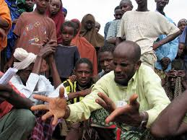

Slide 15
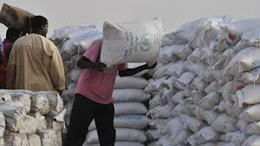

Slide 16
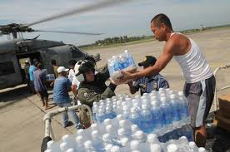

Slide 17
Infrastructure
Development projects funded thorough foreign aid have been of great benefit to the people, such as construction of roads, hospitals, schools, boreholes, which could have taken many years for a country to achieve especially if the income per capita is below level or the revenue collected from tax is insufficient.

Slide 18
Develpment
If used well the funds directed to developmental projects is a major boost to African struggles to achieving development and improving quality of life.
Structural transformation of many developing countries has been sped up by foreign aid as a result of a demand to do so from the donor countries.

Slide 19
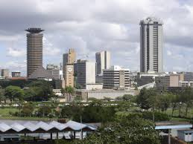
Nairobi

Slide 20
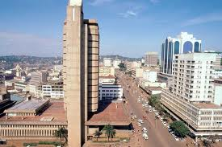
Kampala

Slide 21
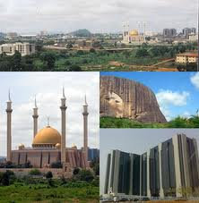
Abuja

Slide 22
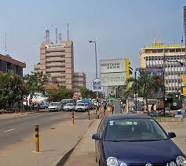
Accra

Slide 23
kigali

Slide 25
Governance
Above all donors emphasis good governance and ensures countries benefiting from the aid meet these standards. Issues on democracy and democratization always draw many potential Foreign Aid givers as it is part of there emphasis, for example the case of Afghanistan.

Slide 26
SHORTCOMMINGS OF FOREIGN AID IN AFRICA.
AID cannot be blamed for all the mistakes made in the projects it bankrolls. But
AID effectively discourages governments from learning from and correcting their mistakes.
Giving an alcoholic the key to a brewery.
Good intentions are no excuse for helping to underwrite an individual's--or a country's-- self-destruction.

Slide 27
Africa embodies one of the most startling economic ironies, when you consider that in the last five decades, Africa, like a dehydrated camel, has gulped an estimated $1trillion in form of foreign dash from developed nations.
Unfortunately, many African nations still wretchedly wallow in starvation and penury.

Slide 28
Prior to the 70s only 10% of Africans were living in poverty. But between 1970 and 1998 when foreign aid was at its peak, poverty rate in Africa skyrocketed to 70%.
it’s as high as 80% in some African countries with annual growth rate of minus 0.2 per cent.

Slide 29
Instead of breaking the "endless cycle of poverty," foreign aid has become the opiate of the Third World.
US AID and other donors have encouraged Third World governments to rely on handouts instead of on themselves for development.

Slide 30
Sustaining corrupt leaders
No matter how irresponsible, corrupt, or oppressive a Third World government may be,
There is always some Western government or international agency anxious to supply it with a few more million dollars.

Slide 31
Failed agriculture
In agriculture, in economic planning, in food assistance, foreign aid has routinely failed to benefit the foreign poor. In Africa, Asia, and Latin America,
The U.S. Agency for International Development (AID) has dotted the countryside with "white elephants": idle cement plants, near-empty convention centers, abandoned road.

Slide 32
Ineffective institutions
Many African institutions officially responsible for planning and implementing development are saturated with development assistance, paralyzed by administrative inefficiency
http://www.guardian.co.uk/world/2012/jun/05/south-sudan-president-accuses-officials-stealing

Slide 33
Reliance on aid
Some African countries receive their entire investment budget from foreign aid.
Governments, because of the importance of donor financing, are often more preoccupied with fund raising than structuring effective development plans.
As long as the foreign aid keeps pouring in, life will continue to be prosperous for the government employees

Slide 35
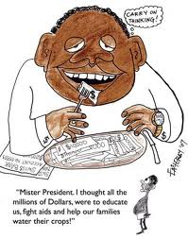

Slide 36
Poor planning.
Ample aid effectively allows governments to neglect reality. The World Bank observed, African governments and donors continue to prefer new projects, especially new schools and hospitals,
when the greatest urgency is to provide more resources to operate and maintain (and, increasingly, rehabilitate) existing projects.

Slide 37
Bad infrastructure &services
Trucks no longer run because there are no spare parts and roads have become impassable; airplanes no longer land at night in some places because there is no electricity to light the runway.
Government health clinics lack medicine, and schools lack textbooks and other supplies.

Slide 38
Food Bankrupts Foreign Farmers
Food for Peace is probably our most harmful foreign aid program.
The United States is dumping over $2 billion worth of surplus agricultural commodities a year on Third World Countries.
Disrupting local agricultural markets and makes it harder for poor countries to feed themselves in the long run.

Slide 39
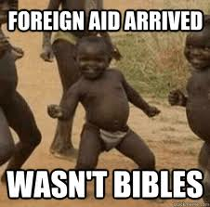

Slide 40
Policy control
In Indonesia, the government confiscated subsistence farmers' meager plots for AID-financed irrigation canals.
In Mali, farmers were forced to sell their crops at giveaway prices to a joint project of AID and the Mali government.
In Egypt, Haiti, and elsewhere, farmers have seen the prices for their own crops when U.S. free food has been given to their countries.

Slide 41
Resource mismanagement.
Foreign aid is extremely fungible: every increase in outside donations frees up an equivalent amount of a recipient government's own revenue to be spent for other purposes.
Many less- developed countries routinely squander their own money

Slide 42
Nigeria’s oil export were worth almost $100 billion which was worth more than total net aid to the whole of sub-Saharan African.
Unleashing the natural resources in this country dwarfs anything aid can achieve and transparency is critical to that.

Slide 43
. Mobutu Sese Seko, president of Zaire, amassed a multi-billion- dollar personal fortune and has built 11 presidential palaces.
Ghana, Brazil, Kenya, and the Ivory Coast have spent billions building new capital cities.

Slide 44
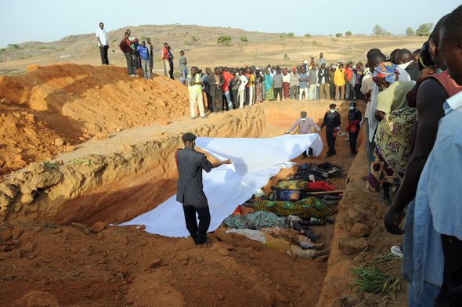

Slide 45
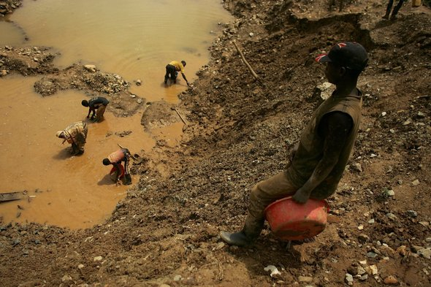
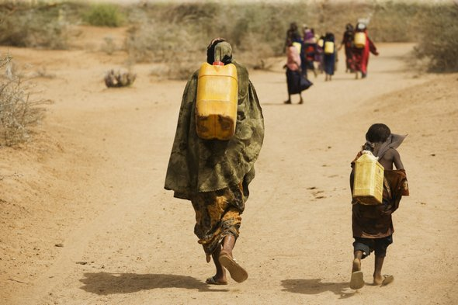

Slide 46
Mercedes-Benz automobiles are so popular among African government officials that a new word has come into use in Swahili to describe them: wabenzi--"men of the Mercedes-Benz.“
OPM Uganda.

Slide 47
Egypt
Despite receiving over $10 billion in U.S. aid, Egypt is still desperately poor. Egypt remains committed to government dominance of the economy, and the United States has made little effort to dissuade it from following wasteful economic policies.

Slide 48
Regardless of our future good intentions, foreign aid programs will still be controlled by politicians anxious to buy goodwill
administered by bureaucrats anxious to meet their quota of loans, and they will still be received by foreign governments careless of the use of free gifts.

Slide 49
CONCLUSSION
Judging from the number of positive and negative effects of foreign aid, the negatives seem to outweigh the positives. Unfortunately for many developing countries foreign aid is seen as a step forward to development but in the real sense development is totally dependent on other countries.
This dependency has caused us to worship Foreign Aid. It is at this that one can conclude that Foreign Aid is a necessary Evil to developing countries.

Slide 50
References.
http://www.africanliberty.org/content/voice-liberty-africa-how-foreign-aid-stagnating-developing-nations-lanre-olagunju
http://en.wikipedia.org/wiki/Aid

