Slide 1
“THE CURRENT STATE OF ART OF FOOD PROCESSING BY-PRODUCTS”
Presented by;
KIZITO KENNEDY FRANCIS

Slide 2
Contents:
1: Introduction:
2. Nature and sources of food processing wastes
3: Utilization of Animal processing wastes
4: Bio-energy production from food processing wastes.
5: Bioactive compounds from selected plant wastes.

Slide 3
Introduction:
Food processing wastes are increasing being considered as valuable resource.
About 45 billion kg of fresh fruits, vegetable, milk, grain products are lost as waste in USA, annually.
20 million tons of food waste in UK annually.
EPA estimates 1$ billion as cost of waste disposal.
Every ton of food waste is equivalent to 4.5 tons of CO2 emissions. (environmental pollution)

Slide 4
Percentage of Food Wastes and By-products generated during different processes
PRODUCTION PROCESS | % OF WASTE AND BY-PRODUCTS
Beef slaughtering | 40-50
Corn starch production | 41-43
Crustaceans processing | 50-60
Fish canning | 30-65
Fish filleting, curing, salting and smoking | 50-75
Fresh, soft and cheese production | 85-90
Fruit and vegetable processing and preservation | 5-30
Milk butter and cream production | Negligible
Mollusk processing | 20-50
Pig slaughtering | 35
Potato starch production | 80
Poultry slaughtering | 31-38
Red wine production | 20-30
Sugar production from beet | 86
Vegetable oil production | 40-70
Wheat starch production | 50
White wine production | 20-30
Yoghurt production | 2-6

Slide 5
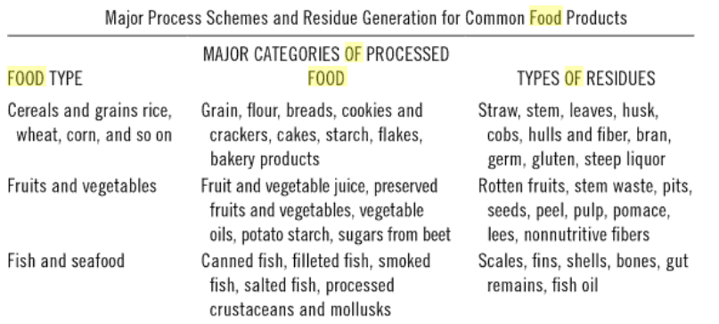

Slide 6
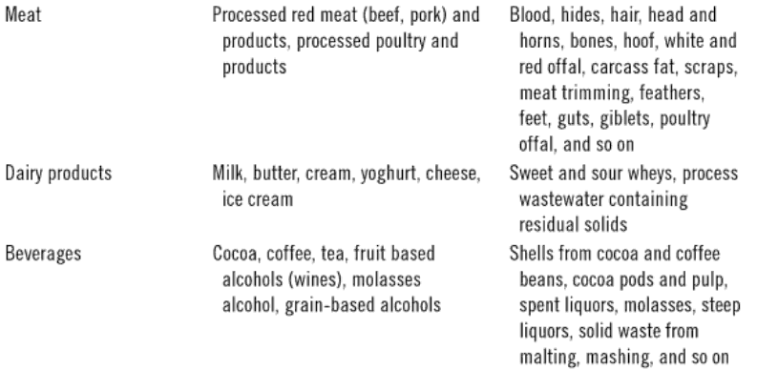
FOOD TYPE: PROCESSED FOOD: RESIDUE TYPE:

Slide 7
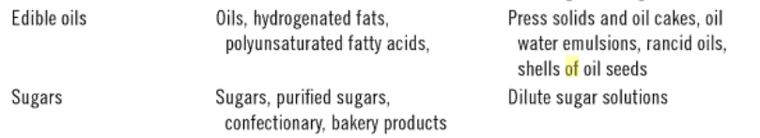
FOOD TYPE: PROCESSED FOOD: RESIDUE TYPE:

Slide 8
Categories of food processing wastes:
Solid food wastes (organic and inorganic)
main source: Raw materials
~ Organic solid waste:
~ Inorganic solid waste:
Liquid food processing wastes.(Effluents)
main source: water used

Slide 9
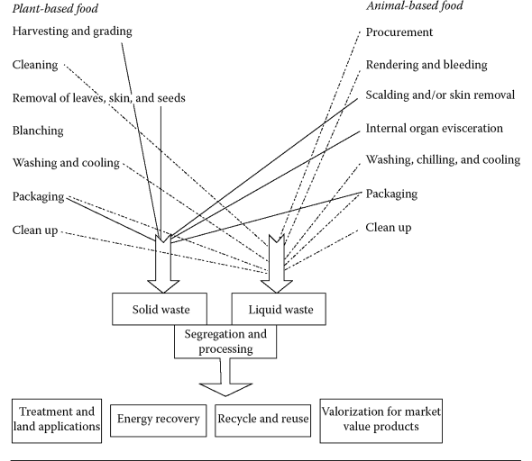

Slide 10
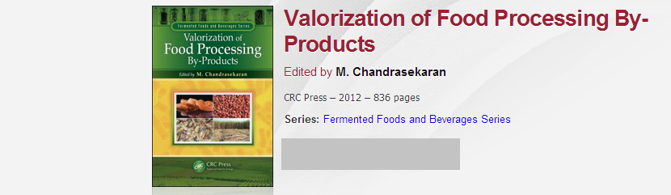
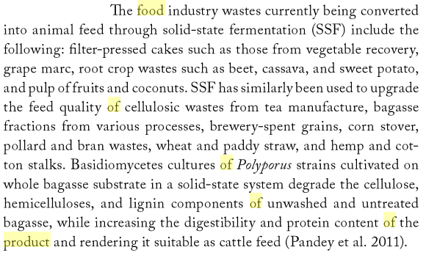

Slide 11
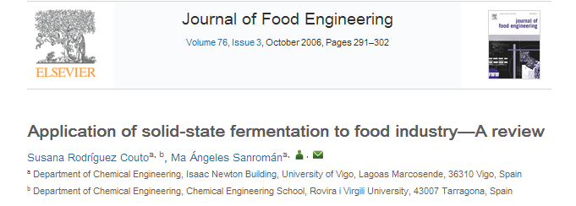
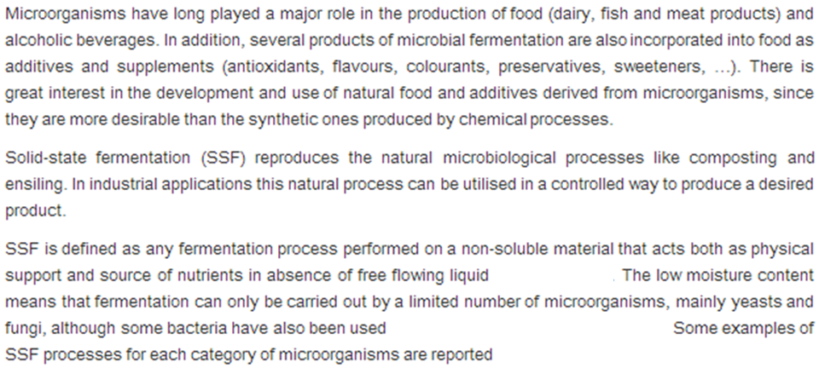
Therefore, SSF is certainly a good way of utilizing nutrient rich solid wastes as a substrate. Both food and agricultural wastes are produced in huge amounts and since they are rich in carbohydrates and other nutrients, they can serve as a substrate for the production of bulk chemicals and enzymes using SSF technique.

Slide 12
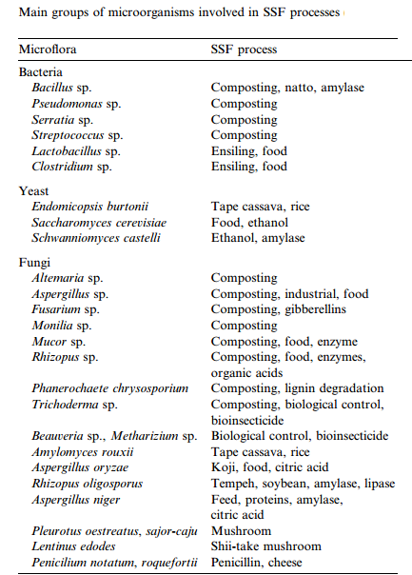

Slide 13
Utilization of by-products of animal, poultry and fish processing:
Nature of by products.
Profitability of processing of these by-products
USDAERS: United States Department of Agriculture Economic Research Service
*11.4% gross income of beef
*7.5% gross income of pork
Pollution

Slide 14
Nutritive value of edible meat by-products:
Amino acids:
Vitamins
Minerals: mineral composition in mg/per 100g of body organ
Vitamin content in relation to RDA per 100 g serving of Liver from beef or pork contributes:
Nutrient (RDA) | % RDA per 100g serving of the liver
Vitamin A 0.9 mg | 450-1100
Vitamin B6 1.7 mg | 65
Vitamin B12 0.0024 mg | 3700
Ascorbic acid 90 mg | 37
Mineral and source | Composition (mg/100g
Manganese (liver) | 0.128-0.344
Copper (liver) | 1.8-7
Phosphorous (thymus) | 393-558
Potassium (thymus) | 360-433
Calcium (mechanically deboned meat) | 315-485

Slide 15
Utilization of Blood:
Blood is 63% Plasma.
Use of blood in food:
Emulsifier
Stabilizer for vaccines
Clarifier
Color additive

Slide 16
Skins and Hides:
Treatments: Air drying, curing with salt, curing by mixer and raceway.
Best quality: 40-48% moisture
Gelatin from hides and skins:
Hydrolysis of collagen (water insoluble)
Elimination of non collagenous raw material
Hydrolysis of collagen
Recovery and drying of final product

Slide 17
Use of gelatin in food & pharmaceutical:
Production of gelled desserts.
Stabilizer for ice creams & frozen desserts.
Inhibit formation of ice crystals & recrystallization of lactose.
Making outer coverings of capsules
Binding agent in medicated tablets
Used in cosmetic products

Slide 18
Utilization of Bones:
Mechanically separated meat:
Used in low percentages:
5-10% in burgers and ground meat
10- 40% in sausages
If used in High percentage:
Flavor & quality are reduced
Meat and bone meal:- Animal nutrition, fuel, phosphorous fertilizer
Carcass | % Bone composition of carcass weight
Beef | 15
Pork | 11
Lamb | 16
Marrow | 4-6

Slide 19
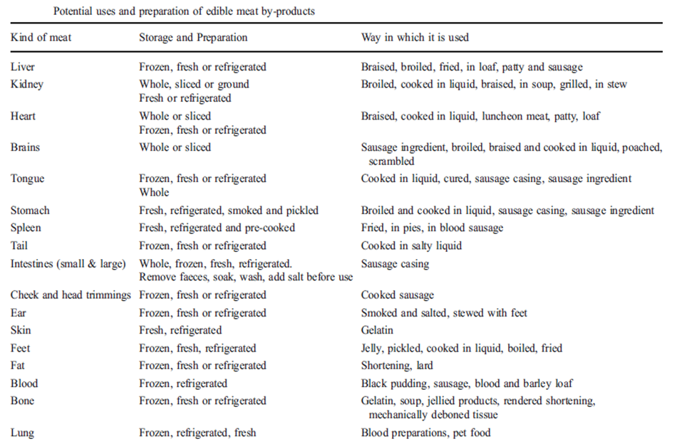
Utilization of Glands and organs:

Slide 20
Medicinal & pharmaceutical values:
CNS is a source of cholesterol:
*For synthesis of vitamin D3.
*Emulsifier in cosmetics
Bile extract: For treatment of ingestion, constipation & bile tract disorders.
Liver: a source of nutritional supplements (Vit. B12)
Heparin: From liver, lungs & small intestinal lining.
Used as blood anticoagulant
Hormones from ovaries:
*Progesterone & estrogen: treatment of reproductive problems.
*Relaxin: used during child birth

Slide 21
Hormones from the pancreas:
*Insulin: regulates sugar metabolism. (Diabetes)
*Glucagon: increase blood sugar, treats insulin overdose.
*Chymotrypsin and trypsin: improve healing after surgery or injury
Catgut manufacture (internal surgical sutures)

Slide 22
Utilization of Lard and Tallow:
Obtained by: ~dry rendering
~wet rendering (better quality)
Used in deep frying (consumer health concerns)
Manufacture of margarine and shortening
Sausages and emulsified products

Slide 23
Water waster from meat and poultry processing:
Sources: scalding, feather removal, carcass washing, sanitizing equipment.
Screening waste waters: separation of soft tissue
Effect of waste water on environment.

Slide 24
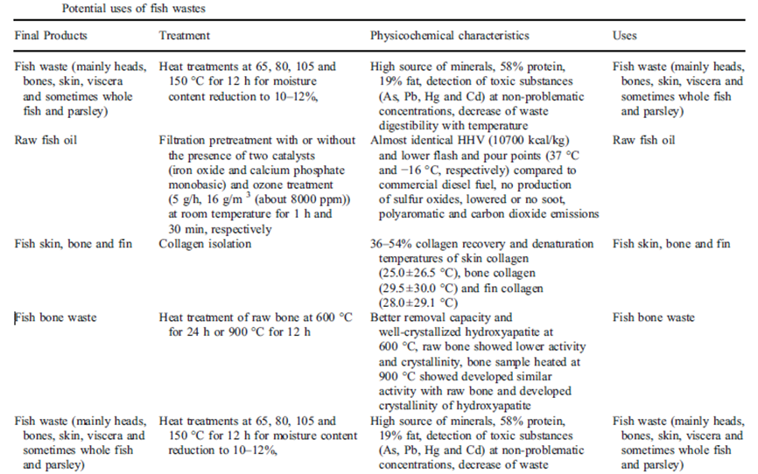
Potential uses of fish wastes

Slide 25
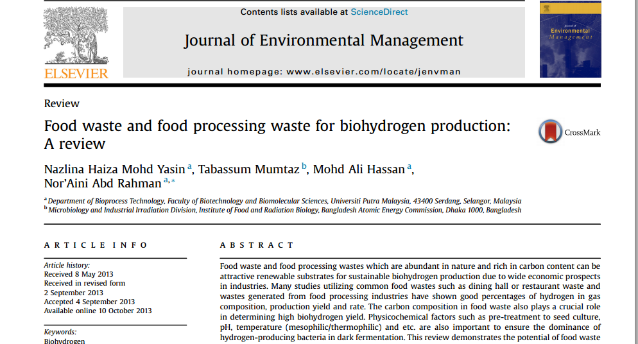

Slide 26
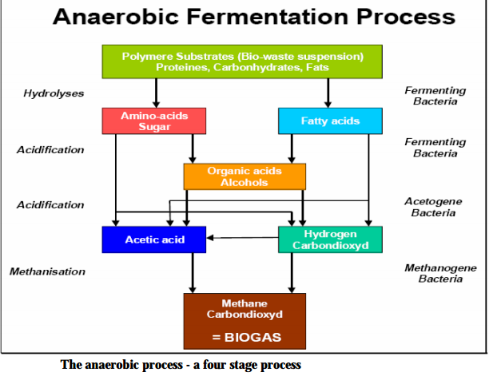
Utilization of wastes as Biofuel:
Biogas production:
From cattle manure, piggery waste water and by products of aquaculture.

Slide 27
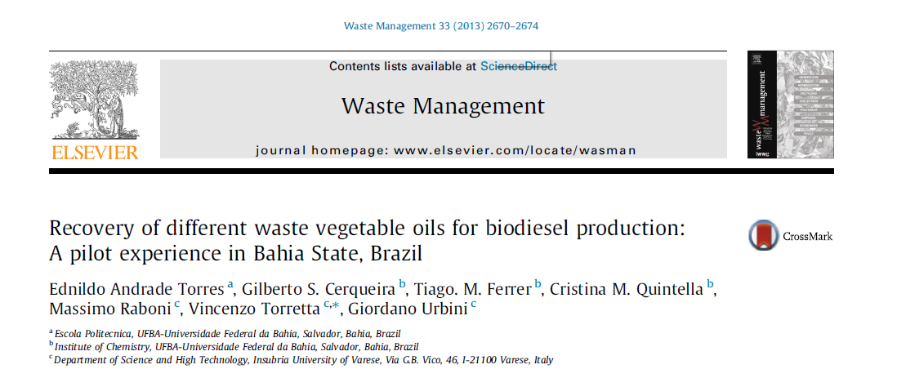
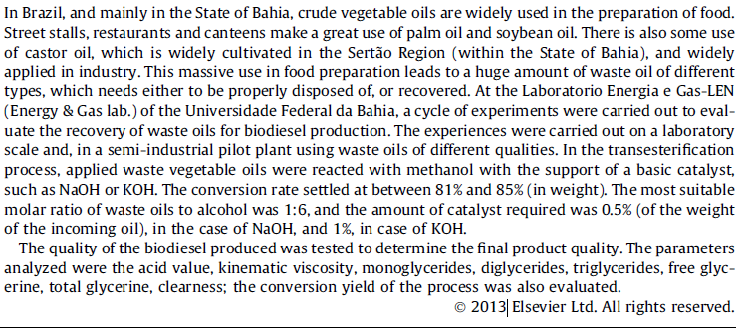

Slide 28
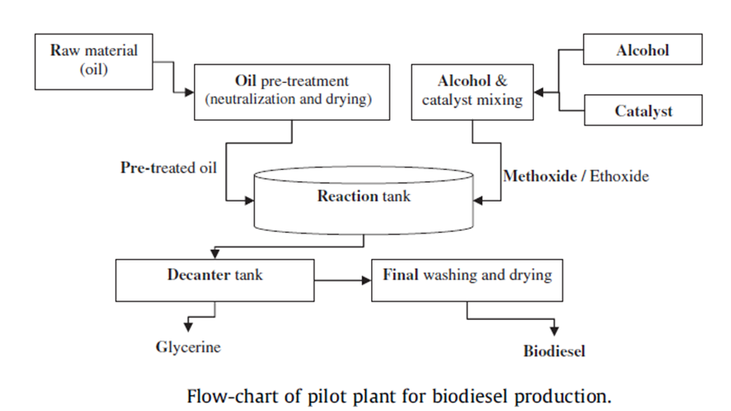
Production of Biodiesel from oil and fat wastes of food processing

Slide 29
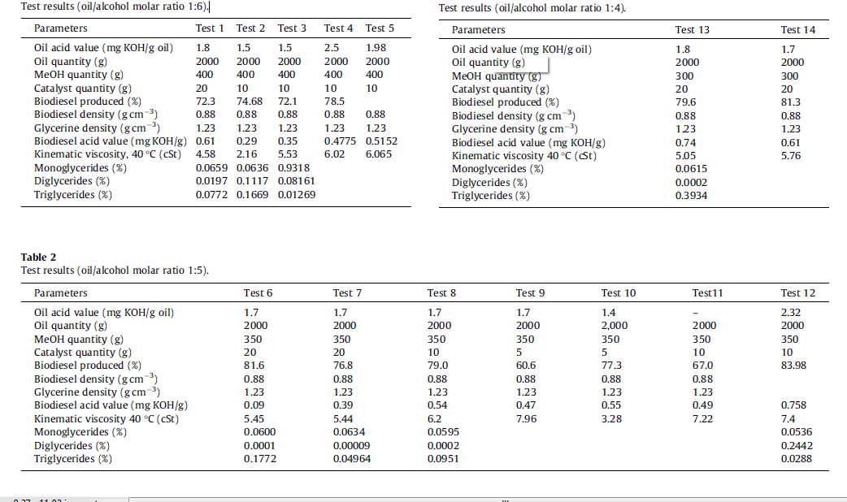

Slide 30
Fruit and Vegetable Wastes (FVW)
Effluents are predominant.
Solid wastes:
UN 2013 report estimates about 15M tons of FVW are generated by India, China, USA and Philipines.
Disposal and Environmental pollution.

Slide 31
Utilization of Fruit and Vegetable Wastes:
Excellent source of nutrients for livestock.
Source of bioactive compounds.
Useful in Bioenergy production.
Artificial fertilizers.

Slide 32
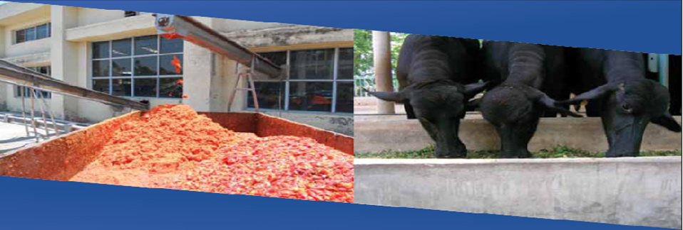
Utilization of FVW as livestock feeds:
Examples:
Banana foliage.
Dried citrus pulp
Mango seed kernel
Pineapple juice waste
Fresh cauliflower & cabbage

Slide 33
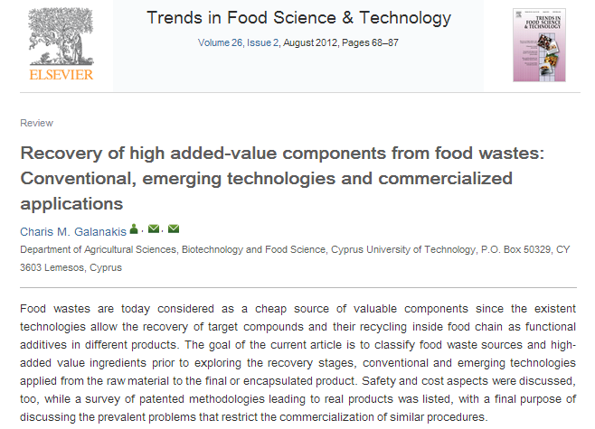

Slide 34
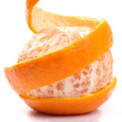
Utilization of FVW as source of Bioactive compounds:
Example:
Bioactive compounds from wastes of Citrus processing:
Sources of bioactive compounds
1: Flavedo layers (8-10% fruit weight):
Source of Essential oils
*used as flavorings, fragrances and solvents.
2: Albedo (white spongy) layer: (15-30% fruit weight)
~Source of pectin
~Naringin can be obtained from the rind of grapefruit.

Slide 35
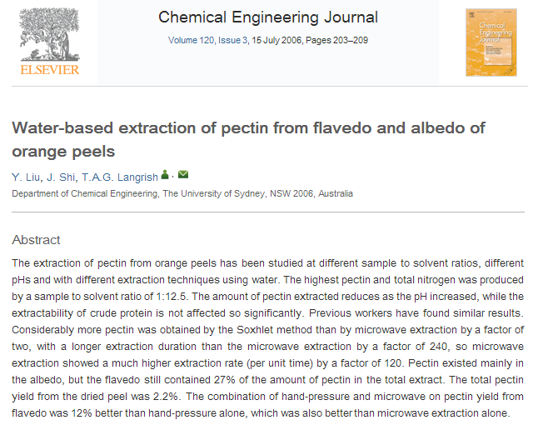

Slide 36
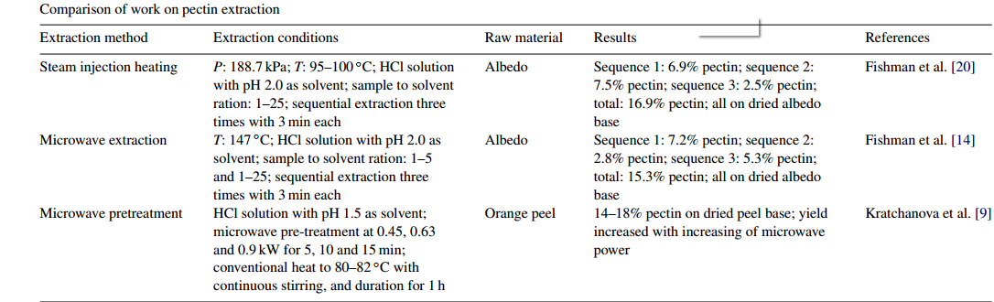
Comparing pectin yield with the various extraction methods:

Slide 37
Pectin extraction:
Acid extraction
Filtration
Precipitation by alcohol.
Uses of pectin:
-gelling in jams & jellies, thickening, texturizing, emulsifier & stabilizer…
Naringin:
* Is converted to Neohesperidian dihydrochalcone:- used as non caloric artificial sweetener. (about 1000-1800 times the sweetness of sucrose solution )

Slide 38
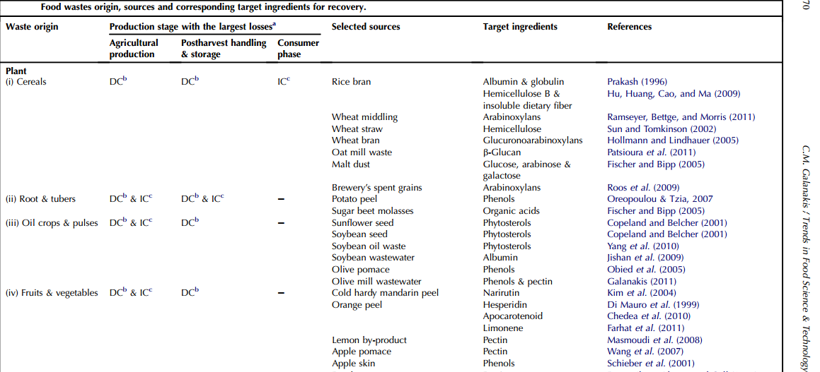
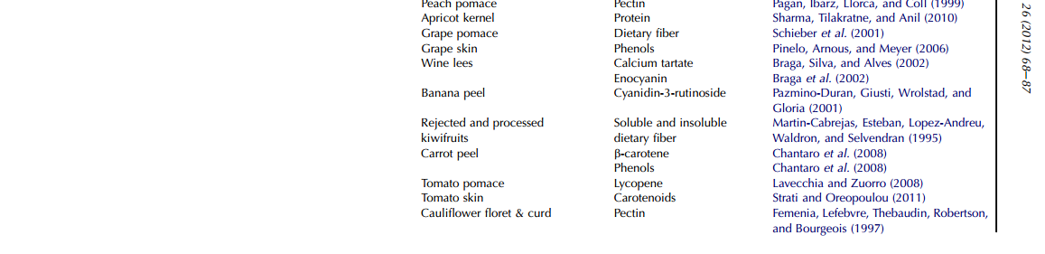

Slide 39
conclusion
Utilization of food processing wastes in the production of high value added products has increased the profitability of the food processing industry by reducing the cost of disposal of these wastes.

Slide 40
THANK YOU FOR YOUR ATTENTION

