Slide 1
Solar Energy Application

Slide 2
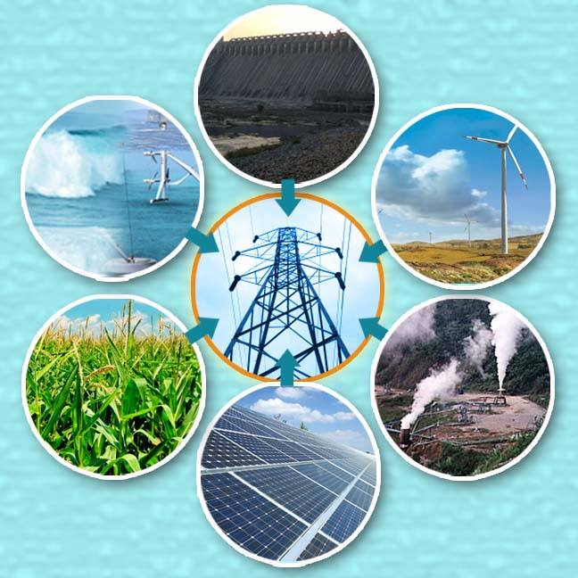
Make concentrated
Content:
Lighting from the sun
Cooking
Heating water
Water desalination
Light a led

Slide 3
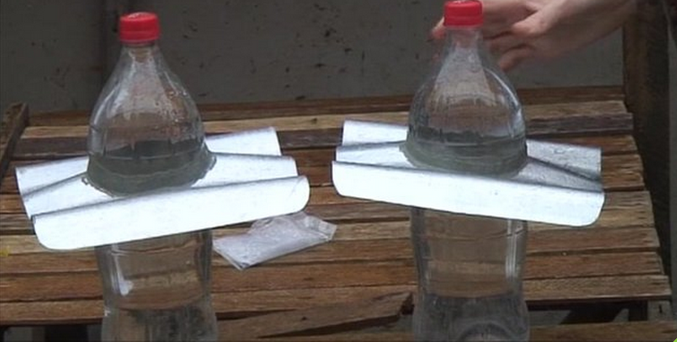
Lighting from the sun
Materials: *PET soda bottle *Iron sheet *Rubber sealant *chlorine *Filtered Water

Slide 4
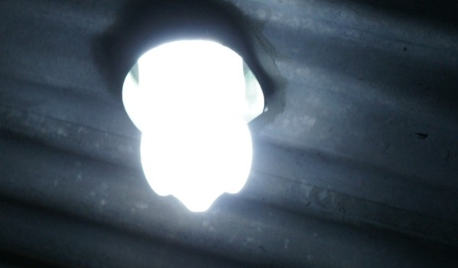
Lighting from the sun

Slide 5
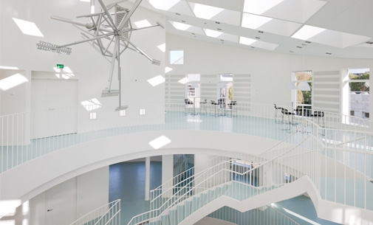
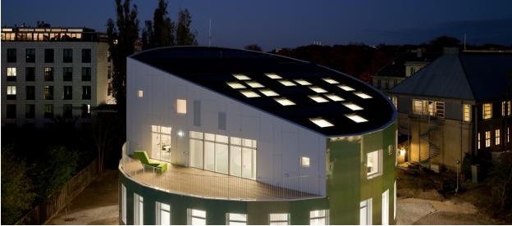
Green light house
Notes:
Carbon Neutral Buildings: Like Zero Net Energy Buildings, but no carbon is produced from renewable energy sources (ex. wind, solar, etc.). Only the operating energy is considered in the analysis.

Slide 6
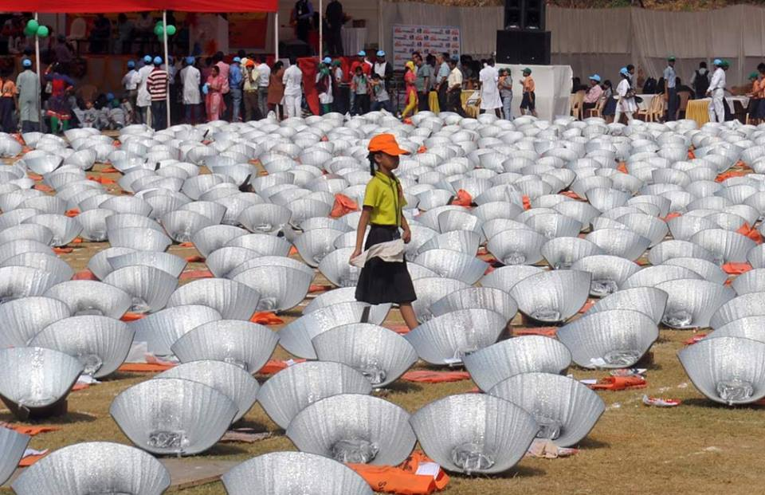
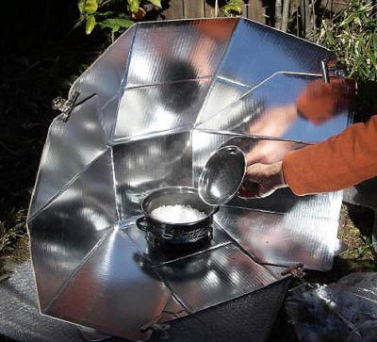
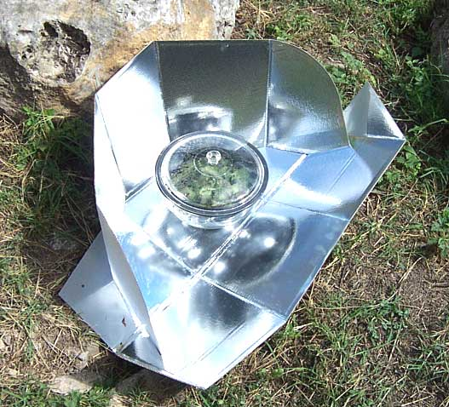
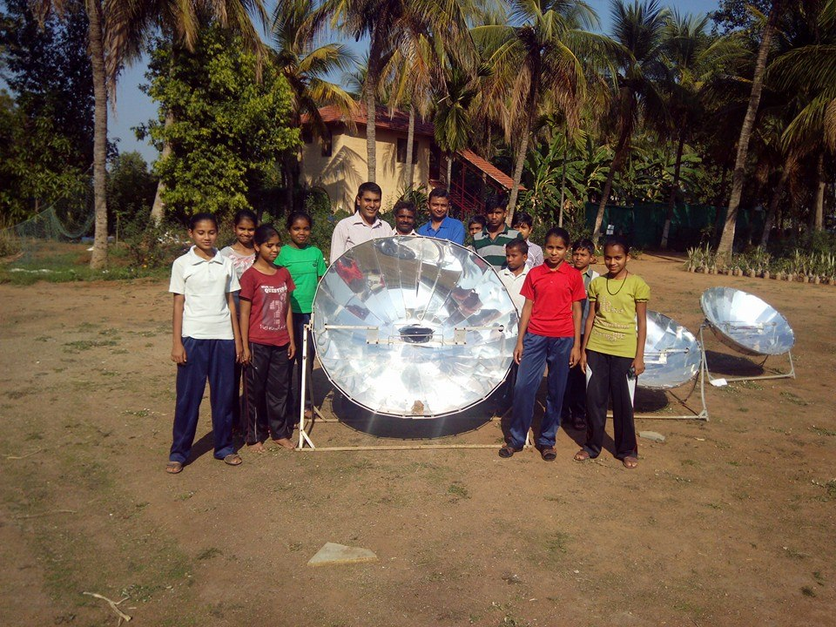
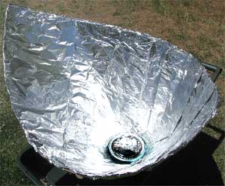
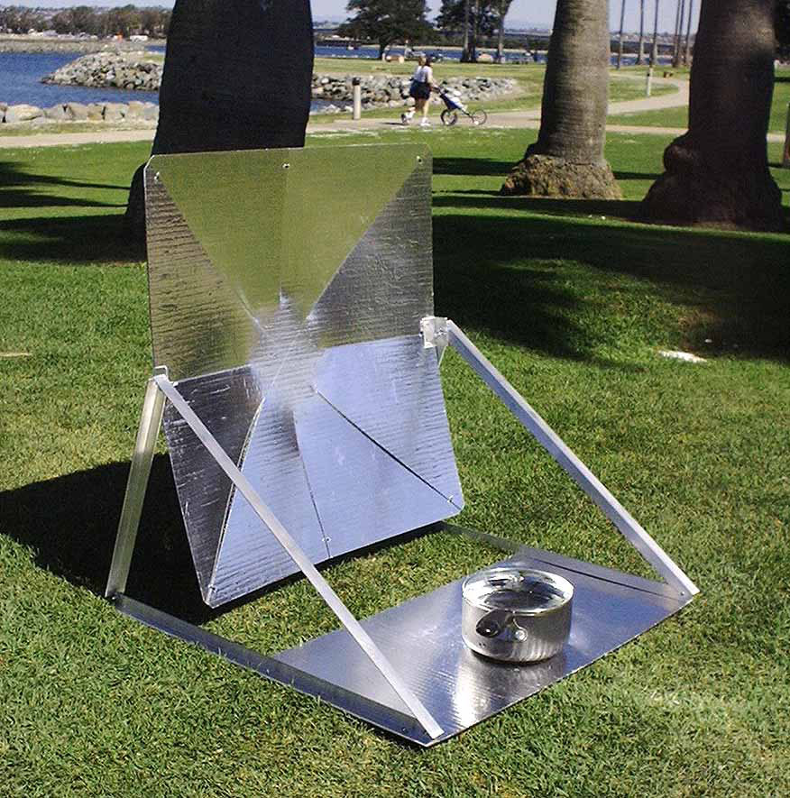
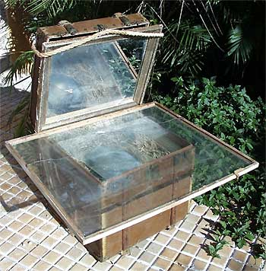
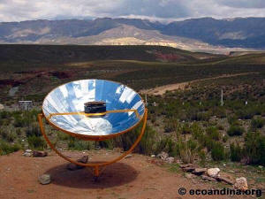
Cooking with solar energy

Slide 7
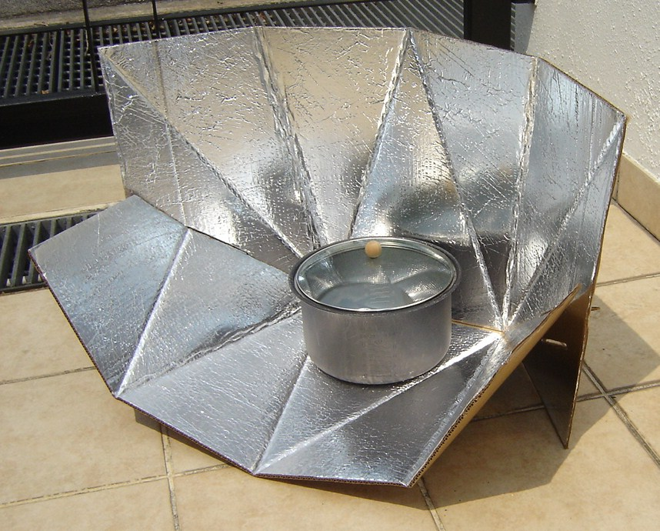
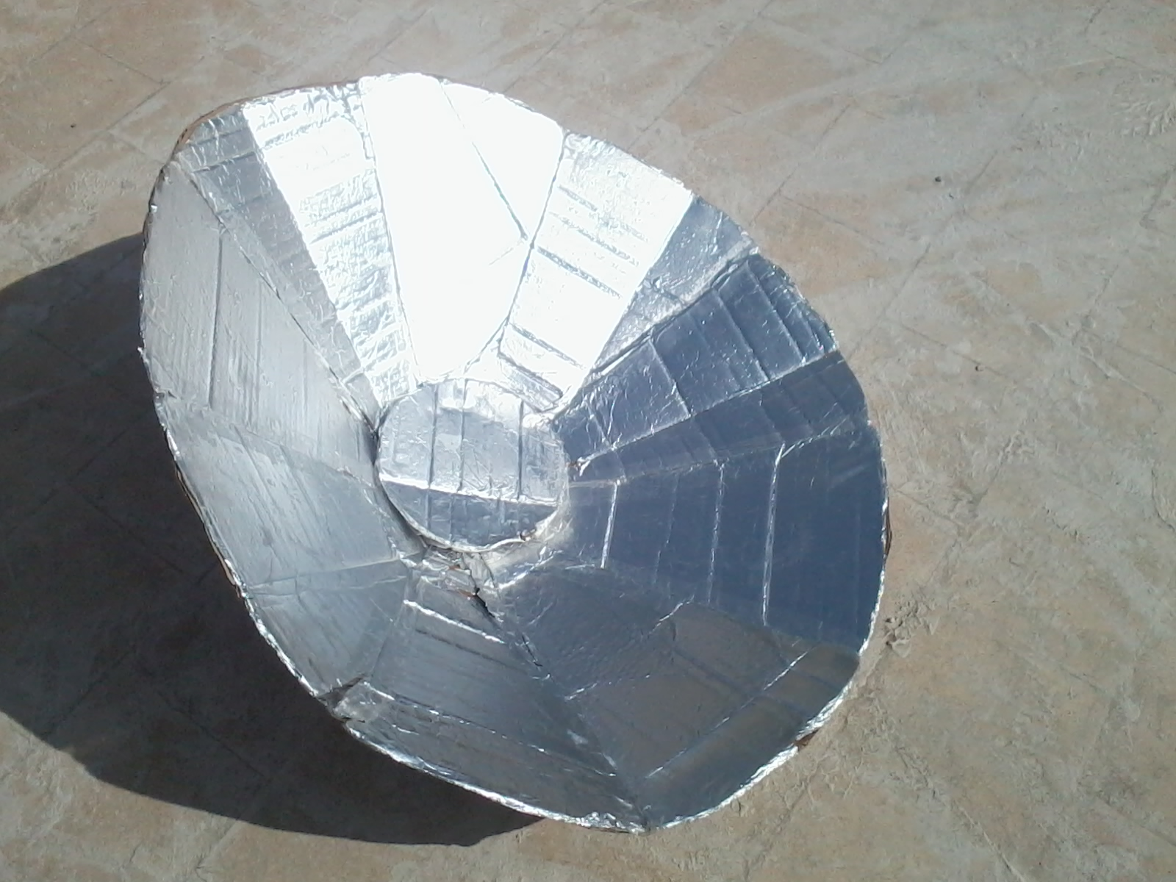
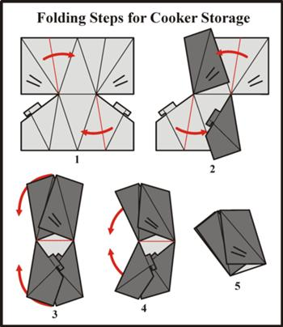
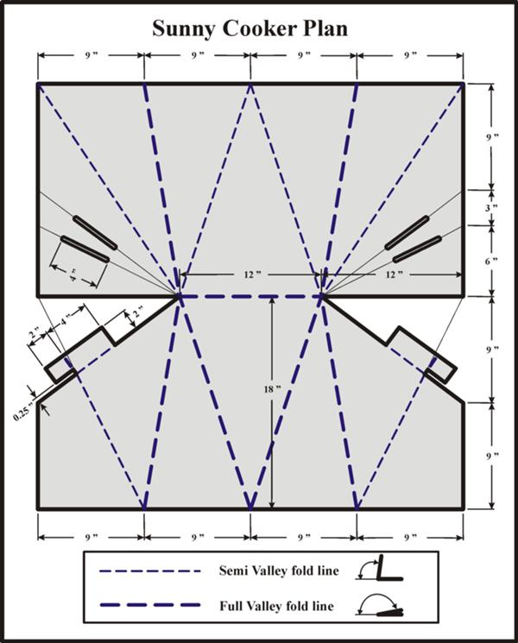
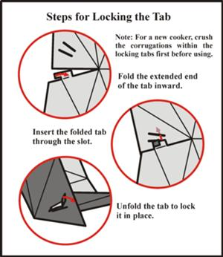
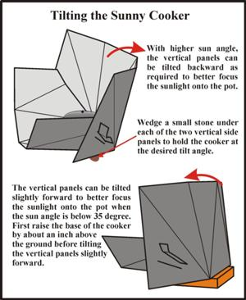
Cooking with solar energy
Materials: *cardboard sheet *Aluminum foil
Notes:
cardboard sheet for solar cooking

Slide 8
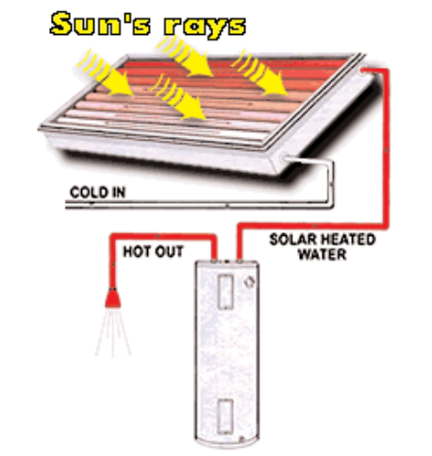
Water heating
Materials: *the box *The Coil
* Paint
* Prep Coil * Assemble Coil
*Assemble Collector
Notes:
cardboard sheet for solar cooking

Slide 9
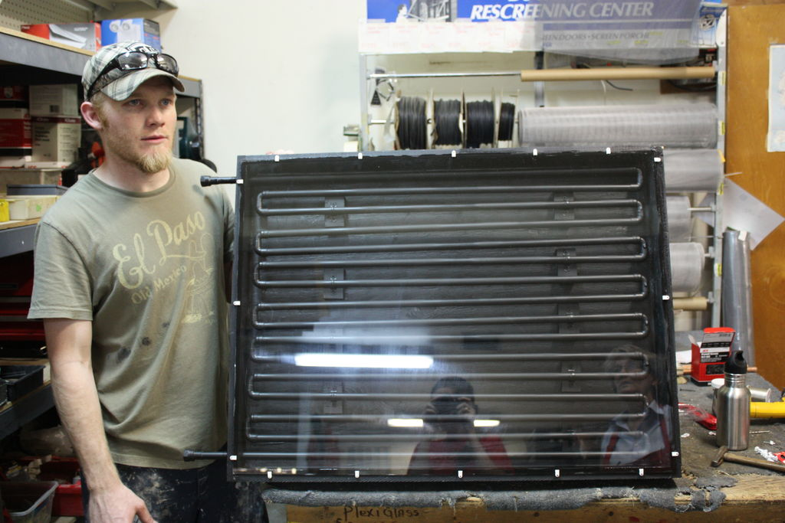
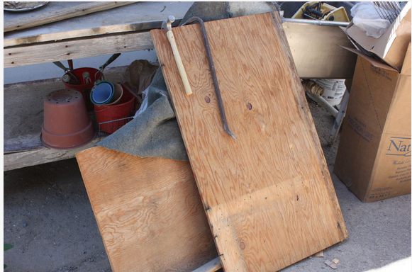
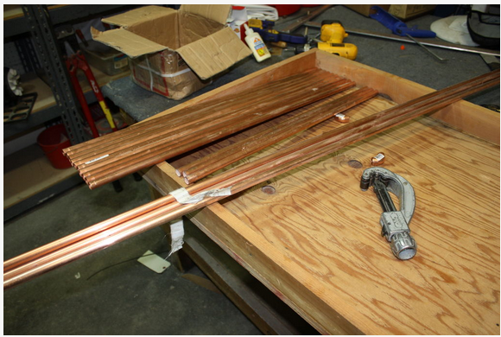
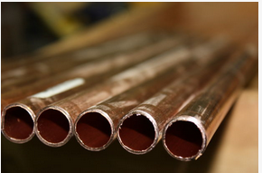
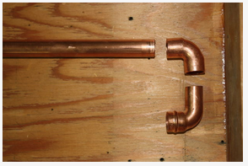
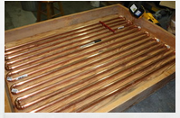
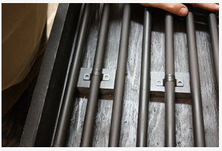
Water heating
Notes:
cardboard sheet for solar cooking

Slide 10
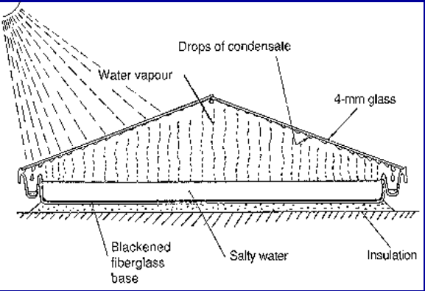
Water desalination
Notes:
cardboard sheet for solar cooking

Slide 11
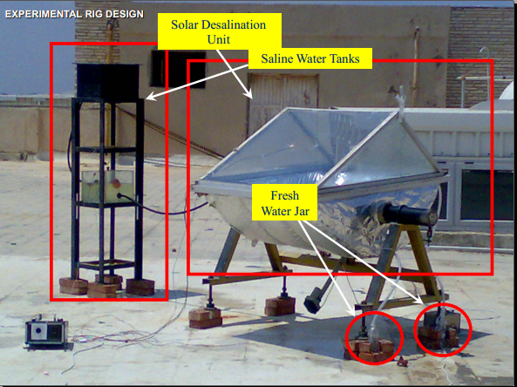
Water desalination
Notes:
cardboard sheet for solar cooking

Slide 12
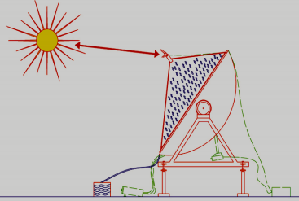
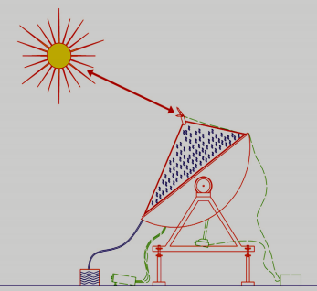
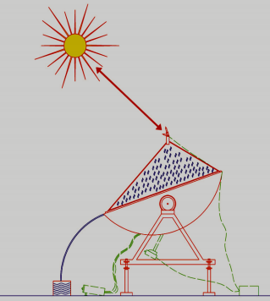
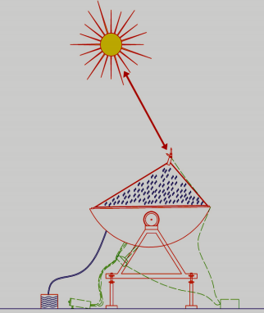
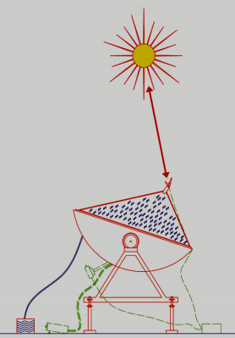
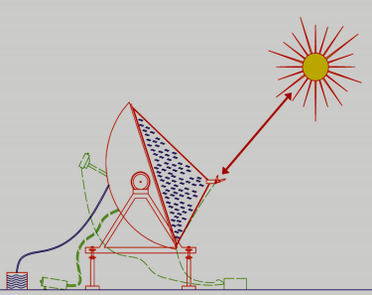
Water desalination(tracking)
Notes:
cardboard sheet for solar cooking

Slide 13
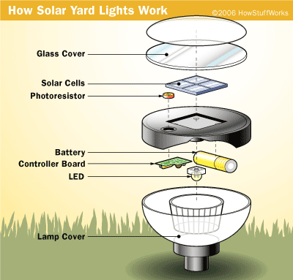
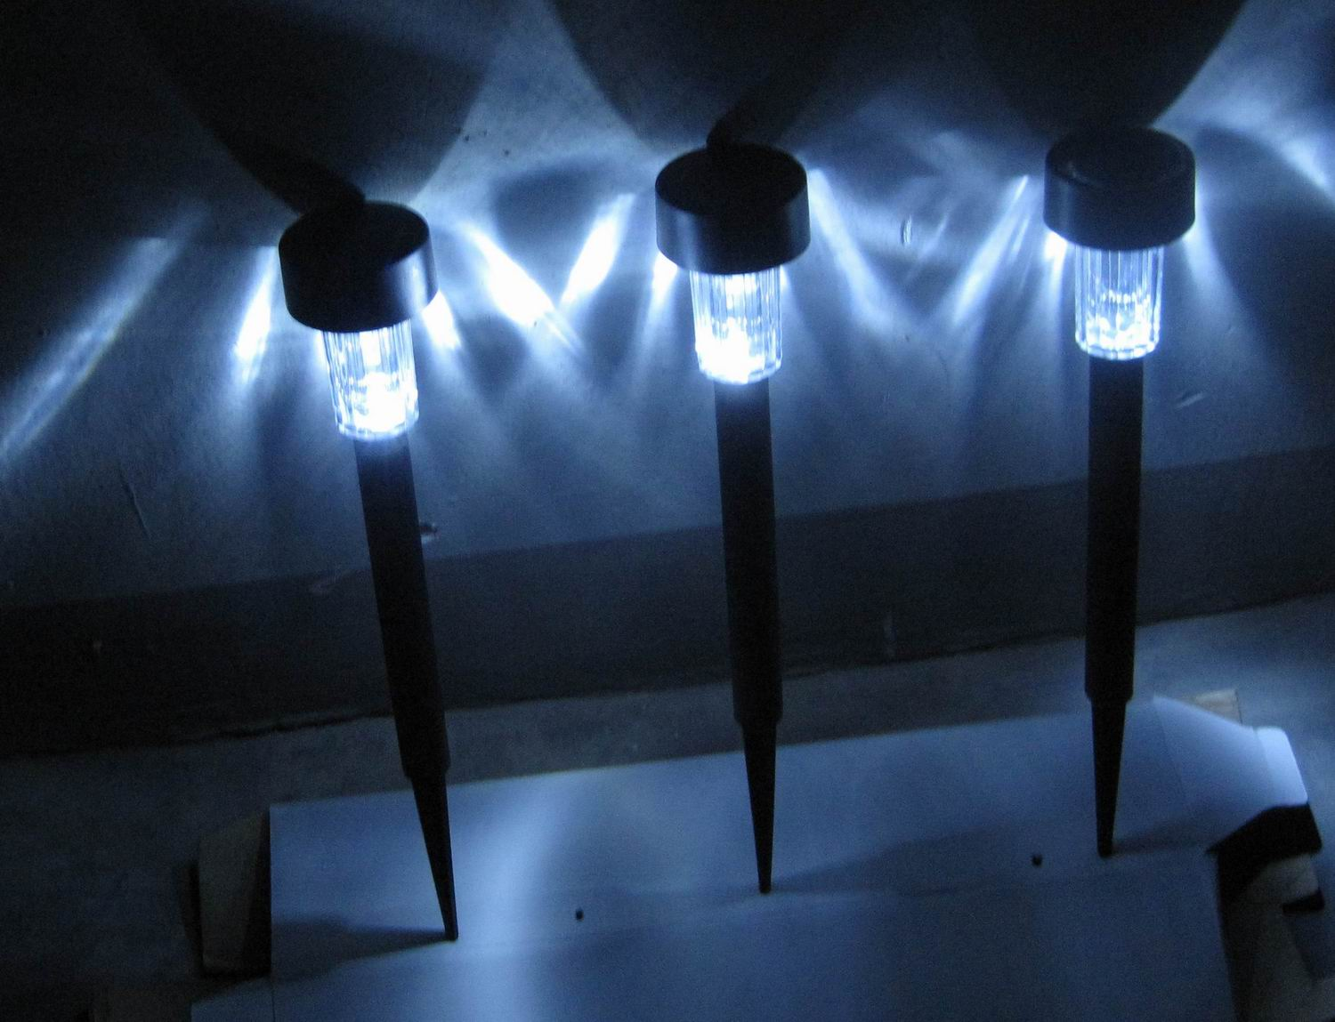
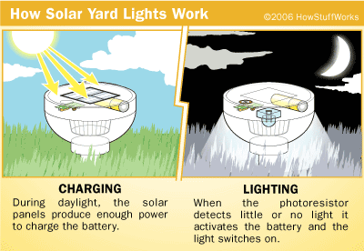
Solar Lights Work
Notes:
cardboard sheet for solar cooking

Slide 14
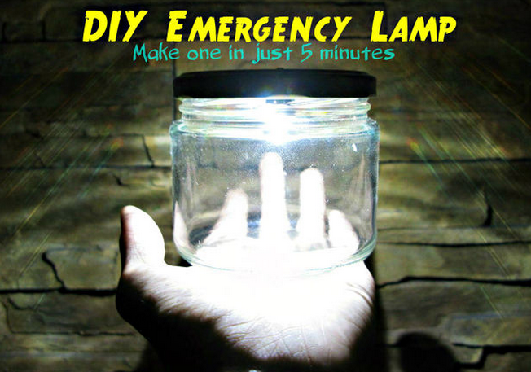
New design for light a led
Notes:
cardboard sheet for solar cooking

Slide 15
End of session
Facebook: www.facebook.com/abdo.fargly Email: engabdo.fargly@gmail.com
Edit by Eng. Abdelrahman Mohamed farghly

Slide 16
Question and discussion
Facebook: www.facebook.com/abdo.fargly Email: abdo.fargly@gmail.com
Edit by Eng. Abdelrahman Mohamed farghly

