Slide 1
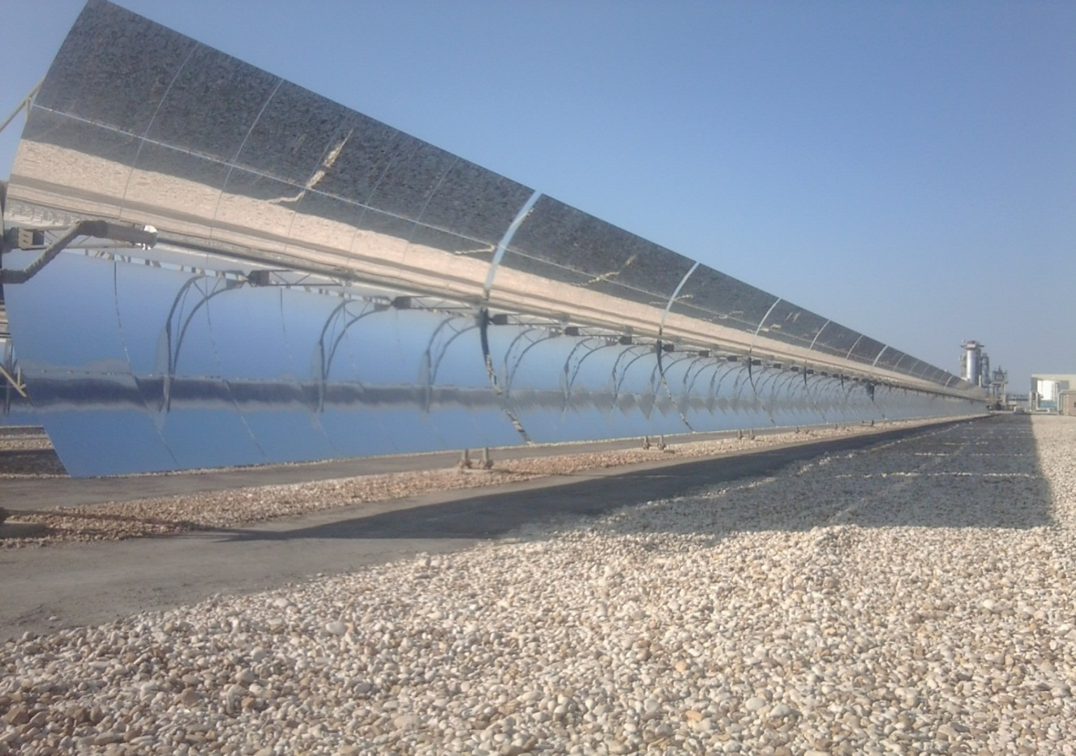
AL Kuraymat solar
power plant
introduction
Basic definitions
and principles
Financial support
location
Overview
Technical details
Prepared by: Bassem Sobaih ©2014

Slide 2
Introduction
Why Solar Energy is Important to us?
Fossil fuels, like gas and oil, are not renewable energy. Once they are gone they can't be replenished.
Fossil fuels create massive pollution in the environment. This pollution affects waterways, the air you breathe, and even the meat and vegetables that you eat.
Solar Energy Is a Clean and renewable Energy

Slide 3
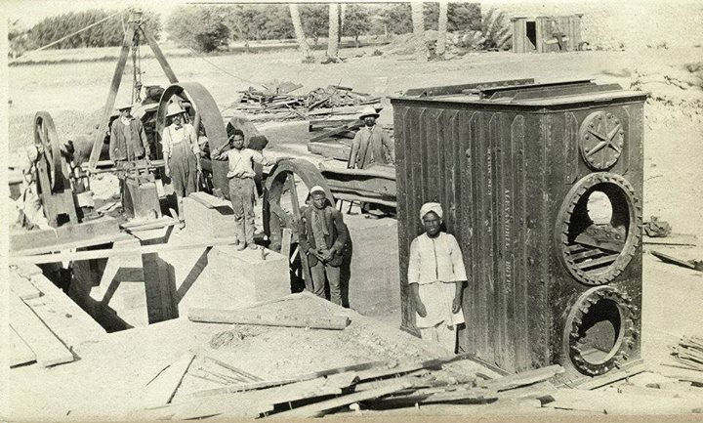
So… who is the first ?
The world’s first solar thermal power station was build by Shuman in Maadi, Egypt (1991). Shuman’s plant used parabolic troughs to power a 60-70 horsepower engine that pumped 6,000 gallons of water per minute from the Nile River to adjacent cotton fields.

Slide 4
Basic definitions and principles
Turbine
a rotary mechanical device that extracts energy from a fluid flow and converts it into useful work.
A turbine is a moving part called a rotor assembly, which is a shaft or drum with blades attached.
Moving fluid acts on the blades so that they move and impart rotational energy to the rotor.
Gas, steam, and water turbines usually have a casing around the blades that contains and controls the working fluid

Slide 5
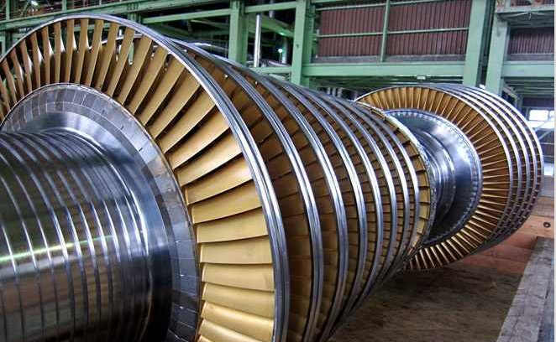

Slide 6
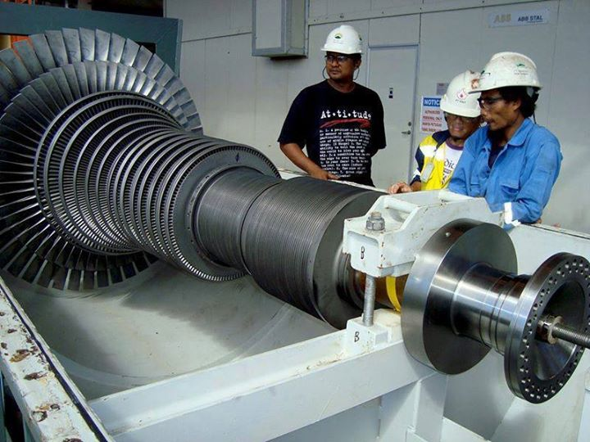

Slide 7
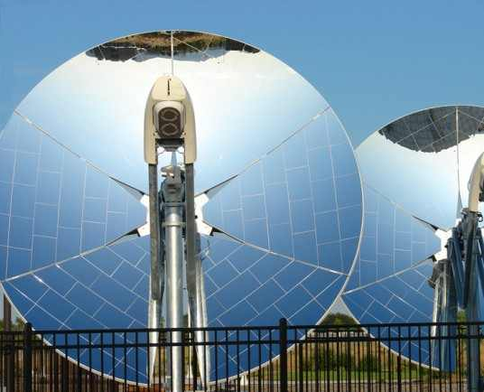
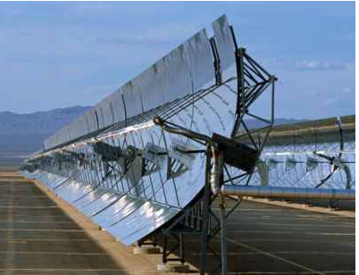
Solar collectors
(mirrors)
A collector is a device for capturing solar radiation.

Slide 8
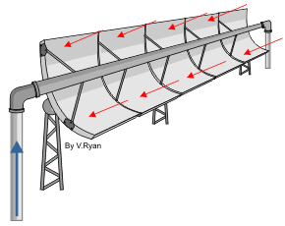
How does it work?
Simply by concentrating the sun radiation and reflect it to the absorber tube which the oil passing through

Slide 9
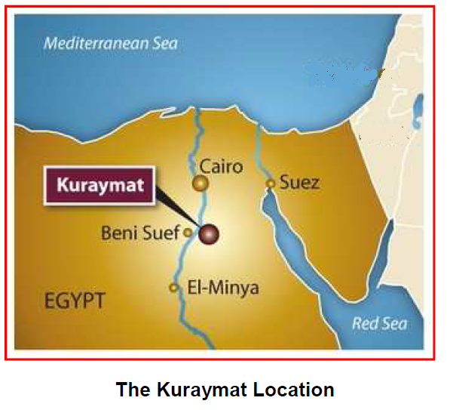
The location of kuraymat project
The Kuraymat project is located at about 95 miles south of Cairo, on the eastern side of the river Nile.
A gas pipeline, which supplies natural gas to the project, is passing.
The construction site is also passed by A 500 kV power line in the North and a double 220 kV power line in the South East

Slide 10
Financial support
The total cost is 340 Million USD
GEF has allocated a grant of 50 million USD to cover a substantial part of the incremental cost
JBIC has agreed to finance the thermal portion of the plant by about 190 Million USD through a soft loan
NREA covering the local currency portion required for the project

Slide 11
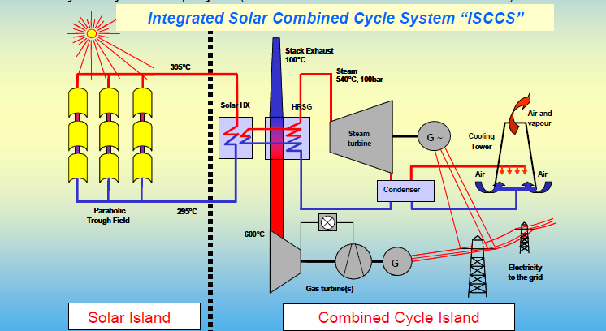
Overview
The project mainly consists of two islands:
-the solar island
-the combined cycle island

Slide 12
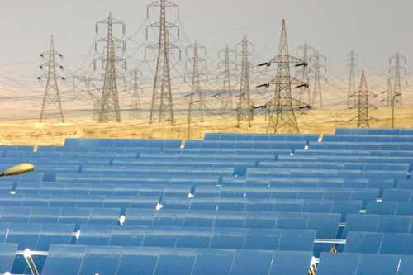
Technical data of solar island
-Number of completed collector loops = 40
-Number of completed collectors per loop = 4
-Number completed collectors = 160
-Number of collectors modules per completed collectors = 12
-Number of the whole collectors modules = 1920

Slide 13
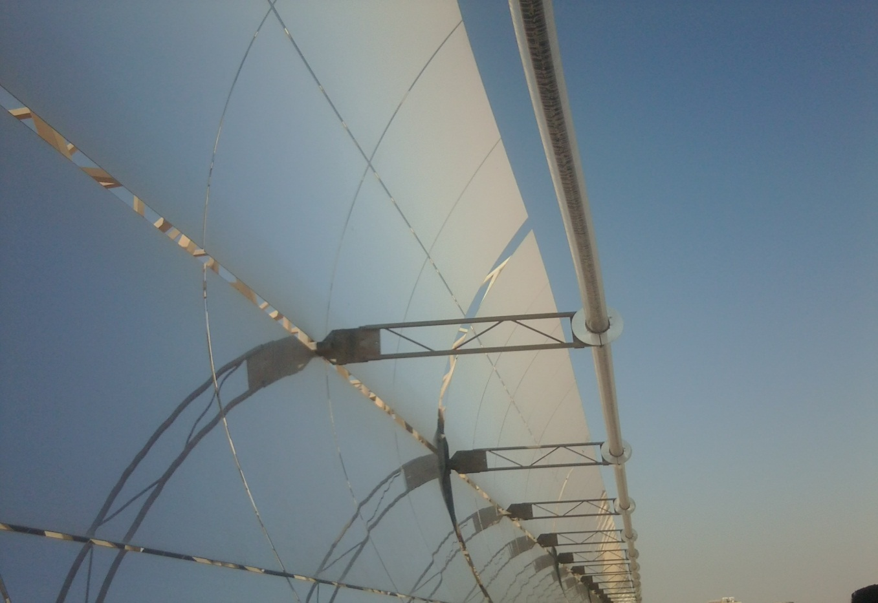
-The loop inlet temperature = 293
-The loop outlet temperature = 393
-Oil freezing temperature of 12⁰c and evaporate at 420⁰c

Slide 14
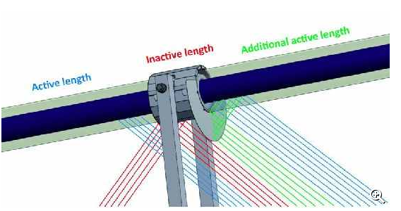
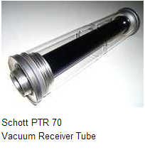
The absorber tube
-Manufactured from high temperature resisting aluminum alloys
-uses an improved highly selective vacuum deposited absorber coating in order to guarantee the lowest thermal emissivity in the market while maintaining excellent absorption of solar energy for conversion
to heat
High corrosion stability
High pressure resistance
High heat conductance

Slide 15
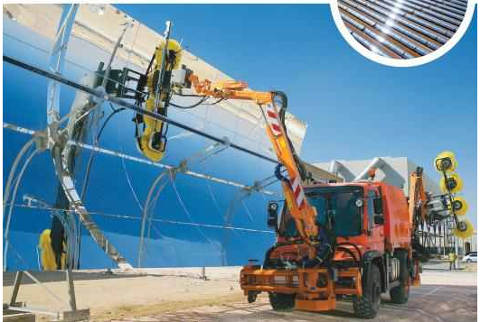
mirror cleaning vehicle

Slide 16
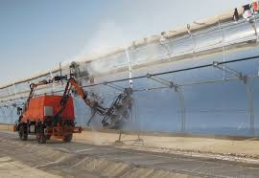
General technical data
Engine: 2.91 Turbo Diesel
Drive: 4x4
Maximum speed: 40Km/h
Tank volume: 3.3 m³
Water pressure: 200 bar
Mirror cleaning: spray bow / brushes
HCE cleaning: hand gun

Slide 17
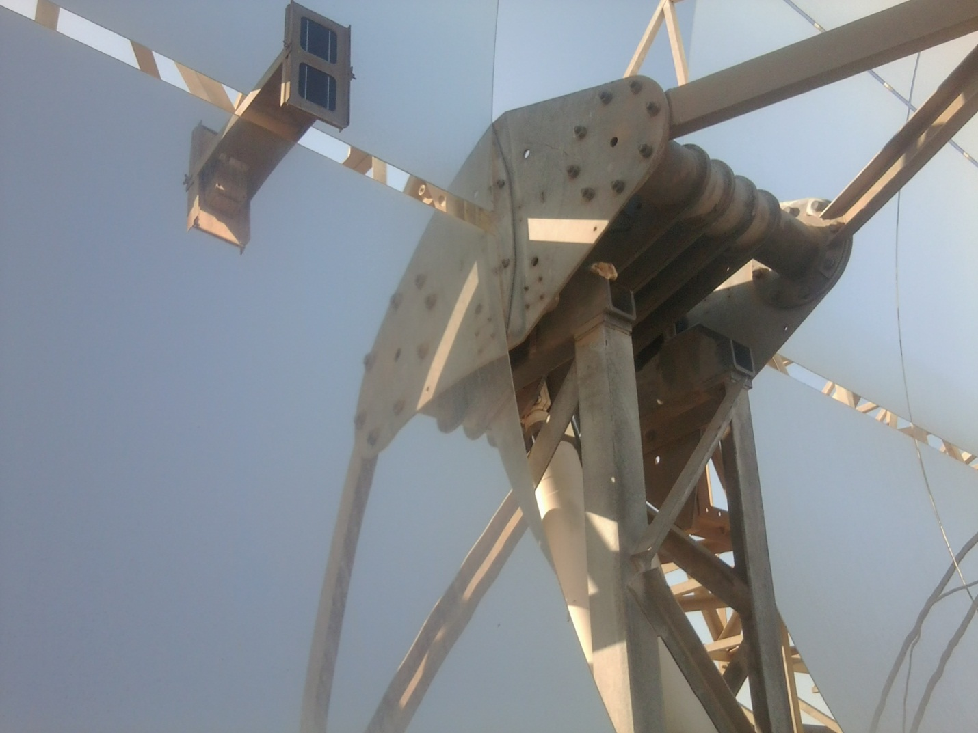
By using hydraulic system consist of:
-tow pistons
-One motor (.6 KW)
The photocell detect the sun light and transmit it into signals to the actuator which start running the motor so that the pistons rise or get down according to the direction of sun motion

Slide 18
Technical data of combined cycle
Gas turbine
74-80 MW at 20⁰ c ambient temperature
Efficiency of 20-25 %
Steam turbine
Siemens SST 900
60 MW @50MJ/S solar heat input
36-40 MW without solar input
Efficiency of 30-40 %
(The total efficiency of combined cycle is about 55%)

Slide 19
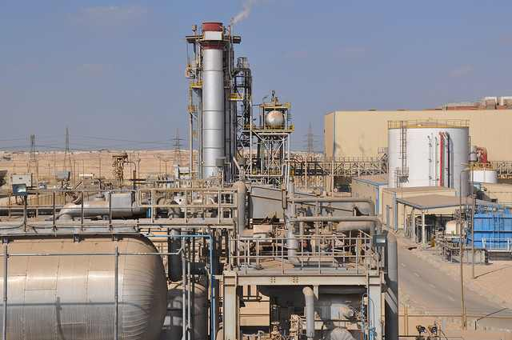
Cooling towers
Evaporative cooling with make-up water from Nile

Slide 20
References
Eng.moustafa the responsible of management of the kuraymat station
http://www.nrea.gov.eg
http://www.shamspower.ae
http://www.cced.gov.eg
http://www.moee.gov.eg
http://en.wikipedia.org/wiki/Frank_Shuman
http://www.greenprophet.com/2011/11/exclusive-pics-kuraymat-egypt/
http://www.nrel.gov/csp/solarpaces/project_detail.cfm/projectID=65

Slide 21
Thank you

