Slide 1
Let’s Go under the Sea ^^

Slide 2
Azza Ahmed ^^
1 sec
T.H.S

Slide 3
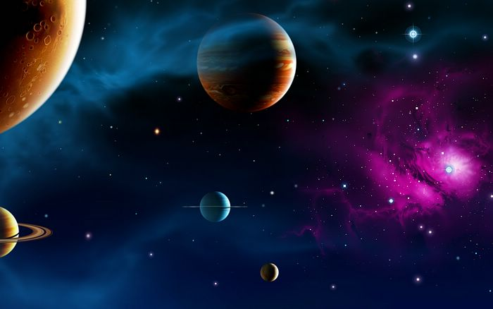

Slide 4
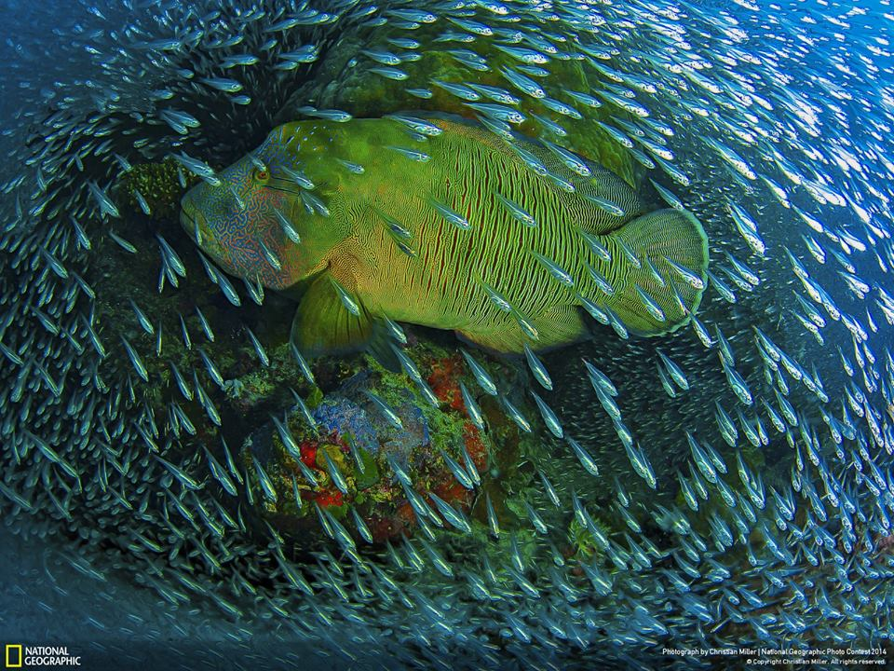

Slide 6
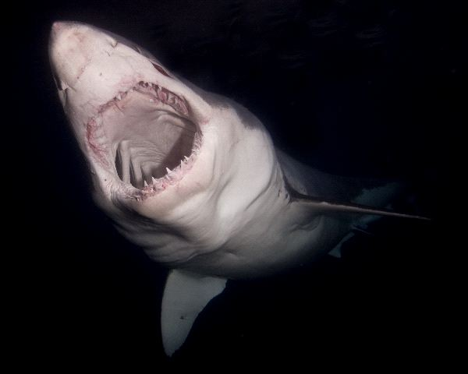
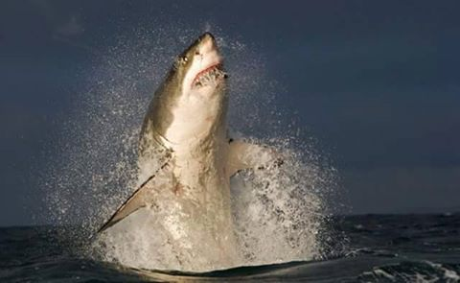

Slide 7
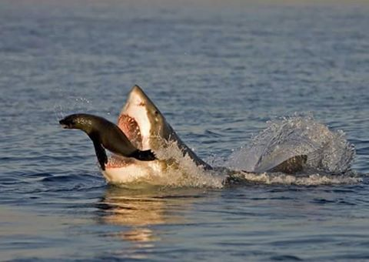
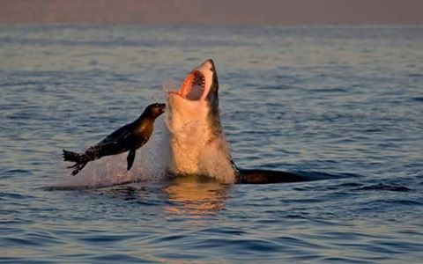

Slide 8
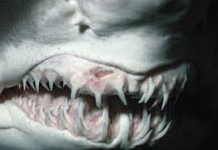
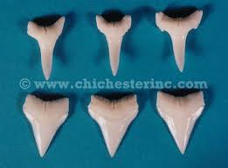

Slide 9
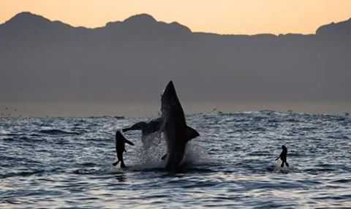

Slide 10
Vedio

Slide 11
References :
http://www.nefsc.noaa.gov/faq/fishfaq8.html
http://www.livescience.com/27338-great-white-sharks.html

Slide 12
http://www.sharksavers.org/en/education/biology/shark-and-ray-reproduction/
http://sharkangels.org/issues-facing-sharks/uses-for-shark
http://www.sharks-world.com/
http://www.sharks-world.com/great_white_shark_in_guadalupe_mexico/

Slide 13
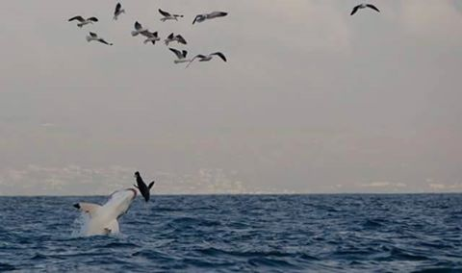
Thank You ^^
Any questions ??!

