Slide 1
Open Sources
Operating systems

Slide 2
What is open sources?!
product that which a company make for you and you can edit it free..

Slide 3
Advantages of open sources ……
Free or cheap
You can edit free

Slide 4
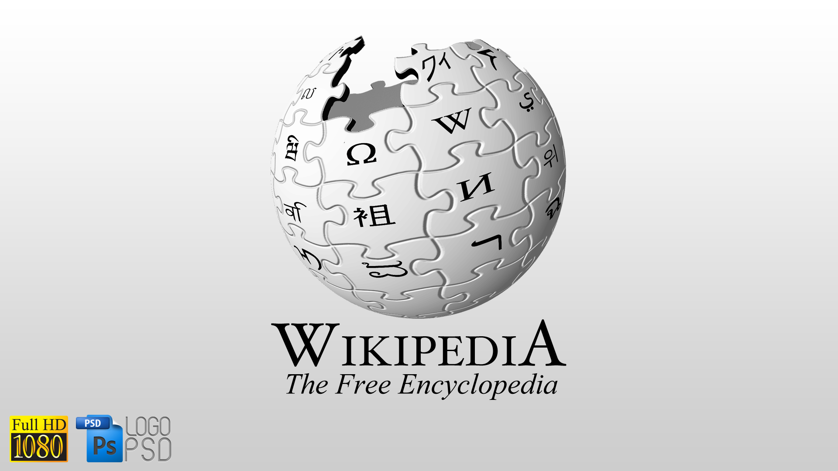

Slide 5
Introduction to computer science ..
Binary system
Programing language

Slide 6
Binary system
Computers can not understand human languages
It can deal only with 0’s & 1’s
Compilers can convert programming languages to machine language (0’s&1’s)

Slide 7
Processors
Not!

Slide 8
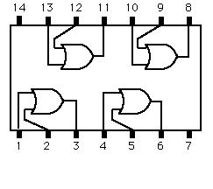
or gate

Slide 9
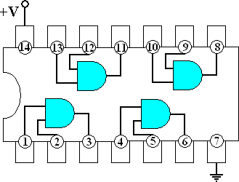
And gate

Slide 10
Programming languages
Language made to make it easy to connect with computers
Like the English
Each one has it’s certain syntax
Ex
C++
C
Html
Css
Fortran
C#

Slide 11
c vs fortran
# include <stdio.h>
Void main()
{
Printf(“hello,lym”);
}
write(*,*)’hello,lym’
END

Slide 12
Linux …
Operating system made in 1969 to be an open source for all users and to make it easy for anyone to make his own programs

Slide 13
Arduino ….
Chip made to connect devices to each others
Can be programed by C
Ex
Arduino uno
Arduino mega
Ardueno micro
void setup() { pinMode(13, OUTPUT); } void loop() { digitalWrite(13, HIGH); delay(1000); digitalWrite(13, LOW); delay(1000); }
Notes:
Digital and analog write

Slide 14
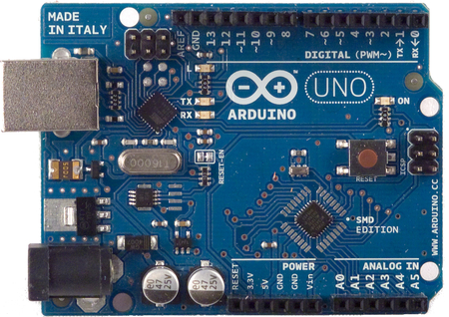

Slide 15
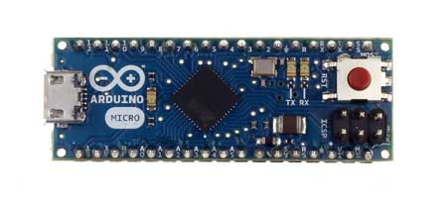

Slide 16
