Slide 1
Paradox & infinity
Moemen Khaled

Slide 2
24.118x Paradox and Infinity

Slide 3
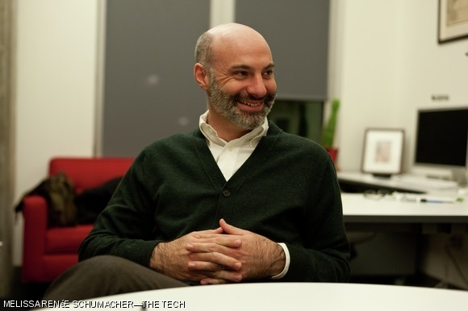
Professor Agustin Rayo
9 topics
1.5 months

Slide 5
Paradox?!
أنا هأتفرج على سبونج بوب أسهل

Slide 6
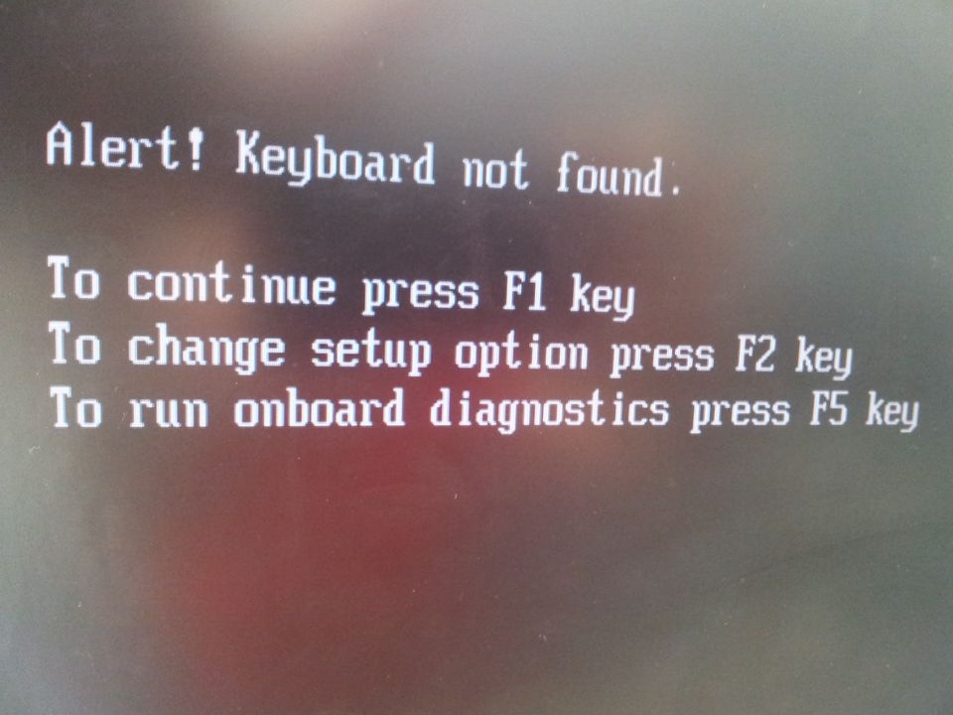

Slide 7
اختم الورق من الدور الأول
اختم الورق من الدور الأخير

Slide 8
Famous Paradoxes
1. This statement is false
2. Crocodile Dilemma
3. What happens when an immoveable object meets an unstoppable force?
4. مفيش صاحب يتصاحب

Slide 9
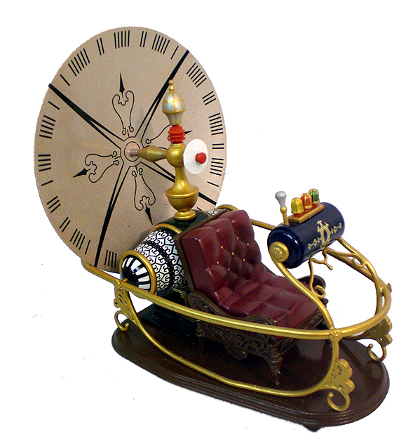
The Grandfather Paradox
2015
حسونة
Evil
Grandfather

Slide 10
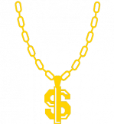
1950

Slide 11
Consistent
1950
2015
but

Slide 12
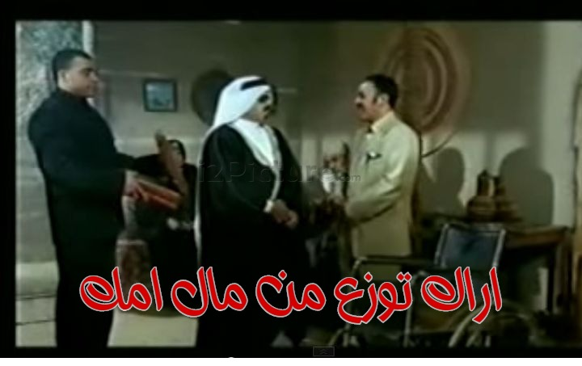
Newcomb’s paradox
1
2
1000$
0$ or 1,000,000$
One or two boxes?

Slide 13
Plot twist
99% Accuracy
Personality Expert
If two boxes,
contains 0$
2
If one box,
2
contains 1,000,000$

Slide 14
Expected value maximization
EV(x) = p(x).v(x)
You assign the values

Slide 15
EV1 = 99% . 1,000,000 = 990,000
EV2 = 99% . 1000 + 1% . 1,001,000 = 11,000
EV1 > EV2
You should One Box.

Slide 16
But consider the situation
1000$
0$
1
2

Slide 17
And one more thing….

Slide 19
References
MITx 24.118 Paradox & Infinity: https://www.edx.org/course/paradox-infinity-mitx-24-118x
Grandfather Paradox – Wireless Philosophy: https://www.youtube.com/watch?t=23&v=M8oITAoaCr4
What Is The Speed Of Dark? – Vsauce: https://www.youtube.com/watch?v=JTvcpdfGUtQ

