Slide 1
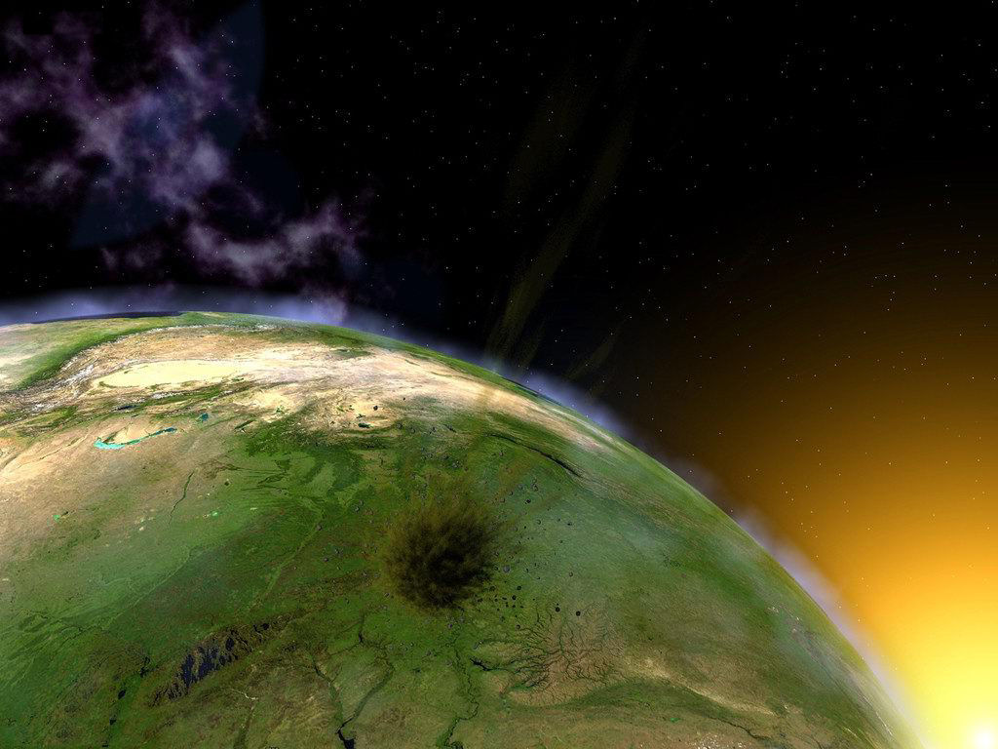
A Global Warning
From
A Global Warming

Slide 2
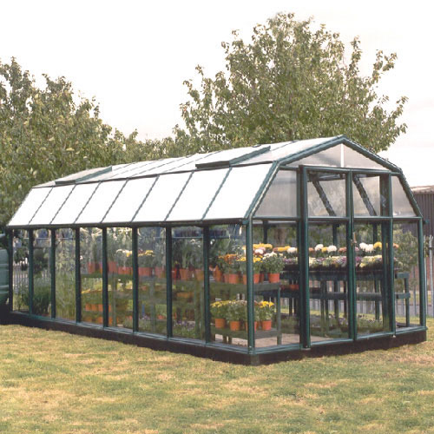
Greenhouse

Slide 3
Greenhouse Gases
Carbon Dioxide
Methane
Nitrous Oxide

Slide 4
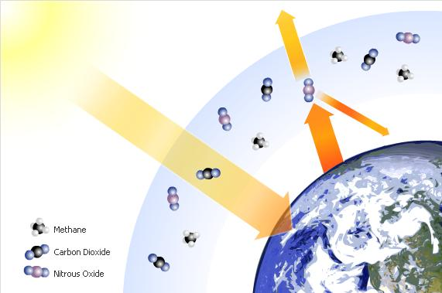
Greenhouse Effect

Slide 5
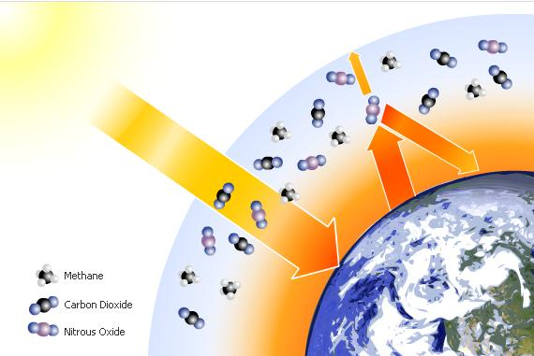
Enhanced Greenhouse Effect

Slide 6
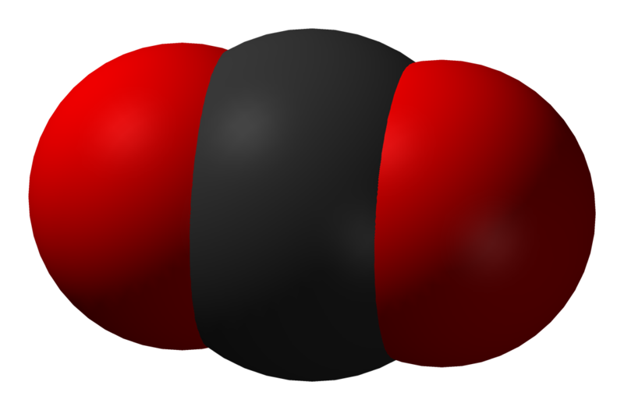
Carbon Dioxide

Slide 7
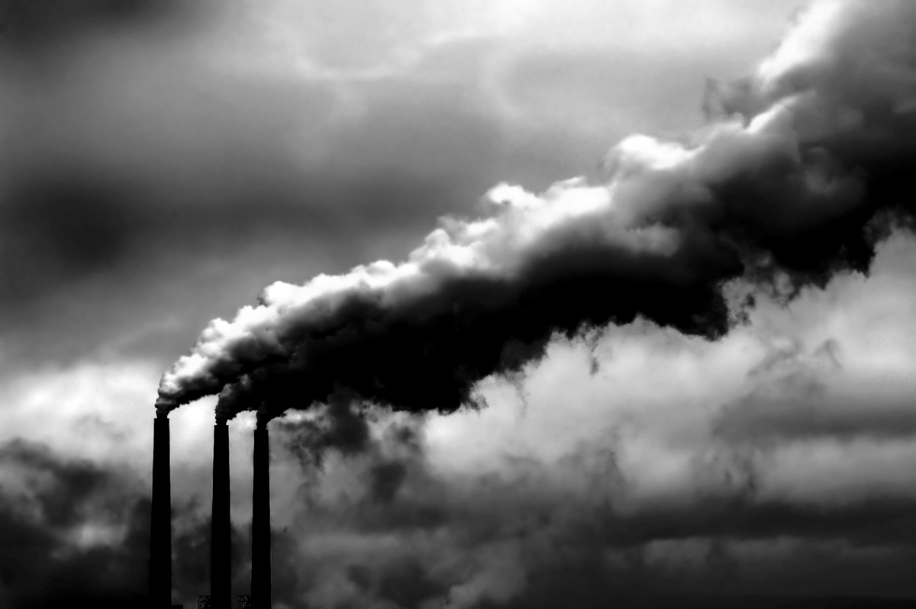

Slide 8
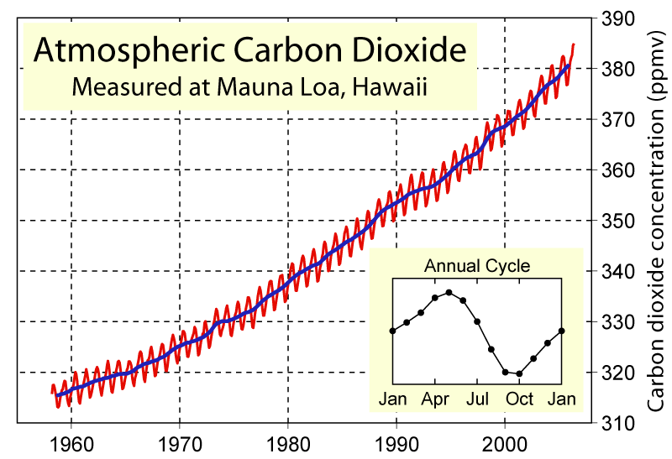

Slide 11
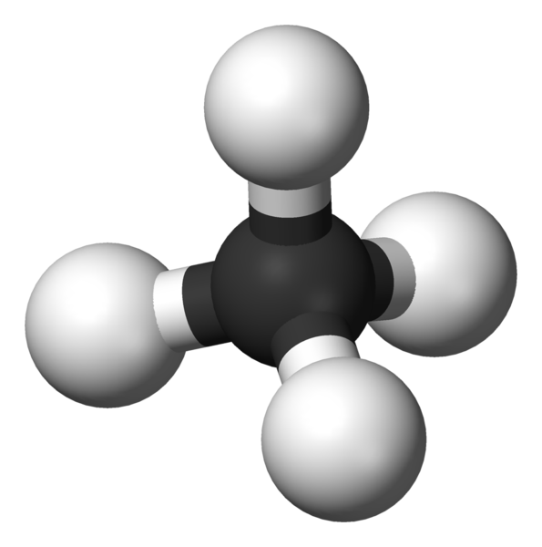
Methane

Slide 12
Organic Matter

Slide 14
The Effects of
Global Warming

Slide 15
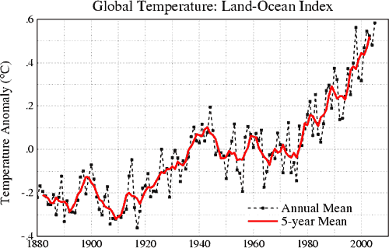

Slide 16
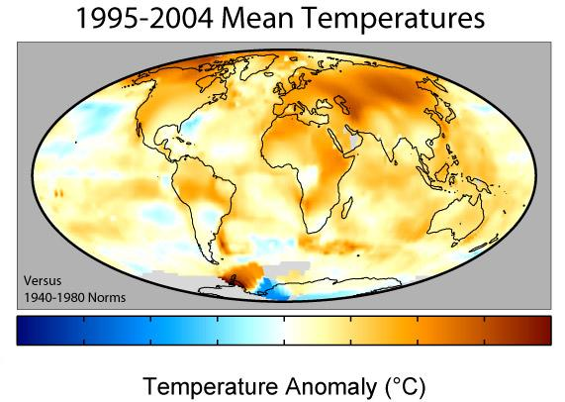

Slide 17
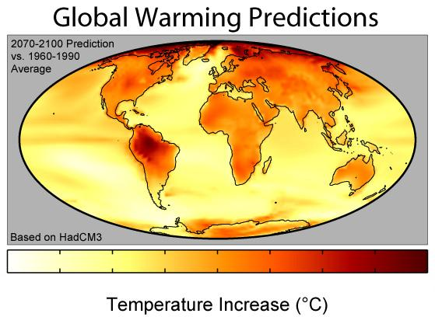

Slide 18
It Will Just Keep Warming
Until …

Slide 19
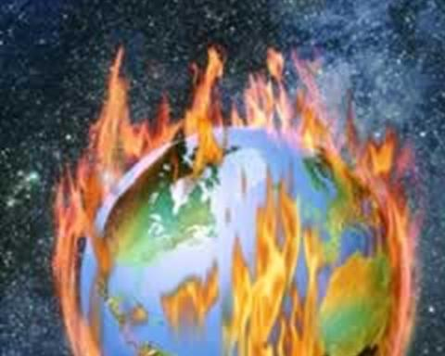

Slide 20
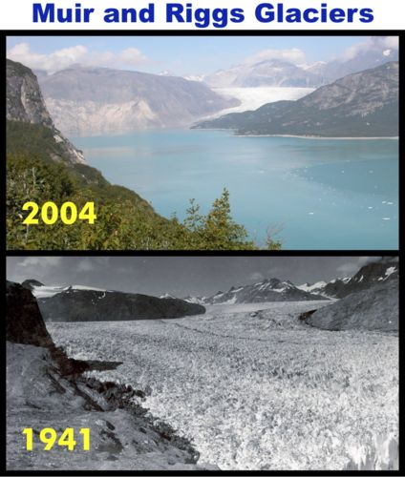

Slide 22
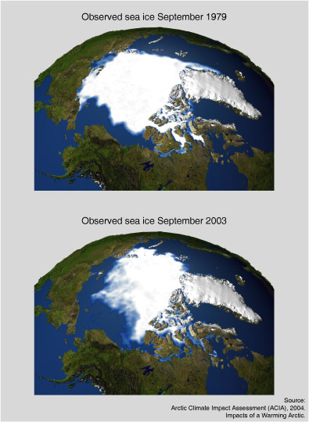
The North Pole Is
Disappearing

Slide 24
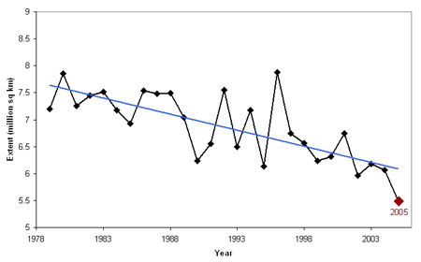

Slide 25
Greenland

Slide 26
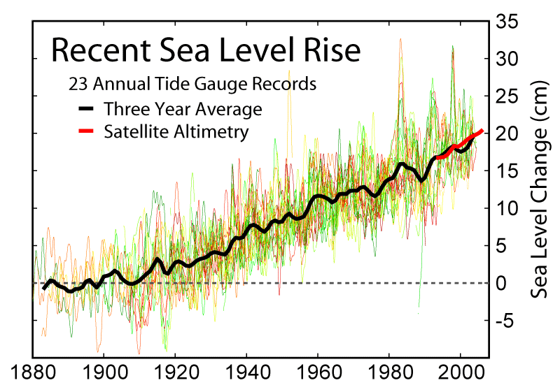

Slide 27
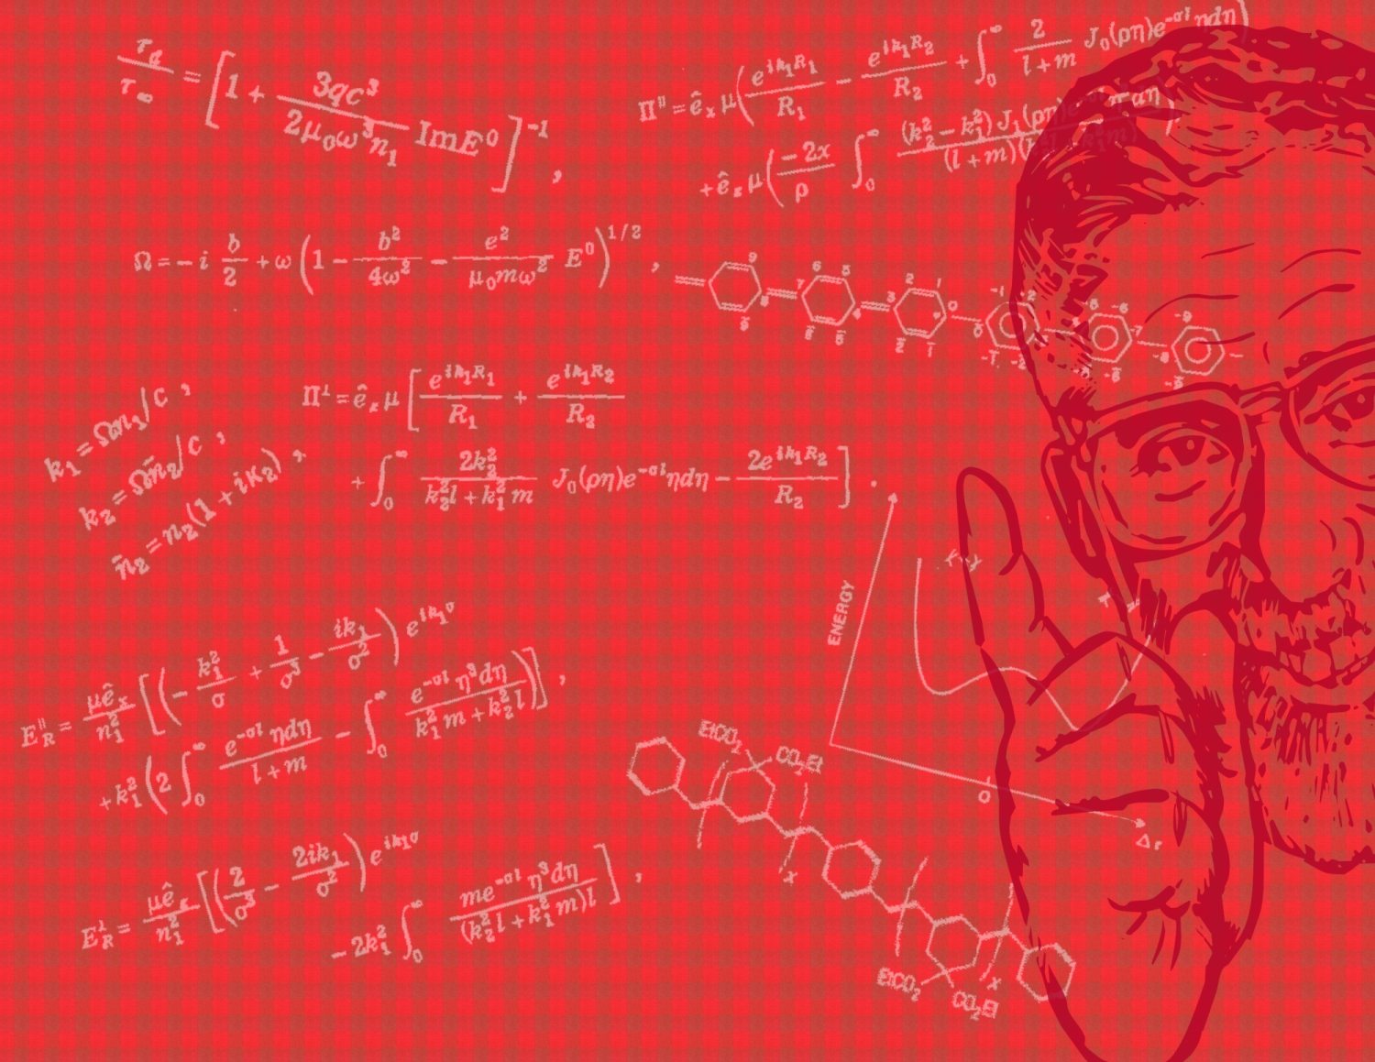
As Well, Many Low-Level Cities Will Be Covered With Water Forever ….

Slide 28
Including ALEXANDRIA

Slide 29
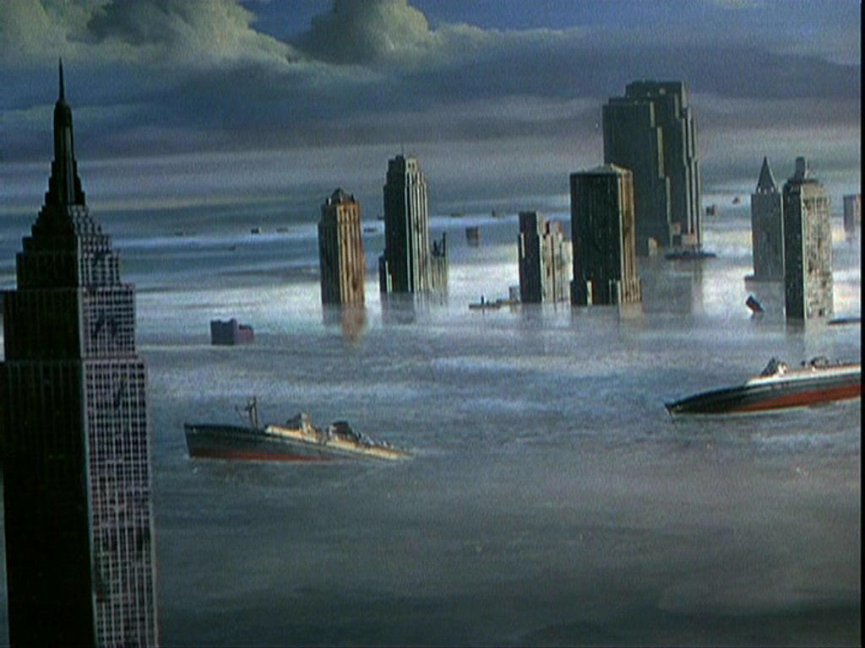

Slide 31
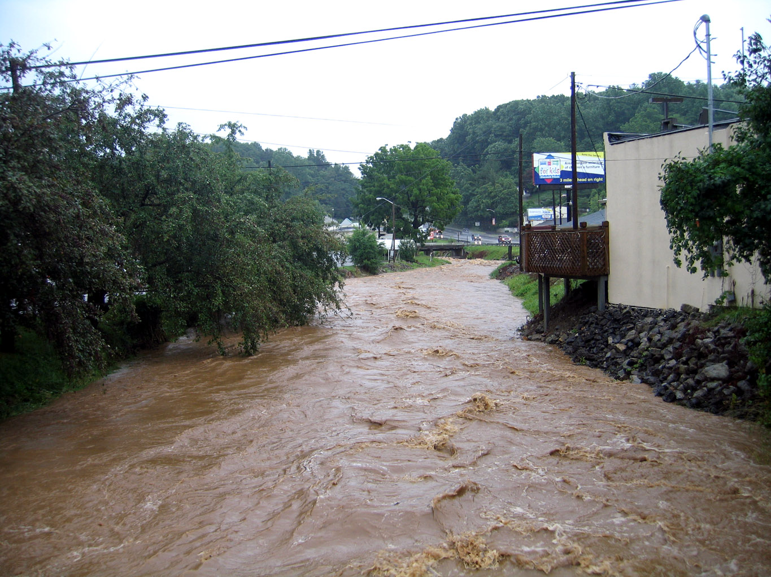
Floods

Slide 32
Dryness

Slide 33
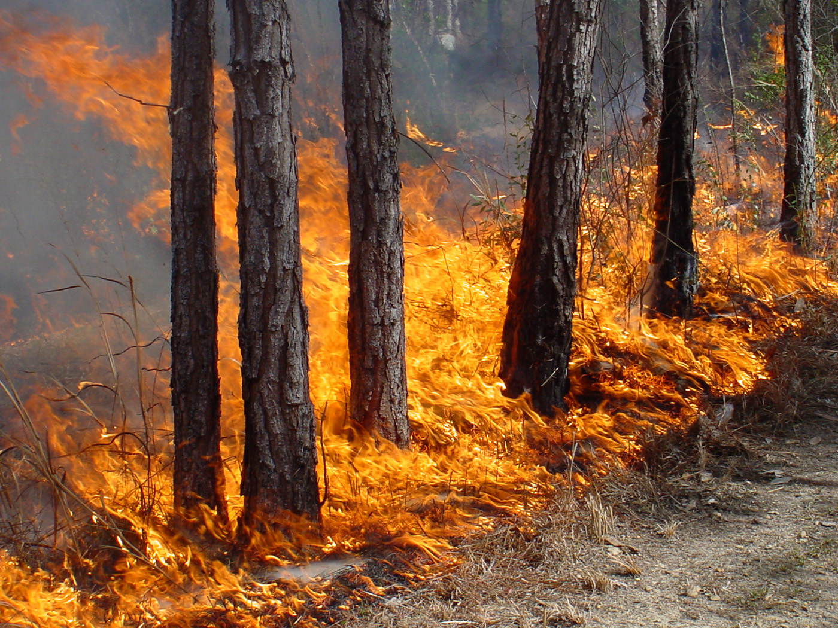
Fire

Slide 34
Hurricanes

Slide 35
Flood And Storms

Slide 36
Bacteria and Virus

Slide 37
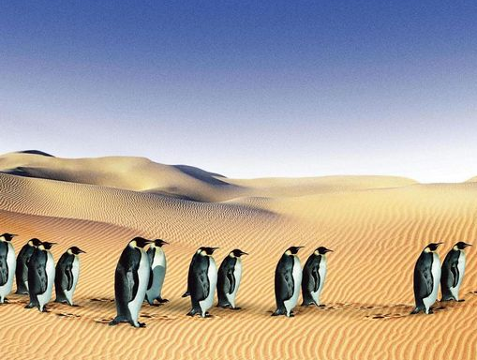

Slide 38
Solutions

Slide 42
Hybrid Cars

Slide 44
That’s Our Planet.
Our Future.
We Have To Start Saving It
NOW

