Slide 1
Loss in cigarette
الخساره فى السيجارة

Slide 2
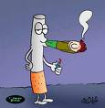
What is smoking ?

Slide 3
Tobacco smoking is the inhalation of smoke from burned dried or cured leaves of the tobacco plant ,most often in the form of a cigarette.
تدخين التبغ عبارة عن استنشاق دخان اوراق التبغ الجافة اوالمصنعة المحروقة من نبات التبغ ،غالبا ما تكون على هيئة .سيجارة

Slide 4
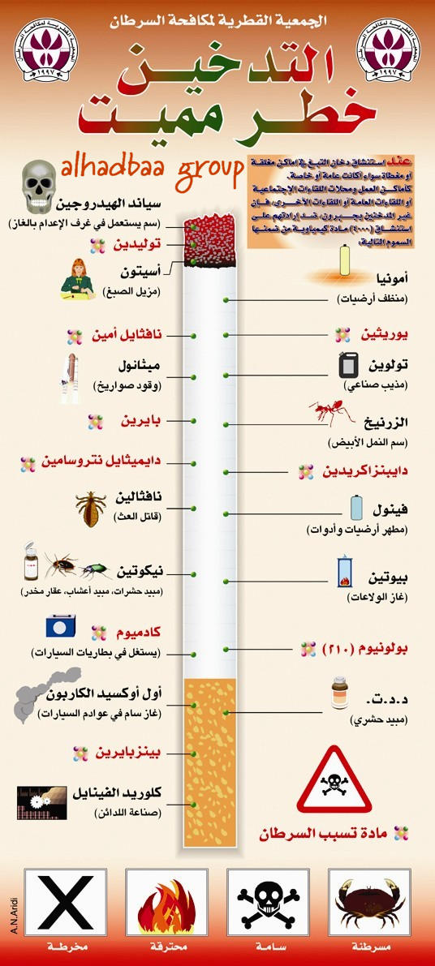

Slide 5
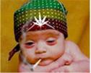
ًًWhy do people smoke?
Some think it looks cool.
Some youth want to imitate their family members or friends.
بعض الافراد يعتقدون ان التدخين يجعلهم احسن مظهرا امام الناس.
آخرون يقلدون الاباء والاقارب والاصدقاء.

Slide 6
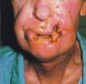
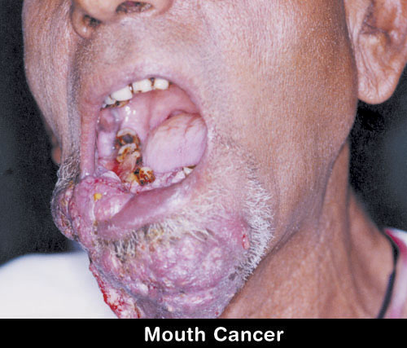
diseases
High blood pressure.
Bad breath.
Greater risk of injured slower healing time.
Smokers get more colds &
flu.
5.It effects the sense of
smelling & tasting.

Slide 7
Lungs

Slide 8
Danger of smoking on the pregnant
smoking while pregnant can also harm the baby.
التدخين اثناء الحمل يعرض الجنين للهلاك .

Slide 9
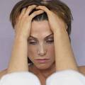
5 Things to know!
1)It is never too late to quit.
No matter how long you have smoked , you will benefit from quitting.
2)Few people kick cigarettes on the first try.
Too often people think one or more failed attempts mean they are incapable of quitting.
3)Get help.
there are many stop smoking aids available like nicotine patches , gums , medicine & counseling.
ما زال الوقت مبكرا للاقلاع عن التدخين.
العديد من الناس يقلعون عن التدخين من اول محاولة .
عندما لا يستطيع المدخن التوقف عن التدخين يمكنه اللجوء لمساعدة الاخرين.

Slide 10
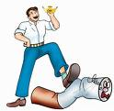
4)Cutting down does not cut it.
If you do not break the addiction you are likely to slip back into smoking as much as you did before.
5)American's smoking days are over.
Cigarettes have become less socially acceptable , smokers are strangers in a smoke free land.
الاقلال من عدد السجائر لا يعني الاقلاع عن التدخين.
اصبحت عادة التدخين فى امريكا غير مقبولة اجتماعيا ، وقاموا بتخصيص اماكن للتدخين.

Slide 11
Average price:5 pounds a box.
In a month it Costs:150p,If the person
Smokes one box every day.
In a year it costs:1800 pounds.
Note:
If a smoker smokes for 10 years,
he may pay for cigarettes 18000p.

Slide 13
References
www.health.nytimes.com
www.annabaa.org
www.the laoroflove.com
www.a7laqalb.com

Slide 14
Nada Magdy
Esraa El Gamal

Slide 15
Thanks every body

