Slide 2
Please

Slide 4
YESBU
شَبَاب مِنْ أَجْلِ بِيئَةٍ مُسْتَدامَةٍ وَفَهْمٍ أَفْضَلْ

Slide 5
LYM
رَابِطَةُ شَبَابِ الصَّفْوَةِ

Slide 6
GEYC
AEYC

Slide 7
First convention

Slide 8
Lund, Sweden

Slide 9
Lund, Sweden
The YMP attracted the participation of some 550 young students in schools from over 100 countries around the world. From the 15 to 19 June 2000 young students, along with teachers, gathered for the Convention in Lund, Sweden. The theme was
Global Environmental Issues.

Slide 10
Second convention

Slide 11
Turin, Italy
Turin, Italy in 2002 From the 29 June to 3 July 2002 the Convention was organised in Turin, Italy. The theme was Sustainable Mobility and Information Communication Technology. With society moving from the "Industrial age" to the "Information society“ the theme encouraged considerable discussion among the 350 young students and teachers

Slide 12
GEYC 2004

Slide 13
GEYC 2004

Slide 14
Alexandria, Egypt
Alexandria, Egypt in 2004 On the 11 to 15 September 2004 a Convention was organised in Alexandria, Egypt. The theme of the Convention was Environment, Culture and Peace, both nationally and globally. The Convention attracted over 500 young students and teachers from around the world. The major partners for the Convention were Bibliotheca Alexandria and the Arab Academy for Science and Technology.

Slide 15
Dubai , 2006
Dubai, UAE in 2006
( 9 to 13 December 2006)
theme : was Peace and the Environment around the world. Over 500 students and teachers attended. The major partner for the Convention was the Dubai Municipality.

Slide 30
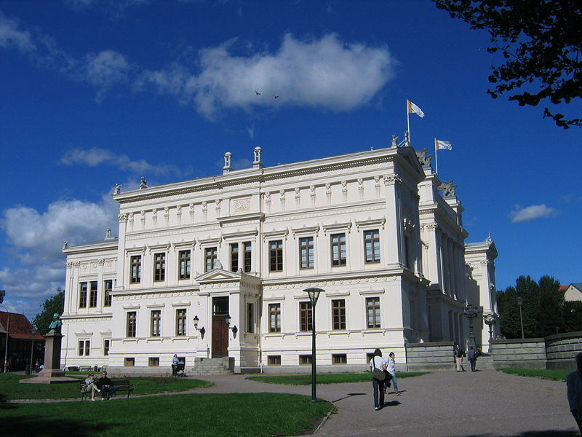
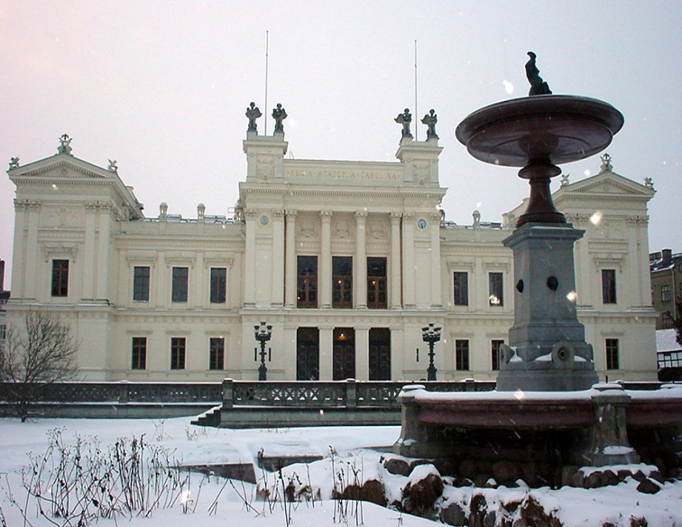
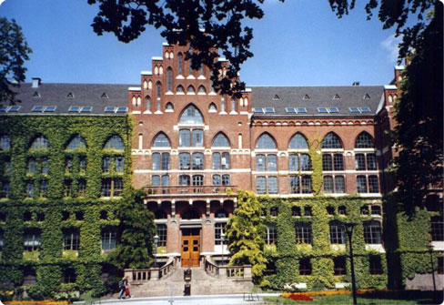
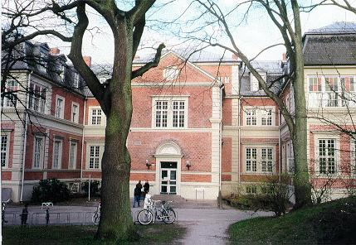

Slide 31
Sustainable ?
sus‧tain‧a‧ble adjective
able to continue
without causing damage
to the environment
Sustainability noun
Longman Dictionary

Slide 32
Preventive ?
pre‧vent‧ive / prɪˈventɪv /
intended to stop something you do not want to happen, such as illness, from happening
Longman Dictionary

Slide 33
YMP
The Young Masters Programme
YMP
The Young Masters Programme :
Is a web-based,
interactive distance-learning course
that focuses on issues related to sustainable development and preventive environmental strategies.

Slide 34
YMP
The Young Masters Programme
The Young Masters Programme is a web-based, interactive distance-learning course
divided into four parts.

Slide 35
YMP
The Young Masters Programme
Part 1 consists of eight weeks of studies with the main heading “Sustainability – Why?”.
Part 2 deals with preventive environmental strategies and is called “Sustainability – How?”.
It consists of ten modules. Each module is estimated to take two to five hours of studies.

Slide 36
YMP
The Young Masters Programme
Part 3, Project Work, is voluntary but necessary to participate in for the fulfillment of the Young Masters Programme. Here the participants develop a project that applies the learned concepts to real, local situations. The project period is about two months.

Slide 37
Certificate

Slide 38
YMP
The Young Masters Programme
Part 4,
All projects will be evaluated by a jury– the Global Environmental Youth Convention (GEYC). The next Convention will be in 2009, in China.

Slide 39
YESBU
شَبَاب مِنْ أَجْلِ بِيئَةٍ مُسْتَدامَةٍ وَفَهْمٍ أَفْضَلْ

Slide 40
تعريف
مَنْ نَحْنُ؟

Slide 41
تعريف
مجموعة من الشباب فى سن (13-18) و سن (18-25)
نهدف لتنمية قدراتنا
نجتمع فى مكتبة الإسكندرية منذ عام 2002
يوم السبت السـاعة 5 مساءً و يوم الأحد السـاعة 4 مساءً

Slide 42
الأنشطة
مَاذَا نَفْعَل؟

Slide 43
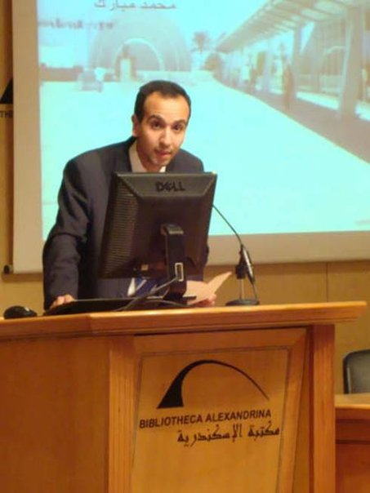
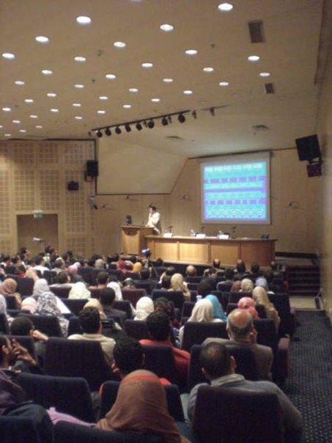
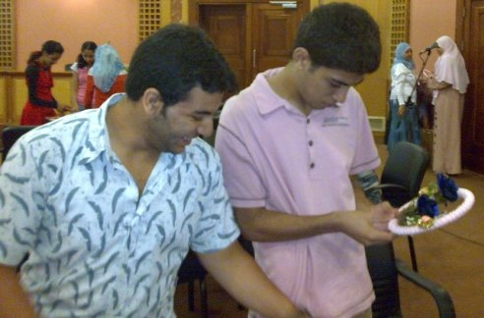
الأنشطة
اللقاءات المباشرة الأسبوعية.
ورش العمل.
المؤتمرات.

Slide 44
التفاعل
كَيفَ تَعْمَلْ مَعَنَا؟

Slide 45
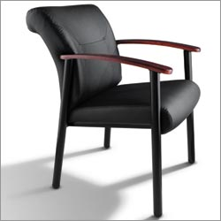
التفاعل
حضورك
شاركنا الرأى
تكلم معنا فى موضوع
شاركنا بفكرة أو مشروع

Slide 46
www.yesbu.org

Slide 48
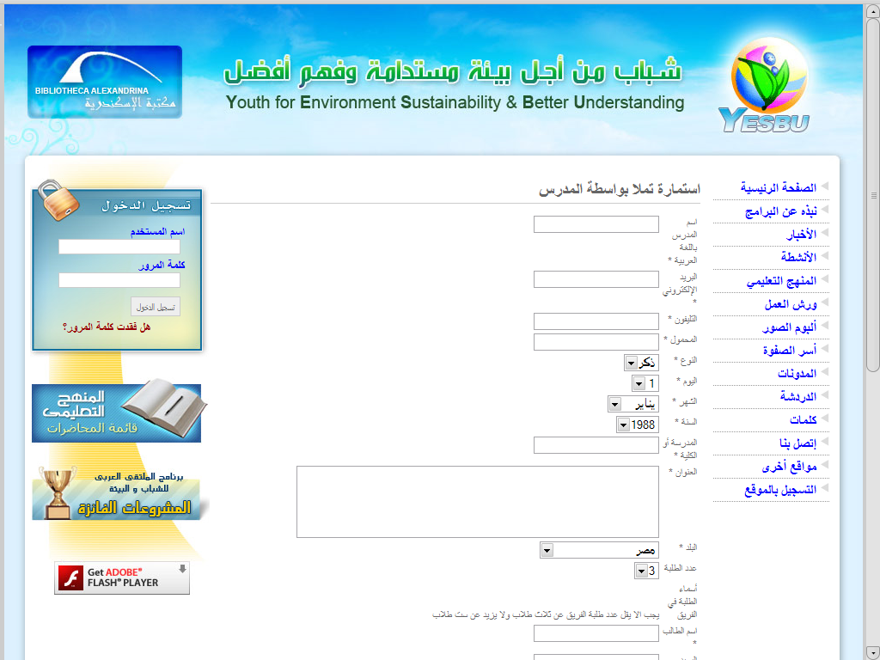

Slide 49
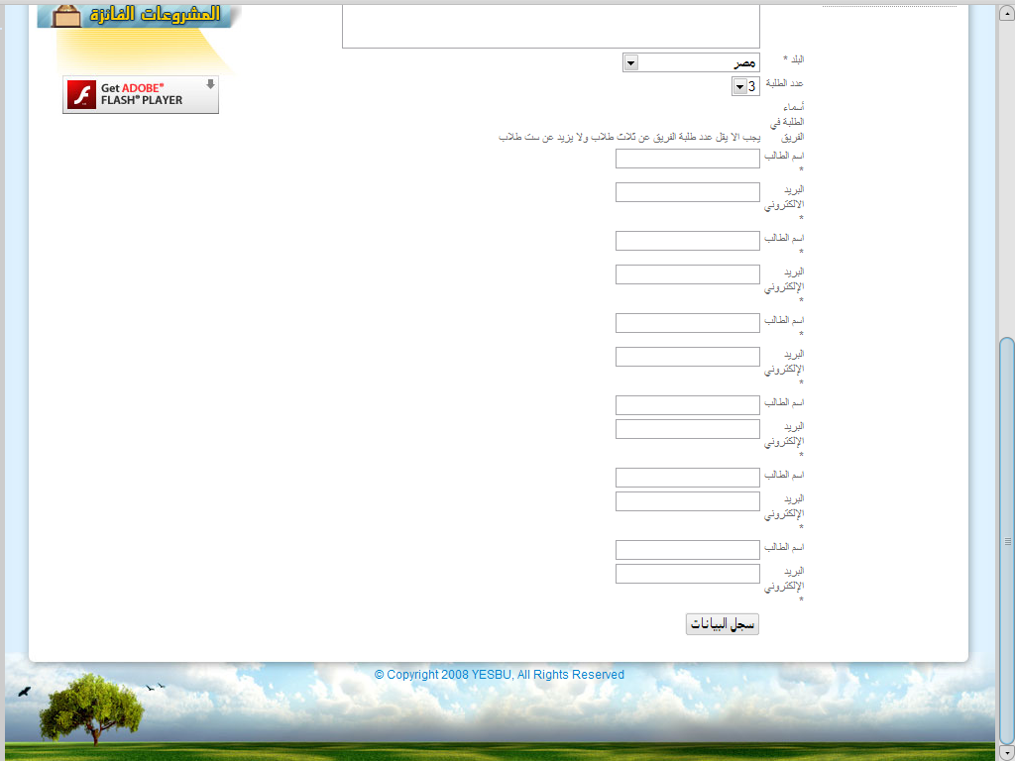

Slide 50
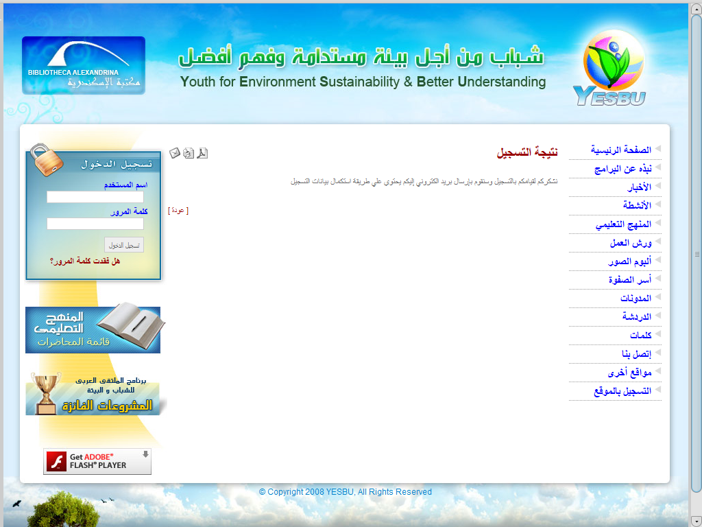
نتيجة التسجيل نشكركم لقيامكم بالتسجيل وسنقوم بإرسال بريد الكتروني إليكم يحتوي علي طريقة استكمال بيانات التسجيل

Slide 51
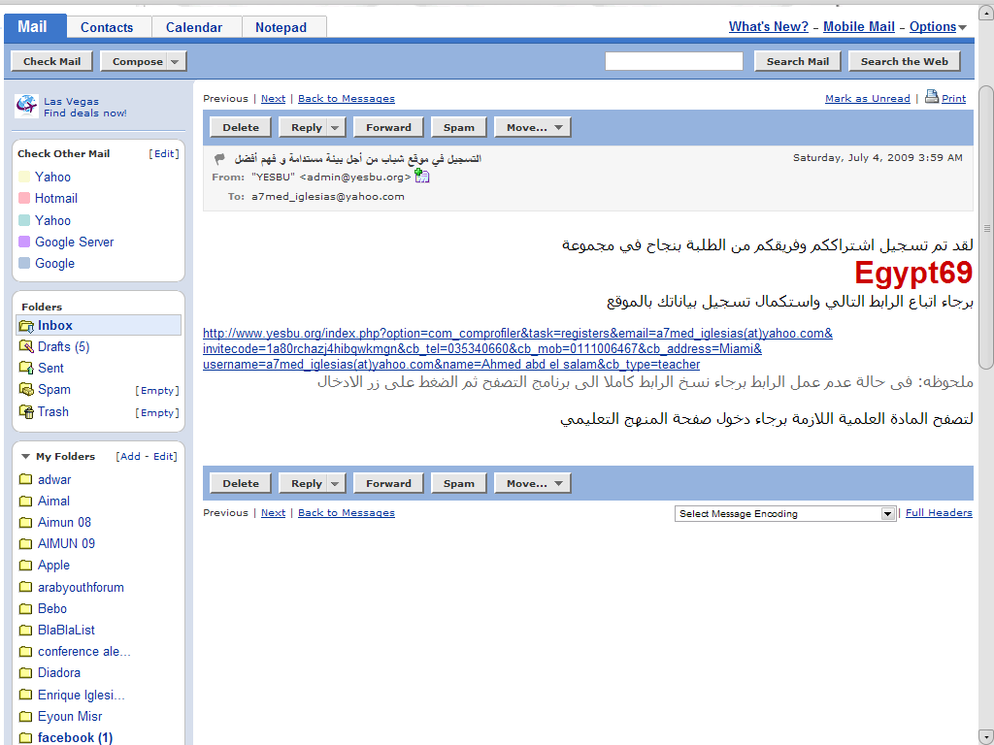

Slide 52
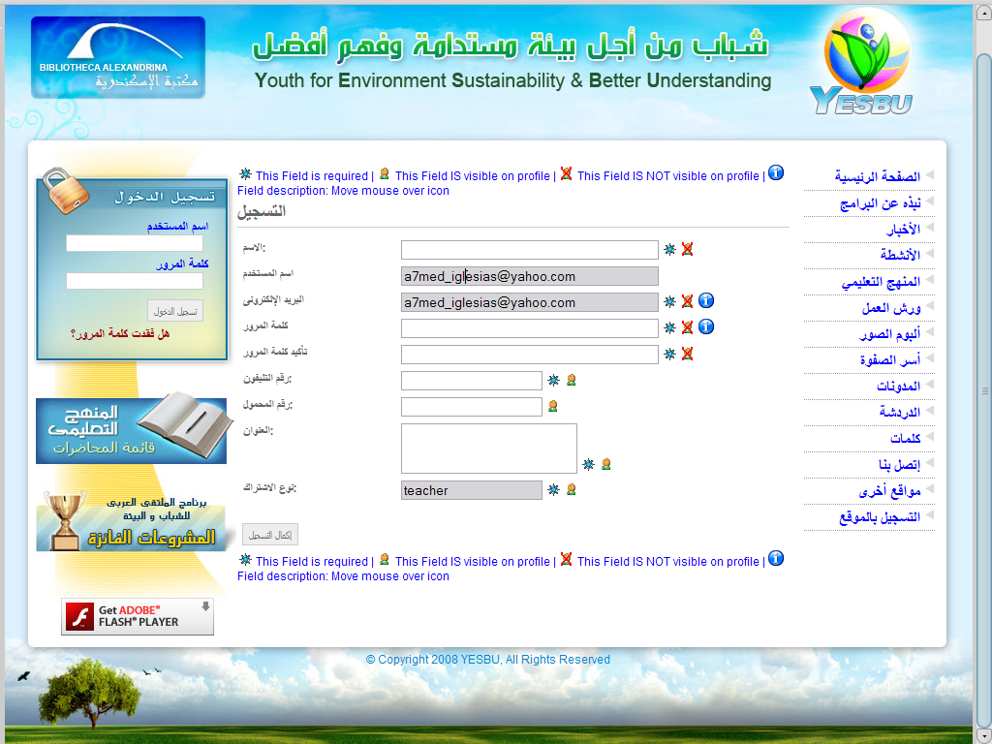

Slide 53
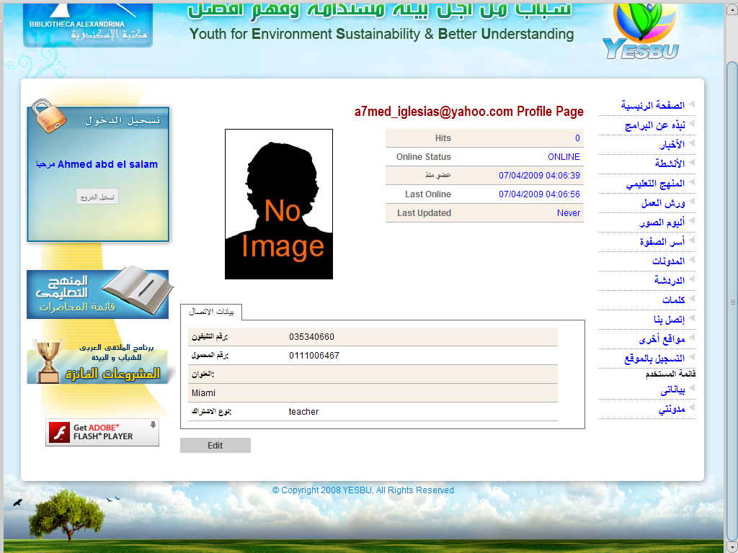

Slide 54
s

Slide 55
التعليم عن بعد
كون مجموعة من 3 إلى 6 أشخاص
اختر مدرسك أو مرشدًا آخر للمجموعة
تابع المحاضرات على الموقع
ابدأ مشروعك و اعرضه علينا

Slide 56
موقع المنهج باللغة العربية
www.yesbu.org

Slide 57
موقع المنهج باللغة الإنجليزية
www.iiiee-ymp.org

Slide 58
If you Need Any Help in your Project …. Feel Free To Contact one of those Volunteers:
Engy Adel
Ali Hassan
Esraa Ramadan
Mohamed Wahbi
Ahmed Abd El-Salam
Nada Zaki
Aya El-Faham
Yomna Adel

Slide 59
If you Need Any Help in your Project …. Feel Free To Contact one of those Volunteers:
Aya El-Faham
Yomna Adel

Slide 60
If you Need Any Help in your Project …. Feel Free To Contact one of those Volunteers:
Esraa Ramadan

Slide 61
If you Need Any Help in your Project …. Feel Free To Contact one of those Volunteers:
Ali Hassan

Slide 62
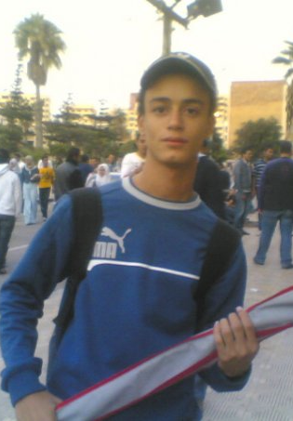
If you Need Any Help in your Project …. Feel Free To Contact one of those Volunteers:
Ahmed Abdel Salam

Slide 63
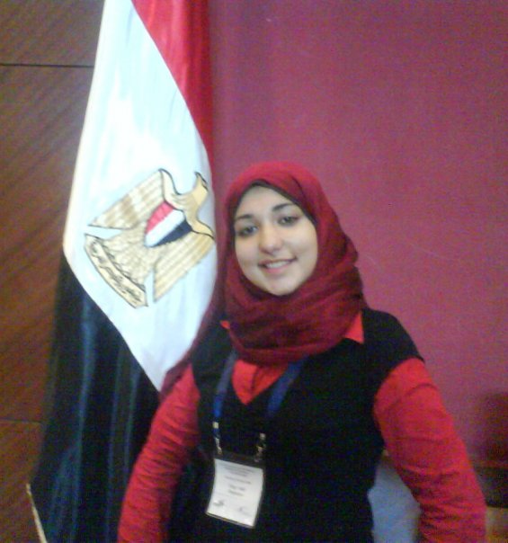
If you Need Any Help in your Project …. Feel Free To Contact one of those Volunteers:
Engy Adel

Slide 64
If you Need Any Help in your Project …. Feel Free To Contact one of those Volunteers:
Nada Zaki

Slide 65
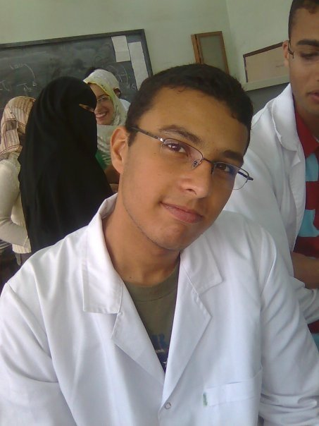
If you Need Any Help in your Project …. Feel Free To Contact one of those Volunteers:
Mohamed Wahbi

Slide 66
كن معنا لنصبح المستقبل المشرق لبلدنا
الإنسان لايستطيع النجاح بمفرده
معًا يمكننا تحقيق
التغيير الفعال

Slide 69
The First Presentation

Slide 70
References
the archival website: www.iiiee.lu.se/site.nsf
http://www.iiiee.lu.se/site.nsf/AllDocuments/3FF88126AF2B70EDC1256F6B00489555
www.yesbu.org

Slide 71
شكرًا لكم
إبراهيم جمال الدين
أحمد رفعت
ahmed_refaat30@hotmail.com
fireball_24@hotmail.com salah.soliman@bibalex.com
ibrahim.gamal.eldin@hotmail.com riham.abdelhamid@bibalex.org

Slide 73
Name :
GEYC & AEYC
Place:
Conference center “West Hall”
Date:
18 &19 / 7 / 2009
Presenters:
Ibrahim Gamal
Ahmed Refaat

