Slide 1
Foot and Mouth Disease
Aphthous fever
FMD
الحمى القلاعية
Bibliotheca Alexandrina
18/3/2012

Slide 2
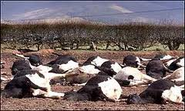
Epizootic events
US 1914-1929
UK 1967
Taiwan 1997
UK 2001
China 2005
UK 2005
Japan and Korea 2010/2011
Bulgaria 2011

Slide 3
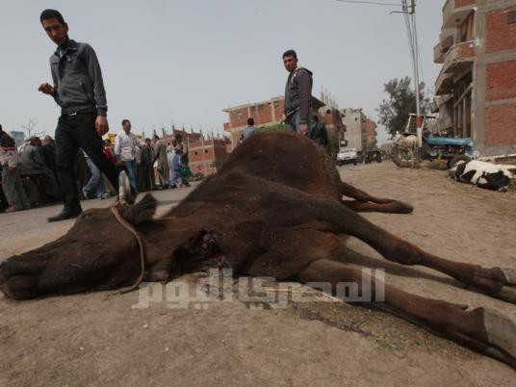
Epizootic events
EGYPT 2006
Losses up to
900.000 head

Slide 4
What is FMD?
VIRAL

Slide 5
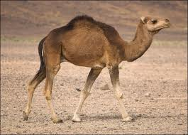
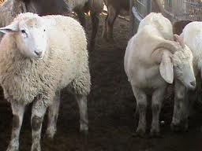
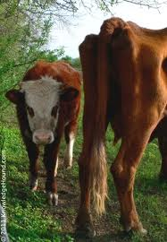
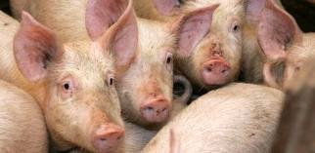
Susceptibility
CLOVEN HOOF
ذوات الظلف المشقوق

Slide 6
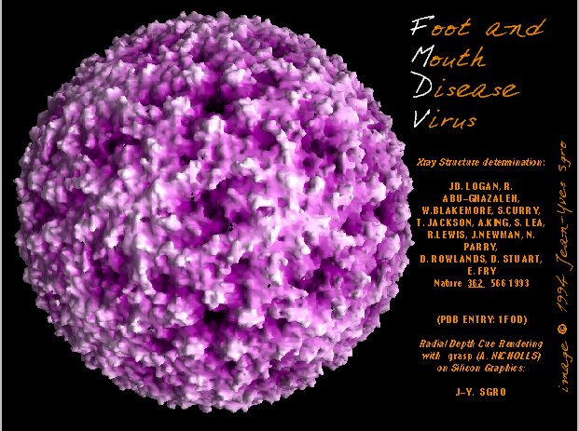

Slide 7
Taxonomy أصله وفصله
Picornaviridae
Picorna virus
FMD VIRUS
Aphthous virus
SAT1
SAT2
SAT3
ASIA1
O
A
C

Slide 8
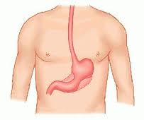
Physico-chemical properties ?
PH : stable at 7.4-7.6 . . . . ! !
Resistant to :
Chloroform
Ether
Bile salts
Detergents ????

Slide 9
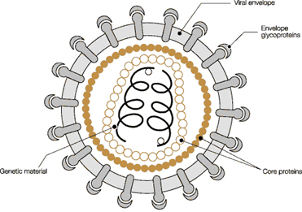
Virus Structure
General virus structure

Slide 10
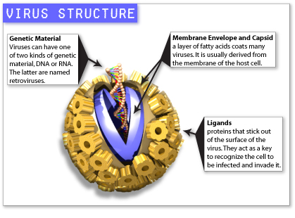

Slide 11
Virus Structure
1.Capsid الإطار الخارجى
2.Viral proteins :
VP1
VP2
VP3
VP4
3. Nucleic Acid “RNA”
ANTIGENICITY
إحداث المرض

Slide 12
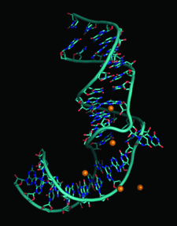
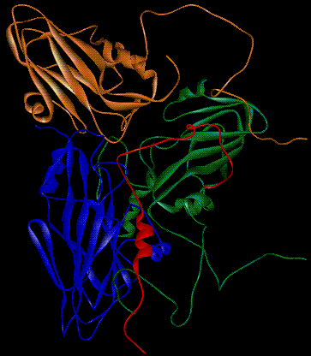
Genetic Material
Viral proteins

Slide 13
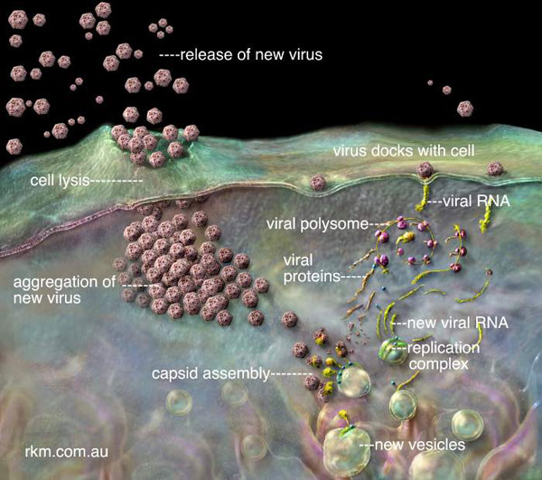
Understanding infection

Slide 14

Why Antigenic Variation??!!
Millions of copies + narrow time + LACK OF CORRECTION = Evolution of New Subtype

Slide 15
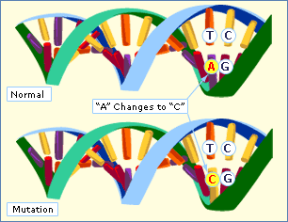
Why Antigenic Variation??!!
Point mutation

Slide 16
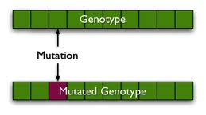
Why Antigenic Variation??!!
Point mutation

Slide 17
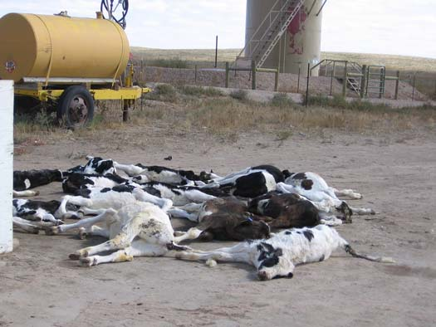
Prognosis
Morbidity: 100%
Mortality: up to 5%
50-70% in calves
up to 100% in suckling calves

Slide 18
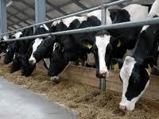
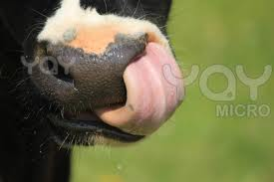
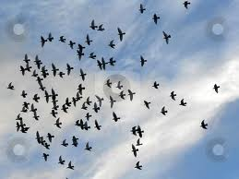
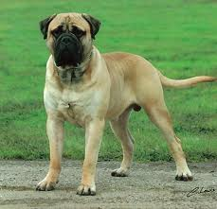
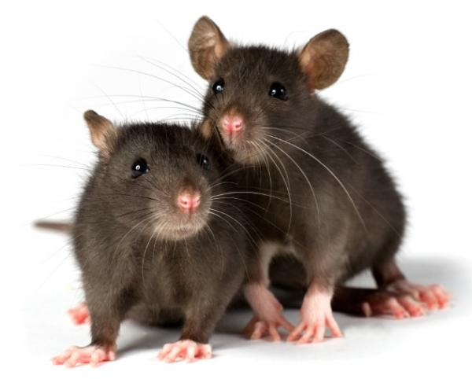
Mode of Transmission

Slide 19
Mode of Transmission
Quantitative risk assessment of FMD virus transmission via water.
National Institute of Health
USA

Slide 20
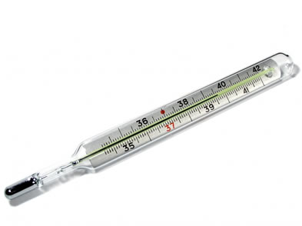
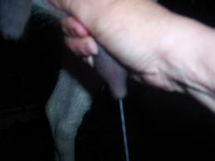
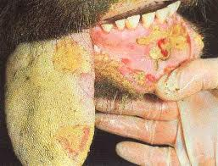
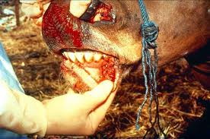
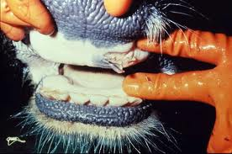
Clinical Signs الأعراض الإكلينيكية

Slide 21
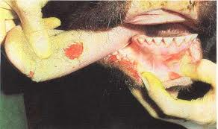
Clinical Signs الأعراض الإكلينيكية

Slide 22
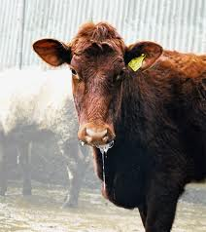
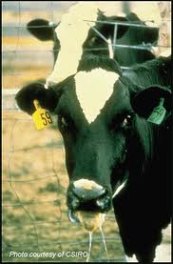
Clinical Signs الأعراض الإكلينيكية

Slide 23
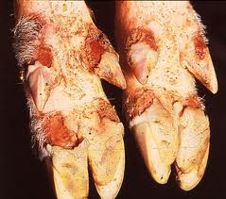
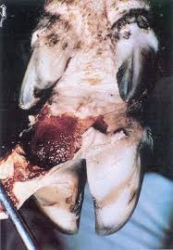
Clinical Signs الأعراض الإكلينيكية

Slide 24
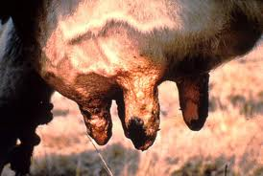
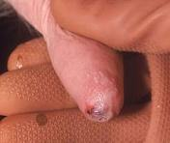
Clinical Signs الأعراض الإكلينيكية

Slide 25
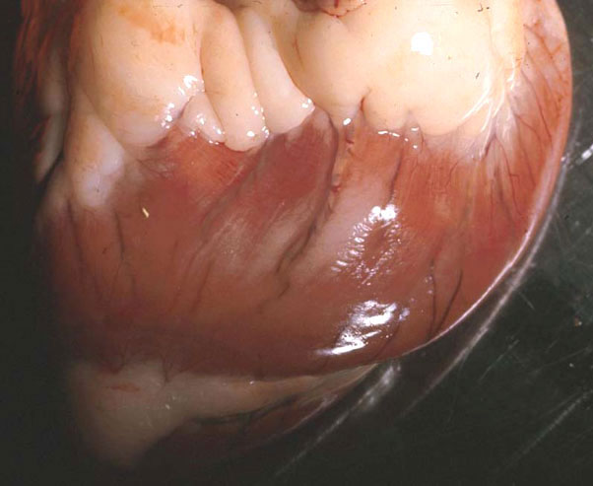
P.M Examination
Calf heart if passed:
MYOCARDIOPATHY

Slide 26
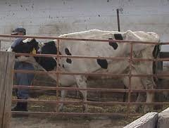
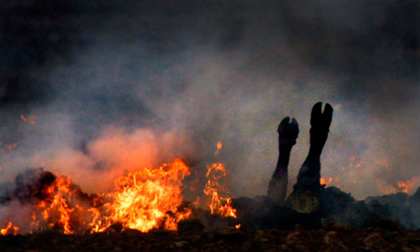
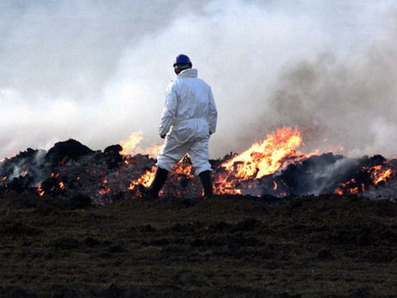
How to control ?
Isolation of suspected cases

Slide 27
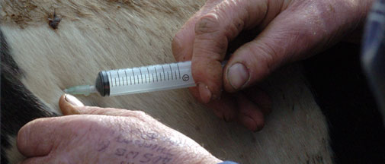
How to control ?
Vaccination
How to control ?
Matching and selection ..
Emergency vaccination ..
Protective Vaccination Vs Suppressive Vaccination . .

Slide 28
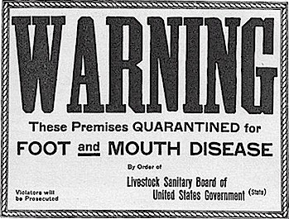
How to control ?
Biosecurity procedures

Slide 29
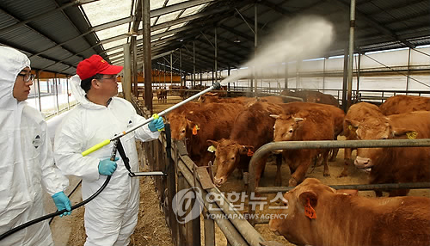
How to control ?
Biosecurity procedures

Slide 30
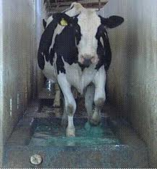
How to control ?
Biosecurity procedures

Slide 31
Public Health concern . .
Zoonotic in very limited conditions
??
Milk. . If unboiled !
Occupational . . Vets !

Slide 32
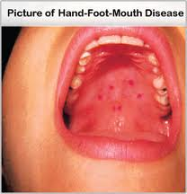
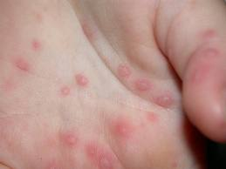
Public Health concern . .
Zoonotic in very limited conditions
??

Slide 33


Syndicate Axial Role

Slide 34
References
http://www.oie.int/eng/A_FMD2012/docs/2.01.05_FMD.pdf http://www.fao.org/ag/againfo/commissions/docs/training/material/Diagnostic_sampling_procedures/Diagnostic_sampling_procedures.pdf http://www.daff.gov.au/animal-plant-health/pests-diseases-weeds/animal/fmd http://veterinaryextension.colostate.edu/News/dzinfo/Japan%20FMD%20_2_1%20_2_.pdf

