Slide 1
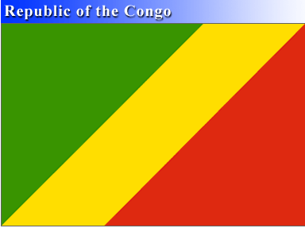
PRESENTATION
of
CONGO
by Jessica Colombe KABA-NDEBOLO MILANDOU

Slide 2
  SUMMARY
I- CONGO MAP....…………………. II- COAT OF ARMS..………………. III- GEOGRAPHIC DATA…………. IV- CONGOLESE FLAG……………. V- DEMOGRAPHIC DATA….………. VI- GENERAL DATA….…………….. VII- ECONOMY............. ……………

Slide 3
VIII- AGRICULTURE…………………. IX- EDUCATION............................... X- HEALTH....................................... XI- CULTURE………………………… XII- CONGOLESE FOOD…………….. XIII- MONUMENTS AND LANDSCAPES..

Slide 4
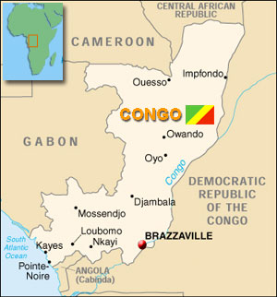
THE MAP OF CONGO
The Congo is in the center Africa, limited
.in North by Cameroon and the Central African Republic
.to the east by the Democratic Republic of Congo which is formerly Zaire,
.the south by Anglola
.in the Southwest there's the Gulf of Guinea Equatorial
.and west by Gabon.
it consists of the equatorial forest, a rich savanna, large rivers rich in fish.
the legendary Congo River is the second most powerful river in the world after the Amazon which separates the two closest capital in the world Brazzaville and Kinshasa

Slide 5
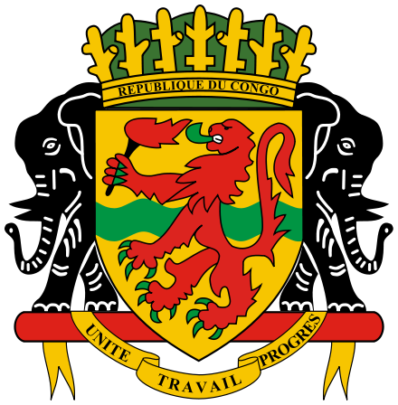
COAT OF ARMS
In the center of the shield, there is a lion which is the symbol of protection carrying a torchlight.
. Two of the elephants support the shield.
. In the lower part, on a belt you can read the national motto: Unity, Work, Progress.

Slide 6
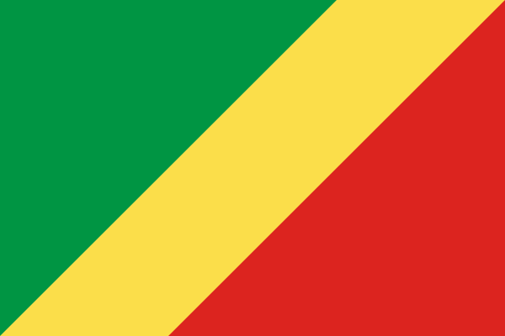
CONGOLESE FLAG
Nature of the country
Natural ressource
Freedom struggle

Slide 7
GEOGRAPHIC DATA
Location: Center Africa
. Area: 342.000 km²
. Capital: Brazzaville
. Principal cities: Pointe-Noire, Nkayi, Loubomo, Ouesso, Owando, Dolisie, Mossendjo
. Official Language: French
. Independence day: 15 August 1960

Slide 8
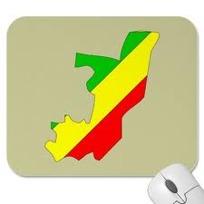
DEMOGRAPHIC DATA
1-Population: 4 243 929 h.
2-DensitY: 12 h./km²
3-Main ethnic group: Kongo, Téké, Mbochi, Oubanguiens, Nzebi, Sangha
4-Development: +1,77%
5-Life expectancy : 55,8 ans
6-literacy rate : 81,1%
7-Religion: Christianism, Animism & Islam

Slide 9
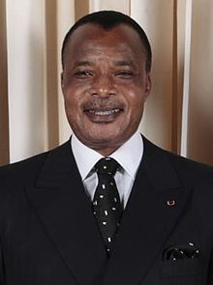
GENERAL DATA
Denis Sassou-Nguesso is a Congolese politician born on November 23, 1943 in Edou.
He was President of the People's Republic of Congo from 1979 to 1992 and is the current President of the Republic of Congo since 1997.

Slide 10
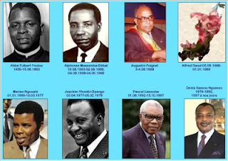
CONGOLESE PRESIDENTS (1961 A 1969)
Alphonse MASSAMBAT-BEBAT
(1963-1968)
Abbé Fulbert YOULOU
(1961-1963)
Augustin PEIGNEL
09-1968)

Slide 11
CONGOLESE FROM 1969 TILL TODAY
Marien NGOUABI
(1969-1977)
Joachim YHOMBI-OPANGO
(1977-1979)
Dénis SASSOU-NGUESSO
(1979-1992
1997- up to now)
Pascal LISSOUMBA
(1992-1997)

Slide 12
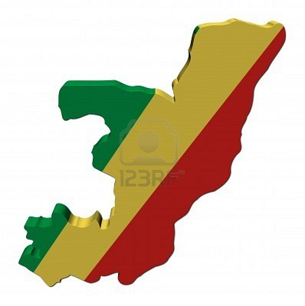
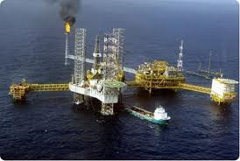
ECONOMIC
Congo is a developing country included in the Initiative heavily in debt poor countries ,That point was reached in January 2010, with the approval of the World Bank and the International Monetary Funds
.Congolese economy remain mainly on the exploitation of hydrocarbons along the Atlantic coast, this activity represents approximately 90 % of exports of the country.

Slide 13
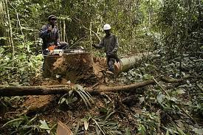
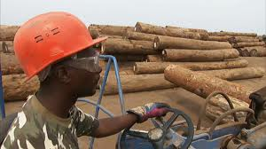
The oil exploration and the production, concentrated in the periphery of Pointe-noire make of it the economic capital of the country.
Wood represents a significant part of the exportation of Congo, whose surface is covered with forests with nearly 60 %, for a total of 21 million hectares.

Slide 14
AGRICULTURE
  Most of the agricultural production (manioc, fruit and vegetables) is consumed locally; nevertheless, the agricultural Company and industrial refining of sugar (SARIS), established in Nkayi in Bouenza markets its products in other countries of central Africa.
- Agricultural working population (2004) = 37.32%
- Starts from agricultural PIB in the total PIB (2004) = 5.8%

Slide 15
Production of cereals in thousands of tons =9 (2004)
The agricultural congolese production is primarily: the Cassava, the Yam, Sweet potato, Banana, Corn, Rice, sorghum and the millet, the groundnut, the bean, the nut of palm, cotton, the cane has sugar, the cocoa, the coffee, the tea, the tobacco .

Slide 16
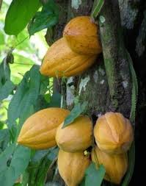
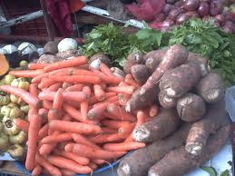
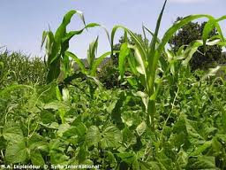
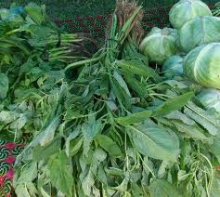
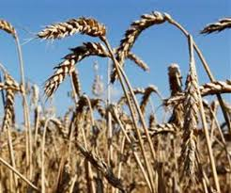

Slide 17
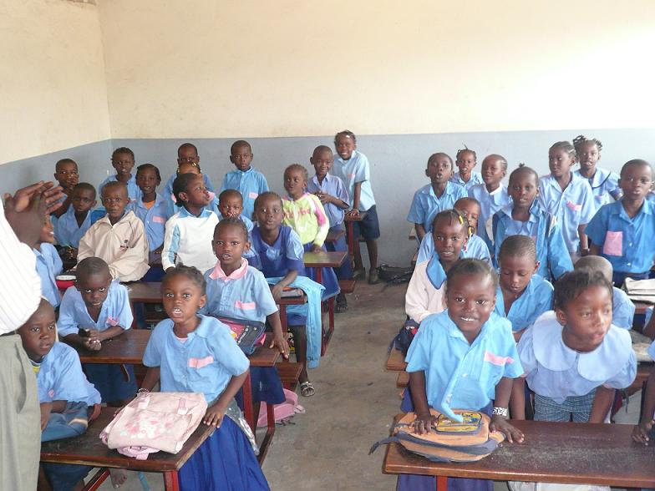
EDUCATION
The education system in Republic of Congo is managed by three government departments, such as:
The ministry for primary education and secondary education, in charge of elimination of illiteracy (MEPSA);
The ministry for technical and professional teaching (METP)

Slide 18
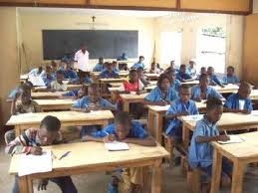
And the ministry for the higher education.
Congo-Brazzaville is one of the countries of Africa having the highest rate of schooling. It is estimated at approximately 83%.
The education system congolais is composed of it of:
1- General education
Pre-school, Primary, College,

Slide 19
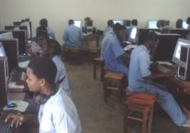
2- Technical Teaching
Center trade, Technical school,
Vocational school
3- University
NB: The rate of schooling of the girls is approximately 42%.

Slide 20
HEALTH
In Republic of Congo the medical system includes/understands two sectors, namely: the sector public and the private sector.
The private sector not being controled, only the statistical data and the various levels of the operation of the public sector are taken into consideration.
The most frequent diseases within the country are: Paludism, Measles, Diarrhoea, the Yellow fever, Influenzas etc.

Slide 21
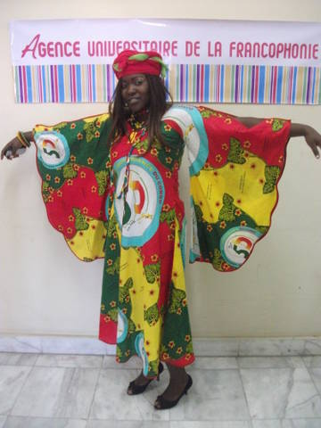
Cultures
The presence of many ethnos groups and formerly of various structures political (Kongo Empire kingdom of Loango Teke kingdom, chefferies of North) equipped the current country with a great diversity of traditional cultures and as many old artistic expressions.

Slide 22
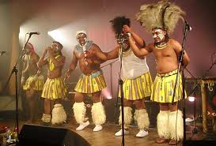
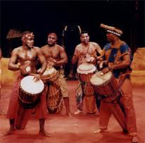
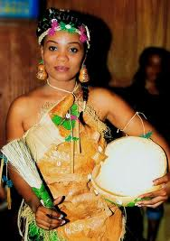
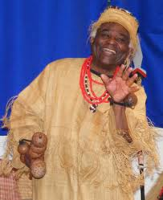
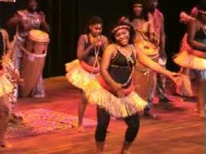
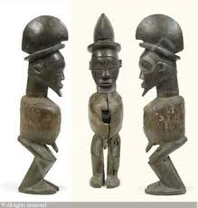

Slide 23
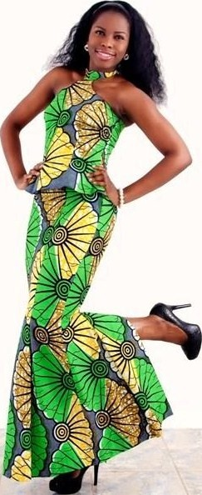
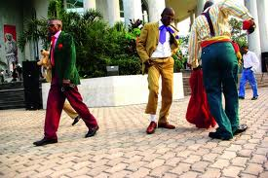
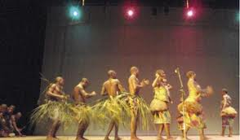
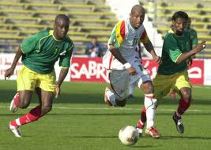

Slide 24
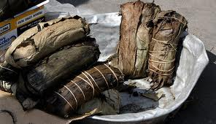
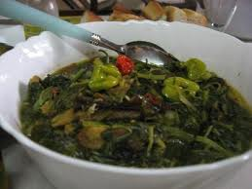
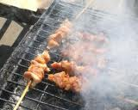
CONGOLESE FOOD

Slide 25
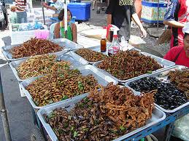
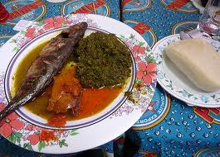
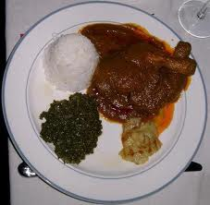
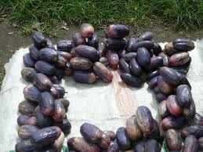

Slide 26
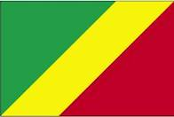
SOME
CONGO PICTURE
Monument and landscape

Slide 27
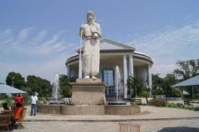
Memorial Pierre Savorgnan de Brazza

Slide 28
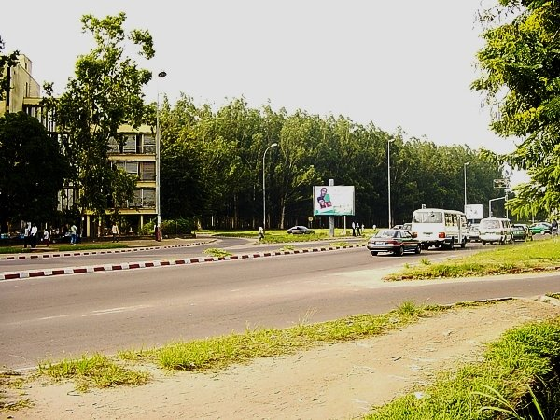
Boulevard Alfred Raoul (Brazzaville )

Slide 29
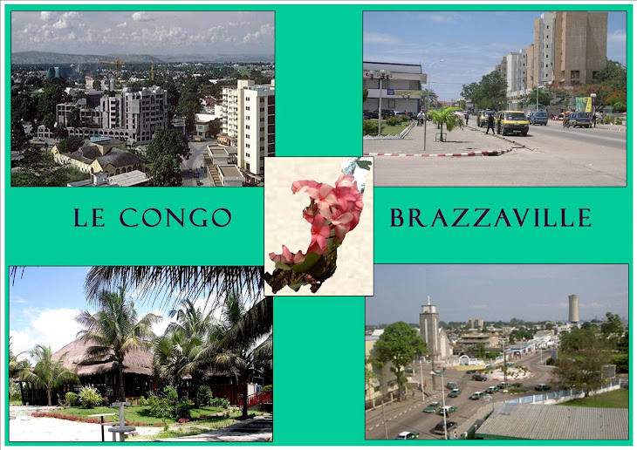

Slide 30
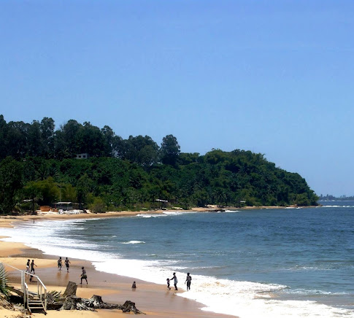
Pointe-Noire beach

Slide 31
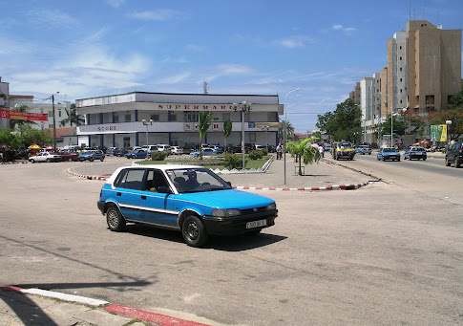
score of Pointe-Noire

Slide 32
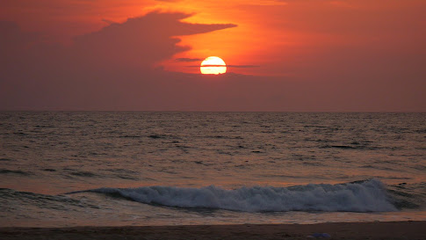
Sunset at
Pointe-Noire

Slide 33
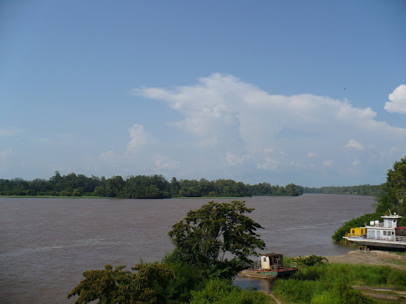
Kouilou river

Slide 34
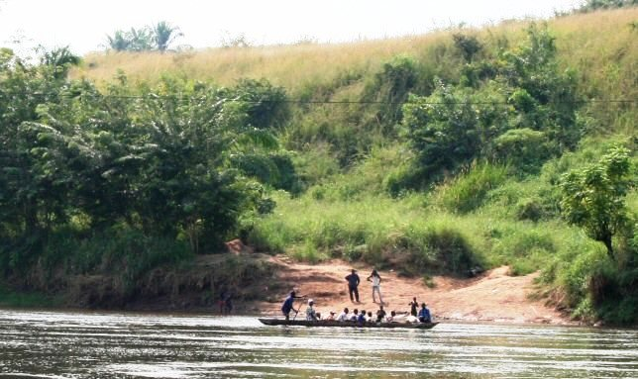
Niari river

Slide 35
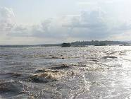
Congo river

Slide 36
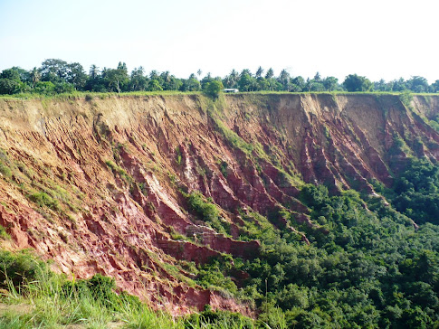
forest

Slide 37
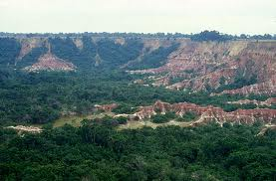
forest

Slide 38
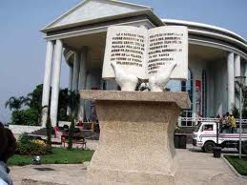
Mémorial Pierre Savorgnan de Brazzaville

Slide 39

Constitutionnal court
Of Brazzaville

Slide 40

de Gaulle Square, in honor of General de Gaulle between 1942-1945

Slide 41

Ministry of Planning and Land Management

Slide 42

Nabemba tower office building Completed in 1986

Slide 43

Roundabout instead of June 5, symbol vestige of the civil war of 1997

Slide 44

Founder of MSA (Mouvement Socialiste Africain) in 1960
Jacques Opagault

Slide 45




Slide 46




Slide 47

Nanga lake, near Pointe-Noire

Slide 48

Total marcket of Brazzaville

Slide 49

Monument funerary of Bas-Congo

Slide 50

Armory official of the Republic of Congo in 1997

Slide 51

Restaurant Abri Côtier at Pointe Noire

Slide 52

is one of the monuments Brazzaville (capital of the Republic of Congo) that have the greatest architectural interest

Slide 53

A seller of saka-saka
in Nkayi

Slide 54
Finally, we see that that Congo is beautifull, peacefull, diverssified and Open country
So, I Welcome all of you one day to visit it.

Slide 55
Thank for your Attention!

