Slide 1
Nanotechnology
Introduction
Yousof Farrag
Master student at Universidad Autónoma de Madrid

Slide 2
Scheme
What is nanotechnology?
Why Nanotechnology?
Tools of Nanotechnology
Applications Of Nanotechnology:
Nanoelectronics (transistors)
Solar cells
Nanomedicine:
Nanogold
Iron oxide nanoparticles
Nanosensors

Slide 3
What is Nanotechnology?
One nanometer
= 1/1,000,000,000 (1 billionth) of a meter
= 1/1,000,000 (1 millionth) of a millimeter
= 1/1,000 (1 thousandth) of a micron
= 10 Angstroms.
One inch = 25,400,000 nm.

Slide 4
What is Nanotechnology?
The head of a pin is roughly 2 mm = 2,000 µm = 2,000,000 nm.
A human hair is roughly 1/10 mm = 100 µm = 100,000 nm in diameter.
A typical cell is 1/40 mm = 25 µm = 25,000 nm.
A red blood cell is roughly 10 µm = 10,000 nm.
A DNA strand is roughly 2 nm wide.
A typical atom is roughly 0.1-0.2 nm = 1-2 Angstrom.

Slide 5
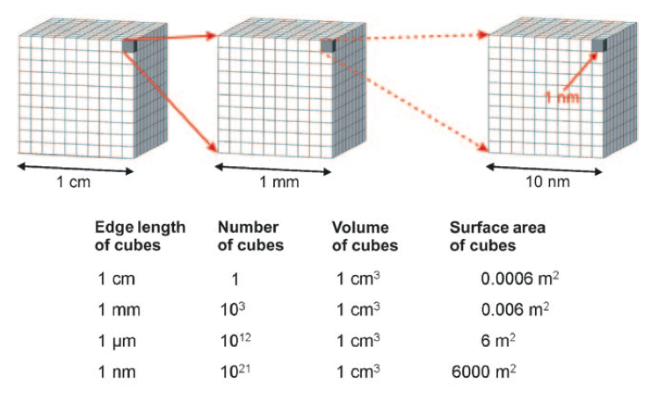
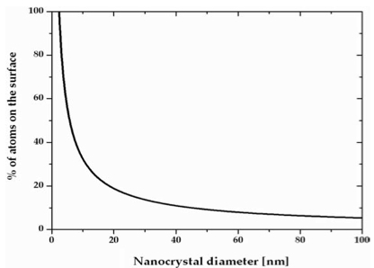
What is Nanotechnology?

Slide 6
What is Nanotechnology?
It refers broadly to a field of applied science and technology whose unifying theme is the control of matter on the atomic and molecular scale, normally 1 to 100 nanometers, and the fabrication of devices within that size range.

Slide 7
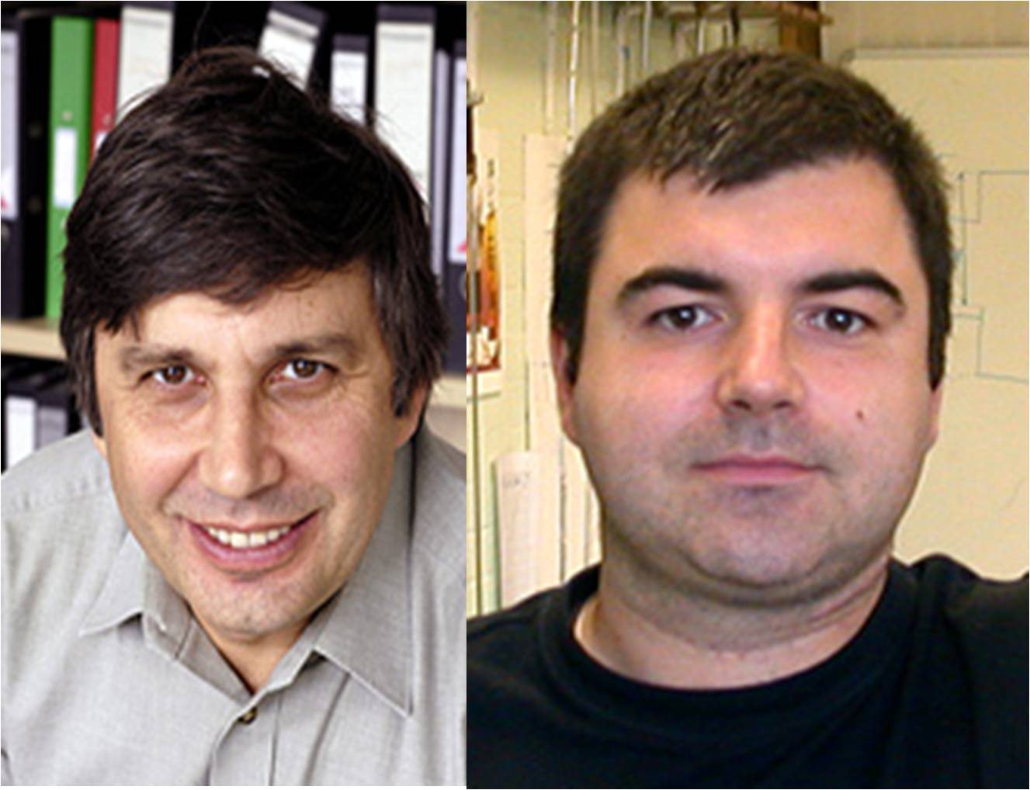
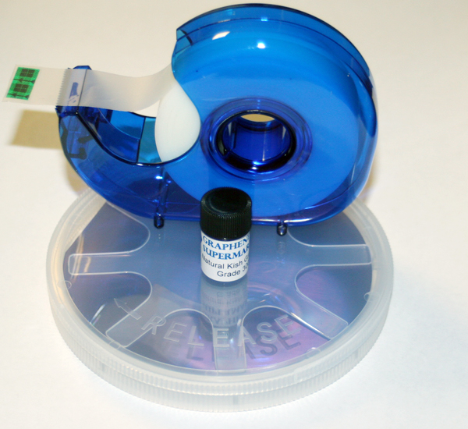
Why Nanotechnology?
Andre Geim
Konstantin Novoselov

Slide 8
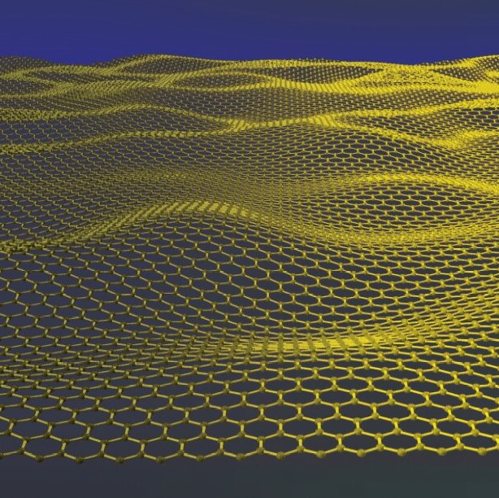
Why Nanotechnology?
Graphene
Strenght
Flexibility
Conductivity.......

Slide 9
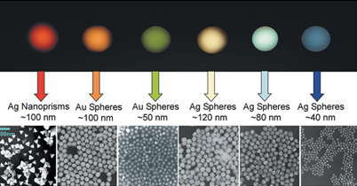
Why Nanotechnology?
Gold ..

Slide 10
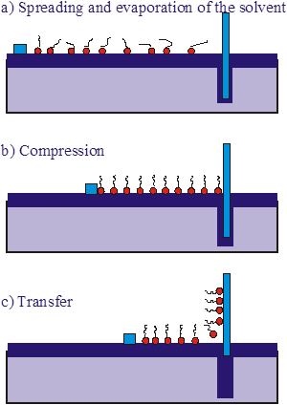
Tools of Nanotechnology
Synthesis
Bottom-up = Nanochemistry
materials and devices are built from molecular components which assemble themselves chemically by principles of molecular recognition
Ex. Langmuir-Blodgett technique

Slide 11
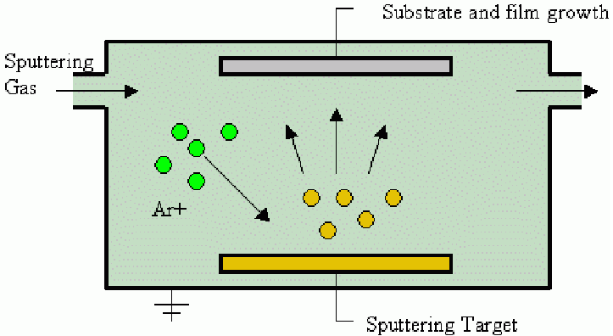
Tools of Nanotechnology
Synthesis
Top-down = Nanophysics: nano-objects are constructed from larger entities without atomic-level control.
Ex. Physical vapour deposition

Slide 12
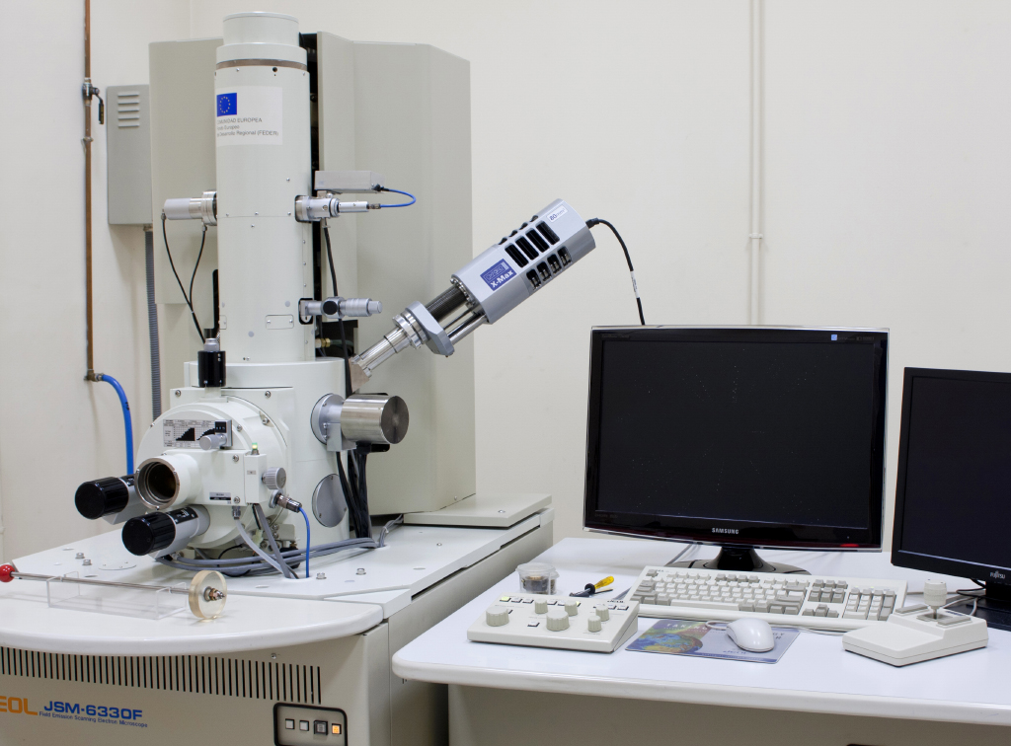
Tools of Nanotechnology
Microscopes
Electron Microscopes
SEM
For Surfaces
SEM Image of
Calcium Phosphate microparticles on the surface of hydrogel

Slide 13
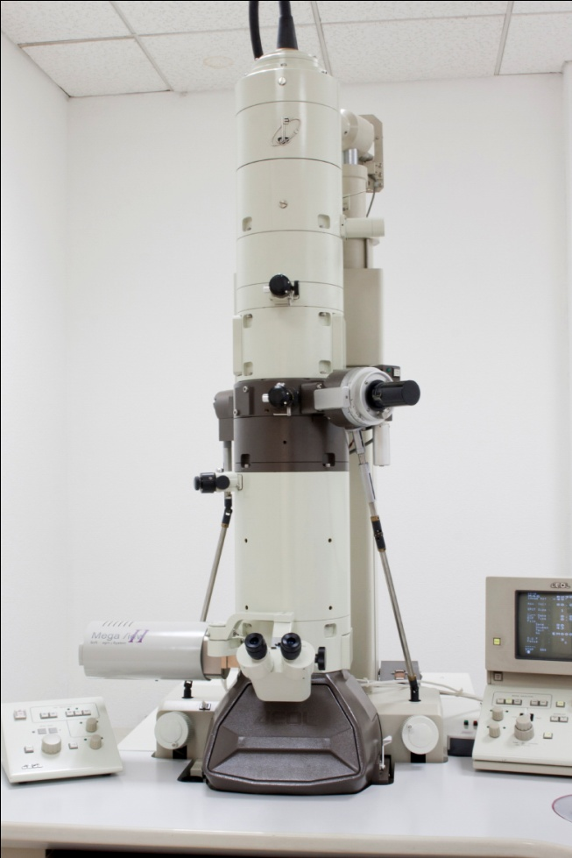
Tools of Nanotechnology
Microscopes
Electron Microscopes
TEM
For Matrix
TEM Image of
Calcium Phosphate microparticles Inside the hydrogel

Slide 14
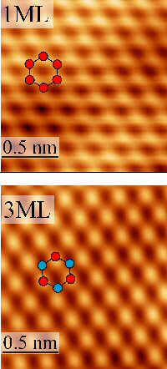
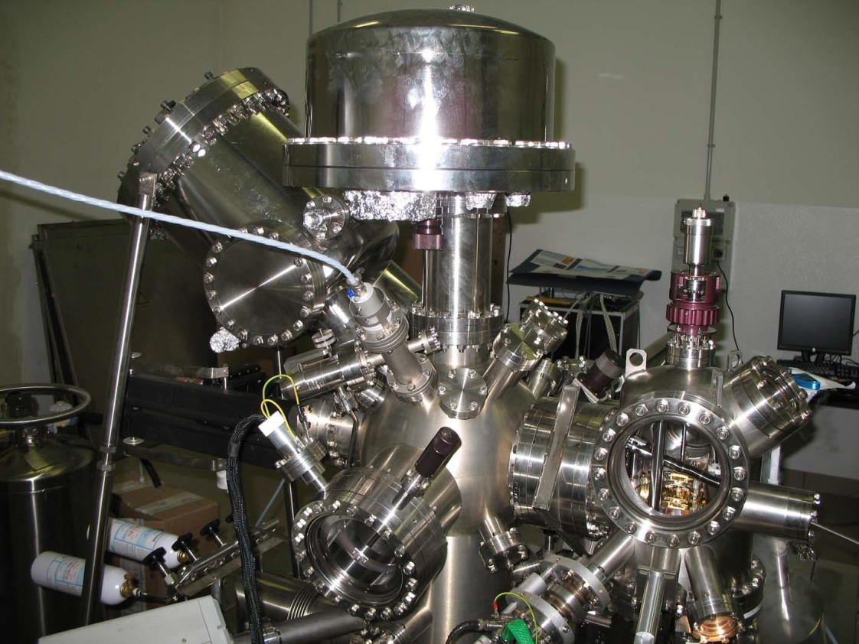
Tools of Nanotechnology
Microscopes
STM image for carbon monolayer (graphene)
STM

Slide 15
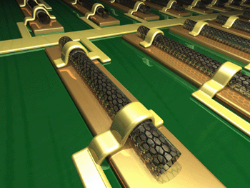
Applications of Nanotechnology
NanoElectronics

Slide 16
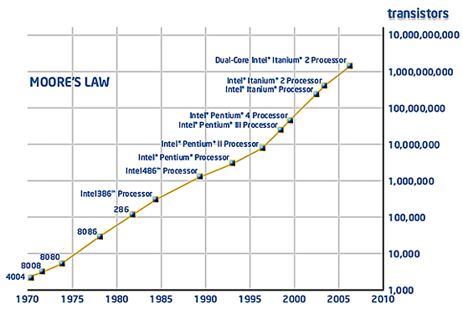
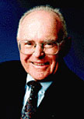
Applications of Nanotechnology

Slide 17
Applications of Nanotechnology

Slide 18
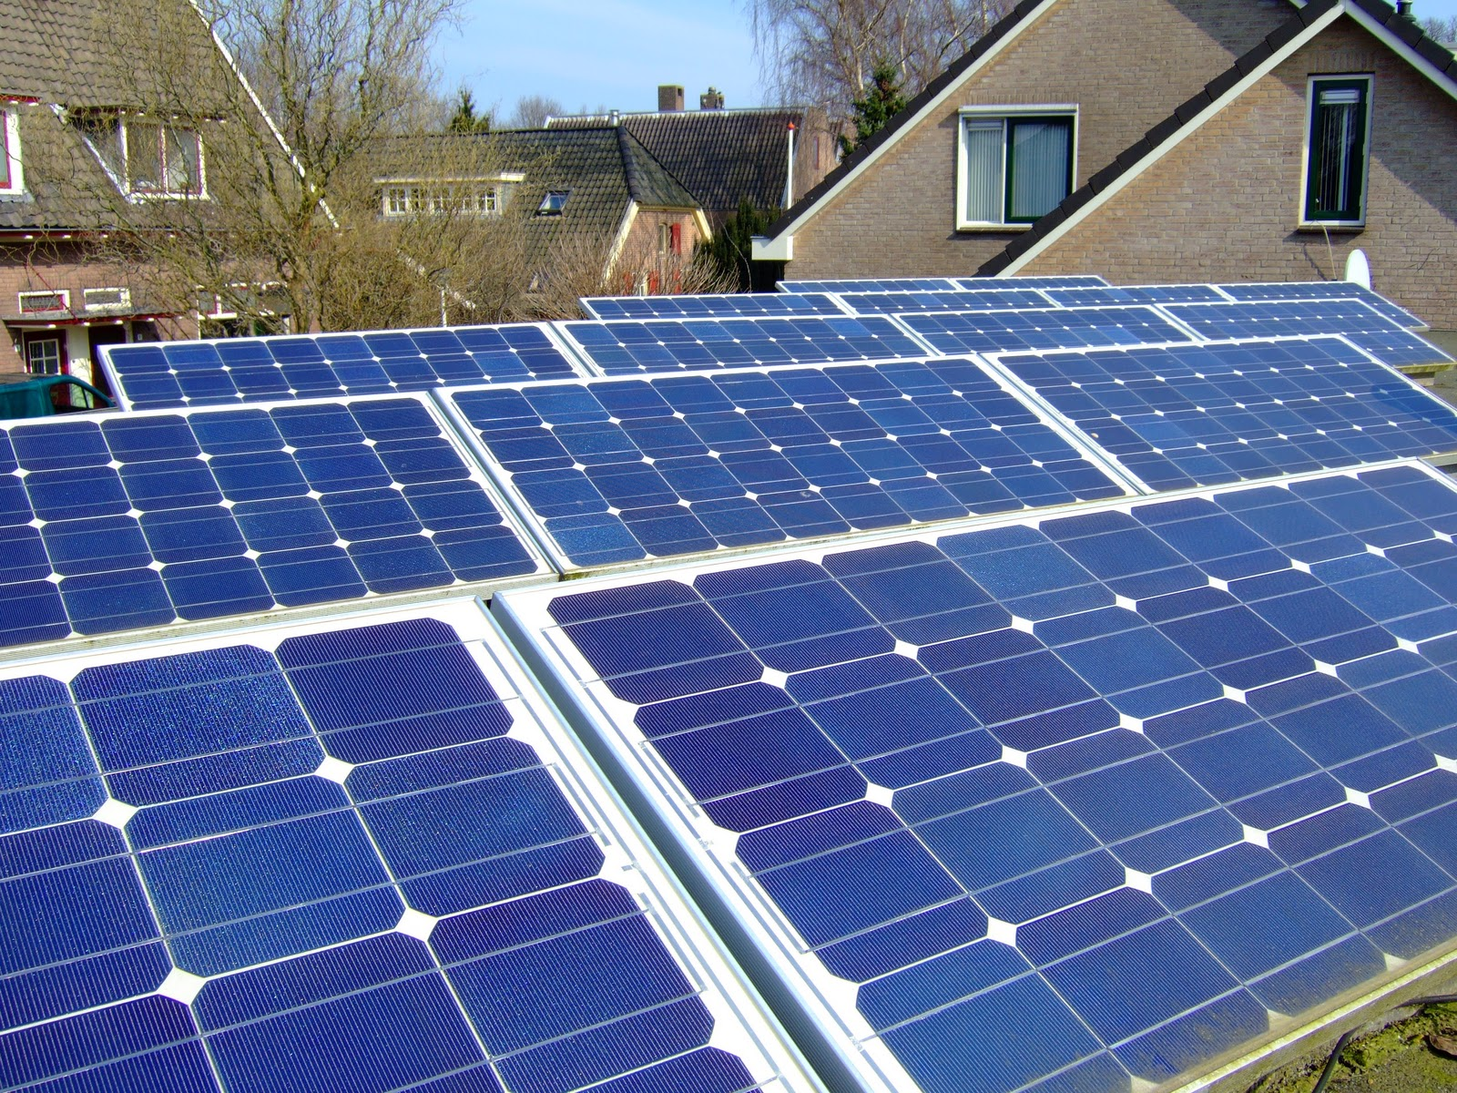
Applications of Nanotechnology
Solar Cells

Slide 19
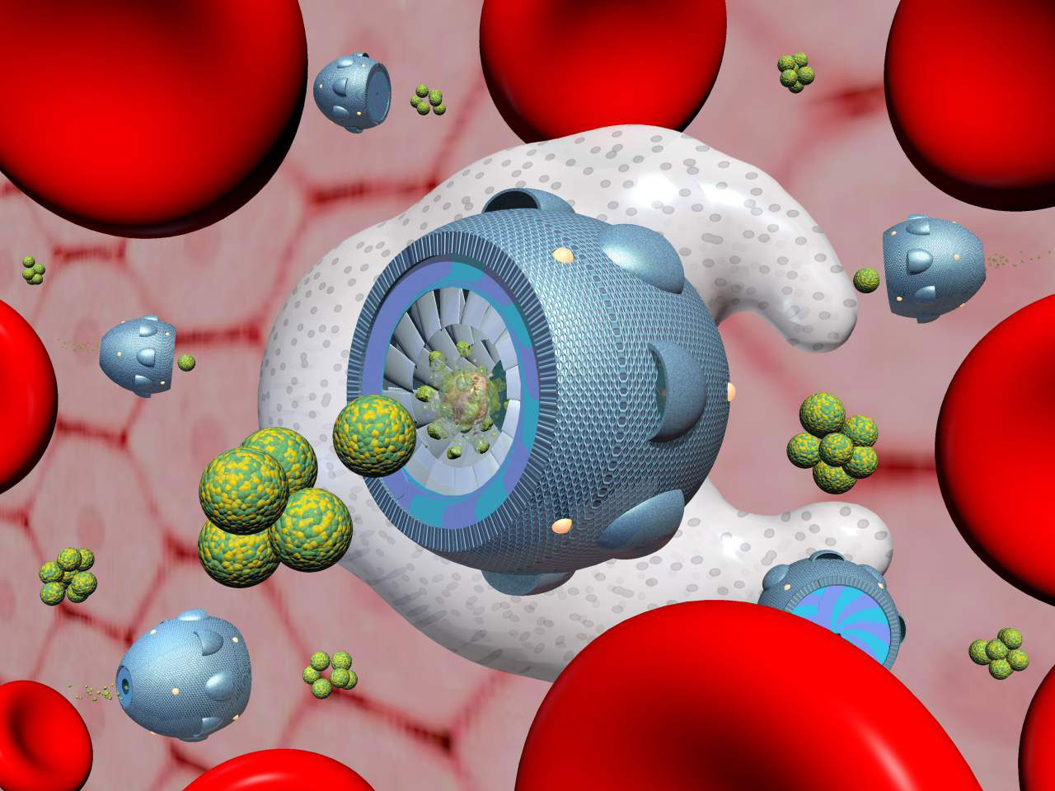
Applications of Nanotechnology
Nanomedicine

Slide 20
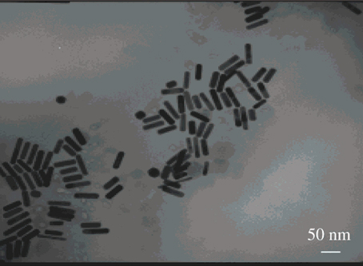
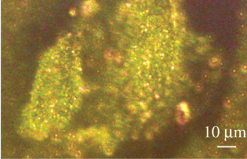
Applications of Nanotechnology
Gold Nanoparticles
Phototherapy
Cancer cell imaging

Slide 21
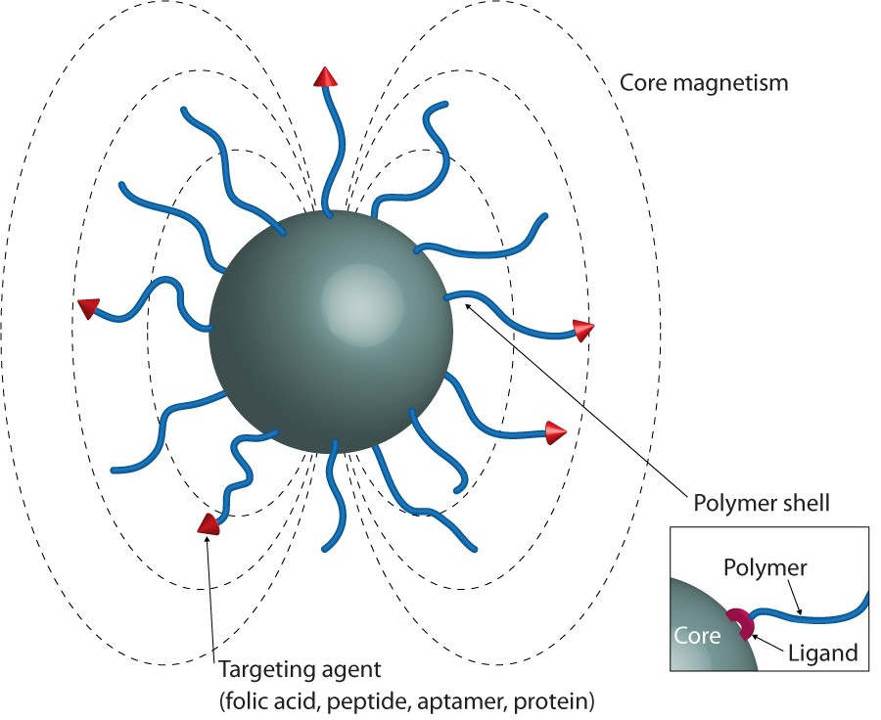
Applications of Nanotechnology
Iron Oxide Nanoparticles
Biodegradable (Adv.)
Imaging
Drug delivery

Slide 22
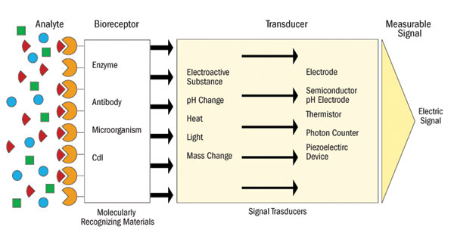
Applications of Nanotechnology?
NanoBiosensors

Slide 23
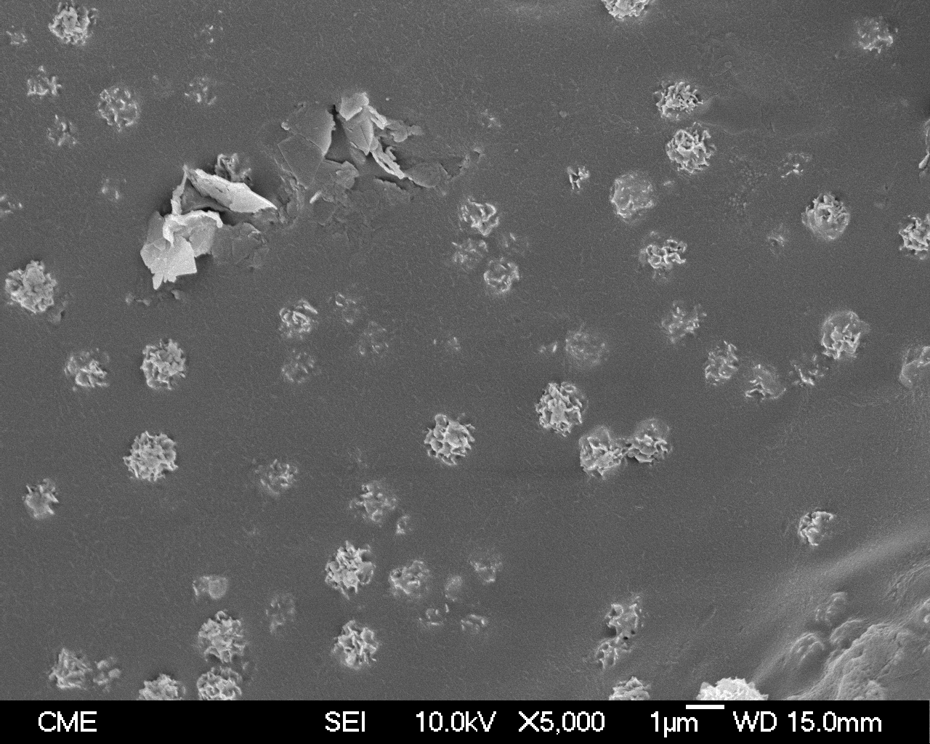
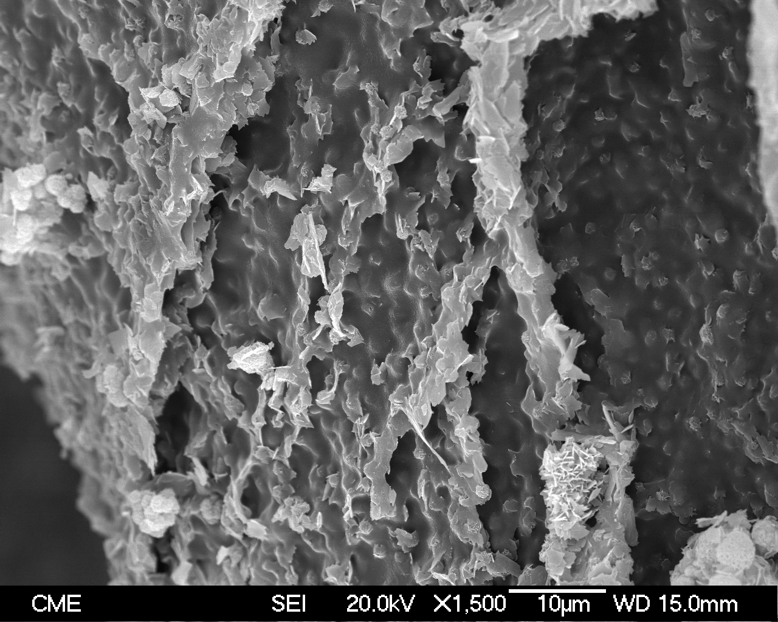
Applications of Nanotechnology?
Calcium phosphate precipitation inside copolymer hydrogel by reaction diffusion method

Slide 24
References
Master lectures [molecular Nanoscience and nanotechnology], Faculty of science , Universidad Autónoma de Madrid.
Prof. Francisco M. Romero , Universidad de Valencia, Valencia, Spain.
Prof. Tomas Torres, Universidad Autónoma de Madrid, Madrid, Spain.
Prof. Fernando Langa , Universidad de Castilla-La Mancha , Toledo, Spain.
Prof. Juan José Palacios, Universidad Autónoma de Madrid, Madrid, Spain.
Prof. María A. Díaz García, Universidad de Alicante, Alicante, Spain.
Prof. Carlos Untiedt Lecuona, Universidad de Alicante, Alicante, Spain.
Prof. María Luz Rodríguez Méndez, Universidad de Valladolid, Valladolid, Spain.
Cancer cell imaging and photothermal therapy in near-infrared region by using gold nanorods," Xiaohua Huang; Ivan H. El-Sayed; Wei Qian and Mostafa A. El-Sayed, J. Am. Chem. Soc.., 128, 2115-2120, (2006).
Wikipedia.

Slide 25
Thank You

