Slide 1
US Drought: Are we heading for a global food crisis?
Impact on Africa
By Eric Uwimana
ALYM 16/08/12

Slide 2
Based on Aljazeera inside story http://www.aljazeera.com/programmes/insidestoryamericas/2012/07/20127257810141930.html

Slide 3
The situation
After months of searing heat and sparse rainfall farmland in the US is drying up. For weeks the US has been suffering its most extensive drought in half a century. And meteorologists expect the severe conditions to continue. What will the impact be on global food prices and is the existing global food market system flawed?

Slide 4
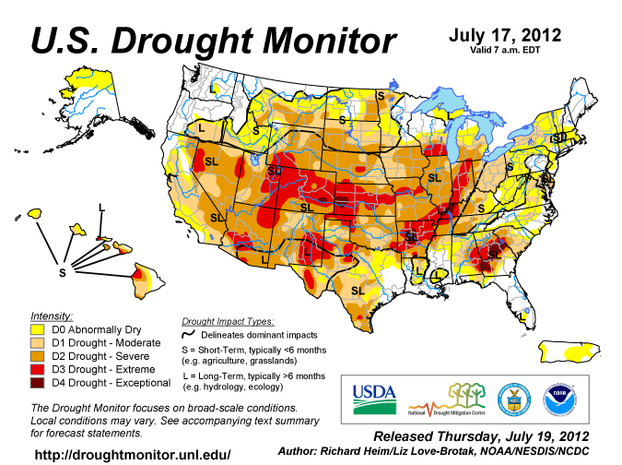

Slide 5
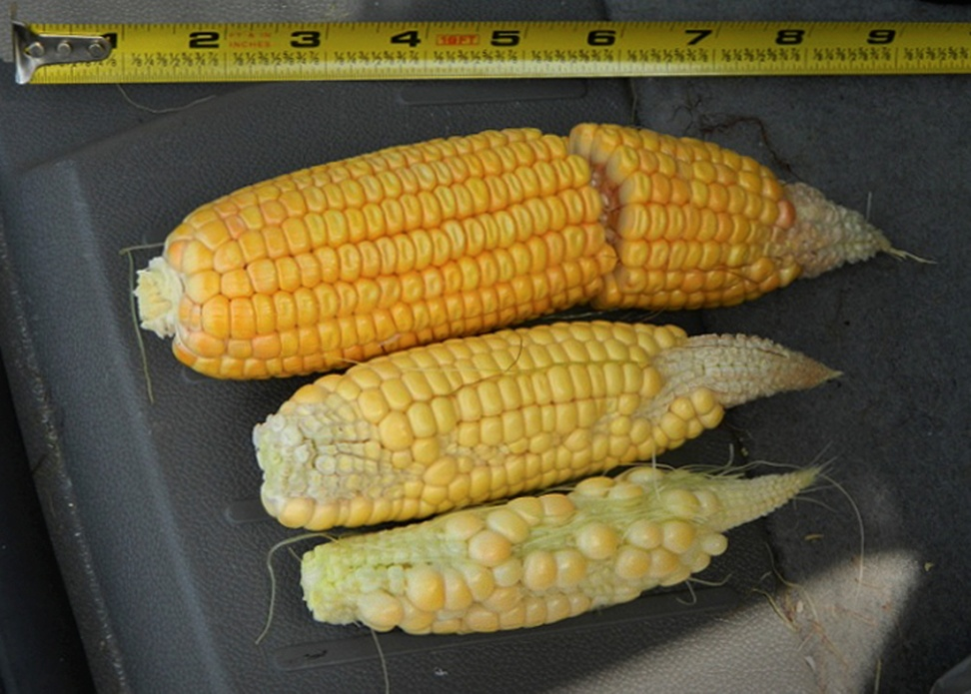
The situation
Us dominates corn market
It expected sharp drop in export for corn, soybean.
Corn: a mega crops uses: production of meat, sugary drink, fuel, food
Damaged crop is beyond repair
60% of continental US is stricken by draught conditions
87% corn and soybean US grown in draught area
40% poor to very poor conditions
Corn yield down at least 12% 2012

Slide 6
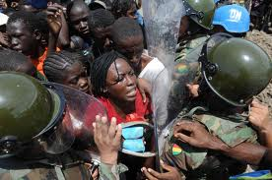
2008 wheat crisis read to protests in Africa Middle least south America
The price rises affected parts of Africa particularly severely with Burkina Fasso, Cameroun, Senegal, Mauritania, Côte d'Ivoire, Egypt and Morroco seeing protests and riots in late 2007 and early 2008 over the unavailability of basic food staples.

Slide 7
Impact
The crisis is likely to affect
on US price rise in dairy and animal products in US supermarket
Rest of the world :
Impact on nations in shortage in corn and on other animal producing country India

Slide 8
Impact on developing countries
There is difference between US and developing country in:
uses of corn: as feed or food
The amount of disposable income spent on food: us 10-15% developed up to 75% impact is more felt strongly
Processed food consumption in developed countries reduce the consumer price on the actual commodity while poor people diet depend on commodity itself so when the price go up they feel it strongly

Slide 9
Is the food crisis in US impacting Africa
The international prices of cereals began to rise to record levels in mid-June this year, when the implications of one of the worst droughts ever to hit the US, the world's largest producer of maize and soybeans, became breaking news and commodity markets reacted.

Slide 10
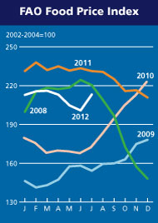

Slide 11
Ethiopian cereal prices have been rising since February 2012, Maize in Uganda increased by about 60 percent between January and April 2012 about 42 percent higher than a year ear In Kenya, maize prices have been rising by an average of 20-25 percent in the last three to four months in main markets

Slide 12
The recent hike in the global maize price was almost instantly transmitted to South Africa, the largest maize producer in Africa.
Maize production in Lesotho - a major importer - has dipped by 77 percent compared to 2010/11, and the country will struggle to feed its people, as will others in the region.

Slide 13
Congo, Equatorial Guinea and Gabon in central Africa "are almost totally reliant on international markets to cover their cereal consumption requirements (wheat and rice), “

Slide 14
Is it that serious?
Impact may be higher whether crisis based on price soar or speculation
speculation in America could have a worldwide effect on food prices is reflected in the globalization of food production. Foreign investment drives productivity improvements, and other gains for farmers
Food inflation may lead to financial repercussion as observed last financial crisis started by a food crisis
Climate change aggravate the situation

Slide 15
Fao say there is enough food to feed every one but more than a billion people are hungry
Why then can’t we feed every one: POVERTY
Will the question change? May be : unable to grow enough food to feed everyone because of climate change

Slide 16
Globalization hazard
Globalization the world being more interdependent: in case of crisis redistribution of commodities?
however
The least food secure places are going to be more insecure: poor in Us more in the global South
Hazard not an accident the global south used to export food now they importing: GLOBAL FOOD VULNELABILITY

Slide 17
Currently globalization
Dependency
Monopoly of market: the big winners
There is a need for
A much more inter dependency: equity, transparency, laws (example in Russia wheat ban case after fire, rules could monitor abrupt change)

Slide 18
In Africa
Why African countries declined in production: unfavourable policy by developed countries: a lot subsidies which lead to less investment in Africa.
In addition studies have linked food crisis to climate change

Slide 19
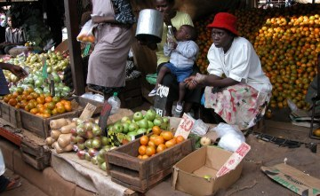
What’s being done?
“We cannot allow short-term food-price spikes to have damaging long-term consequences for the world's most poor and vulnerable” – World Bank Group President Jim Yong Kim

Slide 20
Reference
http://www.aljazeera.com/programmes/insidestoryamericas/2012/07/20127257810141930.html
http://www.irinnews.org/InDepthMain.aspx?indepthid=72&reportid=96032
http://www.worldbank.org/en/news/2012/07/30/food-price-volatility-growing-concern-world-bank-stands-ready-respond
http://allafrica.com/stories/201208100477.html

