Slide 1


By Sarah Mohammed Raafat
Google student Ambassador - University of Alexandria

Slide 2



Online Science competition
Age from 14-18
Age categories : 14-15
15-16
17-18

Slide 3
Interested?! let's get started
You need Google account first
To be able to register , use google apps to help you documenting and presenting your work
Your dashboard will contain all sections needed
You can edit your work till the deadline

Slide 4
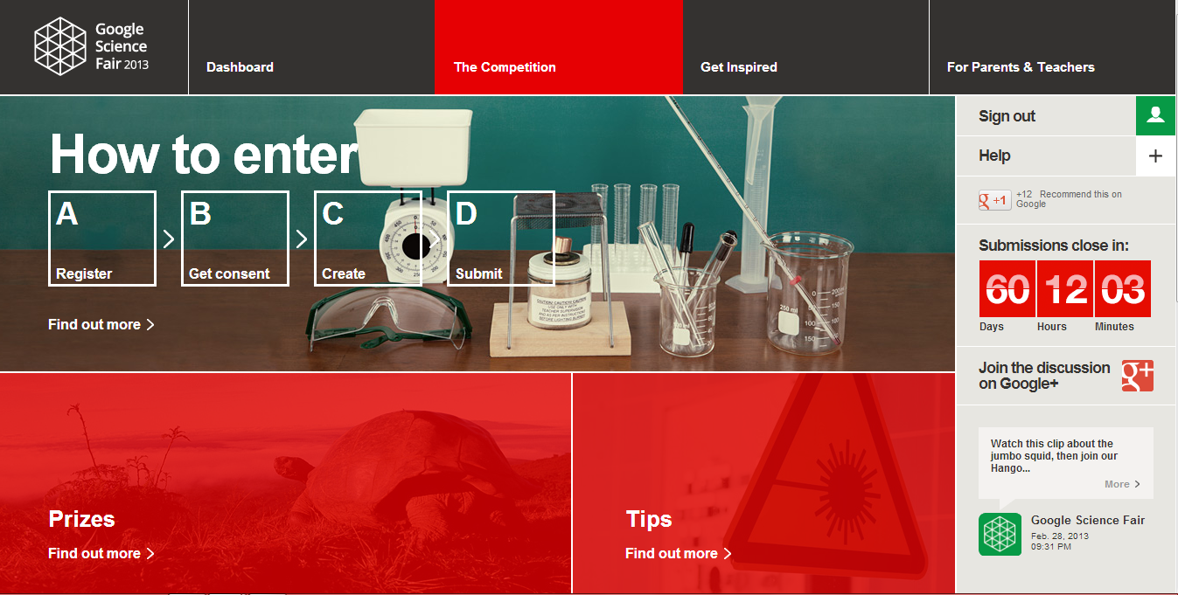
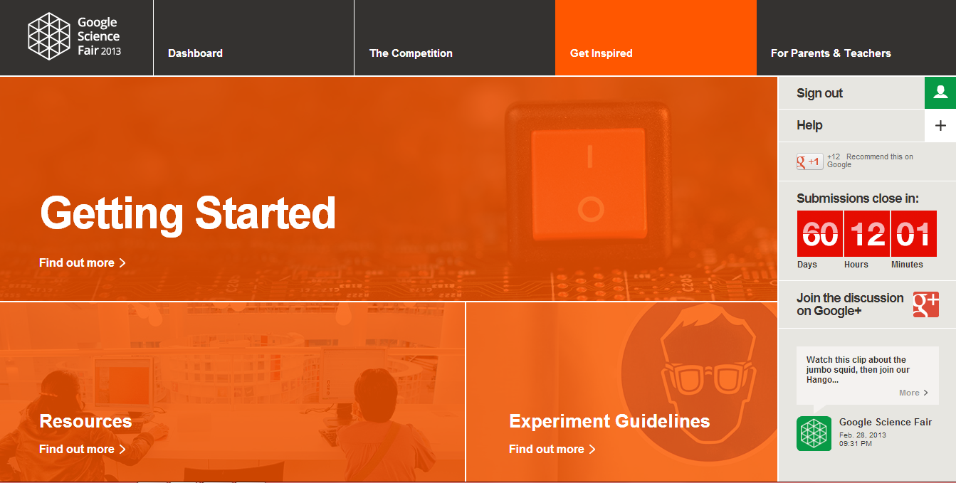
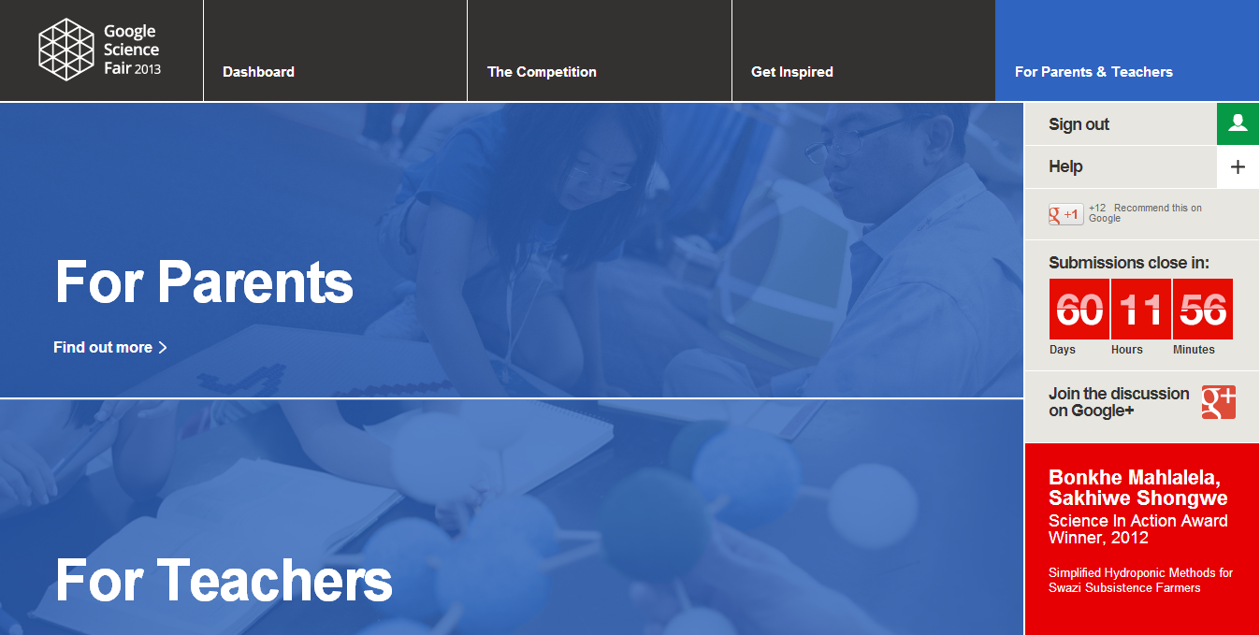
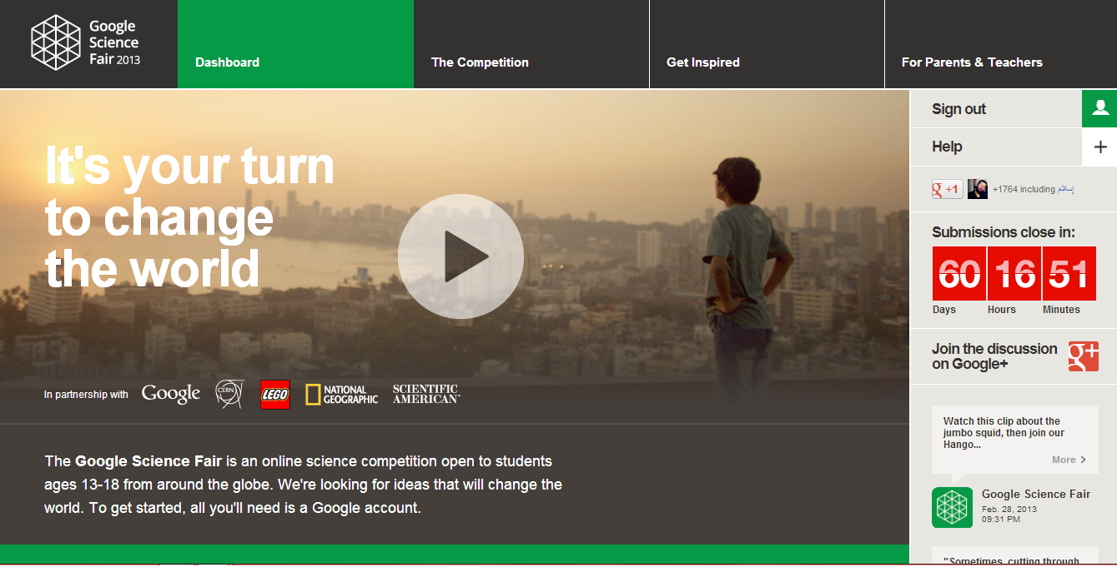
Explore Google Science fair site

Slide 5
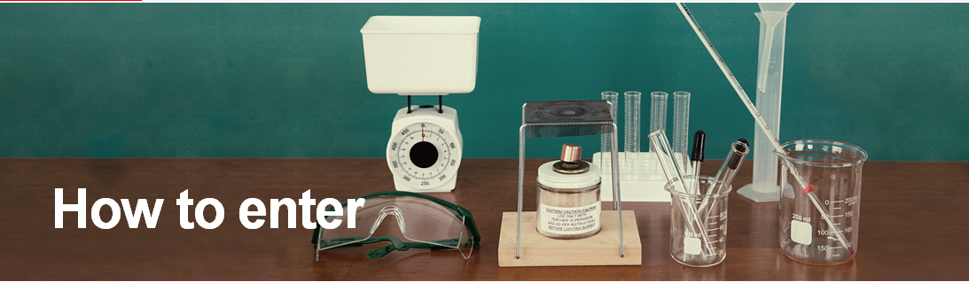
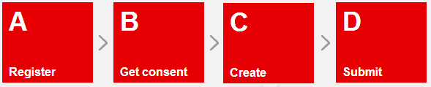

Slide 6
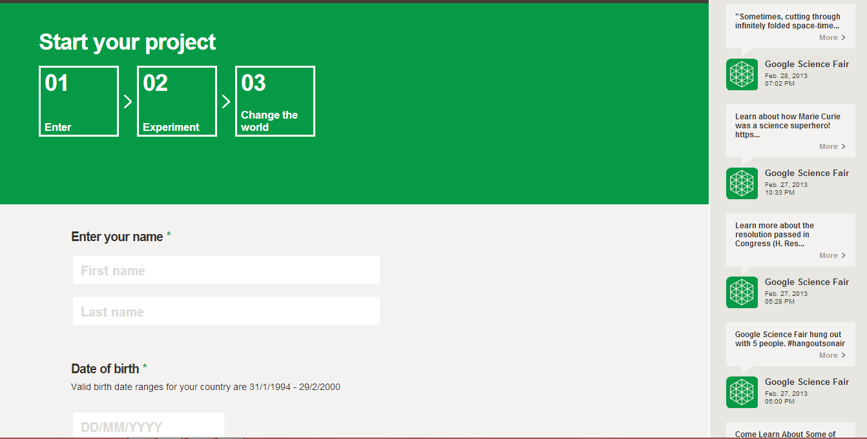
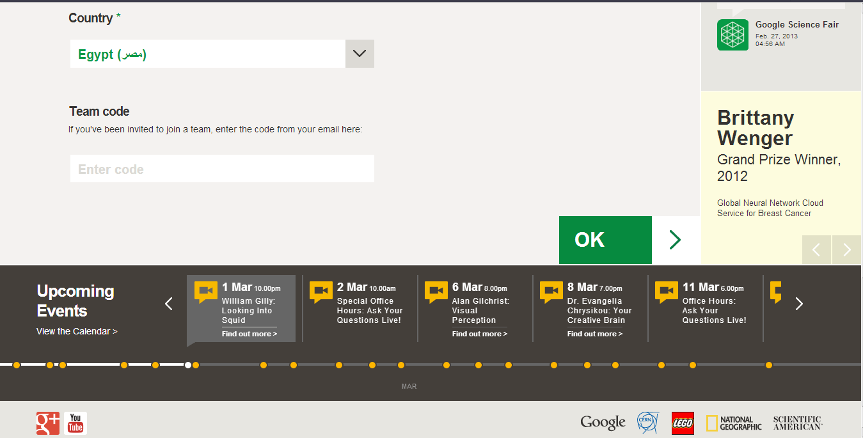
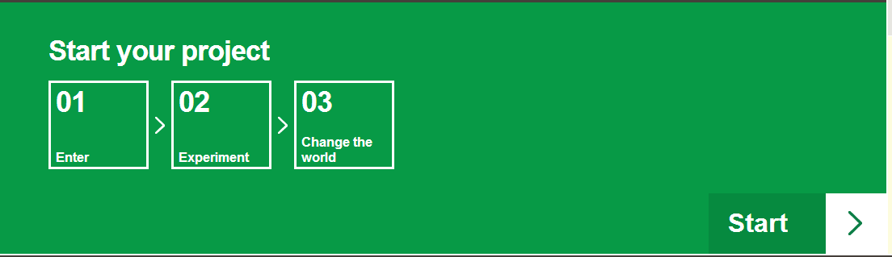
Notes:
Start your project

Slide 7
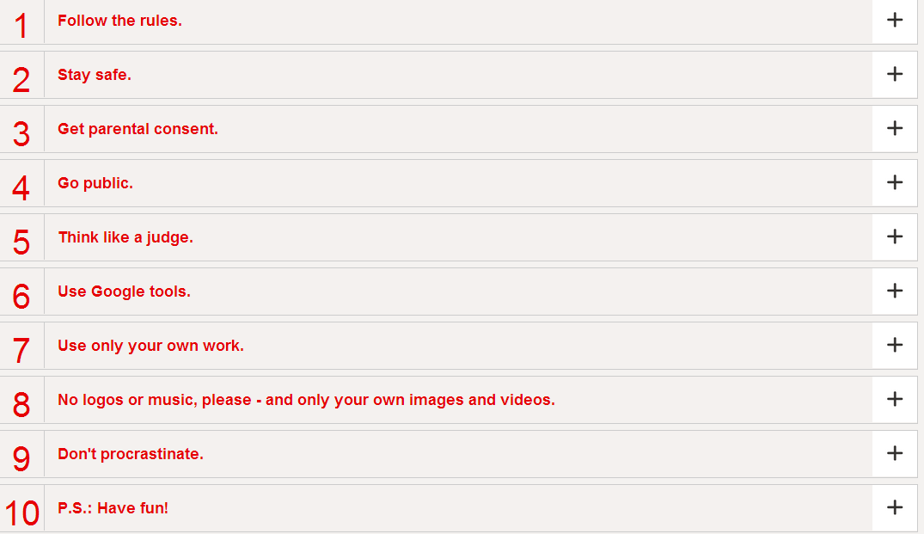
How to win ?

Slide 8
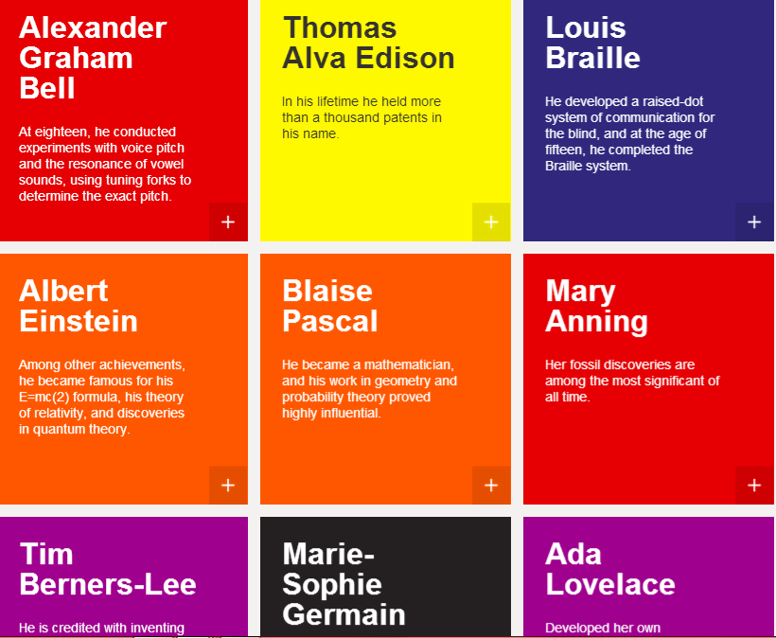
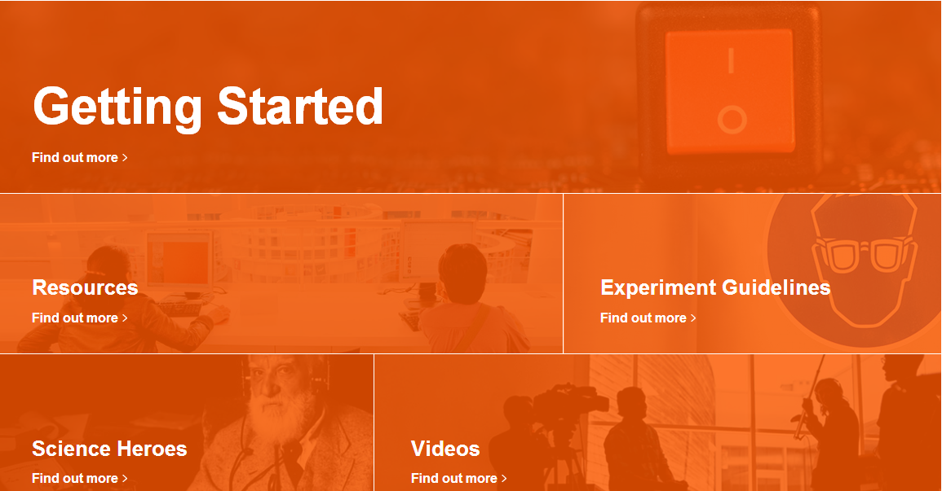
Inspiration

Slide 9
The core of your project
Summary
About Me
Question / Proposal
Research
Method / testing and redesign
Results
Conclusion / Report
Bibliography, References and Acknowledgements

Slide 10

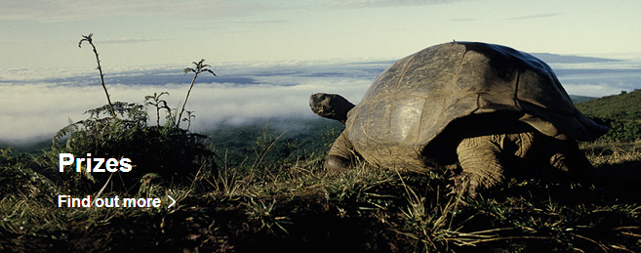

Slide 11
Wrap up
Get inspiration,Find the idea
Explore the site make sure you read the rules , guidelines, and topics
Register and submit your work
While working on your project:
Think like a judge
Get help from: your teacher
GSA
FAQs
Google science fair help forum

Slide 12
Useful links
Google science fair site https://www.googlesciencefair.com/en/2013/
G+ page https://plus.google.com/+GoogleScienceFair/posts
Facebook page https://www.facebook.com/GoogleScienceFair?fref=ts
Google science fair help forum https://groups.google.com/forum/#!forum/google-science-fair-help-forum

Slide 13



Keep me updated!
https://www.facebook.com/Google.AlexU
http://www.twitter.com/GSA_Alexandria
https://plus.google.com/u/0/105504407648761697095/

Slide 14


Remember

