Slide 1
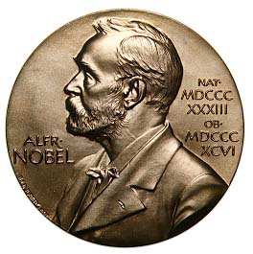
Egyptian Nobel laureates

Slide 2
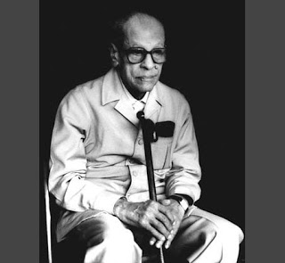
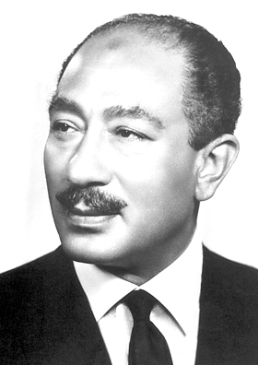
Anwar al-Sadat
The Nobel Peace Prize 1978
Naguib Mahfouz
The Nobel Prize in Literature 1988

Slide 3
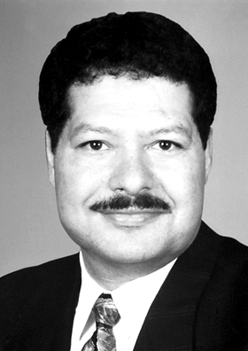
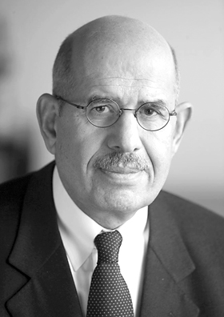
Mohamed ElBaradei
The Nobel Peace Prize 2005
Ahmed Zewail
The Nobel Prize in Chemistry 1999

Slide 4
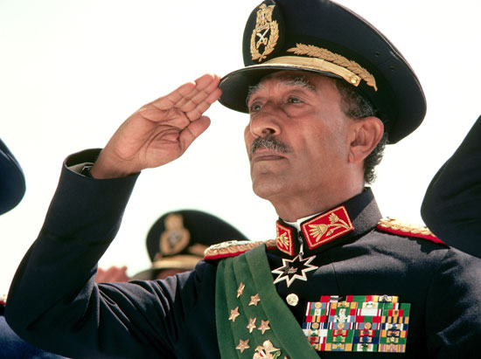
Mohammed Anwar al-Sadat

Slide 5
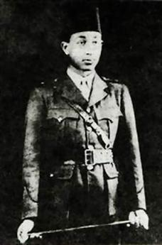
Born:
25 December 1918, Mit Abu al-Kawm, Egypt
He graduated from the Royal Military
Academy in Cairo in 1938

Slide 6
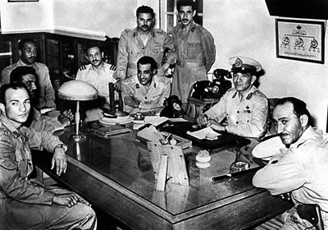
Then he was posted to where he met Gamal Abdel Nasser and formed the secret Free Officers Movement

Slide 7
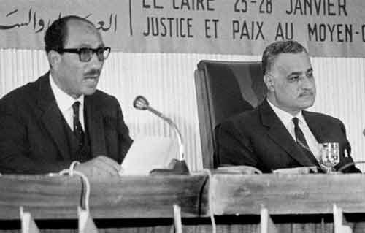
During Nasser presidency
Minister of state 1954
Secretary of the national union 1959
Vice President 1964

Slide 8
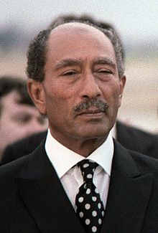
President of Egypt 1970

Slide 9
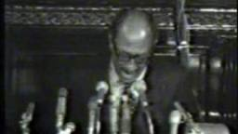
Corrective Revolution

Slide 10
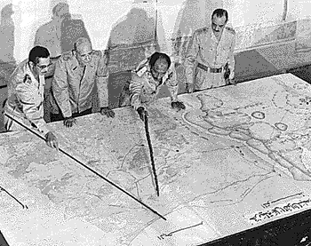
October war 1973

Slide 11
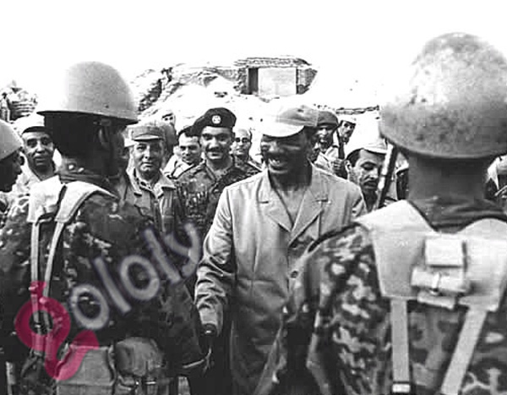

Slide 12
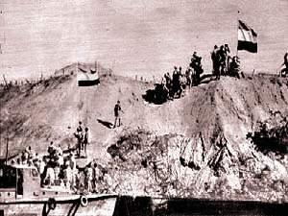

Slide 14
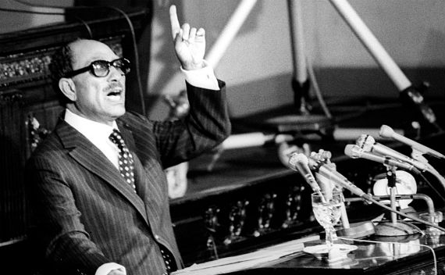
Going to Israel

Slide 15
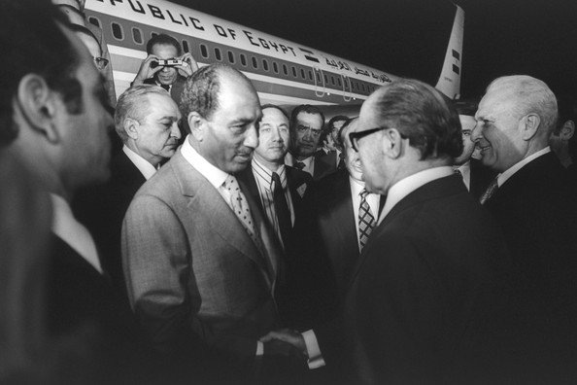

Slide 16
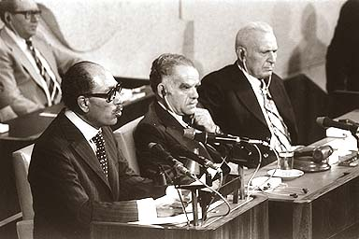

Slide 17
The Negotiations

Slide 18
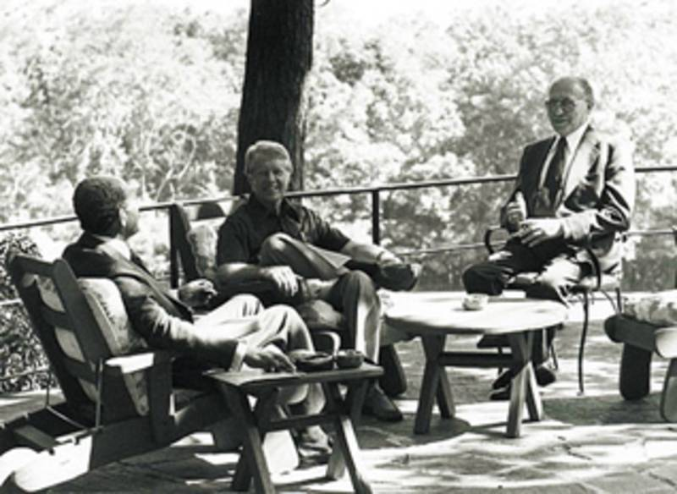

Slide 19
