Slide 1
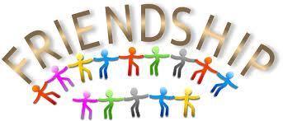
The need and the purpose of friendship building
Presented by Nicolas UWITONZE ALYM ©2013

Slide 2
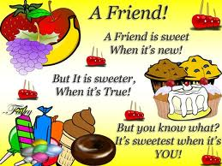
Contents
Overview
Definition of friendship
Definition of collaboration
The ideal partnership intensity
Criteria of collaboration
Redefining our Purpose, Vision, and Mission
Purpose of friendship building
Communication for successful collaborative relationship
Conclusion

Slide 3
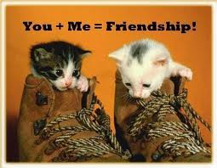
Overview
Plant a seed of friendship; reap a bouquet of happiness. -- Lois L. Kaufman
What is Friendship?
friendly relations: a relationship between people, organizations, or countries that is characterized by mutual assistance, approval, and support ¹
Notes:
¹ Microsoft® Encarta® 2009. © 1993-2008 Microsoft Corporation. All rights reserved.

Slide 4
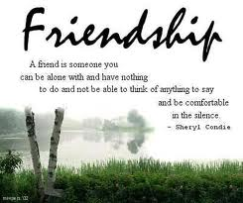

Slide 5
A form of friendship: collaboration
Collaboration is
a mutually beneficial and well-defined relationship entered into by two or more organizations to achieve common goals.
the act of working together with one or more people in order to achieve something.
Notes:
The relationship includes
a commitment to mutual relationships and goals;
a jointly developed structure and shared responsibility;
mutual authority and accountability for success; and
sharing of resources and rewards.

Slide 6
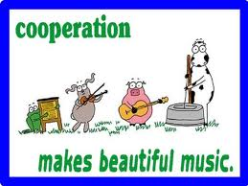
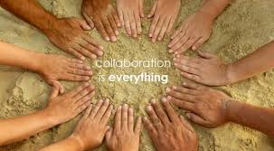
Finding the ideal partnership intensity for the task(s) at hand

Slide 7
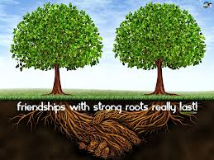
Criteria of collaboration
Do you have a clearly defined vision & purpose in mind for the collaborative effort?
Are you willing to make a firm commitment?
Do you have adequate time and funding?
Would changes and new ideas be welcomed or resisted?

Slide 8
Is the proposed partner is a good fit with your organization?
Consider:
Key goals to be achieved
Gain from the collaboration. i.e Will the end result be a ‘win-win’ situation?
Can all organizations reach an agreement regarding the mandate of the collaboration and the purpose of the collaborative initiatives?
commonalties to work together effectively.
Does the organization have a good understanding of whom you serve?
Plant a seed of friendship; reap a bouquet of happiness. -- Lois L. Kaufman

Slide 9
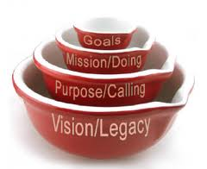

Slide 10
Defining our Purpose, Vision, &Mission The African League of Young Master’s (ALYM)
VISION: Becoming an international organization linking students and graduates of Alexandria university
PURPOSE: Open channels of communication between African students and their Egyptians peers through holding weekly meetings and other activities.
MISSION: Promote the relations between Egypt and African countries
“The only way to have a friend is to be one.” Ralph Waldo Emerson

Slide 11
Purpose of friendship
Who is a friend? The encarta dictionary defines a friend "as an acquaintance, colleague, associate, companion, comrade, workmate, intimate, a person that you know well and like, an ally, supporter, well-wisher, helper, collaborator.
With all the definitions and the description of who a friend should be, we must not fail to understand that: Friendship is by choice and not by force -- and so, make your friendship good/better "on purpose”.
Notes:
Sports organizations and players use various social media platforms to update their fans and promote parasocial relationships between players and fans. The purpose of this study was to investigate how various publics of athletic departments value the use of social media as a relationship development tool. A survey questionnaire was developed based on six indicators of relationship cultivation: access, positivity, openness, sharing of tasks, networking, and assurance

Slide 12
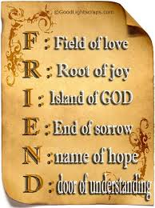
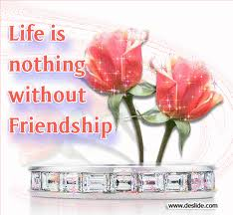
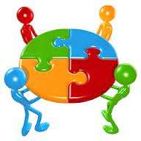

Slide 13
Possible roles of partners
Sharing specialized skills(e.g. networking, marketing, planning)
Sharing ideas and perspectives to address complex issues
Coordination of services and initiatives
Making services more readily available to clients
Volunteers
Donation of space or equipment
Funding or fundraising

Slide 14
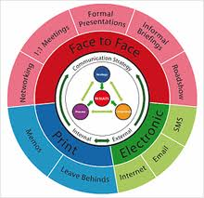
A successful collaborative relationship demands first and foremost, clear communication.
Notes:
Let’s face it, face-to-face communication is still the best way to have a relationship
since various members of ALYM, Intl are dispersed, using internet and social networks should function as a dialogic tool.
most of the information we get in a face-to-face communication is NOT from the words themselves, but rather from body language, facial expression, and tone of voice

Slide 15
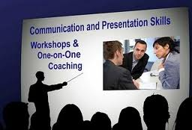
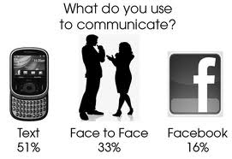
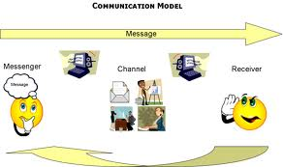
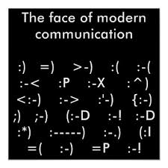

Slide 16
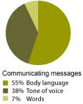
So…When is it best to use technology for communication? I’d say when you have no other choice
Notes:
Only 7% of our face-to-face communication is in our words. This means that 93% of face-to-face communication is in our gestures, facial expressions, body language and eye contact which cannot be transmitted through the internet and can only partially be conveyed through the phone. So face-to-face is the best form of communication—even in the Computer Age and I recommend that to be the best form of communication for spending time, important or difficult topics of conversation. The second best form of communication is via the phone. When you cannot be in person, the phone is the next most effective way to communicate.

Slide 17
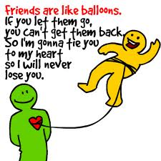
Conclusion
Don't walk in front of me, I may not follow. Don't walk behind me, I may not lead. Just walk beside me and be my friend.-- Albert Camus

Slide 18
References
Woo, Chang Wan & Chung, Wonjun (2012). Social media in relationship-building among collegiate sports organizations: A test of relationship cultivation strategies. In S. Duhé (Ed.), New Media and Public Relations, (2nd ed.,pp. 245–254), New York: Peter Lang Publishing, Inc.
http://www.instituteforpr.org/scienceofsocialmedia/social-media-in-relationship-building-among-collegiate-sports-organizations-a-test-of-relationship-cultivation-strategies/
Carolyn Parkinson(2006) ,Building Successful Collaborations: A guide to collaboration among non-profit agencies and between non-profit agencies and businesses ,Cambridge & North Dumfries Community Foundation http://www.cfc-fcc.ca/link_docs/collaborationReport.pdf

Slide 19
References
Friendship quotes & quotations http://www.indianchild.com/friendship_quotations.htm
PriscaN, Garshepp, Carolyn Barratt, Harri and 1 other, How to Make Friendship on Purpose http://www.wikihow.com/Make-Friendship-on-Purpose
http://www.exforsys.com/career-center/relationship-management/relationship-building-strategies.html
http://artofeloquence.com/articles/face-to-face-communication/

