Slide 1
THE ENERGY REVOLUTION IN AFRICA
A presentation by MPINGIRIKA ERIC ZADOK

Slide 2
Intoduction
Access to energy, ideally clean and renewable energy, is essential for sustainable economic growth .
There is a positive correlation between consumption of energy and per capita income.

Slide 3
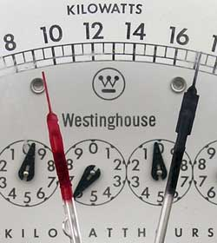
Africa's electricity usage per capita is 124kWh, one-tenth that of other developing countries.
600 million people in rural Africa living without access to electricity.
70-90 percent of primary energy supply is derived from biomass which has grave ecological implications. For example, Malawi, based on the current rate of deforestation, could be devoid of forests in ten years.

Slide 4
Africa's second major sources of energy are diesel and kerosene.
an energy source that is becoming increasingly costly and unreliable.
average cost of energy from coal is around $0.09 per kWh,
most consumers pay around $0.30 to $0.50 per kWh due to the high cost of diesel and kerosene.

Slide 5
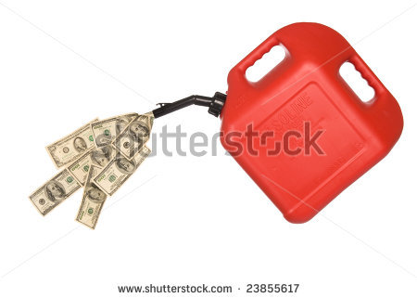
Africa Strategically placed
Africa has 20 percent of the world's land mass and plenty of sun.
Land is cheap and numerous countries are prime locations for installation of solar photovoltaic power plants .
With the right investments, proactive off-takers and conducive legal and regulatory frameworks, African countries can replace their diesel & kerosene usage with solar, hydro, wind, clean coal and gas
.
http://allafrica.com/stories/201202271613.html

Slide 6
BBC Report by Tom Heap
Without access to power Sylvester Muthama, a local barber in rural Kenya has to abandon his electrical clippers for manual ones
His aunt, who shares the room to make clothes, must stitch by hand and power her iron with charcoal.
http://www.bbc.co.uk/news/science-environment-20583663

Slide 7
Meet web designer ,Peter Njenga who lives closer to Nairobi & owns an internet magazine which owes its very existence to electricity.
He finds his ambitions thwarted by power surges which damage his computer and outages which prevent him from working.
http://www.bbc.co.uk/news/science-environment-20583663

Slide 8
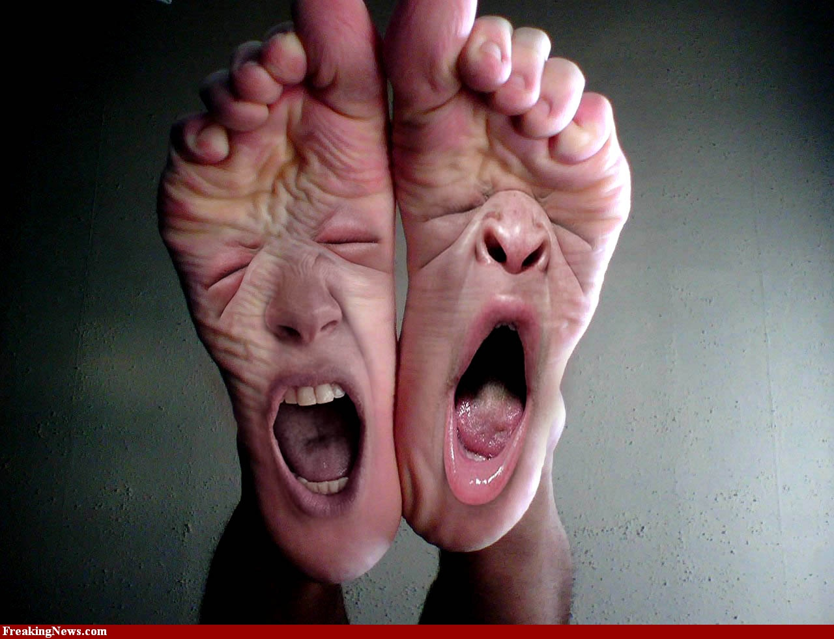
The power beneath their feet.

Slide 9
The Great Rift Valley
A tear in the Earth's crust stretching 3,000 miles (4,830 km) through Africa.

Slide 10
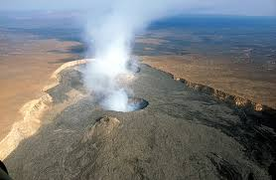
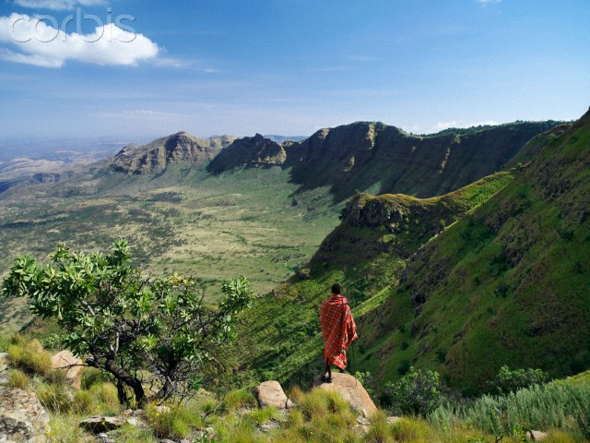
.
Drill down a couple of miles and, if your prospecting is good, you hit pools of water under great pressure and heated to 230C.
Stick in a pipe and steam roars out ready for ducting into power stations to turn turbines and make electricity

Slide 11
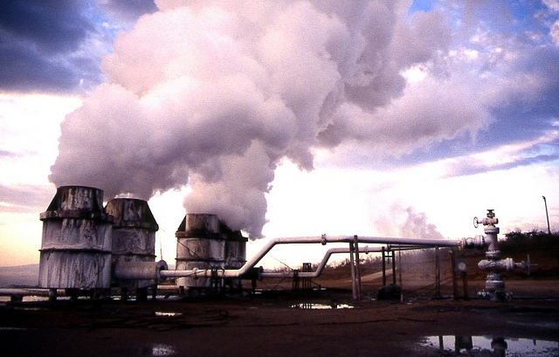
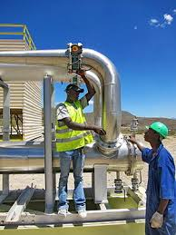
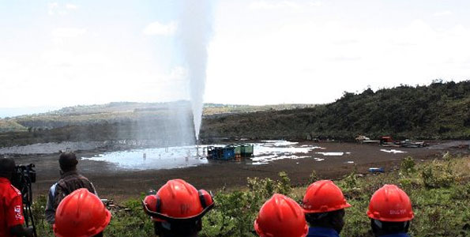
At Olkaria, near Lake Naivasha, in Kenya, they have been generating some electricity for 20 years.
With investment of around £1bn, in a few years they will be able to produce more electricity than the country's entire current average annual demand of 1,600 megawatts.

Slide 12
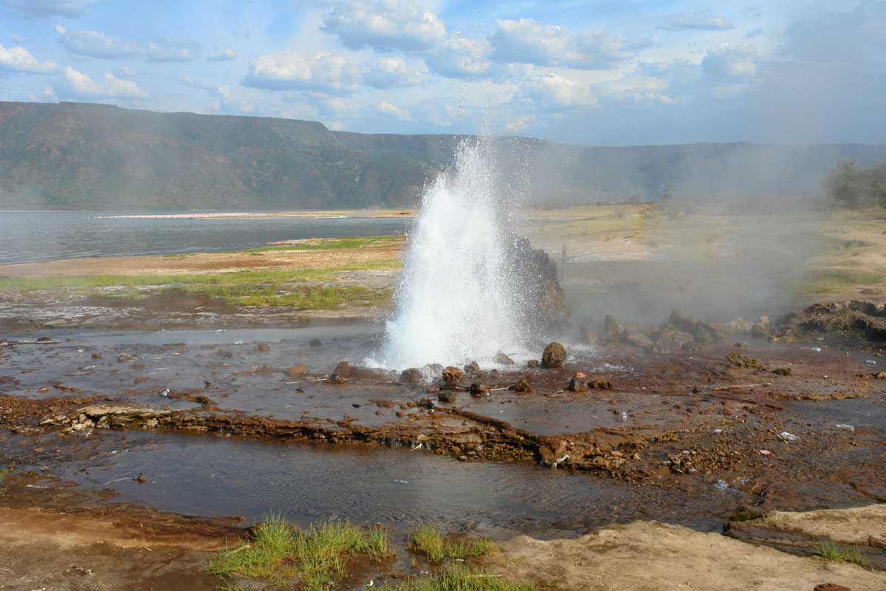
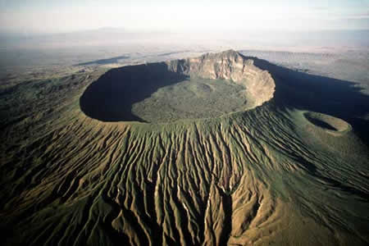
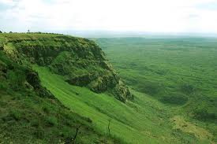
.
A little further north is Menengai Crater, where further test wells are being drilled and the potential could be even greater. Overall it is believed the geothermal potential in Kenya is 10,000 megawatts.

Slide 13
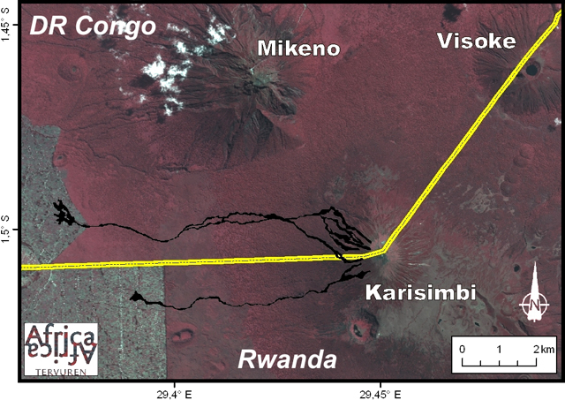
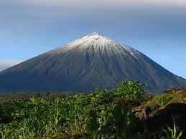
.
Geothermal prospecting is happening in Ethiopia, Rwanda and Tanzania.
Rwandan Government has allocated $27 million (Rwf17.1bn) towards the drilling of three geothermal wells on the southern slopes of the Karisimbi volcano.

Slide 14
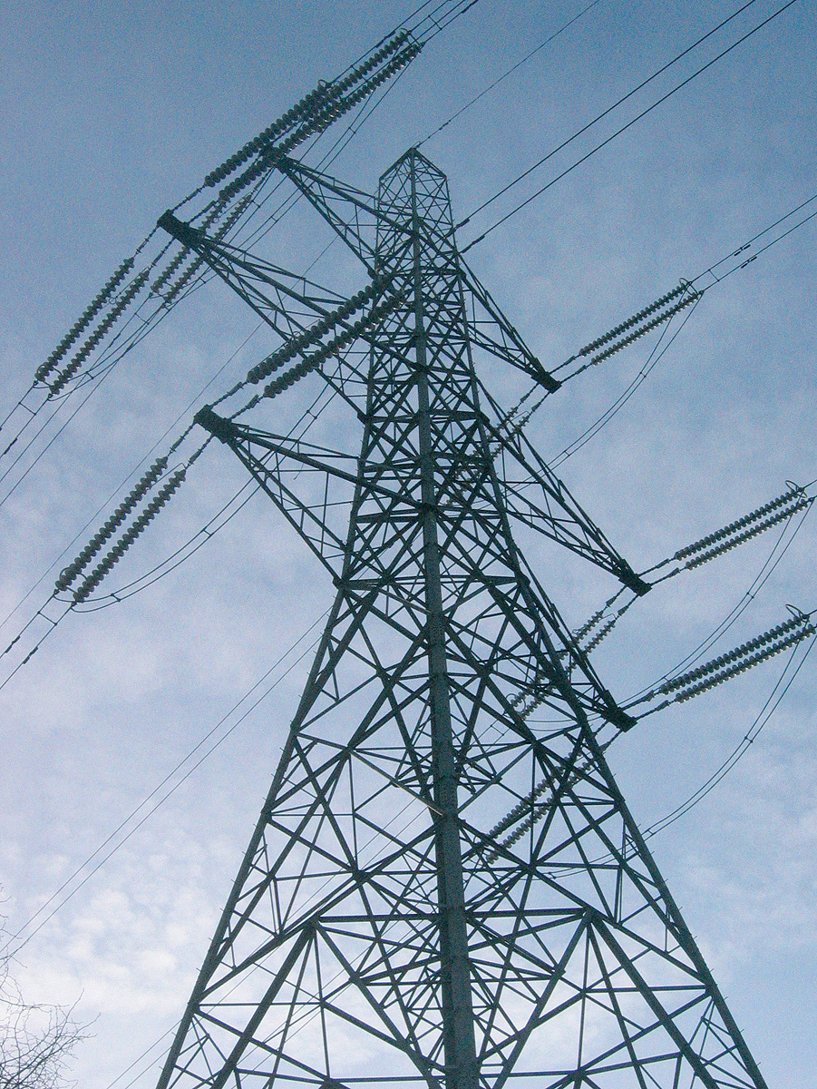
Solar energy
Seven in 10 Africans are not on the mains grid
Wires are not the only way to deliver electricity.

Slide 15
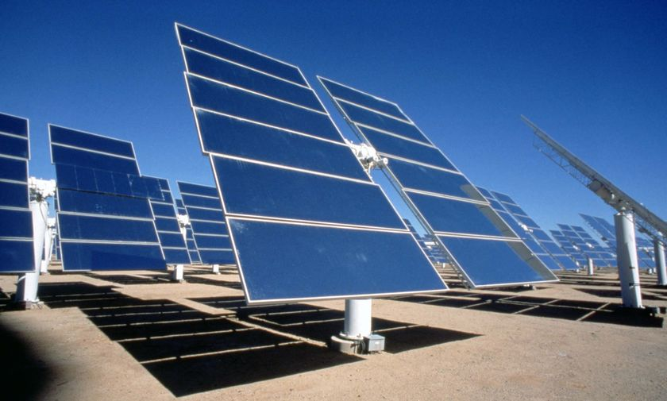
Harnessing the African sun has been considered before and foundered due to high cost and complexity.
But in the last few years the price of technology has gone down
solar panels, batteries and LED bulbs are now better and cheaper.

Slide 16
Kemba primary school in Kenya has helped 600 of its students to acquire solar lights.
The lights enable students to read in the evening, do more homework and get better results:
"Because of the light, the number of students going to good schools has doubled.

Slide 17
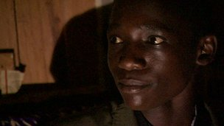
In recent exams star pupil Enoch came 55th out of all of the students in Kenya.
His ability to study improved considerably when his mother purchased a solar lamp.
"Before there was this light I used to read up until seven only, but when it was brought I read up to 10," Enoch, who hopes to one day be a doctor, explains.

Slide 18
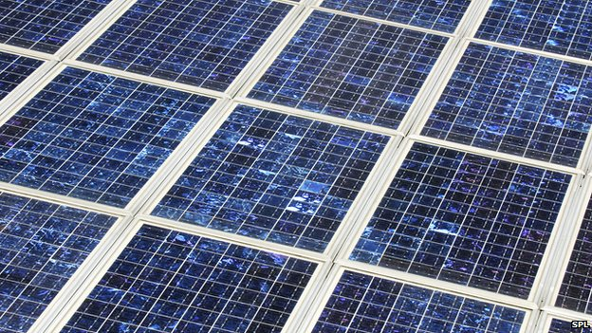
In December 2012, a UK firm announced plans to build what it claims is the biggest photovoltaic (PV) solar power plant in Africa.

Slide 19
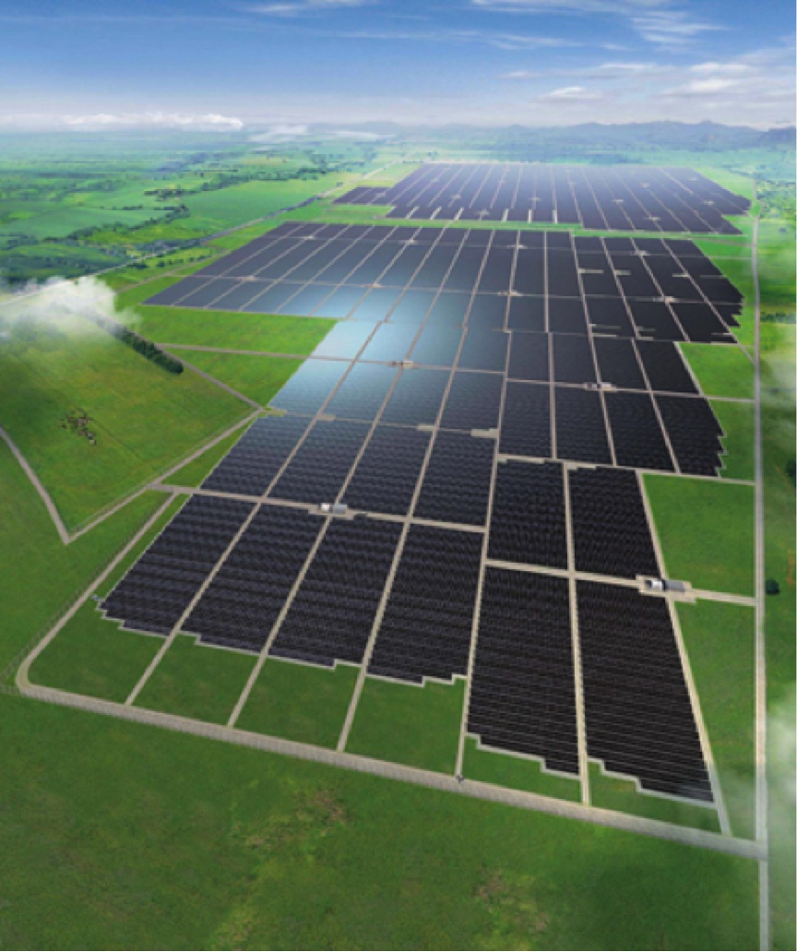
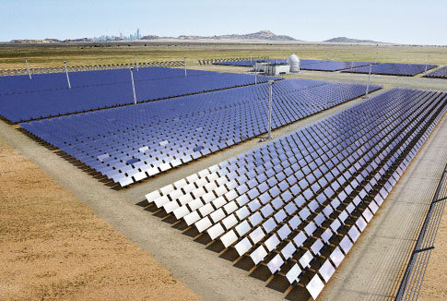
Nzema project, based in Ghana, will be able to provide electricity to more than 100,000 homes.
Construction work on the $400m (£248m) plant is due to start at the end of this year.
The 155 megawatt plant will increase Ghana's generating capacity by 6%.
.
http://www.bbc.co.uk/news/science-environment-20583663

Slide 20
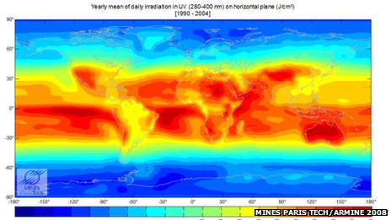
map shows the amount of ultraviolet radiation reaching the ground

Slide 21
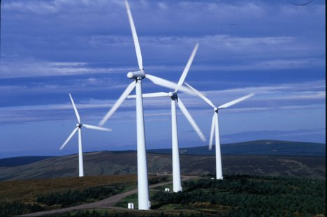
Wind energy
WIND ENERGY

Slide 22
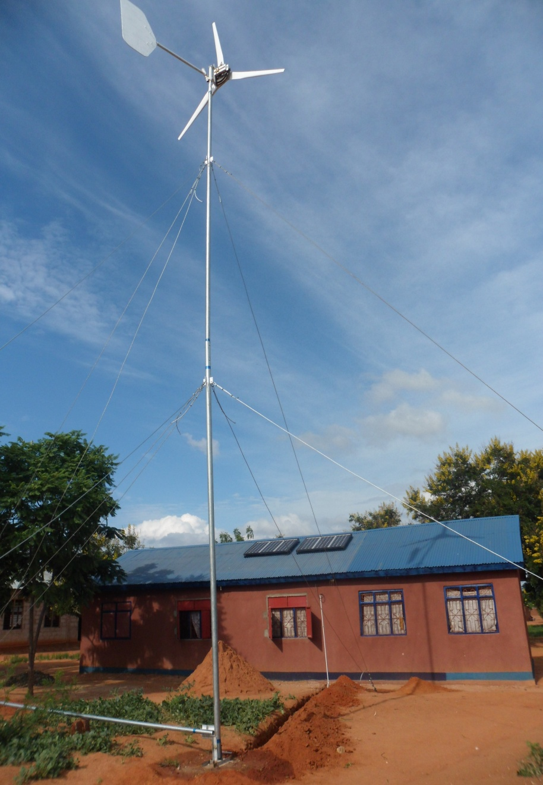
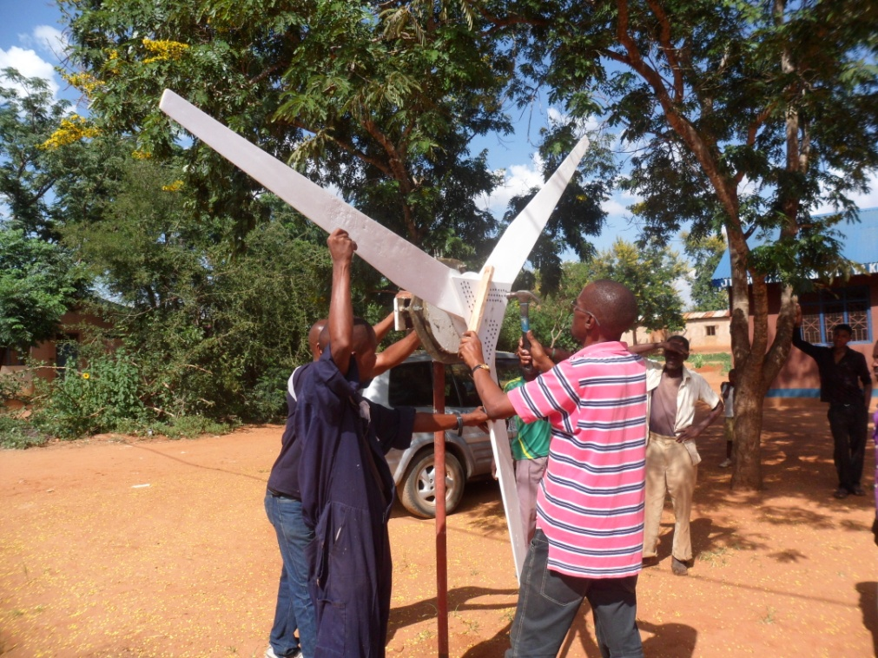
Songambele project, Kenya
One project in East Africa programme is in Songambele.
a community of 21,000 people, 97km from the town of Dodoma in central Tanzania.
http://www.renewable-world.org

Slide 23
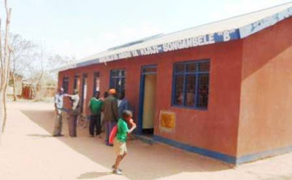
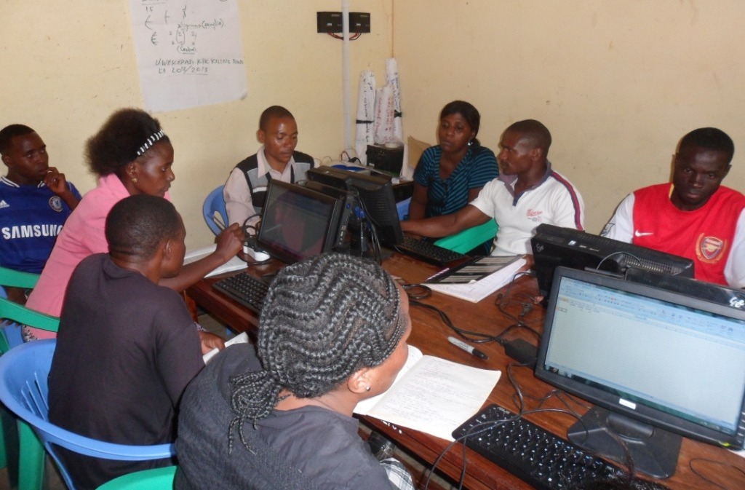
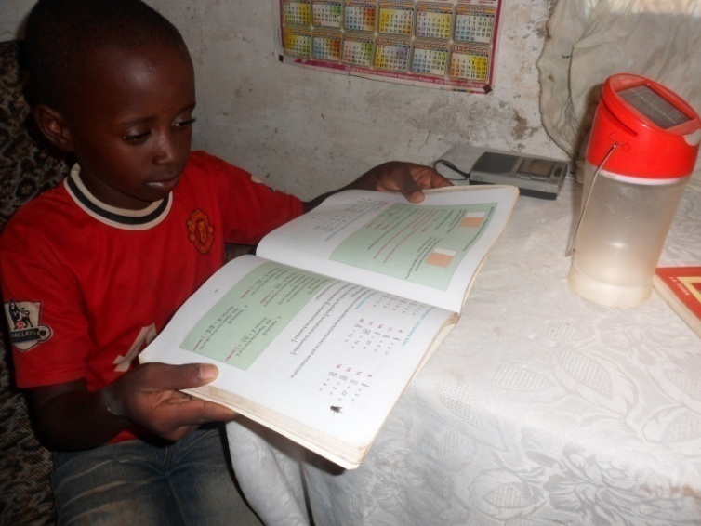
The Maarifa Centre is powered using a wind-solar hybrid system.
It contains computers to reduce the ‘digital divide’ and help improve their livelihoods and opportunities.
Extra power produced by its 1 kW wind turbine is used across the community.

Slide 24
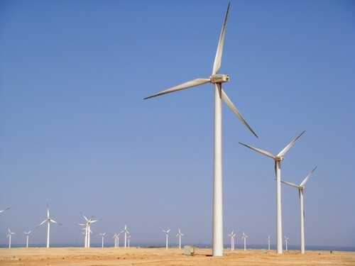
Zafarana wind farm, Egypt
For decades Egypt has been the leading wind energy country of the continent.
In 2009 The Danish, German and Spanish governments helped Egypt set up the 360 MW Zafarana wind farm near the Gulf of Suez.
http://www.renewableenergyfocus.com/view/2467/european-governments-help-egypt-to-build-zafarana-windfarm/
http://www.folkecenter.net/gb/news/world/zafarana/

Slide 25
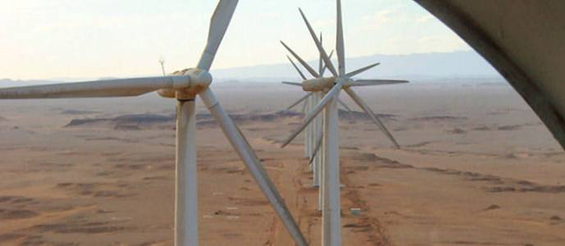
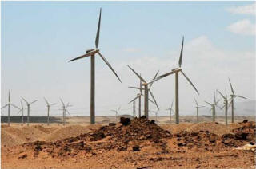
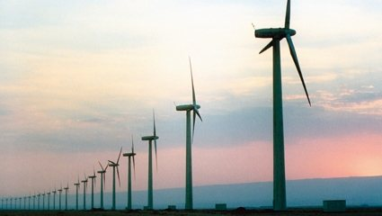
The Egyptian government's target is that 20% of the country's electricity should come from renewable sources by 2020. Of this more than half – about 12% - is expected to be produced by wind power.
To achieve this target the NREA Egyptian New and Renewable Energy Agency (NREA) estimates that a total of 7200 MW of grid-connected wind
farms will be required.

Slide 26
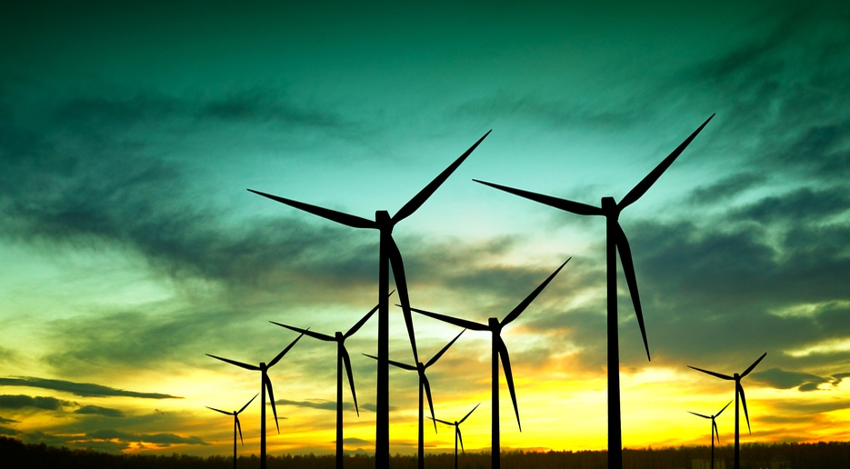
KLIPHEUWEL Wind Energy Project, South Africa

Slide 27
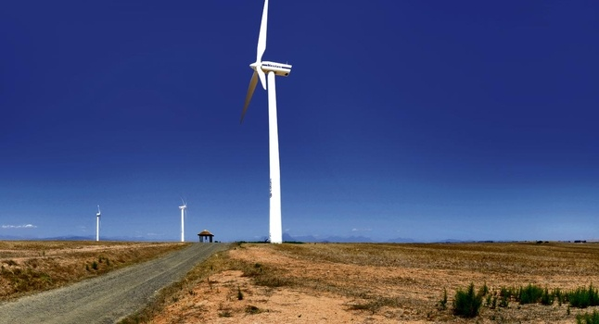
Klipheuwel-Dassiefontein Wind Energy Facility is located approximately 5 km west of Caledon in the Western Cape Province of the Republic of South Africa.
The Project, located on an area of approximately 350 hectares
has a nameplate capacity of 27MW,
comprised of 9 wind turbine generators

Slide 28
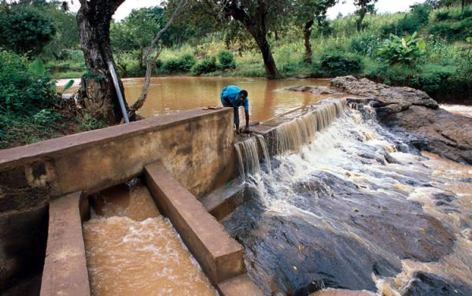
Micro-hydro power

Slide 29
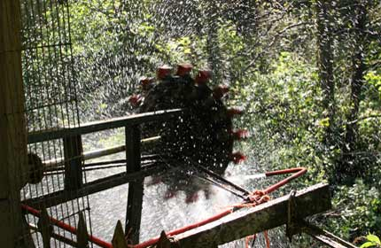
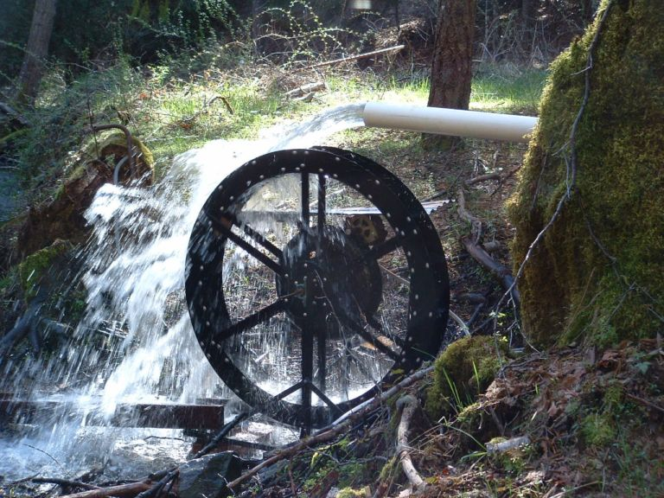
Micro-hydro power is the small-scale harnessing of energy from falling water, such as steep mountain rivers.
micro-hydro plants can generate power for homes, hospitals, schools and workshops.

Slide 30
Practical Action organization promotes small-scale hydro schemes that generate up to 500 kilowatts of power.
The micro-hydro station, which converts the energy of flowing water into electricity, provides poor communities in rural areas with an affordable, easy to maintain and long-term solution to their energy needs.
These systems, which are designed to operate for a minimum of 20 years, are usually 'run-of-the-river' systems.

Slide 31
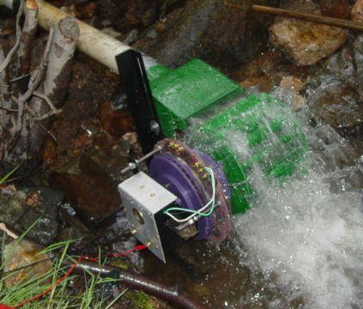
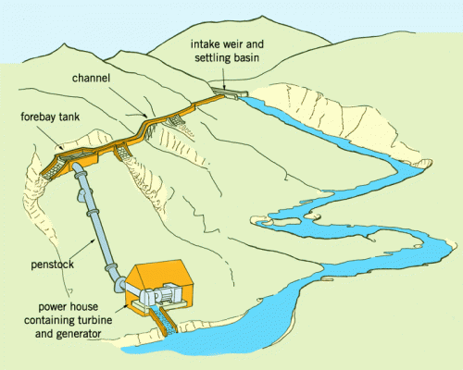
Micro-hydro: the basics
"Run of the river" systems do not require a dam or storage facility to be constructed.
they divert water from the stream or river, channel it in to a valley and drop it in to a turbine via a pipeline called a penstock.
The turbine drives a generator that provides the electricity to the local community.

Slide 32
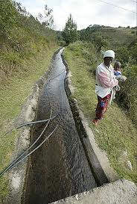
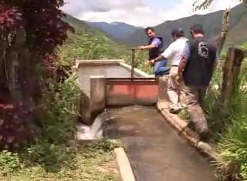
.
Tungu-Kabri micro-hydro power project in Kenya
The Tungu-Kabri micro-hydro power project in Kenya is a cheap, sustainable and small-scale technology that harnesses the energy of falling water to make electricity.
.

Slide 33
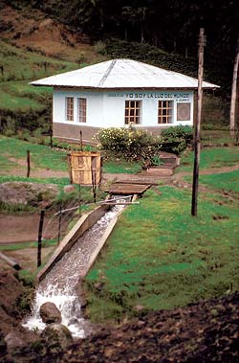
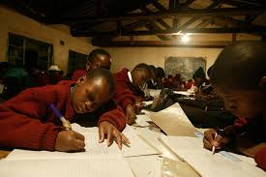
.
This project was the first of its kind in Kenya.
Funded by the United Nations Development Programme and developed by Practical Action East Africa and the Kenyan Ministry of Energy.
the project benefits 200 households (around 1,000 people) in the Mbuiru village river community.

Slide 34
http://www.bbc.co.uk/news/science-environment-20583663
http://www.renewableenergyfocus.com/view/2467/european-governments-help-egypt-to-build-zafarana-windfarm/
http://www.folkecenter.net/gb/news/world/zafarana/
http://www.sawea.org.za/index.php?option=com_content&view=article&id=13:projects-realized-or-in-progress&catid=4:wind-in-sa
https://practicalaction.org/micro-hydro-power
http://www.renewable-world.org/GlobalWindDay

