Slide 1
Stereotypes
A generalized belief about a particular group of people.

Slide 2
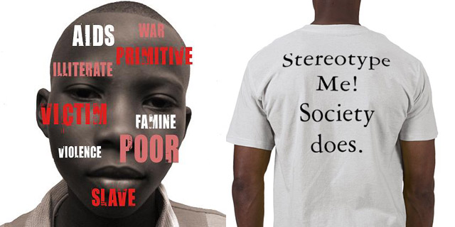
Black people.
Poor health
Victims
Famine
Sick
Poor
Primitive
Violent
Slaves

Slide 3
They know karate
They are awesome at math.
They excel at some kind of instrument -- usually violin, piano, clarinet, flute.
They are very studious and try hard to enter the medical field.
They don't drive well.
They have very strict parents (regarding school mostly).
They have LOTS of relatives.
They speak like Ching Chang Chong.

Slide 4
Hell’s angels.

Slide 5
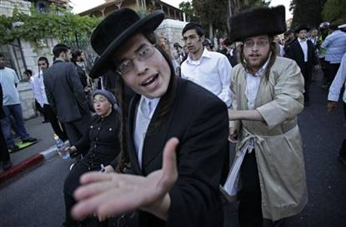
1. Control the USA 2. Good with Money 3. Big Nose 4. Great Lovers 5. Lousy Lovers 6. Suck at Sports (but make great team owners) 7. Educated 8.Arrogant (in my case, this one is true) 9.Call their mothers daily

Slide 6
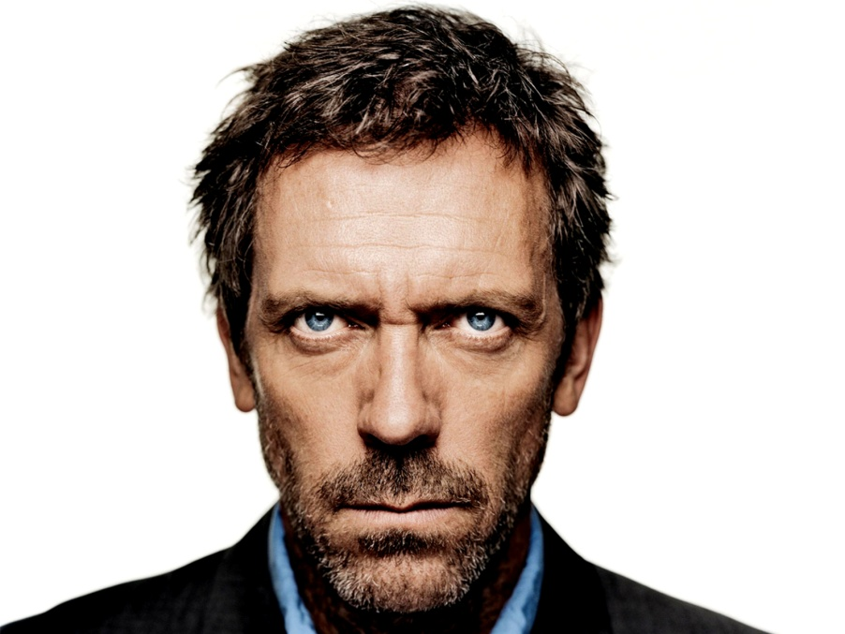
Rich
Smart
Industrous
Kind
Evil
goodlooking

Slide 7
Violent
Rich
Business Oriented
Muslims
Very strict at following customs.

Slide 8
Origin of Stereotypes.
People notice some members more than others
Some information attracts more attention than other information
Social roles trigger correspondence bias
Social roles and gender stereotypes
Between-group interactions generate emotion
Learning stereotypes from the media
Gender stereotypes and the media

Slide 9
We use stereotyping to make an inference about a group.
Stereotyping leads to social categorization – In groups and Out groups.
Most stereotypes often convey a negative impression

Slide 10
Long lasting effects of stereotyping
Experiment : Perform task in the face of negative stereotyping
Measures :-
1. ability to control aggression
2. eat appropriate amounts
3. Make rational decisions
4. Stay focused

Slide 11
Prejudice
An unjustified or incorrect attitude (usually negative) towards an individual based solely on the individual’s membership of a social group.
Aggressiveness
Over-eating
Trouble making good and rational decision
Over-indulgence.

Slide 12
Advantages of stereotyping
It enables us to respond rapidly to situations because we may have had a similar experience before.

Slide 13
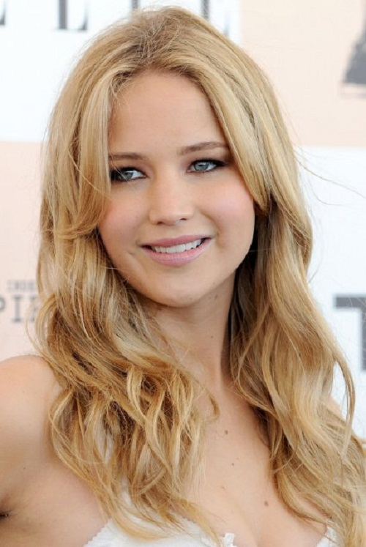
Dis-advantages of stereotyping
We usually assume they are not smart. So we do not take their advice seriously.
This makes us ignore the difference between individuals therefore making generalizations about people that may not be true.

Slide 14
Refs.
http://www.newstimes.com/news/article/How-stereotypes-affect-our-performances-501350.php
http://psypress.co.uk/smithandmackie/resources/topic.asp?topic=ch05-tp-01
http://psychcentral.com/news/2010/08/11/long-term-effects-of-stereotyping/16675.html

