Slide 1

Founder & Director: Mariam Alaa
Vice Director : Wessam zahran

Slide 2
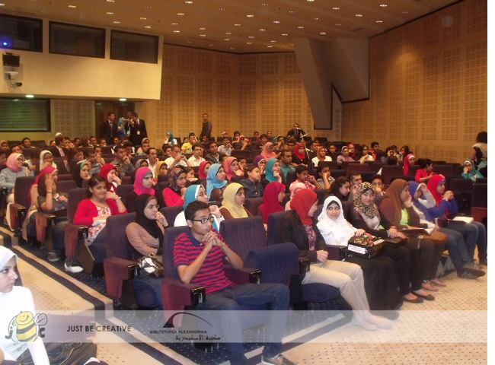

Slide 3
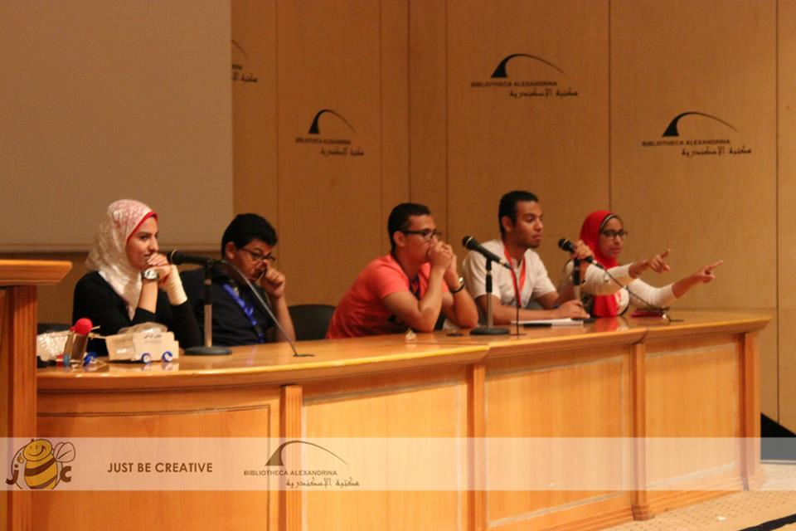

Slide 4
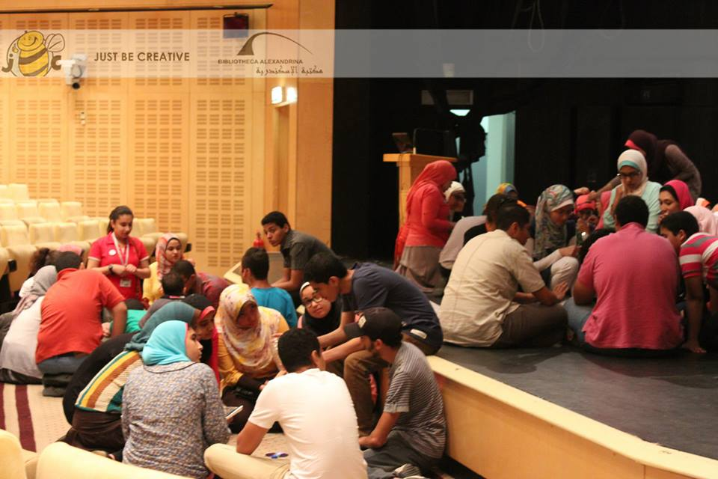

Slide 5
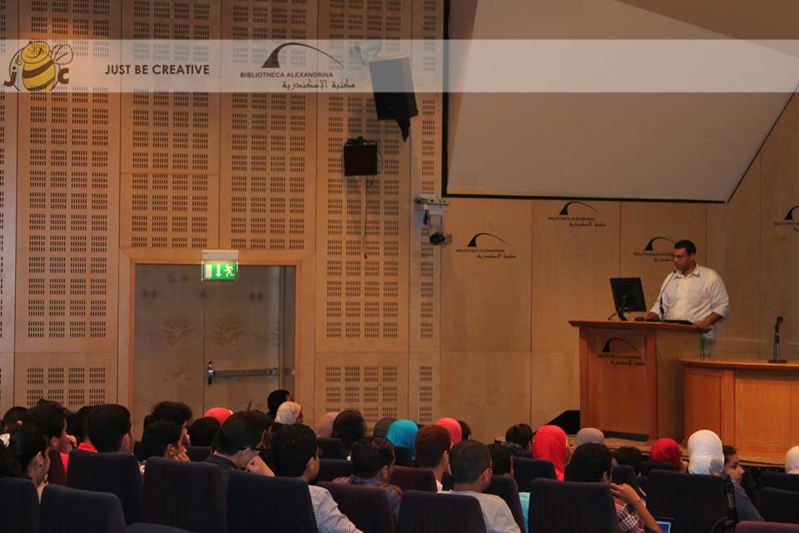

Slide 6
Page link : https://www.facebook.com/BeCreativealex
Event link : https://www.facebook.com/events/510393379035831/?ref=3

